Slide 1


What’s new in
Microsoft 365 Copilot
As of 3rd March 2026
February 2026
Presenter name
Title
Notes:
As of 3rd March 2026
Thank you.
Got Feedback ? – https://aka.ms/WhatsNewCopilot/Feedback
Resources - check appendix slides ☺

Slide 2
What's new in Microsoft 365 Copilot
Updates listed in this document are selected based on relevance to Microsoft 365 Copilot.
Release dates and timings are subject to change.
For a complete list of Copilot for Microsoft 365 roadmap items refer to
Microsoft 365 Roadmap | Microsoft 365
Got feedback ?
https://aka.ms/WhatsNewCopilot/Feedback
Notes:
Feedback – https://aka.ms/WhatsNewCopilot/Feedback
Please note that the dates mentioned in this presentation are tentative and subject to change.

Slide 3

What’s new in Microsoft 365 Copilot
February 2026
As of 3rd March 2026
IT admin capabilities
User capabilities
        Power user report and intelligent summaries for Copilot Dashboard
        Business justification when requesting a Microsoft 365 Copilot license
        A new Copilot readiness page in the Microsoft 365 admin center
        Admins can now enable AI-powered skill updates for user profiles
        Risk-based inventory of AI agents for Microsoft Defender
        GPT-5.3 Instant in Microsoft 365 Copilot
        Text selection for Copilot Chat
        Expanded grounding for Copilot Chat – SharePoint Lists or sites and Outlook
        Project Manager Agent
        Copilot Chat integrated with Copilot Search
        Copilot mobile widgets and actions buttons
        Brand kits within Copilot Create
        Copilot Search – Email attachment search
        Agents in communities
        Updated recaps and customizable templates for Copilot in Teams
        Meeting scheduling and preparation for Copilot in Outlook
        Copilot meeting time analytics
        Edits documents by default with Copilot in Word
        Copilot is now agentic in PowerPoint on the Web
        Agents in OneDrive
        Agent recommendations
        Expansion of People Skills
Copilot Extensibility
        Expanded grounding, access, and coordination for agents
        35 new Copilot connectors
        Introducing Copilot Connector Checker
        Federated Copilot connectors are now available in Public Preview
        Connector Usage report
Notes:
As of 2nd February 2026

Slide 4

User capabilities

Slide 5
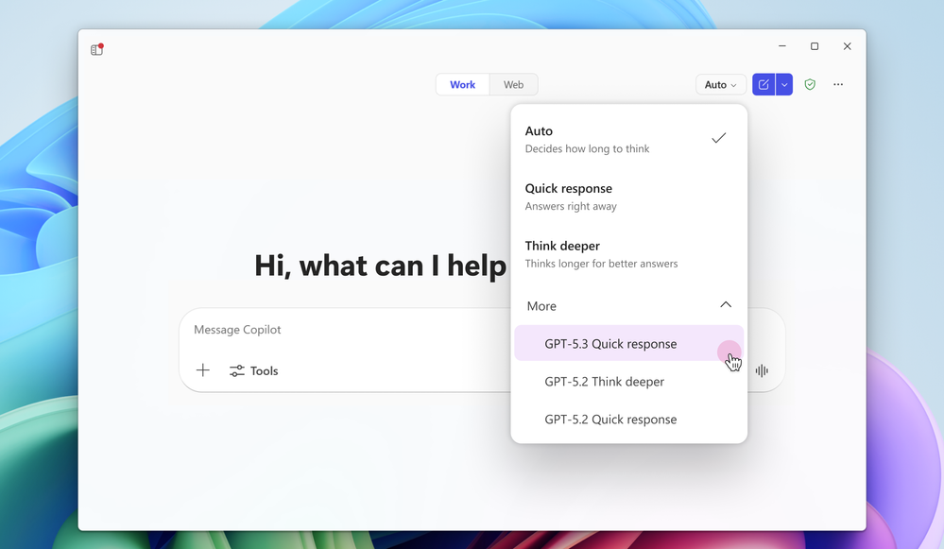
GPT-5.3 Instant in Microsoft 365 Copilot
GPT‑5.3 expands Microsoft 365 Copilot and Copilot Studio with clearer, more accurate, and more expressive AI responses while preserving enterprise-grade security and control.
Higher quality responses. GPT‑5.3 improves conversational accuracy, clarity, and expressive writing, delivering more direct and useful answers to user questions.
Better reasoning and synthesis. The model synthesizes online knowledge with stronger reasoning so responses are less generic and better aligned to user intent and needs.
Flexible access and rollout. Microsoft 365 Copilot licensed users receive priority access, while standard users have standard access, and GPT‑5.3 is available in Copilot Studio early release environments for makers.
GPT-5.3 Instant in Microsoft 365 Copilot
Available today: GPT-5.3 Instant in Microsoft 365 Copilot | Microsoft Community Hub
Notes:
This update introduces GPT‑5.3 into Microsoft 365 Copilot and Copilot Studio, significantly raising the quality of Copilot interactions. GPT‑5.3 delivers more accurate, clearer, and more expressive responses, helping users get direct and usable answers with less prompt iteration.
A key improvement is stronger reasoning and synthesis. Copilot now combines online knowledge with deeper reasoning so responses are less generic and more aligned to the user’s intent and real business needs, which is especially valuable for research, planning, and decision support.
Microsoft is also reinforcing enterprise readiness and customer choice. GPT‑5.3 is part of Microsoft’s ongoing investment in cutting‑edge AI while maintaining security, compliance, and privacy standards customers expect across Microsoft 365.
In terms of availability, Microsoft 365 Copilot licensed users receive priority access to GPT‑5.3. The model is also available in Copilot Studio early release environments for agent builders, enabling organizations to start experimenting and building with GPT‑5.3 right away.

Slide 6
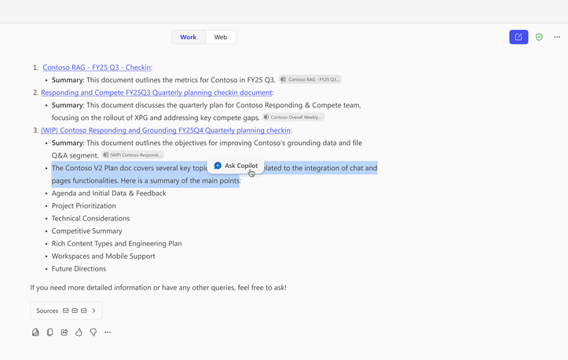
Text selection for Copilot Chat
Copilot Chat now lets users select specific text in responses and ask targeted follow‑up questions, enabling more precise, faster, and more controlled interactions.
Precision targeting – Users can highlight exact text in a Copilot response and click Ask Copilot to focus follow‑up questions on that content only
More relevant answers – Avoids overly broad responses by letting users drill into the specific detail they care about
Faster assistance – Improves speed and quality for explanations, summaries, translations, and next steps
Text selection and expanded grounding for Copilot Chat
This feature is rolling out in March.
Roadmap ID
522616
Notes:
This update introduces a new way for users to interact with Copilot Chat by selecting specific text inside a Copilot response. When a user highlights text, an “Ask Copilot” button appears, allowing them to ask a targeted follow‑up question about exactly that snippet.
This gives users far more precision and avoids the issue of Copilot giving broad answers when the user only wants clarity on a small part of the response. It speeds up workflows by helping users get quicker explanations, summaries, translations, or recommended next steps.
It’s a quality‑of‑life improvement designed to make Copilot feel more responsive, controlled, and efficient — and it begins rolling out in March.

Slide 7
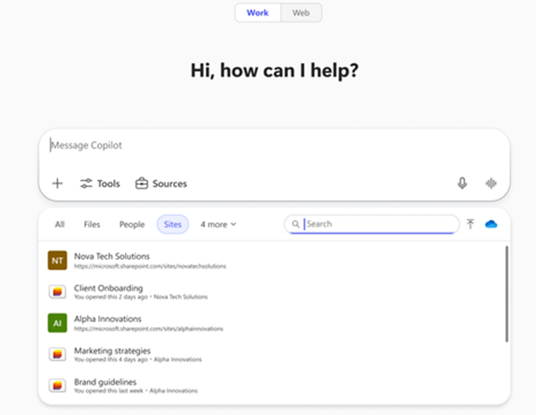
Expanded grounding for Copilot Chat - SharePoint lists or sites when using Copilot Chat in work mode
Copilot Chat in work mode can now be grounded on specific SharePoint lists or sites, bringing structured organisational data directly into AI prompts for more accurate results.
Grounding on SharePoint – Users can include a SharePoint list or site directly in a Copilot Chat prompt to anchor responses in real organisational data.
Simple prompt inclusion – Type “/” in Copilot Chat and select the required SharePoint list or site from the Sites tab.
More accurate responses – Grounding prompts improves relevance and precision by using structured SharePoint data as context.
Ground Copilot prompts on SharePoint lists or sites
This feature is rolling out in March.
Roadmap ID
422308
Notes:
This update enables users to bring SharePoint data directly into Copilot Chat when working in work mode. By typing a simple “/”, users can search for and select a SharePoint list or site, or pick one from the Sites tab.
This effectively grounds the Copilot prompt in the organisation’s structured data — meaning the responses are far more accurate, contextual, and relevant to the user’s task.
It’s particularly useful when users need Copilot to reason over list data, reference site content, or produce outputs aligned to their team’s information sources.
The feature is scheduled to roll out in March, further strengthening how Copilot works with existing SharePoint investments.

Slide 8
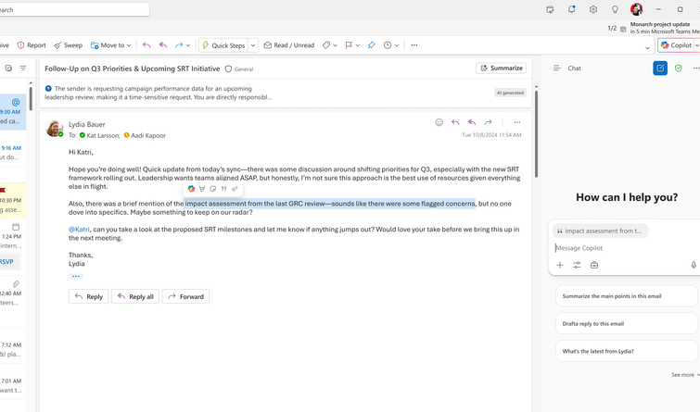
Copilot Chat in Outlook expanded grounding
Copilot Chat in Outlook visually grounds conversations on the open email or selected text, improving clarity and precision even for users without a Microsoft 365 Copilot licence.
Email grounding indicator Copilot Chat clearly shows when it’s grounded on an open email by displaying the email subject in the prompt box
Highlighted text focus Users can select part of an email to ground Copilot only on that specific text for precise follow‑up
Clear visual context Users always know what Copilot is referencing, reducing ambiguity and improving trust
Copilot Chat in Outlook expanded grounding
These features rolled out in February.
Roadmap ID
498320
Notes:
This update enhances how Copilot Chat works inside Outlook, particularly for users who don’t have a Microsoft 365 Copilot licence. When someone opens an email and activates Copilot Chat, Copilot now automatically grounds the conversation in the content of that email.
To make this grounding visible and transparent, the email subject line appears directly in the prompt box, so the user immediately knows that Copilot is using that specific email as context.
If the user highlights only part of the email, Copilot becomes even more precise and grounds the conversation only on the selected snippet. This helps avoid broad responses and keeps Copilot focused on exactly what the user wants to ask about.
These grounding improvements rolled out in February, strengthening how Copilot supports Outlook users, licensed or not.

Slide 9
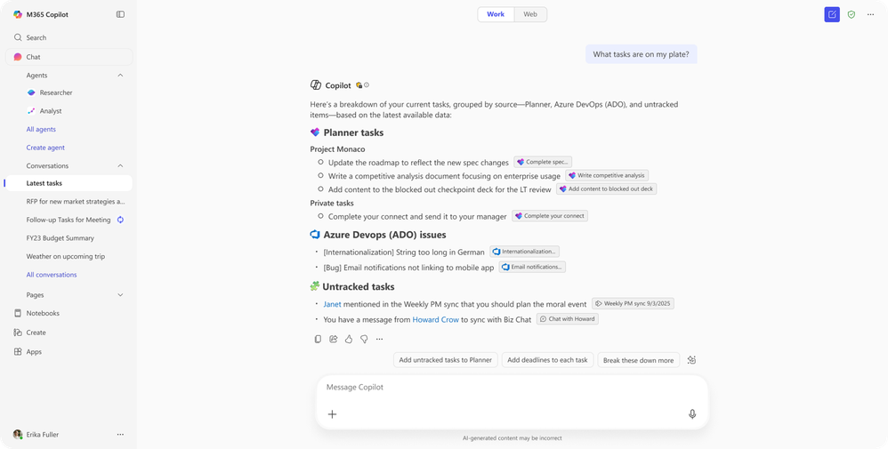
Project Manager Agent
Project Manager Agent provides AI‑assisted project and task management, helping teams plan, organise, and track work more effectively.
AI‑assisted project tracking Helps users plan, organise, and manage work with intelligent project coordination support.
Core task management first Starts with essential task tracking capabilities, simplifying day‑to‑day project execution.
Evolving capabilities Designed to expand over time with more advanced project management features.
Project Manager Agent
This feature is rolling out to Public Preview in March and is rolling out worldwide in April.
Roadmap ID
516576
Notes:
The Project Manager Agent provides AI‑assisted support for planning, organising, and tracking work, starting with core task management and expanding with advanced capabilities over time. Public Preview begins in March, with worldwide rollout in April.

Slide 10
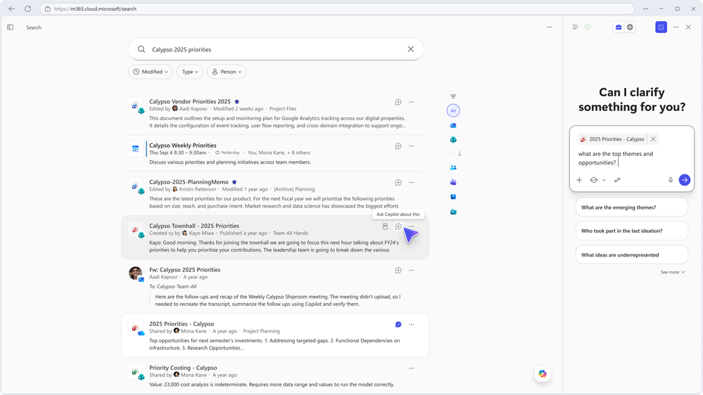
Copilot Chat integrated with Copilot Search
Copilot Chat now stays open alongside Copilot Search, letting users explore search results and ask follow‑up questions in one seamless workflow.
Integrated experience: Users can view search results and chat with Copilot at the same time.
Deeper questioning: Enables follow‑up queries directly about the search results without switching tools.
Reduced context‑switching: Keeps users in one workflow, helping them find information faster and stay productive.
Copilot Chat integrated with Copilot Search
This feature is rolling out in March.
Roadmap ID
537281
Notes:
This update brings Copilot Chat directly into the Copilot Search experience. As users perform a search, the chat pane now remains visible and interactive, allowing them to ask deeper, more targeted questions about the search results without leaving the page.
The key benefit is the removal of unnecessary context‑switching. Instead of toggling between search and chat, users can stay in one unified workflow — reviewing results, clarifying information, and requesting summaries or explanations all in the same place.
This makes the search process more intuitive and significantly boosts productivity, especially when users need to explore complex topics or compare multiple pieces of information.
The integrated experience is rolling out in March, bringing a smoother and more efficient Copilot‑powered search experience to users.

Slide 11
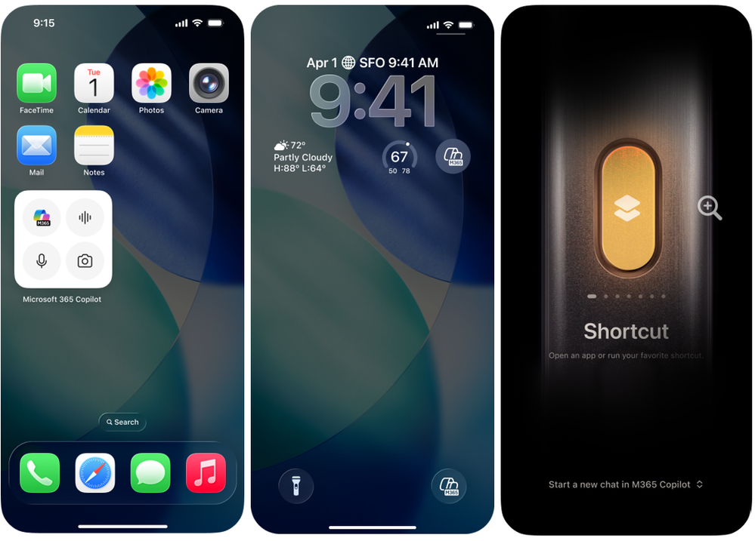
Copilot mobile widgets and action button
Copilot mobile widgets and the iOS action button make it easy for users to start chats, voice conversations, or photo‑based prompts with Copilot directly from their mobile Home or Lock screen.
Instant access: Widgets bring Microsoft 365 Copilot directly to iOS and Android Home and Lock screens.
One‑tap actions: Users can open chat, start a voice conversation, or launch the camera to attach a photo.
On‑the‑go productivity: Makes it easier to ask questions, catch up, or brainstorm while mobile.
Copilot mobile widgets and action button
This feature began rolling out in December.
Mobile widgets on iOS and Android, and action button on iOS rolled out in February.
Notes:
Copilot mobile widgets and action button enable users to chat with Copilot while they’re on the go. The widgets bring Microsoft 365 Copilot features right to a mobile device’s Home and Lock screens. With just one tap of the Copilot widget or Copilot action button, users can start a chat with Copilot, activate a voice conversation, or open the camera to attach a photo to Copilot Chat. This makes it easier to catch up, ask questions, and brainstorm with Copilot on a mobile device. Mobile widgets on iOS and Android, and action button on iOS rolled out in February.

Slide 12
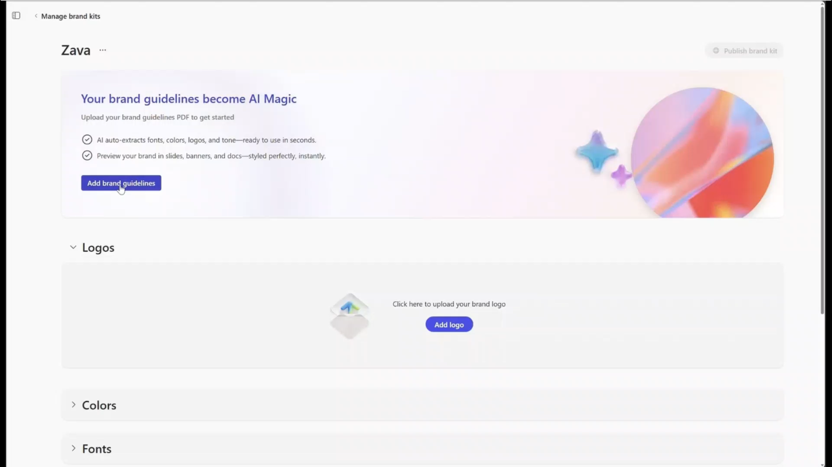
Users can now create brand kits within the Create experience
Users can now generate brand kits in the Create experience by uploading their organization’s brand guidelines.
Automated brand extraction: Copilot pulls colors, fonts, and style elements directly from an uploaded brand guidelines document.
Faster setup: Eliminates manual brand kit creation and simplifies brand asset management.
Consistent output: Ensures all Copilot‑generated content aligns to organizational branding.
Create brand kits within the Create experience
This feature rolled out in February.
Notes:
This update introduces brand kits within the Create experience, making it much easier for teams to keep Copilot‑generated content on brand. Instead of manually defining colors, fonts, and styling, users can now upload their organization’s brand guidelines document, and Copilot automatically extracts all the key brand elements.
This significantly streamlines brand asset management and removes a lot of repetitive setup work. It’s especially helpful for marketing, communications, and sales teams who need to ensure that any content Copilot produces is visually aligned with corporate identity.
The result is faster content creation with built‑in brand consistency, reducing errors and ensuring a uniform experience across presentations, documents, and creative outputs.
This feature rolled out in February, so it’s already available for users.

Slide 13
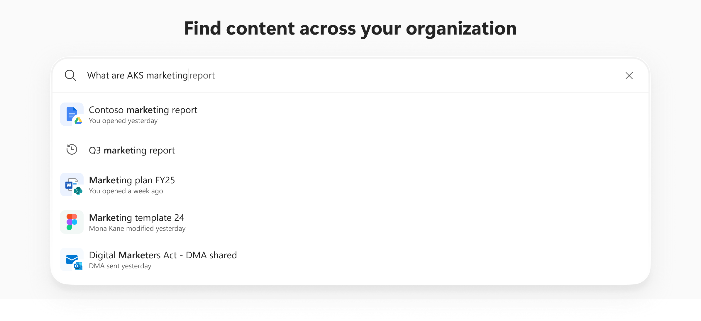
Copilot’s search - Email attachment search
Copilot can now search email attachments alongside other content, making it easier for users to find important documents quickly across Outlook and SharePoint filters.
Attachment search support: Copilot now includes email attachments in search results.
Unified discovery: Attachments surface in full search and when Outlook or SharePoint filters are applied.
Faster file access: Helps users locate key documents regardless of where they were originally stored.
Copilot Search: Email attachment search
This feature rolled out in February.
Notes:
This update expands Copilot’s search capabilities by allowing it to include email attachments in search results. Previously, attachments were harder to surface unless users manually navigated through email threads or folders. Now, Copilot can identify and return attachments just like any other file.
When users perform a search, attachments appear both in full search results and when they apply Outlook or SharePoint filters. This creates a unified discovery experience, making it much easier to find documents that may be stored in different places across Microsoft 365.
The key benefit is improved speed and accuracy. Users can locate important documents more quickly, without having to remember which email they came from or where they were saved.
This enhancement rolled out in February, so the improved search experience is already available.

Slide 14
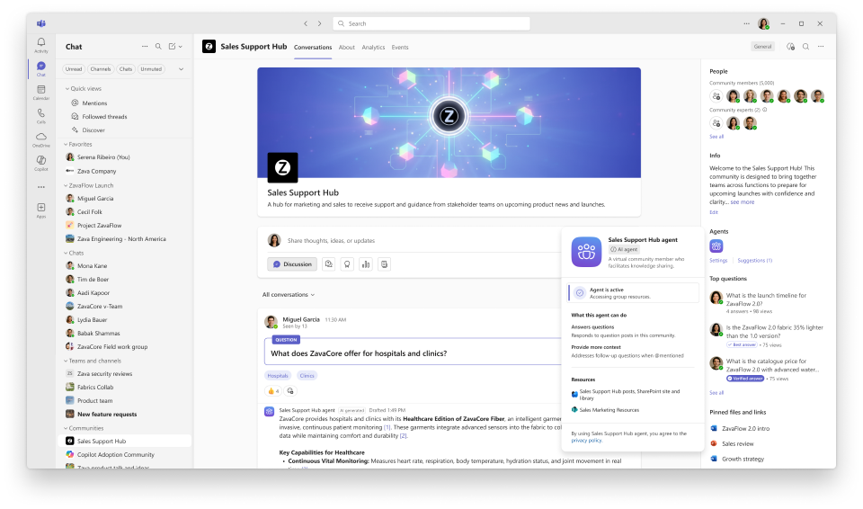
Agents in communities
Communities in Microsoft Teams now include an agent that helps turn community conversations into organizational knowledge by drafting suggested responses using existing discussions and SharePoint content.
Integrated communities: Users can participate in community conversations directly in Teams without switching apps.
AI‑supported responses: The agent drafts suggested replies to unanswered questions using past discussions and specified SharePoint sites.
Knowledge capture: Helps convert community interactions into shared, reusable organizational knowledge.
Agents in communities
This feature rolled out to Public Preview in February and is rolling out worldwide in April.
Roadmap ID
499898
Notes:
This update enhances the Communities experience inside Microsoft Teams by bringing community agents directly into the Teams interface. Users can already participate in community conversations without switching apps, and now the agent adds AI‑powered support on top of that.
The agent scans existing community discussions and any specified SharePoint sites to understand the context of unanswered questions. It then drafts suggested responses for community owners or leaders to review, helping reduce the number of unanswered posts and improving the overall health of the community.
One of the big advantages is knowledge capture. Instead of letting valuable information remain buried in scattered threads, the agent helps convert discussions into reusable organizational knowledge, making communities more impactful and connected to broader company knowledge sources.
This feature entered Public Preview in February, and Microsoft will begin the worldwide rollout in April, expanding access to all users over time.

Slide 15
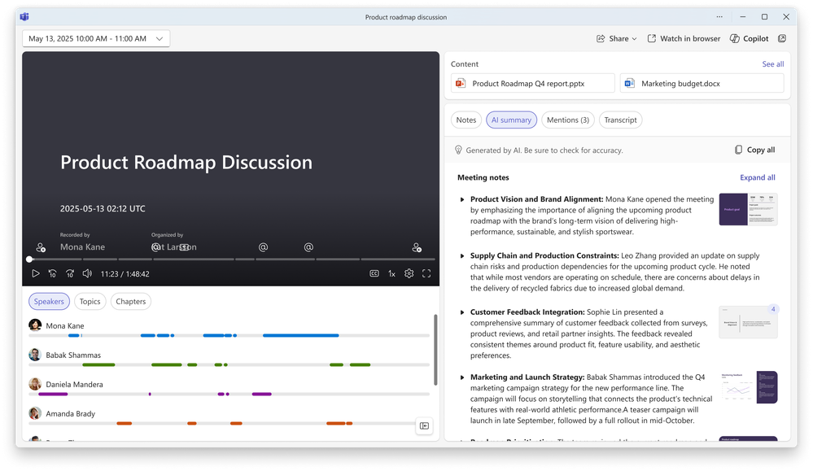
Updated recaps for Copilot in Teams
AI meeting recaps now include key visuals from shared screens, pairing on‑screen moments with the relevant parts of the summary for a more intuitive, scannable review experience.
Visual‑enhanced recaps: Key screen‑shared moments are captured and placed alongside the meeting summary.
Stronger context: Users can see what was presented at each point without watching the recording.
Conversation‑focused notes: The written summary remains focused on the discussion while adding visual context.
Updated recaps for Copilot in Teams
This feature rolled out in February.
Roadmap ID
490052
Notes:
This update improves the Copilot Search experience by introducing source‑specific filters, which help users find information faster and with less noise.
Instead of scanning results from everywhere, users can now refine searches to specific sources. This reduces irrelevant results and removes unnecessary steps, making it easier to get to the right information quickly.
The experience is designed to feel intuitive. Refinement happens naturally as part of the search flow, helping users balance discovery with precision rather than forcing them to re‑search or over‑filter.
These filters work across Microsoft 365 and connected systems through Copilot connectors, which is especially valuable in organisations with content spread across multiple platforms.
Microsoft is continuing to invest in this area, with plans to expand coverage and further improve the end‑to‑end Copilot Search experience over time.

Slide 16
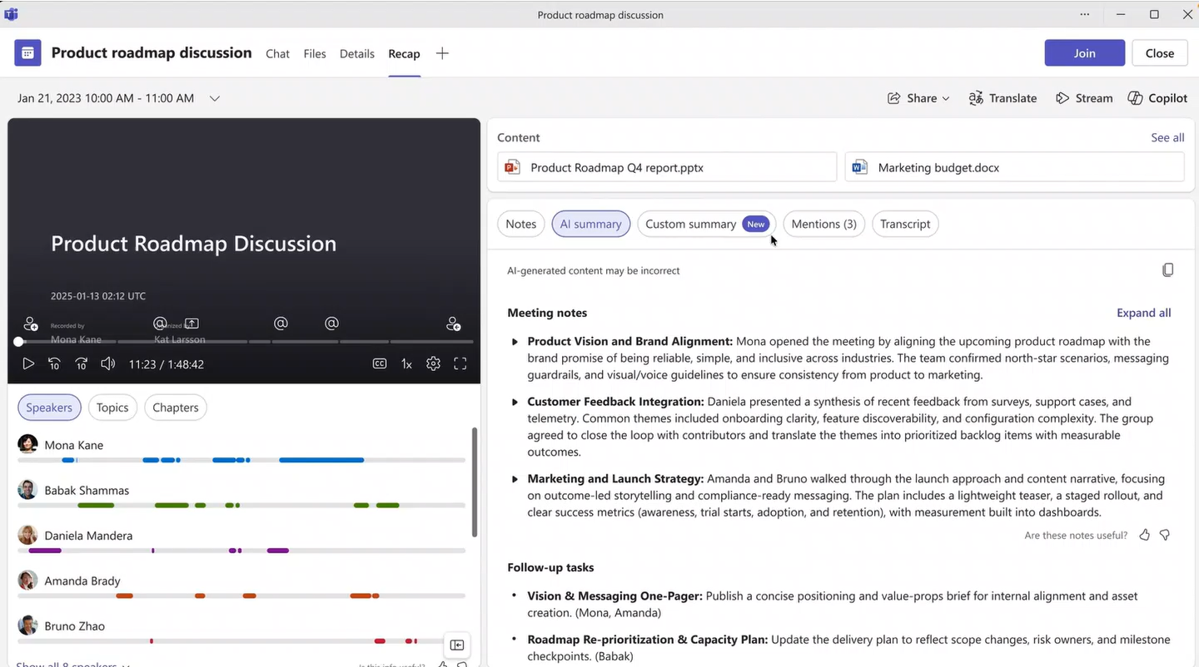
Customizable recap templates
Customizable recap templates let users tailor AI‑generated meeting notes with built‑in or fully custom formats that can be saved and reused for consistent, team‑aligned recaps.
Flexible templates: Users can choose between a Speaker Summary or an Executive Summary to match their preferred recap style.
Custom structures: Users can design their own templates using a free‑text prompt or by pasting an existing format.
Reusable clarity: Custom templates can be saved to ensure every meeting has consistent, high‑quality notes.
Customizable recap templates
Available across all languages that support AI summaries, this feature rolled out to public preview in December and rolled out worldwide in February.
Roadmap ID
501540
Notes:
This update introduces customizable recap templates, giving teams far more control over how their AI‑generated meeting notes are structured. Instead of relying on a single standard recap format, users can now tailor notes to the way their team actually works.
There are two built‑in templates that users can apply instantly:
A Speaker Summary, which organises insights by participant.
An Executive Summary, which highlights key takeaways for quick leadership consumption.
Beyond that, users can create fully custom templates using a simple free‑text prompt. They can describe the structure they want or even paste in a format they’ve used before, and Copilot will automatically shape the recap to match. These templates can also be saved and reused, ensuring consistency and clarity across every meeting.
The feature is available in all languages that support AI summaries. It reached Public Preview in December and then rolled out worldwide in February, so users now have a fully flexible recap experience.

Slide 17
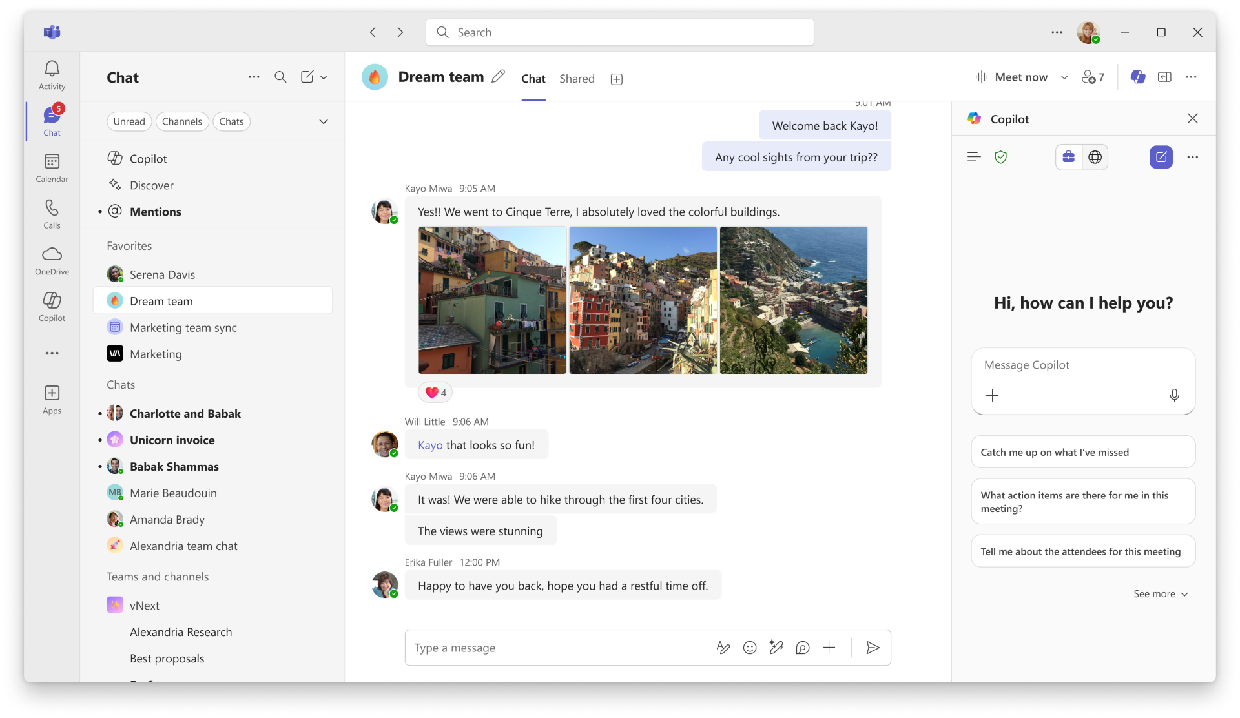
Copilot experience in Teams meeting is updating to Copilot Chat
Copilot in Teams meetings now uses the unified Copilot Chat experience to deliver context‑aware recaps, rewritten messages, and insights based on meeting activity.
Unified experience: Teams meetings now use the same Copilot Chat interface found across Teams chats, channels, and the Microsoft 365 Copilot app.
Richer context: Copilot analyzes chat history, transcripts, and calendar details to understand meeting context.
Smarter follow‑ups: Generates intelligent recaps, suggested rewrites, and relevant insights aligned to user goals.
Teams meeting is updating to Copilot Chat
This feature rolled out in February.
Message ID
MC1156360
Roadmap ID
501107
Notes:
This update brings Copilot Chat into the Teams meeting experience, aligning it with the unified Copilot interface used across Teams chats, channels, and the Microsoft 365 Copilot app. This consistency makes Copilot more predictable and easier for users to adopt across their daily workflow.
With this update, Copilot in Teams meetings now draws on multiple context sources — including meeting chat history, the meeting transcript, and even relevant calendar details. By combining these signals, Copilot can produce smarter, more context‑aware recaps that go beyond simple summaries.
It can also rewrite or refine messages, surface insights tied to user goals, and help users follow up more effectively after a call. Whether someone wants a recap of a discussion thread or actionable next steps from the meeting, Copilot now provides more accurate and tailored output.
This unified experience rolled out in February, so it’s already available for users in Teams meetings.

Slide 18
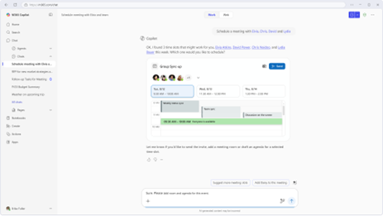
Copilot can now recommend time slots that maximize availability across attendees.
Scheduling meetings with multiple attendees
Copilot Chat can now recommend the best meeting times for multiple attendees, expanding the search when needed and respecting each person’s availability and preferences.
Optimized scheduling: Copilot recommends time slots that maximize availability across all attendees.
Smart alternatives: If no ideal slots exist, Copilot widens the search and explains why specific times are suggested.
Visual context: Options are shown within a broader schedule view for clearer decision‑making.
This feature rolled out in February for new Outlook and will roll out in March for classic Outlook.
Roadmap ID
542185
Notes:
When scheduling meetings with multiple attendees via Copilot Chat, Copilot can now recommend time slots that maximize availability across attendees. When no suitable times are found, Copilot widens the search range to suggest alternatives and clearly explains why specific options are recommended. Copilot can also visually display each option in the context of a broader schedule, and respects personalized time settings like working hours, time zones, and meeting preferences. This feature rolled out in February for new Outlook and will roll out in March for classic Outlook.

Slide 19
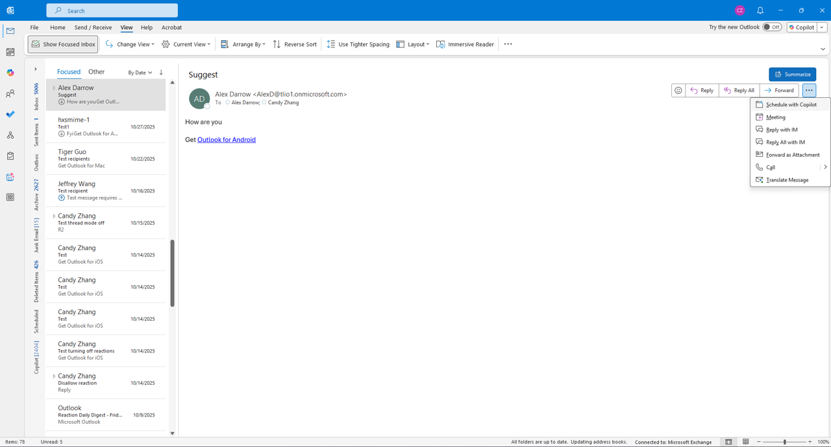
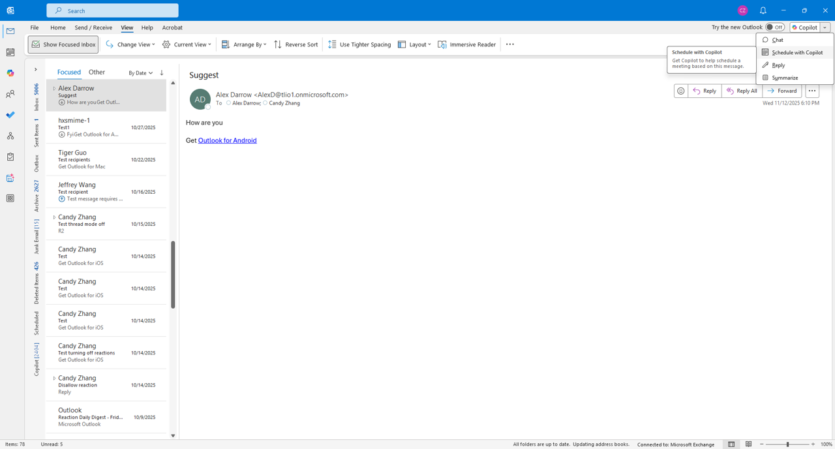
Schedule meetings with Copilot directly from an email thread
Copilot now makes it easy to schedule meetings directly from an email thread by handling time selection, room booking, agenda creation, and invites in one guided chat flow.
One‑click scheduling: Users can select “Schedule with Copilot” from an open email or thread.
End‑to‑end automation: Copilot finds meeting times, books rooms, drafts the agenda, and sends invites.
Seamless workflow: Everything happens within a single guided chat experience.
Schedule with Copilot option
Experience for users with a Microsoft 365 Copilot license
Experience for users without a Microsoft 365 Copilot license
This feature began rolling out in February for new Outlook and will roll out in March for classic Outlook.
Roadmap ID
542185
Message ID
MC1228333
Notes:
This update makes scheduling meetings with Copilot even more seamless by enabling it directly from an email thread. When a user has an email or email chain open, they can simply click “Schedule with Copilot”, and Copilot will take over the entire scheduling process.
Copilot handles everything end‑to‑end: it checks availability across attendees, finds suitable times, books meeting rooms, drafts a proposed agenda, and then sends the meeting invites — all through one smooth guided chat flow. This eliminates the manual back‑and‑forth that usually comes with scheduling meetings from email conversations.
It’s especially useful when an email thread naturally leads to the need for a quick meeting. Instead of switching tools or rebuilding context, Copilot handles the transition automatically and efficiently.
This capability started rolling out in February for the new Outlook, and it will roll out to classic Outlook in March, bringing the same streamlined experience to more users.

Slide 20
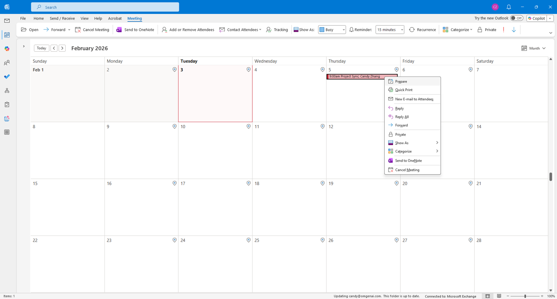
Real-time insights, context summaries, and relevant documents to meeting prep in Classic Outlook
Meeting prep in Classic Outlook
Copilot in classic Outlook now helps users prepare for meetings by delivering real‑time insights, context summaries, and relevant documents directly through chat.
Enhanced meeting prep: Copilot surfaces insights, summaries, and key information for upcoming meetings.
Context‑aware support: Pulls in relevant documents and context so users arrive fully prepared.
In‑chat guidance: Users can chat with Copilot to deepen preparation without switching tools.
This feature rolled out for Classic Outlook in Public Preview in January and is rolling out worldwide in March.
Message ID
MC1228331
Roadmap ID
542186
Notes:
In classic Outlook, Copilot now brings real-time insights, context summaries, and relevant documents to meeting prep. Users can chat with Copilot for deeper preparation on upcoming meetings, enabling them to arrive at meetings fully prepared. This feature rolled out for Classic Outlook in Public Preview in January and is rolling out worldwide in March.

Slide 21
Copilot now provides meeting time analytics
Copilot now gives users meeting time analytics with queries and visualizations that show how their meeting time is spent, helping them make more intentional scheduling decisions.
Time‑spent insights: Users can ask Copilot how much time they spent in meetings over specific periods.
Category breakdowns: Copilot can split meeting time by category for deeper analysis.
Trend visualization: Users can generate month‑over‑month comparisons or bar charts directly through Copilot.
Copilot now provides meeting time analytics
Users can ask Copilot questions like,
“How much time did I spend in meetings last month?”,
“How much time did I spend in meetings last month, split by category—and how does that compare to previous months?”,
“Create a month‑by‑month bar chart comparing my meeting time.”
This feature rolled out in February.
Notes:
Copilot now provides meeting time analytics that let users query and visualize how much time they spend in meetings, including breakdowns by category and month over month comparisons. Users can ask Copilot questions like, “How much time did I spend in meetings last month?”, “How much time did I spend in meetings last month, split by category—and how does that compare to previous months?”, or “Create a month‑by‑month bar chart comparing my meeting time.” This enables users to make more intentional scheduling decisions without additional reporting tools. This feature rolled out in February.

Slide 22
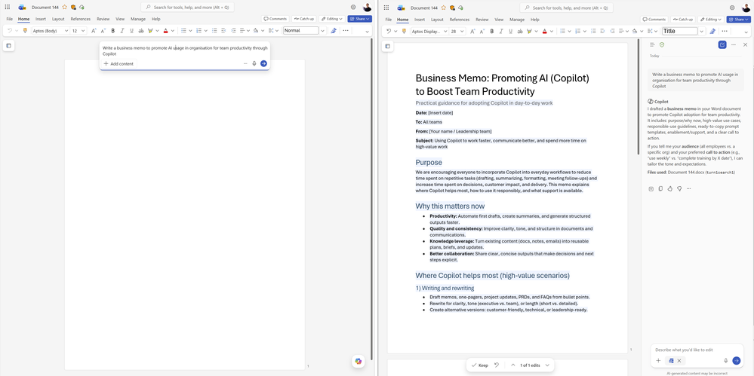
Edits documents by default with Copilot in Word
Copilot in Word now edits documents directly by default, with fully reviewable and reversible changes, helping users work faster without switching modes.
Direct editing: Copilot can make in‑document edits automatically within the default chat experience.
Reviewable changes: All edits are trackable, reversible, and fully under the user’s control.
Friction‑free workflow: Removes the need to choose modes or tools so users can work more quickly.
Edits documents by default with Copilot in Word
This feature started rolling out in February.
Notes:
The default Copilot chat experience in Word now allows Copilot to directly edit documents. All changes made by Copilot are fully reviewable and reversible, and users can turn this experience off if needed. This helps users work faster without choosing modes or tools, so Copilot is simply ready when they are. This feature started rolling out in February.

Slide 23
"Edit with Copilot” will automatically turn on in Word
Users can now start from a blank Word document by prompting Copilot immediately, with “Edit with Copilot” turning on automatically to keep them in a continuous AI‑assisted flow.
Instant start: Users can prompt Copilot directly on a blank document to begin generating content.
Automatic editing mode: “Edit with Copilot” switches on automatically to streamline the workflow.
Continuous iteration: Keeps users in an uninterrupted AI‑supported flow for faster drafting and refinement.
Edits documents by default with Copilot in Word
This feature started rolling out in February.
Roadmap ID
543241
Notes:
Users can now prompt Copilot on a blank document to get started, and "Edit with Copilot” will automatically turn on in Word. This reduces the work of getting started and keeps users in a continuous AI-assisted flow where they can keep iterating. This feature started rolling out in February.

Slide 24
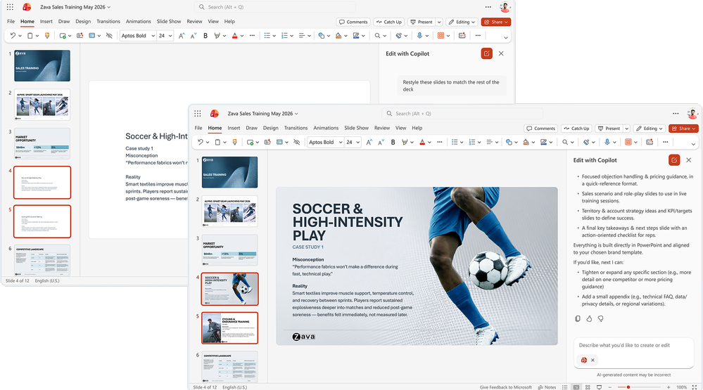
Copilot is now agentic in PowerPoint on the Web
Copilot in PowerPoint on the web is now agentic, enabling users to create, edit, and refine presentations through natural conversation while maintaining structure, formatting, and branding.
Conversational editing: Users can start or refine presentations using natural language directly within the deck.
End‑to‑end creation: ‘Edit with Copilot’ can generate slides, update content, improve layouts, and polish design.
Brand‑aware output: Integrates with brand kits to apply templates, insert approved images, and ensure brand compliance.
Copilot is now agentic in PowerPoint on the Web
This feature started rolling out to the Web in February.
Roadmap ID 548520
Notes:
Copilot is now agentic in PowerPoint on the Web, letting users create, edit, and refine presentations through natural conversation directly in a presentation. Users can start a new presentation or build on an existing one, using ‘Edit with Copilot’ to generate slides, update content, improve layouts, and polish design—while preserving formatting, structure, and branding. Copilot uses files, meetings, emails, and more to help shape content and iterate quickly, and it connects to brand kits so users can apply branded templates, insert brand‑approved images, and check for brand compliance. This feature started rolling out to the Web in February.

Slide 25
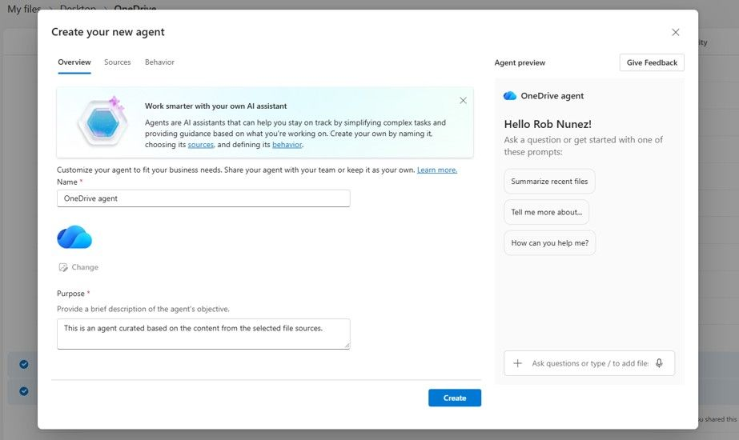
Agents in OneDrive
Agents in OneDrive let users create AI teammates that understand a full set of related files, enabling consistent, context‑aware answers across chosen documents and folders.
Context‑aware agents: Users can build an agent that understands a collection of selected files and folders.
Unified knowledge base: The agent draws on shared documents, plans, specs, notes, research, and decks.
Smarter responses: Provides answers grounded in the full context of the chosen content set.
Agents in OneDrive
This feature rolled out in February.
Notes:
Agents in OneDrive help users stay grounded in the full context of work. Instead of asking the same questions for each file, users can create an agent that understands an entire set of related documents, plans, specs, meeting notes, research, or decks. The agent responds with answers based on that shared content, functioning as an AI teammate built from chosen files and folders. This feature rolled out in February.

Slide 26
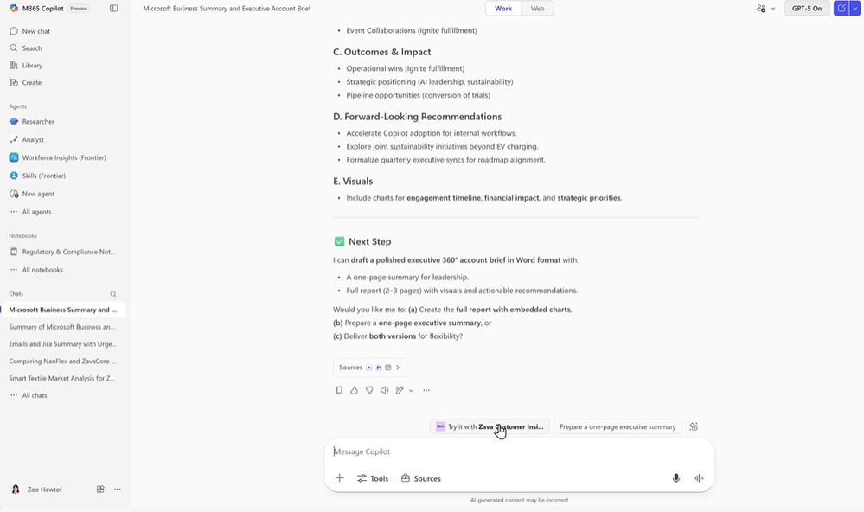
Agent Recommendations
Agent Recommendations proactively suggests the most relevant agents during Copilot conversations based on user context, improving adoption and helping users get the right support at the right time.
Context‑driven suggestions: Copilot surfaces helpful agents automatically based on what the user is doing.
Faster task support: Users are connected to the right specialized agent without needing to search.
Stronger adoption: Helps organizations increase agent usage and effectiveness by presenting agents when they matter most.
Agent Recommendations
This feature rolled out in February.
Notes:
Agent Recommendations proactively suggests helpful agents during Copilot conversations based on user context and needs. This feature connects users with the right specialized agent for their current task without manual searching. This helps your organization improve agent adoption and effectiveness by automatically surfacing relevant agents when users need them most. This feature rolled out in February.

Slide 27
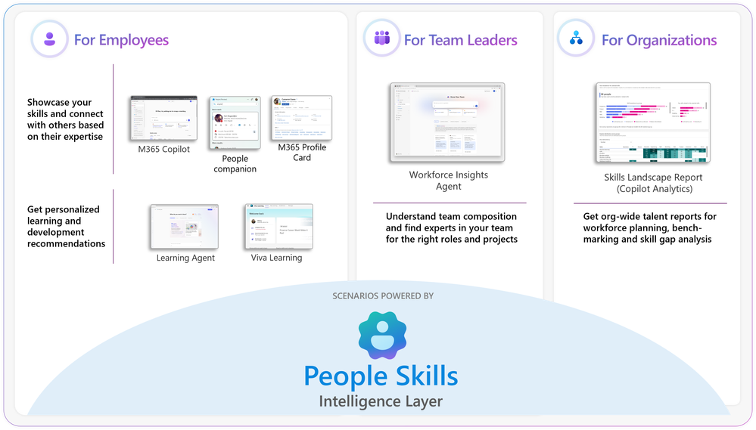
Expansion of People Skills
People Skills provides a shared skills intelligence layer across Microsoft 365 to help employees and leaders understand and act on workforce capabilities. Expansion of People Skills in three key ways:
To more users: AI-powered skill inferencing is now available to Microsoft 365 E3 and E5 license holders.
To more surfaces: Beyond M365 Copilot, skills data is now integrated into a new set of Copilot agents—including the Learning agent and Workforce Insights agent—and will soon appear on the Teams profile card.
Flexible and simplified admin controls: Admins can now enable People Skills for specific users or groups and also import custom skills libraries directly from local files in addition to SharePoint-hosted files.
Expansion of People Skills
People Skills: Expanding skills intelligence to more users and surfaces across Microsoft 365 | Microsoft Community Hub
Notes:
People Skills is now a foundational Microsoft 365 capability that underpins the next generation of Copilot experiences, bringing skills intelligence directly into how people work, learn, and make decisions. Instead of relying on manually updated profiles, People Skills uses AI to infer skills from everyday Microsoft 365 signals like documents, emails, meetings, and job context, keeping skills data current as work evolves.
With the expansion of AI‑powered skill inferencing to Microsoft 365 E3 and E5 users, organizations can now achieve far broader and richer skills coverage across their workforce, with adopters reporting high confidence in accuracy while still giving users control over visibility and privacy.
This skills data powers new Copilot agents such as the Learning Agent and Workforce Insights Agent, and surfaces directly in places like the Teams profile card, helping employees discover expertise, strengthen collaboration, and receive more personalized learning and development guidance.
From an admin perspective, People Skills is designed to be flexible and compliant, with targeted rollout controls, robust privacy and sharing options, and the ability to import custom skills libraries from local or SharePoint‑hosted files to align with organizational taxonomies.

Slide 28
IT admin capabilities

Slide 29
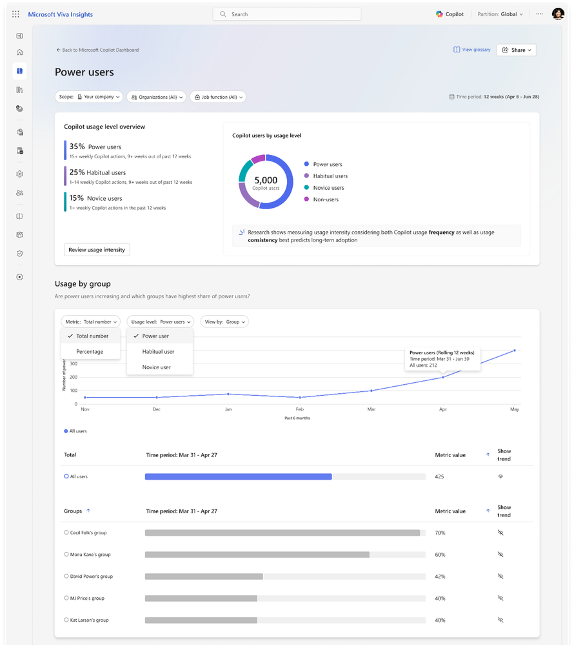
Power User Report in the Copilot Adoption PBI
Admins can now use the Power User Report in the Copilot Adoption Power BI to identify power, habitual, novice, and non‑users, enabling targeted enablement and adoption strategies.
Power User Report: Classifies users by Copilot usage frequency and consistency.
Targeted enablement: Helps admins focus training and support on specific user groups.
Adoption insights: Reveals which users rely on Copilot most and where additional support is needed.
Power User Report in the Copilot Adoption PBI
This feature is rolling out in March.
Notes:
Admins can now target their enablement efforts by identifying Copilot power users in the Power User Report in the Copilot Adoption PBI. The report classifies users as power, habitual, novice, and non‑Copilot users based on usage frequency and consistency. This feature is rolling out in March.

Slide 30
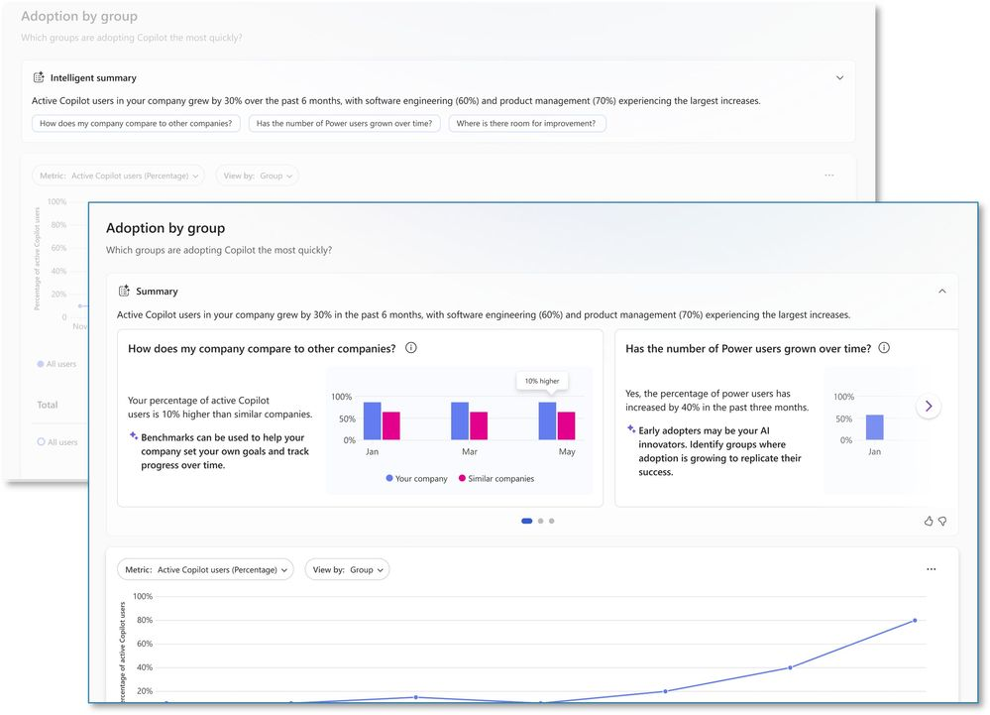
Intelligent summaries
Intelligent summaries surface key Copilot adoption trends and highlight areas where targeted actions can accelerate usage, with prompts that guide deeper exploration.
Trend highlights: Automatically identifies what’s working in Copilot adoption and where attention is needed.
Focused insights: Surfaces success areas so teams can double down on effective adoption patterns.
Guided exploration: Suggested prompts help users dig deeper into underlying drivers and trends.
Intelligent summaries
This feature is rolling out in March.
Notes:
Use intelligent summaries to quickly surface what’s working and where targeted attention can accelerate Copilot adoption. Intelligent summaries highlight key adoption trends to focus on areas of success. Suggested prompts enable deeper exploration of underlying trends and drivers. This feature is rolling out in March.

Slide 31
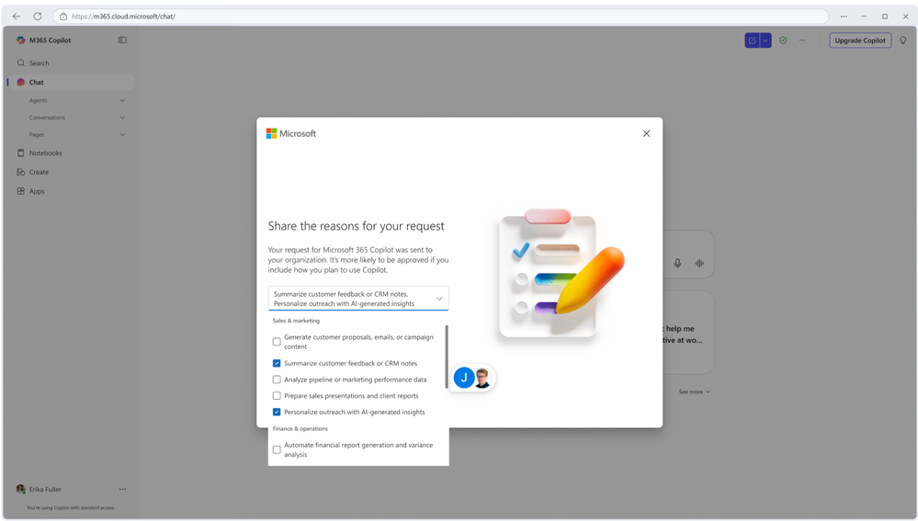
Business justification when requesting a Microsoft 365 Copilot license
Users can now add a business justification when requesting a Microsoft 365 Copilot license, giving IT admins clearer context to approve requests efficiently while maintaining governance.
Justification included: Users provide a business reason directly within the license request.
Faster approvals: IT admins receive clearer context to make quicker, better‑informed decisions.
Stronger governance: Supports audit requirements and maintains visibility into why licenses are requested.
Business justification when requesting
a Microsoft 365 Copilot license
This feature is rolling out in March.
Notes:
When requesting a Microsoft 365 Copilot license, users can now include a business justification explaining why they need Copilot. This information is surfaced to IT admins during review, helping them make faster, more informed approval decisions while supporting governance and audit requirements. By providing clear context upfront, organizations can streamline license approvals while maintaining control and visibility. This feature is rolling out in March.

Slide 32
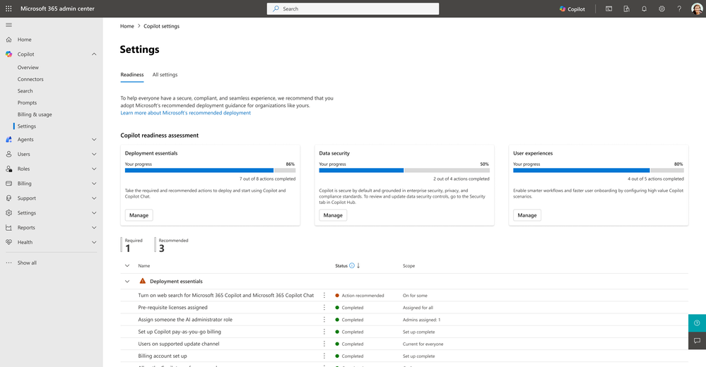
A new Copilot readiness page in the Microsoft 365 admin center
The new Copilot readiness page in the Microsoft 365 admin center helps IT teams plan and deploy Microsoft 365 Copilot by organizing key configuration areas and surfacing progress, insights, and recommendations in one place.
Structured guidance: Recommended settings are grouped into deployment essentials, data security, and user experience.
Clear prioritization: Helps IT teams understand scope, sequence actions, and focus on what matters most.
Progress tracking: Provides completion status and user coverage insights to support confident rollout planning.
Copilot readiness page
This feature rolled out to Public Preview in February and is rolling out worldwide in March.
Roadmap ID
526793
Notes:
The new Copilot readiness page in the Microsoft 365 admin center brings structure and clarity to the configuration and rollout of Microsoft 365 Copilot. The readiness page organizes recommended settings into clear categories of deployment essentials, data security, and user experience. This makes it easier to understand scope, prioritize actions, and track progress. With completion status, user coverage insights, and guided recommendations surfaced in one place, IT teams can plan, sequence, and deploy Microsoft 365 Copilot more confidently and consistently. This feature rolled out to Public Preview in February and is rolling out worldwide in March.

Slide 33
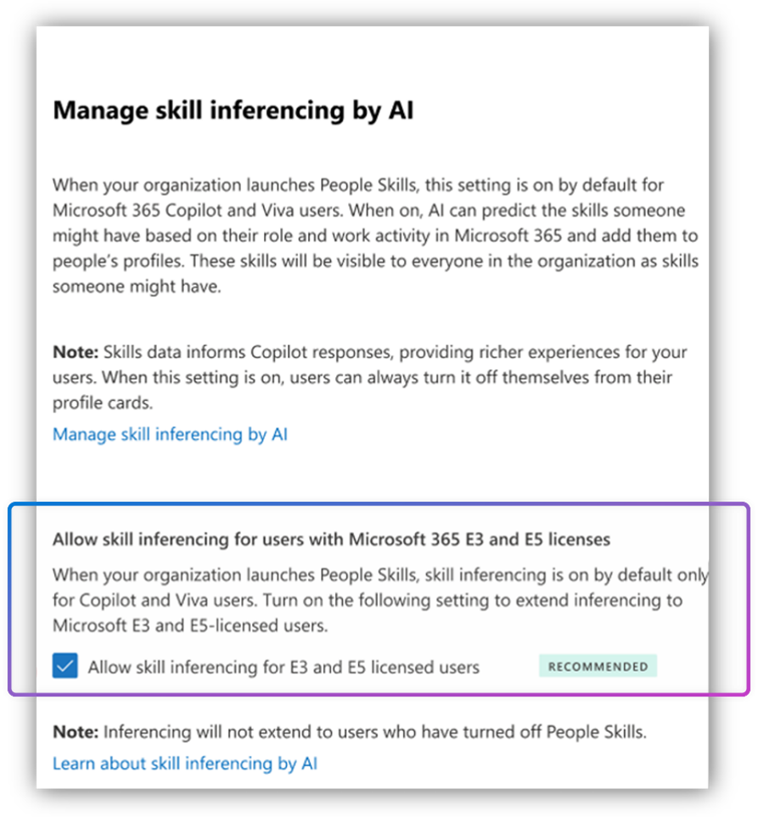
Admins can now enable AI-powered skill updates for user profiles
Admins can now turn on AI‑powered skill updates for user profiles in the Microsoft 365 admin center, helping keep organizational skill data accurate using Microsoft Graph activity.
• AI‑driven updates: Automatically refreshes user skill information based on Microsoft Graph signals.
• Centralized control: Admins enable and manage the feature directly from the Microsoft 365 admin center.
• Accurate skill profiles: Helps organizations maintain up‑to‑date skill data across the workforce.
AI-powered skill updates for user profiles
This feature rolled out in February.
Roadmap ID
548643
Notes:
Admins can now enable AI-powered skill updates for user profiles directly from the Microsoft 365 admin center. This feature helps organizations maintain accurate skill data across their user base using Microsoft Graph activity. This feature rolled out in February.

Slide 34
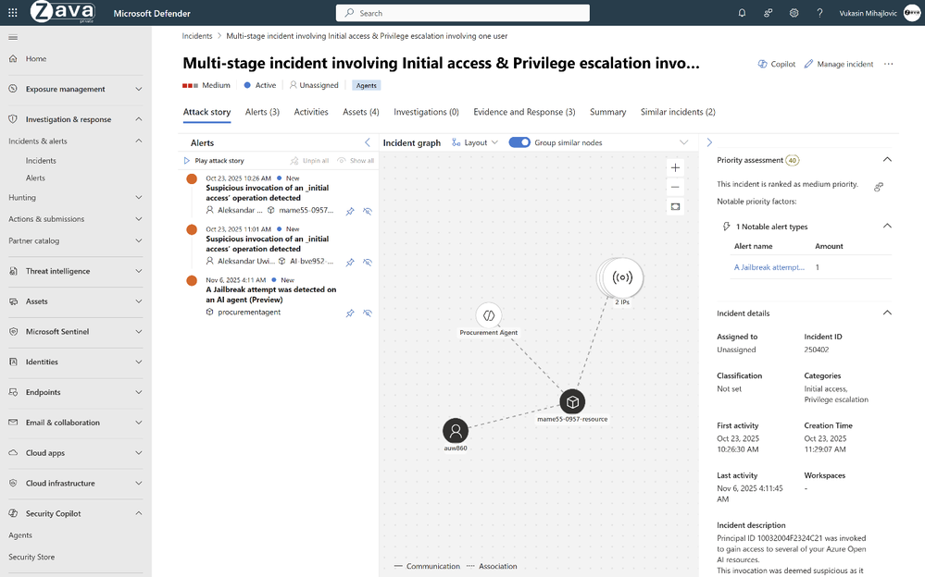
Risk-based inventory of AI agents for Microsoft Defender
Microsoft Defender AI Security Posture Management gives SOC teams a risk-based inventory of AI agents across Microsoft Foundry and Copilot Studio, enabling consistent oversight and control comparable to human identities.
Centralized Agent Visibility — Maintains a risk-based inventory of agents across Microsoft Foundry and Copilot Studio.
Actionable Security Guidance — Surfaces overall posture with recommendations and highlights issues like misconfigurations or excessive permissions.
Integrated Investigation & Hunting — Captures agent activity and supports hunting within Defender’s unified experience.
Risk-based inventory of AI agents for Microsoft Defender
This feature rolled out to Public Preview in November and rolled out worldwide in February.
Notes:
Microsoft Defender AI Security Posture Management now provides SOC teams with a risk-based inventory of AI agents across Microsoft Foundry and Copilot Studio. Analysts can view an agent’s overall security posture, easily implement security recommendations, and identify vulnerabilities such as misconfigurations and excessive permissions. Agent activity is captured for investigation with hunting available through Defender's unified experience. This gives a security team the visibility needed to manage AI agents with the same rigor as human identities. This feature rolled out to Public Preview in November and rolled out worldwide in February.

Slide 35
Copilot Extensibility

Slide 36
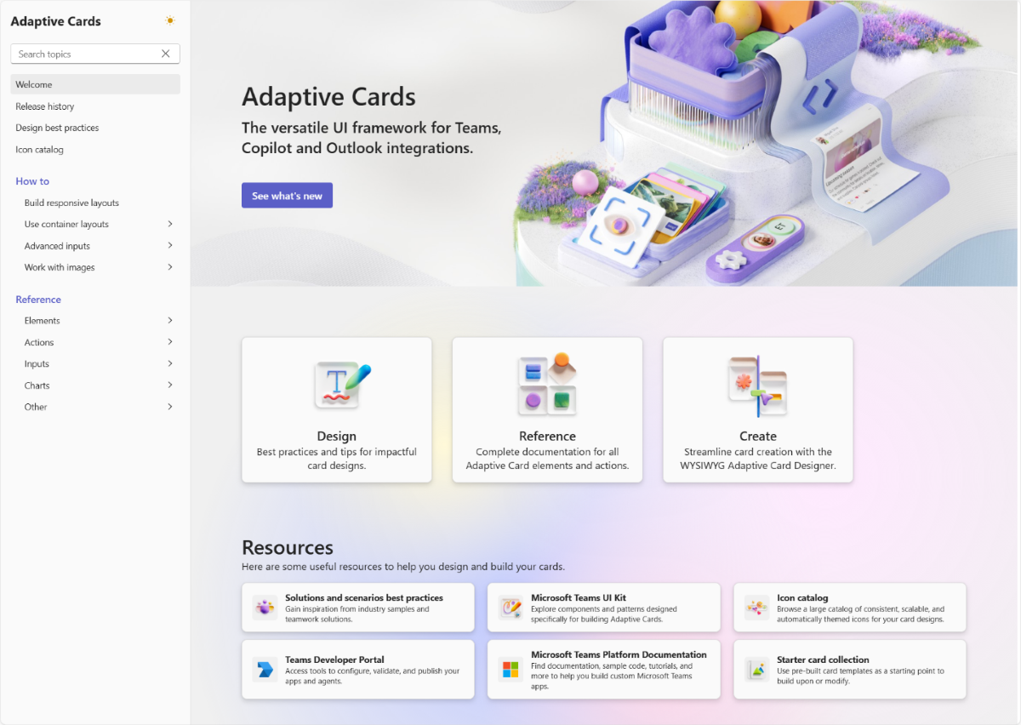
Adaptive Card content can be refreshed
Custom engine agents can now refresh Adaptive Card content in real time, enabling more dynamic, interactive agent experiences.
Real‑time updates: Adaptive Card content can now be refreshed within custom agent experiences.
More interactivity: Enables richer, more responsive interactions inside custom‑built agents.
Dynamic content delivery: Keeps information up to date without requiring users to reload or repeat actions.
Learn more
Adaptive Card content can be refreshed
This feature is rolling out in March.
Notes:
Adaptive Card content can be refreshed within custom engine agent experiences. This feature enhances the interactivity and real-time capabilities of custom-built agents. This enables an organization's custom agents to deliver more dynamic, up-to-date content to users. This feature is rolling out in March.

Slide 37
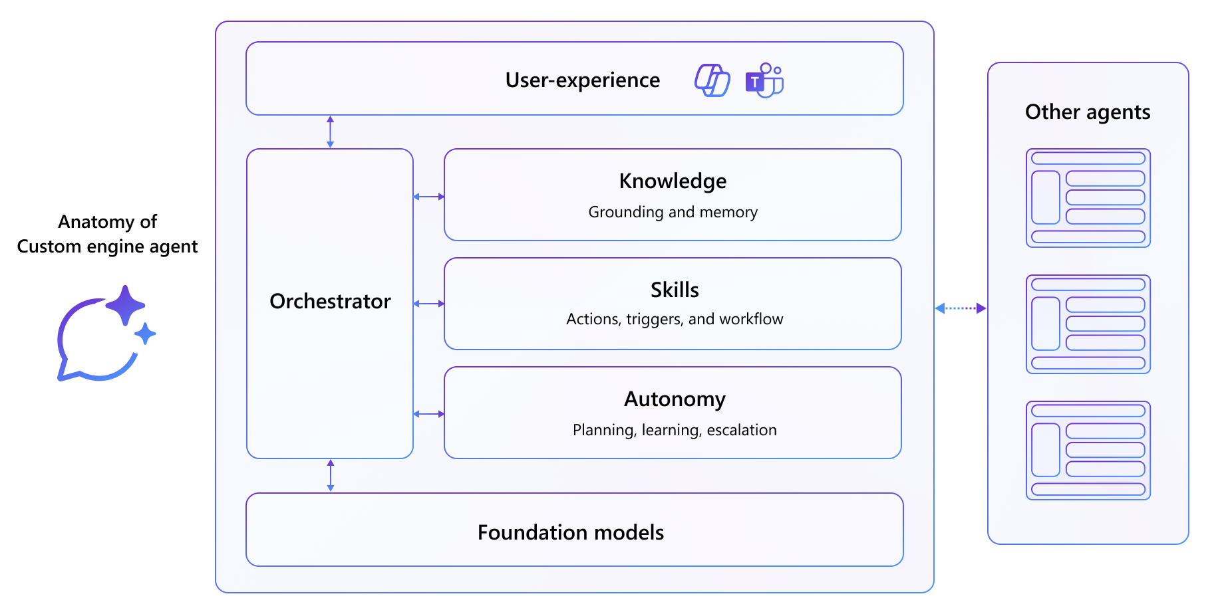
AI agents can coordinate with each other
AI agents can now call other agents as tools, enabling multi‑agent collaboration that combines specialized capabilities for more sophisticated workflows.
Agent‑to‑agent coordination: Agents can invoke other agents directly to complete complex tasks.
Specialized capabilities: Workflows can draw on multiple agents’ strengths for higher‑quality outcomes.
Advanced automation: Organizations can build more powerful, coordinated AI solutions.
Custom engine agents
This feature is rolling out in March.
Notes:
AI agents can coordinate with each other on complex tasks by calling other agents as tools. This multi-agent architecture allows agents to leverage specialized capabilities from other agents, so organizations can build more sophisticated AI workflows through agent-to-agent collaboration. This feature is rolling out in March.

Slide 38
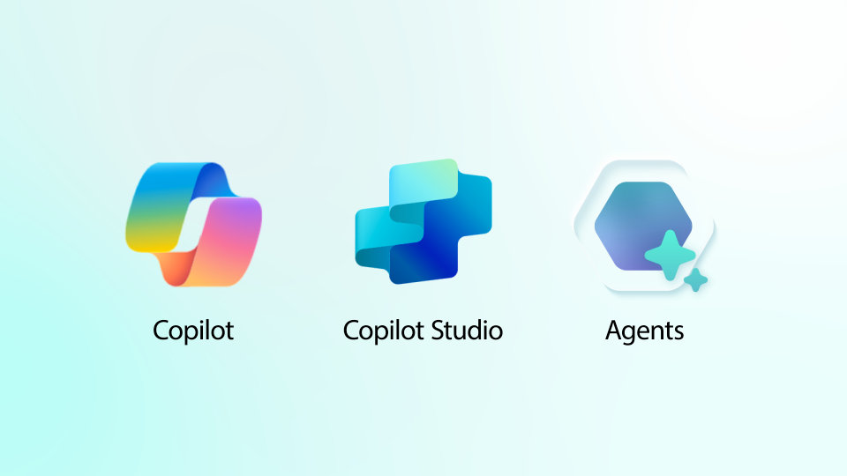

Access to agents built with Copilot Studio and Foundry through Outlook
Users can now access custom agents built with Copilot Studio and Foundry directly inside Outlook, bringing organization‑specific AI capabilities into everyday email workflows.
In‑Outlook access: Custom‑built agents are now available directly within the Outlook experience.
Seamless workflows: Users can leverage organizational agents without switching applications.
Admin deployment: Admins can deploy agents where users spend the most time managing communications.
Access to agents built with Copilot Studio
and Foundry through Outlook
This feature is rolling out in March.
Notes:
Access to agents built with Copilot Studio and Foundry through Outlook gives users access to their organization's custom-built agents directly within the Outlook experience. This integration extends agent capabilities to email workflows without requiring users to switch applications. Admins can deploy custom agents where users spend significant time managing communications. This feature is rolling out in March.

Slide 39
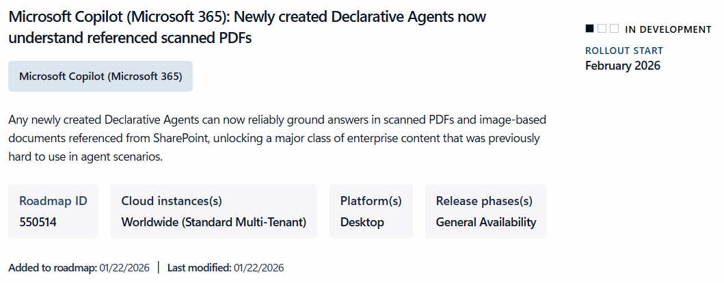
Declarative agents can now ground answers in scanned PDFs
Declarative agents can now ground their answers in scanned PDFs and image‑based documents stored in SharePoint, unlocking AI support for legacy and archive content.
Expanded grounding: Agents can use scanned PDFs and image‑based documents as context.
Broader content coverage: Unlocks enterprise archives and legacy materials previously hard to process.
Enhanced assistance: Enables more accurate, context‑rich answers based on historical or scanned content.
Declarative agents can now ground answers
in scanned PDFs
This feature rolled out in February.
Roadmap ID 550514
Notes:
Newly created declarative agents can now ground answers in scanned PDFs and image-based documents from SharePoint. This unlocks a major class of enterprise content that was previously difficult for agents to process. This enables organizations to leverage AI assistance with document archives and legacy scanned materials. This feature rolled out in February.

Slide 40
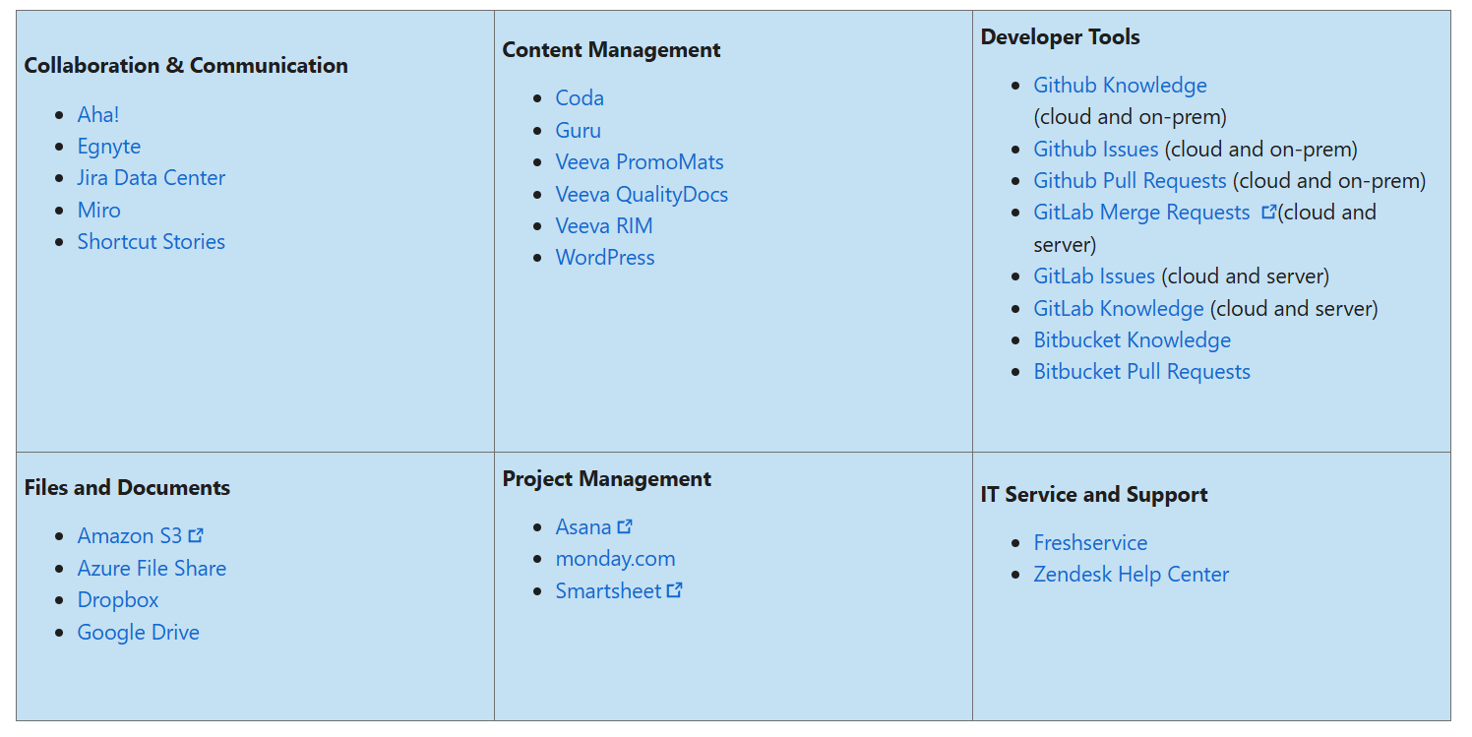
Microsoft 365 Copilot with Expanded Copilot Connectors Catalog
Copilot connectors bring external enterprise data into Microsoft 365 Copilot, helping employees find, analyze, and act on information beyond Microsoft apps.
New connectors now available. General availability of 35 new Copilot connectors expands coverage across developer tools, project management, IT service management, content management, and healthcare verticals.
Expanding the connector ecosystem. Microsoft now offers more than 100 Copilot connectors, making it one of the fastest-growing enterprise connector ecosystems.
35 new Copilot connectors built by Microsoft
Fueling New Experiences in Microsoft 365 Copilot with Expanded Copilot Connectors Catalog | Microsoft Community Hub
Notes:
Microsoft Defender AI Security Posture Management now provides SOC teams with a risk-based inventory of AI agents across Microsoft Foundry and Copilot Studio. Analysts can view an agent’s overall security posture, easily implement security recommendations, and identify vulnerabilities such as misconfigurations and excessive permissions. Agent activity is captured for investigation with hunting available through Defender's unified experience. This gives a security team the visibility needed to manage AI agents with the same rigor as human identities. This feature rolled out to Public Preview in November and rolled out worldwide in February.

Slide 41
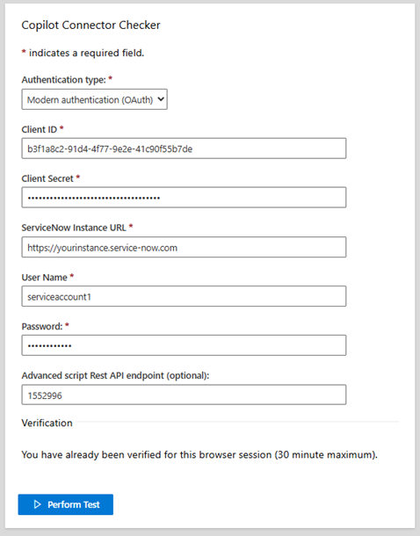
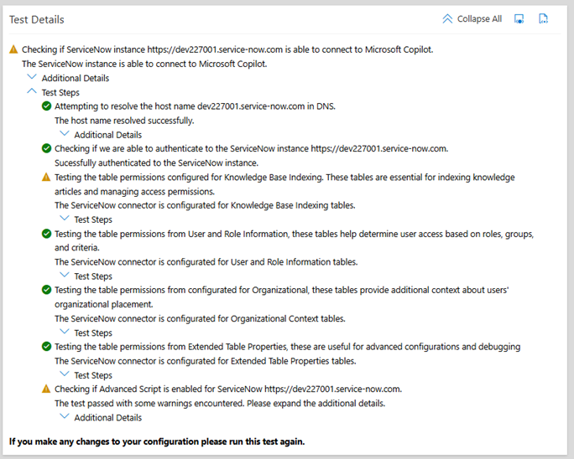
Introducing Copilot Connector Checker
Copilot connectors extend Microsoft 365 Copilot by securely bringing external business system content into Copilot search, agents, and broader Microsoft 365 experiences.
Copilot Connector Checker: A lightweight pre‑flight validation tool provides fast, guided checks with clear diagnostics to verify third‑party prerequisites before connector deployment.
Initial Availability: The first release supports the ServiceNow Knowledge Base connector, with additional connectors planned.
Try it here: https://aka.ms/CopilotConnectorChecker
Introducing Copilot Connector Checker
Introducing Copilot Connector Checker | Microsoft Community Hub
Notes:
Microsoft Defender AI Security Posture Management now provides SOC teams with a risk-based inventory of AI agents across Microsoft Foundry and Copilot Studio. Analysts can view an agent’s overall security posture, easily implement security recommendations, and identify vulnerabilities such as misconfigurations and excessive permissions. Agent activity is captured for investigation with hunting available through Defender's unified experience. This gives a security team the visibility needed to manage AI agents with the same rigor as human identities. This feature rolled out to Public Preview in November and rolled out worldwide in February.

Slide 42
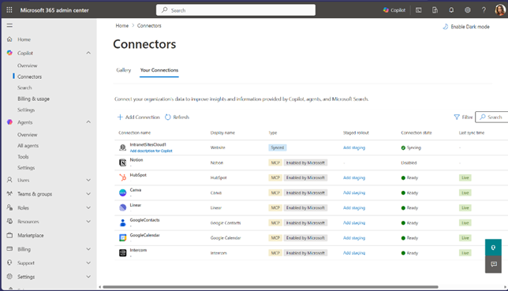
Federated Copilot connectors are now available in Public Preview
Federated Copilot connectors are now available by default in Public Preview, allowing users to securely access live data from supported external services while admins manage connector availability centrally.
Live external data: Users can authenticate into services like Canva, HubSpot, Notion, Linear, Intercom, Google Contacts, and Google Calendar.
Real‑time access: Connector data is retrieved live (not indexed) and currently supported only in Researcher.
Admin governance: Admins can enable, disable, and review connectors in the Microsoft 365 admin center.
Federated Copilot connectors
This feature rolled out in February.
Roadmap ID
501584
Notes:
Federated Copilot connectors are now available in Public Preview by default across all tenants, allowing users to authenticate and securely access live data from supported external services such as Canva, HubSpot, Notion, Linear, Intercom, Google Contacts, and Google Calendar. Admins can govern availability from the Microsoft 365 admin center—reviewing, enabling, and disabling these connectors—while users connect with their own credentials. Federated connector data is retrieved in real time (not indexed) and is currently supported only in Researcher. This feature rolled out in February.

Slide 43
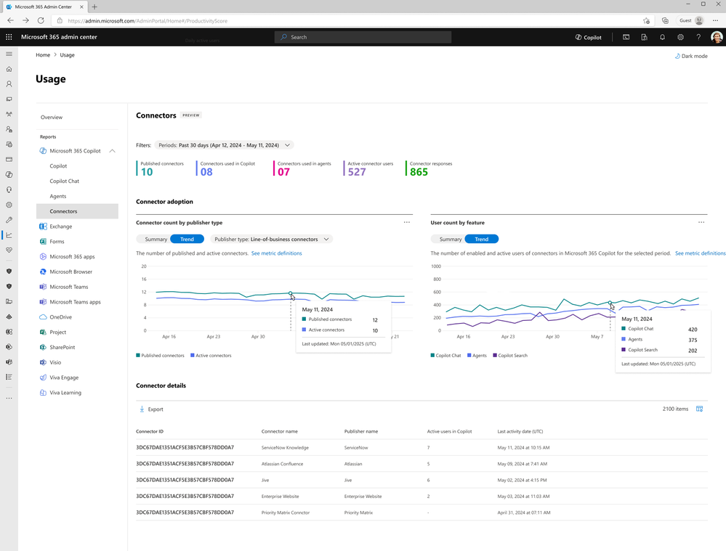
Connector Usage Report
The Connector Usage Report in the M365 admin center shows how connectors are enhancing Copilot experiences, providing metrics and trends that help organizations optimize adoption and identify high‑value integrations.
• Visibility into usage: Reports active connectors, usage trends, and which agents reference each connector.
• Engagement insights: Includes daily trends, response counts, and individual‑level engagement metrics.
• Adoption optimization: Helps organizations refine training and identify high‑impact integrations.
Connector Usage Report
This feature is rolling out in March.
Roadmap ID
519571
Notes:
The Connector Usage Report in Microsoft 365 admin center provides information on how connectors are augmenting Microsoft 365 Copilot experiences, with metrics including number of active connectors, and agents that reference connectors. With insights into daily trends, connector response counts, and individual-level engagement, organizations can optimize training, improve adoption strategies, and identify high-impact integrations. This feature is rolling out in March.

Slide 44
Microsoft 365 Copilot release notes
As of 3rd March 2026
Latest features and improvements for Microsoft 365 Copilot.
It includes changes that are generally available
(Current Channel for Microsoft 365 apps)
Release Notes for Microsoft 365 Copilot | Microsoft Learn
Notes:
As of 3rd March 2026
This page lists the latest features and improvements for Microsoft 365 Copilot. It includes changes that are generally available (Current Channel for Microsoft 365 apps) and specific to each platform.

Slide 45
Microsoft 365 Copilot release notes – February 2026
As of 3rd March 2026
Copilot extensibility (16)
PowerPoint (2)
Connect Copilot with Monday.com to track work and team progress [Web]
Connect Copilot with WordPress.com and WordPress.org [Web]
Connect Copilot with Azure File Share [Web]
Connect Copilot with Veeva [Web]
Connect Copilot with Jira Data Center to manage engineering tasks [Web]
Out‑of‑box filter support for data sources in Copilot Search [Web]
Scope grounding for declarative agents to specific data sources [Windows, Web]
Embedded knowledge support for declarative agents [Web]
Declarative agents upgraded to GPT‑5.1
Admins can set up connector authentication faster with a simplified experience [Web]
Users can refresh Adaptive Cards in agents to view the latest information [Web]
Field teams can accelerate Copilot adoption using champion connectors [Web]
Declarative Agents help users stay in their workflow [Web]
More frequent ticket status updates for the ServiceNow Tickets Copilot connector [Web]
Query Miro boards and diagrams with Copilot connectors [Web]
Connect Copilot to GitHub Server with Copilot Connector [Web]
Use Copilot to get a detailed and contextual explanation [Web, Windows, Mac]
Steer presentation length, tone, style, and images with Copilot [Web, Windows, Mac]
Microsoft Teams (1)
Configure and manage agent manifests in Developer Portal
Viva Insights (1)
Copilot Studio agent report enhancements [Web, Windows, Mac]
Learn more | Release Notes for Microsoft 365 Copilot
Updates released between January 27, 2026, February 24, 2026.
Notes:
Updates released between January 27, 2026, February 24, 2026.
This page lists the latest features and improvements for Microsoft 365 Copilot. It includes changes that are generally available (Current Channel for Microsoft 365 apps) and specific to each platform.
As of 3rd March 2026
Learn more - Release Notes for Microsoft 365 Copilot | Microsoft Learn
https://learn.microsoft.com/en-us/copilot/microsoft-365/release-notes?tabs=all

Slide 46
Microsoft 365 Copilot release notes – January 2026
As of 2nd Feb 2026
Microsoft 365 Copilot Chat (3)
PowerPoint (1)
        Copilot Chat model selector now offers GPT‑5.2 [Android, Windows, iOS, Mac, Web]
        Copilot icon visibility in Microsoft Edge [Web]
        Search for meetings by organizer using Copilot Chat [Windows]
Use Copilot to get a detailed and contextual explanation
Microsoft 365 Copilot app (1)
Copilot extensibility (15)
Access all your Copilot-generated content in one library [Android, Windows, iOS, Mac, Web]
Advanced understanding for comments and attachments in SNOW KB and Azure DevOps connectors [Windows, Web]
Build smarter agents with GPT‑5 in Agent Builder [Android, Windows, iOS, Mac, Web]
Bring your own Microsoft Foundry agents into Microsoft 365 Copilot [Web]
Connect Dropbox for smarter Copilot file access [Web]
Connect Microsoft 365 Copilot with Guru for enhanced insights [Web]
Copy an agent from Agent Builder to Copilot Studio [Windows, Web]
Expand Copilot Agents with Mail, People, and Meeting Insights [Windows, Web]
Generate icons using AI in Agent Builder [Windows, Web]
Generate Office documents from agents in Copilot Studio lite [Windows, Web]
Improve relevance and personalization by connecting user identities across data sources [Windows, Web]
Publish Azure AI Foundry agents to Copilot [Web]
Simplified ServiceNow tickets setup with per-table ACL rules [Web]
Smart document management with Google Drive integration [Web]
Template-based knowledge ingestion for ServiceNow Knowledge Connector [Web]
Users can leverage multi-agent workflows [Windows, Web]
Microsoft Loop (1)
Generate PowerPoint grounded on a Copilot page [Web]
Viva Glint (2)
Copilot employee experience outcomes report with Viva Glint [Web]
Workplace patterns report in Viva Glint [Web]
Microsoft 365 Admin Center (1)
Admin control to customize AI disclaimers in Copilot Chat [Windows, Web]
Learn more | Release Notes for Microsoft 365 Copilot
28 Updates released between December 23, 2025, and January 27, 2026.
Notes:
Updates released December 23, 2025, and January 27, 2026.
This page lists the latest features and improvements for Microsoft 365 Copilot. It includes changes that are generally available (Current Channel for Microsoft 365 apps) and specific to each platform.
As of 2nd February 2026
Learn more - Release Notes for Microsoft 365 Copilot | Microsoft Learn
https://learn.microsoft.com/en-us/copilot/microsoft-365/release-notes?tabs=all

Slide 47
Microsoft 365 Copilot release notes – December 2025
As of 2nd Jan 2026
Copilot extensibility (9)
Microsoft 365 Copilot app (3)
SharePoint (1)
        Access IT service documentation with Freshservice integration [Web]
        Upload larger files in Copilot Studio Agent Builder (512 MB support) [Android, Windows, iOS, Web]
        Use .NET client libraries to integrate Microsoft 365 Copilot APIs [Web]
        Use Python client libraries to integrate Microsoft 365 Copilot APIs [Web]
        Use TypeScript client libraries to integrate Microsoft 365 Copilot APIs [Web]
        View and manage SharePoint agents with greater control [Web]
        Access custom engine agents in multiple apps [Web]
        Edit adaptive cards inline for a faster build process [Web]
        Better security insights help you build confidently [Web]
GPT-5 powers Copilot Chat by default [Android, Windows, iOS, Mac, Web]
Create polished videos faster with seamless editing and brand customization [Web]
Get AI-powered summaries with search views [Web]
Add multiple SharePoint agents in one Teams conversation [Web]
Viva Glint
Multilingual support in Copilot for Viva Glint [Web]
Microsoft 365 Copilot Chat (1)
Word (1)
        Streamlined Copilot chat navigation with expanded history [Windows, Web]
Referenced sources cited in drafted content [Windows]
PowerPoint (1)
Use your organization’s approved assets in Copilot presentations [Mac, Windows, Web]
Copilot Studio (1)
Build Copilot agents using organizational People data [Windows, Web]
Learn more | Release Notes for Microsoft 365 Copilot
16 Updates released between November 25, 2025, and December 23, 2025
Notes:
Updates released between November 25, 2025, and December 23, 2025.
This page lists the latest features and improvements for Microsoft 365 Copilot. It includes changes that are generally available (Current Channel for Microsoft 365 apps) and specific to each platform.
As of 2nd January 2026
Learn more - Release Notes for Microsoft 365 Copilot | Microsoft Learn
https://learn.microsoft.com/en-us/copilot/microsoft-365/release-notes?tabs=all

Slide 48
Microsoft 365 Copilot Public Roadmap
Changes this month
As of 3rd March 2026
Microsoft 365 Roadmap - See What's Coming | Microsoft 365
Notes:
As of 3rd March 2026

Slide 49
Microsoft 365 Copilot Public Roadmap
As of 3rd March 2026
Launched and Rolling Out “Changed within last month”
Launched (31) 🚀
  Rolling Out (21)
Copilot in Teams can generate an audio overview of your meetings
Copilot Chat - Loop Notebooks in ContextIQ
Review PDFs using Copilot context menu and AI actions
Outlook: Agents for Microsoft 365 Copilot available in Copilot Chat in classic Outlook for Windows
Microsoft Edge: v.145 - Securely enable AI generated applications
Agent Mode in Excel for desktop apps
Scheduling with Copilot
Agent Mode in Excel
Microsoft Edge: Ask Copilot from the address bar
People Skills - Expanded AI inferencing for E3/E5 users
[Copilot Chat] Agent Mode in Excel
Edit capability for selecting permission reading option for existing ServiceNow Knowledge & Catalog Connections
New Create module with Word, Excel and PPT templates
Teams Channels in Context IQ
Increased efficiency with auto-generated Copilot Pages
Query Bitbucket Pull Requests with Copilot Connectors
Use Copilot with OneDrive files in Finder
Query Miro Visuals with Microsoft 365 Copilot Connectors
Microsoft Copilot (Microsoft 365): Query GitLab Merge Requests and Content with Copilot
[Copilot Extensibility] Customers can connect M365 Copilot with Shortcut to manage agile development workflows with Copilot Connector
[Copilot Extensibility] Customers can connect M365 Copilot with Aha! to manage product features and customer ideas with Copilot Connector
Summarize email with Copilot chat in Outlook
Ticket Status updates more frequently in ServiceNow Tickets Copilot Connector
Preview and chat with Word, Excel, and PowerPoint files in the Microsoft 365 Copilot app on Android
Microsoft Viva: Copilot Dashboard - Benchmarks
[Copilot Extensibility] Customers can connect M365 Copilot with Dropbox to access and manage cloud files with Copilot Connector
Microsoft Edge: v.144 - Contextual nudges on address bar offering help summarizing webpages.
OneDrive: Agents in OneDrive
Microsoft Teams: Facilitator can help manage tasks and create documents
Microsoft Purview: Insider Risk Management - Risky AI usage
Graph API - Copilot for Microsoft 365 usage
SharePoint list agent
Enhanced M365 Copilot Memory - Copilot is now personalized with work data
Voice chats can reference Memory
Copilot voice support in Word & PowerPoint.
Metadata understanding support for queries scoped to SharePoint document libraries or folders
Enable watermarks for AI-generated content for M365 Copilot
Agent Mode in PowerPoint
Microsoft 365 app: Overview Page in Copilot Notebooks
Word Agent
Microsoft Edge: Ground Microsoft 365 Copilot Chat in Edge for Business in your open YouTube videos
Microsoft Edge: Microsoft 365 Copilot Chat access to page content will soon extend to work across multiple open tabs
Copilot Search Helps You Discover People
Copilot Search Matches on People's Department
Updated Copilot Notebooks UX
Admins can now edit user mappings and query filters for ServiceNow Connector
Find Exactly What You Need, Faster
Scatter image effect in Microsoft 365 Copilot
Use voice for Q&A during Read Aloud in Word
Admins can create and deploy custom Model Context Protocol (MCP) connectors across Microsoft 365.
Floating Copilot icon in File Previewer for OneDrive
Intelligent meeting recap can summarize content shared on screen
Notes:
As of 3rd March 2026

Slide 50
Microsoft 365 Copilot Public Roadmap
As of 3rd March 2026
New items added “New within the last month”
New items (35) – In development
Microsoft Viva: Insights - New Copilot Metrics Available
Reference SharePoint libraries and OneDrive folders when creating a presentation with Agent Mode in PowerPoint
Share agents to Teams
Create Videos in the Clipchamp Start Page
Copilot can edit your document by default in Word
Branded footer in the Microsoft 365 Copilot app
Explain slide selection during PowerPoint Live
Microsoft Viva: Copilot Analytics: Copilot adoption PBI version update including Power user insights.
Local file support for Agent Mode in Excel
Microsoft 365 admin center: Copilot - Billing and usage - Standalone consumption of prepaid capacity pack credits
[Copilot Extensibility] IT Admins will be able to enable Anthropic models by specific users and groups in the tenant
Submit agent to Agent Store from Agent Builder
Reference an attached PowerPoint deck’s style when creating a new presentation with Agent Mode in PowerPoint
Infinite Scroll Chat History
Microsoft 365 admin center: Copilot - Billing & usage: High-usage users
Microsoft Purview: Data Loss Prevention to prevent Microsoft 365 Copilot processing content with sensitivity labels supports all storage locations
Consecutive mode for Interpreter
Agent Mode in PowerPoint
OneDrive: Microsoft 365 Copilot in OneDrive
Create executive summary slides with Agent Mode in PowerPoint
Reference webpages when creating a presentation with Agent Mode in PowerPoint
Reference the content of a PowerPoint file when creating a presentation with Agent Mode in PowerPoint
Attach and reference an image when creating a presentation with Copilot in PowerPoint using Agent Mode.
Reference an email when creating a presentation with Agent Mode in PowerPoint
Reference a Teams meeting or chat when creating a presentation with Agent Mode in PowerPoint
Attach and reference an image when creating a presentation with Copilot in PowerPoint using Agent Mode.
Create presentations with Work IQ using Agent Mode in Copilot in PowerPoint
Microsoft Clipchamp: Improved audio for Copilot AI-generated video projects
Makers can build DA's with Flexible layouts and rich UX components
Microsoft 365 Copilot Search Supports SharePoint Online Custom Properties Search
[Copilot Extensibility] Admins can govern and manage federated copilot connectors in Microsoft 365 admin center
Copilot Chat in Outlook expands to reason over inbox, calendar, and enterprise data
Researcher Agent for GCC
Copy Tables in Microsoft 365 Copilot Chat
Unified Plus menu (+)
Notes:
As of 3rd March 2026

Slide 51
Microsoft 365 Copilot Public Roadmap
As of 3rd March 2026
In development “Changed within last month”
In development (71)
Copilot Analytics - Export metrics in the Copilot Dashboard at Day Level
Capture voice notes in the Microsoft 365 Copilot mobile app
Web Link as a Reference in Copilot Notebooks
Microsoft Viva: Insights - New Copilot Metrics Available
Reference SharePoint libraries and OneDrive folders when creating a presentation with Agent Mode in PowerPoint
Share agents to Teams
Create Videos in the Clipchamp Start Page
Excel: =COPILOT Function
Satisfaction Rate Metric for Microsoft 365 Copilot in Copilot Dashboard
Generate text for a PowerPoint slide using slide context
Content Sources in Copilot Chat
SharePoint: Chat one-on-one with SharePoint agents in Teams
Copilot can edit your document by default in Word
Copilot uses enterprise assets hosted on Adobe Experience Manager when creating presentations
Microsoft SharePoint: New web part for FAQs
Branded footer in the Microsoft 365 Copilot app
Copilot Analytics - Agent Dashboard.
Copilot Analytics - Prompt category metrics for Microsoft 365 Copilot Chat
Explain slide selection during PowerPoint Live
Microsoft Viva: Copilot Analytics: Copilot adoption PBI version update including Power user insights.
Express voice enrollment in Microsoft Teams
Local file support for Agent Mode in Excel
Microsoft Viva: Copilot Dashboard - Broader access to M365 Copilot Chat insights
Copilot - Billing and usage - Standalone consumption of prepaid capacity pack credits
Microsoft Edge: Summarization, Translation, and Citation will soon be supported by Microsoft Copilot and Microsoft 365 Copilot Chat in our menus
[Copilot Extensibility] IT Admins will be able to enable Anthropic models by specific users and groups in the tenant
Submit agent to Agent Store from Agent Builder
Reference an attached PowerPoint deck’s style when creating a new presentation with Agent Mode in PowerPoint
Real-time voice interactions in a podcast in Word
Viva Engage - Agents in communities
Admins will be able to define rules to automate agent lifecycle management.
Infinite Scroll Chat History
Microsoft 365 admin center: Copilot - Billing & usage: High-usage users
Consecutive mode for Interpreter
Data Loss Prevention to prevent Microsoft 365 Copilot processing content with sensitivity labels supports all storage locations
Chat & Search Browser Extension for Chrome
Microsoft Graph APIs for App & Agent Inventory and Details.
OneDrive: Microsoft 365 Copilot in OneDrive
Create executive summary slides with Agent Mode in PowerPoint
Microsoft Edge: Adding contextual nudges to the Microsoft 365 Copilot Chat icon
Support permission sync missed in incremental crawl
Ask Copilot about highlighted response content
Reference webpages when creating a presentation with Agent Mode in PowerPoint
Reference the content of a PowerPoint file when creating a presentation with Agent Mode in PowerPoint
Reference an email when creating a presentation with Agent Mode in PowerPoint
Attach and reference an image when creating a presentation with Copilot in PowerPoint using Agent Mode.
Reference a Teams meeting or chat when creating a presentation with Agent Mode in PowerPoint
Create presentations with Work IQ using Agent Mode in Copilot in PowerPoint
Create presentations with Work IQ using Agent Mode in PowerPoint
Surveys Agent and Copilot Chat in Microsoft Forms
Query Coda Docs and Wikis with Copilot Connectors
Customers can connect M365 Copilot with Monday.com to track work and team progress with Copilot Connector
Customers can connect M365 Copilot with Asana to manage projects and tasks with Copilot Connector
Expanded Agent Support in Copilot Notebooks
Generative-AI skills for Create in Microsoft 365 Copilot app for Government Clouds
Microsoft Clipchamp: Improved audio for Copilot AI-generated video projects
Makers can build DA's with Flexible layouts and rich UX components
Microsoft 365 Copilot Search Supports SharePoint Online Custom Properties Search
[Copilot Extensibility] Admins can govern and manage federated copilot connectors in Microsoft 365 admin center
Structured Document Generation with Forms
Frontier and Microsoft agent user request approval flow in Microsoft 365 admin center
Copilot Chat in Outlook expands to reason over inbox, calendar, and enterprise data
Researcher Agent for GCC
Agent Mode in Excel for GCC
Data Lifecycle Management - Retention based on Last Accessed for files in OneDrive and SharePoint
Masking in Copilot chat
Relight images in Microsoft 365 Copilot
Copy Tables in Microsoft 365 Copilot Chat
Unified Plus menu (+)
Export Copilot metrics in the Copilot Dashboard
Notes:
As of 3rd March 2026

Slide 52
Thank you 👏
Got feedback ?
https://aka.ms/WhatsNewCopilot/Feedback
Notes:
Thank you.

Slide 53

Feedback Form

Slide 54
Resources
Microsoft 365 Copilot Blog | Microsoft Community Hub
What’s New in Microsoft 365 Copilot | February 2026 | Microsoft Community Hub
Release Notes for Microsoft 365 Copilot | Microsoft Learn
Microsoft 365 Roadmap | Microsoft 365
What's new in Copilot Studio - Microsoft Copilot Studio | Microsoft Learn
Copilot Studio | Microsoft Copilot Blog
Microsoft 365 Copilot News and Insights | Microsoft 365 Blog
Available today: GPT-5.3 Instant in Microsoft 365 Copilot | Microsoft Community Hub
People Skills: Expanding skills intelligence to more users and surfaces across Microsoft 365 | Microsoft Community Hub
Fueling New Experiences in Microsoft 365 Copilot with Expanded Copilot Connectors Catalog | Microsoft Community Hub
Introducing Copilot Connector Checker | Microsoft Community Hub
Frontier program – Microsoft Adoption

Slide 55
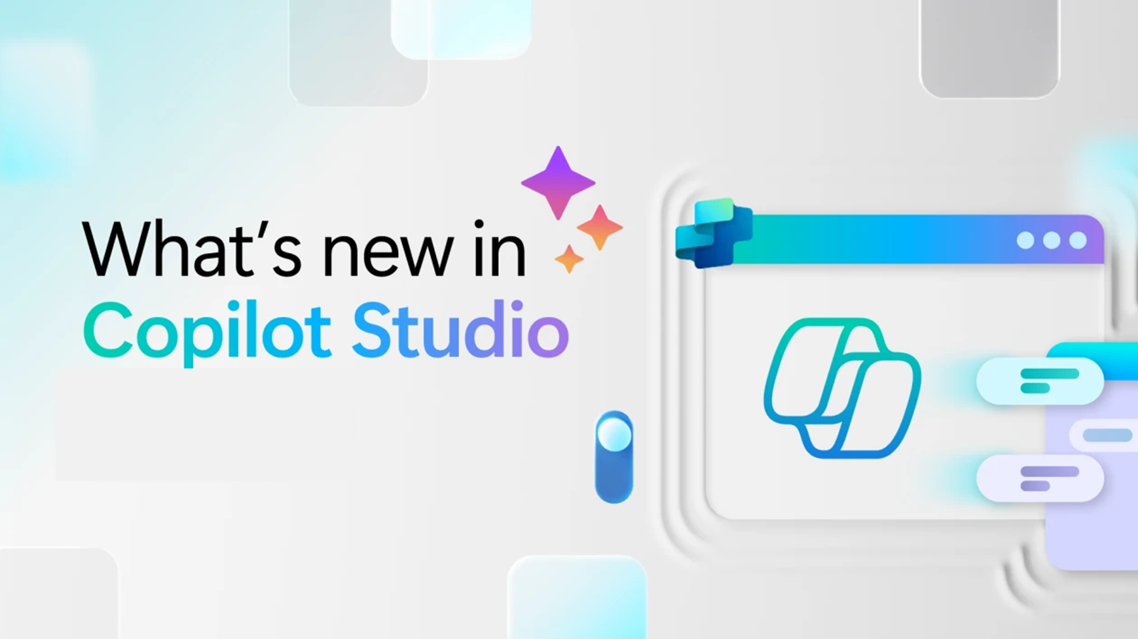
Whats new in Copilot Studio

Slide 56
What's new in Copilot Studio
The following table displays the month of release for each new feature.
Month of release | What’s new
February 2026 | Improved agent responses for ticket‑based Microsoft 365 Graph connectors. Agents more accurately retrieve ServiceNow tickets and Azure DevOps work items and generate clear, actionable summaries, which improves workflow reliability, and time to value. Select Claude Sonnet 4.5 (beta) for Computer Use agents. This model improves nuanced decision‑making for complex tasks, increasing reliability, and success rates for advanced uses. Enhancements to the prompt builder include: Configure content moderation sensitivity per prompt to control how hate/fairness, sexual, violence, and self‑harm content is filtered—supporting regulated and document‑processing scenarios with low or high sensitivity settings for managed models. Optimize prompts with new Claude models by choosing Claude Opus 4.6 or Claude Sonnet 4.5, enabling fine‑grained control over reasoning depth, quality, latency, and cost per prompt. Edit prompt instructions and settings inline in agent tool details, bringing model selection, inputs, knowledge, and testing into a single, streamlined authoring experience.
January 2026 | (Preview) New enhancements to agent evaluations: Provide real‑time thumbs‑up/down feedback on evaluation results to verify grading performance and drive ongoing improvements to evaluation reliability. View your agent's sequence of inputs, decisions, and outputs with activity maps so you can quickly diagnose issues and get clearer insight into how your agent behaves at runtime. Use a validated CSV template to create test sets, reducing formatting errors, and helping your team standardize evaluation data more quickly. (Preview) Expand computer use capabilities with new model support, built‑in credentials, enhanced audit logging with session replay, and Cloud PC pooling—giving you greater security, scalability, and governance for agent‑driven workflows. (General availability) Use the Microsoft Copilot Studio extension for Microsoft Visual Studio Code to build, edit, and manage agents inside Microsoft Visual Studio Code, supporting advanced and highly flexible developer workflows.
What's new in Copilot Studio - Microsoft Copilot Studio | Microsoft Learn | Copilot Studio Archive | Microsoft Copilot Blog
Notes:
As of 5th March 2026
What's new in Copilot Studio - Microsoft Copilot Studio | Microsoft Learn
https://learn.microsoft.com/en-us/microsoft-copilot-studio/whats-new
Copilot Studio Archive | Microsoft Copilot Blog
https://www.microsoft.com/en-us/microsoft-copilot/blog/copilot-studio/
What’s new in Copilot Studio: May 2025 | Microsoft Copilot Blog

Slide 57

What's new in Frontier
Get hands-on with breakthrough preview features, share your insights with product teams, and help shape the future of AI.
With Frontier, you’re not just adopting new technology, you’re co-creating what comes next.
Frontier program – Microsoft Adoption

Slide 58
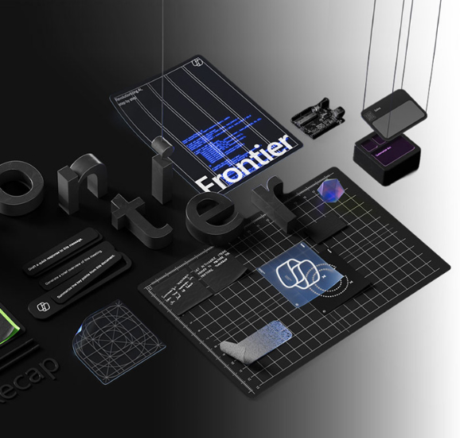
What's new in Frontier
Try out the latest agents and features in Microsoft 365 Copilot and see how they can transform your day-to-day.​
NEW: Agents to drive AI workforce transformation
NEW: Microsoft Agent 365: The control plane for AI Agents
NEW: Build and create with Copilot Pages
NEW: Learn more about the Sales Development Agent
NEW: How Sales Development Agent connects with Dynamics 365
NEW: Learn more about Project Opal
NEW: Experience next-gen productivity with Windows 365 AI-enabled Cloud PCs
Frontier Getting started guide
Notes:
As of 5th March 2026
What's new in Copilot Studio - Microsoft Copilot Studio | Microsoft Learn
https://learn.microsoft.com/en-us/microsoft-copilot-studio/whats-new
Copilot Studio Archive | Microsoft Copilot Blog
https://www.microsoft.com/en-us/microsoft-copilot/blog/copilot-studio/
What’s new in Copilot Studio: May 2025 | Microsoft Copilot Blog

Slide 59
Microsoft 365 Copilot
September 2025
Copilot Control System
User capabilities
        Expanding model choice in Microsoft 365 Copilot
        Admins can view and measure agents used in Microsoft 365 Copilot
        A new policy gives enhanced control over Copilot prompts
        Admins can manage ownerless agents
        Manage data security risks with Microsoft Purview Data Security Posture Management for AI apps
        Merge people data with other sources with Microsoft Copilot connectors
        Employees can use their personal Microsoft 365 subscriptions to access Copilot features at work
        The new Copilot Chat Roadmap
        Copilot Chat is now available in Word, Excel, PowerPoint, Outlook, and OneNote
        Updated Copilot with a long context model
        Seamlessly launch the full M365 Copilot app
        Copilot Chat now lets users interact with embedded images inside any document
        Generating PPT grounded on a Copilot Page
        Teams Chats and Channels in ContextIQ
        The new Edit in Outlook button
        Email attachment summarization
        Access email from delegated mailboxes
        Users can access their shared mailboxes.
        Users can search for meeting RSVPs
        Microsoft 365 Copilot Library
        Copilot Search, users can find meetings
        AI Views in Copilot Search
        Produce videos from text prompts and existing files
        Formula completion with Copilot in Excel
        Users can easily summarize any open email or email thread in a single click
        Copilot now extends to helping users search their Outlook inboxes
        Schedule meetings using Copilot Chat
        Copilot now makes it easier to resolve scheduling conflicts
        Update documents and fix spelling and grammar with Copilot in Word
        Thread summaries from Copilot in Teams
        Improve text with Copilot in PowerPoint
        Copilot now available in Viva Engage
        Moving sales, service, and finance with Microsoft 365 Copilot
        New app icons designed for the AI era
Agents
        New output controls for Researcher agent
        Skills Agent
        Knowledge Agent in SharePoint
        Facilitator in Microsoft Teams
        Teams channel can now have a Channel Agent
        Agents in Viva Engage communities
        SharePoint agents can now reason over metadata
        Introducing Agent Mode and Office Agent in Microsoft 365 Copilot
Notes:
As of 3rd July 2025

Slide 60
Microsoft 365 Copilot
October 2025
Copilot Control System
User capabilities
        Copilot Control System features on M365 Public Roadmap
        New reports and management tools in Microsoft 365 admin center
        The new Microsoft 365 Copilot usage report
        Agent ownership reassignment
        Enhanced Agent Inventory Export
        Model Context Protocol & Unified Agent Management
        Copilot Credit Capacity for SharePoint & Tuning
        Microsoft 365 companion apps—People, Files, and Calendar
        Team views in Copilot Dashboard
        Copilot Chat quality Roadmap
        Session persistence enhancement for Copilot Chat
        Improving response accuracy for file-based questions
        Agent recommendations in Copilot Chat
        GPT-5 will soon become the default model in Copilot Chat
        Copilot Chat is simplifying calendar management.
        Bing Web Cards
        Copilot Chat API
        AI Views in Microsoft 365 Copilot Search
        Copilot Search Enhancements
        Copilot Chat in Mobile File Preview
        Audio recapnew file summaries for Copilot in Teams
        Speaker notes and translation for Copilot in PowerPoint
        Agent Mode in Word
        Agent Mode in Excel
        Meeting planning improvements for Copilot in Outlook
        Teams Mode for Microsoft 365 Copilot
        Employees can use their personal Microsoft 365 subscriptions to access Copilot features at work
Agents
        Employee Self-Service Agent
        Surveys Agent
        App Builder agent
        Researcher updates
        Introducing Researcher with Computer Use
Notes:
As of 5th October 2025

Slide 61
Microsoft 365 Copilot
November + December 2025
As of 2nd Jan 2026
Copilot Control System
User capabilities
        New reports and benchmarking for Copilot Dashboard
        Richer audit logs, baseline security mode, and organizational messages in Microsoft 365 admin center
        Innovations in the SharePoint admin center
        Safeguards and remediations in Microsoft Purview
        New capabilities for AI admins from Ignite 2025
        Track Adoption Trends and Export Insights with Copilot and Agent Analytics
        Work IQ enhancements
        Improvements to quality and agent performance in Copilot Chat
        Updated navigation and search capabilities in the Microsoft 365 Copilot app
        Suggested references, student access, and OneNote availability for Copilot Notebooks
        Unified experience, Entra authentication, agent update, and more for Copilot in Teams
        Formula completion in Excel
        Explanations and image editing for Copilot in PowerPoint
Agents
        New agents available
          People agent
          Learning agent
          Insight agent
          Survey agent
        Agent mode in Excel
        Agent mode in Word
        New features in Facilitator
        Enhancements to Channel Agent
Notes:
As of 2nd January 2026

Slide 62
Microsoft 365 Copilot
January 2026
As of 2nd Jan 2026
Copilot Control System
User capabilities
        Expanded availability of Copilot Chat Insights in Copilot Dashboard
        Drive secure adoption of Copilot with Microsoft Purview
        New overview and readiness report in Microsoft 365 admin center
        Accelerating Microsoft 365 Copilot Adoption with Automated Readiness Assessment
        General availability of Microsoft 365 Copilot Business
        GPT-5.2 in Microsoft 365 Copilot
        Voice chats reference memory in Microsoft 365 Copilot app
        Copilot in Outlook mobile now offers an interactive voice experience
        Implicit grounding on emails and text in Copilot Chat in Outlook
        Common email triage actions using natural language
        Set up automatic replies using natural language
        Locally stored modern workbooks for Copilot in Excel
        View-only mode for Copilot in PowerPoint and enterprise assets for Copilot in PowerPoint
        Enterprise assets for Copilot in PowerPoint
        more control when creating presentations with Copilot in PowerPoint.
        General availability of source specific filters in Copilot Search
Agents
        Agent mode in Word, Excel, and PowerPoint
        Word, Excel, and PowerPoint Agents from Copilot Chat
        Ground Agents on a Copilot Notebook
Notes:
As of 2nd February 2026

