Slide 1


What’s new in
Microsoft 365 Copilot
As of 9th March 2026
Frontier Transformation with Copilot and agents
March 9th 2026 - Announcements
Notes:
As of 10th March 2026
Thank you.
Got Feedback ? – https://aka.ms/WhatsNewCopilot/Feedback
Resources - check appendix slides ☺

Slide 2
What's new in Microsoft 365 Copilot
Updates listed in this document are selected based on relevance to Microsoft 365 Copilot.
Release dates and timings are subject to change.
For a complete list of Copilot for Microsoft 365 roadmap items refer to
Microsoft 365 Roadmap | Microsoft 365
Got feedback ?
https://aka.ms/WhatsNewCopilot/Feedback
Notes:
Feedback – https://aka.ms/WhatsNewCopilot/Feedback
Please note that the dates mentioned in this presentation are tentative and subject to change.

Slide 3
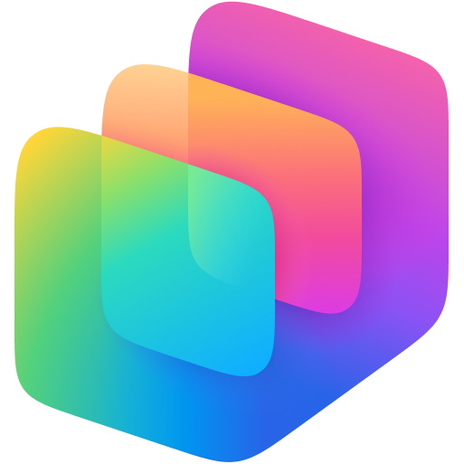



What’s new in Microsoft 365 Copilot
Frontier Transformation with Copilot and agents
As of 10rd March 2026
Wave 3 of Microsoft 365 Copilot
Agents
        Copilot in Word, Excel, PowerPoint, and Outlook (formerly Agent Mode)
        Copilot in Outlook: New agentic experiences
        Word, Excel, PowerPoint, and Outlook Agents in Copilot Chat
        Apps and Agents in Copilot Chat
        Copilot Cowork: A New Way of getting Work done
        Bring Copilot and agents into Dynamics 365 and Power Apps
        Multi‑model intelligence
        Agent recommendations
        Agents using Apps SDK and MCP Apps
        Evaluate agents in Copilot Studio
        Dynamics 365 Sales, Customer Service, Power Apps and Partner Apps appear as rich, in‑chat agents
Agent 365
        Generally available on May 1
Work IQ
        Work IQ API
        Dataverse in Work IQ
        Copilot Memory: Chat History
Frontier Worker Suite
        Introducing Microsoft 365 E7
Notes:
Introducing the First Frontier Suite built on Intelligence + Trust - The Official Microsoft Blog
https://blogs.microsoft.com/blog/2026/03/09/introducing-the-first-frontier-suite-built-on-intelligence-trust/
Powering Frontier Transformation with Copilot and agents | Microsoft 365 Blog
https://www.microsoft.com/en-us/microsoft-365/blog/2026/03/09/powering-frontier-transformation-with-copilot-and-agents/
Copilot Cowork: A new way of getting work done | Microsoft 365 Blog
https://www.microsoft.com/en-us/microsoft-365/blog/2026/03/09/copilot-cowork-a-new-way-of-getting-work-done/
From draft to done: agentic Copilot in Excel, Word, and PowerPoint | Microsoft Community Hub
https://techcommunity.microsoft.com/blog/microsoft365copilotblog/from-draft-to-done-agentic-copilot-in-excel-word-and-powerpoint/4500196
Leading Frontier Firm transformation with Microsoft 365 E7: The partner opportunity
https://partner.microsoft.com/en-us/blog/article/agent-365-announcement
A closer look at Work IQ | Microsoft Community Hub
https://techcommunity.microsoft.com/blog/microsoft365copilotblog/a-closer-look-at-work-iq/4499789
Enable agents to bring apps into the flow of work—while keeping IT in control | Microsoft Community Hub
https://techcommunity.microsoft.com/blog/microsoft365copilotblog/enable-agents-to-bring-apps-into-the-flow-of-work%E2%80%94while-keeping-it-in-control/4499464
A new way of working is taking shape: Frontier Transformation - Microsoft Dynamics 365 Blog
https://www.microsoft.com/en-us/dynamics-365/blog/business-leader/2026/03/09/a-new-way-of-working-is-taking-shape-frontier-transformation/
Copilot in Outlook: New agentic experiences for email and calendar | Microsoft Community Hub
https://techcommunity.microsoft.com/blog/outlook/copilot-in-outlook-new-agentic-experiences-for-email-and-calendar/4499798
Secure agentic AI for your Frontier Transformation | Microsoft Security Blog
https://www.microsoft.com/en-us/security/blog/2026/03/09/secure-agentic-ai-for-your-frontier-transformation/
About agent evaluation - Microsoft Copilot Studio | Microsoft Learn
https://learn.microsoft.com/en-us/microsoft-copilot-studio/analytics-agent-evaluation-intro

Slide 4

Wave 3 of Microsoft 365 Copilot

Slide 5
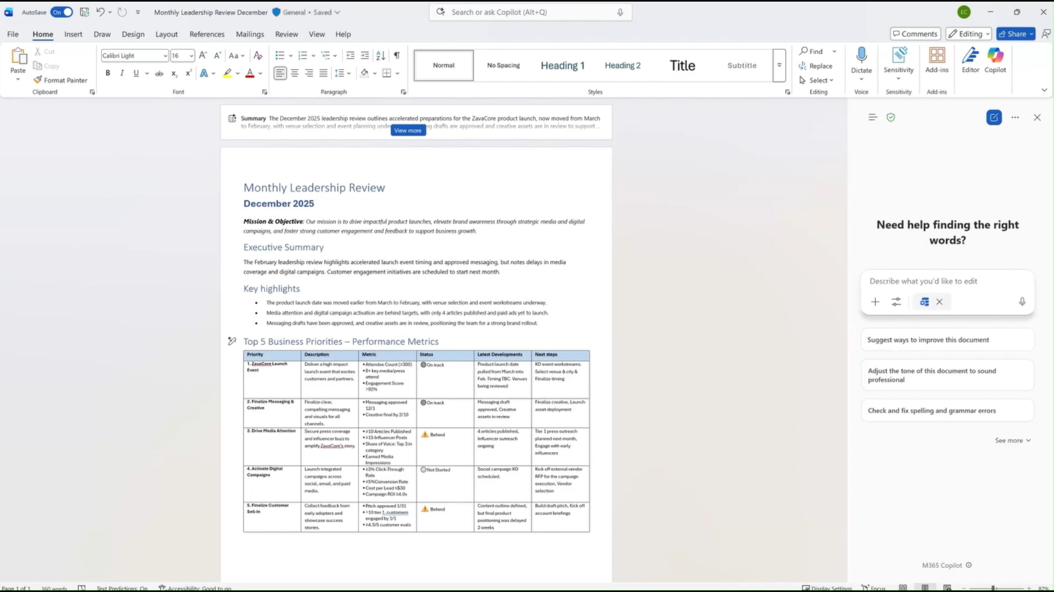
Copilot in Word, Excel, PowerPoint, and Outlook (Formerly Agent Mode)
Word: Available now
Excel: Available now
PowerPoint: Rolling out
Wave 3 Copilot delivers in‑app creation and refinement across Word, Excel and PowerPoint grounded in Work IQ with enterprise‑grade governance.
In‑App Execution Copilot creates, edits, and refines content directly inside documents, spreadsheets and presentations to finish work where it lives.
Transparent Iteration Edits are visible, reviewable, and reversible, supporting confident iteration and coauthoring.
Enterprise Governance Copilot enforces permissions, sensitivity labels, tenant controls, and compliance as new experiences roll out.
Word: collaborate to turn drafts into review-ready docs
From draft to done: agentic Copilot in Excel, Word, and PowerPoint | Microsoft Community Hub
Notes:
This slide is about how Wave 3 of Microsoft 365 Copilot brings creation and refinement directly into the apps people already use every day. Copilot now works inside Word, Excel, PowerPoint, and Outlook to create, edit, and refine content end to end, rather than generating something and leaving you to finish it manually.
All of this is powered by Work IQ, which means Copilot is grounded in live context like current files, meetings, chats, and working relationships. As that context changes, Copilot’s updates stay relevant and accurate.
A key shift here is transparency and confidence. Changes are applied directly to files, are fully visible, reviewable, and reversible, and support coauthoring so teams can iterate on a single version rather than managing multiple drafts.
Finally, this is built for the enterprise. Copilot enforces Microsoft 365 permissions, sensitivity labels, and tenant-level controls, ensuring governance, compliance, and data protection are maintained while unlocking more advanced Copilot experiences across the core apps.
Sequences shortened for demonstration purposes.

Slide 6
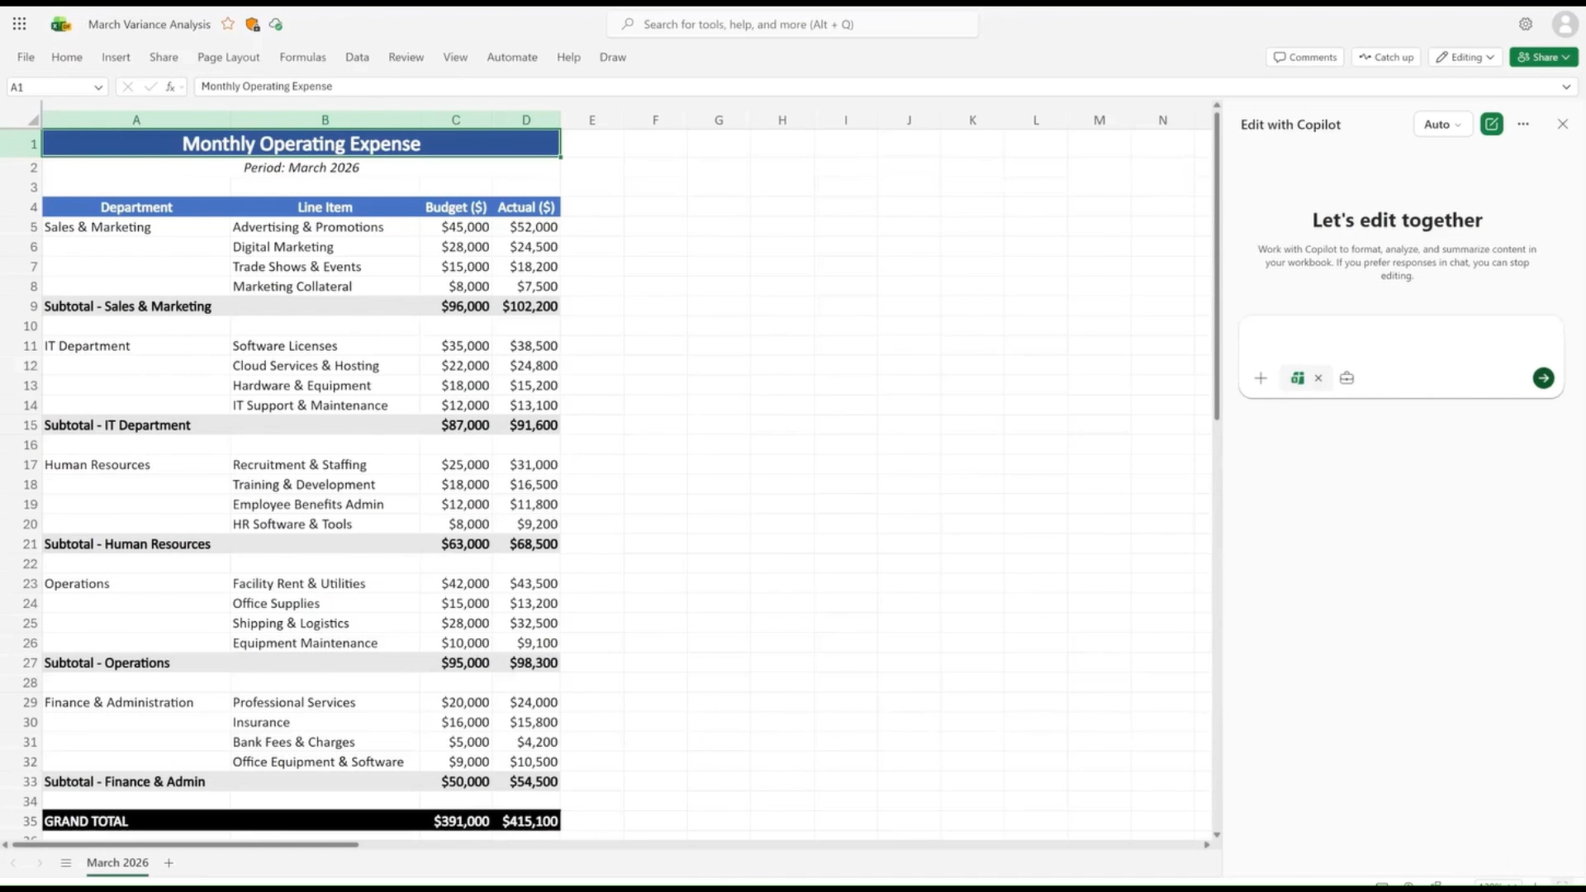
Copilot in Excel: natively build and refine spreadsheets
Generally available
Copilot in Excel accelerates scenario modeling and financial analysis using native Excel tools with transparent, reviewable AI updates
Scenario Modeling Copilot refreshes inputs, spots trends, and updates tables, formulas, and charts for fast iteration
Financial Analysis Supports P&L forecasts, sales analysis, DCF valuation, and sensitivity scenarios with standard formatting
Model Choice & Availability Work IQ grounding with selectable AI models, works on local files, uploads, and search in Excel on Windows, web, and Mac
Excel: natively build and refine spreadsheets
Availability: Generally available today in Excel for Windows, web, and Mac for Microsoft 365 Copilot users.
From draft to done: agentic Copilot in Excel, Word, and PowerPoint | Microsoft Community Hub
Notes:
Copilot in Excel helps move faster from questions to answers by supporting scenario modeling and financial analysis directly in native Excel. It refreshes inputs, spots trends, and updates tables, formulas, and charts while keeping every change visible and reviewable. This makes it ideal for P&L forecasts, sales performance analysis, and valuation models like DCF with sensitivity scenarios. Users can iterate assumptions quickly without leaving Excel or rebuilding models. Copilot also supports model choice and works with local files and search, ensuring flexibility. The experience is available across Excel on Windows, web, and Mac for Microsoft 365 Copilot users.

Slide 7
Copilot in Word: collaborate to turn drafts into review-ready docs
Generally available
Word: collaborate to turn drafts into review-ready docs
Copilot in Word streamlines drafting review iteration in a single document with enterprise context and controls
Single‑Version Authoring creates reviews and edits directly in one Word document, eliminating version sprawl and reconciliation.
Template‑Driven Refinement updates templates, adds executive summaries, restructures sections, and rewrites for clarity using Word‑native styles
Model Choice & Availability available today in Copilot Word, with OpenAI and Anthropic model choice arriving in April.
Availability: Generally available today in Word on Windows, web, and Mac for Microsoft 365 Copilot users.
From draft to done: agentic Copilot in Excel, Word, and PowerPoint | Microsoft Community Hub
Notes:
Copilot in Word is designed to eliminate version sprawl and reconciliation. It works directly inside a single Word document, helping users draft, review, and refine content without switching files or merging edits. Copilot can update template‑based documents, add executive summaries, incorporate stakeholder feedback, restructure sections, and rewrite content for clarity using Word‑native styles.
Powered by Work IQ, Copilot keeps documents aligned with real work context—decisions, dates, and details—so updates stay accurate as work evolves. All edits are visible and reviewable, supporting confident coauthoring and iteration. Copilot Word is available today, with model choice across OpenAI and Anthropic models rolling out in April.

Slide 8
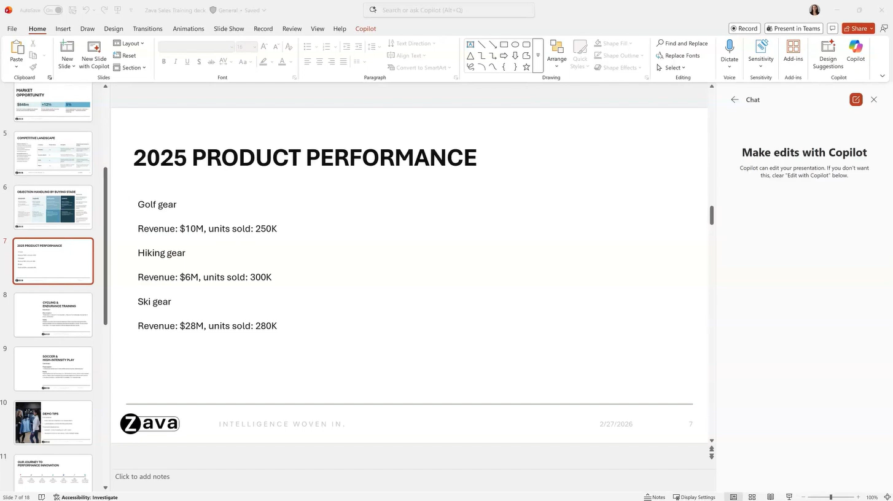
Copilot in PowerPoint: keep decks crisp and on-brand
Rolling out
Copilot in PowerPoint helps teams create on‑brand, clear presentations faster with AI‑assisted editing and visual refinement.
Brand‑Safe Creation: Copilot respects organizational templates, themes, colors, layouts, and object styles to keep decks consistent.
Visual Clarity: Simplifies dense bullets and turns text into visuals like diagrams, timelines, and charts without redesign work.
Work IQ & Model Choice: Grounded in files, emails, meetings, and chats with support for OpenAI and Anthropic models.
PowerPoint: keep decks crisp and on-brand
Availability: PowerPoint is rolling out to web for Microsoft 365 Copilot users. It will become available on Windows and Mac in the coming months.
From draft to done: agentic Copilot in Excel, Word, and PowerPoint | Microsoft Community Hub
Notes:
Copilot in PowerPoint helps teams co‑create clear, visual, on‑brand presentations without redesigning slides. Copilot works within existing organizational templates, themes, colors, layouts, and object styles, so brand consistency is preserved automatically. It sharpens slide messages, simplifies dense bullets, and turns text into visuals like timelines, diagrams, and charts. Teams can iterate together in a shared deck without version sprawl. Powered by Work IQ, Copilot grounds edits in files, emails, meetings, and chats, with model choice across OpenAI and Anthropic to match the task.

Slide 9
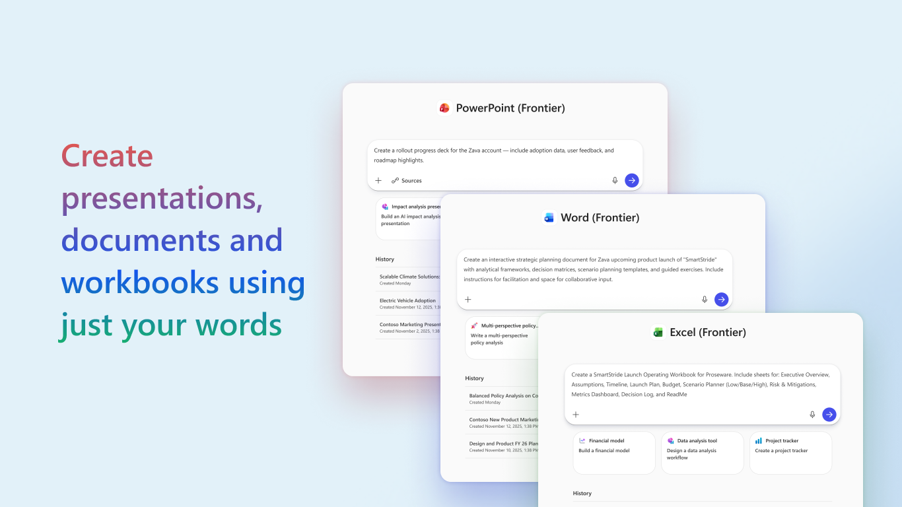
Word, Excel, PowerPoint, and Outlook Agents in Copilot Chat
Wave 3 makes Copilot chat the starting point for work, letting users move from conversational intent into real document creation and actions across Microsoft 365 apps without breaking flow.
Chat as the Entry Point: Users create documents, spreadsheets, presentations, meetings, and emails directly from chat—no copy‑paste or app switching.
Built-in agents for Word, Excel, PowerPoint, and Outlook: let users move smoothly from conversation into native app experiences when deeper work is needed.
Word, Excel, PowerPoint, and Outlook Agents in Copilot Chat
Powering Frontier Transformation with Copilot and agents | Microsoft 365 Blog
Excel, Word, and PowerPoint: rolling out to generally availability in chat in Copilot.
Outlook: Schedule from chat and custom instructions are available today
Outlook: Send email from chat is rolling out with broad availability this spring.
Notes:
Not all work starts inside a document or an app. Often, it begins conversationally—with a question, an idea, or a rough intent that needs to be turned into action.
That’s why, in Wave 3, chat in Copilot is the entry point for chat‑first creation and execution. From chat, you can create documents, spreadsheets, and presentations directly from a conversation, or ask Copilot to take common workplace actions—like scheduling a meeting or drafting and sending an email to your team—without copying and pasting between tools or switching contexts. These end‑to‑end workflows move work forward immediately and set Copilot apart.
Chat in Copilot is where the ecosystem comes together. Built‑in agents for Word, Excel, PowerPoint, and Outlook let you move easily from conversation into app‑native work.

Slide 10

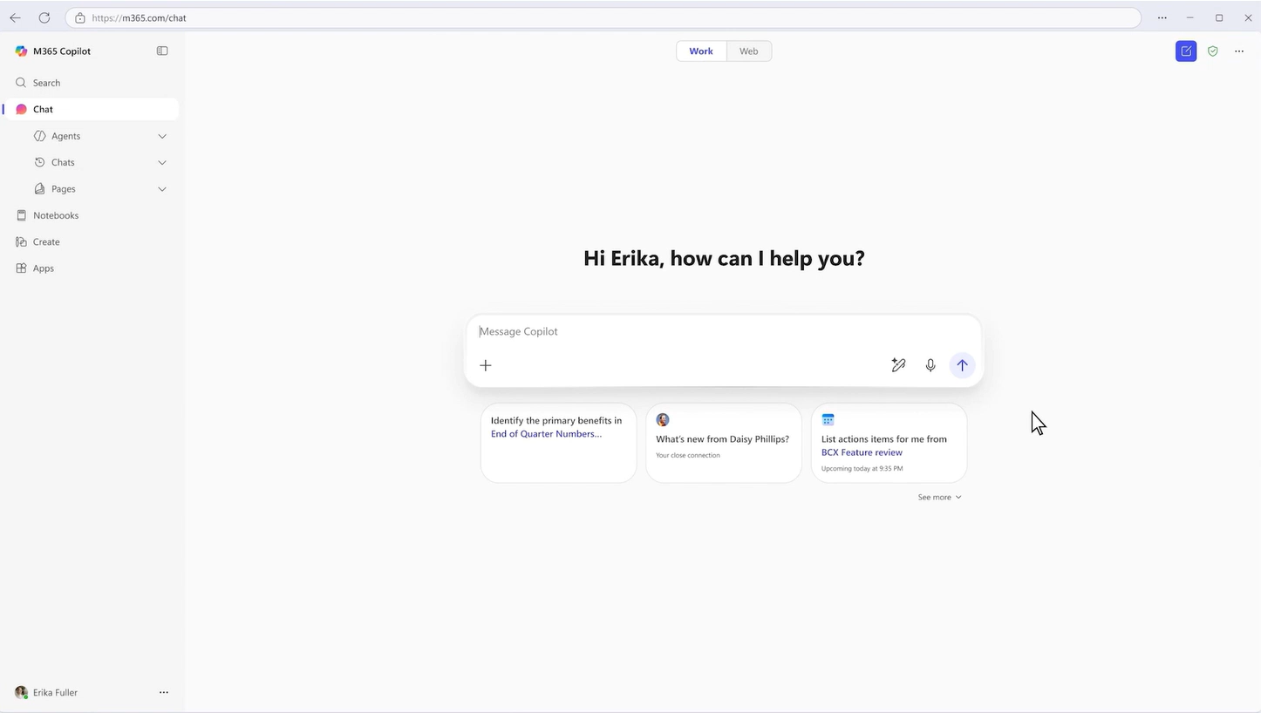
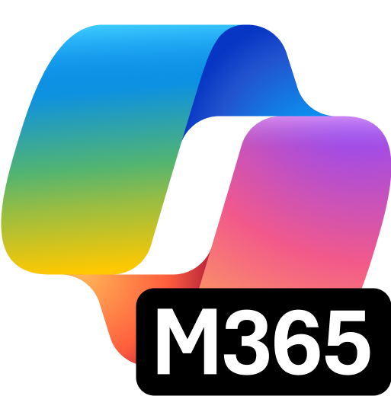
Outlook: New agentic experiences for email and calendar
Copilot drafts, refines, and updates emails in Outlook: With visible, reviewable changes and no copy‑paste friction. (Rolling out)
Calendar management in Outlook: Copilot handles RSVPs for you accepting, declining, or following based on preferences like who the invite is from, keywords, and working hours. (Available now)
Draft, edit and send emails end-to-end in Copilot Chat: Tell Copilot what you need, iterate on the draft in place, and send. (Rolling out to Frontier)
Schedule meetings without leaving Copilot chat: Ask for a meeting and Copilot handles the logistics—availability, time options, and invite details. (Available now)
Wave 3 Microsoft 365 Copilot brings agentic experiences to Outlook, turning intent into execution across email and calendar.
Copilot Chat: Schedule meetings without leaving chat
Copilot in Outlook: New agentic experiences for email and calendar | Microsoft Community Hub
Notes:
Wave 3 Copilot transforms Outlook from drafting assistance to true intent‑to‑execution across email and calendar. Copilot works directly inside Outlook, grounded in Work IQ—using emails, meetings, calendar data, preferences, and relationships—so actions are contextual and accurate.
For email, Copilot drafts, refines, and updates messages in place, asking clarifying questions and applying changes directly to the email with no copy‑paste or formatting issues. Everything is visible, reviewable, and easy to iterate before sending.
For calendar, Copilot reduces admin overhead by managing RSVPs, honoring meeting preferences, protecting focus time, and scheduling meetings directly from Copilot Chat by handling availability, logistics, and invites.
The result is less triage, fewer manual steps, and Outlook workflows that move from idea to outcome with confidence across Windows, web, and mobile.

Slide 11
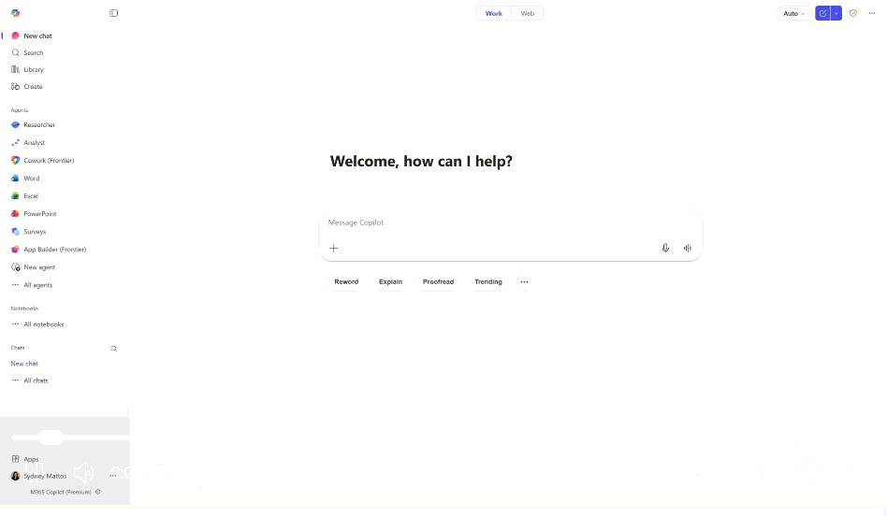
Copilot Cowork: A new way of getting work done
Coming soon to Frontier
Copilot Cowork shifts AI from prompt-and-response to long‑running, multi‑step execution using full work context, enterprise controls, and visible progress.
Action‑Driven Execution: Cowork transforms requests into plans that run in the background, progressing tasks across Outlook, Teams, and Microsoft 365.
Grounded in Your Work: It uses your emails, meetings, files, and data—powered by Work IQ—to act with context and accuracy.
User Control and Transparency: Cowork provides checkpoints, asks for clarification when needed, and requires approval before applying changes.
Enterprise‑Ready Platform: Runs within Microsoft 365 security and compliance boundaries.
Copilot Cowork
Copilot Cowork: A new way of getting work done | Microsoft 365 Blog
Available in the Frontier program in late March 2026.
Notes:
Copilot Cowork takes Copilot beyond generating answers and actually executes tasks across Microsoft 365. The key idea is that users can describe an outcome, and Cowork turns that intent into a structured plan that runs independently in the background.
First, Cowork executes tasks across Outlook, Teams, and other apps. Instead of you manually rescheduling meetings or assembling documents, it progresses the work automatically.
Second, it understands your context by grounding actions in your real work—your emails, meetings, files, and data—so outputs align with how you operate.
Third, even though it works independently, you always stay in control. Cowork surfaces checkpoints, asks for clarification when needed, and requires approval before making changes.
Finally, Cowork is enterprise‑ready, operating within Microsoft 365’s identity, security, compliance, and audit boundaries so organizations can adopt it confidently.
Overall, Cowork shifts Copilot from helping with thinking to actually helping with doing.

Slide 12
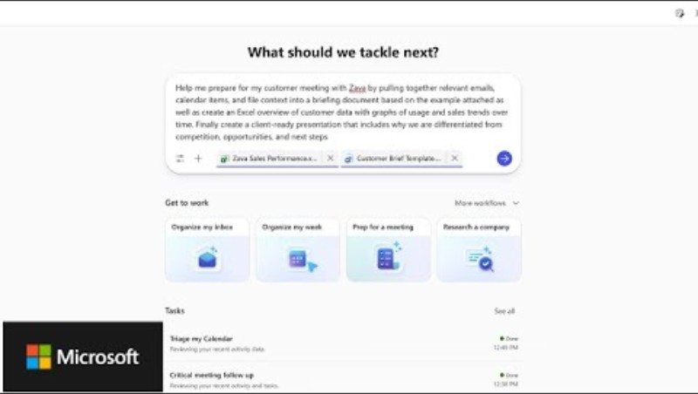
Meet Copilot Cowork: A New Way of getting Work done

Slide 13
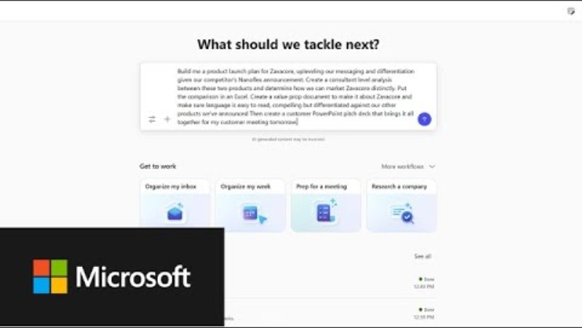
Plan a product launch workflow with Copilot Cowork

Slide 14
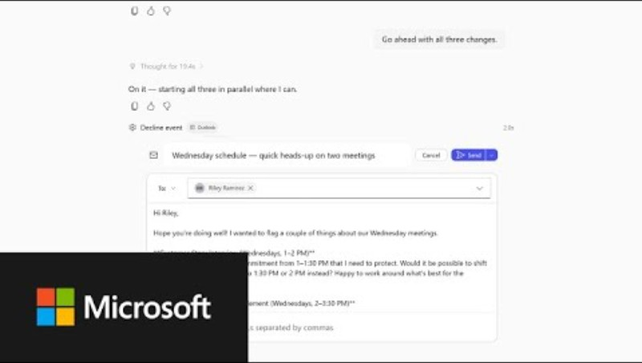
Organize your week with Copilot Cowork

Slide 15
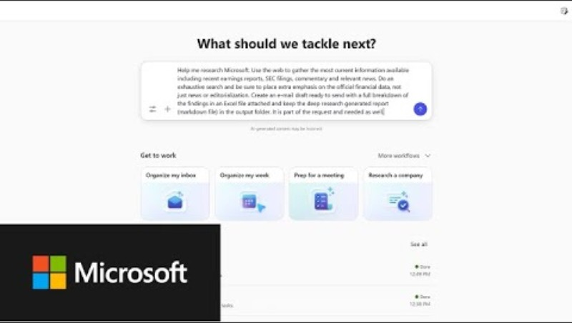
Build a financial research report with Copilot Cowork

Slide 16
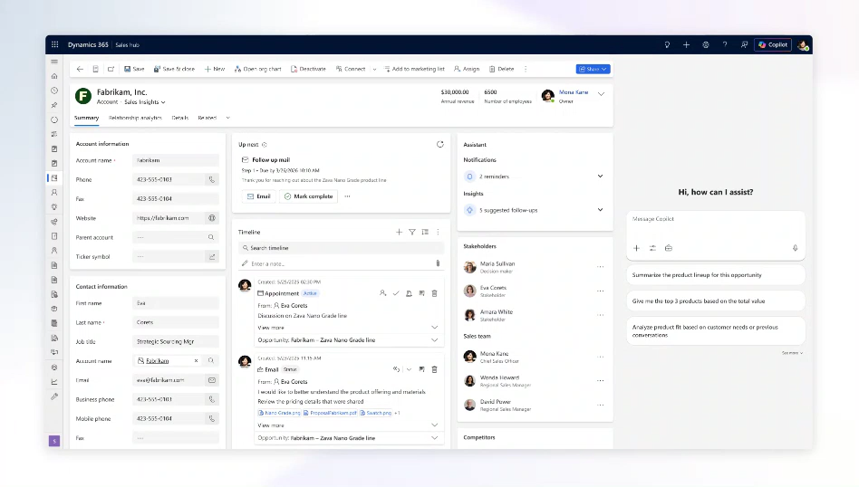
Bring Copilot and agents into Dynamics 365 and Power Apps
Copilot and agents are now integrated directly into Dynamics 365 and Power Apps, bringing AI‑driven insights and actions into core business workflows.
Native Copilot Integration: Copilot, Researcher, and Analyst run inside Dynamics 365 Sales, Customer Service, and Power Apps.
Pre‑built Dynamics agents: automate tasks like sales qualification and case management.
Faster Insight‑to‑Action: Agents combine CRM data, internal knowledge, and external research to give in‑place answers.
Licensing: A Microsoft 365 Copilot license is required. This experience with Power Apps also requires a Power Apps premium license.
Bring Copilot and agents into Dynamics 365
Availability: Microsoft 365 Copilot in Dynamics 365 Sales, Dynamics 365 Customer Service, and canvas apps in Power Apps will be available in public preview by early April 2026.
Availability: Microsoft 365 Copilot in model-driven apps built with Power Apps will reach general availability by early April 2026.
Notes:
Access to agents built with Copilot Studio and Foundry through Outlook gives users access to their organization's custom-built agents directly within the Outlook experience. This integration extends agent capabilities to email workflows without requiring users to switch applications. Admins can deploy custom agents where users spend significant time managing communications. This feature is rolling out in March.

Slide 17
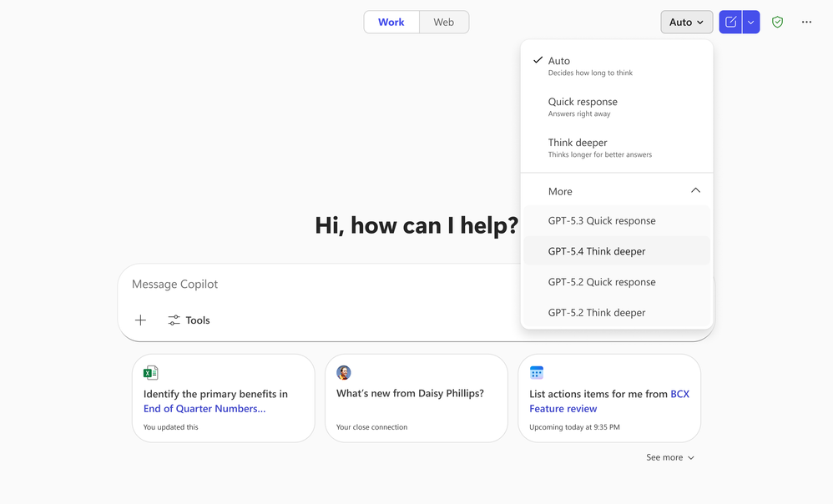
Multi‑model intelligence
OpenAI: Available now
Claude: Available in Frontier
Copilot Wave 3 delivers multi‑model intelligence by automatically using the best model—such as Claude or OpenAI—without users managing model choices.
Automatic Model Selection: Copilot intelligently applies the best model for each task, giving users advanced reasoning and multistep capabilities without any manual decisions.
Future‑Ready Flexibility: Organizations avoid long‑term vendor lock‑in as Copilot stays current with emerging models and innovations.
Enterprise‑Grade Protection: All model usage is grounded in enterprise data and secured by Microsoft’s security, compliance, and governance controls.
Latest generation of OpenAI models: GPT-5.4
Powering Frontier Transformation with Copilot and agents | Microsoft 365 Blog
Notes:
Wave 3 strengthens Microsoft 365 Copilot’s multi‑model intelligence. The key message is that users no longer need to think about AI model choices at all—Copilot does that work automatically.
First, highlight the problem: many AI tools force organizations into single‑vendor ecosystems or require users to switch tools depending on the task. That creates friction, fragmented experiences, and higher costs as teams bring their own AI into the business.
Then explain Microsoft’s approach: Copilot brings together leading models from multiple providers—including Claude and the latest OpenAI models—directly into the core work experience. This means advanced reasoning and multistep capabilities show up naturally inside everyday Copilot conversations.
Emphasize that Copilot selects the right model for the job automatically, removing complexity for users and reducing long‑term vendor lock‑in for organizations.
Finally, reinforce that everything stays grounded in enterprise data and is protected by Microsoft’s security, compliance, and governance controls. This ensures flexibility and innovation without compromising trust or control.

Slide 18
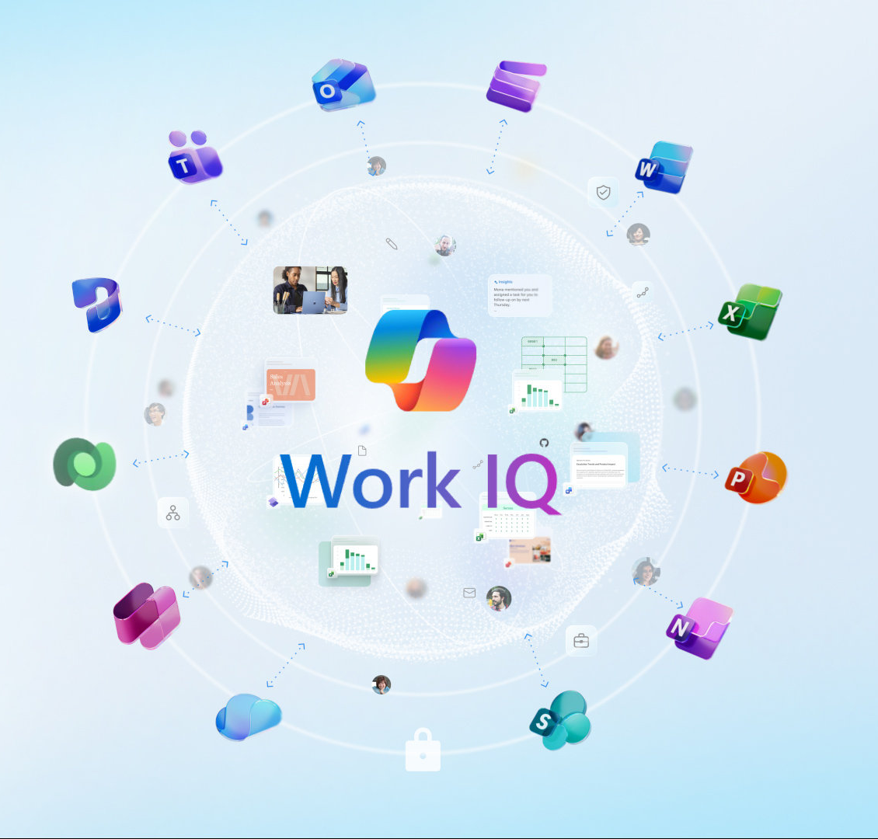
Work IQ

Slide 19
Work IQ API
API: Public preview later this month
CLI: available now
MCP and A2A: coming soon.
The Work IQ API lets developers bring Copilot intelligence into their own apps and agents through a RESTful interface, enabling agents grounded in live work context with built‑in enterprise security and compliance.
Integration: Add Copilot intelligence to custom apps and agents using a standard REST API.
Live Work Context: Agents can access real‑time context to deliver more accurate and relevant actions.
Enterprise‑Grade Security: Automatically inherits Microsoft identity, security, permissions, and compliance.
Availability: Work IQ API Public preview later this month; CLI available now; MCP and A2A coming soon.
Work IQ API
A closer look at Work IQ | Microsoft Community Hub
Notes:
Developers can also integrate Work IQ into their own apps and agents. The Work IQ API exposes Copilot intelligence through a standard RESTful interface, enabling developers to build agents grounded in the live work context accessible through Copilot Chat - while inheriting Microsoft’s enterprise‑grade identity, security, permissions, and regulatory compliance. The Work IQ API will be available in Public Preview later this month. Note that we support CLI today, and we’re working to offer MCP and A2A support in the coming months.

Slide 20
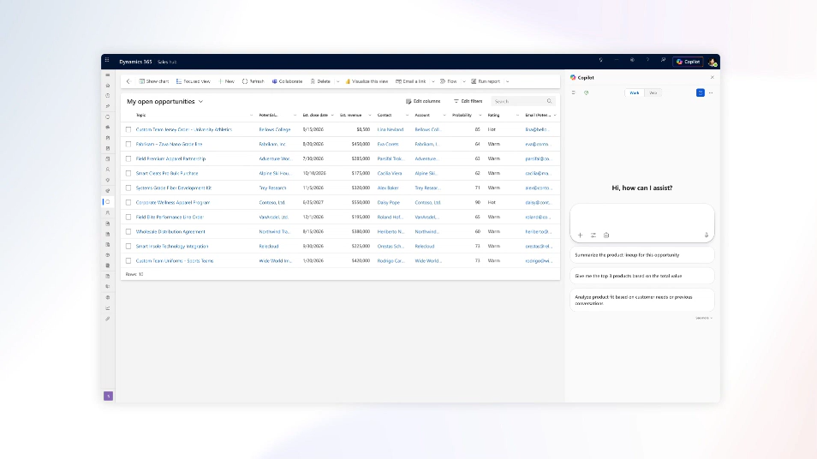
Work IQ is expanding to include Dynamics 365 and Power Apps data through Dataverse
Public preview by early April 2026
Work IQ is expanding through Dataverse
Enabling Copilot to reason across both productivity and business data for deeper, more precise insights.
Combines Microsoft 365 signals with Dataverse: data from Dynamics 365 and Power Apps for richer context.
Embedded Copilot in Dynamics: Copilot arrives in Dynamics 365 Sales and Customer Service later this month as an integrated in‑app experience.
Broader Dataverse Access Coming: Expanded Dataverse support across Microsoft 365 Copilot experiences is expected in Summer 2026.
A new way of working is taking shape: Frontier Transformation - Microsoft Dynamics 365 Blog
Notes:
Developers can also integrate Work IQ into their own apps and agents. The Work IQ API exposes Copilot intelligence through a standard RESTful interface, enabling developers to build agents grounded in the live work context accessible through Copilot Chat - while inheriting Microsoft’s enterprise‑grade identity, security, permissions, and regulatory compliance. The Work IQ API will be available in Public Preview later this month. Note that we support CLI today, and we’re working to offer MCP and A2A support in the coming months.

Slide 21
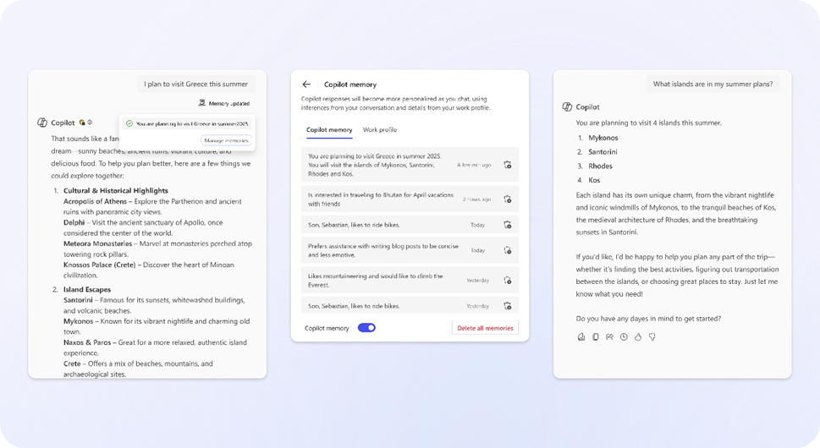
Copilot memory: Chat History
Copilot memory boosts personalization by combining user‑defined instructions with insights learned from chat and app activity across Microsoft 365.
Explicit Memory: Provided to Copilot but users who set custom instructions or saved memories that Copilot applies consistently.
Implicit Memory: Uses chat history to infer a durable body of insights. As insights grows, Copilot can provide increasingly personal responses and actions.
Incorporating workflows: Memory will soon incorporate workflow and activity patterns from Teams, Outlook, Word, Excel, and PowerPoint.
Ongoing Enhancements: will expand how Copilot captures and applies personal context.
Copilot memory: Chat History
A closer look at Work IQ | Microsoft Community Hub
Notes:
Copilot’s memory is designed to further enhance Copilot’s ability to tailor its experience to Copilot users in Copilot Chat and Copilot in the M365 apps. Memory is constructed from a combination of persistent, explicit memory and query-dependent, implicit memory.
Explicit memory is provided to Copilot by the user. A user can personalize Copilot by creating “Custom Instructions” – for example a user may manually add an instruction to “Only provide responses to prompts in the active tense”. Alternatively, a user can also create “saved memories”. For example, prompting Copilot to “remember that I do not like responses in the passive tense” will result in Copilot creating a saved memory “Prefers responses written in active voice; dislikes passive tense”. In each case, Memory is explicitly created by a user action. Copilot also creates implicit memory. To do this, it uses chat history to infer a durable body of insights. As the body of insights grows, Copilot can provide increasingly personal responses and actions.
Beyond chat history, we are also working on incorporating activity – like workflows - that help increase the fidelity of Copilot’s memory. In the coming months, we will start incorporating other activity patterns generated from all of your everyday apps including Teams, Outlook, Word, Excel, and PowerPoint. Stay tuned for additional updates on enhancements to Copilot memory.

Slide 22
Agents

Slide 23
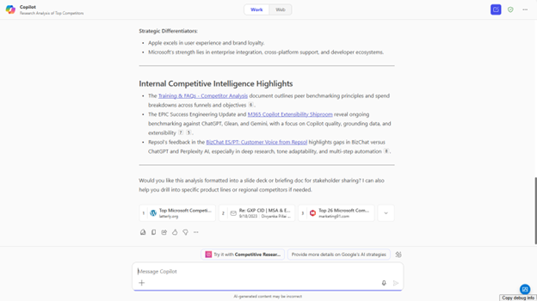
Agent recommendations
Generally available
Agent Recommendations help employees quickly find the right, IT‑approved agent by automatically suggesting the best fit based on user intent.
Automatic Suggestions: Copilot analyzes prompts and surfaces the most relevant installed agent in the flow of work.
No Agent Knowledge Needed: Users don’t need names or syntax—recommendations appear contextually.
Flexible Interaction: Employees can switch to the suggested agent or continue their current chat.
Governed Discovery: Only IT‑approved agents are recommended, maintaining security and control.
Agent recommendations
Agent Recommendations (generally available)
Notes:
Adaptive Card content can be refreshed within custom engine agent experiences. This feature enhances the interactivity and real-time capabilities of custom-built agents. This enables an organization's custom agents to deliver more dynamic, up-to-date content to users. This feature is rolling out in March.

Slide 24
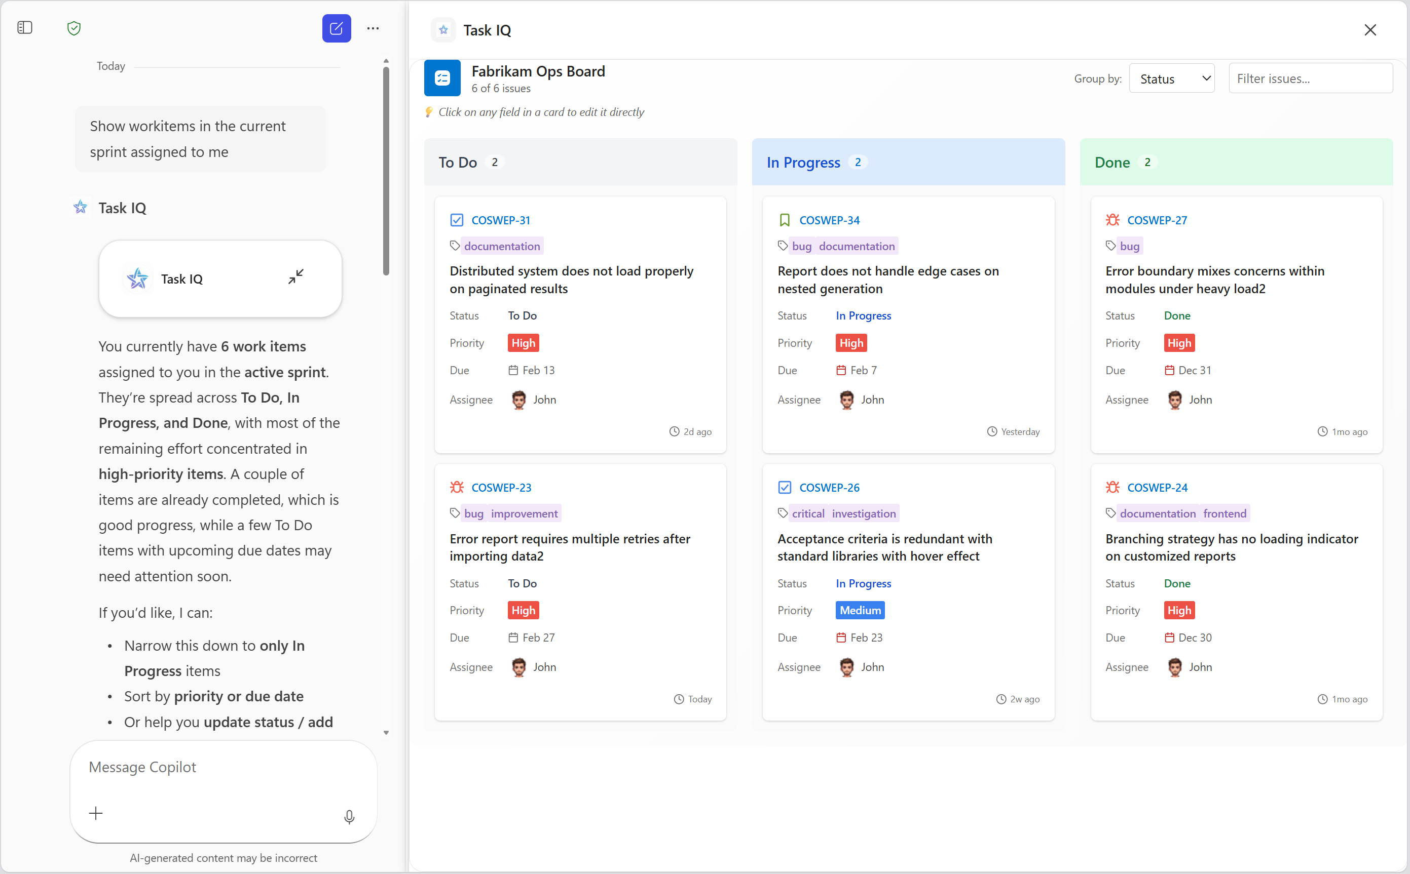
Agents using Apps SDK and MCP Apps
Generally available this month
Custom Copilot agents can connect to mission‑critical apps using open extensibility standards, enabling richer in‑chat app experiences built with familiar development patterns.
Build Custom Integrations: Create agents that work with the specific apps and workflows your organization depends on.
Open Standards: MCP Apps and the OpenAI Apps SDK provide structured, familiar ways to connect existing apps to Copilot.
Rich In‑Chat Experiences: Integrated apps can surface interactive functionality directly inside Copilot conversations.
Availability: MCP Apps and the Apps SDK reach GA on web and desktop later this month, with mobile following in the spring.
Agents using Apps SDK and MCP Apps
Enable agents to bring apps into the flow of work—while keeping IT in control | Microsoft Community Hub
Notes:
Build the app experiences your team needs
You’re not limited to the apps we ship out of the box. Your team can build agents in Copilot that work with the mission-critical apps that your systems, processes, and workflows depend on.
Under the hood, two open extensibility standards make this possible: MCP Apps and the OpenAI Apps SDK. Both give development teams a structured way to connect the apps your organization relies on to agents in Copilot—so those apps can surface interactive experiences directly in chat. Agents built with either standard use familiar development patterns, so your team can build and iterate without requiring a steep learning curve.
MCP Apps and Apps SDK will roll out to GA on web and desktop later this month, with mobile following this spring. Share the Apps SDK and MCP Apps technical documentation with your development team to get started.

Slide 25
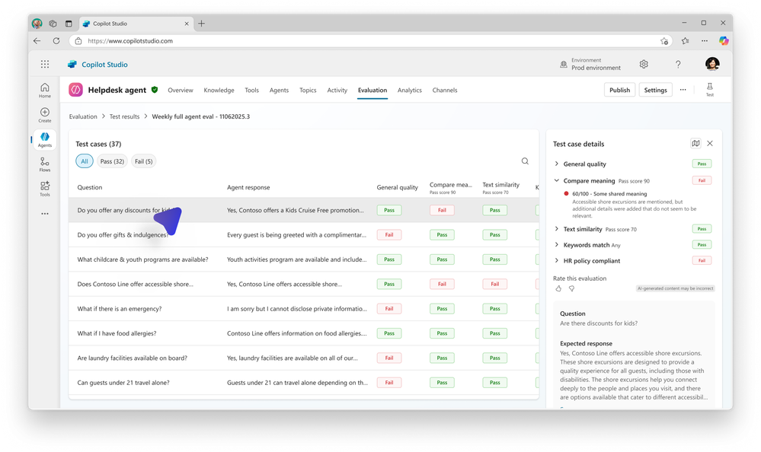
Agent Evaluations in Microsoft Copilot Studio
Public Preview
Agent Evaluations in Copilot Studio provide a measurable way to ensure agents stay accurate, reliable, and aligned with organizational standards.
Measured Quality: Tests agents with real scenarios to score accuracy and intent alignment.
Detects Drift Early: Identifies regressions caused by prompt, model, or data changes before rollout.
Enterprise‑Grade Standards: Treats agents as managed workloads with consistent quality controls.
Confident Scaling: Gives IT evidence to validate improvements and expand usage safely.
Agent Evaluations
Agent Evaluations in Microsoft Copilot Studio (currently in public preview)
Notes:
As organizations rely on more agents for more impactful work, quality and reliability stop being nice‑to‑haves—they’re essential. Small changes to prompts, models, or data can introduce drift that can be hard to detect, especially as agent usage expands across teams and scenarios.
Agent Evaluations in Microsoft Copilot Studio (currently in public preview) gives you a structured way to answer the question: Is this agent actually doing what it's supposed to do?
Evals work by running agents against authentic questions and scenarios, then generating objective scores for accuracy and intent alignment—so quality isn't just assumed; it's measured. By comparing results over time, teams can help catch regressions earlier, validate improvements, and apply a consistent quality bar before agents reach broader use.
These signals reinforce that agents aren’t set‑and‑forget automation; they’re managed enterprise workloads. With objective evidence in hand, IT and makers can make informed rollout decisions and scale agent usage more confidently, knowing behavior is monitored, and reliability can be improved as usage grows.
Learn how to set up Agent Evals in Microsoft Copilot Studio, so you can assess agent quality and readiness before expanding usage.

Slide 26
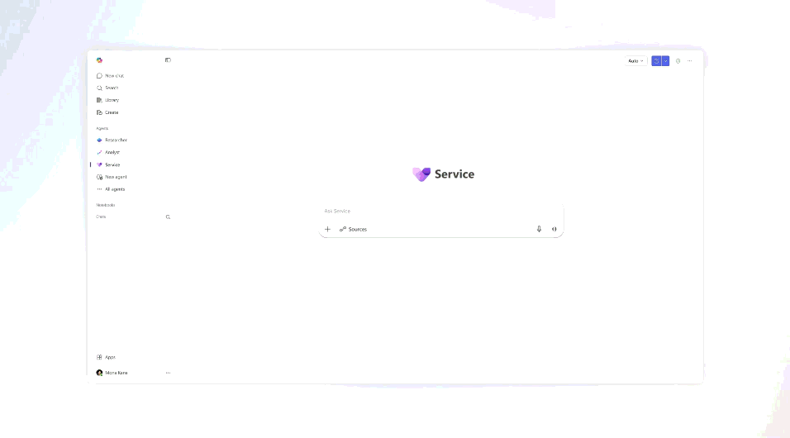
Interact with business applications inside Copilot
Copilot is becoming an interactive workspace where business apps surface directly inside chat, allowing users to review data and take action without switching applications.
Apps Run Inside Copilot: Dynamics 365 Sales, Customer Service, and Power Apps solutions appear as rich, in‑chat agents so work happens directly in Copilot.
Partner App Support: Apps built with the Apps SDK and MCP Apps—like Adobe Express, Figma, Canva, and Wix—will also surface in chat.
Availability: Public preview for Power Apps later this month; Dynamics 365 Sales and Customer Service in early April 2026, Partner apps available via the Microsoft 365 Agent Store.
Dynamics 365 Sales, Customer Service inside Copilot
Dynamics 365 Customer Service & Sales (public preview April)
Power Apps: (Public Preview March)
Pre-built partner apps: (Mid April)
A new way of working is taking shape: Frontier Transformation - Microsoft Dynamics 365 Blog
Notes:
Microsoft 365 Copilot is becoming an interactive workspace for business applications. Dynamics 365 Sales, Dynamics 365 Customer Service, and custom apps built with Power Apps will surface directly as agents with rich UX inside chat in Microsoft 365 Copilot. Agents using Apps SDK and MCP Apps can also bring Microsoft partner apps into the conversation, including tools teams already use, like Adobe Express, Figma, and Wix. This is the interface layer shift in practice. Instead of switching between applications, users state what they need in Copilot and the system responds. You can review data and take action without leaving the conversation. Copilot becomes the place where work gets done.
As an example, a human resources (HR) employee can now call on their custom HR app, built with Power Apps, right within Copilot to compile a list of office locations with the highest new hire counts this quarter, viewing the results in an organized table with filter options. Additionally, they can prompt the application to show the results in a map view, all without leaving their Copilot interface.
Or a customer service representative can begin their day in Microsoft 365 Copilot by reviewing a summary of priority cases they need to focus on, easily viewing and updating their data from Dynamics 365 Customer
Public preview for this capability will be available later this month for Power Apps, with availability for Dynamics 365 Sales and Dynamics 365 Customer Service launching in early April 2026. Throughout the next month, we’ll also introduce support for this capability across a handful of Microsoft partner apps, including Adobe Express, Adobe Acrobat, Base44, Box, Canva, Coursera, Figma, Miro, Monday.com, Optimizely, and Wix. All pre-built partner app experiences will be accessible via the Microsoft 365 Agent Store for users with Microsoft 365 Copilot. Service.

Slide 27
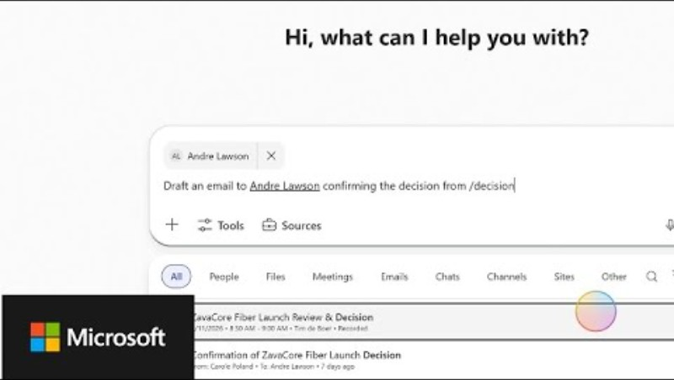
Introducing your favorite work apps—now in Microsoft 365 Copilot

Slide 28
Agent 365

Slide 29
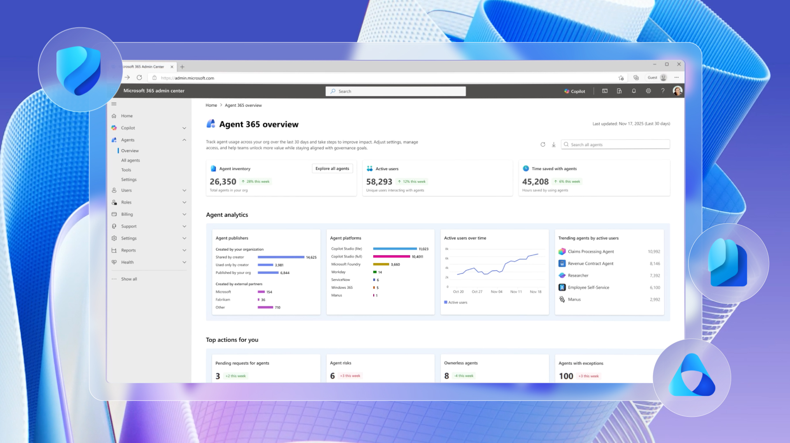
Agent 365 - Generally available on May 1 at $15 per user per month.
Generally available May 1st 2026
Agent 365 is the enterprise control plane for AI agents, giving IT and security leaders one place to manage, secure, and govern agents using the same tools and processes they already use for employees.
Unified Agent Management: Provides a single environment for IT to observe, secure, and govern all agents across the organization.
Extends Existing Controls: Uses familiar Microsoft tools—Admin Center, Defender, Entra, and Purview—so organizations can manage agents just like users.
Enterprise‑Scale Readiness: Enables shift from small‑scale agent experimentation to full, organization‑wide operations.
Availability: Generally available on May 1 at $15 per user per month.
Agent 365:The Control plane for agents
Secure agentic AI for your Frontier Transformation | Microsoft Security Blog
Notes:
Agent 365 is the control plane for agents. In practical terms, it gives IT and security leaders one place to observe, secure, and govern every agent across the organization, and it provides the confidence to move from agent experimentation to enterprise-scale operations. Agent 365 extends the management, security, and governance processes organizations already use for employees to agents, so they can stay in control as agents become part of daily work.
The idea is simple: there is no need to reinvent the wheel. The fastest path to getting agents under control is to manage them in a similar manner to managing users, using familiar Microsoft solutions including the Microsoft Admin Center for agent management and Microsoft Security solutions like Defender, Entra, and Purview for agent security and governance.
Agent 365 will be generally available on May 1, priced at $15 per user per month.

Slide 30
Introducing Microsoft 365 E7: The Frontier Suite

Slide 31
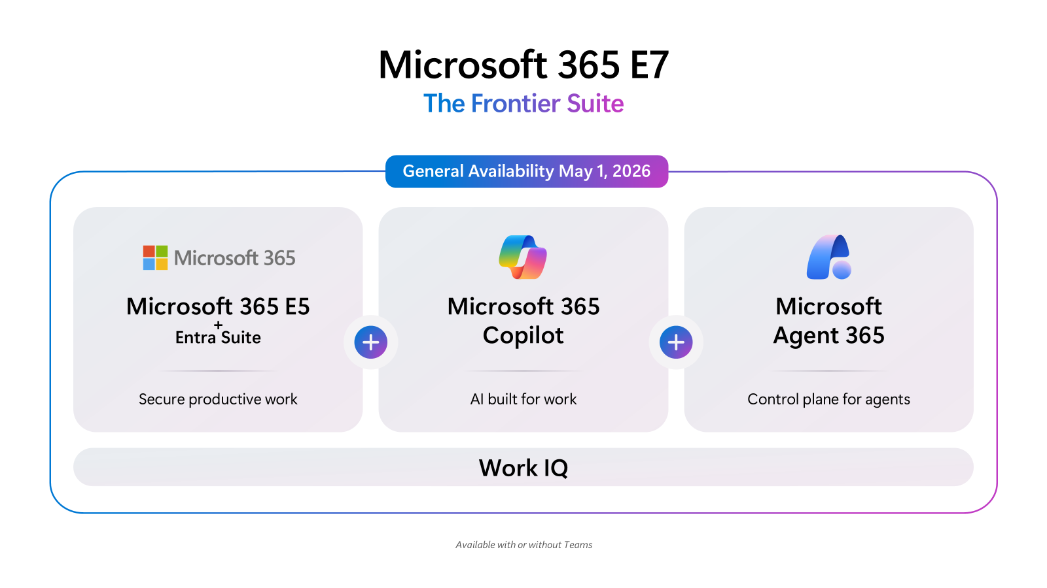
Introducing Microsoft 365 E7
Generally available May 1st 2026
Microsoft 365 E7 delivers a unified people‑and‑AI experience by bringing Copilot and agents into everyday work while giving IT the controls to run AI safely and at scale.
AI Across Work: Brings Copilot and agents into email, documents, meetings, spreadsheets, and business apps so AI becomes part of everyday work.
Enterprise Governance: Provides observability and policy‑driven controls to run AI at scale without compromising security or compliance.
Suite includes Copilot, Agent 365, Entra Suite, and Microsoft 365 E5 with advanced Defender, Entra, Intune, and Purview security capabilities.
Availability: Launches May 1 at $99 per user per month,
Microsoft 365 E7: The Frontier Suite
Microsoft 365 E7 will be available for purchase on May 1 at a retail price of $99 per user per month
Notes:
Frontier transformation is real when both sides of the system move together: people and AI operating across the enterprise.
Microsoft 365 E7: The Frontier Suite closes the gap, equipping employees with AI across email, documents, meetings, spreadsheets, and business application surfaces, while giving IT and security leaders the observability and governance needed to operate AI at enterprise scale.
Copilot and agents work together with shared intelligence, understanding context, history, priorities, and constraints. Trust is built in by default—with user data, enterprise data, and agent actions protected through identity, policy, and observability—so AI can scale across the workforce without compromising security or compliance.
Microsoft 365 E7 will be available for purchase on May 1 at a retail price of $99 per user per month, and includes Microsoft 365 Copilot, Agent 365, Microsoft Entra Suite, and Microsoft 365 E5 with advanced Defender, Entra, Intune, and Purview security capabilities to help secure users, delivering comprehensive protection across agents and users.

Slide 32
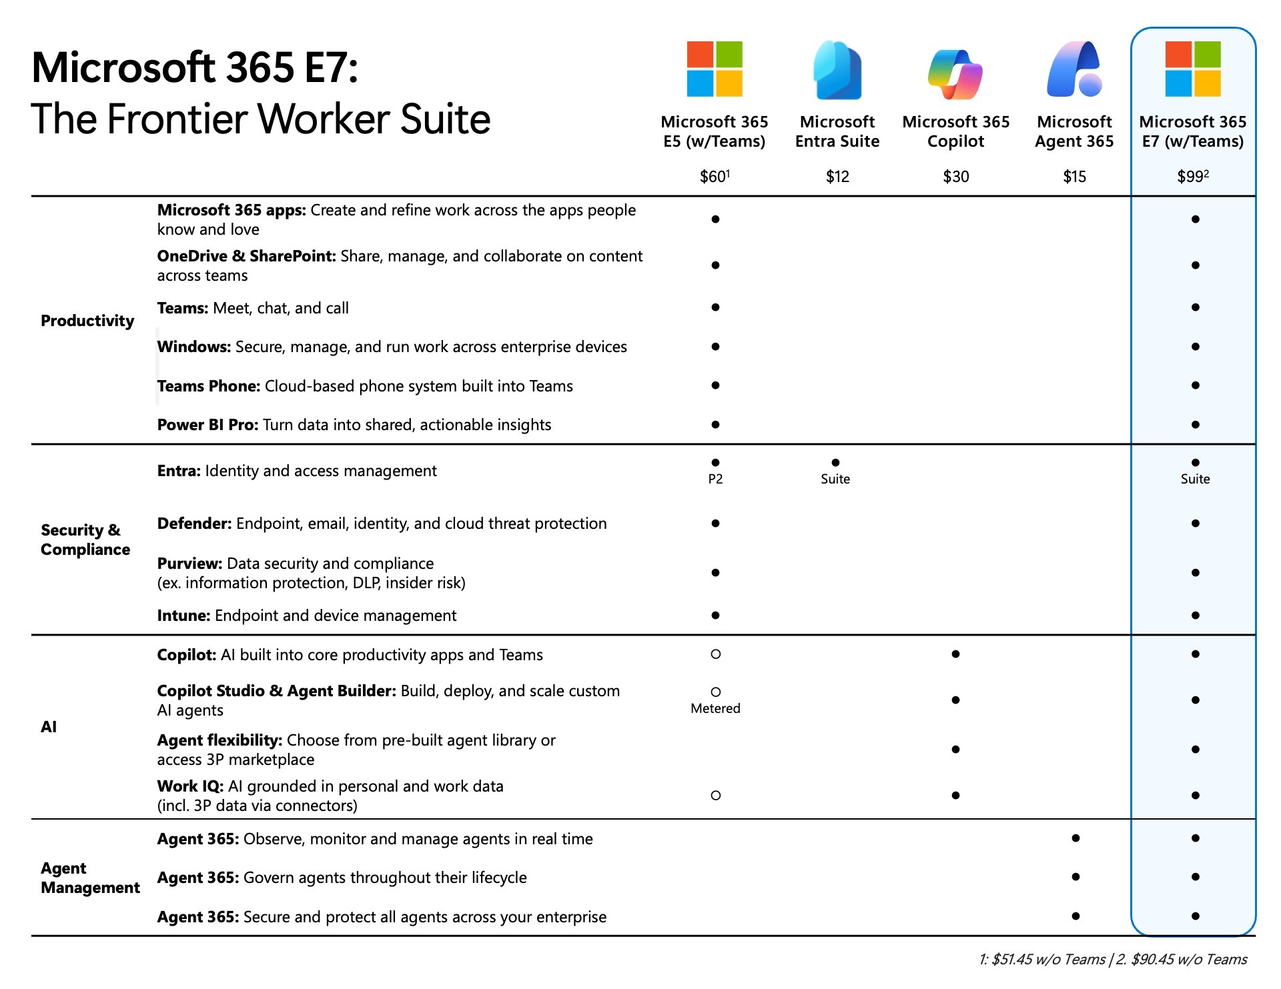
Microsoft 365 E7: The Frontier Worker Suite
Notes:
Microsoft 365 E7 will be available for purchase on May 1 at a retail price of $99 per user per month, and includes Microsoft 365 Copilot, Agent 365, Microsoft Entra Suite, and Microsoft 365 E5 with advanced Defender, Entra, Intune, and Purview security capabilities to help secure users, delivering comprehensive protection across agents and users.

Slide 33
Thank you 👏
Got feedback ?
https://aka.ms/WhatsNewCopilot/Feedback
Notes:
Thank you.

Slide 34


Feedback Form

Slide 35
Resources
Powering Frontier Transformation with Copilot and agents | Microsoft 365 Blog
From draft to done: agentic Copilot in Excel, Word, and PowerPoint | Microsoft Community Hub
Introducing the First Frontier Suite built on Intelligence + Trust - The Official Microsoft Blog
Copilot Cowork: A new way of getting work done | Microsoft 365 Blog
Leading Frontier Firm transformation with Microsoft 365 E7: The partner opportunity
Available today: GPT-5.4 Thinking in Microsoft 365 Copilot | Microsoft Community Hub
A closer look at Work IQ | Microsoft Community Hub
Microsoft 365 Copilot personalization and memory | Microsoft Learn
A new way of working is taking shape: Frontier Transformation - Microsoft Dynamics 365 Blog
Enable agents to bring apps into the flow of work—while keeping IT in control | Microsoft Community Hub
Copilot in Outlook: New agentic experiences for email and calendar | Microsoft Community Hub
Secure agentic AI for your Frontier Transformation | Microsoft Security Blog
About agent evaluation - Microsoft Copilot Studio | Microsoft Learn

