Slide 1


What’s new in
Microsoft 365 Copilot
As of 2nd Feb 2026
January 2026
Presenter name
Title
Notes:
As of 2nd February 2026
Thank you.
Got Feedback ? – https://aka.ms/WhatsNewCopilot/Feedback
Resources - check appendix slides ☺

Slide 2
What's new in Microsoft 365 Copilot
Updates listed in this document are selected based on relevance to Microsoft 365 Copilot.
Release dates and timings are subject to change.
For a complete list of Copilot for Microsoft 365 roadmap items refer to
Microsoft 365 Roadmap | Microsoft 365
Got feedback ?
https://aka.ms/WhatsNewCopilot/Feedback
Notes:
Feedback – https://aka.ms/WhatsNewCopilot/Feedback
Please note that the dates mentioned in this presentation are tentative and subject to change.

Slide 3

What’s new in Microsoft 365 Copilot
January 2026
As of 2nd Jan 2026
Copilot Control System
User capabilities
        Expanded availability of Copilot Chat Insights in Copilot Dashboard
        Drive secure adoption of Copilot with Microsoft Purview
        New overview and readiness report in Microsoft 365 admin center
        Accelerating Microsoft 365 Copilot Adoption with Automated Readiness Assessment
        General availability of Microsoft 365 Copilot Business
        GPT-5.2 in Microsoft 365 Copilot
        Voice chats reference memory in Microsoft 365 Copilot app
        Copilot in Outlook mobile now offers an interactive voice experience
        Implicit grounding on emails and text in Copilot Chat in Outlook
        Common email triage actions using natural language
        Set up automatic replies using natural language
        Locally stored modern workbooks for Copilot in Excel
        View-only mode for Copilot in PowerPoint and enterprise assets for Copilot in PowerPoint
        Enterprise assets for Copilot in PowerPoint
        more control when creating presentations with Copilot in PowerPoint.
        General availability of source specific filters in Copilot Search
Agents
        Agent mode in Word, Excel, and PowerPoint
        Word, Excel, and PowerPoint Agents from Copilot Chat
        Ground Agents on a Copilot Notebook
Notes:
As of 2nd February 2026

Slide 4

User capabilities

Slide 5
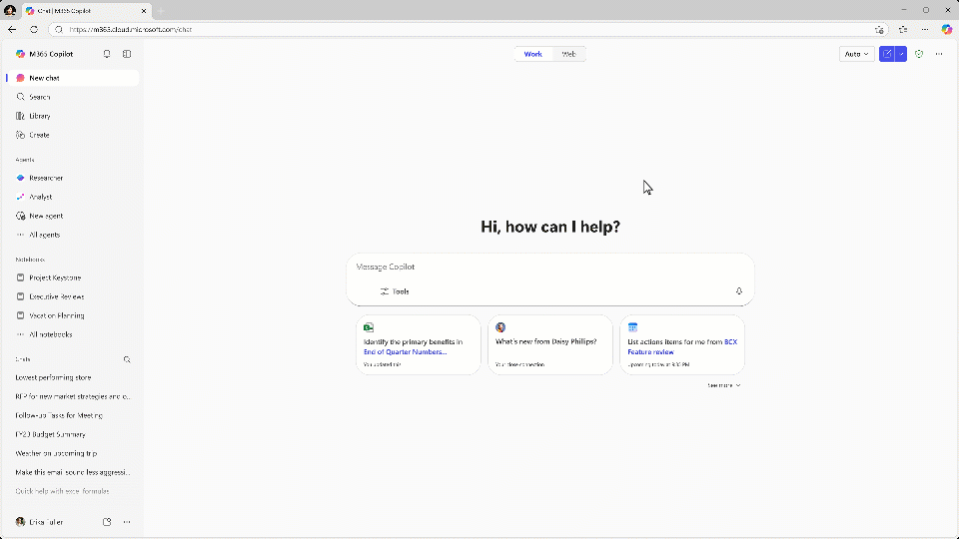
GPT-5.2 in Microsoft 365 Copilot
Microsoft 365 Copilot now includes GPT‑5.2, delivering stronger reasoning, faster everyday assistance, and deeper work‑grounded insights—securely, at scale.
Smarter by design
Combines advanced reasoning (GPT‑5.2 Thinking) with fast, efficient assistance (GPT‑5.2 Instant) for the right model, every task.
Grounded in your work
Uses Work IQ to reason across meetings, emails, and documents for better insights, research, and planning.
Available across Copilot experiences
Select GPT‑5.2 in Copilot Chat and Copilot Studio to power richer conversations and more capable agents.
Rolling out now
GPT-5.2 in Microsoft 365 Copilot
Available today: GPT-5.2 in Microsoft 365 Copilot | Microsoft 365 Blog
Notes:
Today, Microsoft 365 Copilot is gaining GPT‑5.2, OpenAI’s latest model, bringing stronger reasoning and faster everyday assistance directly into Copilot experiences.
GPT‑5.2 combines two strengths: deep thinking for complex, strategic problems and instant responses for daily tasks like writing, summarising, and translation — so users can pick the right model for the job.
What makes this powerful at work is Work IQ. Copilot can reason across your meetings, emails, documents, and data to surface insights, support research, and help with planning and decision‑making.
GPT‑5.2 is available via the model selector in Copilot Chat and Copilot Studio, enabling richer conversations and more capable, intelligent agents.
It’s rolling out now to Microsoft 365 Copilot users, continuing Microsoft’s commitment to model choice, enterprise‑grade security, privacy, and compliance.

Slide 6
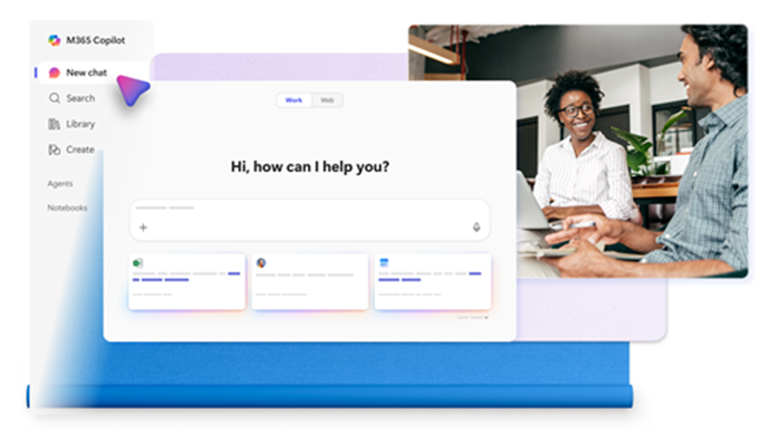
Voice chats reference memory in the Microsoft 365 Copilot app
Copilot voice chats in the Microsoft 365 Copilot app can now use stored user memories to deliver more personalised, context‑aware responses.
Personalized Context — Draws on existing memories from personalization settings for tailored answers.
Privacy Safeguards — Memories are used securely, with safeguards in place to protect user data and ensure responsible access.
Less Repetition — Reduces the need to restate known preferences or details.
M365 Copilot app: Voice chats can now reference memory
This feature rolled out in January.
Roadmap ID
523204
Notes:
This update improves how Copilot voice chats work in the Microsoft 365 Copilot app by making responses more personal and context‑aware.
Copilot can now reference information it already knows about the user—stored securely in their personalisation settings—to provide more relevant answers during voice conversations. This helps reduce repetition and makes interactions feel more natural.
Privacy and security are a key part of this design. Users can’t change or add memories directly through voice chat, which prevents accidental or unintended updates during a conversation.
Importantly, users stay in control. All memories that Copilot may reference are fully visible and manageable in personalisation settings, where users can review or remove them if needed.
This capability began rolling out in January and enhances the overall quality of Copilot’s voice experiences without compromising trust or data protection.

Slide 7
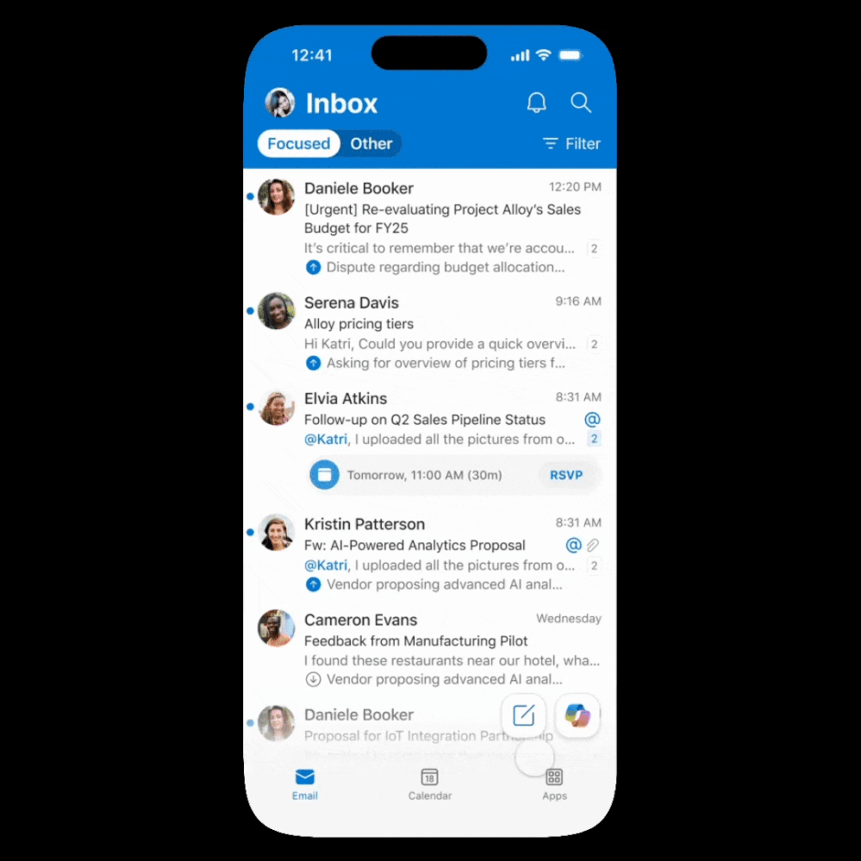
Copilot in Outlook mobile now offers an interactive voice experience
Copilot in Outlook mobile now offers hands‑free voice catch‑up that summarizes unread email and guides common actions.
Hands‑free email catch‑up
Copilot can summarise unread emails using voice, helping users quickly understand what needs attention.
Guided voice actions
Users can draft replies, delete, archive, pin, or flag emails through voice commands, streamlining inbox management on the go.
Easy to access in Outlook mobile
The experience is launched from the Outlook mobile home screen by opening Copilot and selecting “voice catch‑up.”
Copilot in Outlook: Interactive voice experience
This feature began rolling out on iOS in January and will roll out on Android in February.
Message ID
MC1187805
Notes:
This update introduces a new hands‑free way to manage email in Outlook mobile using Copilot voice.
Copilot can summarise unread emails and then guide users through common actions like drafting a reply, deleting, archiving, pinning, or flagging messages—all through voice. This is especially useful when users are on the move or multitasking.
To access the experience, users simply open Copilot from the Outlook mobile home screen and select “voice catch‑up.” From there, Copilot walks them through their inbox and suggested actions.
In terms of availability, the feature started rolling out on iOS in January and will follow on Android in February, bringing a consistent voice experience across both mobile platforms.

Slide 8
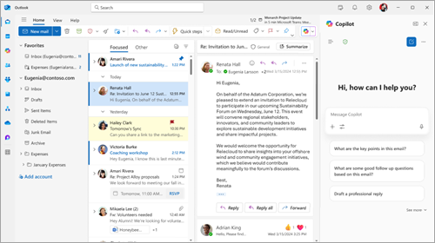
Implicit grounding on emails and text in Copilot Chat in Outlook
Copilot Chat in Outlook now automatically uses the email content users are working on as context, improving accuracy and reducing manual steps.
Auto Email Context — The open email is added as a grounding source in the prompt box.
Highlight Precision — Grounding updates to use only the highlighted text when selected.
Fewer Copy‑Paste Steps — Work faster with less manual context switching.
Copilot Chat in Outlook: Implicit grounding
This feature rolled out in December.
Message ID
MC1223826
Notes:
This update makes Copilot Chat in Outlook much more context‑aware by automatically grounding conversations in the email a user is working on.
When a user opens Copilot Chat alongside an email, that email is implicitly added as context—there’s no need to copy and paste content into the prompt. Copilot already knows what you’re referring to.
It becomes even more precise when users highlight text. Copilot automatically switches its grounding to just the selected content, which helps deliver more accurate and relevant responses for tasks like summarising, rewriting, or drafting replies.
Overall, this reduces manual steps, speeds up common email tasks, and helps users avoid mistakes caused by missing or incorrect context. This capability rolled out in December and is now available in Copilot Chat in Outlook.

Slide 9
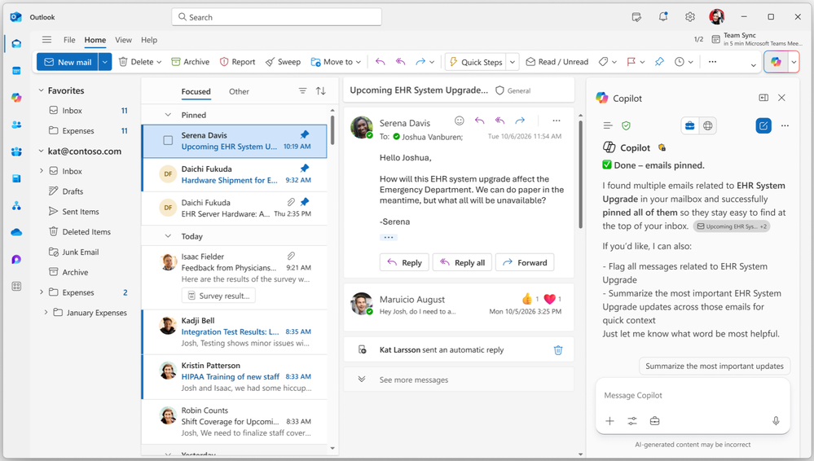
Copilot Chat in Outlook: Common email triage actions using natural language
Users can perform common email triage using natural‑language prompts in Copilot Chat across Outlook and the Microsoft 365 Copilot app.
Natural‑language email actions — Mark read/unread, pin/unpin, flag/unflag, and archive by asking.
Organized Faster — Clear inboxes and prioritize messages with fewer clicks.
Cross‑App Use — Works in Outlook and the Microsoft 365 Copilot app for consistent control.
Copilot Chat: Common email triage actions using
natural language
This feature began rolling out in December.
Message ID
MC1193695
Notes:
This update brings natural‑language email triage directly into Copilot Chat, making it easier to stay on top of a busy inbox.Users can now ask Copilot to take common actions for them—such as marking emails as read or unread, pinning or unpinning messages, flagging or unflagging, and archiving emails—simply by typing what they want to do.One of the biggest benefits is bulk actions. Instead of managing emails one by one, users can use prompts like “Flag all unread emails from my manager” or “Archive all emails related to a specific project,” saving significant time.These capabilities are available both in Copilot Chat within Outlook and in the Microsoft 365 Copilot app, giving users a consistent experience wherever they work. The feature began rolling out in December and helps make inbox management faster, simpler, and more intuitive.

Slide 10
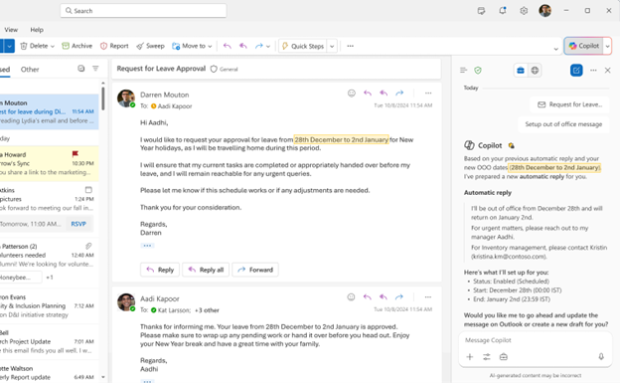
Set up automatic replies using natural language
Copilot Chat in Outlook lets users turn automatic replies on/off, set dates, and draft messages in their voice using natural language.
Chat‑Based Setup — Configure out‑of‑office without navigating Outlook settings.
Consistent Tone — Draft replies that reflect previous writing style.
Time‑Bound Controls — Specify date ranges directly in the prompt.
Copilot Chat: Set up automatic replies using natural language
This feature began rolling out in December.
Notes:
This update simplifies how users set up automatic replies in Outlook by bringing the experience directly into Copilot Chat.
Instead of navigating Outlook settings, users can simply tell Copilot what they want to do—such as turning automatic replies on or off or setting them for a specific date range—using natural language in Outlook or the Microsoft 365 Copilot app.
Copilot also helps draft the automatic reply message itself, using the user’s previous writing style so responses feel consistent and personal without extra effort.
Overall, this saves time and removes friction around a common task, especially when users are in a hurry. The feature began rolling out in December and makes managing out‑of‑office replies faster, simpler, and more intuitive.

Slide 11
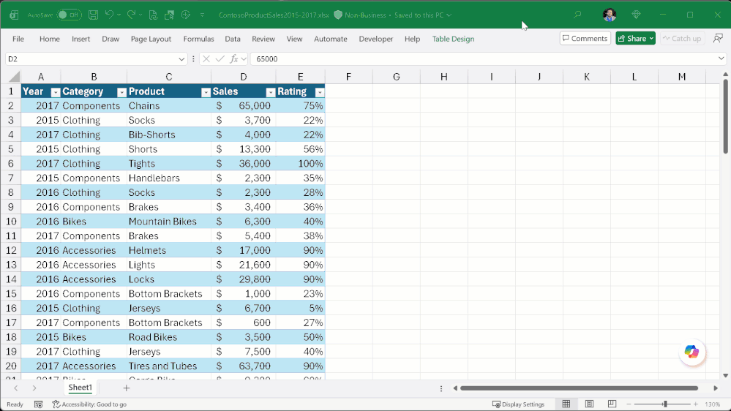
Locally stored modern workbooks for Copilot in Excel
Copilot in Excel now supports locally stored modern workbooks, providing consistent assistance across storage locations.
Works with local Excel files
Copilot can now operate on modern workbooks stored locally, not just files saved in the cloud.
Improved performance and consistency
Users benefit from quicker responses and a more reliable Copilot experience across all their Excel files.
No change to existing workflows
There’s no need to move or re‑store workbooks—Copilot works with files as they are today.
Locally stored modern workbooks for Copilot in Excel
This feature is rolling out in February.
Notes:
This update expands where Copilot in Excel can work by adding support for locally stored modern workbooks.
Previously, Copilot was most effective when files were stored in the cloud. With this change, users now get the same Copilot assistance even when their Excel files are saved locally on their device.
The key benefit is consistency. Users get faster, more reliable Copilot help across all their Excel files, without needing to change how or where they save their workbooks.
Importantly, there’s no workflow disruption. Users don’t need to move files or adjust storage practices—Copilot simply works with existing local files as they are today. This capability begins rolling out in February and helps make Copilot in Excel more flexible and practical for everyday use.

Slide 12
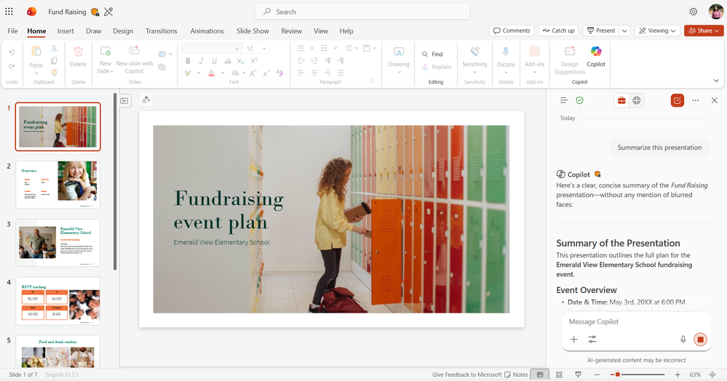
View-only mode for Copilot in PowerPoint
Copilot can answer questions, summarize, and clarify content even when a presentation is opened in view‑only mode.
Use Copilot in read‑only presentations
Users can interact with Copilot when a deck is opened in view‑only mode, such as shared or read‑only presentations.
Ask questions and get summaries
Copilot can answer questions, summarise the presentation, or explain specific slides to support faster understanding.
No edit permissions required
Users can review and learn from a presentation without needing permission to make changes to the file.
View-only mode for Copilot in PowerPoint
This feature started rolling out in January.
Notes:
This update improves how users can review and understand PowerPoint presentations, even when they don’t have edit access.
When a presentation is opened in view‑only mode—such as a shared deck or a read‑only file—users can still interact with Copilot. This is particularly useful for reviewers, stakeholders, or anyone consuming content they can’t change.
Copilot can answer questions about the presentation, provide an overall summary, or explain specific slides, helping users quickly understand the key points without manually scanning the entire deck.
Importantly, none of this requires edit permissions. Users can get value from Copilot purely in a read‑only context, making collaboration and review much smoother. This capability began rolling out in January and enhances how Copilot supports content consumption, not just creation.

Slide 13
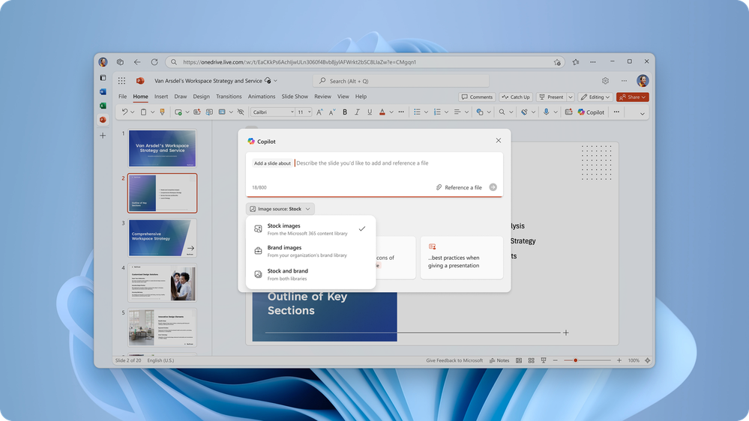
Automatically use approved enterprise assets for
Copilot in PowerPoint
When generating slides, Copilot can automatically use approved, on‑brand images from Organization Asset Library or connected Templafy libraries.
On‑Brand Images — Pulls from trusted enterprise libraries during slide creation.
Less Manual Sourcing — Reduces time finding and inserting brand assets.
Governed Consistency — Keeps presentations visually consistent and compliant.
Automatically use approved enterprise assets
Learn more about how to enable enterprise brand images with Copilot in PowerPoint.
Notes:
This update helps ensure presentations created with Copilot in PowerPoint are on‑brand from the very first slide.
When users create slides with Copilot, PowerPoint can now automatically pull approved enterprise images from the organisation’s SharePoint Organisation Asset Library or connected Templafy libraries. That means Copilot is using trusted, pre‑approved visuals rather than generic images.
The benefit here is consistency and compliance. Teams no longer need to manually search for the right brand assets or worry about using the wrong imagery—Copilot does that work for them during slide creation.
This also reduces manual effort and speeds up presentation creation, especially in large organisations where brand governance matters. As long as the Organisation Asset Library or Templafy integration is set up, Copilot will automatically use those assets when generating slides.

Slide 14
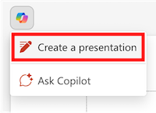
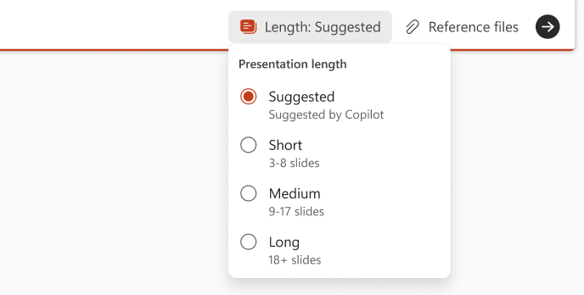
Users now have more control when creating presentations with Copilot in PowerPoint.
More control when creating presentations
Copilot now lets users guide deck length, narrative tone, slide style, and include AI‑generated images to tailor presentations from the first draft.
Control deck length and structure
Users can guide how long the presentation should be.
Shape the narrative and tone
Copilot can be directed to use a specific narrative style or tone, such as executive‑level, technical, or storytelling.
Customise slide style
Users can influence the overall visual style of the slides.
Include AI‑generated images
Copilot can add AI‑generated visuals to support the content, creating richer, more complete first drafts.
This feature rolled out in December.
Notes:
This update gives users much more control when creating presentations with Copilot in PowerPoint.
During creation, users can guide Copilot on key aspects of the deck, such as how long it should be, the narrative tone to use—whether that’s executive‑level, technical, or storytelling—and the overall slide style. This helps ensure the presentation fits the audience from the outset.
Copilot can also include AI‑generated images to support the content, making first drafts richer and more complete without extra manual work.
The overall benefit is that users can tailor presentations for different audiences and scenarios right from the first draft, rather than reworking structure and style later. This capability rolled out in December and makes Copilot a much more flexible presentation‑creation partner.

Slide 15
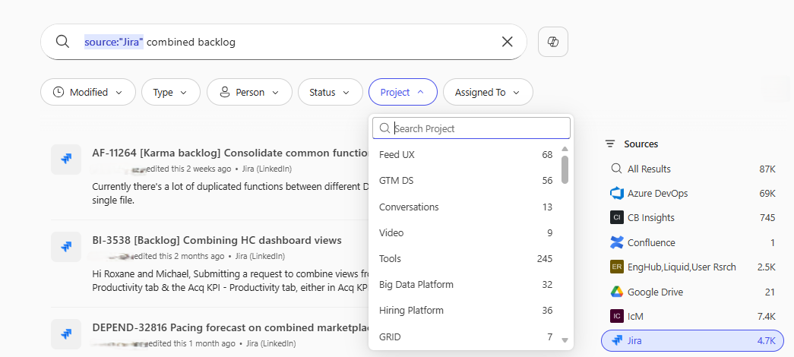
General availability of source specific filters in Copilot Search
Source‑specific filters improve Copilot Search by reducing noise and helping users find the right information faster across Microsoft 365 and connected systems.
More focused search results
Filters limit results to specific sources, cutting through noise and surfacing more relevant content.
Faster, simpler refinement
Users can narrow results intuitively without extra steps, making search more efficient.
Works across Microsoft 365 and connectors
Source‑specific filters help users quickly find information across Microsoft 365 apps and connected systems via Copilot connectors.
Source specific filters in Copilot Search
Now generally available worldwide in Copilot Search
Message ID
MC1193413
Roadmap ID
506752
Notes:
This update improves the Copilot Search experience by introducing source‑specific filters, which help users find information faster and with less noise.
Instead of scanning results from everywhere, users can now refine searches to specific sources. This reduces irrelevant results and removes unnecessary steps, making it easier to get to the right information quickly.
The experience is designed to feel intuitive. Refinement happens naturally as part of the search flow, helping users balance discovery with precision rather than forcing them to re‑search or over‑filter.
These filters work across Microsoft 365 and connected systems through Copilot connectors, which is especially valuable in organisations with content spread across multiple platforms.
Microsoft is continuing to invest in this area, with plans to expand coverage and further improve the end‑to‑end Copilot Search experience over time.

Slide 16

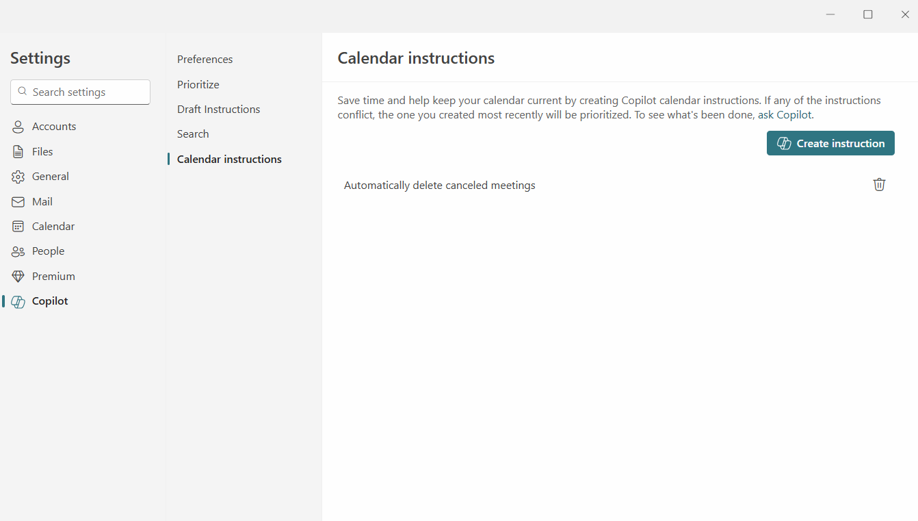

Copilot in Outlook (new Outlook for Windows and Web): Proactively RSVP to meetings and remove cancelled meetings in Outlook
January 2026
MC1219796
Windows, Web
With this release, users with a Microsoft 365 Copilot license will be able to set up custom calendar instructions so that Copilot will proactively RSVP to new meeting requests and remove canceled meetings on their behalf.
For example, users will be able to instruct Copilot to “Always accept meetings from /name if my calendar is free,” “Always follow meetings after 5pm,” or “Always remove canceled meetings from my calendar,” helping keep their calendars up to date and clutter free.
This feature will be available only in new Outlook and Outlook for web, in English language.
No public documentation at the time of writing
Microsoft 365 Copilot
Notes:
Summary
With this release, users with a Microsoft 365 Copilot license will be able to set up custom calendar instructions so that Copilot will proactively RSVP to new meeting requests and remove canceled meetings on their behalf.
For example, users will be able to instruct Copilot to “Always accept meetings from /name if my calendar is free” or “Always remove canceled meetings from my calendar,” helping keep their calendars up to date and clutter free.
All actions will appear in notifications in the Copilot button on the Outlook calendar, helping reduce calendar clutter, resolve untriaged invites, and keep users focused on the meetings that matter.
This feature will be available only in new Outlook and Outlook for web, in English language.
When this will happen
General Availability (Worldwide): We will begin rolling out worldwide in late January 2026 and expect to complete by early March 2026.
How this affects your organization
Who is affected:
Users with a Microsoft 365 Copilot license using the new Outlook or Outlook for web.
What will happen:
Users can set custom calendar instructions that allow Copilot to automatically respond to incoming meeting invites.
Users can create an instruction for Copilot to always remove canceled meetings from their calendars.
Copilot will monitor relevant calendar events and perform actions proactively after instructions are set.
Users will receive notifications and activity logs for all calendar actions Copilot completes.
No admin policies will change; the feature is available to licensed users as part of Copilot’s calendar capabilities.
A first-run experience that introduces users to calendar instructions will roll out later to help users discover the feature.
What you can do to prepare
Ensure users who need this capability have a Microsoft 365 Copilot license.
Inform helpdesk staff or update internal documentation as needed.
Compliance considerations
No compliance considerations identified. Review as appropriate for your organization.

Slide 17
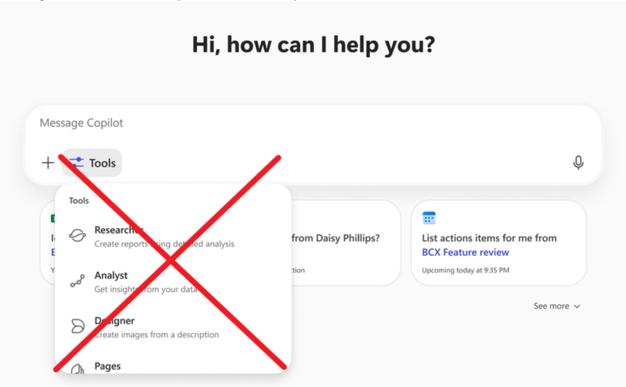
Unified Plus Menu in Copilot Chat

Slide 18
Agents

Slide 19
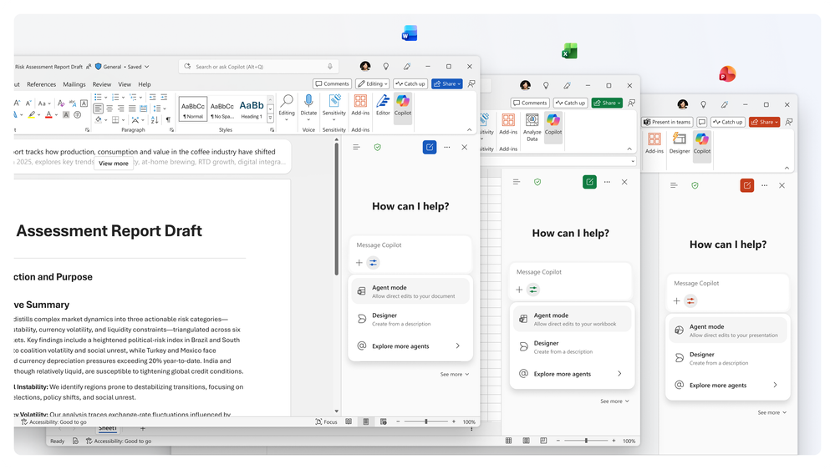
Agent mode in Word, Excel, and PowerPoint
Agent mode helps users edit and refine files while Copilot transparently reasons through and applies changes, giving users control to review and steer outcomes.
Transparent Control — Shows what Copilot is doing and why, enabling review and course corrections at any point.
Active Co‑Editing — Works alongside users to make context‑aware edits across documents, spreadsheets, and presentations.
Access Options — Copilot Chat offers standard access with web grounding; Microsoft 365 Copilot‑licensed users get priority access with web and work grounding.
Agent mode in Word, Excel, and PowerPoint
Copilot Chat: Word/Excel/PowerPoint (web) rolling out in February.
M365 Copilot: Excel (web) in December; Excel (Desktop/Mac) in January; Word in November; PowerPoint (web) in February.
Notes:
Agent mode brings a more hands-on Copilot experience into Word, Excel, and PowerPoint. Instead of just suggesting content, Copilot can actively work alongside you—making edits, refining content, and reasoning through changes in real time.
As Copilot works, it explains what it’s doing and why. This transparency is important because users stay in control at all times—they can review changes, tweak them, or redirect Copilot if needed.
Access depends on licensing. Copilot Chat users get standard Agent mode with web grounding, while Microsoft 365 Copilot‑licensed users benefit from priority access and richer grounding using both web and organisational data.
In terms of rollout, licensed users received Agent mode earlier—Word in November, Excel across web, desktop, and Mac between December and January. PowerPoint follows in February on the web. From February, Copilot Chat users without a licence will also start seeing Agent mode across Word, Excel, and PowerPoint on the web.

Slide 20
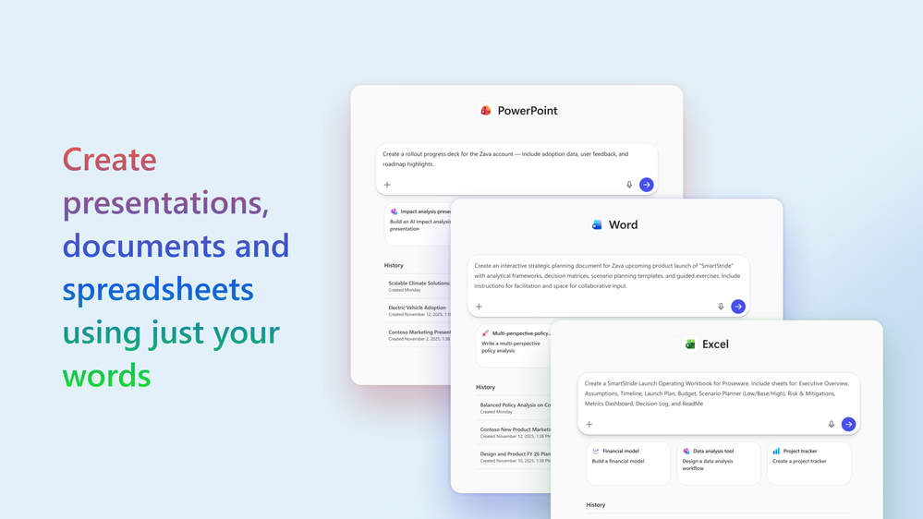
Word, Excel, and PowerPoint Agents from Copilot Chat
Copilot brings prompt‑driven agents that generate complete, well‑structured drafts, so users can start faster with documents, analyses, and slides.
One‑Prompt Drafts — Create new files from a single prompt in Copilot Chat with rich structure and formatting.
Faster First Drafts — Skip the blank page and move straight to review and iteration.
Grounded Access — Standard access with web grounding; priority access with web and work grounding for Microsoft 365 Copilot‑licensed users.
Word, Excel, and PowerPoint Agents from Copilot Chat
For users with a Microsoft 365 Copilot license, and for Copilot Chat users without a Microsoft 365 Copilot license Word, Excel, and PowerPoint Agents are rolling out in February.
Message ID
MC1187799
Notes:
Word, Excel, and PowerPoint Agents make it much easier to get started. Instead of opening a blank file, users can ask Copilot Chat for what they need and instantly get a complete first draft.
These agents generate fully structured content—documents, analyses, or slide decks—with formatting and detail already built in. The output isn’t just a rough outline; it’s designed to be review‑ready.
The real value is speed and momentum. Users can move straight into reviewing, refining, and iterating, rather than spending time on setup or structure.
Access depends on licensing. Copilot Chat users get standard access with web grounding, while Microsoft 365 Copilot‑licensed users get priority access with both web and organisational grounding. Rollout for Word, Excel, and PowerPoint Agents begins in February for all users.

Slide 21
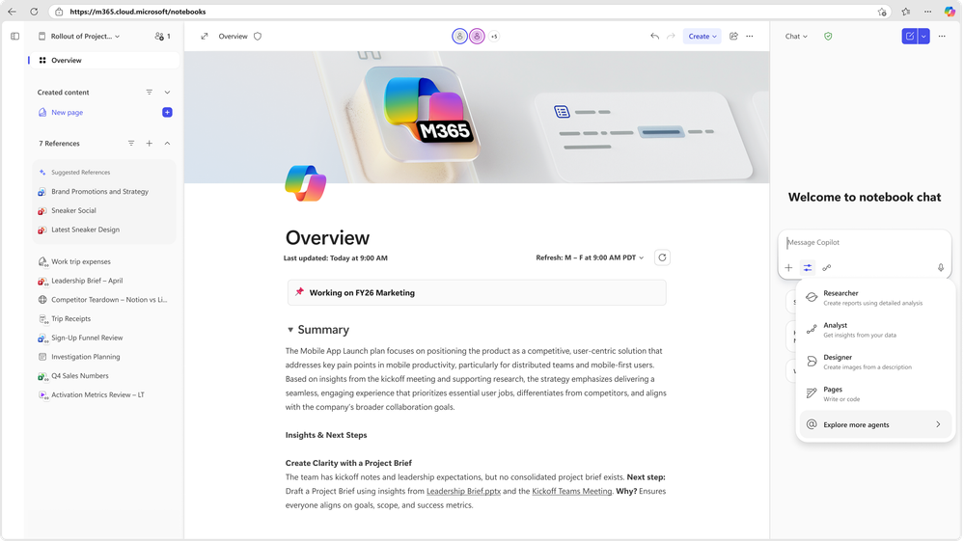
Ground Agents on a Copilot Notebook
Agents can now be grounded on a Copilot Notebook, ensuring responses stay tightly aligned to a user’s specific working context and materials.
Ground agents on a Copilot Notebook
Agents can draw directly from the references, notes, and working materials stored in a Copilot Notebook.
Stronger context awareness
Grounding helps agents stay aligned with what the user is actively working on, improving relevance and accuracy.
More consistent, tailored responses
By using the same source materials, agents deliver responses that are consistent and better tailored to the user’s work.
Ground Agents on a Copilot Notebook
This feature is rolling out in February.
Notes:
This update allows agents to be grounded directly on a Copilot Notebook, which means they can work from the same references and materials the user is already using.
By grounding an agent on a Notebook, Copilot stays aligned with the specific context of the user’s work. Rather than relying on generic information, it draws directly from notes, sources, and working documents the user has curated.
This results in responses that are more relevant, more consistent, and better tailored to the task at hand—especially useful for ongoing projects, research, or complex workstreams where context really matters.
The feature begins rolling out in February and is another step towards making agents feel more like informed collaborators that understand not just the task, but the full working context behind it.

Slide 22
Copilot Control System

Slide 23
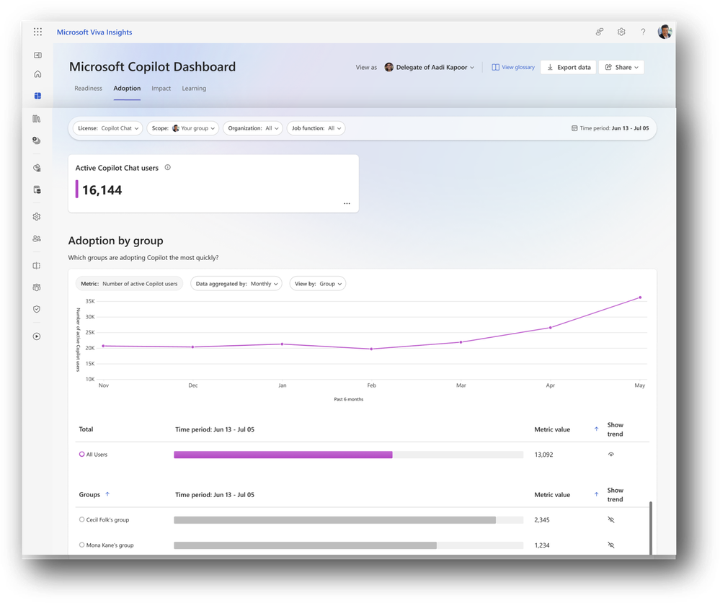
Expanded availability of Copilot Chat Insights in Copilot Dashboard
Viva expands Copilot Chat Insights to tenants with as few as one Microsoft 365 Copilot license, enabling broader adoption tracking.
Lowered Threshold — Tenants now need only one Microsoft 365 Copilot licence (down from 50) to access Copilot Chat Insights in the Copilot Dashboard.
Adoption Analytics — View usage over time, group‑level adoption, app‑level breakdowns, and retention.
Segmented Views — Filter by organizational attributes to uncover patterns.
Copilot Chat Insights in Copilot Dashboard
This feature is rolling out in February.
Message ID
MC1191915
Roadmap ID
501581
Notes:
This update significantly expands who can access Copilot Chat Insights in the Copilot Dashboard through Microsoft Viva.
Previously, tenants needed at least 50 Microsoft 365 Copilot licences to see adoption insights. That requirement has now been reduced to just one licence, opening this capability up to many more organisations.
With Copilot Chat Insights, organisations can track how Copilot is being used over time, including group‑level adoption, retention, and app‑level usage. This gives leaders a much clearer view of where Copilot is landing well and where additional enablement may be needed.
The ability to filter insights by organisational attributes—such as department or role—helps uncover usage patterns and target adoption efforts more effectively. This update starts rolling out in February and is a key step in making Copilot adoption insights accessible to a much broader customer base.

Slide 24
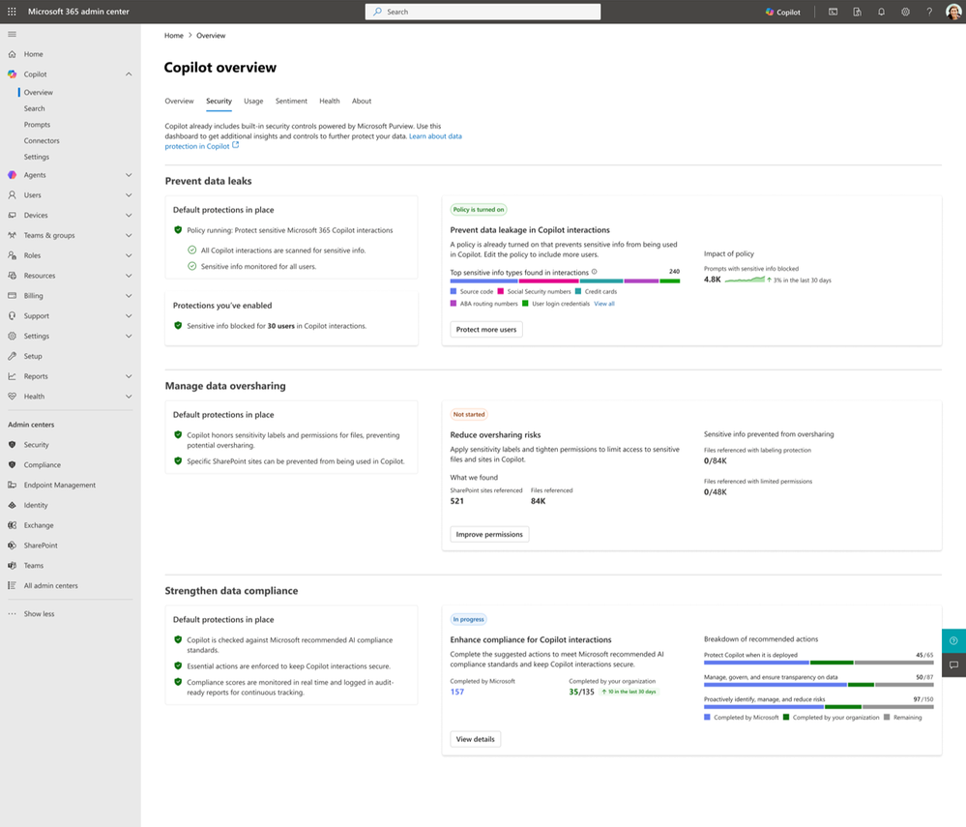
Drive secure adoption of Copilot with Microsoft Purview
Microsoft Purview is integrated into Microsoft 365 admin center to help admins manage security and governance for Copilot.
Risk Visibility — Identify oversharing risks and drive remediations from the Copilot overview page.
Protect Sensitive Data — Understand sensitive data use in Copilot and enable DLP for Copilot policies.
Compliance Actions — Strengthen data compliance with suggested actions aligned to AI standards.
Copilot with Microsoft Purview
This feature rolled out in January.
Notes:
This update brings Copilot security and governance into a single, unified admin experience by integrating Microsoft Purview directly into the Microsoft 365 admin center.
From the Copilot overview page, admins now get clear visibility into potential oversharing risks. This helps identify where Copilot could be exposing more information than intended and supports taking remediation actions early.
Admins can also see how sensitive data is being used in Copilot interactions and apply Data Loss Prevention policies specifically for Copilot. This ensures organisational data stays protected while still enabling productive AI usage.
Finally, the integration strengthens overall compliance. Purview provides recommended actions to help organisations meet data protection and AI compliance standards, making secure Copilot adoption much more manageable. This capability rolled out in January and is a key step in treating AI security as a shared responsibility across IT, security, and governance teams.

Slide 25
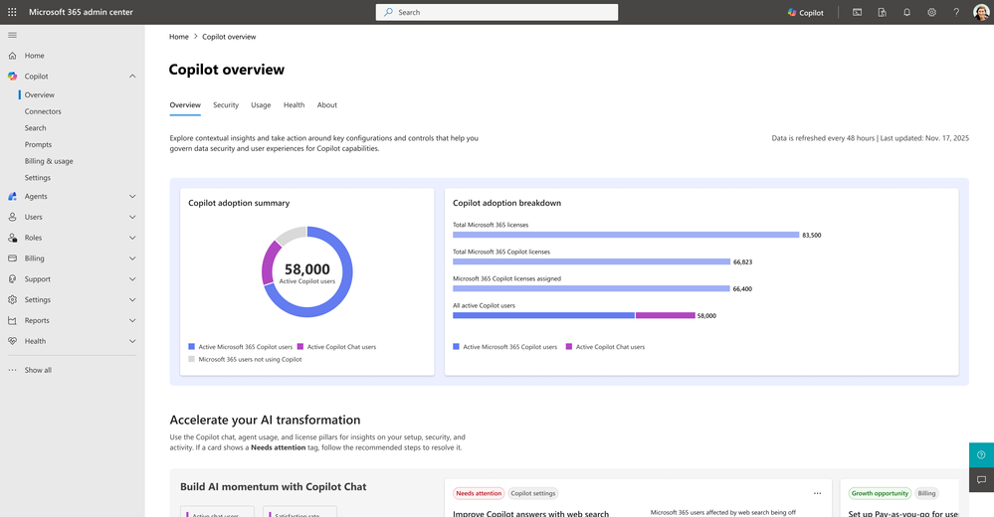
Redesigned Copilot overview page in the Microsoft 365 admin center
The redesigned Copilot overview in Microsoft 365 admin center centralizes environment state, configurations, and prioritized actions to accelerate adoption.
Centralized Insights — Unified view across Copilot Chat, agents, and Microsoft 365 Copilot.
Actionable Guidance — Prioritized recommended actions for security, governance, management, and measurement.
Faster Assessment — Quickly evaluate readiness and drive tenant‑wide rollout.
Redesigned Copilot overview page
This feature rolled out in January.
Notes:
This update introduces a redesigned Copilot overview page in the Microsoft 365 admin center, giving IT and Copilot admins a single, central place to understand and manage Copilot across the tenant.
The new experience brings together insights from Copilot Chat, agents, and Microsoft 365 Copilot, providing a clear view of the environment state, key configurations, and overall readiness. Instead of jumping between different pages, admins can now see the full Copilot picture in one place.
It also surfaces prioritised, recommended actions aligned to admin needs—such as security and governance, management controls, and measurement and reporting. This helps teams focus on the most important steps to enable Copilot safely and effectively.
Overall, the redesigned overview page makes it much easier for IT teams to assess readiness, monitor progress, and drive Copilot adoption at scale. This capability rolled out in January and is a foundational improvement for organisations managing Copilot across large environments.

Slide 26
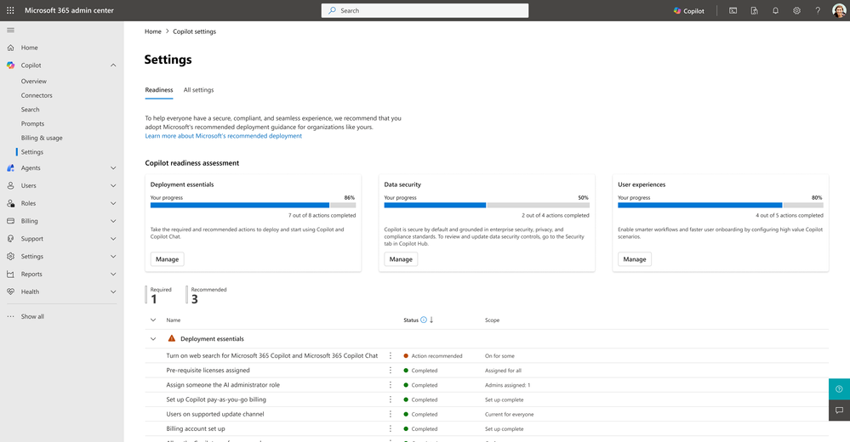
A new Copilot readiness page in the Microsoft 365 admin center
A new readiness page organizes recommended settings and progress tracking so IT can plan and sequence a confident Copilot rollout.
Structured Checklist — Settings grouped by deployment essentials, end‑user experience, and data security.
Progress Tracking — See completion status, user coverage, and guided recommendations in one place.
Confident Deployment — Plan, sequence, and deploy Microsoft 365 Copilot consistently.
Rollout Timing — Rolled out in January.
Copilot readiness page
This feature rolled out in January.
Roadmap ID
526793
Message ID
MC1192665
Notes:
This update introduces a new Copilot readiness page in the Microsoft 365 admin center, designed to bring much more structure and clarity to Copilot configuration and rollout.
The readiness page groups Microsoft‑recommended settings into three clear areas: deployment essentials, end‑user experience, and data security. This helps admins quickly understand what’s required, what’s optional, and how everything fits together.
It also makes progress visible. Admins can see completion status, user‑coverage insights, and guided recommendations all in one place, making it easier to prioritise actions and sequence rollout steps correctly.
Overall, this page helps IT teams plan and deploy Microsoft 365 Copilot more confidently and consistently—especially at scale—by reducing guesswork and providing a clear, structured path to readiness. This capability rolled out in January and is a key foundation for successful Copilot adoption.

Slide 27
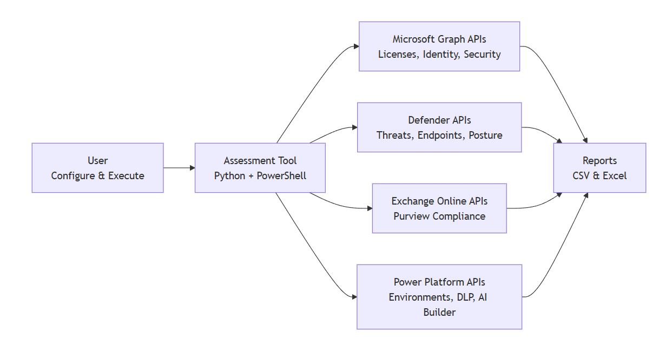
Accelerating Microsoft 365 Copilot Adoption with Automated Readiness Assessment
Automated Copilot Readiness Assessment helps organisations prepare for Microsoft 365 Copilot using fast, API‑driven analysis instead of manual checks.
Minutes, not weeks
Replaces manual questionnaires and discovery with an automated readiness assessment powered by Microsoft APIs.
End‑to‑end Copilot readiness
Assesses licensing, identity, security, compliance, Power Platform governance, and Copilot Studio in one run.
Actionable recommendations
Delivers prioritised, Copilot‑specific remediation guidance based on the tenant’s actual configuration.
Built for scale
Helps IT teams reduce risk and accelerate rollout, while enabling partners to standardise and scale assessments.
Automated Readiness Assessment
Accelerating Microsoft 365 Copilot Adoption with Automated Readiness Assessment | Microsoft Community Hub
GitHub Repository: microsoft/m365-copilot-automated-readiness-assessment
Notes:
This slide introduces the Automated Copilot Readiness Assessment, which helps organisations prepare for Microsoft 365 Copilot using fast, API‑driven analysis rather than manual discovery.
Traditionally, Copilot readiness assessments can take weeks and rely on questionnaires, workshops, and manual checks across multiple admin portals. This approach replaces that with an automated process that runs in minutes.
The assessment looks across the full Copilot landscape—covering licensing, identity, security, compliance, Power Platform governance, and Copilot Studio—so organisations get a complete, end‑to‑end view of readiness in one run.
The key value is the output: prioritised, Copilot‑specific recommendations based on the tenant’s actual configuration. This helps IT teams reduce risk and accelerate deployment, while giving partners a scalable, repeatable way to assess and support customers.
Resources
GitHub Repository: microsoft/m365-copilot-automated-readiness-assessment - https://github.com/microsoft/m365-copilot-automated-readiness-assessment?tab=readme-ov-file#readme
Microsoft 365 Copilot Overview: https://learn.microsoft.com/microsoft-365-copilot/
Copilot Adoption Framework: https://learn.microsoft.com/microsoft-365-copilot/microsoft-365-copilot-adoption

Slide 28
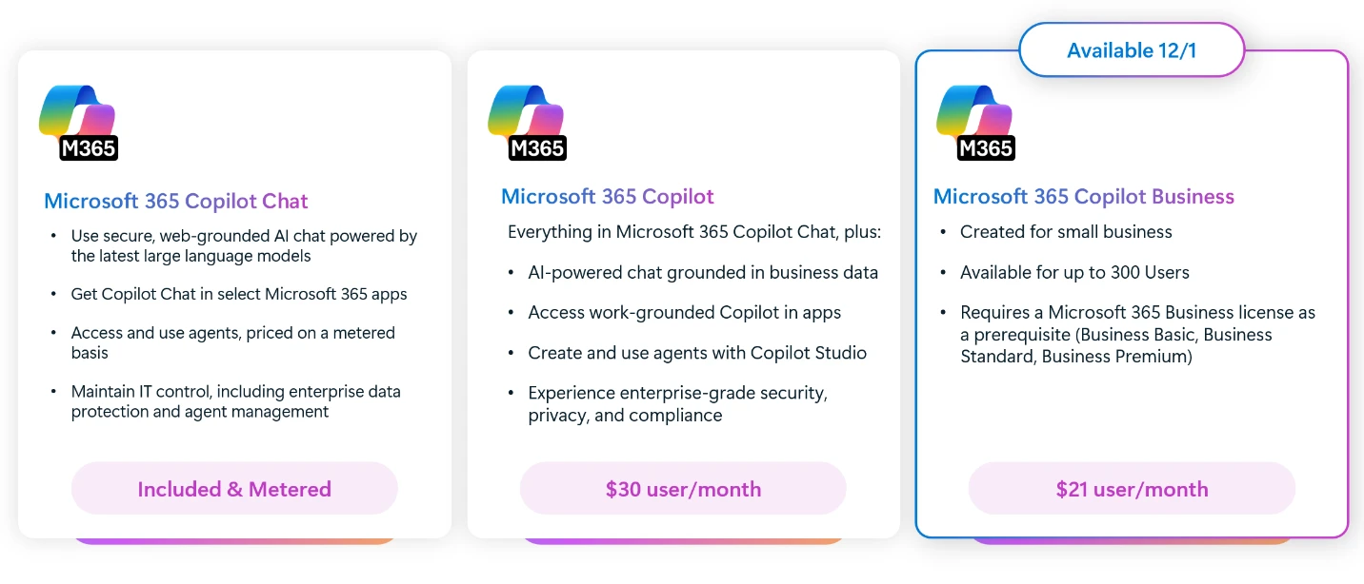
General availability of Microsoft 365 Copilot Business
Copilot Business delivers full‑featured, secure AI for small and midsize businesses at a simple, affordable price.
Designed for SMBs
A comprehensive AI solution designed specifically for small and midsize businesses, without compromising on capability or security.
Embedded in Microsoft 365 apps
Copilot Business works directly in Word, Excel, PowerPoint, Outlook, and Teams—enhancing the tools SMBs already use every day.
Simple pricing, limited‑time savings
USD 21 per user/month, with additional bundle discounts available until 31 March 2026.
Microsoft Copilot Business is now available
Microsoft 365 Copilot Business: The future of work for small businesses | Microsoft 365 Blog
Notes:
Microsoft is expanding its Copilot lineup for small and midsize businesses with the general availability of Microsoft 365 Copilot Business.
This brings full‑featured, enterprise‑grade AI to SMBs, designed specifically for their needs but without compromising on security, compliance, or capability.
Copilot Business is built directly into the Microsoft 365 apps teams already use every day — including Word, Excel, PowerPoint, Outlook, and Teams — helping people work smarter without changing tools.
Pricing is simple and accessible at USD 21 per user per month, and for a limited time there are additional savings when Copilot Business is purchased with Microsoft 365 Business plans, available until 31 March 2026.

Slide 29
Microsoft 365 Copilot release notes
As of 2nd Feb 2026
Latest features and improvements for Microsoft 365 Copilot.
It includes changes that are generally available
(Current Channel for Microsoft 365 apps)
Release Notes for Microsoft 365 Copilot | Microsoft Learn
Notes:
As of 2nd February 2026
This page lists the latest features and improvements for Microsoft 365 Copilot. It includes changes that are generally available (Current Channel for Microsoft 365 apps) and specific to each platform.

Slide 30
Microsoft 365 Copilot release notes – January 2026
As of 2nd Feb 2026
Microsoft 365 Copilot Chat (3)
PowerPoint (1)
        Copilot Chat model selector now offers GPT‑5.2 [Android, Windows, iOS, Mac, Web]
        Copilot icon visibility in Microsoft Edge [Web]
        Search for meetings by organizer using Copilot Chat [Windows]
Use Copilot to get a detailed and contextual explanation
Microsoft 365 Copilot app (1)
Copilot extensibility (15)
Access all your Copilot-generated content in one library [Android, Windows, iOS, Mac, Web]
Advanced understanding for comments and attachments in SNOW KB and Azure DevOps connectors [Windows, Web]
Build smarter agents with GPT‑5 in Agent Builder [Android, Windows, iOS, Mac, Web]
Bring your own Microsoft Foundry agents into Microsoft 365 Copilot [Web]
Connect Dropbox for smarter Copilot file access [Web]
Connect Microsoft 365 Copilot with Guru for enhanced insights [Web]
Copy an agent from Agent Builder to Copilot Studio [Windows, Web]
Expand Copilot Agents with Mail, People, and Meeting Insights [Windows, Web]
Generate icons using AI in Agent Builder [Windows, Web]
Generate Office documents from agents in Copilot Studio lite [Windows, Web]
Improve relevance and personalization by connecting user identities across data sources [Windows, Web]
Publish Azure AI Foundry agents to Copilot [Web]
Simplified ServiceNow tickets setup with per-table ACL rules [Web]
Smart document management with Google Drive integration [Web]
Template-based knowledge ingestion for ServiceNow Knowledge Connector [Web]
Users can leverage multi-agent workflows [Windows, Web]
Microsoft Loop (1)
Generate PowerPoint grounded on a Copilot page [Web]
Viva Glint (2)
Copilot employee experience outcomes report with Viva Glint [Web]
Workplace patterns report in Viva Glint [Web]
Microsoft 365 Admin Center (1)
Admin control to customize AI disclaimers in Copilot Chat [Windows, Web]
Learn more | Release Notes for Microsoft 365 Copilot
28 Updates released between December 23, 2025, and January 27, 2026.
Notes:
Updates released December 23, 2025, and January 27, 2026.
This page lists the latest features and improvements for Microsoft 365 Copilot. It includes changes that are generally available (Current Channel for Microsoft 365 apps) and specific to each platform.
As of 2nd February 2026
Learn more - Release Notes for Microsoft 365 Copilot | Microsoft Learn
https://learn.microsoft.com/en-us/copilot/microsoft-365/release-notes?tabs=all

Slide 31
Microsoft 365 Copilot release notes – December 2025
As of 2nd Jan 2026
Copilot extensibility (9)
Microsoft 365 Copilot app (3)
SharePoint (1)
        Access IT service documentation with Freshservice integration [Web]
        Upload larger files in Copilot Studio Agent Builder (512 MB support) [Android, Windows, iOS, Web]
        Use .NET client libraries to integrate Microsoft 365 Copilot APIs [Web]
        Use Python client libraries to integrate Microsoft 365 Copilot APIs [Web]
        Use TypeScript client libraries to integrate Microsoft 365 Copilot APIs [Web]
        View and manage SharePoint agents with greater control [Web]
        Access custom engine agents in multiple apps [Web]
        Edit adaptive cards inline for a faster build process [Web]
        Better security insights help you build confidently [Web]
GPT-5 powers Copilot Chat by default [Android, Windows, iOS, Mac, Web]
Create polished videos faster with seamless editing and brand customization [Web]
Get AI-powered summaries with search views [Web]
Add multiple SharePoint agents in one Teams conversation [Web]
Viva Glint
Multilingual support in Copilot for Viva Glint [Web]
Microsoft 365 Copilot Chat (1)
Word (1)
        Streamlined Copilot chat navigation with expanded history [Windows, Web]
Referenced sources cited in drafted content [Windows]
PowerPoint (1)
Use your organization’s approved assets in Copilot presentations [Mac, Windows, Web]
Copilot Studio (1)
Build Copilot agents using organizational People data [Windows, Web]
Learn more | Release Notes for Microsoft 365 Copilot
16 Updates released between November 25, 2025, and December 23, 2025
Notes:
Updates released between November 25, 2025, and December 23, 2025.
This page lists the latest features and improvements for Microsoft 365 Copilot. It includes changes that are generally available (Current Channel for Microsoft 365 apps) and specific to each platform.
As of 2nd January 2026
Learn more - Release Notes for Microsoft 365 Copilot | Microsoft Learn
https://learn.microsoft.com/en-us/copilot/microsoft-365/release-notes?tabs=all

Slide 32
Microsoft 365 Copilot release notes – November 2025
As of 19th Dec 2025
Copilot extensibility (6)
Microsoft 365 Copilot Chat (6)
Outlook (1)
        Access Custom Engine Agents on Copilot Chat (Mobile) [Android, iOS]
        Custom Agents in Office Applications [Web]
        Enhanced Agent Store Search Experience [Windows, Web]
        Export Detailed Agent Metadata for Governance [Web]
        Message Extensions as Declarative Agents on Mobile [Android, iOS]
        Unified Permissions Management for Agents [Windows, Web]
        Access Shared Mailboxes in Copilot Chat [Android, Windows, iOS, Mac, Web]
        Find Files Faster with Improved Filters [Windows, Web]
        Iterate on Images with Multi‑Turn Editing [Windows, Mac, Web]
        RSVP‑Based Meeting Search [Android, Windows, Web]
        Talk to Copilot with Voice [Android, Windows, iOS, Mac, Web]
        Updated Copilot Chat Navigation Pane in Teams [Web]
Intelligent Draft Agenda with Copilot [Web]
PowerPoint (2)
Create New Presentations Without Overwriting Originals [Windows, Mac, Web]Reference Loop Components or Pages in Presentations [Mac, Windows, Web]
SharePoint (1)
Copilot Skills for Smarter SharePoint Administration [Web]
Copilot Studio (3)
Microsoft 365 Admin Center (5)
Control Org‑Wide Agent Sharing from One Place [Web]
Quarantine and Block Unsecured Agents [Web]
Upload Up to 1,000 Files for Agent Training [Web]
Block SharePoint Agents from Agents & Connectors Page [Web]
Monitor Copilot Usage with Capacity Packs [Mac]
New Enhancements in Organizational Data Ingestion [Web]
Reassign Agent Ownership [Windows, Web]
Restrict Org‑Wide Agent Sharing for Better Governance [Web]
Viva Insights (1)
Copilot Chat Metrics in Teams & Outlook [Windows, Web]
Excel (1)
        Build and Analyze Surveys with Surveys Agent [Windows, Mac, Web]
Microsoft 365 Copilot app (1)
Customize Audio Overviews for Copilot Notebooks [Web]
Learn more | Release Notes for Microsoft 365 Copilot
27 Updates released between between October 28, 2025, and November 25, 2025
Notes:
27 Updates released between between October 28, 2025, and November 25, 2025
This page lists the latest features and improvements for Microsoft 365 Copilot. It includes changes that are generally available (Current Channel for Microsoft 365 apps) and specific to each platform.
As of 19th December 2025
Learn more - Release Notes for Microsoft 365 Copilot | Microsoft Learn
https://learn.microsoft.com/en-us/copilot/microsoft-365/release-notes?tabs=all

Slide 33
Microsoft 365 Copilot Public Roadmap
Changes this month
As of 2nd Feb 2026
Microsoft 365 Roadmap - See What's Coming | Microsoft 365
Notes:
As of 2nd February 2026

Slide 34



Microsoft 365 Copilot Public Roadmap
As of 2nd Feb 2026
Launched and Rolling Out “Changed within last month”
Launched (23) 🚀
  Rolling Out (15)
Automatic summary of documents on file-open in Word
Catch up on a summary of document comments in the top of your document
Copilot can now answer questions about opened Copilot Pages in chat
Data source specific filters
Generate icons for your agents using AI in Microsoft 365 Copilot
Generating PPT grounded on a Copilot Page
Improved Python-powered answers in Copilot in Excel
In Copilot Pages, the Chat can now be used to modify the Page
Knowledge templates support for ServiceNow Knowledge Connector
Microsoft 365 admin center: Agent Ownership Reassignment
Microsoft 365 Copilot - your AI assistant in the GCCH environment
Microsoft 365 Copilot Chat - General Availability for the GCC High environment
Microsoft Edge: v.144 - Contextual nudges on address bar offering help summarizing webpages.
Microsoft Edge: v.144 - Copilot icon visibility
Microsoft Graph: Graph API - Copilot for Microsoft 365 usage
Microsoft Purview Information Protection: Doc library default labeling for SharePoint Online and Copilot
Microsoft Purview: Data Loss Prevention - Data Loss Prevention to restrict Microsoft 365 Copilot processing on content with sensitivity labels
Microsoft Teams: Ability for IT admins to customize the user notification strings for recording and transcription
Microsoft Teams: Enhancements to Interpreter and multilingual meeting experience
Microsoft Viva: Copilot Analytics - Copilot Employee Experience Outcomes Report with Viva Glint
Microsoft Viva: Enhancement to Copilot studio agents report
PowerPoint: Designer is now part of Copilot, enhanced with new template and slide Suggestions.
Steer your presentation length, tone, style, and images when creating with Copilot.
[Copilot Chat] Agent Mode in Excel
[Copilot Extensibility] Customers can connect M365 Copilot with Dropbox to access and manage cloud files with Copilot Connector
Admins can create and deploy custom Model Context Protocol (MCP) connectors across Microsoft 365.
Agent Mode in Excel for desktop apps
Calendar search for email delegates
Chat History Landing page: Filtering UI Refresh
Copilot Chat in Outlook expands to reason over inbox, calendar, and enterprise data
Edit Scheduled prompts
Microsoft Purview: Insider Risk Management - Risky AI usage
Outlook: Agents for Microsoft 365 Copilot available in Copilot Chat in classic Outlook for Windows
Quickly edit an image in PowerPoint
Scheduling with Copilot
Updates to Memory and Personalization in Microsoft 365 Copilot
Use Copilot to Share with Summary for OneDrive files in Windows
Use Copilot with OneDrive files in Finder
Notes:
As of 2nd February 2026

Slide 35


Microsoft 365 Copilot Public Roadmap
As of 2nd Feb 2026
New items added “New within the last month”
New items (21) – In development
Agent Mode in PowerPoint
Business Justification for Copilot License Requests
Customize M365 Copilot for your organization with Copilot Tuning
Enable watermarks for AI-generated content for M365 Copilot
Enhanced M365 Copilot Memory - Copilot is now personalized with work data
Image Upload in Copilot Chat for Government Cloud
Microsoft 365: New profile cards for buildings, rooms and desks
Microsoft Copilot (Microsoft 365): Copilot connectors are available for U.S. Department of Defense environment
Microsoft Viva: Copilot Analytics - Copilot configuration insights in the Copilot Dashboard Readiness page
Microsoft Viva: Copilot Analytics - Export metrics in the Copilot Dashboard at Day Level
Newly created Declarative Agents now understand referenced scanned PDFs
Open Word, Excel, and PowerPoint Files in Copilot Chat
People Skills - Expanded AI inferencing for E3/E5 users
Quickly edit an image in PowerPoint
Researcher Output Formats
Simplifying Content in the Input Box
Structured Document Generation with Forms
Surveys Agent and Copilot Chat in Microsoft Forms
Upload Local Files now Support .eml and .msg file types
When using Agent Mode in Word, you will be able to manually select which model to use
Notes:
As of 2nd February 2026

Slide 36
Microsoft 365 Copilot Public Roadmap
As of 2nd Feb 2026
In development “Changed within last month”
In development (41)
[Copilot Extensibility] [AdminX] Pre-setup guides, editability, actionable errors & alerting support available for Connector admins
[Copilot Search] [Copilot Search] Copilot Chat available when using Copilot Search
Agent Mode in Excel for GCC
Ask Copilot about highlighted response content
Catchup on important emails in Copilot Chat
Content Sources in Copilot Chat
Domain exclusion for web grounding
Excel: =COPILOT Function
Frontier and Microsoft agent user request approval flow in Microsoft 365 admin center
Generate text for a PowerPoint slide using slide context
Learning agent in Microsoft 365 Copilot
Lists in Context IQ
Meeting Prepare from Up Next
Microsoft 365 admin center: Copilot settings – readiness
Microsoft 365 Admin Center: Usage reports - Message consumption for Pay-as-you-go experiences in Copilot Chat.
Microsoft CoPilot (Microsoft 365): Microsoft Graph APIs for App & Agent Inventory and Details.
Microsoft Edge: Adding contextual nudges to the Microsoft 365 Copilot Chat icon
Microsoft Edge: Ground Microsoft 365 Copilot Chat in Edge for Business in your open OneDrive and SharePoint documents
Microsoft Edge: Ground Microsoft 365 Copilot Chat in Edge for Business in your open YouTube videos
Microsoft Edge: Microsoft 365 Copilot Chat access to page content will soon extend to work across multiple open tabs
Microsoft Edge: Microsoft Edge can now send work related browsing history to Copilot for more relevant work results when searching on M365 Copilot search
Microsoft Edge: Securely enable AI generated applications
Microsoft Teams: Enhanced Copilot chat summary
Microsoft Teams: Express voice enrollment in Microsoft Teams
Microsoft Viva: Copilot Analytics - Agent Dashboard.
Microsoft Viva: Copilot Analytics - Highlights on Copilot adoption from Viva Engage
Microsoft Viva: Copilot Analytics - Prompt category metrics for Microsoft 365 Copilot Chat
Microsoft Viva: Copilot Dashboard - Broader access to M365 Copilot Chat insights
Natural language support for Scheduling prompts
OneNote: Summary and Q&A in OneNote Mobile with Copilot (Android)
OneNote: Summary and Q&A in OneNote Mobile with Copilot (Iphone)
Planner capabilities in Copilot chat (M365 Copilot)
Project Manager Agent in M365 Copilot
Real-time voice interactions in a podcast in Word
Say "Hey Copilot" to activate voice conversations with the Microsoft 365 Copilot app on Windows
Scheduled prompts for Agents
Scheduled prompts for Web tab
Support for refining query filters for Confluence Copilot connectors
Updated Copilot Notebooks UX
Use voice for Q&A during Read Aloud in Word
Web Link as a Reference in Copilot Notebooks
Notes:
As of 2nd February 2026

Slide 37
Thank you 👏
Got feedback ?
https://aka.ms/WhatsNewCopilot/Feedback
Notes:
Thank you.

Slide 38

Feedback Form

Slide 39
Resources
Microsoft 365 Copilot Blog | Microsoft Community Hub
What’s New in Microsoft 365 Copilot | January 2026 | Microsoft Community Hub
Release Notes for Microsoft 365 Copilot | Microsoft Learn
Microsoft 365 Roadmap | Microsoft 365
What's new in Copilot Studio - Microsoft Copilot Studio | Microsoft Learn
Copilot Studio | Microsoft Copilot Blog
General availability of source specific filters in Copilot Search | Microsoft Community Hub
Microsoft 365 Copilot Business: The future of work for small businesses | Microsoft 365 Blog
Accelerating Microsoft 365 Copilot Adoption with Automated Readiness Assessment | Microsoft Community Hub
GitHub Repository: microsoft/m365-copilot-automated-readiness-assessment
Available today: GPT-5.2 in Microsoft 365 Copilot | Microsoft 365 Blog
Microsoft 365 Copilot News and Insights | Microsoft 365 Blog

Slide 40
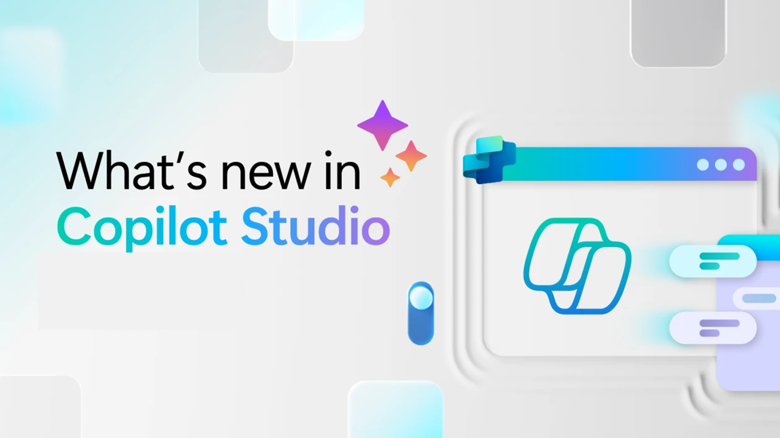
Whats new in Copilot Studio

Slide 41
What's new in Copilot Studio
The following table displays the month of release for each new feature.
Month of release | What’s new
December 2025 | Compare multiple agent versions side by side to validate improvements and quickly spot regressions when evaluating agents with test sets.
November 2025 | Updates for models used in Copilot Studio: On November 24, 2025, GPT-5 Chat rolls out to Copilot Studio in general availability for European and United States regions. You can use generally available models for orchestration in production agents. For more information on choosing orchestration models, see Select a primary AI model for your agent. (Preview) Automatically create Microsoft Entra agent identities for agents. When turned on, automatically apply identity management to individual agents by assigning a Microsoft Entra agent identity, helping admins secure and manage agents more effectively. Improved knowledge retrieval for SharePoint-grounded agents using tenant graph grounding. Updated system architecture and new retrieval methods deliver more precise, context-rich responses, enhancing answer quality. Improve response accuracy with SharePoint metadata filters. Use metadata like filename, owner, and modified date to refine knowledge retrieval and ensure responses come from the most relevant, up-to-date documents. Orchestrate multiple agents to break down complex tasks across specialized agents, improving accuracy and speeding up end‑to‑end automation. Enhance your agents by linking them to other agents—either within your environment or external sources like Microsoft Fabric data agents—for modular, task-specific functionality. (Preview) Add tool groups to agents for faster setup. Quickly equip your agents with curated sets of tools from Outlook and SharePoint connectors in one step. This streamlines setup, reduces errors, and ensures consistent, reliable orchestration. Copy agents from Microsoft 365 Copilot to Copilot Studio. Easily move agents you created in Microsoft 365 Copilot into Copilot Studio to unlock advanced capabilities like multi-step workflows, custom integrations, and broader deployment options. (Preview) Add human input to agent workflows with the request for information action. Pause an agent flow to collect details from designated reviewers via Outlook, then resume execution using their responses as dynamic parameters. This action ensures workflows can handle missing data or context without relying on hard-coded values. Update Power Platform API calls to use the new 'copilotstudio' namespace. The previous namespace will continue to work temporarily, but switching now ensures compatibility with future updates. Use component collections with new enhancements. Access collections directly from the sidebar, quickly export or import collections, and take advantage of support for primary agents and new connector types, including child agents and Model Context Protocol (MCP).
What's new in Copilot Studio - Microsoft Copilot Studio | Microsoft Learn | Copilot Studio Archive | Microsoft Copilot Blog
Notes:
As of 1st September 2025
What's new in Copilot Studio - Microsoft Copilot Studio | Microsoft Learn
https://learn.microsoft.com/en-us/microsoft-copilot-studio/whats-new
Copilot Studio Archive | Microsoft Copilot Blog
https://www.microsoft.com/en-us/microsoft-copilot/blog/copilot-studio/
What’s new in Copilot Studio: May 2025 | Microsoft Copilot Blog

Slide 42

What's new in Frontier
Get hands-on with breakthrough preview features, share your insights with product teams, and help shape the future of AI.
With Frontier, you’re not just adopting new technology, you’re co-creating what comes next.
Frontier program – Microsoft Adoption

Slide 43
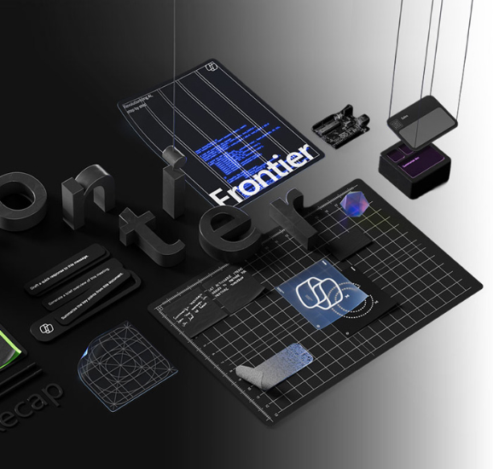
What's new in Frontier
Try out the latest agents and features in Microsoft 365 Copilot and see how they can transform your day-to-day.​
NEW: Agents to drive AI workforce transformation
NEW: Microsoft Agent 365: The control plane for AI Agents
NEW: Build and create with Copilot Pages
NEW: Learn more about the Sales Development Agent
NEW: How Sales Development Agent connects with Dynamics 365
NEW: Learn more about Project Opal
NEW: Experience next-gen productivity with Windows 365 AI-enabled Cloud PCs
Frontier Getting started guide
Notes:
As of 1st September 2025
What's new in Copilot Studio - Microsoft Copilot Studio | Microsoft Learn
https://learn.microsoft.com/en-us/microsoft-copilot-studio/whats-new
Copilot Studio Archive | Microsoft Copilot Blog
https://www.microsoft.com/en-us/microsoft-copilot/blog/copilot-studio/
What’s new in Copilot Studio: May 2025 | Microsoft Copilot Blog

Slide 44
Microsoft 365 Copilot
September 2025
Copilot Control System
User capabilities
        Expanding model choice in Microsoft 365 Copilot
        Admins can view and measure agents used in Microsoft 365 Copilot
        A new policy gives enhanced control over Copilot prompts
        Admins can manage ownerless agents
        Manage data security risks with Microsoft Purview Data Security Posture Management for AI apps
        Merge people data with other sources with Microsoft Copilot connectors
        Employees can use their personal Microsoft 365 subscriptions to access Copilot features at work
        The new Copilot Chat Roadmap
        Copilot Chat is now available in Word, Excel, PowerPoint, Outlook, and OneNote
        Updated Copilot with a long context model
        Seamlessly launch the full M365 Copilot app
        Copilot Chat now lets users interact with embedded images inside any document
        Generating PPT grounded on a Copilot Page
        Teams Chats and Channels in ContextIQ
        The new Edit in Outlook button
        Email attachment summarization
        Access email from delegated mailboxes
        Users can access their shared mailboxes.
        Users can search for meeting RSVPs
        Microsoft 365 Copilot Library
        Copilot Search, users can find meetings
        AI Views in Copilot Search
        Produce videos from text prompts and existing files
        Formula completion with Copilot in Excel
        Users can easily summarize any open email or email thread in a single click
        Copilot now extends to helping users search their Outlook inboxes
        Schedule meetings using Copilot Chat
        Copilot now makes it easier to resolve scheduling conflicts
        Update documents and fix spelling and grammar with Copilot in Word
        Thread summaries from Copilot in Teams
        Improve text with Copilot in PowerPoint
        Copilot now available in Viva Engage
        Moving sales, service, and finance with Microsoft 365 Copilot
        New app icons designed for the AI era
Agents
        New output controls for Researcher agent
        Skills Agent
        Knowledge Agent in SharePoint
        Facilitator in Microsoft Teams
        Teams channel can now have a Channel Agent
        Agents in Viva Engage communities
        SharePoint agents can now reason over metadata
        Introducing Agent Mode and Office Agent in Microsoft 365 Copilot
Notes:
As of 3rd July 2025

Slide 45
Microsoft 365 Copilot
October 2025
Copilot Control System
User capabilities
        Copilot Control System features on M365 Public Roadmap
        New reports and management tools in Microsoft 365 admin center
        The new Microsoft 365 Copilot usage report
        Agent ownership reassignment
        Enhanced Agent Inventory Export
        Model Context Protocol & Unified Agent Management
        Copilot Credit Capacity for SharePoint & Tuning
        Microsoft 365 companion apps—People, Files, and Calendar
        Team views in Copilot Dashboard
        Copilot Chat quality Roadmap
        Session persistence enhancement for Copilot Chat
        Improving response accuracy for file-based questions
        Agent recommendations in Copilot Chat
        GPT-5 will soon become the default model in Copilot Chat
        Copilot Chat is simplifying calendar management.
        Bing Web Cards
        Copilot Chat API
        AI Views in Microsoft 365 Copilot Search
        Copilot Search Enhancements
        Copilot Chat in Mobile File Preview
        Audio recapnew file summaries for Copilot in Teams
        Speaker notes and translation for Copilot in PowerPoint
        Agent Mode in Word
        Agent Mode in Excel
        Meeting planning improvements for Copilot in Outlook
        Teams Mode for Microsoft 365 Copilot
        Employees can use their personal Microsoft 365 subscriptions to access Copilot features at work
Agents
        Employee Self-Service Agent
        Surveys Agent
        App Builder agent
        Researcher updates
        Introducing Researcher with Computer Use
Notes:
As of 5th October 2025

Slide 46
Microsoft 365 Copilot
November + December 2025
As of 2nd Jan 2026
Copilot Control System
User capabilities
        New reports and benchmarking for Copilot Dashboard
        Richer audit logs, baseline security mode, and organizational messages in Microsoft 365 admin center
        Innovations in the SharePoint admin center
        Safeguards and remediations in Microsoft Purview
        New capabilities for AI admins from Ignite 2025
        Track Adoption Trends and Export Insights with Copilot and Agent Analytics
        Work IQ enhancements
        Improvements to quality and agent performance in Copilot Chat
        Updated navigation and search capabilities in the Microsoft 365 Copilot app
        Suggested references, student access, and OneNote availability for Copilot Notebooks
        Unified experience, Entra authentication, agent update, and more for Copilot in Teams
        Formula completion in Excel
        Explanations and image editing for Copilot in PowerPoint
Agents
        New agents available
          People agent
          Learning agent
          Insight agent
          Survey agent
        Agent mode in Excel
        Agent mode in Word
        New features in Facilitator
        Enhancements to Channel Agent
Notes:
As of 2nd January 2026

