Slide 1

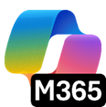
What’s new in
Microsoft 365 Copilot
As of 2nd Jan 2026
November & December 2025
Presenter name
Title
Notes:
As of 2nd January 2026
Thank you.
Got Feedback ? – https://aka.ms/WhatsNewCopilot/Feedback
Resources - check appendix slides ☺

Slide 2
What's new in Microsoft 365 Copilot
Updates listed in this document are selected based on relevance to Microsoft 365 Copilot.
Release dates and timings are subject to change.
For a complete list of Copilot for Microsoft 365 roadmap items refer to
Microsoft 365 Roadmap | Microsoft 365
Got feedback ?
https://aka.ms/WhatsNewCopilot/Feedback
Notes:
Feedback – https://aka.ms/WhatsNewCopilot/Feedback
Please note that the dates mentioned in this presentation are tentative and subject to change.

Slide 3

What’s new in Microsoft 365 Copilot
November + December 2025
As of 2nd Jan 2026
Copilot Control System
User capabilities
        New reports and benchmarking for Copilot Dashboard
        Richer audit logs, baseline security mode, and organizational messages in Microsoft 365 admin center
        Innovations in the SharePoint admin center
        Safeguards and remediations in Microsoft Purview
        New capabilities for AI admins from Ignite 2025
        Track Adoption Trends and Export Insights with Copilot and Agent Analytics
        Work IQ enhancements
        Improvements to quality and agent performance in Copilot Chat
        Updated navigation and search capabilities in the Microsoft 365 Copilot app
        Suggested references, student access, and OneNote availability for Copilot Notebooks
        Unified experience, Entra authentication, agent update, and more for Copilot in Teams
        Formula completion in Excel
        Explanations and image editing for Copilot in PowerPoint
Agents
        New agents available
          People agent
          Learning agent
          Insight agent
          Survey agent
        Agent mode in Excel
        Agent mode in Word
        New features in Facilitator
        Enhancements to Channel Agent
Notes:
As of 2nd January 2026

Slide 4

User capabilities

Slide 5
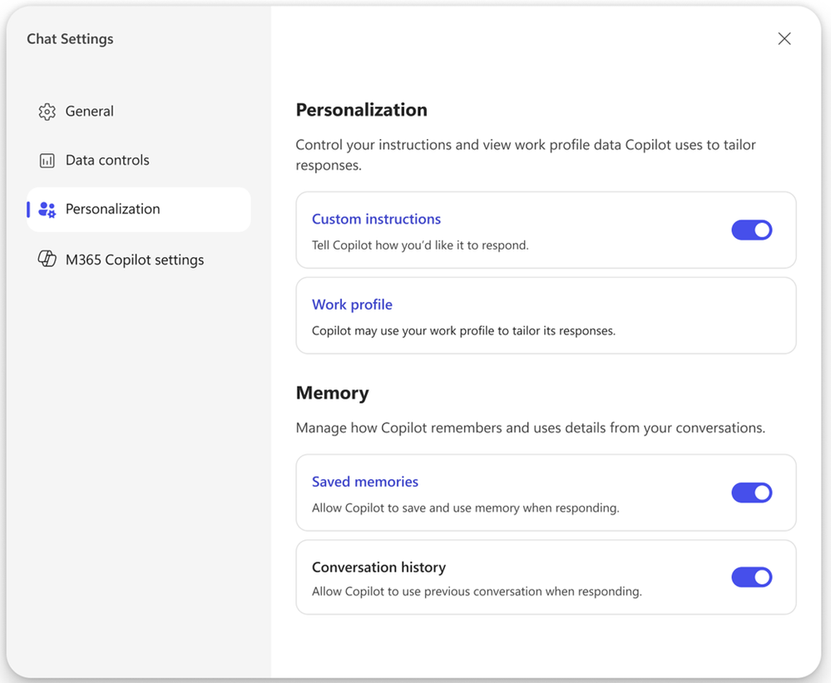
Work IQ enhancements
Work IQ is gaining improved memory capabilities, enabling Copilot to recall details from past conversations and deliver more personalised, contextual responses.
Smarter Recall
Copilot can now draw on relevant memories from previous interactions to improve accuracy and relevance.
Greater Personalisation
Work IQ deepens Copilot’s understanding of each user’s role, preferences, and organisational context.
User‑Controlled Experience
New settings make it easier to manage and tailor how Copilot uses memory.
Work IQ enhancements
This feature is rolling out in December.
Notes:
“Work IQ is getting smarter with enhanced memory capabilities.”
This update allows Copilot to recall relevant details from previous conversations, making responses feel more personal and more accurate.
“This isn’t just a technical upgrade — it’s about context.”
Because Work IQ understands a user’s role, preferences, and organisational environment, these new memory features help Copilot adapt to how each person works.
“Users stay in control.”
The new settings make it easy for people to see, manage, and fine‑tune the memories Copilot uses, which reinforces trust and keeps the experience transparent.
“Rollout begins in December.”
So organisations and users will start feeling the benefits very soon.
What’s New in Microsoft 365 Copilot | November & December 2025 | Microsoft Community Hub
https://techcommunity.microsoft.com/blog/microsoft365copilotblog/what%E2%80%99s-new-in-microsoft-365-copilot--november--december-2025/4469738

Slide 6
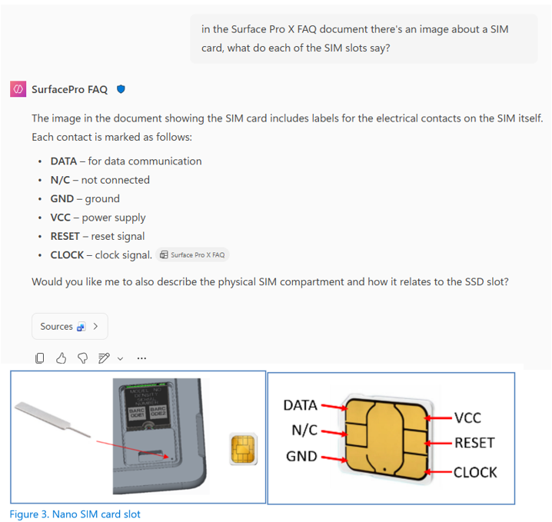
Improvements to quality in Copilot Chat
Copilot continues to improve productivity with better chat quality and enhanced agent capabilities for richer, context-aware responses.
Chat Quality Gains
Positive feedback surged: 3× more thumbs up, 17% higher satisfaction, and thumbs down halved over the past six months.
User Feedback Matters
Keep rating responses and check the monthly Copilot Chat Quality Roadmap for updates.
Visual Context in Responses
Declarative Agents now interpret images in Word, PowerPoint, and PDFs, extracting insights from charts, diagrams, and screenshots.
Interpret and ground responses
using images embedded in files
This feature is rolling out in December.
Notes:
“We’ve continued innovating on Copilot, but we’ve placed a strong emphasis on improving the core quality of Copilot Chat.”
Over the last six months, we’ve seen clear, measurable improvements driven directly by user feedback.
“The numbers really highlight the progress.”
We’re seeing three times more thumbs up, a 17% increase in satisfaction, and thumbs down cut in half. This shows the quality investments are resonating.
“Your feedback genuinely shapes the product.”
Thumbs up/down signals help guide the next rounds of improvements. And the monthly Copilot Chat Quality Roadmap is the best place to see what’s shipped and what’s coming next.
“Declarative Agents just got significantly smarter.”
They can now interpret images inside Word, PPT, and PDF files — things like charts, diagrams, screenshots — to ground responses in visual context, not just text.
“This means more complete and accurate answers.”
By combining text and visual understanding, Copilot can handle more complex queries with higher-quality responses.
“This enhancement begins rolling out in December.”
So customers will start benefiting right away.
What’s New in Microsoft 365 Copilot | November & December 2025 | Microsoft Community Hub
https://techcommunity.microsoft.com/blog/microsoft365copilotblog/what%E2%80%99s-new-in-microsoft-365-copilot--november--december-2025/4469738

Slide 7
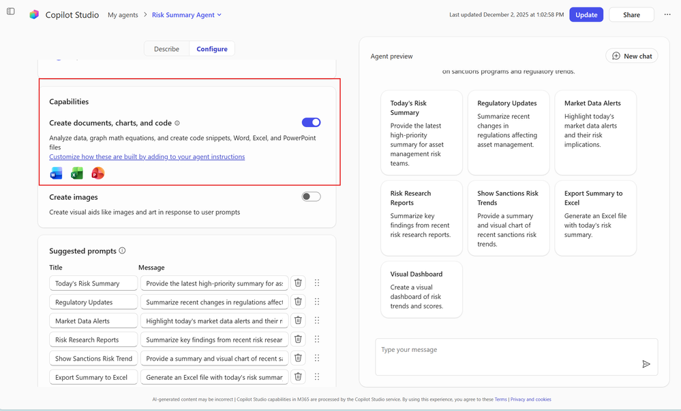
Improvements to agent performance in Copilot Chat
Custom agents in Microsoft 365 Copilot can now generate Word, Excel, and PowerPoint content, extending powerful creation capabilities to Agent Builder.
Expanded Skills
Formerly known as Code Interpreter, this feature enables agents to create documents, charts, and code for common tasks.
Efficiency Boost
Designed to help users complete work faster with integrated content generation.
From October to November
Skills introduced in October now extend to custom agents, bringing advanced creation tools into Agent Builder.
Agent Builder can now generate Word, Excel,
and PowerPoint content
This feature rolled out in November.
Notes:
With the new session persistence enhancement for Copilot Chat, users can seamlessly continue conversations even after navigating away from a session, meaning they never lose progress and can easily pick up right where they left off. After submitting a prompt, Copilot instantly creates an entry in the navigation pane’s session history, preserving the conversation. This means users can leave the current session and return later to find everything just as they left it. This update also boosts reliability and continuity, making navigation smoother and ensuring workflows remain uninterrupted. This feature rolled out in October.

Slide 8
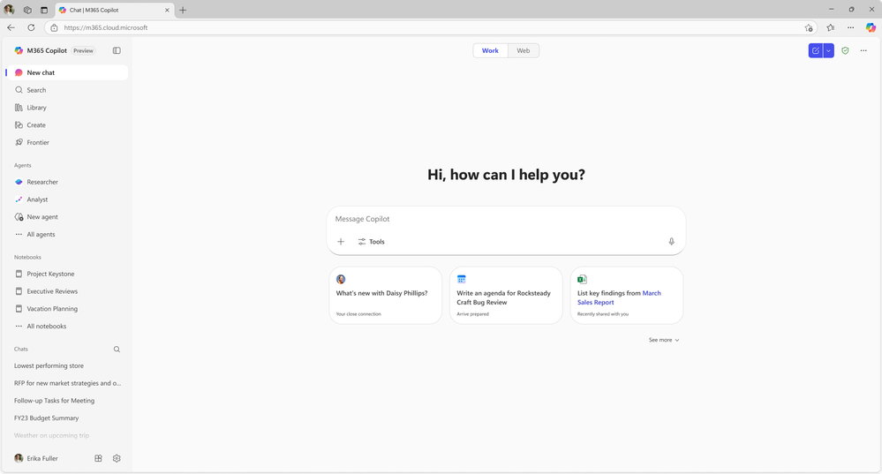
Updated navigation & search capabilities in the Microsoft 365 Copilot app
The Microsoft 365 Copilot app now offers a cleaner, more intuitive navigation experience to help users find content faster and unlock more AI value.
Enhanced Navigation Pane
Includes expanded chat history, chat search, and a larger recent Notebooks list.
New Library Experience
Centralises Copilot-generated content like images and Pages in one easy-to-access location.
Frontier Tab Added
Quick access to frontier experiences such as Opal and Word, Excel, and PowerPoint agents.
Simpler and more intuitive navigation
This feature is rolling out in December.
Notes:
“The Copilot app has received a major usability upgrade.”
The navigation is now cleaner and more intuitive, helping users get to what they need faster.
“We’ve improved discoverability across the board.”
The navigation pane now includes expanded chat history, a chat search, and a more comprehensive recent Notebooks list, making it easier for users to return to prior work.
“There’s also a brand-new Library experience.”
This brings all Copilot‑generated content—like images and Pages—into one place so users don’t have to hunt across apps or chats.
“And we’ve introduced the Frontier tab.”
This gives quick access to frontier experiences such as Opal and the Word, Excel, and PowerPoint agents, making it easier to explore new capabilities.
“All of these updates start rolling out in December.”
So users will soon notice smoother navigation and faster workflows inside the Copilot app.

Slide 9
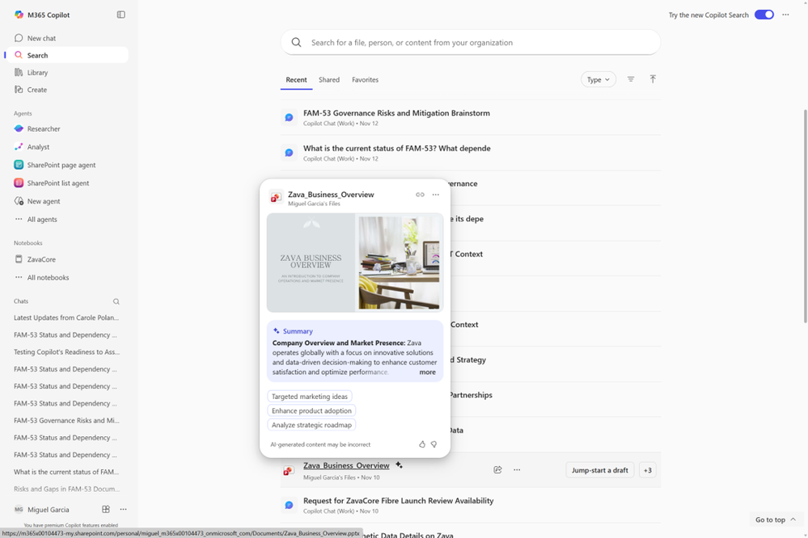
Glance cards in Copilot Search
Glance cards now bring quick, contextual insights to Copilot users—even without a Microsoft 365 Copilot licence—streamlining decision-making and boosting productivity.
Instant Context
Displays relevant details like recent documents, upcoming meetings, and key actions without a full search.
In-Flow Experience
Provides at-a-glance information right where people work, reducing time spent navigating across apps.
Simplifies Decisions
Helps users act faster by surfacing what matters most in the moment.
Glance cards in Copilot Search
This feature is rolling out in December.
Notes:
“Glance cards are now available to all Copilot users, even without a Microsoft 365 Copilot licence.”
This broadens access to quick, contextual insights directly within search.
“These cards surface the essentials instantly.”
Users can see recent documents, upcoming meetings, and key actions without running a full search or jumping across apps.
“It’s all about keeping people in their flow of work.”
By providing context at a glance, Glance cards cut down on navigation time and help users make faster, more informed decisions.
“This helps keep productivity front and centre.”
Users don’t need to switch apps or dig through files—they get the right information in the right moment.
“The rollout starts in December.”
So organisations and users will benefit from this simplified search experience very soon.

Slide 10
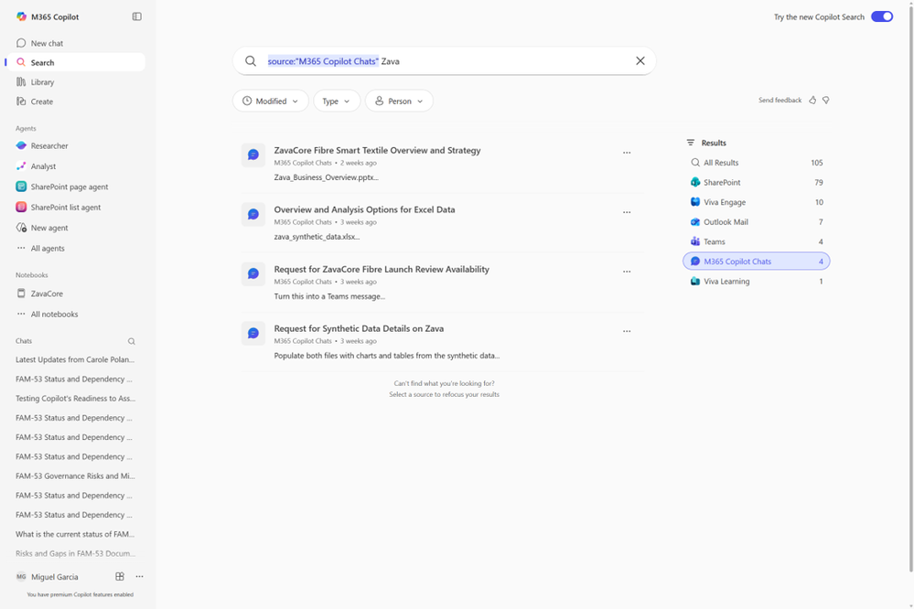
Copilot conversations are now integrated into Copilot Search results
Copilot conversations are now integrated into Copilot Search, making it easier to revisit past interactions and retrieve relevant content.
Unified Search Experience
Historical chats from notebooks, agents, and the main Copilot interface appear directly in search results.
New “Copilot Chats” Source
A dedicated data source in the right rail enables scoped searches focused on Copilot-generated content.
Smart Query Suggestions
Dynamic prompts help distinguish between recalling previous sessions and creating new ones, ensuring accurate results.
Copilot conversations in Copilot Search results
This feature rolled out in November
Notes:
“Copilot conversations are now fully integrated into Copilot Search.”
This makes it much easier for users to revisit and reuse past interactions without digging through different parts of the app.
“We’re unifying the search experience.”
Historical chats—from notebooks, agents, and the main Copilot interface—now appear directly in search results, bringing everything into one place.
“There’s also a new ‘Copilot Chats’ data source.”
This sits in the right rail and lets users run scoped searches specifically focused on Copilot‑generated content.
“The search box now adapts to user intent.”
Dynamic suggestions help people distinguish between recalling a previous conversation and starting a brand‑new prompt, ensuring the results match what they're trying to do.
“This rolled out in November.”
Users should already be seeing this improvement in their day‑to‑day Copilot experience.

Slide 11
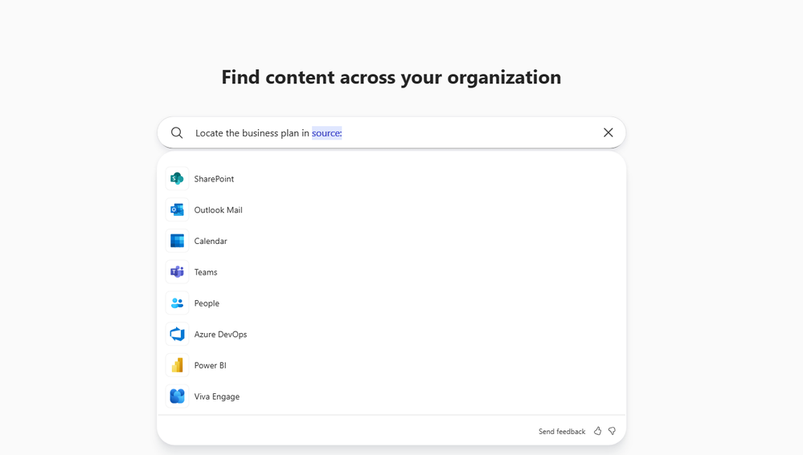
Microsoft 365 Copilot Search now offers dynamic, data source-specific filters
Copilot Search now includes dynamic, data source-specific filters to help users refine results quickly and accurately.
Smart Filter Suggestions
Typing “person:” or “source:” triggers Copilot to suggest options for narrowing the search.
Precision Refinement
Selecting a person or source updates suggestions to focus only on that context, making searches faster and more relevant.
Improved Search Experience
Helps users find exactly what they need without extra steps or guesswork.
Dynamic, data source-specific filters
These features rolled out in November and December.
Notes:
“Copilot Search now includes intelligent, dynamic filters to make searching more precise and intuitive.”
These filters adjust based on what the user types, helping refine results with minimal effort.
“Typing ‘person:’ or ‘source:’ now triggers smart suggestions.”
Copilot automatically recommends people or data sources to complete the prompt, reducing guesswork.
“Filters adapt as the user selects an option.”
Once a person or source is chosen, Copilot updates further suggestions to focus only on that context—making searches faster and far more relevant.
“This significantly improves the search experience.”
Users can quickly drill down to exactly what they need without extra steps or trial-and-error searching.
“These enhancements rolled out in November and December.”
So users should already be benefiting from the more streamlined search workflow.

Slide 12
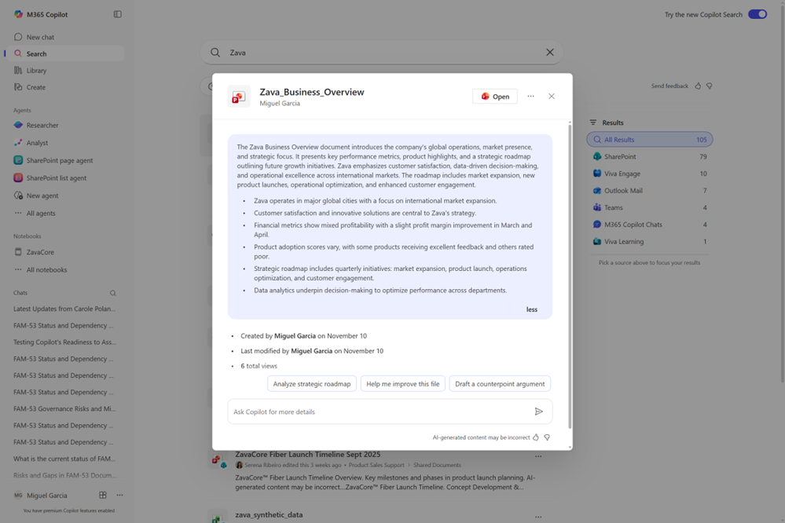
AI Views in Copilot Search results
AI Views now provide richer, context-aware summaries in search results, helping users quickly assess relevance without opening files or messages.
Smarter Summaries
Incorporates metadata, related resources, and suggested actions for deeper context.
Broader Coverage
Extends across more Microsoft 365 apps and major third-party platforms for enterprise-wide scenarios.
Faster Decision-Making
Enables users to gauge relevance instantly, reducing time spent navigating content.
AI Views in Copilot Search results
This feature rolled out in November.
Notes:
“AI Views now provide much richer summaries in Copilot Search results.”
Instead of just showing text snippets, they now bring together deeper context so users can understand relevance instantly.
“These summaries go beyond the surface.”
AI Views incorporate metadata, related resources, and suggested actions, giving users a clearer picture before opening the file or message.
“Coverage is broader than ever.”
This capability now spans more Microsoft 365 apps and major third‑party platforms, making it useful across a wide range of enterprise scenarios.
“This helps users make decisions faster.”
They can assess what’s important at a glance, which reduces time spent opening, navigating, and reviewing content.
“This rolled out in November.”
Users should already see the upgraded AI View experience in their search results.

Slide 13
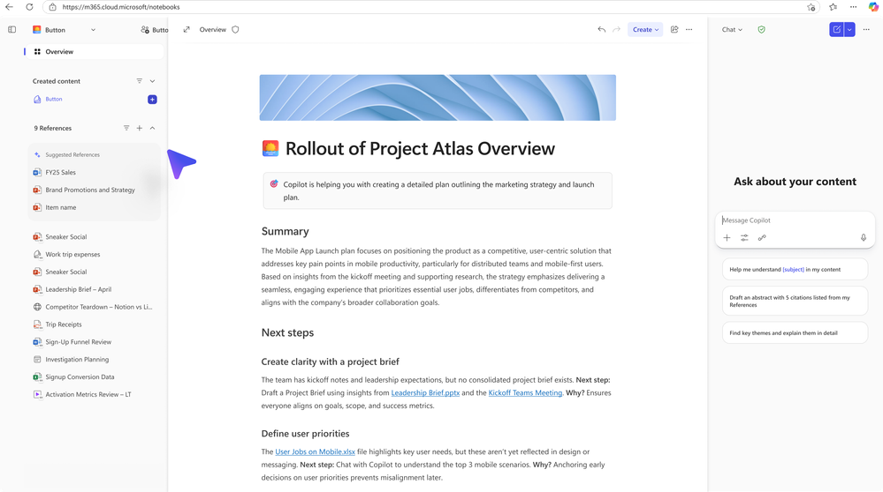
Suggested references for Copilot Notebooks
Suggested references automatically surface relevant files, emails, and meeting notes to enrich Notebook content, saving time and improving context.
Context Made Easy
Pulls in the most useful information without searching across multiple sources.
Boosts Productivity
Helps users quickly add depth and accuracy to their Notebook entries.
Integrated Experience
Works seamlessly within Copilot to keep workflows smooth and efficient.
Suggested references for Copilot Notebooks
This feature is rolling out in December.
Notes:
“Suggested references now help users enrich their Notebook content automatically.”
Copilot identifies the most relevant files, emails, and meeting notes and surfaces them at just the right time.
“This removes the need to search across multiple apps.”
Instead of jumping between Outlook, Teams, SharePoint, and Notebooks, users get the context they need delivered directly into their workflow.
“It makes creating high‑quality content much faster.”
By pulling in the right supporting information instantly, users can focus on writing, planning, or analysis rather than gathering materials.
“The experience is fully integrated into Copilot.”
It works seamlessly behind the scenes to keep the workflow smooth, consistent, and efficient.
“This capability rolls out in December.”
Users will soon see richer, more contextual Notebook experiences with far fewer manual steps.

Slide 14
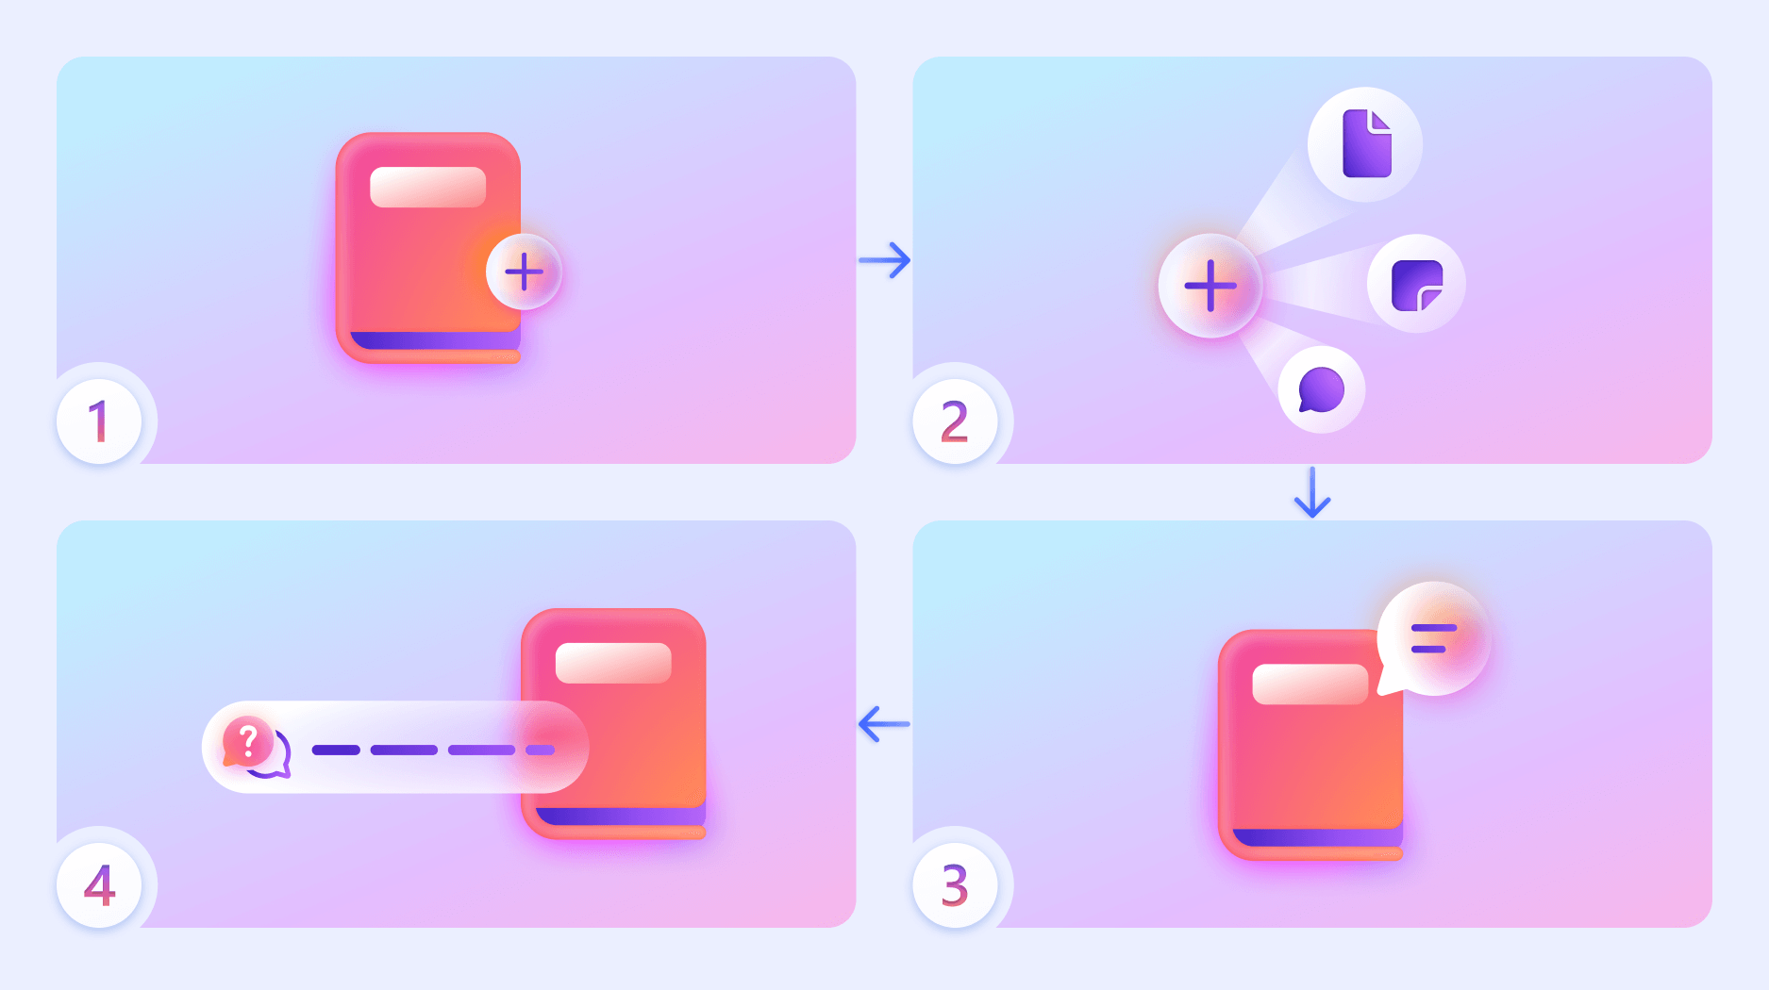
Copilot Notebooks for Students
Students aged 13–17 with Entra ID accounts can now access Copilot Notebooks in Microsoft 365 Copilot and OneNote, enabling collaborative, AI‑powered project work.
Unified Workspace
Gather and share all project‑related content in one place for easier organisation.
AI‑Driven Support
Copilot uses Notebook content to provide focused insights, updates, and guidance as projects evolve.
Empowers Student Collaboration
Simplifies teamwork and keeps resources centralised for better productivity.
Copilot Notebooks for Students
This feature rolled out in November
Notes:
“Students aged 13–17 with Entra ID accounts can now use Copilot Notebooks in both Microsoft 365 Copilot and OneNote.”
This opens up AI‑powered project support to younger learners.
“Notebooks become a central workspace for student projects.”
Students can gather and organise all their project‑related content in one place—notes, files, sources, and drafts.
“Copilot uses this content to provide targeted help.”
By grounding responses in the material students collect, Copilot can offer focused insights, updates, and guidance as their work develops.
“This really supports iterative learning.”
As students add more content, Copilot adapts, helping them refine ideas, improve structure, and stay on track.
“This feature rolled out in November.”
It’s already available to eligible students across education tenants.

Slide 15
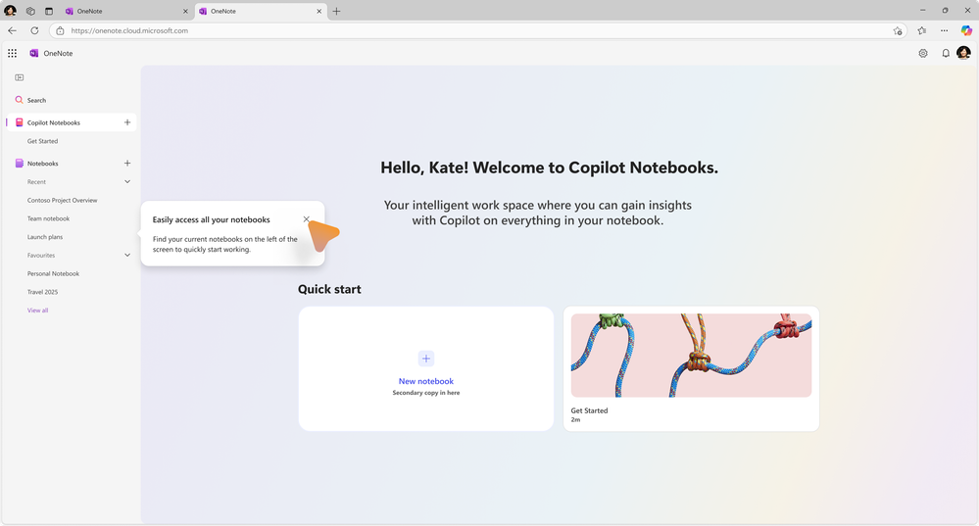
Copilot Notebooks is coming to OneNote
Copilot Notebooks is now integrated with OneNote, creating a unified, context‑rich workspace that combines organisation with AI assistance.
Central Hub for Projects
Capture and organise notes, files, images, recordings, and more in one place.
AI‑Powered Insights
Copilot grounds its suggestions, updates, and insights in the content stored in OneNote.
Connected Collaboration
Reduces app‑switching and helps teams move projects forward with clearer context.
Copilot Notebooks is coming to OneNote
This feature rolled out in November on the web.
Notes:
“Copilot Notebooks is now available directly inside OneNote.”
This brings together OneNote’s organisational strengths with Copilot’s ability to deliver targeted AI assistance.
“OneNote becomes a central hub for project work.”
Users can pull together everything—notes, files, images, recordings, and more—into one unified workspace.
“Copilot grounds its intelligence in that content.”
By using the material stored in OneNote, Copilot can offer context‑rich insights, updates, and suggestions that evolve as the project progresses.
“This reduces app‑switching and improves collaboration.”
Teams can stay focused, work more fluidly, and keep all project information connected in a single location.
“This feature rolled out in November on the web.”
OneNote web users already have access to this enhanced, AI‑powered workspace.

Slide 16
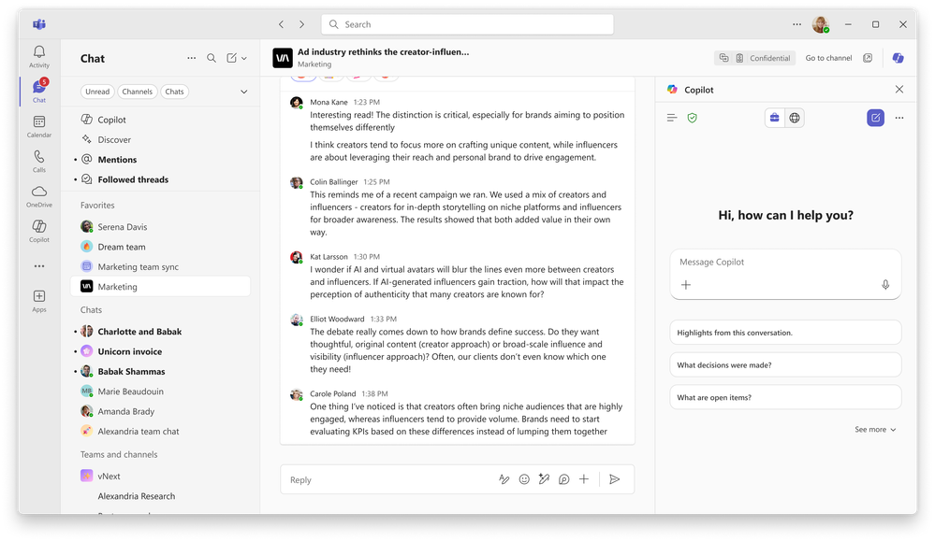
Unified Copilot Experience in Teams
Copilot in Teams now offers a consistent experience across chats, channels, and meetings, aligned with the Microsoft 365 Copilot app.
One Interface Everywhere
Unified design across Teams and Microsoft 365 Copilot for a seamless user experience.
Context‑Aware Assistance
Analyses chat history, meeting transcripts, and calendar content to deliver smart recaps and relevant insights.
Productivity Boost
Generates summaries, rewrites messages, and suggests follow‑ups based on user activity and goals.
Unified Copilot Experience in Teams
This feature rolled out to chat and channels in November, and is rolling out to public preview for meetings in December.
Notes:
“Copilot in Teams is now unified across chats, channels, and meetings.”
This means the experience is consistent with the Microsoft 365 Copilot app, reducing friction as users move between tools.
“The updates go beyond the interface.”
Copilot can now analyze chat history, meeting transcripts, and calendar content to give users more intelligent, personalised support.
“It delivers context‑aware assistance wherever you are in Teams.”
Whether someone is reviewing a long chat thread or catching up after a meeting, Copilot generates smart recaps, rewrites messages, and surfaces relevant insights based on what the user is working on.
“This directly boosts productivity.”
Users save time, get clearer next steps, and can act faster because Copilot understands the ongoing context and goals.
“Rollout details.”
The unified experience has been available in chats and channels since November, with public preview for meetings rolling out in December.

Slide 17
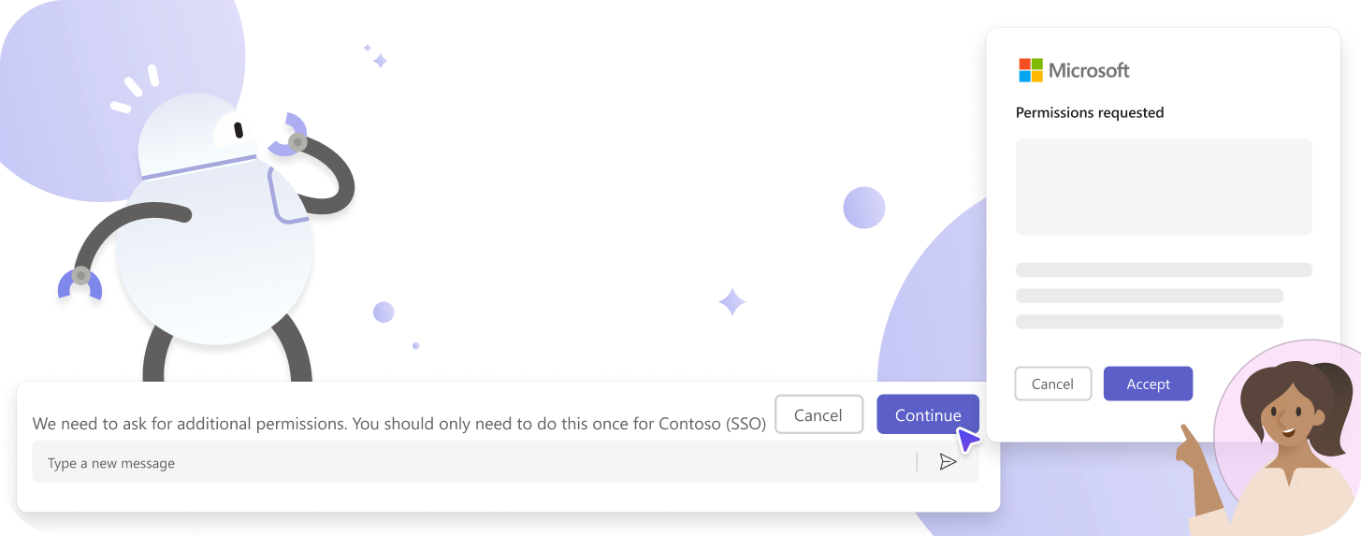
Agents and bots in group chats can now use Entra for secure authentication
Agents and bots in Teams group chats now use Entra for secure authentication, giving users more control and a seamless experience.
Private Permission Flow
If an agent/bot needs an Entra token, users receive a private message guiding them through app installation and permission granting.
Simple & Secure
The process ensures only the user sees the request, making authentication safe and hassle‑free.
Full Functionality
Once permissions are granted, agents/bots can access resources like Microsoft Graph for complete functionality.
Agents and bots in group chats can now use Entra
This feature rolled out in November.
Notes:
“Teams agents and bots in group chats now authenticate securely using Entra.”
This introduces a clearer, more controlled permission model for users.
“The experience is private and user-friendly.”
If an agent or bot needs an Entra token and the user hasn’t granted permission yet, they’ll get a private message—only visible to them—guiding them through installation and permission approval.
“This keeps security front and center.”
Users stay in control of what they grant, and the workflow ensures no sensitive permissions are requested publicly in the group chat.
“Once permissions are granted, everything just works.”
The agent/bot can then access what it needs—like Microsoft Graph—so users receive the full, intended experience without interruptions.
“This feature rolled out in November.”
It’s already available, improving how agents and bots operate in group conversations.

Slide 18
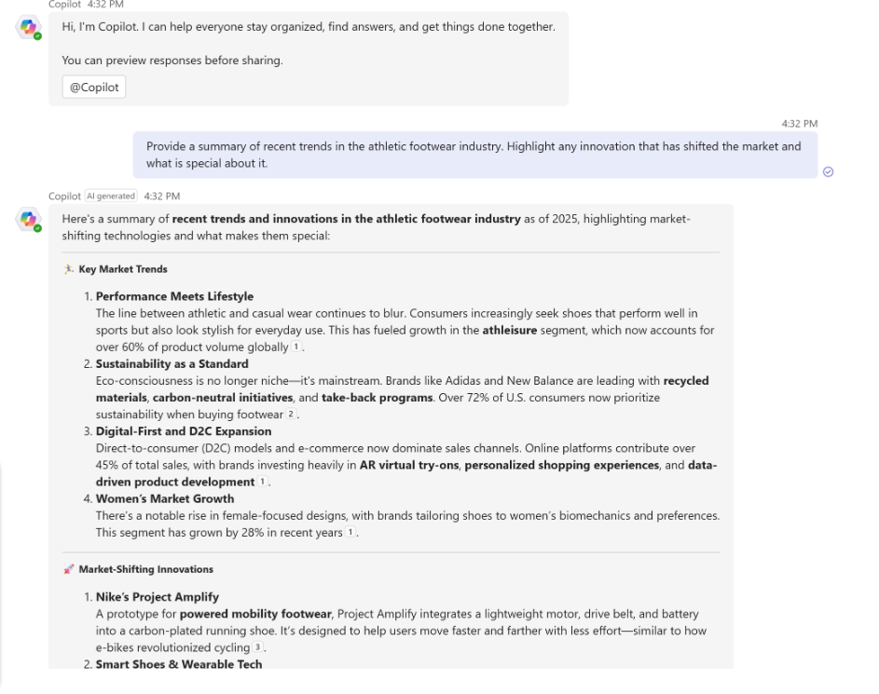
Teams Mode for Microsoft 365 Copilot
Teams Mode lets users turn individual Copilot chats into group AI conversations in Microsoft Teams, enabling collaborative work with Copilot.
From Solo to Group
Start a group chat from the Copilot app or add Copilot to any existing Teams chat—just like adding a teammate.
Collaborative AI Support
Copilot helps teams research, draft, coordinate, and complete tasks together.
Easy Interaction
Within the group chat, members can request help by typing @copilot and making their request.
Teams Mode for Microsoft 365 Copilot
This feature rolled out to public preview in November.
Notes:
“Teams Mode brings collaboration directly into Copilot.”
Instead of AI being a solo experience, users can now bring colleagues into the same conversation, transforming individual Copilot chats into group AI chats inside Microsoft Teams.
“It’s simple to start.”
From a 1:1 Copilot chat, users just select ‘start a group chat’. This instantly creates a group chat in Teams with selected colleagues and Copilot included.
“It works with existing Teams chats too.”
You can also add Copilot to any existing Teams group chat—just like adding another teammate—so the whole group can get help drafting, researching, planning, or coordinating tasks together.
“Everyone participates.”
Any member of the group can call on Copilot by typing @copilot and making a request, keeping the whole team aligned and accelerating the work.
“Availability.”
This capability rolled out to public preview in November.

Slide 19
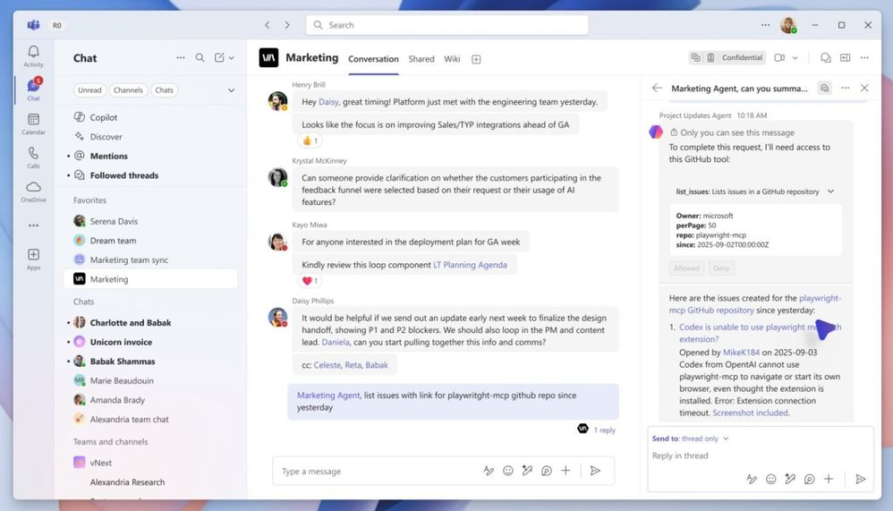
Connect with Asana, Atlassian, and GitHub via MCP server
Channel Agent now connects to Asana, Atlassian, and GitHub via the MCP server, enabling richer workflow execution across external tools.
Cross‑Tool Integration
MCP connectivity allows the agent to work seamlessly with Asana, Atlassian, and GitHub.
More Complex Workflows
Agents can now execute tasks outside their native domain, supporting broader scenarios.
Better Coordination Across Tools
Helps teams bridge gaps between work systems and keep activities aligned.
Connect with Asana, Atlassian, and GitHub via MCP server
This feature rolled out to Public Preview in November.
Notes:
“This update is all about extending Channel Agent beyond Microsoft tools.”
By connecting to Asana, Atlassian, and GitHub via the MCP server, the agent can now operate across multiple third‑party platforms.
“It means the agent can run workflows on behalf of users.”
Instead of just providing guidance, Channel Agent can actually execute tasks in these external systems, helping teams move faster and avoid app‑switching.
“This unlocks much more complex scenarios.”
With agent‑to‑MCP communication, Channel Agent can bridge processes between tools, coordinate multi‑system tasks, and support work that traditionally required manual hand‑offs.
“This is already live in Public Preview.”
These integrations rolled out in November, so teams can take advantage of them right away.

Slide 20
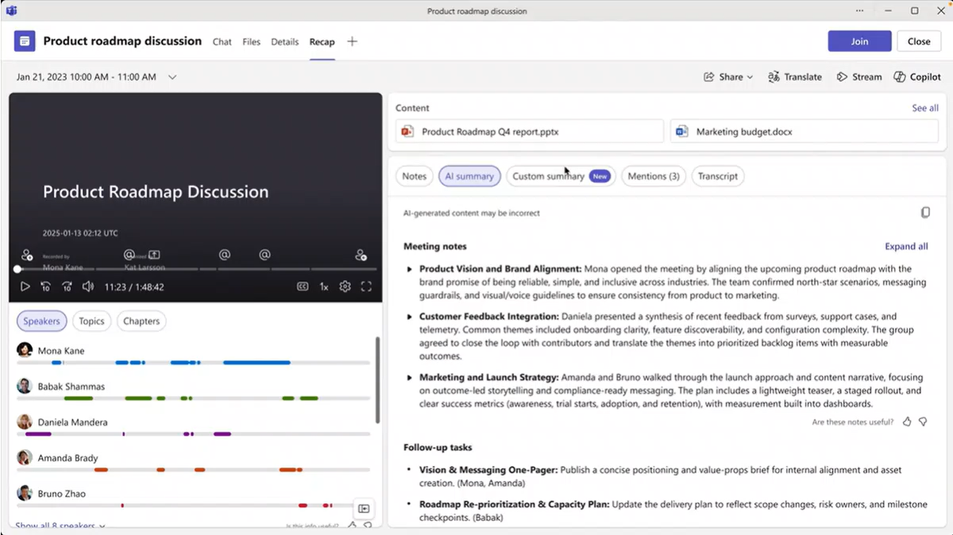
New customizable meeting recap templates
Customizable meeting recap templates let users tailor AI-generated notes to fit their team’s style for clarity and consistency.
Ready-Made Options
Choose from templates like Speaker Summary (organized by participant) or Executive Summary (key takeaways at a glance).
Create Custom Templates
Use a simple text prompt or paste an existing format to design your own structure for meeting notes.
Save for Reuse
Custom templates can be saved, ensuring every meeting follows the same clear and consistent format.
New customizable meeting recap templates
This feature is rolling out to Public Preview in December.
Notes:
“This update gives teams full control over how their AI meeting notes are structured.”
Instead of one generic format, users can now tailor recaps to match exactly how their team prefers to consume information.
“We’re introducing two ready-made templates to make this simple.”
Speaker Summary organizes insights by participant, while Executive Summary highlights the key takeaways at a glance. These options help teams quickly pick a format that fits their workflow.
“But the real power comes from custom templates.”
Users can write a simple free‑text description—or even paste in an existing format they already use—and the AI will instantly generate notes in that structure. No complex setup required.
“These templates are reusable.”
Custom templates can be saved and applied to future meetings, ensuring consistency and clarity across the team’s entire meeting rhythm.
“And this capability is rolling out to Public Preview in December.”

Slide 21
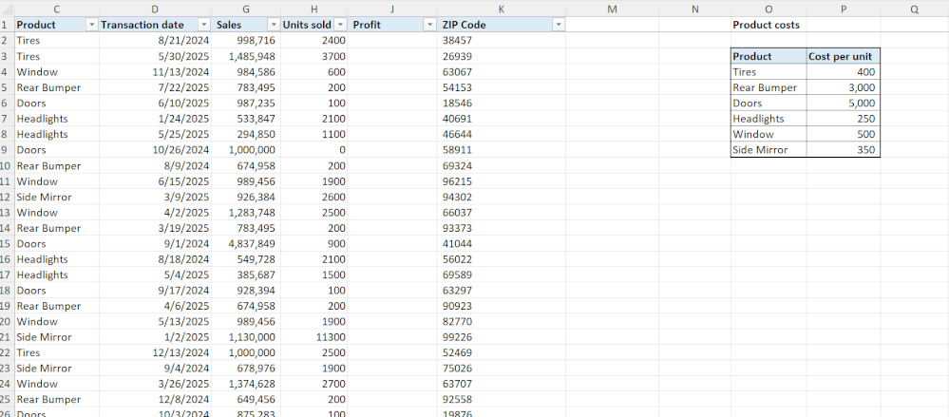
Formula completion in Excel
Formula completion in Excel speeds up writing formulas by suggesting and autocompleting them based on worksheet context.
Proactive Suggestions
Copilot offers real-time formula recommendations as soon as users type “=”.
Context-Aware Accuracy
Suggestions leverage headers, nearby cells, and tables for precise results.
Faster, Error-Free Workflows
Reduces syntax errors and saves time so users can focus on insights.
Public Preview Availability
Rolled out in November on Windows.
Formula completion in Excel
This feature rolled out in November on Windows.
Notes:
“This update brings a big quality-of-life improvement for anyone who works with formulas in Excel.”
As soon as the user types “=”, Excel now proactively suggests formulas, helping them get started faster.
“What makes this powerful is the context awareness.”
Copilot looks at headers, nearby cells, and tables in the worksheet to generate accurate, relevant suggestions—not generic guesses.
“This reduces both time and errors.”
Users no longer need to remember formula syntax or troubleshoot mistakes; they can focus on analysing data rather than wrestling with the formula bar.
“And this feature is already available.”
Formula completion rolled out on Windows in November, so users can try it immediately.

Slide 22
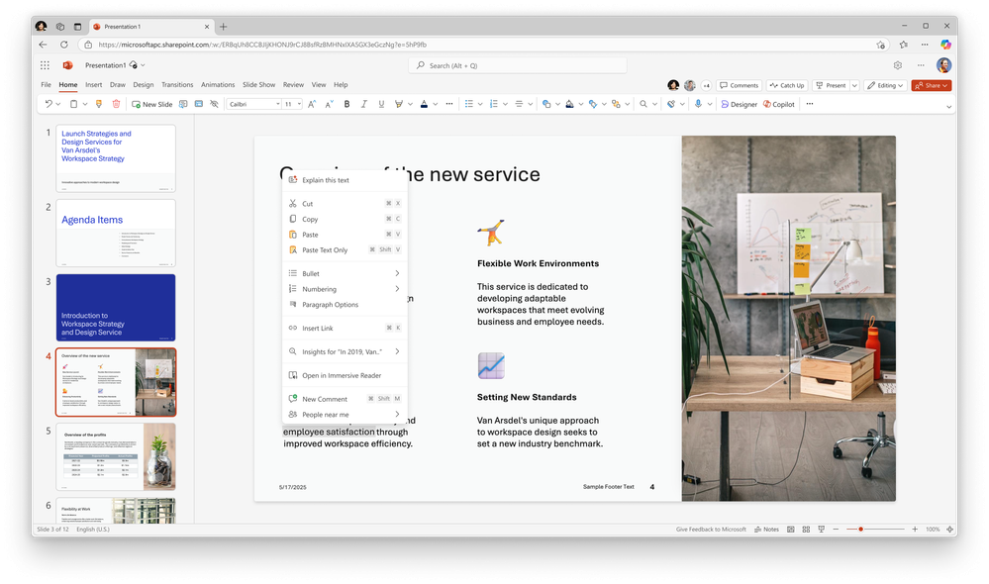
Explanations for Copilot in PowerPoint
The “Explain this” feature in Copilot for PowerPoint provides instant, contextual explanations for selected content, helping users understand complex information quickly.
Flexible Selection
Works on acronyms, text boxes, tables, or entire slides for tailored explanations.
Boosts Clarity and Productivity
Reduces confusion by delivering clear, relevant context for complex content.
Enhances Understanding
Helps users grasp details without leaving the slide or searching elsewhere.
Explanations for Copilot in PowerPoint
This feature rolled out in November on the web and is rolling out in December on Windows desktop and Mac.
Notes:
“This feature is all about speeding up understanding.”
With Explain This, users can select an acronym, a text box, a table, or even an entire slide, and Copilot instantly provides a clear, contextual explanation of whatever they highlighted.
“It removes the guesswork.”
Instead of hunting for definitions or asking for clarification, users get tailored explanations right inside PowerPoint, helping them quickly grasp complex content.
“The productivity impact is huge.”
By reducing confusion and keeping everything in context, users stay in the flow—no switching apps or searching external references.
“And it's rolling out broadly.”
The feature launched on the web in November and is expanding to Windows desktop and Mac in December.

Slide 23
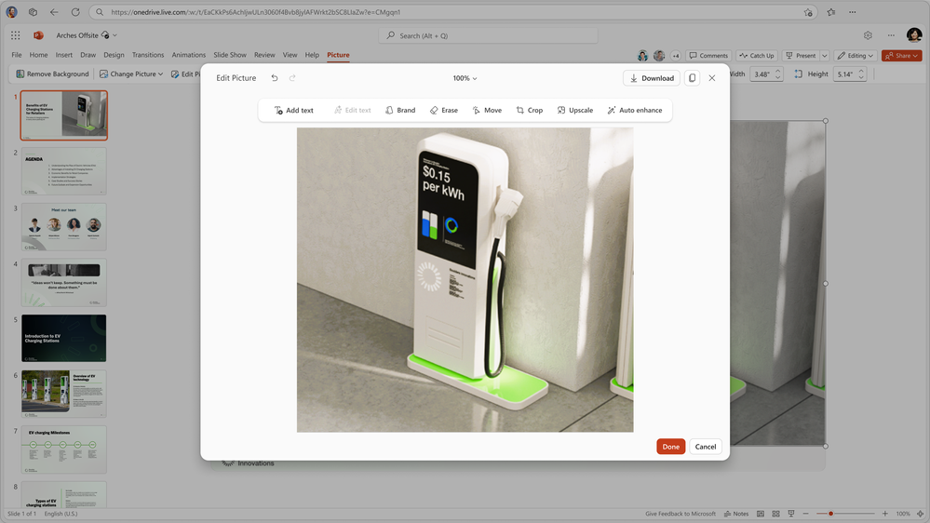
Image editing for Copilot in PowerPoint
Image editor integration in PowerPoint allows users to edit images directly within slides, streamlining workflows and improving visual quality.
Edit Without Leaving PowerPoint
Provides a modern, intuitive interface for image editing inside the app.
Enhance Visuals Easily
Helps refine presentation images, marketing materials, and slide aesthetics.
Save Time and Stay in Flow
Eliminates app-switching, making it faster to create polished, professional slides.
Image editing for Copilot in PowerPoint
This feature is rolling out in December.
Notes:
“This update brings a modern image‑editing experience directly into PowerPoint.”
Users no longer need to switch to external apps just to crop, adjust, or refine images—the editing tools are now built straight into the PowerPoint interface.
“The goal is to keep people in the flow.”
By eliminating app‑switching, users can stay focused on building their presentations while still making professional, polished visual edits.
“It also makes slides look better, faster.”
Whether it’s marketing content, product imagery, or simple presentation visuals, users can enhance and refine images seamlessly without breaking their workflow.
“And this feature is rolling out this month.”
Image editor integration begins rolling out in December.

Slide 24
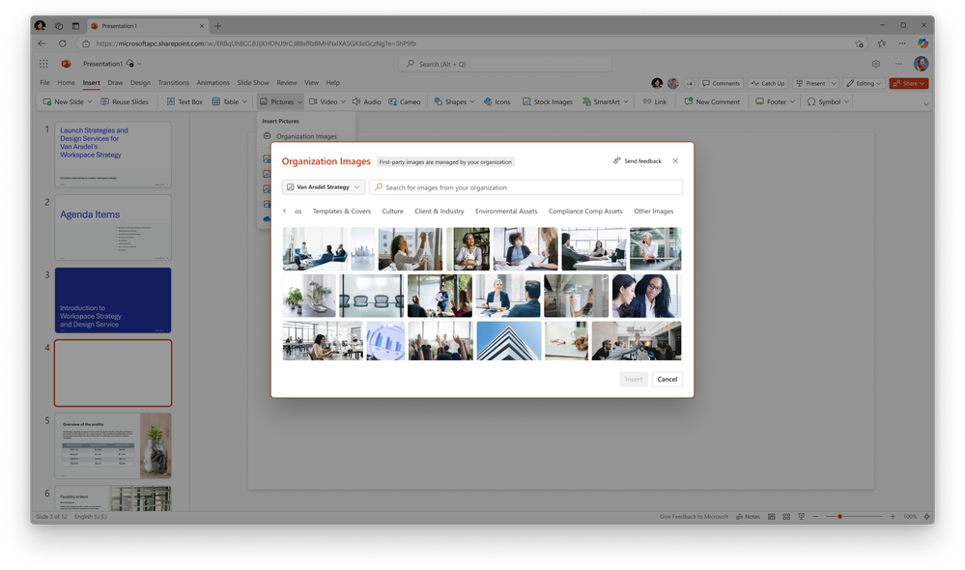
Organization images
Organization images
Organization Images in PowerPoint provides quick access to company-approved visuals, ensuring consistency and professionalism in presentations.
Integrated Asset Library
Connects to your organization’s image sources for logos, icons, and photos.
Easy Access in PowerPoint
Available under Insert > Picture > Organization Images for instant use.
Streamlines Brand Consistency
Helps teams create polished, on-brand presentations without searching externally.
This feature rolled out November on the web, and is rolling out in December on Windows desktop and Mac.
Notes:
“This feature makes it much easier for teams to stay on brand.”
Organization Images provides a built‑in library of company‑approved visuals—logos, icons, and photos—directly inside PowerPoint.
“It’s all integrated into the normal workflow.”
Under Insert > Picture, users will now see a new Organization Images option. From there, they can browse all approved assets without leaving PowerPoint.
“This removes the usual hurdles.”
No more digging through shared drives, outdated folders, or old decks to find the right logo. Everything is centralised, up‑to‑date, and instantly accessible.
“The result is greater consistency and faster slide creation.”
Teams can build polished, professional, on‑brand presentations without extra effort.
“And rollout is well underway.”
The feature launched on the web in November and is rolling out to Windows desktop and Mac in December.

Slide 25
Agents

Slide 26
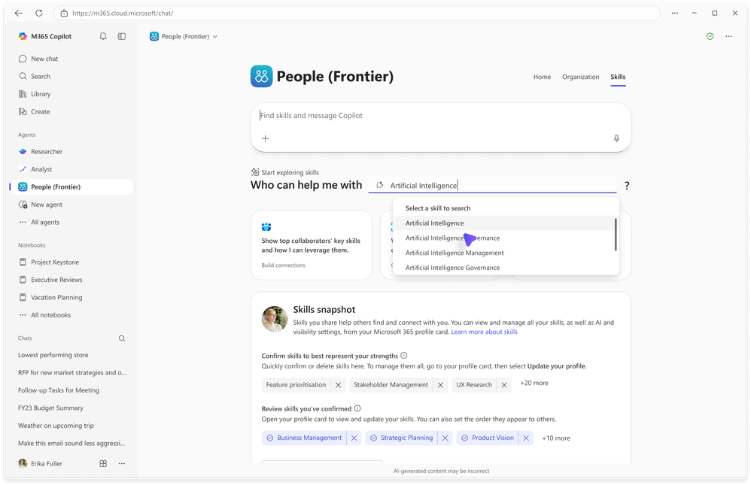
New agents available: People Agent
Find colleagues and build connections faster with AI.
Smart Search
Locate people by role or skill and view top collaborators in one place.
Guided Experience
Suggested prompts tailored to your role, communication patterns, and history.
Relationship Building
Spend less time searching and more time collaborating effectively.
Availability
This agent rolled out to the Frontier program in November.
Make connections effortlessly
Introducing new Microsoft 365 Copilot agents to drive workforce transformation | Microsoft Community Hub
Notes:
Finding the right person at the right time is becoming increasingly challenging as organizational structures evolve. Powered by WorkIQ, the People agent brings all your people-related information together in one place – helping you quickly find colleagues by role or skill, view your top collaborators, and prepare for upcoming interactions.
This agent offers a guided experience with suggested prompts tailored to your role, communication patterns, and collaboration history, so you can make meaningful connections faster and nurture existing relationships. With the People agent, employees spend less time searching and more time building relationships that move work forward.
The People agent is available now for customers with a Microsoft 365 Copilot license as part of the Frontier program.

Slide 27
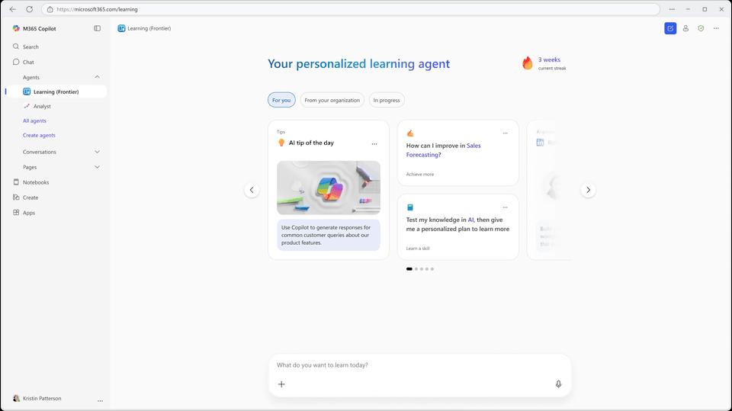
New agents available: Learning agent
Personalized guidance for skill development and Copilot mastery.
Tailored Recommendations
Suggests learning paths based on your role, tasks, and skills.
AI-Powered Role-Play
For LinkedIn Learning users, practice real-world scenarios to build soft skills.
Empowers Employees
Helps own skilling journey and maximize Copilot’s capabilities in daily workflows.
Availability
This agent rolled out to the Frontier program in November
Stay ahead with personalized upskilling
Introducing new Microsoft 365 Copilot agents to drive workforce transformation | Microsoft Community Hub
Notes:
Learning new skills can feel overwhelming, especially if you’re unsure what to focus on or where to start. The Learning agent guides employees through their skill development journey. It understands the tasks you’re working on and provides relevant, actionable recommendations to help you work smarter with Copilot.
You’ll receive tailored learning suggestions based on your role and skills. For organizations using LinkedIn Learning, the agent also offers AI-powered role-play scenarios to practice real-world interactions and strengthen soft skills. The Learning agent empowers employees to own their skilling journey and maximize Copilot’s capabilities in everyday workflows.
The Learning agent is available now for customers with a Microsoft 365 Copilot license as part of the Frontier program.

Slide 28
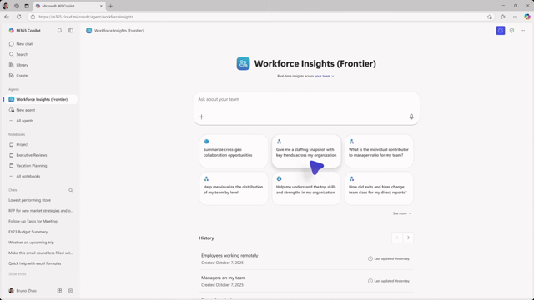
Workforce Insights agent
Smarter workforce planning powered by WorkIQ.
Dynamic Insights
Provides real-time views of roles, locations, and levels for better decisions.
Actionable Prompts
Suggests steps to rebalance teams, close skill gaps, and align with benchmarks.
Efficiency
Eliminates manual org chart analysis—delivers insights in minutes.
Availability
This agent is rolling out to the Frontier program in December.
Make informed workforce planning decisions
Introducing new Microsoft 365 Copilot agents to drive workforce transformation | Microsoft Community Hub
Notes:
For managers and leaders, understanding who’s doing what, spotting gaps, and shaping the right team structure can often feel daunting. The Workforce Insights agent provides a clear, up-to-date view of your workforce so you can make smarter decisions about hiring, upskilling, and organizational design – keeping your business ahead of the curve.
Instead of spending hours analyzing org charts and static reports, Workforce Insights leverages WorkIQ to deliver dynamic, actionable insights in minutes. With prompts like “Show me how my organization is staffed by role, location, and level. Suggest steps to improve based on industry benchmarks,” leaders can quickly uncover opportunities to rebalance teams, close skill gaps, and plan for growth.
The Workforce Insights agent is available now for customers with a Microsoft 365 Copilot license as part of the Frontier program.

Slide 29
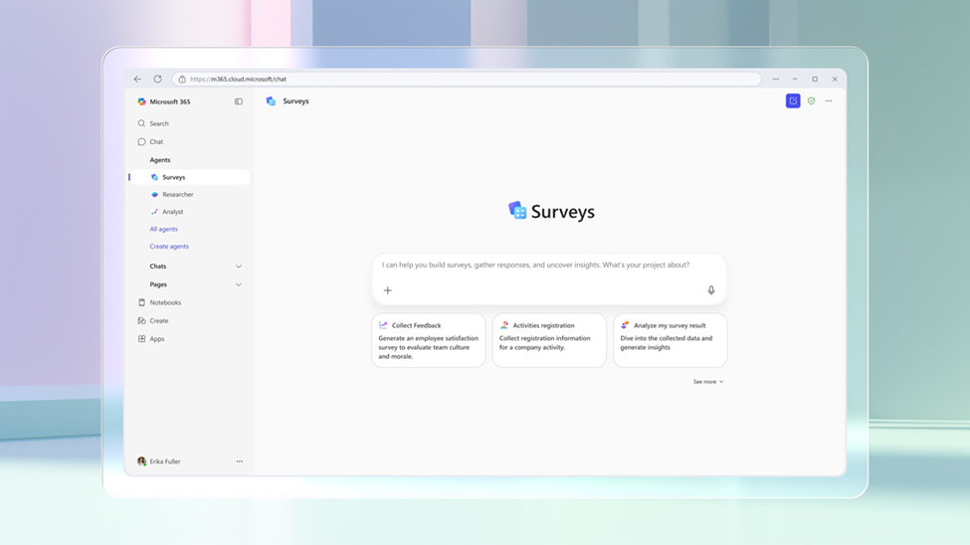
Surveys Agent
All-in-One Survey Solution
Combines survey creation, distribution, and feedback analysis into one conversational experience.
Pre-Built & Ready to Use
Designed to simplify scenarios like training feedback, employee satisfaction, and customer research.
Streamlined Workflow
Removes the need for multiple tools, saving time and reducing complexity.
Personal Survey Expert
Guides users through every step, from drafting questions to interpreting results.
Surveys Agent
This agent rolled out in October.
Notes:
The Employee Self-Service Agent provides a centralized experience for employee support, starting with HR and IT, helping employees quickly find answers and complete tasks like checking leave balances or submitting IT tickets. It integrates with existing systems and can hand off inline and with context to Workday or ServiceNow agents, so users don't have to switch between tools. Built in Copilot Studio for HR and IT scenarios, this custom agent has connectors and preconfigured workflows for existing systems such as Workday, ServiceNow, and SAP SuccessFactors, while also being customizable and fully extensible to fit organizational needs. The agent streamlines employee experiences, improves resolution times, and supports Microsoft 365 security and compliance, with future support for Facilities and other verticals. This agent is rolling out in November.

Slide 30
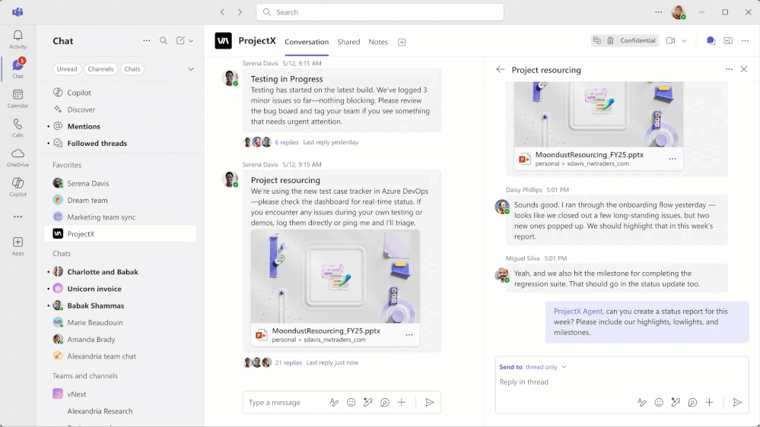
New enhancements to Channel Agent
Channel Agent now offers smarter, context‑aware support with new capabilities for generating status reports and workback plans directly in the channel.
Smarter, Contextual Assistance
Draws on conversations, files, and meetings to act as a domain expert.
Automatic Status Reports
@mention the agent to instantly create and post status updates in the channel.
Easy Workback Plans
Provide an objective and deadline to automatically generate a sequenced task plan before sending to Planner.
New enhancements to Channel Agent
New enhancements rolled out to public preview in November.
Notes:
“Channel Agent continues to get smarter.”
These enhancements make the agent more context‑aware by using conversations, files, and meetings to act like a domain expert for the team.
“Status reports are now effortless.”
You can simply @mention the agent and say something like ‘create a status report’. The report is generated automatically and posted straight into the channel so the whole team stays aligned.
“Workback planning is now built‑in.”
When a user provides an objective and a deadline, the agent creates a sequenced task plan with due dates. You can quickly review and adjust it before pushing it into Planner.
“All of this is already available in Public Preview.”
These improvements rolled out in November, so teams can start using them today.

Slide 31
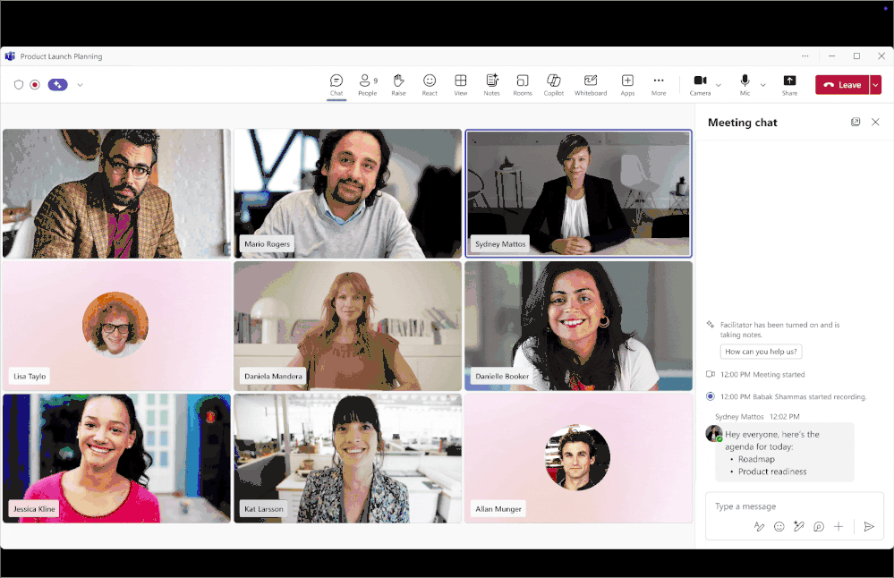
New features in Facilitator
Facilitator introduces new features to keep meetings focused and productive, combining context awareness with proactive support.
Agenda Recognition & Progress Tracker
Detects agendas from chat, invites, or notes and builds a live tracker at the top of the meeting. (Rolled out in November)
Proactive Participant Reminders
If an invited person hasn’t joined and is mentioned twice, Facilitator pings them to join. (Rolling out in the new year)
Document Drafting
Creates Word or Loop documents from meeting discussions, shaping outputs like blogs, briefs, or whitepapers. (Rolled out in November)
Task Capture & Management
Automatically captures tasks as mentioned and allows updates or reassignment via chat. (Rolled out in November)
New features in Facilitator
Notes:
“Facilitator is becoming even more proactive and context‑aware.”
These updates are all about helping meetings stay focused, productive, and moving forward without extra effort from the team.
“First, it now recognises agendas shared in the meeting chat.”
Previously it relied on the invite or meeting notes, but now if someone drops an agenda in chat, Facilitator picks it up and automatically builds a live progress tracker at the top of the meeting. This rolled out in November.
“Next, it helps get the right people into the meeting at the right time.”
If someone is invited but hasn’t joined, and their name comes up twice, Facilitator politely pings them in chat. This is rolling out in the new year and helps avoid stalled discussions.
“It can also turn meeting conversations into documents.”
Whether you need a blog, a whitepaper, or a project brief, Facilitator can draft it in Word or Loop based on what was said. This is live as of November and helps teams turn ideas into action more quickly.
“And finally, it’s getting smarter with tasks.”
Facilitator captures tasks as they’re mentioned and can add, update, or reassign tasks through chat. This also rolled out in November.

Slide 32
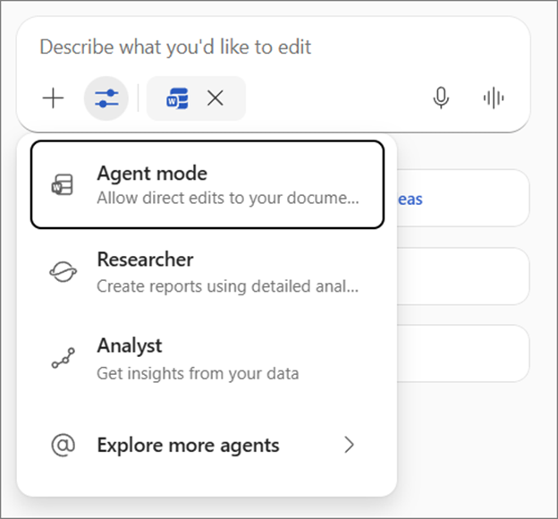
Agent Mode in Word
Agent Mode in Word transforms document creation into an interactive, conversational experience, making writing faster and more engaging.
Conversational Writing
Users describe what they need, and Copilot drafts content, suggests refinements, and asks clarifying questions.
Smart Content Generation
Finds relevant sources, applies Word’s native styles, and delivers polished formatting.
Faster Iteration & Better Ideas
Turns writing into a dialogue, helping teams move from intent to finished content quickly.
Agent Mode in Word
This feature started rolling out in November.
Notes:
Agent Mode in Excel plans, executes, and validates multi-step tasks—like building models, reshaping tables, and creating charts—directly in the grid. Users stay in control with transparent steps and editable outputs, making complex workflows faster and more intuitive. Agent Mode in Excel rolled out in October through the Frontier program, now available directly in Copilot in Excel for Web through the Tools menu, and will be rolling out to desktop in the future.

Slide 33
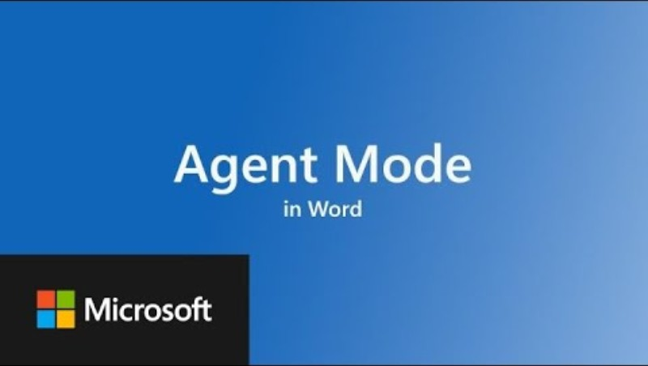
Agent Mode in Word Video
Roadmap ID 499428
Notes:
We’re introducing Agent Mode in Microsoft 365 Copilot in Word that enhance how users interact with Copilot to create and refine content. These updates are designed to streamline document creation and editing through a more conversational and iterative experience.
Roadmap ID 499428

Slide 34
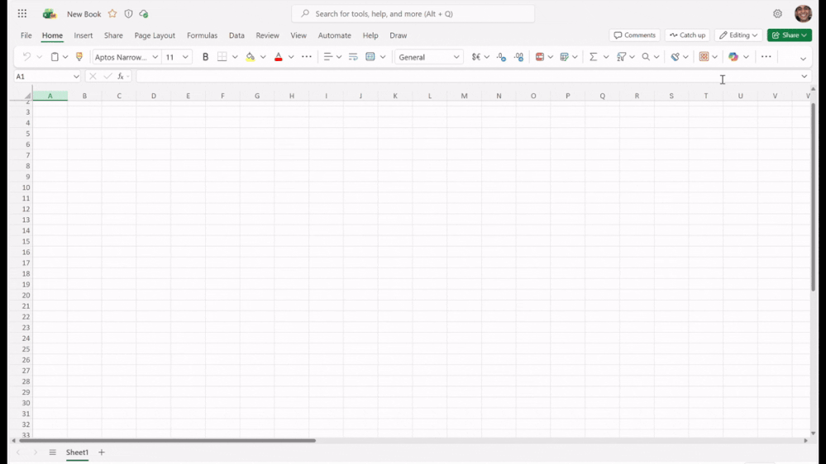
Agent Mode in Excel
Agent Mode in Excel automates multi-step tasks directly in the grid, making complex workflows faster and more intuitive.
Plans and Executes Tasks
Handles processes like building models, reshaping tables, and creating charts without leaving the grid.
Transparent and Editable
Shows each step clearly and allows users to edit outputs for full control.
Streamlines Complex Workflows
Speeds up tasks that normally require multiple manual steps.
Availability
Rolled out in November on Windows via Frontier; rolling out in December on the Web.
Agent Mode in Excel
This feature rolled out in October.
Notes:
“Agent Mode is designed to take the friction out of complex Excel work.”
It can plan, execute, and validate multi‑step tasks directly in the grid—things like building models, reshaping tables, and creating charts—without needing to jump between menus or formulas.
“Users stay fully in control.”
Every step the agent takes is transparent, and all outputs remain editable. This keeps the workflow intuitive while still giving users the flexibility to adjust anything the agent produces.
“The real value is speed and clarity.”
Tasks that normally take multiple manual steps can now be completed in a streamlined flow, reducing time spent on setup and letting users focus on the insights their data can provide.
“And this capability is already rolling out.”
Agent Mode launched in November on Windows through the Frontier program, and it’s currently rolling out to Excel for the Web in December.

Slide 35
Copilot Control System

Slide 36
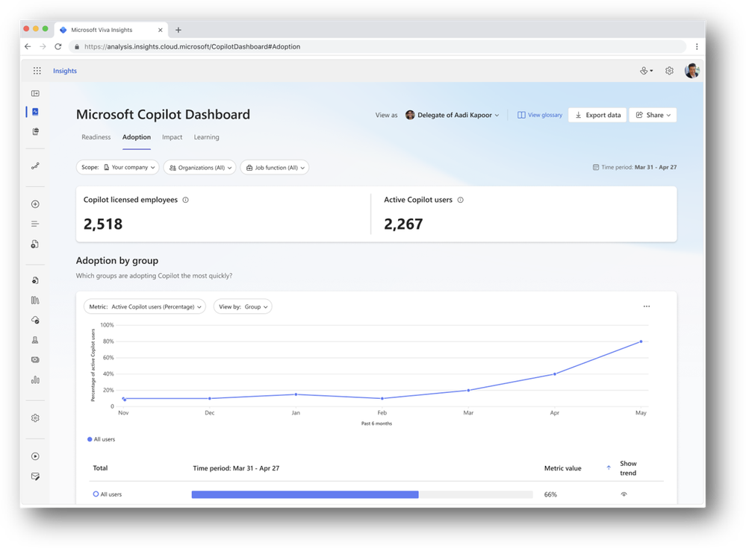
Export Copilot Dashboard data through a CSV file
Admins will soon be able to export Copilot Dashboard data as a CSV file for custom reporting and deeper insights.
Easy Data Export
Download Copilot usage metrics directly from the Dashboard for tailored analysis.
Supports Advanced Insights
Enables custom reporting to drive adoption and transformation initiatives.
Includes Trend Data
Export covers weekly Copilot metrics for the past six months for pattern analysis.
Export Copilot Dashboard data through a CSV file
This feature will roll out to Public Preview in December.

Slide 37
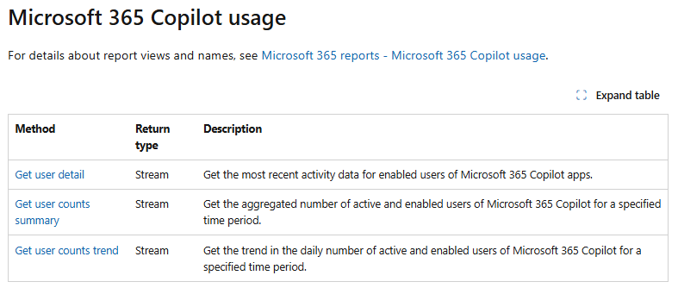
Copilot Analytics endpoints now available in Microsoft Graph API
Copilot Analytics endpoints in Microsoft Graph API enable custom reporting and seamless integration of Copilot data with internal tools.
Custom Reporting via Graph API
Build tailored reports and connect Copilot usage data to existing systems.
Access Robust Metrics
Includes tenant-level counts of enabled and active users, plus each user’s last activity date across Microsoft 365 apps.
Deeper Insights for Analysts
Same metrics as the Microsoft 365 Copilot usage report, now available programmatically.
Copilot Analytics endpoints
This feature rolled out in November.
Notes:
“This update gives admins and analysts far more flexibility in how they work with Copilot data.”
With new Copilot Analytics endpoints now available in Microsoft Graph API, organisations can pull usage data programmatically and integrate it directly into their own internal tools, dashboards, and datasets.
“It unlocks true custom reporting.”
Instead of relying only on the built‑in dashboards, teams can build fully customised views that align to their business needs, governance requirements, or transformation goals.
“All the key metrics are available.”
These endpoints expose the same robust data found in the Microsoft 365 Copilot usage report — including tenant‑level counts of enabled and active users, plus each user’s last activity date across Microsoft 365 apps.
“This is already live.”
The Graph API analytics endpoints rolled out in November, so teams can start integrating them into their analytics workflows today.

Slide 38
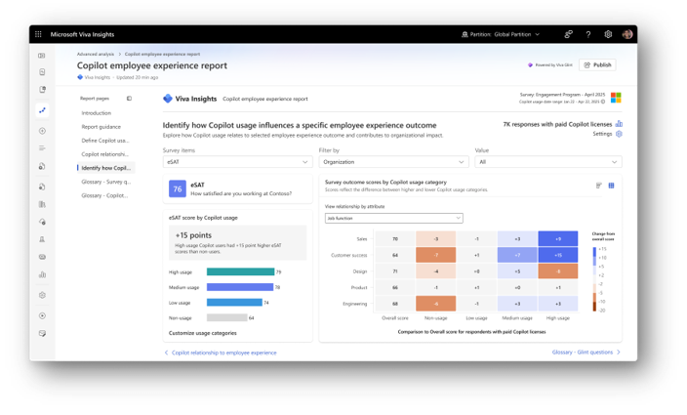
Copilot employee experience report
The Copilot Employee Experience Report helps admins link Copilot usage with employee engagement insights from Viva Glint.
Analyze Impact on Engagement
Understand how Copilot adoption correlates with employee sentiment and experience.
Tailored Insights
Combine Copilot usage data with Viva Glint survey metrics to uncover opportunities for improvement.
Requirements
Available to customers with Microsoft 365 Copilot and Viva Glint.
Copilot employee experience report
This feature rolled out in November
Notes:
“This update helps organisations understand not just how Copilot is being used, but how it’s impacting people.”
The new Copilot Employee Experience Report connects Copilot usage data with employee sentiment from Viva Glint, giving admins a clearer view of how AI adoption relates to engagement and experience.
“It helps identify what’s working — and where to improve.”
By analysing correlations between usage patterns and Glint insights, admins can spot teams that are thriving with Copilot and areas where additional support, training, or change management could drive deeper impact.
“The analysis is customisable.”
Admins can tailor their view using key metrics from Glint surveys, allowing more targeted insights based on organisational priorities or culture goals.
“There are a couple of requirements.”
Organisations need both Microsoft 365 Copilot and Viva Glint to use this report.
“And this feature is already live.”
It rolled out in November, so teams can begin exploring these insights right away.

Slide 39
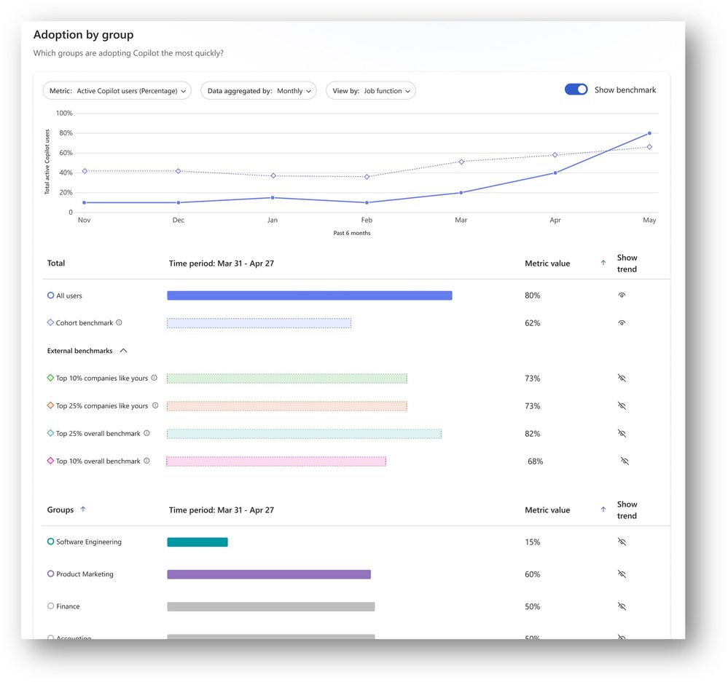
New benchmarks in Copilot Dashboard
Copilot Dashboard now includes internal and external benchmarks to help admins compare usage and adoption trends.
External Benchmarks
Compare active usage against other organisations by company size, industry, and top 10% or 25% performers.
Internal Benchmarks
Measure similar groups within your company for adoption and engagement insights.
Key Metrics
Includes active users, adoption by app, and retention percentage for deeper analysis.
New benchmarks in Copilot Dashboard
This feature rolled out in November.
Notes:
“This update gives admins clearer context for Copilot adoption.”
The new benchmarking capability in the Copilot Dashboard lets organisations compare their usage against both external peers and internal groups.
“External benchmarks provide a broader market view.”
Admins can now see how their active usage compares to other companies by industry, company size, and even against the top 10% and top 25% of users. This helps leaders understand whether their adoption is ahead, behind, or right on track.
“Internal benchmarks offer an equally important lens.”
These allow admins to compare usage across similar teams or departments within the organisation, giving insight into where Copilot is thriving and where targeted enablement might be needed.
“The metrics are practical and meaningful.”
Benchmarks include active users, adoption by app, and retention percentage, giving a fuller picture of engagement trends.
“And this capability is already available.”
Benchmarks rolled out to the Copilot Dashboard in November.

Slide 40
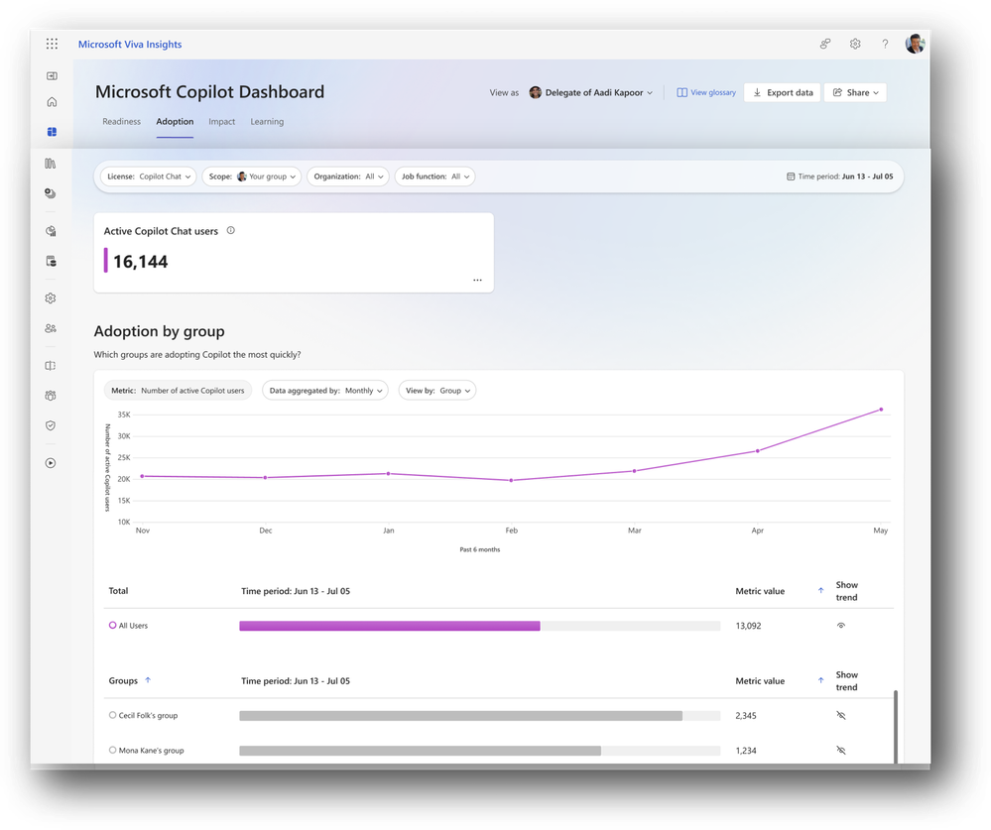
Track Copilot Chat adoption in the Copilot Dashboard
Admins can now track Copilot Chat adoption in the Copilot Dashboard with detailed metrics to optimize licensing and enablement.
Comprehensive Adoption Metrics
View total users, usage trends, adoption by group, intensity, retention, and app-level breakdowns.
Actionable Insights
Analyze patterns by organizational attributes to uncover group-level adoption trends.
Requirements
Available for customers with 50+ Microsoft 365 Copilot licenses and access to the Copilot Dashboard.
Track Copilot Chat adoption in the Copilot Dashboard
This update is available for customers with access to the Copilot Dashboard with 50+ Microsoft 365 Copilot licenses, and rolled out in November.
Notes:
“This update brings much deeper visibility into how Copilot Chat is being used across the organisation.”
Admins can now see total users, usage trends over time, which groups are adopting Copilot Chat, how intensely they’re using it, and how well they’re retaining it.
“It’s extremely useful for targeted enablement.”
Because the data can be broken down by organisational attributes, admins can quickly spot which departments or teams are embracing Copilot Chat — and where additional training or support may be needed.
“It also helps optimise licensing.”
With clearer insight into active usage and group‑level patterns, organisations can make more informed decisions about Copilot license allocation and expansion.
“There are some prerequisites.”
This capability is available to customers who have 50 or more Microsoft 365 Copilot licenses and access to the Copilot Dashboard.
“And it’s already live.”
Copilot Chat adoption tracking rolled out in November.

Slide 41
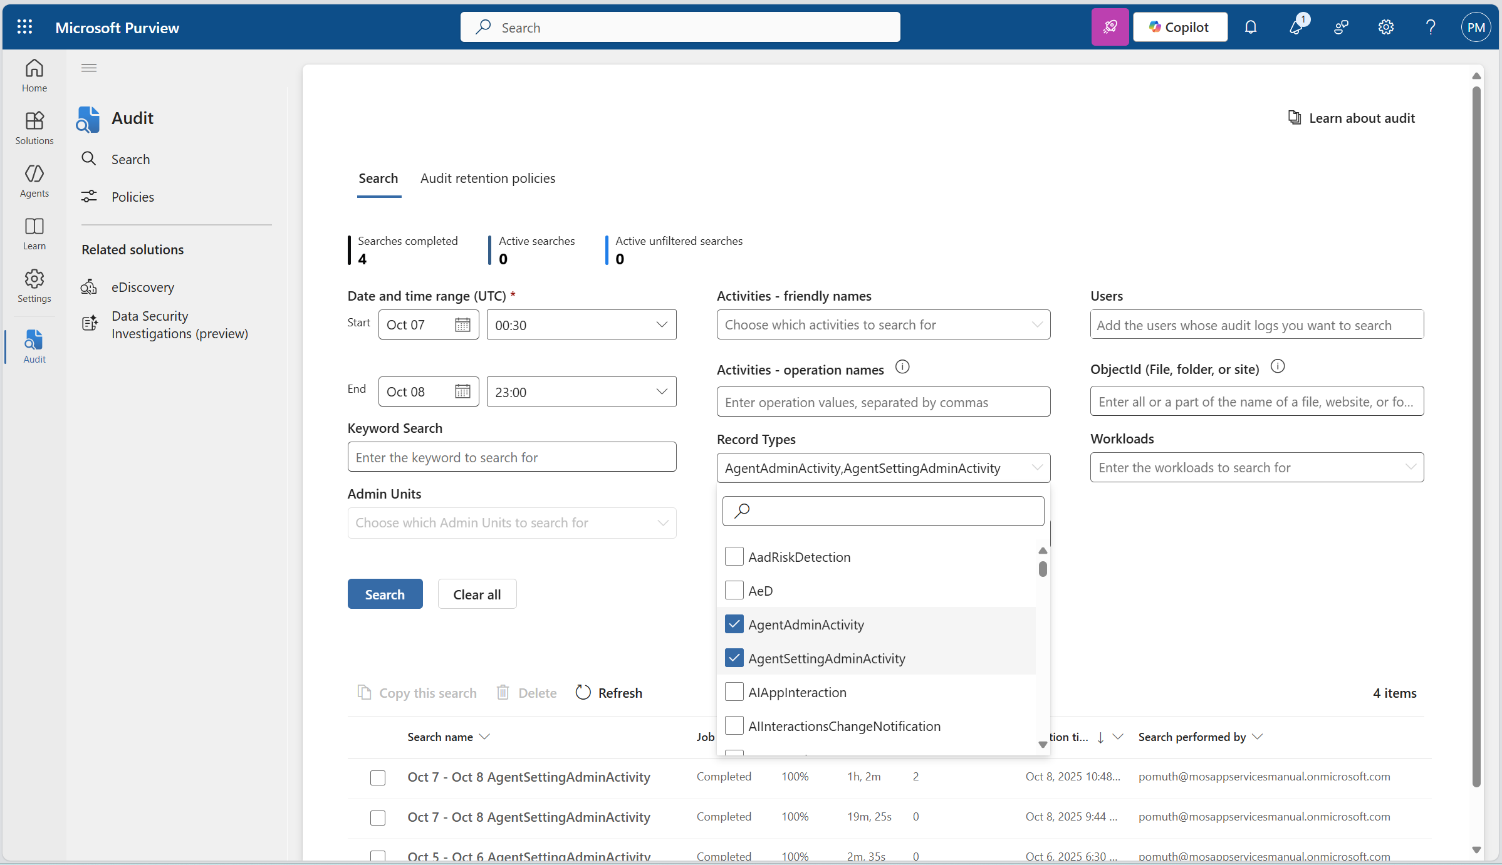
Microsoft Purview unified audit logs will include all agent-related admin activities
Microsoft Purview unified audit logs will soon capture all agent-related admin activities for improved visibility and compliance.
Comprehensive Audit Coverage
Tracks actions like publishing, updating, or removing agents in the Microsoft 365 admin center.
Enterprise-Grade Compliance
Enables organisations to validate security posture and meet regulatory requirements.
Centralised Governance
Helps IT teams investigate issues, demonstrate policy adherence, and strengthen agent lifecycle management.
Microsoft Purview unified audit logs
This feature is rolling out in December.
Notes:
“This update brings full visibility into how agents are being managed across the organisation.”
Purview unified audit logs will now capture all agent-related admin actions in the Microsoft 365 admin center — including publishing, updating, and removing agents.
“It strengthens enterprise compliance and governance.”
By logging every configuration change, organisations can validate their security posture, meet regulatory requirements, and maintain a clear audit trail for internal or external reviews.
“It also streamlines investigations.”
With all agent lifecycle events centrally audited, IT teams can quickly troubleshoot issues, understand what changed and when, and demonstrate adherence to policies.
“And rollout is imminent.”
This capability is rolling out in December, giving customers more oversight and control heading into the new year.

Slide 42
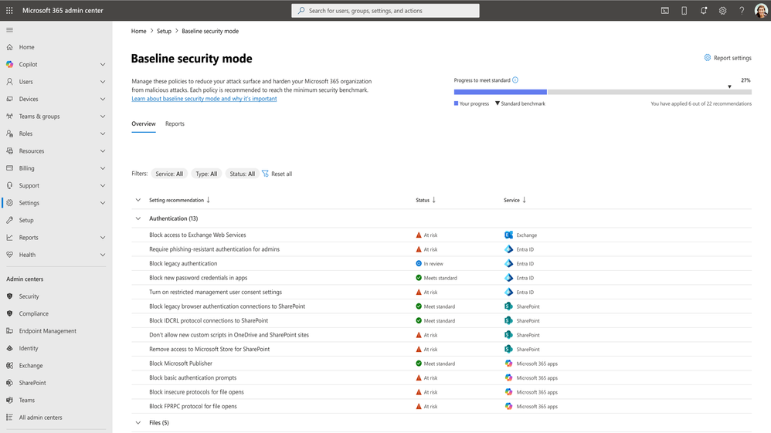
Baseline security mode (BSM)
Baseline Security Mode applies Microsoft-recommended security settings across Microsoft 365 services to standardize protections and reduce risk.
Unified Security Posture
Applies consistent settings across Microsoft 365 apps, SharePoint, OneDrive, Teams, Exchange Online, and Entra.
Tailored Recommendations
Preconfigured defaults protect against legacy vulnerabilities and emerging AI risks.
Safe Adoption
Test changes in simulation mode before rollout for controlled implementation.
Learn more
Baseline security mode (BSM)
This feature rolled out in November.
Notes:
“Baseline Security Mode brings a consistent, recommended security posture across Microsoft 365.”
Instead of configuring protections separately, this mode applies Microsoft‑recommended settings across Microsoft 365 apps, SharePoint, OneDrive, Teams, Exchange Online, and the Entra identity platform.
“It makes it much easier for admins to spot gaps and reduce risk.”
With standardized settings in place, organisations can avoid inconsistent configurations and strengthen their cloud security baseline.
“It includes tailored recommendations to protect against real-world risks.”
Preconfigured defaults help guard against legacy vulnerabilities and emerging AI‑driven threats that may try to exploit outdated configurations.
“And you can adopt changes safely.”
Admins can test everything in simulation mode before rollout, ensuring changes don’t disrupt users or workloads.
“This capability is already available.”
Baseline Security Mode rolled out in November.

Slide 43
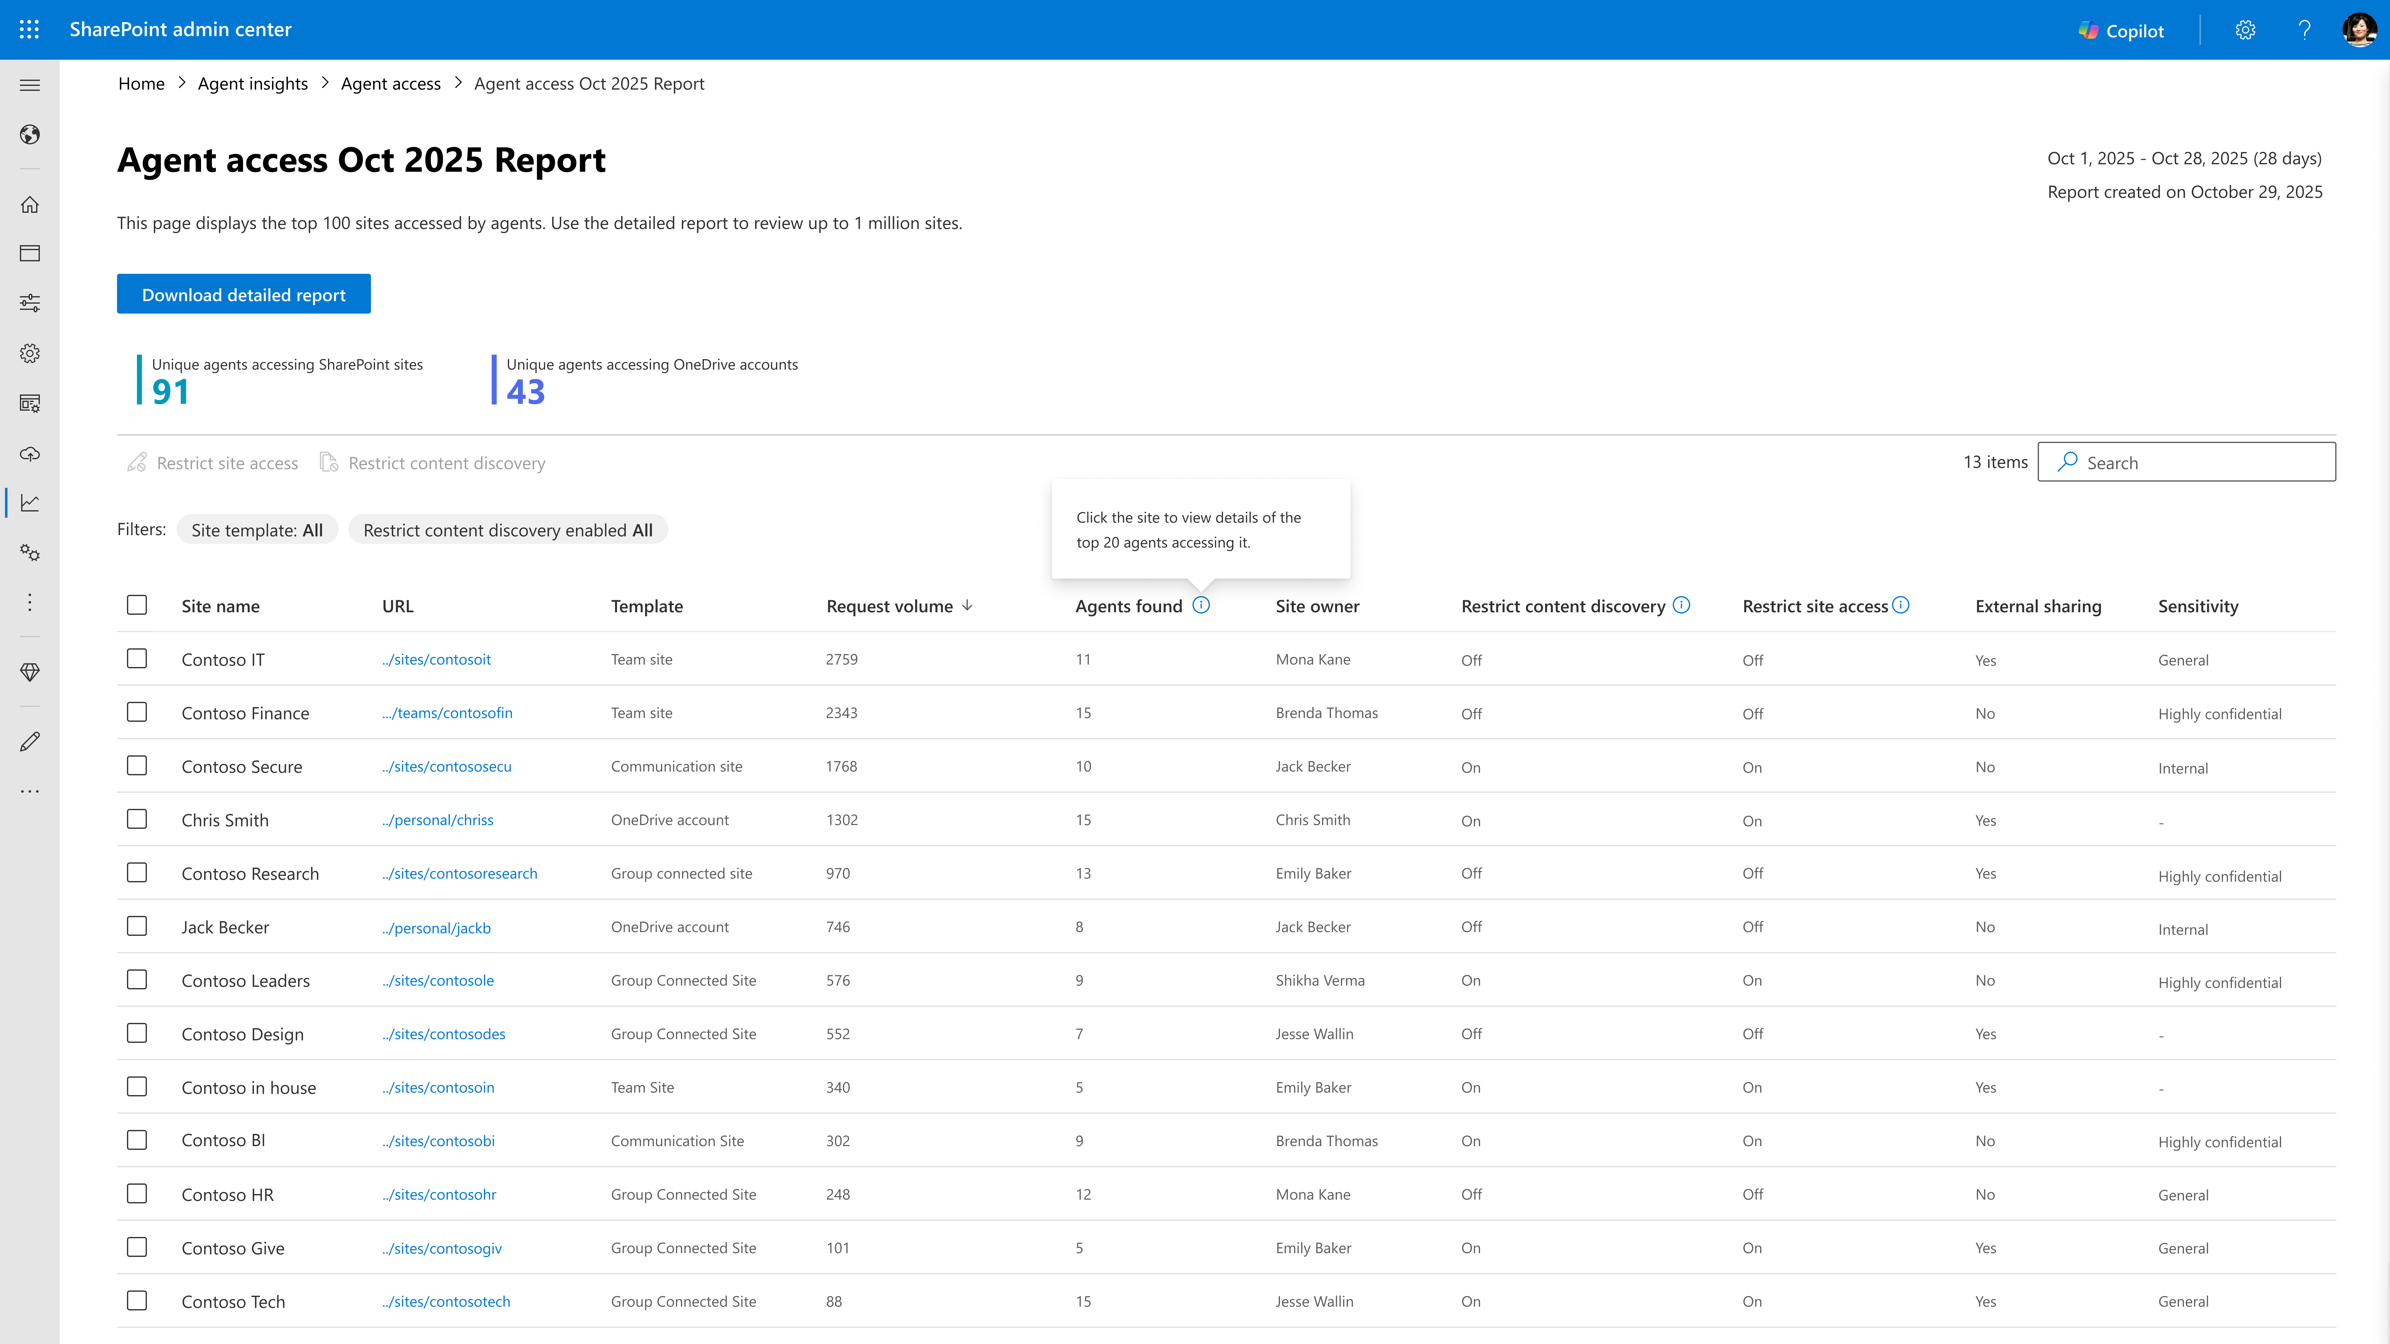
Agent Insights with SharePoint Advanced Management (SAM)
Agent Insights with SharePoint Advanced Management (SAM) provides tenant-wide visibility into SharePoint agent activity at the site level.
Comprehensive Site-Level View
See where agent usage is high to strengthen governance and reduce risk.
Actionable Metrics
Common pivots include agents created or used per site and whether safeguards like Restricted Content Discovery (RCD) and Restricted Access Control (RAC) are in place.
Flexible Analysis Options
Available in the SharePoint admin center with export and PowerShell support for deeper analysis and automation.
Agent Insights with SharePoint Advanced Management (SAM)
This feature rolled out in November.
Notes:
“This feature gives admins a clear, tenant‑wide view of how agents are being used across SharePoint.”
Agent Insights surfaces site‑level activity so IT can quickly see where agent usage is high and where additional governance might be needed.
“The visibility is very actionable.”
Admins can pivot on key metrics like how many agents were created or used per site, and whether important safeguards — Restricted Content Discovery (RCD) and Restricted Access Control (RAC) — are already in place.
“It strengthens governance and reduces risk.”
By understanding which sites are most active, admins can prioritise oversight, tighten controls, and ensure responsible agent usage across the tenant.
“Reporting is flexible.”
Insights are available directly in the SharePoint admin center, and admins can also export reports or use PowerShell for deeper analysis and automation workflows.
“And this capability is already live.”
Agent Insights with SAM rolled out in November.

Slide 44
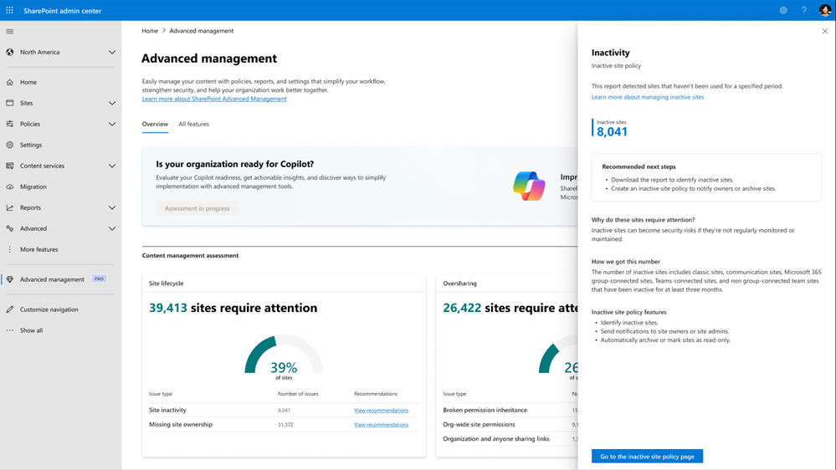
Content management assessment
Content Management Assessment helps tenant admins evaluate site health, permissions, and lifecycle readiness in one actionable report.
Unified Governance View
Combines multiple SAM reports, including Site Lifecycle Management and Data Access Governance.
Actionable Recommendations
Provides clear guidance to strengthen governance and prepare for Copilot onboarding.
Simplifies Admin Workflows
Delivers a single, consolidated report for faster decision-making.
Content management assessment
This feature rolled out in October.
Notes:
“This feature gives admins a single, consolidated view of site health and readiness.”
The Content Management Assessment brings together key governance signals—site health, permissions, and lifecycle status—into one actionable report.
“It unifies multiple SAM reports into one place.”
Instead of reviewing Site Lifecycle Management and Data Access Governance separately, admins can now see both in a combined, streamlined view.
“The output is highly actionable.”
The report provides clear, tailored recommendations to strengthen governance controls and ensure sites are properly prepared for Copilot onboarding.
“It simplifies admin workflows.”
By consolidating multiple assessments, it helps IT teams make faster decisions and identify risks or gaps more efficiently.
“And this capability is already live.”
Content Management Assessment rolled out in October.

Slide 45
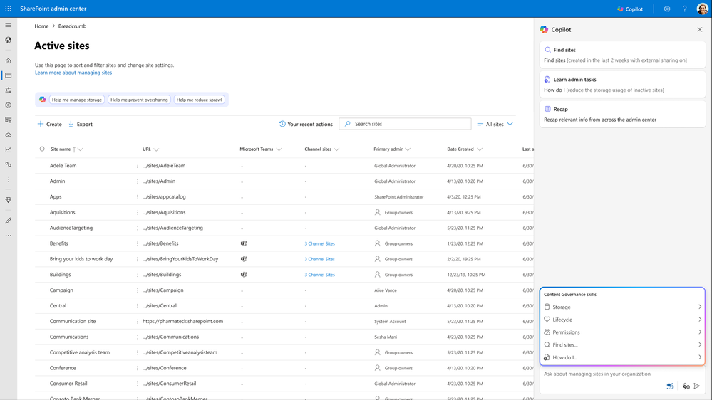
SharePoint Admin Agent
SharePoint Admin Agent simplifies governance tasks for admins by using AI to manage permissions, storage, lifecycle, and access.
AI-Powered Governance
Removes the need for admins to know which SAM reports to run or how to interpret them.
Problem-Focused Approach
Admins simply state the issue, and the agent recommends actions to resolve it.
Comprehensive Management
Handles permissions, storage, lifecycle, and access, with more capabilities planned.
SharePoint Admin Agent
This feature rolled out to Public Preview in November.
Notes:
“SharePoint Admin Agent is designed to simplify governance in the AI era.”
It supports admins who are responsible for keeping organizational content secure, compliant, and well‑managed — but without requiring deep knowledge of every SAM report or setting.
“The key shift is that it’s problem‑focused, not report‑focused.”
Instead of needing to know which reports to run, how to interpret them, or what actions to take, admins can simply describe the issue they’re trying to solve. The agent guides them through the recommended steps.
“It handles a wide range of governance tasks.”
The agent can help manage permissions, storage, lifecycle, and access, with even more capabilities planned in future updates.
“This lowers the barrier for effective governance.”
By removing complexity, it allows more admins — not just specialists — to maintain strong governance across the environment.
“And it’s already available.”
SharePoint Admin Agent rolled out to Public Preview in November.

Slide 46
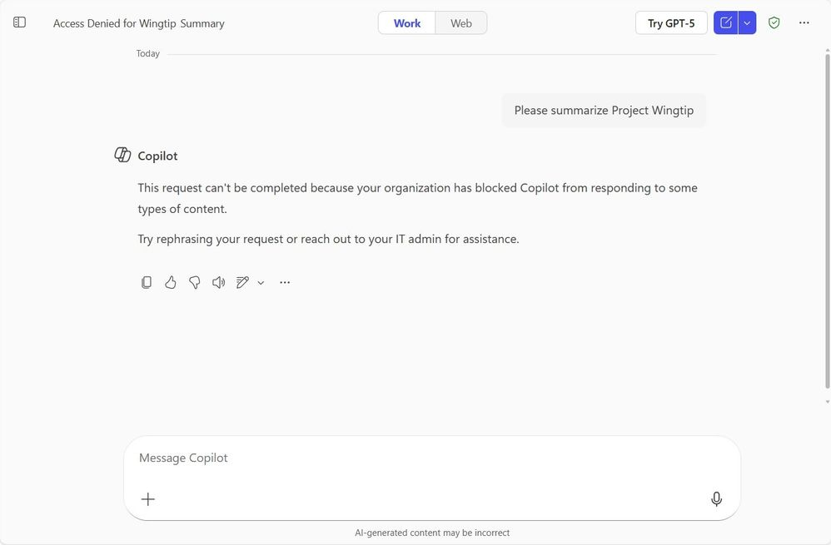
Data Loss Prevention for Microsoft 365 Copilot to safeguard prompts
Data Loss Prevention (DLP) for Microsoft 365 Copilot now safeguards prompts containing sensitive data to prevent oversharing and data leakage.
Expanded DLP Coverage
Applies to all Microsoft 365 Copilot and Copilot Chat users, including pre-built agents.
Real-Time Protection
Blocks Copilot from returning responses when prompts include sensitive information.
Mitigates Risk
Helps organisations maintain compliance and reduce data exposure during AI interactions.
DLP for Microsoft 365 Copilot
This feature rolled out to Public Preview in November.
Notes:
“This update strengthens Copilot’s security posture by extending Data Loss Prevention to prompts themselves.”
DLP for Microsoft 365 Copilot now safeguards sensitive information at the moment a user types it, helping organisations prevent accidental data leakage.
“Coverage is broad and automatic.”
This protection now applies to all Microsoft 365 Copilot and Copilot Chat users, including pre‑built agents in the experience. No extra configuration is required to begin benefiting from this expanded guardrail.
“The control works in real time.”
If a prompt contains sensitive data — such as confidential financials, regulated info, or protected content — Copilot simply does not return a response. This prevents oversharing before it happens.
“This helps admins reduce risk at scale.”
By stopping sensitive prompts from generating AI output, organisations can better maintain compliance, reduce exposure, and uphold internal data‑handling policies.
“And it’s already available in Public Preview.”
The expanded DLP protections rolled out in November.

Slide 47
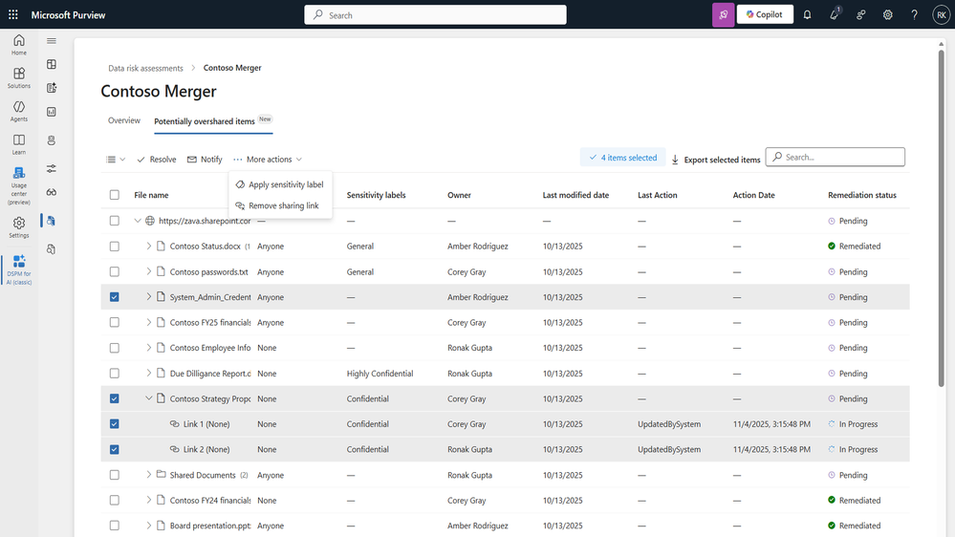
Microsoft Purview Data Security Posture Management (DSPM) item-level investigation and remediation for data risk assessments
Microsoft Purview DSPM now enables item-level investigation and bulk remediation of overshared links to reduce data exposure and strengthen compliance.
Enhanced Risk Management
Identify overshared links across SharePoint sites and remediate at scale.
Bulk Remediation Capability
Admins can disable or fix overshared links in bulk, streamlining governance.
Improves Compliance Posture
Ensures sensitive files remain accessible only to the right people.
DSPM
This feature rolled out to Public Preview in November.
Notes:
“This update significantly strengthens data security by addressing oversharing at scale.”
Microsoft Purview DSPM now supports item‑level investigation and remediation, enabling admins to identify overshared links across SharePoint sites with much greater precision.
“The biggest improvement is bulk remediation.”
Instead of fixing overshared links one at a time, admins can now remediate or disable them in bulk, dramatically reducing the time and effort required to close security gaps.
“This has a major impact on compliance posture.”
By eliminating oversharing quickly and consistently, organisations can proactively reduce exposure, ensure sensitive files are only accessible to the right people, and strengthen overall data governance.
“This capability is built for scale.”
Whether dealing with thousands of files or dozens of sites, DSPM allows IT teams to take action efficiently through the Purview interface.
“And it’s already available.”
Item‑level investigation and bulk remediation rolled out to Public Preview in November.

Slide 48
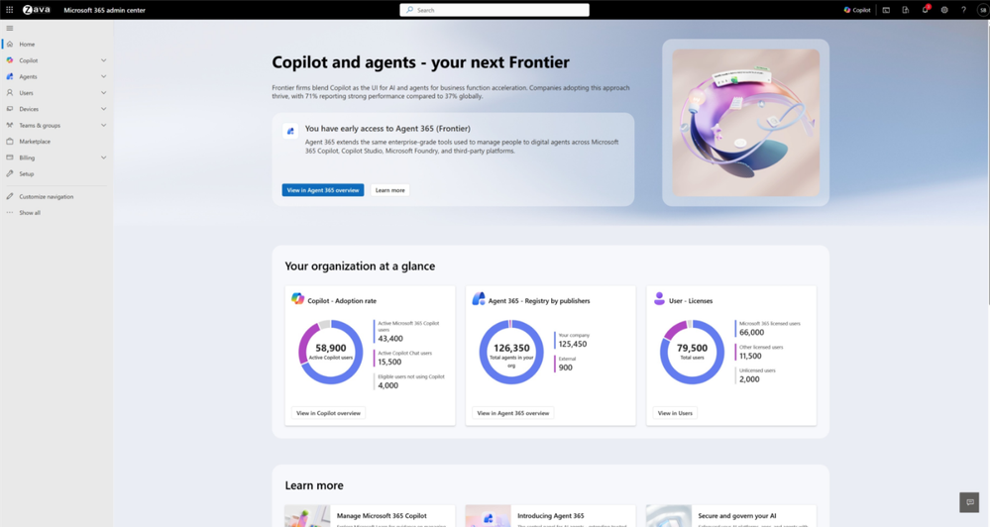
New home page for AI admins
Microsoft has introduced a dedicated home page for the Entra AI Administrator role, giving AI admins clearer insights, faster navigation, and curated learning to support Copilot and agent governance.
Centralized AI oversight – A new home page provides an at‑a‑glance view of organization-wide AI usage and key metrics.
Faster access to critical tools – Direct links to the most important AI admin surfaces streamline Copilot and agent management.
Curated learning resources – Microsoft provides tailored educational and inspirational AI content to elevate admin capability.
Built for the AI Administrator role – Expands the evolving Microsoft Entra AI Admin role to better support AI adoption at scale.
New home page for AI admins
New capabilities for AI admins from Ignite 2025 | Microsoft Community Hub
Notes:
“Microsoft has launched a dedicated AI Admin home page in the Microsoft 365 admin center to support the Entra AI Administrator role.”
Centralized AI view: Gives admins a quick snapshot of key Copilot and agent metrics.
Quick access to tools: Direct links to core AI management surfaces for faster navigation.
Built‑in learning resources: Curated Microsoft training and guidance to help admins stay current.
Designed for AI admins: Expands the capabilities of the Entra AI Administrator role introduced last year.

Slide 49
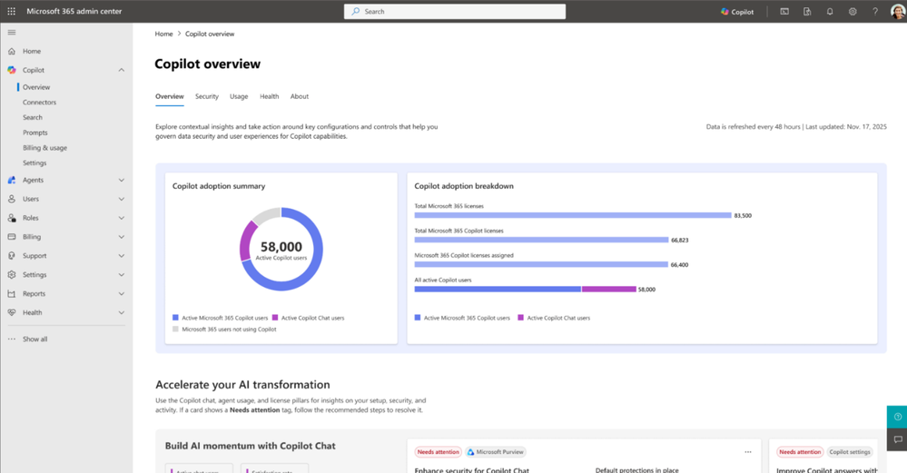
Copilot overview section redesign
Microsoft has redesigned the Copilot overview section in the Microsoft 365 admin center to make Copilot management centralized, comprehensive, and contextual.
Centralized Copilot insights – Unified view tailored to your environment and configurations.
Actionable recommendations – Includes relevant actions for Copilot Chat, agents, and Microsoft 365 Copilot.
Aligned to the Copilot Control System – Insights mapped to Security & Governance, Management Controls, and Measurement & Reporting.
Now in Private Preview – Announced at Ignite, with General Availability planned for January 2025.
Copilot overview section redesign
New capabilities for AI admins from Ignite 2025 | Microsoft Community Hub
Notes:
“This update reflects customer feedback asking for clearer, more centralized Copilot management. The redesigned overview pulls together environment-specific insights and recommended actions across Copilot Chat, agents, and M365 Copilot. These insights map directly to the Copilot Control System pillars — security, management controls, and reporting — to support responsible and scalable AI adoption. It’s currently in Private Preview following the Ignite announcement, with GA expected in January 2025.”

Slide 50
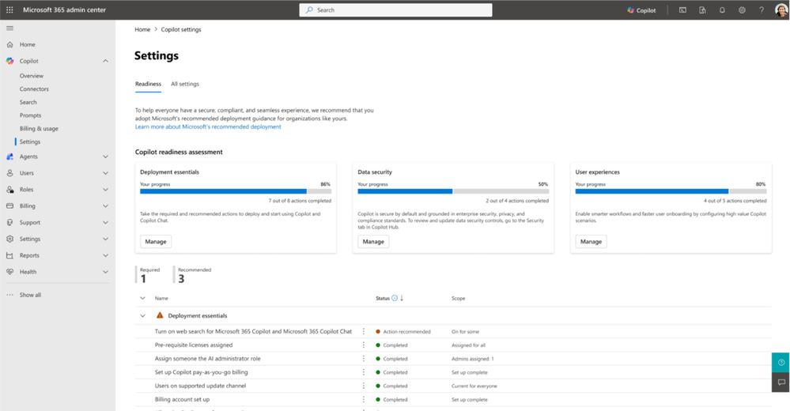
Copilot readiness settings: structured guidance for Copilot configuration
Microsoft is introducing a new readiness page in Copilot settings (rolling out January) to help admins manage Copilot deployment in a structured, centralized, and more guided way.
Centralized configuration management – A single place to view and manage Copilot settings, controls, and policies.
Clear, Microsoft‑defined categories – Controls organized into deployment essentials, end‑user experience, and data security.
Progress and coverage tracking – Completion status, user coverage, and explanations help admins plan and sequence deployment.
Actionable recommendations – Surfaces new or recommended actions (e.g., enabling image generation) with simple guidance.
Structured guidance for Copilot configuration
New capabilities for AI admins from Ignite 2025 | Microsoft Community Hub
Notes:
“This new readiness page gives AI admins a more structured way to manage Copilot rollout. Instead of the old flat list of settings, Microsoft now organizes all recommended controls into meaningful categories—deployment essentials, end‑user experience, and data security. The page also shows progress indicators, user coverage, and descriptions to help admins plan and sequence their rollout. And importantly, it highlights recommended actions like enabling image generation, so teams can ensure users get the full Copilot experience.”

Slide 51
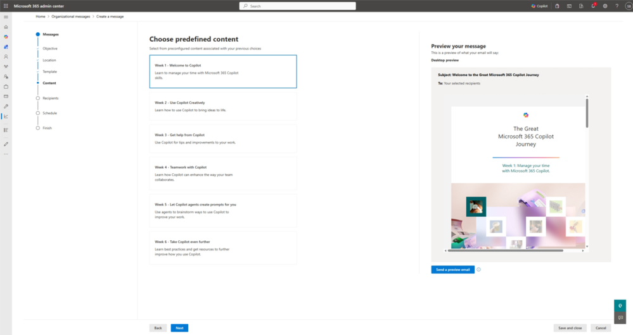
Organizational messages improvements: Enhanced audience targeting and Email as a delivery channel
Enhanced audience targeting
Microsoft is expanding Organizational Messages to improve Copilot and agent adoption through smarter targeting and broader communication channels.
Action Segments (Preview) – Target users based on behavior (e.g., inactive Copilot users). Public Preview started Nov 2025; GA expected March 2026.
Email Delivery Channel (Preview) – Send Organizational Messages via email using premade templates; customizable emails coming at GA in March 2026.
Broader reach & impact – Reach users in familiar channels and deliver more relevant, timely prompts to boost adoption.
New capabilities for AI admins from Ignite 2025 | Microsoft Community Hub
Notes:
“Microsoft is enhancing Organizational Messages to make Copilot and agent adoption more effective. First, Action Segments allow admins to target users based on behavior — like inactive Copilot users — giving much smarter, more purposeful messaging. Second, Organizational Messages can now be delivered via email, alongside Windows and Teams channels, with customizable templates arriving at GA in March 2026. Overall, this helps IT teams reach users in familiar places and deliver more relevant guidance to drive adoption.”

Slide 52
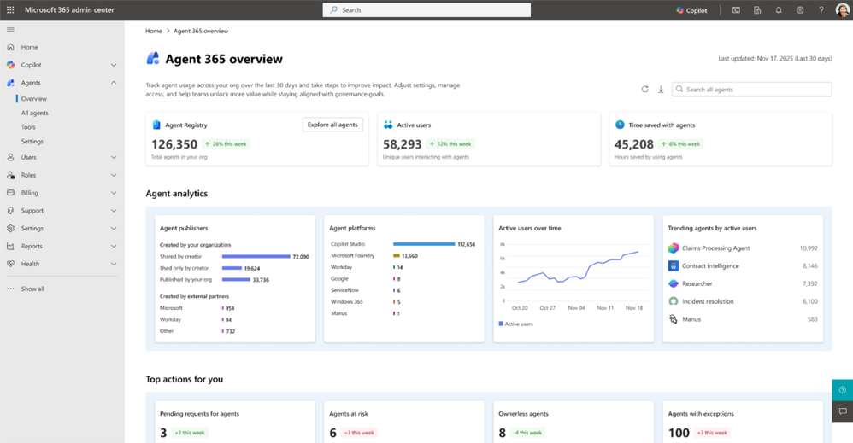
Agent 365: Agent overview – your agents console
Microsoft introduced a centralized Agent Overview dashboard that gives admins clear visibility into all agents, their impact, and where action is needed.
Unified agent visibility – See total agents, active users, and hours saved in one dashboard.
Deep analytics – View trending agents, usage patterns over time, and insights by publisher or platform.
Action-focused alerts – Highlights pending access requests, risky agents, ownerless agents, and exceptions.
Faster admin decisions – Helps admins quickly review, approve, or intervene where it matters most.
Agent overview
New capabilities for AI admins from Ignite 2025 | Microsoft Community Hub
Start exploring Agent 365 today through the Frontier early access program . Learn more at the Microsoft Agent 365 web page.
Notes:
“This new Agent Overview page gives admins a single dashboard to understand all their agents at a glance. It shows high‑level impact metrics like number of agents, unique active users, and even estimated hours saved. Admins also get richer analytics such as trending agents, usage patterns, and breakdowns by publisher or platform. Importantly, it surfaces top actions that need attention — things like access requests, risky agents, ownerless agents, or exceptions — so admins always know where to focus and can take quick, informed action.”
Customers can start exploring Agent 365 today through the Frontier early access program . Learn more at the Microsoft Agent 365 web page.

Slide 53
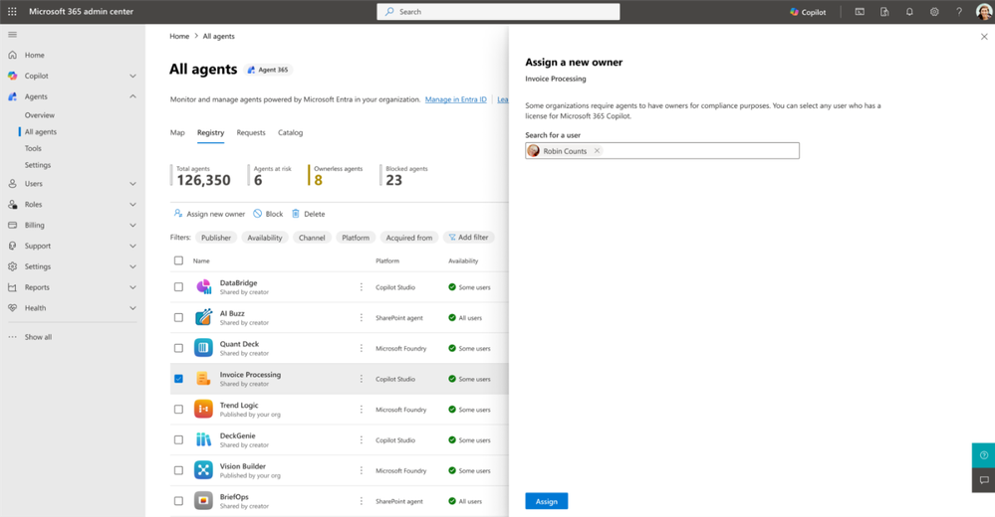
Agent 365: Agent ownership reassignment – Identify and assign agent ownership
Agent ownership reassignment
Microsoft introduced a new workflow in the Microsoft 365 admin center to help admins quickly identify and manage “ownerless” agents for better governance and security.
Why it matters – Ownerless agents create compliance gaps, security risks, and operational overhead.
New workflow – Identify unmanaged agents using the Missing an owner card in Agents → All agents → Registry.
Admin actions – Block, reassign, or retire ownerless agents directly from the dashboard.
New capabilities for AI admins from Ignite 2025 | Microsoft Community Hub
Notes:
“Ownerless agents are a big governance risk because they often occur when employees leave or change roles. They create compliance gaps and blind spots for IT. To address this, Microsoft added a simple workflow in the admin center. Admins can now filter for ownerless agents using the ‘Missing an owner’ card and take immediate action — block, reassign, or retire them — all from the Agents Registry page. This helps maintain security and continuity without manual tracking.”

Slide 54
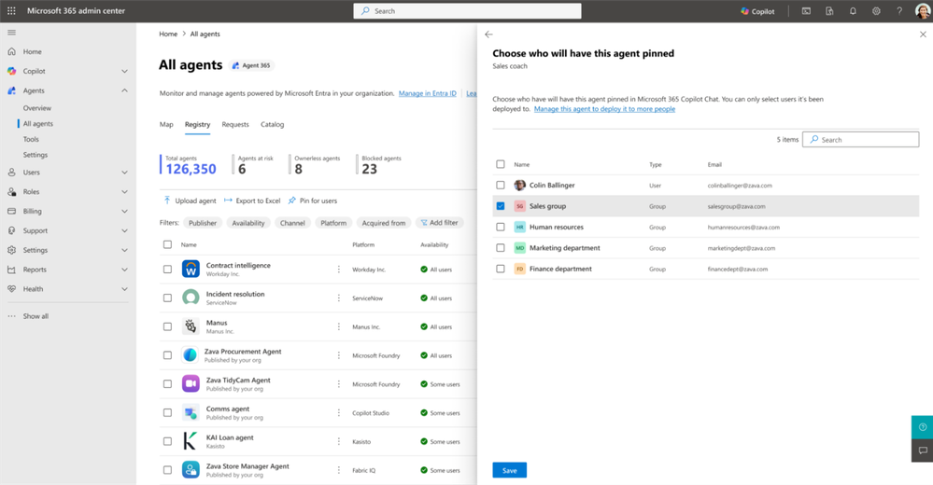
Agent 365: Agent Pinning
New admin pinning controls allow AI administrators to centrally curate and pin high‑value agents for better adoption and discoverability.
Centralized pinning – Admins can pin strategic agents for the entire organization.
Targeted experiences – Pin function‑specific agents for selected users or security groups.
Boost adoption – Helps teams start faster and stay focused by surfacing relevant agents.
Improved discoverability – Makes high‑value agents visible from day one.
Agent Pinning
New capabilities for AI admins from Ignite 2025 | Microsoft Community Hub
Notes:
“Pinning agents in Copilot ensures users have quick access to the most relevant AI capabilities for their roles. With new admin controls, IT can now centrally curate and pin high‑value agents across the organization or tailor pinning for specific groups. This helps guide adoption, highlight strategic workflows, and make Copilot agents more useful and discoverable from the start.”

Slide 55
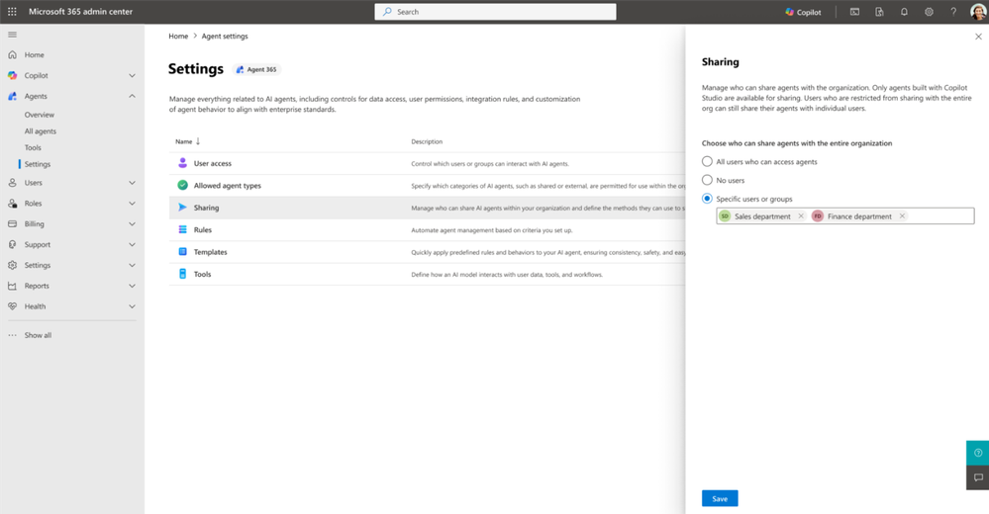
Agent 365: Agent enablement controls in agents settings
New admin controls in Microsoft 365 help manage agent adoption responsibly and prevent uncontrolled sharing.
Enable by security groups or departments – Roll out agents selectively for pilots or targeted teams.
Control by publisher type – Decide if agents from Microsoft, your org, or external publishers are allowed.
Manage org‑wide sharing – Define which users can create org‑wide sharing links for user‑built agents.
Agent enablement controls
New capabilities for AI admins from Ignite 2025 | Microsoft Community Hub
Notes:
“To help IT manage agent adoption responsibly, Microsoft added new enablement controls under Agents > Settings in the admin center. Admins can now enable agents by security groups or departments for phased rollouts, control which publisher types are allowed, and restrict who can create org‑wide sharing links for user‑built agents. These controls give organizations the flexibility to scale Copilot agents safely while maintaining governance.”

Slide 56

Agent 365: Policy-driven agent management
Agent Policies introduce automation to agent management using a simple “If This Then That” rules-based model.
Rules-based automation – Define conditions and actions for governance tasks (e.g., expire unused agents after 90 days).
Continuous enforcement – Policies run in the background to eliminate manual work and improve compliance.
Security actions – Block risky agents and notify security teams automatically.
Full visibility – Includes audit logging and transparency for every triggered action.
Policy-driven agent management
New capabilities for AI admins from Ignite 2025 | Microsoft Community Hub
Notes:
“Agent Policies bring automation to agent governance with an intuitive ‘If This Then That’ approach. IT can set rules like expiring agents unused for 90 days or blocking risky ones and notifying security. These policies run continuously, reducing manual effort and improving consistency. With audit logs and full visibility, this feature turns agent management into an automated, secure process.”

Slide 57

Graph API support for agent management
New Graph API support enables IT teams to automate agent management at scale, moving beyond UI-driven controls.
Public Preview next month – Script and automate key oversight tasks programmatically.
Inventory & metadata access – Retrieve full agent lists, filter by attributes, and access rich metadata.
Lifecycle operations – Upcoming support for PATCH (update agent states) and POST (upload/update packages).
Enterprise scalability – Integrate governance into approval pipelines and automation frameworks for thousands of agents.
Graph API support for agent management
New capabilities for AI admins from Ignite 2025 | Microsoft Community Hub
Notes:
“Customers asked for deeper automation beyond the UI, and Microsoft is delivering with new Graph API support. In Public Preview next month, IT can script tasks like retrieving agent inventories and filtering by attributes. Soon, APIs will allow updating agent states and uploading packages, enabling full lifecycle automation. For organizations managing hundreds or thousands of agents, this means integrating governance into existing workflows for greater scalability and consistency.”

Slide 58

Managing MCP servers
New capabilities allow AI admins to centrally manage MCP servers for better security, compliance, and operational oversight.
Centralized MCP server view – Dedicated Tools page to monitor availability and manage access.
Govern agent interactions – Control how agents connect to user data and business systems.
Simple actions – Block or unblock servers to maintain policy alignment.
Rich metadata & filters – Quickly assess tool status, type, and publisher for streamlined oversight.
Managing MCP servers
New capabilities for AI admins from Ignite 2025 | Microsoft Community Hub
Notes:
“Microsoft has introduced MCP server management in the admin center for Frontier program customers. This gives AI admins a centralized dashboard to monitor all MCP servers powering Copilot and agent experiences across apps like Teams, Outlook, Word, and SharePoint. Admins can block or unblock servers, review metadata, and apply filters to maintain compliance and security. This capability ensures trust and consistency as organizations scale agent-based productivity.”

Slide 59

Managing agents with MCP server connections
Microsoft is adding visibility for MCP-powered agents in the Microsoft 365 admin center to strengthen governance and trust.
MCP as a foundation – Enables richer agent experiences by integrating tools and APIs via standardized endpoints.
Admin visibility – MCP-enabled agents now appear in Copilot > Agents > Inventory (or Registry for Frontier customers).
Detailed metadata – View capabilities, data sources, supported actions, and MCP server details (URL, authentication type, dynamic/static status).
Managing agents with MCP server connections
New capabilities for AI admins from Ignite 2025 | Microsoft Community Hub
Notes:
“Model Context Protocol is becoming the backbone for integrating tools and APIs with Copilot and agents. MCP servers expose callable actions that make agents more powerful and flexible. Starting this month, admins can see MCP-enabled agents in the Microsoft 365 admin center, along with rich metadata and server details like URL and authentication type. This visibility ensures governance and compliance as MCP becomes core to the Copilot ecosystem.”

Slide 60

Cloud Update Reaches General Availability: Transforming Microsoft 365 Apps Management
Cloud Update
Cloud Update, now GA, automates Microsoft 365 Apps servicing to keep environments secure, current, and optimized for Copilot and agents.
Modernized update model – Cloud-driven servicing ensures devices stay up to date automatically.
Critical for AI workloads – Maintains optimized, secure environments for Copilot and agent performance.
Reduced operational overhead – Eliminates manual patching so admins can focus on delivering AI experiences.
Consistency at scale – Addresses compatibility concerns and prepares environments for AI-driven demands.
Learn more
New capabilities for AI admins from Ignite 2025 | Microsoft Community Hub
Notes:
“Cloud Update is now generally available and modernizes how organizations manage Microsoft 365 Apps. It automates updates to keep environments secure and consistent, which is critical for Copilot and agents to run optimally. By reducing manual maintenance, admins can focus on enabling AI experiences. This approach also ensures compatibility and readiness for AI workloads, providing a strong foundation for accurate and secure assistance across Microsoft 365.”

Slide 61

Track Adoption Trends & Export Insights with Copilot and Agent Analytics
New analytics capabilities provide actionable insights into Copilot and agent adoption, performance, and impact.
Copilot Chat Reporting – Track adoption trends, retention, and group comparisons in the Copilot Dashboard.
Copilot Benchmarks – Compare your organization’s adoption internally and against peers.
Agent Dashboard – Centralized view of agent adoption and performance, including top performers.
Readiness Recommendations – Tailored guidance to maximize Copilot and agent utilization.
Export Functionality – Download dashboard data as CSV for custom reporting and analysis.
Graph API Integration – Access analytics data programmatically for custom reports and internal tools.
The latest Copilot and Agent Analytics updates
New! Centralized Agent Dashboard and Enhanced Reporting | Microsoft Community Hub
Notes:
“At Ignite 2025, Microsoft introduced major updates to Copilot and Agent Analytics to give organizations transparent, actionable insights into AI adoption. These features include dashboards for Copilot Chat and agent performance, benchmarks to compare adoption against peers, and readiness recommendations to guide rollout. Export functionality and Graph API integration allow deeper custom analysis, helping IT and business leaders optimize AI deployment and measure impact at scale.”

Slide 62
Microsoft 365 Copilot release notes
As of 2nd Jan 2026
Latest features and improvements for Microsoft 365 Copilot.
It includes changes that are generally available
(Current Channel for Microsoft 365 apps)
Release Notes for Microsoft 365 Copilot | Microsoft Learn
Notes:
As of 2nd January 2025
This page lists the latest features and improvements for Microsoft 365 Copilot. It includes changes that are generally available (Current Channel for Microsoft 365 apps) and specific to each platform.

Slide 63
Microsoft 365 Copilot release notes – December 2025
As of 2nd Jan 2026
Copilot extensibility (9)
Microsoft 365 Copilot app (3)
SharePoint (1)
        Access IT service documentation with Freshservice integration [Web]
        Upload larger files in Copilot Studio Agent Builder (512 MB support) [Android, Windows, iOS, Web]
        Use .NET client libraries to integrate Microsoft 365 Copilot APIs [Web]
        Use Python client libraries to integrate Microsoft 365 Copilot APIs [Web]
        Use TypeScript client libraries to integrate Microsoft 365 Copilot APIs [Web]
        View and manage SharePoint agents with greater control [Web]
        Access custom engine agents in multiple apps [Web]
        Edit adaptive cards inline for a faster build process [Web]
        Better security insights help you build confidently [Web]
GPT-5 powers Copilot Chat by default [Android, Windows, iOS, Mac, Web]
Create polished videos faster with seamless editing and brand customization [Web]
Get AI-powered summaries with search views [Web]
Add multiple SharePoint agents in one Teams conversation [Web]
Viva Glint
Multilingual support in Copilot for Viva Glint [Web]
Microsoft 365 Copilot Chat (1)
Word (1)
        Streamlined Copilot chat navigation with expanded history [Windows, Web]
Referenced sources cited in drafted content [Windows]
PowerPoint (1)
Use your organization’s approved assets in Copilot presentations [Mac, Windows, Web]
Copilot Studio (1)
Build Copilot agents using organizational People data [Windows, Web]
Learn more | Release Notes for Microsoft 365 Copilot
16 Updates released between November 25, 2025, and December 23, 2025
Notes:
Updates released between November 25, 2025, and December 23, 2025.
This page lists the latest features and improvements for Microsoft 365 Copilot. It includes changes that are generally available (Current Channel for Microsoft 365 apps) and specific to each platform.
As of 2nd January 2026
Learn more - Release Notes for Microsoft 365 Copilot | Microsoft Learn
https://learn.microsoft.com/en-us/copilot/microsoft-365/release-notes?tabs=all

Slide 64
Microsoft 365 Copilot release notes – November 2025
As of 19th Dec 2025
Copilot extensibility (6)
Microsoft 365 Copilot Chat (6)
Outlook (1)
        Access Custom Engine Agents on Copilot Chat (Mobile) [Android, iOS]
        Custom Agents in Office Applications [Web]
        Enhanced Agent Store Search Experience [Windows, Web]
        Export Detailed Agent Metadata for Governance [Web]
        Message Extensions as Declarative Agents on Mobile [Android, iOS]
        Unified Permissions Management for Agents [Windows, Web]
        Access Shared Mailboxes in Copilot Chat [Android, Windows, iOS, Mac, Web]
        Find Files Faster with Improved Filters [Windows, Web]
        Iterate on Images with Multi‑Turn Editing [Windows, Mac, Web]
        RSVP‑Based Meeting Search [Android, Windows, Web]
        Talk to Copilot with Voice [Android, Windows, iOS, Mac, Web]
        Updated Copilot Chat Navigation Pane in Teams [Web]
Intelligent Draft Agenda with Copilot [Web]
PowerPoint (2)
Create New Presentations Without Overwriting Originals [Windows, Mac, Web]Reference Loop Components or Pages in Presentations [Mac, Windows, Web]
SharePoint (1)
Copilot Skills for Smarter SharePoint Administration [Web]
Copilot Studio (3)
Microsoft 365 Admin Center (5)
Control Org‑Wide Agent Sharing from One Place [Web]
Quarantine and Block Unsecured Agents [Web]
Upload Up to 1,000 Files for Agent Training [Web]
Block SharePoint Agents from Agents & Connectors Page [Web]
Monitor Copilot Usage with Capacity Packs [Mac]
New Enhancements in Organizational Data Ingestion [Web]
Reassign Agent Ownership [Windows, Web]
Restrict Org‑Wide Agent Sharing for Better Governance [Web]
Viva Insights (1)
Copilot Chat Metrics in Teams & Outlook [Windows, Web]
Excel (1)
        Build and Analyze Surveys with Surveys Agent [Windows, Mac, Web]
Microsoft 365 Copilot app (1)
Customize Audio Overviews for Copilot Notebooks [Web]
Learn more | Release Notes for Microsoft 365 Copilot
27 Updates released between between October 28, 2025, and November 25, 2025
Notes:
27 Updates released between between October 28, 2025, and November 25, 2025
This page lists the latest features and improvements for Microsoft 365 Copilot. It includes changes that are generally available (Current Channel for Microsoft 365 apps) and specific to each platform.
As of 19th December 2025
Learn more - Release Notes for Microsoft 365 Copilot | Microsoft Learn
https://learn.microsoft.com/en-us/copilot/microsoft-365/release-notes?tabs=all

Slide 65
Microsoft 365 Copilot release notes – October 2025
As of 5th Nov 2025
Copilot extensibility (3)
Microsoft 365 Admin Center (4)
PowerPoint (2)
        @mention capability for mainline Copilot Chat [Android, iOS]
        Static tab for custom agents in Teams meetings [Windows, Web]
        Context-aware search ranking [Windows, Web]
Harmful content protection toggle [Web]
Historical Data Upload Support in Organizational Data in Microsoft 365 [Web]
Manage table list views with security roles [Web]
Prepurchase capacity packs for chat [Web]
On‑canvas experience for generating speaker notes [Mac, Web, iOS]
On‑canvas experience for translating presentations [Mac, Web, iOS]
Microsoft 365 Copilot (1)
Microsoft Loop (1)
Microsoft Teams (2)
Private previews in shared page edits [Web]
New file extension for Copilot pages (.page) [Web]
Teams chats in ContextIQ [Web]
Use Copilot in a call without recording or transcribing [Windows, Mac]
Microsoft 365 Copilot Chat (6)
Planner (3)
        Focus mode in Teams [Web]
        Launch full app from side panes in Copilot Chat [Platform not specified]
        Stay informed with email alerts for scheduled prompts [Web]
        Create new images using reference uploads [Windows, Mac, Web]
        Image generation with multiple aspect ratios [Windows, Mac, Web]
        Inline citations and references in side pane [Web]
Copilot faster with new Planner button [Web]
Get a project manager agent in all premium plans [Windows, Web]
Get task recommendations grounded in real‑time web data [Web]
Viva Learning (1)
Providing users with notifications about Copilot Academy in Teams [Platform not specified]
Viva Insights (1)
Outlook (1)
Weekly user insights in Copilot Studio agent reports [Windows, Mac, Web]
Expanded coverage and improvements to Preparing for Meetings with Copilot [Windows, Web]
Word (1)
Instantly get helpful options from Copilot [Mac]
Learn more | Release Notes for Microsoft 365 Copilot
26 Updates released between September 30, 2025 and October 28, 2025
Notes:
Updates released September 30, 2025 and October 28, 2025
This page lists the latest features and improvements for Microsoft 365 Copilot. It includes changes that are generally available (Current Channel for Microsoft 365 apps) and specific to each platform.
As of 5th November 2025
Learn more - Release Notes for Microsoft 365 Copilot | Microsoft Learn
https://learn.microsoft.com/en-us/copilot/microsoft-365/release-notes?tabs=all

Slide 66
Microsoft 365 Copilot Public Roadmap
Changes this month
As of 2nd Jan 2026
Microsoft 365 Roadmap - See What's Coming | Microsoft 365
Notes:
As of 2nd January 2026

Slide 67



Microsoft 365 Copilot Public Roadmap
As of 2nd Jan 2026
“Changed” within last month
Launched (22) 🚀
  Rolling Out (18)
[Copilot Chat] Updated UI for Microsoft Copilot Navigation Pane in Word, Excel, PowerPoint, OneNote, Outlook, and Teams
[Copilot Extensibility] [1.02] Generate Word, Excel, and PowerPoint documents from agents built in Microsoft 365 Copilot
[Copilot Extensibility] Customers can connect M365 Copilot with Freshservice to access IT service documentation with Copilot Connector
Calendar Search in M365 Copilot Search
Continue editing in Outlook from Copilot Chat
Copilot APIs TypeScript Client Libraries
Copilot for PowerPoint will help you build your story's narrative
Copilot uses enterprise assets hosted on SharePoint OAL or Templafy when creating a slide
GPT-5 in Agent Builder inside Microsoft 365 Copilot
Larger file upload support in Copilot Studio agent builder
Library in the Microsoft 365 Copilot app
Microsoft 365 admin center: Manage SharePoint agents via Agents page
Microsoft 365 Copilot: Work from your recent prompts in Draft with Copilot
Microsoft Purview compliance portal: Data Loss Prevention - restrict Microsoft 365 Copilot processing on content with sensitivity labels
Microsoft Purview compliance portal: OneDrive support for Data Risk Assessments
Microsoft Teams: Intelligent meeting recap available in multi-tenant set ups
Microsoft Viva: Copilot Dashboard - M365 Copilot Chat adoption metrics
Microsoft Viva: Copilot Dashboard - Updated meeting metrics for Intelligent Recap
Model Selector in Microsoft 365 Copilot
Receive coaching on your writing in Copilot in Word
Updates to video creation in Microsoft 365 Copilot
Write a prompt for selected portions of text in Word
Agent Mode in Excel
App Navigation Pane Update
Copilot Chat - Session Persistence Enhancement
Copilot chats conversations
Copilot voice support in Word & PowerPoint.
Customize AI-generated notes in meeting recap
Data source specific filters
Microsoft 365 (Microsoft Copilot): Copilot Chat - Loop Notebooks in ContextIQ
Microsoft 365 Copilot Chat - General Availability for the GCC High environment
Microsoft Graph: Graph API - Copilot for Microsoft 365 usage
Microsoft Teams: Enhancements to Interpreter and multilingual meeting experience
Microsoft Viva: Copilot Analytics - Copilot Employee Experience Outcomes Report with Viva Glint
Preview and chat with Word, Excel, and PowerPoint files in the Microsoft 365 Copilot app on Android
Rich Bing web answer cards on M365 Copilot
Teams Channels in Context IQ
Updated UI for Copilot Chat entry point in Word, Excel and PowerPoint apps
Use Copilot to get a detailed and contextual explanation
Video recap in Copilot Chat
Notes:
As of 2nd January 2026

Slide 68


Microsoft 365 Copilot Public Roadmap
As of 2nd Jan 2026
New items within the last month
New items (29) – In development
[Copilot Chat] Agent Mode in Excel
[Copilot Chat] Agent mode in Word enables conversational support to create, edit and refine document content from chat
[Copilot Search] [Copilot Search] Copilot Chat available when using Copilot Search
Admins can manage access more precisely with support for nested permissions in Jira, Confluence, and ServiceNow
Agent Mode in Excel for desktop apps
Agent Mode in Excel for GCC
Capture voice notes in the Microsoft 365 Copilot mobile app
Chat History Landing page: Filtering UI Refresh
Copilot Shortcuts for Pages on Mobile
Deep citations in Copilot
Edit a Page using Copilot Chat on Mobile
Excel Agent
Excel: =COPILOT Function
Masking in Copilot chat
Microsoft Copilot (Microsoft 365): Support for refining query filters for Confluence Copilot connectors
Microsoft Copilot (Microsoft M365): Review PDFs using Copilot context menu and AI actions
Microsoft Edge: Adding contextual nudges to the Microsoft 365 Copilot Chat icon
Microsoft Edge: Copilot icon visibility
Microsoft Edge: Microsoft Edge can now send work related browsing history to Copilot for more relevant work results when searching on M365 Copilot search
Microsoft Teams: Ability for IT admins to customize the user notification strings for recording and transcription
Microsoft Teams: Express voice enrollment in Microsoft Teams
PowerPoint Agent
Recommended Notebooks in Copilot Notebooks
Relight images in Microsoft 365 Copilot
Scatter image effect in Microsoft 365 Copilot
SharePoint list agent
Suggested References in Copilot Notebooks
Support permission sync missed in incremental crawl
Word Agent
Notes:
As of 2nd January 2026

Slide 69
Microsoft 365 Copilot Public Roadmap
As of 2nd Jan 2026
“Changed” within last month
In development (28)
Microsoft Edge: Summarization, Translation, and Citation will soon be supported by Microsoft Copilot and Microsoft 365 Copilot Chat in our menus
1-click to create a Brief page based on content in Copilot Notebook
1-click to create a FAQ page based on content in Copilot Notebook
Admins can create and deploy custom Model Context Protocol (MCP) connectors across Microsoft 365.
AI Learning Agent (AILA) in Microsoft 365 Copilot
Content Sources in Copilot Chat
Copilot Prompt Gallery - Company-wide prompt publishing
Copilot uses enterprise assets hosted on Adobe Experience Manager when creating presentations
Copilot uses enterprise assets hosted on Adobe Experience Manager when creating presentations
Copilot uses enterprise assets hosted on Adobe Experience Manager when creating presentations
Domain exclusion for web grounding
Frontier and Microsoft agent user request approval flow in Microsoft 365 admin center
Generate text for a PowerPoint slide using slide context
Generative-AI skills for Create in Microsoft 365 Copilot app for Government Clouds
Microsoft 365 admin center: Agents usage report
Microsoft 365 admin center: Copilot settings – readiness
Microsoft 365 Admin Center: Usage reports - Message consumption for Pay-as-you-go experiences in Copilot Chat.
Microsoft 365 app: Overview Page in Copilot Notebooks
Microsoft CoPilot (Microsoft 365): List email attachments in M365 Copilot
Microsoft CoPilot (Microsoft 365): Microsoft Graph APIs for App & Agent Inventory and Details.
Microsoft Edge: Ground Microsoft 365 Copilot Chat in Edge for Business in your open OneDrive and SharePoint documents
Microsoft Edge: Ground Microsoft 365 Copilot Chat in Edge for Business in your open YouTube videos
Microsoft Edge: Microsoft 365 Copilot Chat access to page content will soon extend to work across multiple open tabs
Microsoft Purview compliance portal: Data Lifecycle Management - Retention based on Last Accessed for files in OneDrive and SharePoint
Microsoft Viva: Copilot Analytics - Prompt category metrics for Microsoft 365 Copilot Chat
Microsoft Viva: Satisfaction Rate Metric for Microsoft 365 Copilot in Copilot Dashboard
Quickly edit an image in PowerPoint
Real-time voice interactions in a podcast in Word
Scope prompts to specific Channels in Teams in Copilot Chat
Updated Copilot Notebooks UX
Updates to Memory and Personalization in Microsoft 365 Copilot
Use voice for Q&A during Read Aloud in Word
Viva Engage - Agents in communities
Voice chats can reference Memory
Web Link as a Reference in Copilot Notebooks
Notes:
As of 2nd January 2026

Slide 70
Thank you 👏
Got feedback ?
https://aka.ms/WhatsNewCopilot/Feedback
Notes:
Thank you.

Slide 71

Feedback Form

Slide 72
Resources
Microsoft 365 Copilot Blog | Microsoft Community Hub
What’s New in Microsoft 365 Copilot | November & December 2025 | Microsoft Community Hub
New capabilities for AI admins from Ignite 2025 | Microsoft Community Hub
Cloud Update Reaches General Availability: Transforming Microsoft 365 Apps Management | Microsoft Community Hub
New! Centralized Agent Dashboard and Enhanced Reporting | Microsoft Community Hub
Security and governance innovations for Microsoft 365 Copilot and agents from Ignite 2025 | Microsoft Community Hub
Release Notes for Microsoft 365 Copilot | Microsoft Learn
Microsoft 365 Roadmap | Microsoft 365
What's new in Copilot Studio - Microsoft Copilot Studio | Microsoft Learn
Copilot Studio | Microsoft Copilot Blog
Enable SSO with Microsoft Entra ID - Teams | Microsoft Learn
Introducing Teams Mode for Microsoft 365 Copilot | Microsoft Community Hub
Five Ways to Implement the Great Copilot Journey | Microsoft Community Hub

Slide 73

Whats new in Copilot Studio

Slide 74
What's new in Copilot Studio
The following table displays the month of release for each new feature.
Month of release | What’s new
November 2025 | Updates for models used in Copilot Studio: On November 24, 2025, GPT-5 Chat rolls out to Copilot Studio in general availability for European and United States regions. You can use generally available models for orchestration in production agents. For more information on choosing orchestration models, see Select a primary AI model for your agent. (Preview) Automatically create Microsoft Entra agent identities for agents. When turned on, automatically apply identity management to individual agents by assigning a Microsoft Entra agent identity, helping admins secure and manage agents more effectively. Improved knowledge retrieval for SharePoint-grounded agents using tenant graph grounding. Updated system architecture and new retrieval methods deliver more precise, context-rich responses, enhancing answer quality. Improve response accuracy with SharePoint metadata filters. Use metadata like filename, owner, and modified date to refine knowledge retrieval and ensure responses come from the most relevant, up-to-date documents. Orchestrate multiple agents to break down complex tasks across specialized agents, improving accuracy and speeding up end‑to‑end automation. Enhance your agents by linking them to other agents—either within your environment or external sources like Microsoft Fabric data agents—for modular, task-specific functionality. (Preview) Add tool groups to agents for faster setup. Quickly equip your agents with curated sets of tools from Outlook and SharePoint connectors in one step. This streamlines setup, reduces errors, and ensures consistent, reliable orchestration. Copy agents from Microsoft 365 Copilot to Copilot Studio. Easily move agents you created in Microsoft 365 Copilot into Copilot Studio to unlock advanced capabilities like multi-step workflows, custom integrations, and broader deployment options. (Preview) Add human input to agent workflows with the request for information action. Pause an agent flow to collect details from designated reviewers via Outlook, then resume execution using their responses as dynamic parameters. This action ensures workflows can handle missing data or context without relying on hard-coded values. Update Power Platform API calls to use the new 'copilotstudio' namespace. The previous namespace will continue to work temporarily, but switching now ensures compatibility with future updates. Use component collections with new enhancements. Access collections directly from the sidebar, quickly export or import collections, and take advantage of support for primary agents and new connector types, including child agents and Model Context Protocol (MCP).
What's new in Copilot Studio - Microsoft Copilot Studio | Microsoft Learn | Copilot Studio Archive | Microsoft Copilot Blog
Notes:
As of 1st September 2025
What's new in Copilot Studio - Microsoft Copilot Studio | Microsoft Learn
https://learn.microsoft.com/en-us/microsoft-copilot-studio/whats-new
Copilot Studio Archive | Microsoft Copilot Blog
https://www.microsoft.com/en-us/microsoft-copilot/blog/copilot-studio/
What’s new in Copilot Studio: May 2025 | Microsoft Copilot Blog

Slide 75
Microsoft 365 Copilot
August 2025
Copilot Control System
User capabilities
        SharePoint agents will be included in the Microsoft 365 admin center agent inventory
        Microsoft 365 Copilot Search within the Usage reports in the Microsoft 365 admin center
        Microsoft 365 admin center now includes a request and approval workflow for Frontier as well as agents in Microsoft 365.
        Manage Copilot Chat usage with pre-purchased capacity packs
        Block, reassign, or retire ownerless agents
        Identify risky AI usage with Microsoft Purview
        Access SharePoint agents directly in the Microsoft 365 Copilot app
        SharePoint agents are now discoverable in the Teams app store
        GPT-5 in Microsoft 365 Copilot
        The new Tools menu in Copilot Chat
        Referencing an email in Copilot Chat
        Users can now describe a presentation idea in Copilot Chat
        Image reasoning and editing in Copilot Chat
        Copilot Chat will soon have a new side-by-side visual editor
        Create Features Now Available Without M365 Copilot License
        Generate and edit images in the Microsoft 365 Copilot App
        Summarize with Copilot in Microsoft Edge for Business
        Custom dictionaries available for Copilot in Teams
Notes:
As of 1st September 2025

Slide 76
Microsoft 365 Copilot
September 2025
Copilot Control System
User capabilities
        Expanding model choice in Microsoft 365 Copilot
        Admins can view and measure agents used in Microsoft 365 Copilot
        A new policy gives enhanced control over Copilot prompts
        Admins can manage ownerless agents
        Manage data security risks with Microsoft Purview Data Security Posture Management for AI apps
        Merge people data with other sources with Microsoft Copilot connectors
        Employees can use their personal Microsoft 365 subscriptions to access Copilot features at work
        The new Copilot Chat Roadmap
        Copilot Chat is now available in Word, Excel, PowerPoint, Outlook, and OneNote
        Updated Copilot with a long context model
        Seamlessly launch the full M365 Copilot app
        Copilot Chat now lets users interact with embedded images inside any document
        Generating PPT grounded on a Copilot Page
        Teams Chats and Channels in ContextIQ
        The new Edit in Outlook button
        Email attachment summarization
        Access email from delegated mailboxes
        Users can access their shared mailboxes.
        Users can search for meeting RSVPs
        Microsoft 365 Copilot Library
        Copilot Search, users can find meetings
        AI Views in Copilot Search
        Produce videos from text prompts and existing files
        Formula completion with Copilot in Excel
        Users can easily summarize any open email or email thread in a single click
        Copilot now extends to helping users search their Outlook inboxes
        Schedule meetings using Copilot Chat
        Copilot now makes it easier to resolve scheduling conflicts
        Update documents and fix spelling and grammar with Copilot in Word
        Thread summaries from Copilot in Teams
        Improve text with Copilot in PowerPoint
        Copilot now available in Viva Engage
        Moving sales, service, and finance with Microsoft 365 Copilot
        New app icons designed for the AI era
Agents
        New output controls for Researcher agent
        Skills Agent
        Knowledge Agent in SharePoint
        Facilitator in Microsoft Teams
        Teams channel can now have a Channel Agent
        Agents in Viva Engage communities
        SharePoint agents can now reason over metadata
        Introducing Agent Mode and Office Agent in Microsoft 365 Copilot
Notes:
As of 3rd July 2025

Slide 77
Microsoft 365 Copilot
October 2025
Copilot Control System
User capabilities
        Copilot Control System features on M365 Public Roadmap
        New reports and management tools in Microsoft 365 admin center
        The new Microsoft 365 Copilot usage report
        Agent ownership reassignment
        Enhanced Agent Inventory Export
        Model Context Protocol & Unified Agent Management
        Copilot Credit Capacity for SharePoint & Tuning
        Microsoft 365 companion apps—People, Files, and Calendar
        Team views in Copilot Dashboard
        Copilot Chat quality Roadmap
        Session persistence enhancement for Copilot Chat
        Improving response accuracy for file-based questions
        Agent recommendations in Copilot Chat
        GPT-5 will soon become the default model in Copilot Chat
        Copilot Chat is simplifying calendar management.
        Bing Web Cards
        Copilot Chat API
        AI Views in Microsoft 365 Copilot Search
        Copilot Search Enhancements
        Copilot Chat in Mobile File Preview
        Audio recapnew file summaries for Copilot in Teams
        Speaker notes and translation for Copilot in PowerPoint
        Agent Mode in Word
        Agent Mode in Excel
        Meeting planning improvements for Copilot in Outlook
        Teams Mode for Microsoft 365 Copilot
        Employees can use their personal Microsoft 365 subscriptions to access Copilot features at work
Agents
        Employee Self-Service Agent
        Surveys Agent
        App Builder agent
        Researcher updates
        Introducing Researcher with Computer Use
Notes:
As of 5th October 2025

