Slide 1


What’s new in
Microsoft 365 Copilot
As of 6th May 2026
April 2026
Presenter name
Title
Notes:
As of 6th May 2026
Thank you.
Got Feedback ? – https://aka.ms/WhatsNewCopilot/Feedback
Resources - check appendix slides ☺

Slide 2
What's new in Microsoft 365 Copilot
Updates listed in this document are selected based on relevance to Microsoft 365 Copilot.
Release dates and timings are subject to change.
For a complete list of Copilot for Microsoft 365 roadmap items refer to
Microsoft 365 Roadmap | Microsoft 365
Got feedback ?
https://aka.ms/WhatsNewCopilot/Feedback
Notes:
Feedback – https://aka.ms/WhatsNewCopilot/Feedback
Please note that the dates mentioned in this presentation are tentative and subject to change.

Slide 3

What’s new in Microsoft 365 Copilot
April 2026
As of 6th May 2026
IT admin capabilities
User capabilities
        Reporting by day and by power users in Copilot Dashboard
        Billing management and new organizational message options in Microsoft 365 admin center
        Microsoft 365 E7 - Generally available on May 1
        Copilot’s agentic capabilities in Word, Excel, PowerPoint: Generally Available
        Outlook: New agentic experiences for email and calendar
        Microsoft 365 Copilot mobile app refresh
        Work IQ in Copilot Pages
        Updates for Copilot Notebooks
        Plan mode and Python support for Copilot in Excel
        Image editing options and public website grounding for Copilot in PowerPoint
        Claude for Copilot in Word
        Call delegation and consecutive interpretation with Copilot in Teams
        Ready-to-use prompts for Copilot in OneDrive
        Submit agents to Agent Store using Agent Builder
        First draft in the canvas for Copilot in Outlook
        Word: Legal Agent in Frontier
        Copilot in OneNote understands more
        Claude Opus 4.7 across Microsoft 365 Copilot
        GPT-5.5 Thinking and ChatGPT Images 2.0 in M365 Copilot
Copilot agents and extensibility
        Submit agents to Agent Store via Agent Builder
        Real-time voice agents in Copilot Studio
        Agent 365 - Generally available on May 1
        Cowork release notes
        Copilot Studio: New and improved multi-agent orchestration, connected experiences, and faster prompt iteration
Notes:
As of 6th May 2026

Slide 4

User capabilities

Slide 5
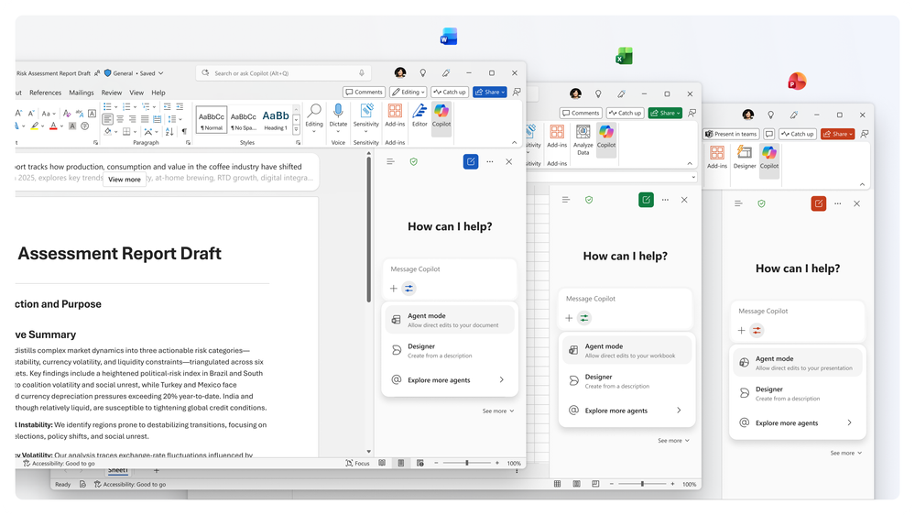
Copilot’s agentic capabilities in Word, Excel, PowerPoint: Generally Available
Copilot delivers in‑app creation and refinement across Word, Excel and PowerPoint grounded in Work IQ with enterprise‑grade governance.
In‑App Execution: Copilot creates, edits, and refines content directly inside documents, spreadsheets and presentations to finish work where it lives.
Transparent Iteration: Edits are visible, reviewable, and reversible, supporting confident iteration and co-authoring.
Enterprise Governance: Copilot enforces permissions, sensitivity labels, tenant controls, and compliance as new experiences roll out.
Agent mode in Word, Excel, and PowerPoint
Copilot's agentic capabilities in Word, Excel, and PowerPoint are generally available | Microsoft 365 Blog
Notes:
This slide is about how Wave 3 of Microsoft 365 Copilot brings creation and refinement directly into the apps people already use every day. Copilot now works inside Word, Excel, PowerPoint, and Outlook to create, edit, and refine content end to end, rather than generating something and leaving you to finish it manually.
All of this is powered by Work IQ, which means Copilot is grounded in live context like current files, meetings, chats, and working relationships. As that context changes, Copilot’s updates stay relevant and accurate.
A key shift here is transparency and confidence. Changes are applied directly to files, are fully visible, reviewable, and reversible, and support co-authoring so teams can iterate on a single version rather than managing multiple drafts.
Finally, this is built for the enterprise. Copilot enforces Microsoft 365 permissions, sensitivity labels, and tenant-level controls, ensuring governance, compliance, and data protection are maintained while unlocking more advanced Copilot experiences across the core apps.
Sequences shortened for demonstration purposes.

Slide 6
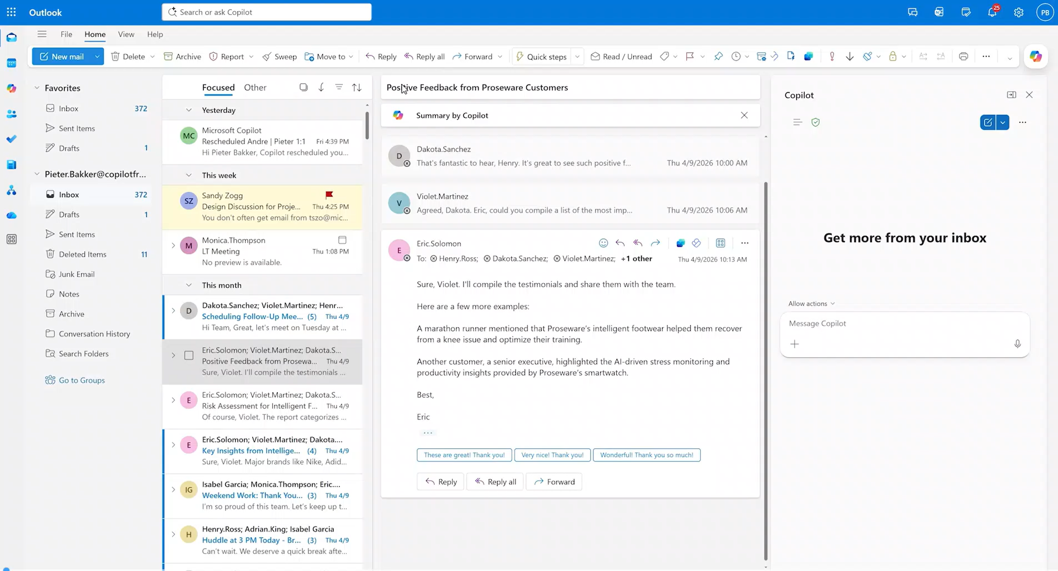
Outlook: New agentic experiences for email and calendar
Copilot in Outlook becomes an agentic assistant that proactively manages your inbox and calendar to reduce manual work and improve focus.
Manage your inbox with Copilot: Copilot now prioritizes emails, drafts follow-ups, and applies rules to keep your inbox organized automatically.
Delegate calendar management to Copilot: Copilot continuously manages your schedule by resolving conflicts, rescheduling meetings, and protecting focus time.
Proactively monitor and manage your schedule: Copilot handles ongoing tasks like catching you up, drafting updates, and preparing agendas.
Align your time to your priorities: Copilot helps align your time to priorities by reducing meeting load and improving preparation.
Manage your inbox with Copilot
Copilot in Outlook: New agentic experiences for email and calendar | Microsoft Community Hub
Notes:
Managing your inbox isn’t just about reading and replying. It’s the steady work of keeping things moving. Copilot in Outlook now takes on that work, prioritizing emails, surfacing what needs a response, drafting follow-ups, and setting up rules to keep your inbox clutter-free.
You tell Copilot what you need, and it works through the steps, showing what it’s doing along the way so you can review, adjust, or step in whenever you choose.
Prompts to try:
Help me with follow-ups: Identify people who haven’t replied to my emails after 24 hours, prioritize the ones that matter most, and draft polite follow-up emails for me.
Draft complex emails: Pull the latest updates on [project name] over the last week. Draft a confidential, high‑importance update email for my manager.
Stay on top of important emails: Create an inbox rule that assigns the “High Priority” category to all new emails from my manager where I’m on the “To:” line.
Catch up after vacation: I just returned from vacation. Help me catch up: summarize what I’ve missed, highlight what’s most urgent, and draft a short briefing email. Then suggest emails I can safely archive and 1-2 tasks I should focus on first.
Availability: Available via the Frontier program for all Outlook endpoints beginning April 27.

Slide 7
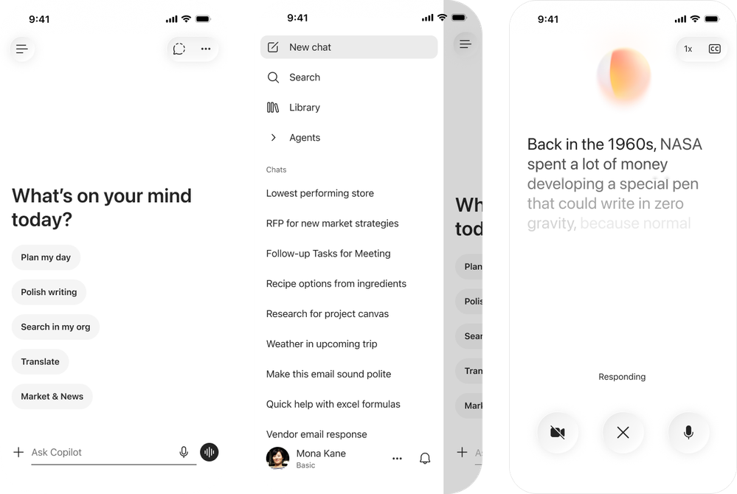
Microsoft 365 Copilot mobile app refresh
A redesigned, chat-first mobile experience for Microsoft 365 Copilot featuring a liquid-glass visual style, faster access to recent conversations and a streamlined home screen.
Chat-first design: The home experience now centers on conversations, putting recent chats and prompts within a single tap.
Liquid-glass styling: A refreshed visual language across iOS and Android to align with Microsoft's broader design system and improve readability on the move.
Faster everyday tasks: Quicker entry points for prompts, file pickers and agent shortcuts cut the time to start a useful conversation on mobile.
Microsoft 365 Copilot mobile app refresh
This feature is rolling out in May.
Roadmap ID
559310
Message ID
MC1266021
Notes:
The Microsoft 365 Copilot mobile app now includes a refreshed, chat‑first design that delivers a cleaner and more intuitive user experience. This update improves the Copilot Chat experience by adding support for text formatting in prompts and introducing a new layout that makes chat responses easier to view, copy, reopen, and reference through citations. A newly streamlined app menu means users can more easily navigate their Copilot experiences. Overall, the app has a more modern look and feel, featuring liquid glass styling and a new visualization for voice conversations. This feature is rolling out in May.
Learn more: https://techcommunity.microsoft.com/blog/microsoft365copilotblog
Source: https://techcommunity.microsoft.com/blog/microsoft365copilotblog/what%E2%80%99s-new-in-microsoft-365-copilot--april-2026/4510935

Slide 8
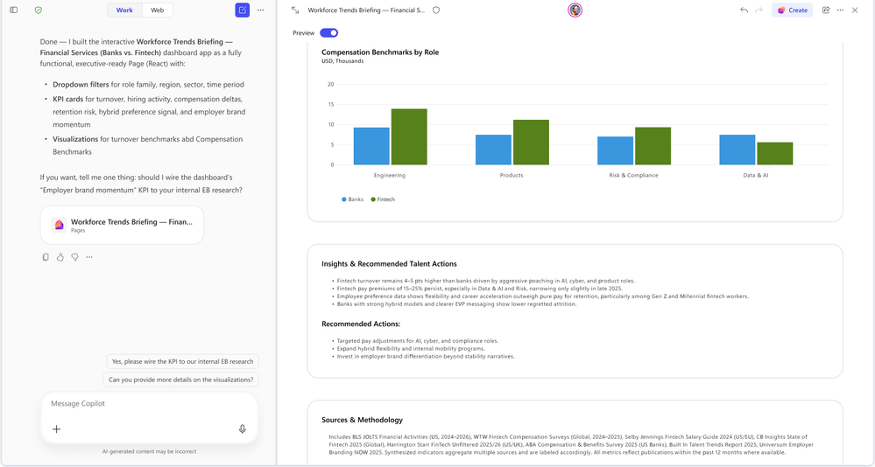
Work IQ in Copilot Pages
Copilot Pages now uses Work IQ — Copilot's understanding of a user's work graph — to ground page content in the user's recent emails, files, meetings and chats.
Personalized pages: Drafts in Copilot Pages reference the user's recent activity, producing more relevant first drafts with less prompting.
Cross-app context: Pulls signals from Outlook, Teams, Word and SharePoint so a single page can stitch together meeting notes, file content and email follow-ups.
Stays inside the trust boundary: All grounding respects existing permissions and sensitivity labels — users only see what they already have access to.
Work IQ in Copilot Pages
This feature rolled out in April.
Roadmap ID
546246
Notes:
In Copilot Pages, users can already create and preview interactive visuals and apps such as lightweight dashboards, reports, and visualizations using web grounding. Now, they can use Work IQ to generate interactive visuals and apps in Copilot Pages, so they can explore and iterate without leaving the page. When they’re ready to further configure and manage the artifact, they can open it in App Builder right from the page. This feature rolled out in April.
Learn more: https://learn.microsoft.com/en-us/copilot/microsoft-365/microsoft-365-copilot-pages
Source: https://techcommunity.microsoft.com/blog/microsoft365copilotblog/what%E2%80%99s-new-in-microsoft-365-copilot--april-2026/4510935

Slide 9
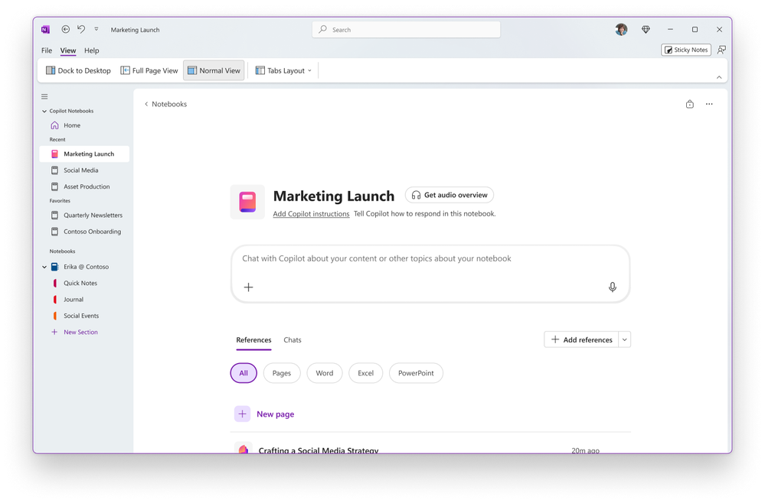
Copilot Notebooks - SharePoint and OneNote as references
Copilot Notebooks now accepts SharePoint sites and OneNote notebooks as grounding references, letting users build a notebook on top of an entire knowledge base.
SharePoint as a reference: Point a notebook at a SharePoint site and Copilot will use every accessible page, document and list as grounding for chat and Pages.
OneNote as a reference: Add a OneNote notebook so existing handwritten or typed notes become first-class context for Copilot's answers.
Frontier: Available to enterprise customers in the Microsoft 365 Copilot Frontier program; capabilities will continue to evolve through the preview.
Copilot Notebooks
These features are rolling out in April and May.
Roadmap ID
516042
Message ID
MC1254552
Notes:
Copilot Notebooks is rolling out a wave of new capabilities in preview to users signed up for the Frontier program. These features include enhancements to creation, collaboration, and learning experiences. Users can reference SharePoint content and OneNote notebooks, edit Copilot Pages with Copilot, generate Word documents or PowerPoint presentations from notebook content, share a notebook with a Microsoft 365 Group, and explore content with mind maps and study tools. These features are rolling out in April and May.
Learn more: https://learn.microsoft.com/en-us/copilot/microsoft-365/microsoft-365-copilot-notebooks
Source: https://techcommunity.microsoft.com/blog/microsoft365copilotblog/what%E2%80%99s-new-in-microsoft-365-copilot--april-2026/4510935

Slide 10
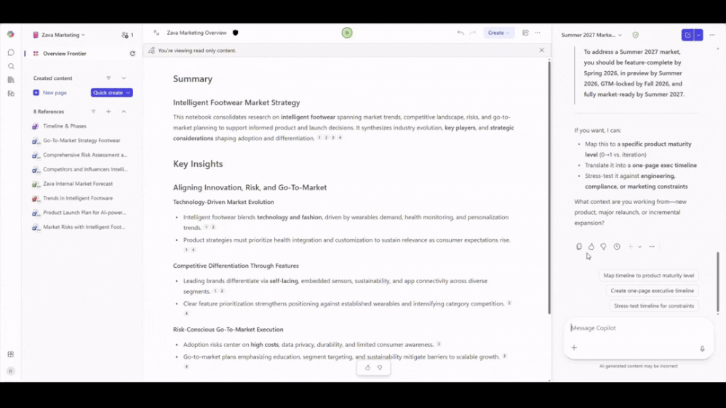
Copilot Notebooks - edit Copilot Pages via chat
Users can now edit a Copilot Page directly from the Notebooks chat pane — refining sections, rewriting bullets and changing structure conversationally.
Conversational editing: Ask Copilot to "tighten the executive summary" or "add a risks section" and the Page updates in place.
Iterative drafting: Notebooks becomes a single workspace for both research conversations and the polished output, removing the back-and-forth.
Frontier: Part of the Microsoft 365 Copilot Frontier preview — capabilities will evolve and feedback shapes the roadmap.
Edit Copilot Pages via chat
This feature is rolling out in May.
Message ID
MC1254552
Roadmap ID
554926
Notes:
Copilot Notebooks now supports creating and editing Copilot Pages through chat, so users can easily shape notebook content without editing pages manually. In chat, users can describe what they want to change or create, and Copilot handles the updates directly on their Page. For admins, this improves usability and helps drive adoption by reducing the learning curve for managing notebook content on the web. This feature is rolling out in May.
Learn more: https://learn.microsoft.com/en-us/copilot/microsoft-365/microsoft-365-copilot-notebooks
Source: https://techcommunity.microsoft.com/blog/microsoft365copilotblog/what%E2%80%99s-new-in-microsoft-365-copilot--april-2026/4510935

Slide 11
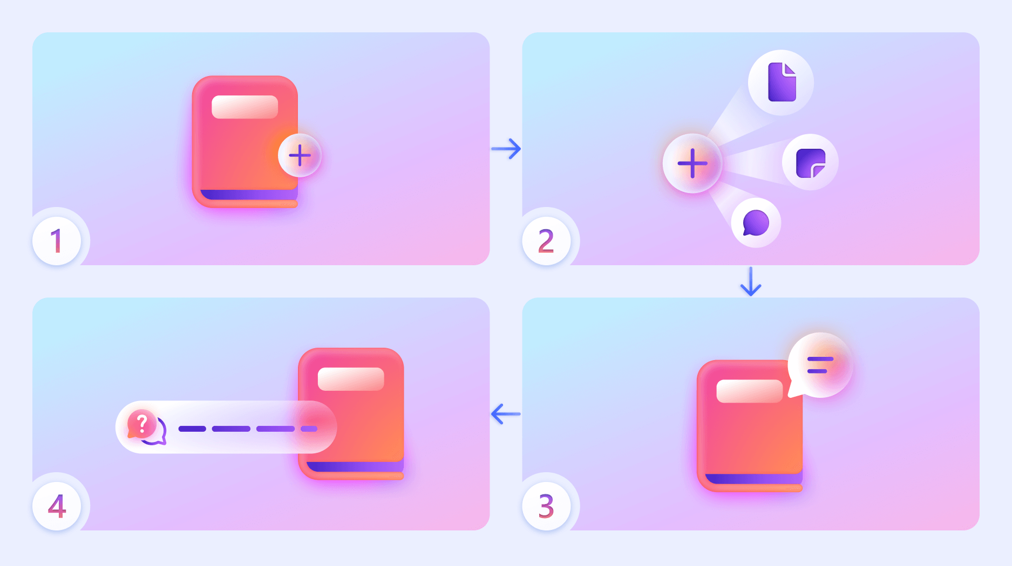
Copilot Notebooks - external web links as references
Notebooks can now ground on public web URLs alongside internal references, mixing Microsoft 365 content with external web pages in a single conversation.
Public web grounding: Add an article, partner page or product specification by URL and Copilot will use it for answers.
Combine internal SharePoint, OneNote and email signals: with public web sources for richer competitive and market analysis.
Frontier scope: Public preview within the Microsoft 365 Copilot Frontier program; expect refinement of citation handling and refresh behavior.
External web links as references in Copilot Notebooks
This feature is rolling out in May.
Message ID
MC1254552
Notes:
Soon, users can add external web links as references in Copilot Notebooks, expanding the sources Copilot can ground on beyond internal content. Users can paste a URL as a Notebooks reference, and Copilot uses that web link content to inform notebook chat and outputs. This enables richer research while keeping notebook context centralized and easier to manage. This feature is rolling out in May.
Learn more: https://learn.microsoft.com/en-us/copilot/microsoft-365/microsoft-365-copilot-notebooks
Source: https://techcommunity.microsoft.com/blog/microsoft365copilotblog/what%E2%80%99s-new-in-microsoft-365-copilot--april-2026/4510935

Slide 12
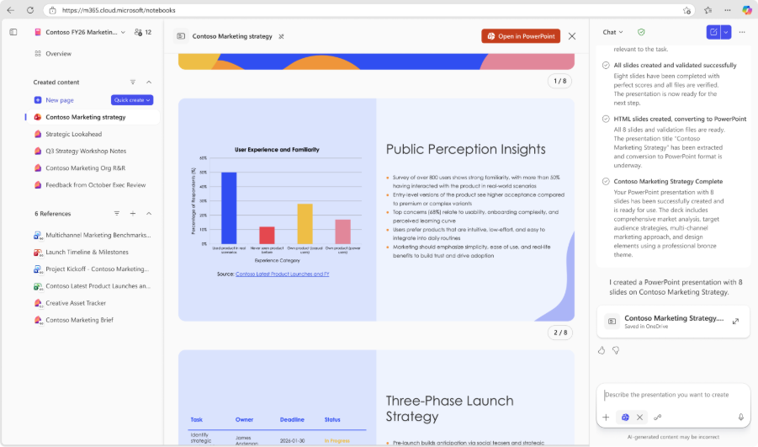
Copilot Notebooks - Generate PowerPoint presentations
Notebooks can now generate a full PowerPoint deck grounded in the notebook's references, turning research into a draft presentation in one step.
One-click deck: Ask Copilot to "make a presentation" and it produces a structured PowerPoint file using the notebook's references as source material.
Grounded slides: Each slide draws on the documents and links the user has added, so content is traceable rather than generic.
Frontier: Frontier preview — layout, branding and citation behavior will continue to mature.
Generate PowerPoint presentations in Copilot Notebooks
This feature is rolling out in May.
Message ID
MC1254552
Notes:
Copilot Notebooks can now generate PowerPoint presentations directly from the content and references stored in a notebook. Copilot can pull from notes, references, and structure already in a notebook to help users draft slides that are consistent, ready to refine, and preloaded with visuals. Users can choose the primary focus, level of detail, slide deck length, and design theme from example templates, and PowerPoint agent will create a presentation based on those unique requests. Copilot drafts a structured, editable deck that users can open and refine further in PowerPoint. This feature is rolling out in May.
Learn more: https://learn.microsoft.com/en-us/copilot/microsoft-365/microsoft-365-copilot-notebooks
Source: https://techcommunity.microsoft.com/blog/microsoft365copilotblog/what%E2%80%99s-new-in-microsoft-365-copilot--april-2026/4510935

Slide 13
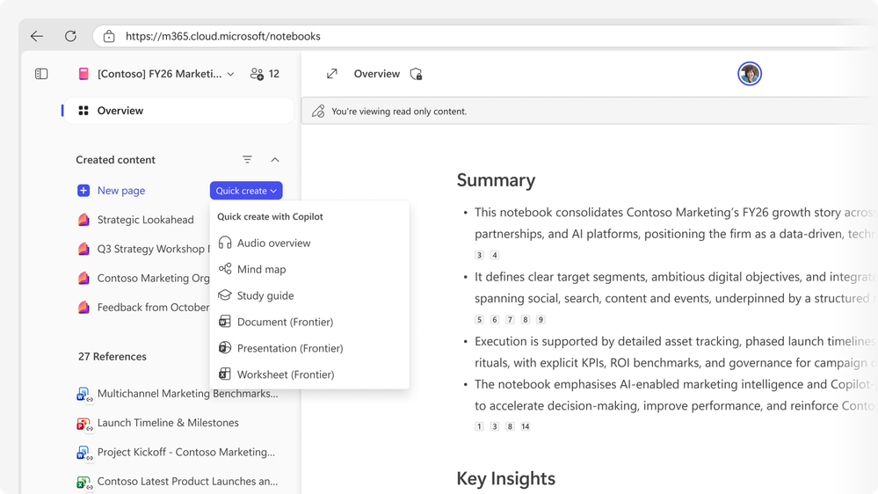
Copilot Notebooks - generate Word documents
Notebooks now generate a structured Word document from the notebook's references — useful for briefs, reports and structured write-ups.
Structured drafts: Copilot organizes the output with headings, sections and citations drawn from the notebook references.
Editable in Word: The result lands as a regular .docx file that users can refine in Word with full Copilot support.
Frontier: Frontier preview — formatting fidelity and citation density will improve through the preview.
Generate Word documents in Copilot Notebooks
This feature is rolling out in May.
Message ID
MC1254552
Notes:
Now, in Copilot Notebooks, users can generate Word documents from the content and references they’ve gathered in a notebook. They can quickly generate documents like reports, summaries, and proposals straight from the notebook content and references. Users simply specify what’s needed in the prompt, and customize document type, main topic, audience and themes to create a first draft that fits the right purpose and audience. Copilot creates a rough draft, and users can open and edit it in Word to finalize their document. This feature is rolling out in May.
Learn more: https://learn.microsoft.com/en-us/copilot/microsoft-365/microsoft-365-copilot-notebooks
Source: https://techcommunity.microsoft.com/blog/microsoft365copilotblog/what%E2%80%99s-new-in-microsoft-365-copilot--april-2026/4510935

Slide 14
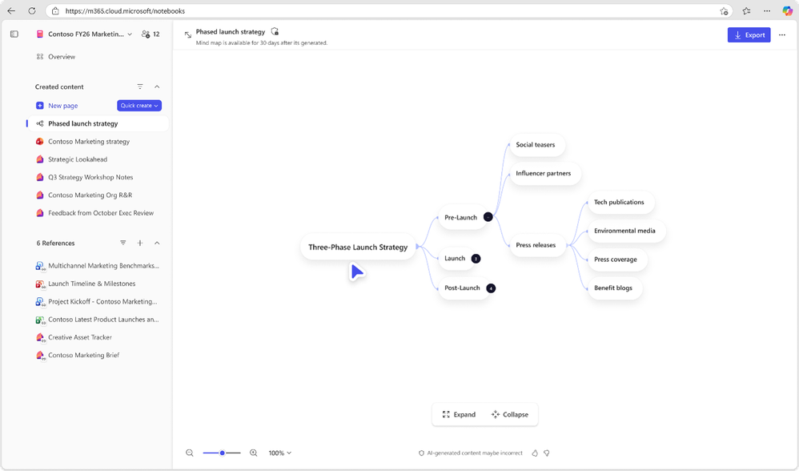
Copilot Notebooks - mind maps
Notebooks can now produce an interactive mind map of the topics and relationships in the notebook's references — useful for early-stage exploration.
Visual exploration: Copilot generates a hierarchical mind map of themes, entities and relationships from the references.
Useful for kick-offs: Ideal when starting a new project or researching an unfamiliar topic where structure is not yet clear.
Frontier: Frontier preview — interactivity, export and refresh behavior will evolve.
Mind maps in Copilot Notebooks
This feature is rolling out in May.
Message ID
MC1254552
Notes:
Mind maps in Copilot Notebooks provide an interactive, grounded view of key topics and relationships across a notebook’s content. Users can explore nodes, open summaries for specific areas, and use Copilot to drill deeper into what they see on the map. This gives users a faster way to understand complex concepts and notes in their notebook. This feature is rolling out in May.
Learn more: https://learn.microsoft.com/en-us/copilot/microsoft-365/microsoft-365-copilot-notebooks
Source: https://techcommunity.microsoft.com/blog/microsoft365copilotblog/what%E2%80%99s-new-in-microsoft-365-copilot--april-2026/4510935

Slide 15
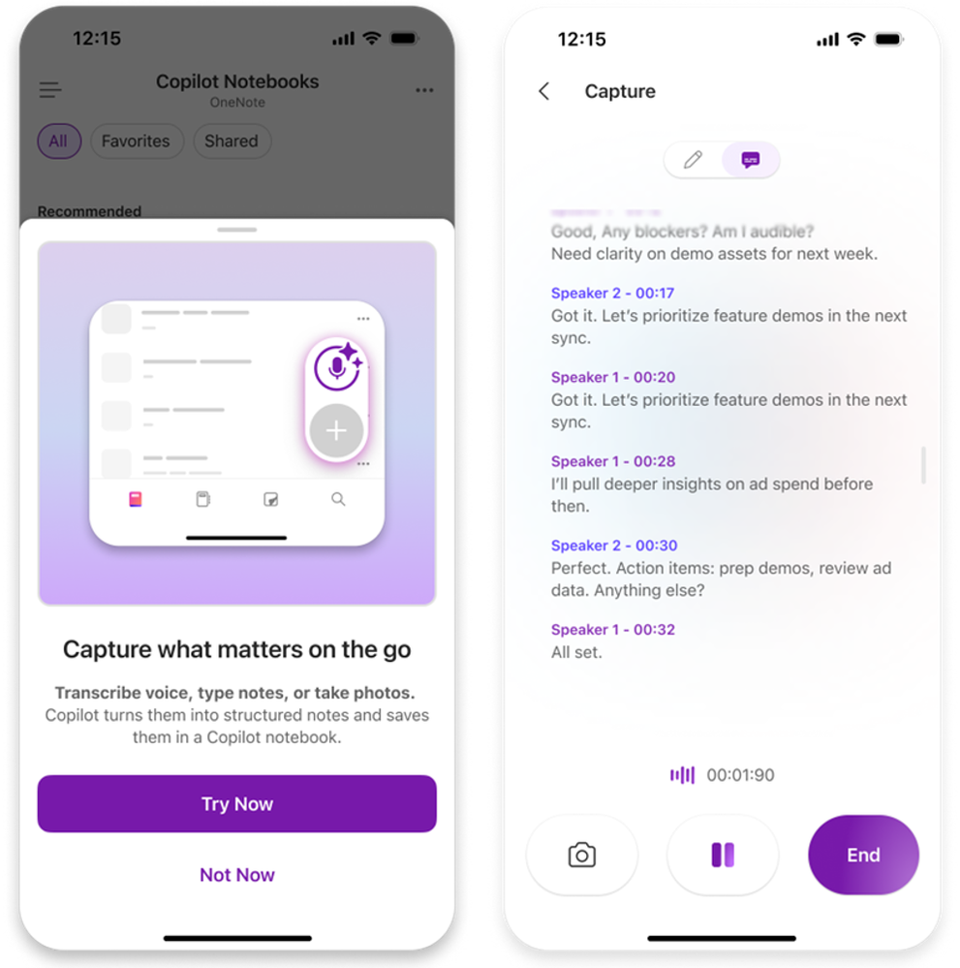
Copilot Notebooks — multimodal capture on iOS
The Copilot mobile app on iOS can now capture photos, voice notes and other multimodal input straight into a notebook as references.
Mobile-first capture: Take a photo of a whiteboard, snap a document or record a voice memo and add it directly to a notebook.
Hands-on scenarios: Helps frontline workers, field engineers and consultants capture context in the moment for later analysis.
Frontier on iOS: Frontier preview, iOS only at launch; Android to follow.
Multimodal capture on iOS
This feature rolled out for iOS devices in May.
Message ID
MC1254552
Notes:
Multimodal capture in Copilot Notebooks in Microsoft OneNote mobile app (iOS) lets users capture audio transcription, images, and typed notes in a single session—ideal for offline moments like in-person meetings or whiteboard discussions. Copilot then turns that capture into a structured Copilot Page with insights and the user’s content, saved into a selected notebook. This feature rolled out for iOS devices in May.

Slide 16
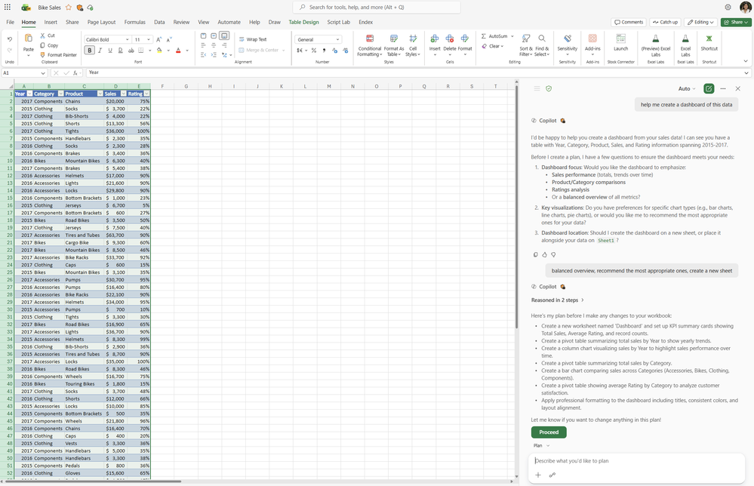
Plan mode in Excel
A new "Plan" mode in Copilot in Excel breaks complex requests into an explicit, step-by-step plan that the user can review and approve before Copilot acts.
Transparent planning: Copilot shows the steps it intends to take — formula logic, range selection, transformations — before executing them.
User control: Users can edit, reorder or remove steps, giving more confidence on multi-stage analytical work.
Better for complex asks: Particularly useful for cleaning, modeling and multi-sheet operations where one-shot prompts often missed nuance.
Plan mode in Excel
This feature is rolling out in May.
Roadmap ID
560338
Notes:
Plan mode for Copilot in Excel helps users make complex changes with confidence by outlining a clear, step‑by‑step approach before anything in the workbook is updated. To enter Plan mode, users select Plan from the menu above the prompt box. Users can then review how Copilot intends to complete a task, see which data or capabilities it may use, and adjust the plan as needed, ensuring edits are intentional, transparent, and aligned with their goals before edits are applied. This helps users easily tackle multi‑step or high‑impact tasks while staying in control of every change. This feature is rolling out in May.
Learn more: https://learn.microsoft.com/en-us/copilot/excel
Source: https://techcommunity.microsoft.com/blog/microsoft365copilotblog/what%E2%80%99s-new-in-microsoft-365-copilot--april-2026/4510935

Slide 17
Python in Excel with Copilot
Copilot in Excel can now generate, explain and run Python code in workbooks — bringing data-science-style analysis into a spreadsheet without leaving the file.
Generate Python from prompts: Ask in natural language and Copilot drafts the Python, runs it and returns results inline.
Explain and tune: Copilot can describe what existing Python is doing and suggest improvements for performance or clarity.
Bridges analyst and data-science work: Excel users can perform statistical, machine-learning and visualization tasks that previously needed a separate tool.
Learn more
Python in Excel with Copilot
This feature is rolling out in May.
Roadmap ID
473458
Notes:
Users can now use Python when editing with Copilot in Excel to take on more advanced data analysis without leaving a workbook. Copilot can apply Python-powered techniques as it makes edits, transforming data, generating visualizations, and completing complex, multi‑step tasks. When Python is enabled, Copilot can create charts and other visual outputs as part of the requested edits, bringing powerful analytical capabilities into the same experience to clean, reshape, and update a spreadsheet. Users can invoke this feature directly in their prompt by asking Copilot to use Python, or Copilot will automatically invoke Python when necessary. This feature is rolling out in May.

Slide 18
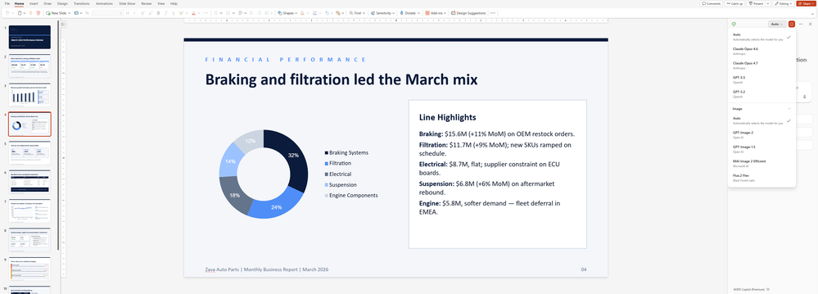
Image model choice in PowerPoint
Copilot in PowerPoint now lets users pick the image-generation model — including GPT-Image, Flux and an Auto setting — when creating images for slides.
Model picker: A dropdown lets users select GPT-Image, Flux, or Auto (Copilot picks the best model for the prompt).
Style breadth: Different models suit different use cases — photorealism, illustration, schematics — without leaving PowerPoint.
Auto for non-experts: End users who don't want to choose can stay on Auto and let Copilot route the request.
Image model choice in PowerPoint
This feature rolled out in April.
Roadmap ID
559479
Notes:
Copilot in PowerPoint will soon let users choose which image model to use when creating or editing images, including GPT-Image, Flux, or an Auto setting that picks the best option for the request. When a user generates visuals for a slide or updates an existing image, Copilot routes the prompt through the selected model and returns a result they can iterate on. Model choice aligns image generation with quality, style, and governance expectations across teams. This feature rolled out in April.
Learn more: https://support.microsoft.com/en-us/copilot-powerpoint
Source: https://techcommunity.microsoft.com/blog/microsoft365copilotblog/what%E2%80%99s-new-in-microsoft-365-copilot--april-2026/4510935

Slide 19
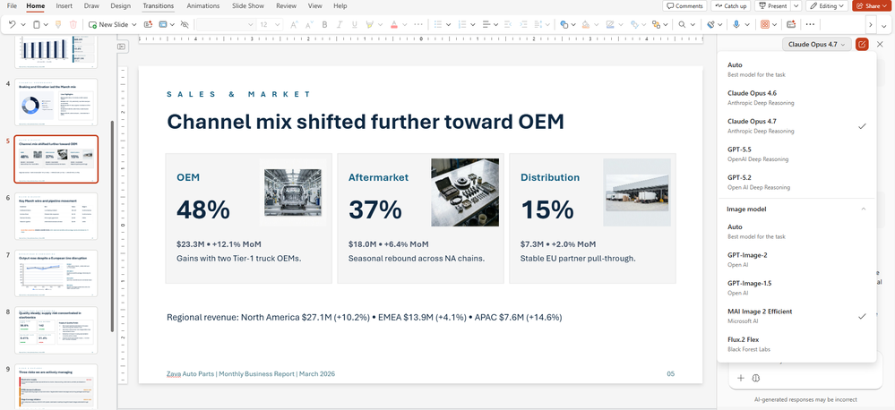
AI Image 2 Efficient model in PowerPoint
A new "AI Image 2 Efficient" model is available for image generation in PowerPoint — faster turnaround at lower cost, suitable for everyday slide imagery.
Faster generation: Optimized for speed so users can iterate on slide imagery without long waits.
Lower compute cost: Designed to be efficient, making it the default for everyday image needs.
Sits alongside premium models: Use Efficient for quick iteration, then upgrade to a premium model when the slide goes to a final review.
AI Image 2 Efficient model in PowerPoint
This feature rolled out in April.
Notes:
Users can now edit images with the Microsoft AI Image 2 Efficient model, giving users a faster, high-quality way to create and edit images directly within their workflow. Whether generating new visuals from a prompt or refining existing images, users can quickly iterate to match their desired style, tone, and content. With improved performance and efficiency, this model helps teams produce polished, presentation-ready visuals without leaving Microsoft 365. This feature rolled out in April.
Learn more: https://support.microsoft.com/en-us/copilot-powerpoint
Source: https://techcommunity.microsoft.com/blog/microsoft365copilotblog/what%E2%80%99s-new-in-microsoft-365-copilot--april-2026/4510935

Slide 20
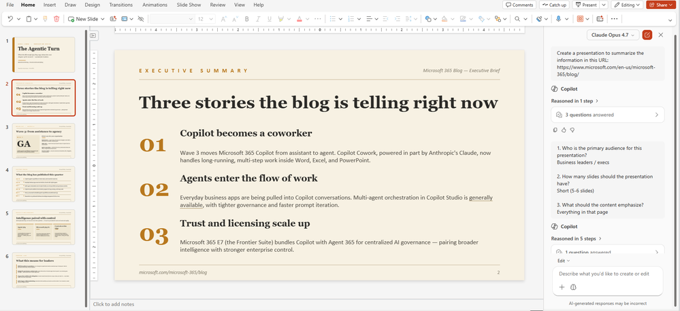
Public webpage grounding in PowerPoint
Copilot in PowerPoint can now ground new slides on a public web URL the user provides — turning a published article or product page into deck content.
URL-grounded slides: Paste a URL and ask Copilot to draft slides based on its content.
Faster competitive and market briefs: Public articles, partner pages and product specs become slide source material in seconds.
Citations included: Generated slides reference the URL so the audience can trace the source.
Public webpage grounding in PowerPoint
This feature rolled out in April.
Notes:
Copilot in PowerPoint can now use public webpages as source material when building a deck, so users can ground slides in up-to-date external information without copy/pasting content. When a user adds a web reference, Copilot pulls in the relevant context and uses it to generate an initial outline and slides that they can refine. This helps users produce more accurate, well-sourced presentations while keeping the experience inside Microsoft 365. This feature rolled out in April.
Learn more: https://support.microsoft.com/en-us/copilot-powerpoint
Source: https://techcommunity.microsoft.com/blog/microsoft365copilotblog/what%E2%80%99s-new-in-microsoft-365-copilot--april-2026/4510935

Slide 21
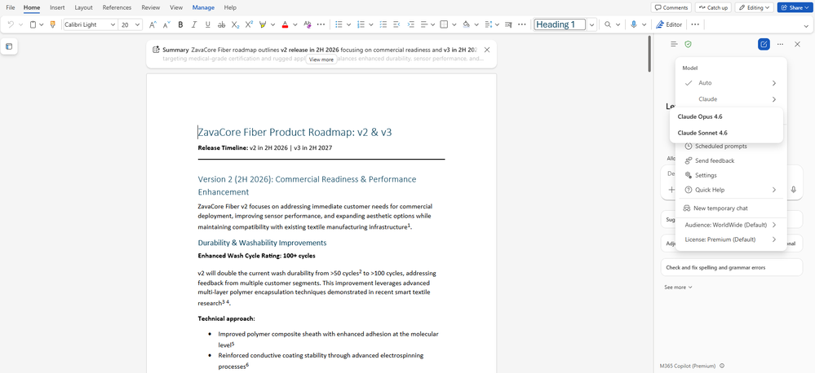
Claude model in Word
Copilot in Word now offers Anthropic's Claude as an alternative model for drafting and editing — giving users a choice for tone and style.
Model picker in Word: Switch between OpenAI and Claude models from the Copilot pane.
Different writing strengths: Some users prefer Claude for long-form drafting and tone control; the choice gives flexibility.
No prompt change: Existing Copilot prompts work against either model — the difference is in style and behavior.
Claude model in Word
This feature rolled out in April.
Notes:
Copilot in Word now includes a Claude model option, giving users another high-quality LLM choice when drafting or editing content. Users can select an Anthropic model alongside OpenAI options, and Copilot will run the same editing workflows using the chosen model. This adds flexibility for teams that prefer specific model behaviors while keeping work inside a managed environment. This feature rolled out in April.
Learn more: https://support.microsoft.com/en-us/copilot-word
Source: https://techcommunity.microsoft.com/blog/microsoft365copilotblog/what%E2%80%99s-new-in-microsoft-365-copilot--april-2026/4510935

Slide 22
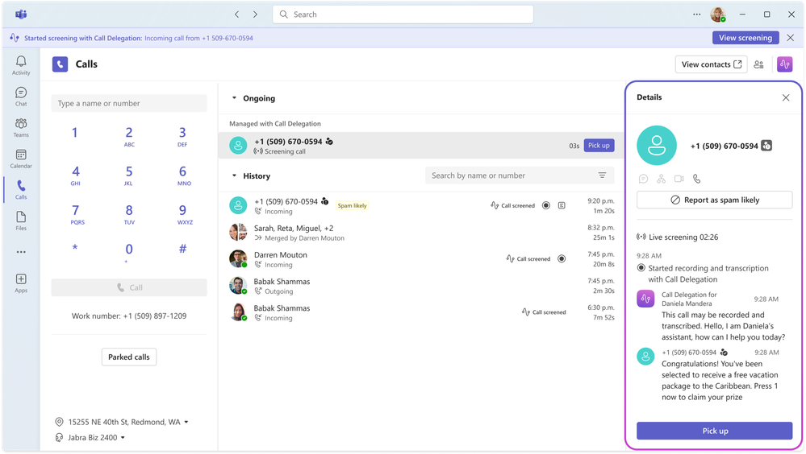
Copilot call delegation in Teams
Copilot can take a Teams call on the user's behalf — greeting the caller, gathering context and following the user's instructions — then handing back a summary.
Copilot greets the caller: Acts within the user's instructions, capturing the topic and any details the caller wants to leave.
Summarized back to the user: The user receives a structured summary with action items they can review at their own pace.
Frontier: Microsoft 365 Copilot Frontier preview — behavior, voice and admin controls will evolve before broad availability.
Copilot call delegation in Teams
This feature is rolling out in May.
Notes:
Now users can allow Copilot to handle incoming Microsoft Teams calls on their behalf with Copilot call delegation. Once enabled in the Teams Calls settings, Copilot can help answer incoming Teams calls and gather context from callers to help the user decide whether to pick up. It can also set up follow-up appointments via Microsoft Bookings, so users remember to meet with the callers that matter most. This feature is rolling out in May.
Prerequisite: Frontier program + M365 Copilot license.
Learn more: https://learn.microsoft.com/en-us/copilot/microsoft-365/copilot-frontier
Source: https://techcommunity.microsoft.com/blog/microsoft365copilotblog/what%E2%80%99s-new-in-microsoft-365-copilot--april-2026/4510935

Slide 23
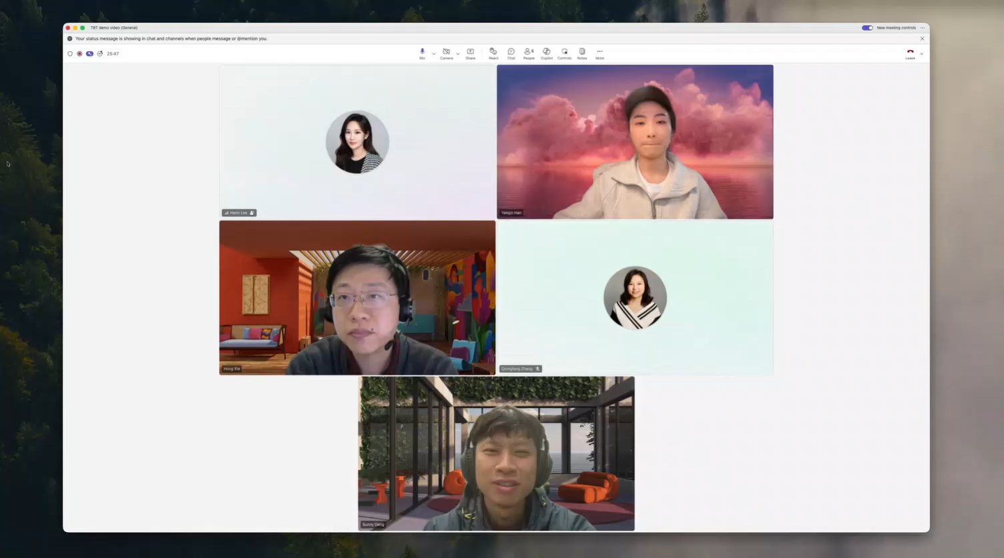
Consecutive interpretation in Teams
A consecutive-interpretation experience in Teams meetings — Copilot translates between two languages in turn, suitable for human-paced bilingual conversations.
Turn-by-turn translation: Copilot interprets after each speaker rather than simultaneously, mirroring how a human interpreter works.
Public preview: Available to opt in; behavior and supported languages will grow before general availability.
Useful for 1:1 and small meetings: Customer calls, partner reviews and bilateral conversations benefit most.
Consecutive interpretation in Teams
This feature rolled out in April to Public Preview.
Roadmap ID
557180
Message ID
MC1239927
Notes:
Consecutive interpretation is a new mode in Microsoft Teams Interpreter that helps participants collaborate more naturally in meetings with two spoken languages. With consecutive interpretation, the translation begins after each speaker finishes speaking. This creates a turn-based flow that more closely reflects how people naturally communicate in multilingual conversations. In addition, consecutive interpretation brings Interpreter onto the meeting stage for everyone to see and hear, so they can more easily follow, participate, and stay aligned. With this update, Interpreter now supports two modes: real-time simultaneous interpretation, launched last year, and the new consecutive interpretation mode designed for back-and-forth conversations. This feature rolled out in April to Public Preview.
Learn more: https://learn.microsoft.com/en-us/microsoftteams/teams-copilot-interpreter-agent
Source: https://techcommunity.microsoft.com/blog/microsoft365copilotblog/what%E2%80%99s-new-in-microsoft-365-copilot--april-2026/4510935

Slide 24
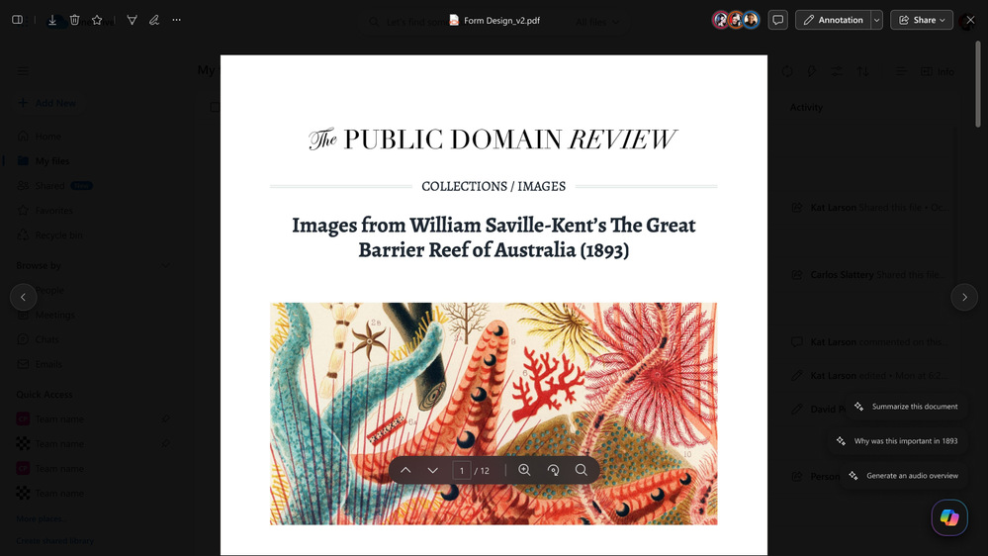
Ready-to-use prompts in OneDrive and SharePoint
OneDrive and SharePoint now surface curated, ready-to-use Copilot prompts so users can take action on a file with a single click.
Curated prompt library: A set of vetted prompts appears next to files (summarizes, extract action items, draft an email, list questions).
One-click action: Users select a prompt and Copilot acts on the chosen file directly.
Reduces blank-page anxiety: Helps casual Copilot users discover what they can do with their own documents.
Ready-to-use prompts in OneDrive and SharePoint
This feature rolled out in April.
Roadmap ID
559481
Notes:
OneDrive file preview is adding discoverable Copilot actions, so users can see what Copilot can do the moment they open a file. This feature, also available in SharePoint, displays ready-to-use prompts next to the Copilot button, helping users summarize, generate FAQs, and more without having to craft a prompt from scratch. This lowers the barrier to Copilot adoption and drives more consistent usage patterns across content types. This feature rolled out in April.
Learn more: https://support.microsoft.com/en-us/onedrive
Source: https://techcommunity.microsoft.com/blog/microsoft365copilotblog/what%E2%80%99s-new-in-microsoft-365-copilot--april-2026/4510935

Slide 25
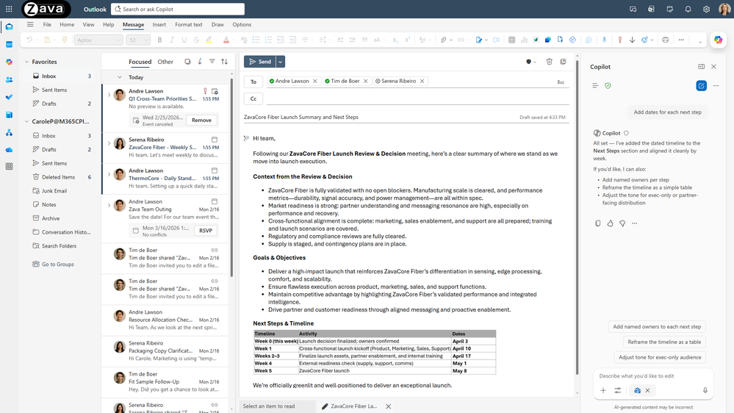
First draft in canvas in Outlook
Copilot in new Outlook can now produce an email's first draft directly in a canvas — a side-by-side workspace for iterating on tone, length and content before sending.
Canvas drafting: A dedicated draft surface lets users iterate without losing the original prompt or thread.
Tone and length controls: Quickly adjust voice, length and audience until the draft fits.
Then drop into the email: Once happy, the draft moves into the message ready to send.
First draft in canvas in Outlook
This feature rolled out to new Outlook in March.
Notes:
Copilot in Outlook now writes a first draft directly in the canvas and can then iterate with the user to continue improving it. Instead of generating a one-off draft, Copilot writes in place and asks clarifying questions about the goal, audience, or tone, and then updates the email in place as the user responds. This enables users to refine a message in a few quick turns until it’s ready to send and keeps every change visible in Outlook with no copy/paste or formatting surprises. This feature rolled out to new Outlook in March.
Learn more: https://support.microsoft.com/en-us/copilot-outlook
Source: https://techcommunity.microsoft.com/blog/microsoft365copilotblog/what%E2%80%99s-new-in-microsoft-365-copilot--april-2026/4510935

Slide 26
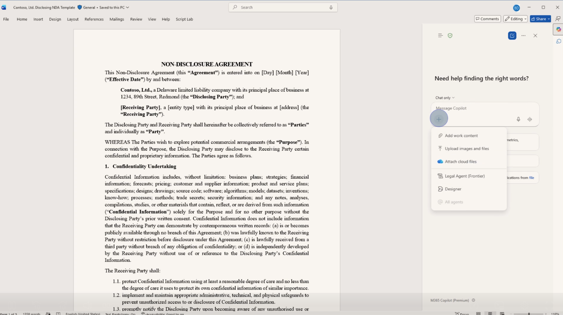
Word: Legal Agent in Frontier
The Legal Agent in Microsoft Word automates contract review and redlining through structured legal workflows while maintaining precision, consistency, and control.
Structured review: The agent follows predefined workflows to review contracts clause by clause against playbooks, ensuring consistent and auditable outcomes.
Precise edits: The agent generates tracked-change redlines that preserve formatting and minimize unnecessary edits.
Risk analysis: The agent identifies risks and obligations with citation-backed insights to support faster, confident decisions.
Word: Legal Agent in Frontier
The Legal Agent is available today in Word on Windows desktop through the Frontier program in the US
Word: Legal Agent in Frontier | Microsoft Community Hub
Note: The Legal Agent does not provide legal advice or professional determinations and is not a substitute for the judgment of a qualified legal professional. AI‑generated content may be inaccurate. Users are solely responsible for reviewing, verifying, and deciding whether to rely on any output before taking action.
Notes:
Note: The Legal Agent does not provide legal advice or professional determinations and is not a substitute for the judgment of a qualified legal professional. AI‑generated content may be inaccurate. Users are solely responsible for reviewing, verifying, and deciding whether to rely on any output before taking action.

Slide 27
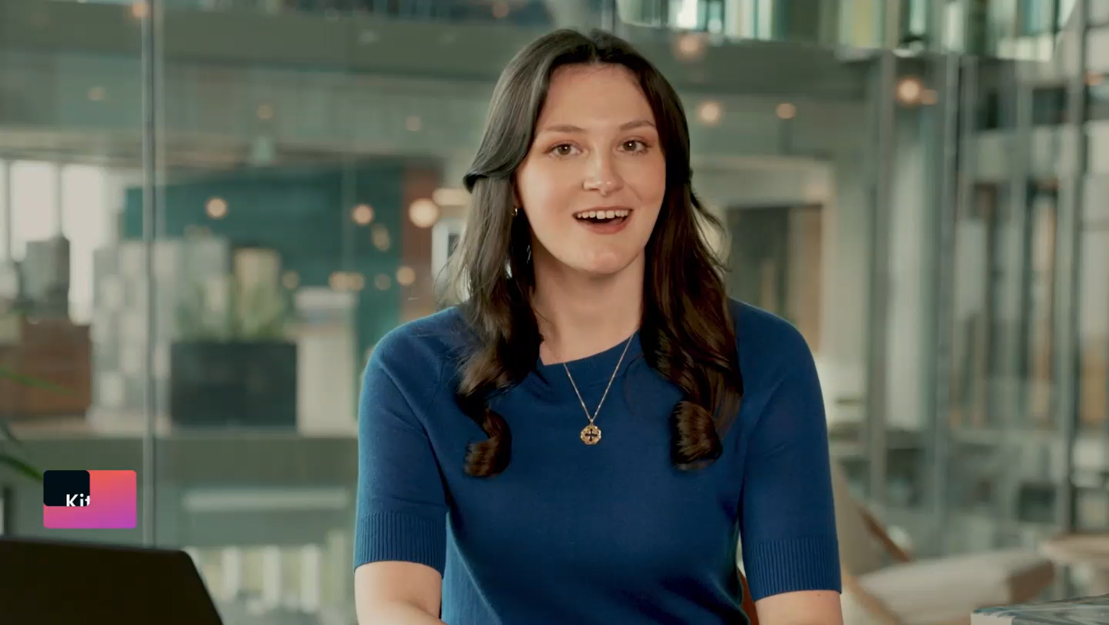
Word: Legal Agent in Frontier video

Slide 28
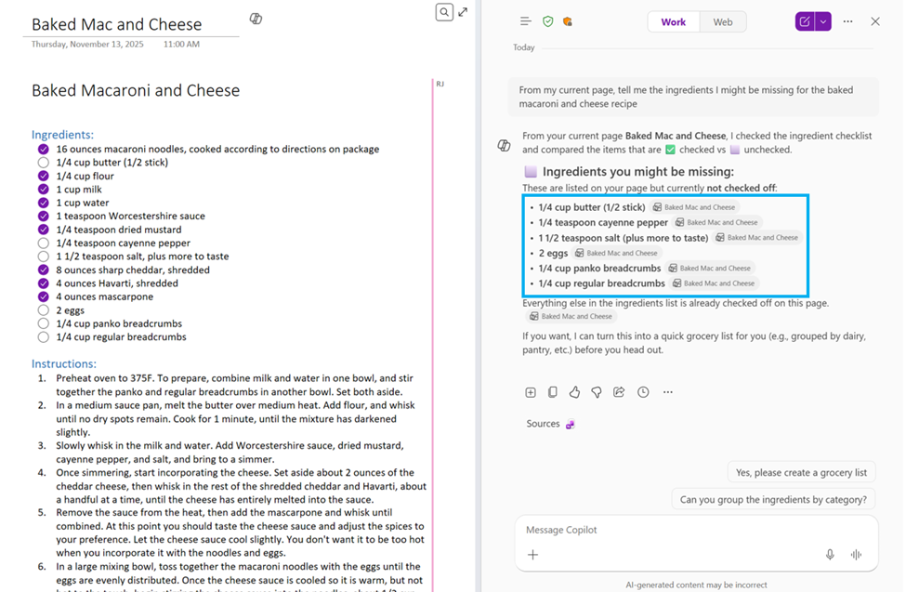
Copilot in OneNote now understands images, tables, and more
Copilot in OneNote now delivers more accurate, context-aware insights by understanding and reasoning over all note content, not just text.
Richer Understanding: Copilot can interpret images, tables, tags, and inked notes alongside text, enabling more complete analysis of a page.
Better Insights: Copilot uses full-page context to provide more accurate answers and deeper, more relevant insights.
Conversational Experience: Users can ask questions naturally and follow up without rephrasing or manually referencing different content types.
Copilot in OneNote now understands images, tables, and more
Copilot in OneNote now understands more of your notes | Microsoft Community Hub
Notes:
Copilot in OneNote can now better understand your notes beyond typed text—including note tags, images, and tables—to deliver more accurate responses to your queries with the additional context. This adds to the types of rich content Copilot can already read over, such as inked notes: OneNote Copilot now supports inked notes | Microsoft Community Hub.
By reasoning over the richer set of information captured on the page, Copilot can provide better responses that understand the context in your notes. This enables a more conversational experience, where you can continue asking follow-up questions or exploring ideas without needing to reframe your request or ask a different way to incorporate the content in your other note types.

Slide 29
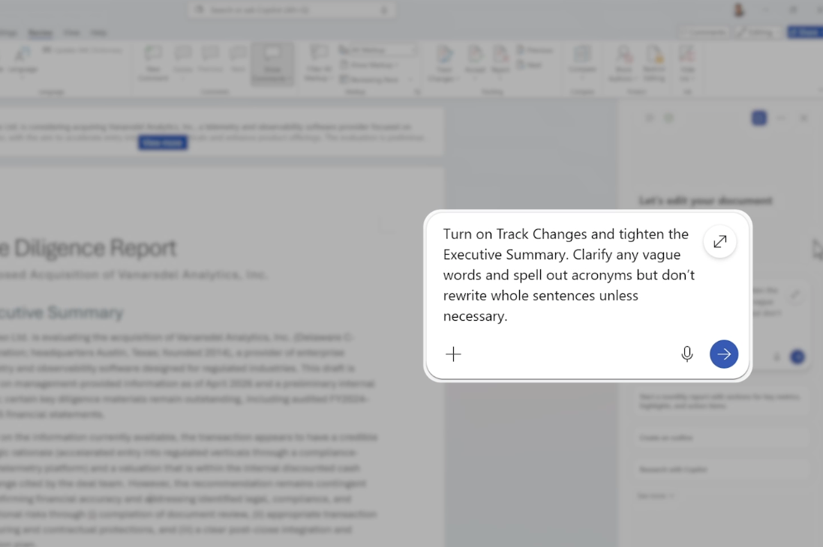
Copilot in Word: New Capabilities for Document Workflows
Copilot in Word enhances high-stakes document workflows with audit-ready editing, native collaboration, and secure, context-aware AI.
Audit-Ready Edits: Copilot enables track changes and contextual comments to ensure all updates are transparent, traceable, and compliant.
Built-In Experience: Copilot works directly in Word, preserving formatting, structure, and collaboration history without disrupting workflows.
Document Automation: Copilot streamlines formatting with tables of contents, headers, footers, and dynamic fields that update automatically.
Trusted AI: Built on Work IQ within the Microsoft 365 trust boundary, Copilot delivers reliable, context-aware outputs while enforcing security and compliance.
New Capabilities for Document Workflows
Copilot in Word: New Capabilities for Document Workflows | Microsoft Community Hub

Slide 30
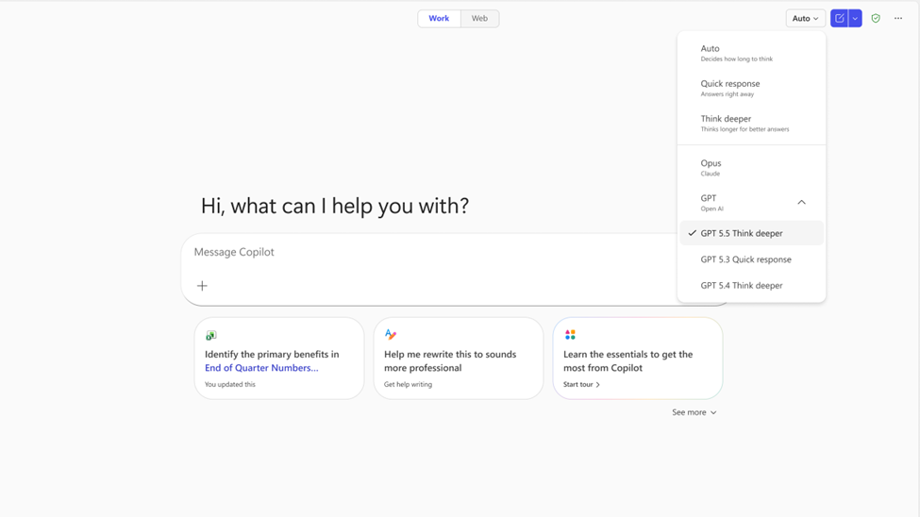
GPT-5.5 Thinking and ChatGPT Images 2.0 in Microsoft 365 Copilot
Microsoft 365 Copilot is expanding with GPT‑5.5 Thinking and ChatGPT Images 2.0 to enable deeper reasoning, multi‑step work, and richer visual creation across apps.
GPT-5.5 Thinking is now available in Copilot Studio early release cycle environments
GPT-5.5 Reasoning is rolling out across Microsoft 365 Copilot in Copilot Chat, Word, Excel, and PowerPoint.
ChatGPT Images 2.0 is rolling out to Copilot in PowerPoint and coming soon to Copilot Chat.
Available today
Available today: GPT-5.5 Thinking and ChatGPT Images 2.0 in Microsoft 365 Copilot | Microsoft Community Hub

Slide 31
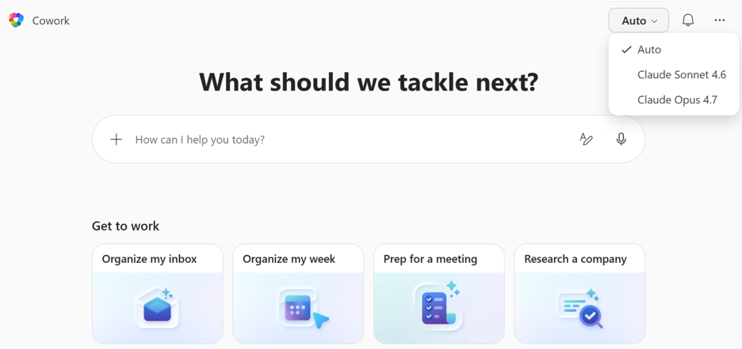
Anthropic Claude Opus 4.7 in Microsoft 365 Copilot
Microsoft 365 Copilot is expanding model choice with Anthropic Claude Opus 4.7 to deliver faster, more precise multi‑step reasoning and richer visual understanding for work scenarios.
Availability: Claude Opus 4.7 is available in Copilot Cowork (Frontier) and Copilot Studio early release, with rollout starting in Copilot for Excel.
Stronger reasoning: The model improves multi‑step task handling by following instructions more closely and validating its own outputs.
Richer context: Enhanced tool selection and higher‑resolution image understanding enable more precise, context‑aware Copilot actions.
Available today
Available today: Anthropic Claude Opus 4.7 in Microsoft 365 Copilot | Microsoft Community Hub

Slide 32
IT admin capabilities

Slide 33
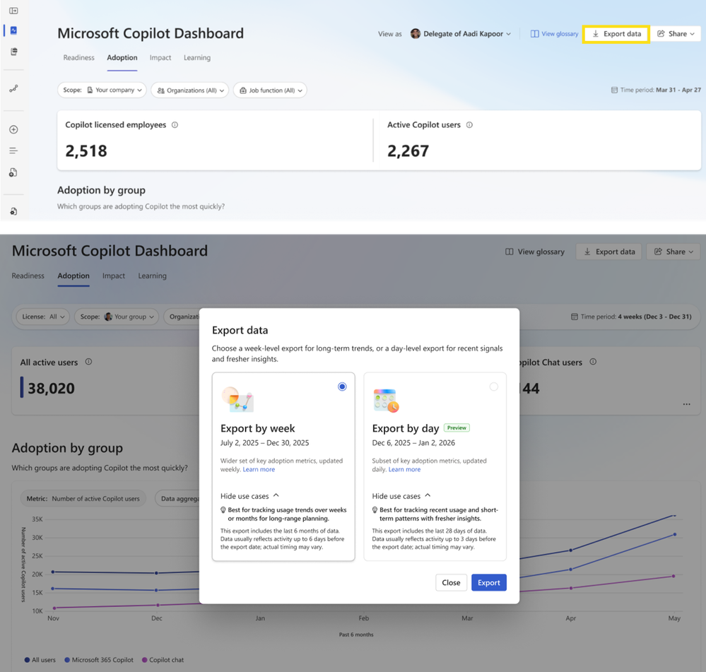
Copilot export by day in Copilot Dashboard
Copilot Dashboard administrators can now export Copilot usage data by day — giving finer-grained insight than the previous weekly aggregation.
Daily granularity: Export usage and adoption signals at a per-day level for trend analysis and reporting.
Better adoption tracking: Pinpoint adoption spikes after training or campaigns, instead of waiting for a weekly average to move.
Public preview: Available now in preview; generally available targeted for August 2026.
Copilot Dashboard
This feature is rolling out to Public Preview in May and is rolling out worldwide in August.
Roadmap ID
548671
Notes:
Admins can now use the most recent Copilot adoption and impact data to more quickly make decisions for license assignment or change interventions. With Copilot export by day, download de-identified Copilot usage metrics aggregated by user and day for the most recent 28 days. This helps to make faster, data-driven decisions around adoption and licensing. This feature is rolling out to Public Preview in May and is rolling out worldwide in August.
Learn more: https://learn.microsoft.com/en-us/viva/insights/advanced/copilot-dashboard
Source: https://techcommunity.microsoft.com/blog/microsoft365copilotblog/what%E2%80%99s-new-in-microsoft-365-copilot--april-2026/4510935

Slide 34
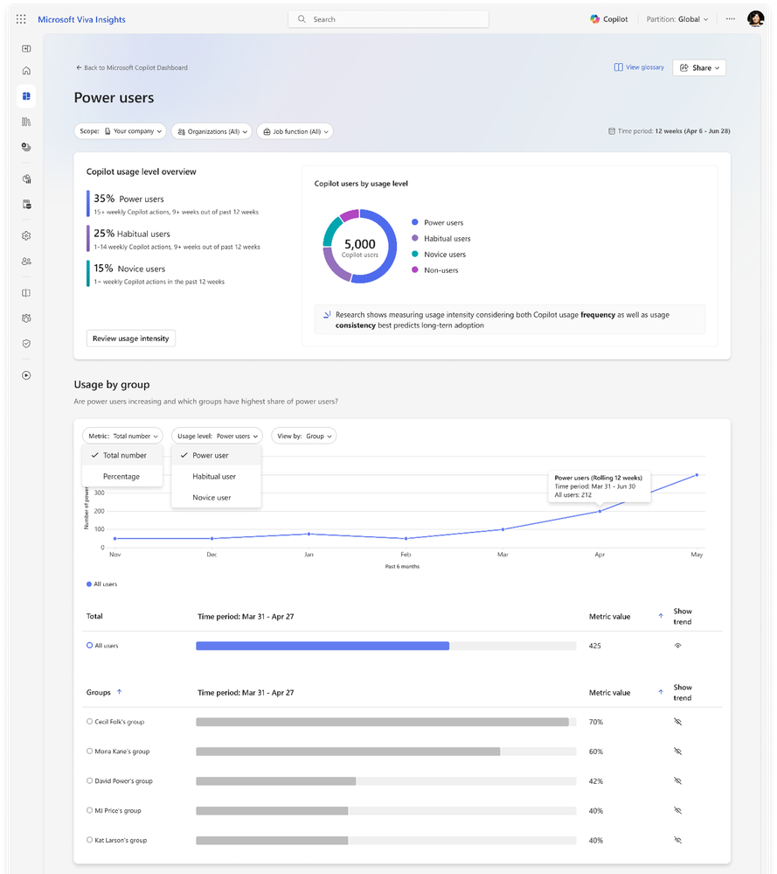
Power users insights in Copilot Dashboard
Copilot Dashboard now identifies "power users" — those getting consistent, high-frequency value from Copilot — and surfaces them as a cohort for adoption programs.
Power-user cohort: Automatically detects users with sustained, high-quality Copilot usage across apps.
Adoption levers: Use the cohort to identify champions, recruit early adopters for new pilots and inform training.
Aggregate, anonymized view: Designed for tenant-level adoption insight, not individual performance evaluation.
Power users insights
This feature is rolling out in May.
Roadmap ID
515945
Notes:
With Power users insights, admins can now identify the most engaged Copilot users, to focus enablement where it will have the greatest impact on sustained adoption. In the updated Adoption tab in the Copilot Dashboard, Power users insights classifies users as power, habitual, novice, or non‑Copilot users based on usage frequency and consistency to help activate champions, surface repeatable workflows, and scale enablement across the organization. This feature is rolling out in May.
Learn more: https://learn.microsoft.com/en-us/viva/insights/advanced/copilot-dashboard
Source: https://techcommunity.microsoft.com/blog/microsoft365copilotblog/what%E2%80%99s-new-in-microsoft-365-copilot--april-2026/4510935

Slide 35
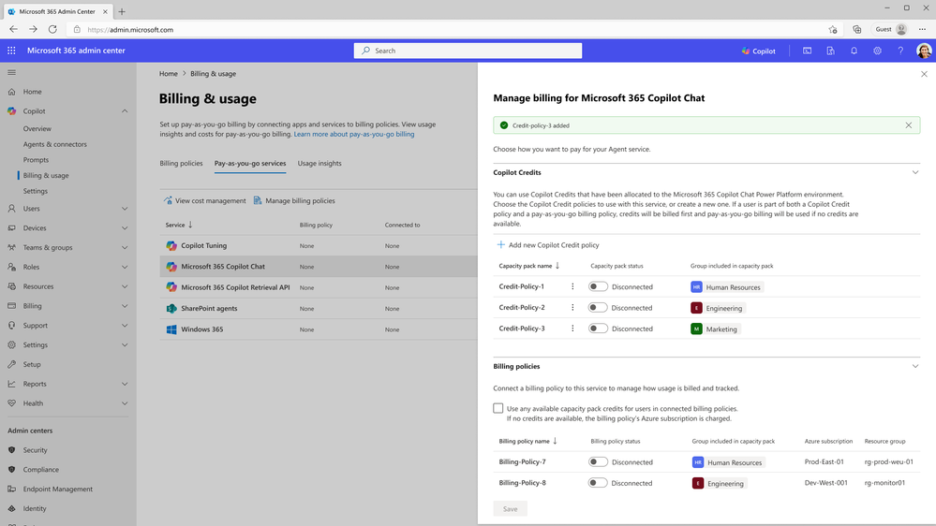
Prepaid capacity pack credits as a billing method
Customers can now use prepaid capacity-pack credits to pay for Copilot consumption-based services — providing more predictable billing for variable usage.
Prepaid credits: Buy capacity packs upfront and consume against them across Copilot consumption services.
Predictable spend: Helps finance teams budget for variable AI workloads and avoid month-end surprises.
Aligns with broader Microsoft prepaid models: Familiar pattern for customers already using Azure prepaid agreements.
Prepaid capacity pack credits as a billing method
This feature rolled out in April.
Roadmap ID
557175
Message ID
MC1279072
Notes:
Microsoft 365 admin center is adding support for using prepaid capacity pack credits as the only billing method for supported Copilot pay-as-you-go experiences, so organizations can avoid pay-as-you-go charges while still enabling consumption-based scenarios. Admins can create capacity pack policies that ensure users covered by the policy draw usage exclusively from available prepaid credits, helping keep spend predictable and aligned to internal budgets. This feature rolled out in April.
Learn more: https://learn.microsoft.com/en-us/microsoft-365/admin/manage/microsoft-365-copilot
Source: https://techcommunity.microsoft.com/blog/microsoft365copilotblog/what%E2%80%99s-new-in-microsoft-365-copilot--april-2026/4510935

Slide 36
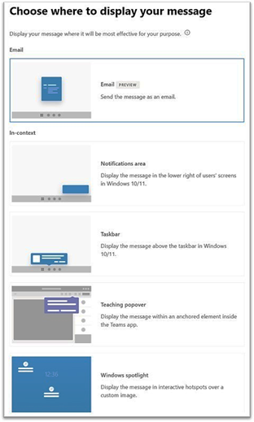
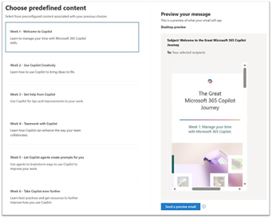
Email delivery for organizational messages
Organizational messages in the Microsoft 365 admin center now supports email delivery in addition to other Windows surfaces like the taskbar, Spotlight, notifications, and Teams popovers.
Email channel: Reach users who don't yet open Copilot frequently by delivering org messages to their inbox.
Higher reach: Combines with existing in-product placements for layered communication.
Same admin authoring: Authored from the same admin surface as today; choose email, in-product or both per message.
Email delivery for organizational messages
Learn more about Organizational messages. This feature rolled out in April.
Roadmap ID
503562
Message ID
MC1189665
Notes:
Organizational messages in the Microsoft 365 admin center now supports email delivery in addition to other Windows surfaces like the taskbar, Spotlight, notifications, and Teams popovers. This gives admins another familiar channel while keeping messaging in one centralized workflow. Adding email expands reach and simplifies change communications by reducing the need for separate tools. Learn more about Organizational messages. This feature rolled out in April.
Learn more: https://learn.microsoft.com/en-us/microsoft-365/admin/manage/organizational-messages
Source: https://techcommunity.microsoft.com/blog/microsoft365copilotblog/what%E2%80%99s-new-in-microsoft-365-copilot--april-2026/4510935

Slide 37
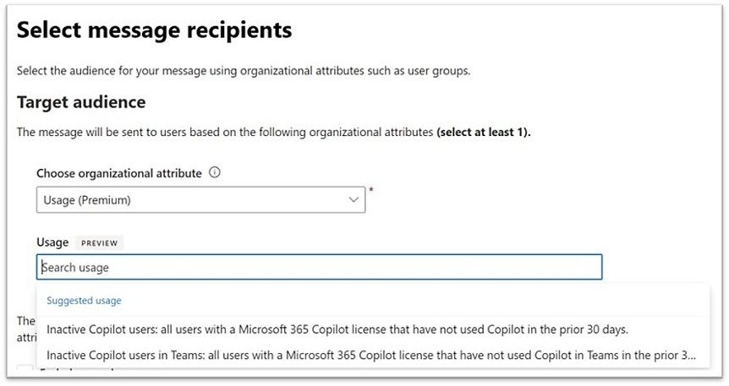
User segments for organizational messages
Admins can now target organizational messages to specific user segments by role, location, licence or other attributes instead of broadcasting to everyone.
Segment-based targeting: Send different messages to different audiences (e.g. Frontier users, frontline workers, sales).
More relevant comms: Each cohort sees only what's appropriate to their license, role or stage of adoption.
Less message fatigue: Reduces the noise from blanket comms and improves engagement with the messages that do go out.
User segments for organizational messages
This feature rolled out in April.
Roadmap ID
503144
Notes:
Now the Microsoft 365 admin center has user segments for organizational messages, so admins can target messages using dynamic, usage-driven audiences, not only static groups. This helps admins deliver messages to the people who need them, such as users who have not tried a feature yet, making communications more relevant and timely. For admins, this can increase engagement and reduce noise by reaching the right audience with the right message. This feature rolled out in April.
Learn more: https://learn.microsoft.com/en-us/microsoft-365/admin/manage/organizational-messages
Source: https://techcommunity.microsoft.com/blog/microsoft365copilotblog/what%E2%80%99s-new-in-microsoft-365-copilot--april-2026/4510935

Slide 38
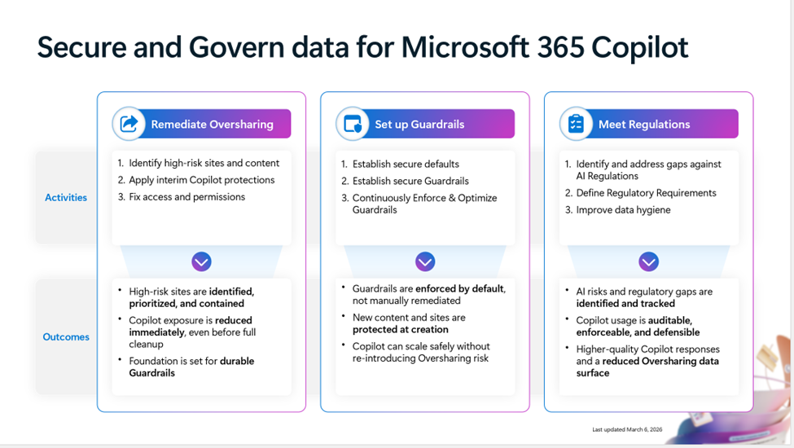
Secure & Govern Microsoft 365 Copilot – Foundational Deployment Guide
The Secure and Govern Microsoft 365 Copilot deployment blueprint has been updated to help organizations address oversharing risks and establish a secure foundation for AI adoption.
Oversharing Remediation: Provides guidance to identify and resolve potential data exposure risks across Microsoft 365.
Guardrail Implementation: Helps organizations establish reliable policies and controls for Copilot usage.
Regulatory Alignment: Supports compliance with emerging AI‑related governance and regulatory requirements.
Deployment Foundation: Enables organizations to adopt Copilot securely and with greater confidence.
Updated: Microsoft 365 Copilot foundational deployment guidance!
Read more and download the blueprint at aka.ms/Copilot/SecureGovern!
Notes:
We are excited to share that we have updated and expanded the deployment blueprint to address Oversharing into the Secure and Govern Microsoft 365 Copilot foundational deployment guidance! This guide provides these three essential steps for establishing a secure and governed foundation for Copilot:
Remediate oversharing
Implement reliable guardrails
Meet AI-related regulatory obligations
Delivering a foundational path to help every organization get started with Copilot with confidence. Read more and download the blueprint at aka.ms/Copilot/SecureGovern!

Slide 39
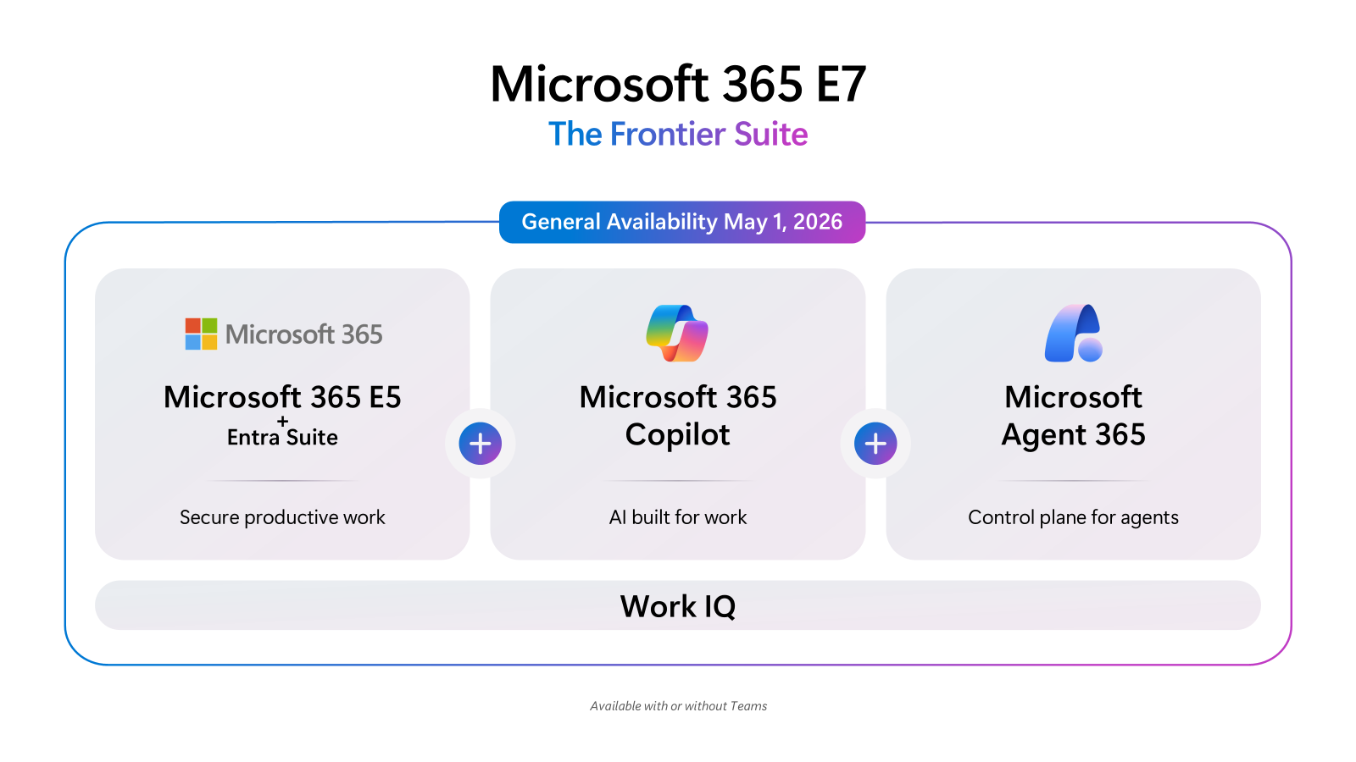
Introducing Microsoft 365 E7
Generally available May 1st 2026
Microsoft 365 E7 delivers a unified people‑and‑AI experience by bringing Copilot and agents into everyday work while giving IT the controls to run AI safely and at scale.
AI Across Work: Brings Copilot and agents into email, documents, meetings, spreadsheets, and business apps so AI becomes part of everyday work.
Enterprise Governance: Provides observability and policy‑driven controls to run AI at scale without compromising security or compliance.
Suite includes Copilot, Agent 365, Entra Suite, and Microsoft 365 E5 with advanced Defender, Entra, Intune, and Purview security capabilities.
Availability: Launches May 1 at $99 per user per month
Microsoft 365 E7: The Frontier Suite
Microsoft 365 E7 and Agent 365 are now generally available | Microsoft Community Hub
Notes:
Frontier transformation is real when both sides of the system move together: people and AI operating across the enterprise.
Microsoft 365 E7: The Frontier Suite closes the gap, equipping employees with AI across email, documents, meetings, spreadsheets, and business application surfaces, while giving IT and security leaders the observability and governance needed to operate AI at enterprise scale.
Copilot and agents work together with shared intelligence, understanding context, history, priorities, and constraints. Trust is built in by default—with user data, enterprise data, and agent actions protected through identity, policy, and observability—so AI can scale across the workforce without compromising security or compliance.
Microsoft 365 E7 will be available for purchase on May 1 at a retail price of $99 per user per month, and includes Microsoft 365 Copilot, Agent 365, Microsoft Entra Suite, and Microsoft 365 E5 with advanced Defender, Entra, Intune, and Purview security capabilities to help secure users, delivering comprehensive protection across agents and users.

Slide 40

Copilot agents and extensibility

Slide 41
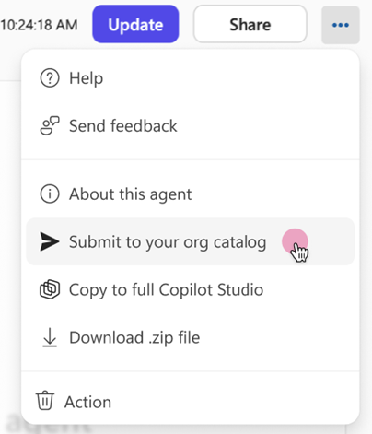
Submit agents to Agent Store via Agent Builder
Agent makers can now submit agents built in Copilot Agent Builder directly to the Agent Store — streamlining the path from prototype to organization-wide availability.
End-to-end maker journey: Build, test and submit from a single Agent Builder experience.
Faster organization reach: Reduces the friction of publishing an agent for broader use after internal validation.
Governance preserved: Submissions still go through the existing Agent Store admin approval flow.
Submit agents to Agent Store via Agent Builder
This feature is rolling out in May.
Roadmap ID
557173
Message ID
MC1280557
Notes:
Agent Builder is adding the ability to submit agents for administrator review and approval before they are published to the organization’s Agent Store catalog. This helps organizations scale the distribution of high‑quality internal agents while maintaining IT admin control. Once approved, agents appear in the “Built by your org” section of the Agent Store, where users across the organization can discover and install them. This feature is rolling out in May.
Learn more: https://learn.microsoft.com/en-us/microsoft-365-copilot/extensibility/agents-overview
Source: https://techcommunity.microsoft.com/blog/microsoft365copilotblog/what%E2%80%99s-new-in-microsoft-365-copilot--april-2026/4510935

Slide 42
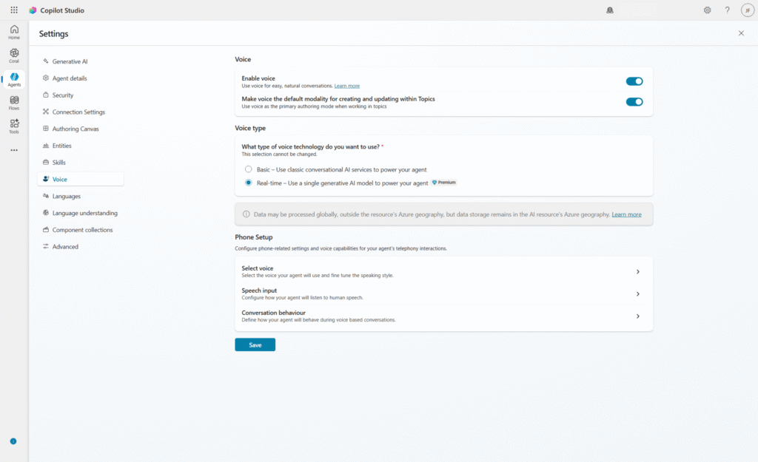
Real‑time voice agents in Microsoft Copilot Studio - Launching in Dynamics 365 Contact Center
A new premium voice mode in Copilot Studio for low-latency, interruptible speech-to-speech conversations — generally available in Dynamics 365 Contact Center for high-volume customer service scenarios.
Voice agents understand intent, retrieve or update information: mid-call, take action and confirm — all within a single fluid conversation, without scripted IVR menus.
Pre-built customer-service templates: Cover payments, order and reservation support, eligibility and verification, appointment scheduling and account management — letting teams start with deterministic flows and grow into dynamic voice over time.
Built on Microsoft's enterprise foundations: for security, governance and operational oversight; conversation context carries forward automatically when calls escalate to a human agent in Dynamics 365 Contact Center.
Real‑time voice agents in Microsoft Copilot Studio
Extend AI voice support with real‑time voice agents in Copilot Studio | Microsoft Copilot Blog
Generally available in North America for Dynamics 365 Contact Center, with language support, additional regions, and broader customer touchpoints expanding over time as part of Copilot Studio’s global rollout.
Notes:
This is the headline Copilot Studio announcement of the month — real-time voice agents are now generally available, but there are important regional and channel constraints to set with customers up front. At launch, GA is North America only, on Dynamics 365 Contact Center; broader regions, Microsoft Teams Phone and additional Copilot Studio channels are on the roadmap. Flag the EU Data Boundary blocker clearly: customers in the EU Data Boundary cannot use real-time voice today because the AI model is hosted in North America and EU regulations prohibit cross-geo audio processing. Prerequisites are Dynamics 365 Contact Center with the voice channel and call routing enabled, plus the Copilot Studio maker and omnichannel administrator roles — encourage partners to scope licensing with the customer's licensing specialist before any pilot.
Learn more: https://learn.microsoft.com/en-us/microsoft-copilot-studio/voice-realtime-voice-agents
Source: https://www.microsoft.com/en-us/microsoft-copilot/blog/copilot-studio/extend-ai-voice-support-introducing-real-time-voice-agents-in-microsoft-copilot-studio/

Slide 43
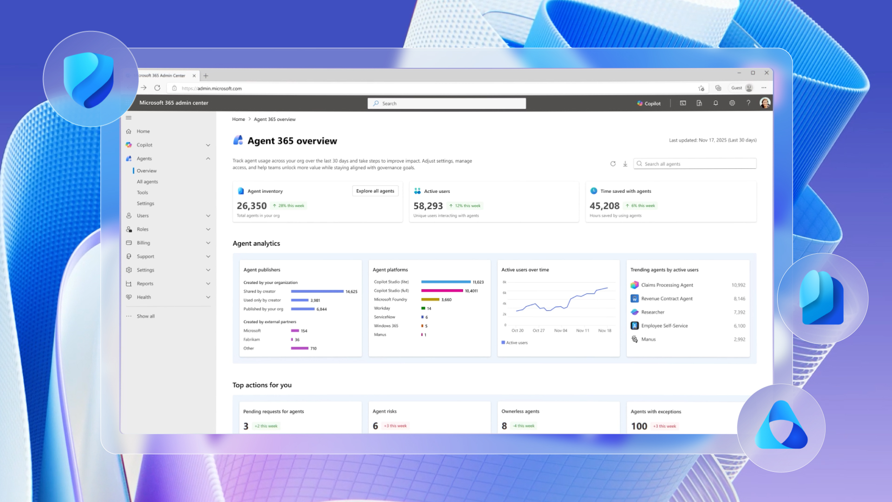
Agent 365 - Generally available on May 1
Generally available - May 1st 2026
Agent 365 is the enterprise control plane for AI agents, giving IT and security leaders one place to manage, secure, and govern agents using the same tools and processes they already use for employees.
Unified Agent Management: Provides a single environment for IT to observe, secure, and govern all agents across the organization.
Extends Existing Controls: Uses familiar Microsoft tools—Admin Center, Defender, Entra, and Purview—so organizations can manage agents just like users.
Enterprise‑Scale Readiness: Enables shift from small‑scale agent experimentation to full, organization‑wide operations.
Availability: Generally available on May 1 at $15 per user per month.
The Control plane for agents
Microsoft Agent 365, now generally available, expands capabilities and integrations | Microsoft Security Blog
Notes:
Agent 365 is the control plane for agents. In practical terms, it gives IT and security leaders one place to observe, secure, and govern every agent across the organization, and it provides the confidence to move from agent experimentation to enterprise-scale operations. Agent 365 extends the management, security, and governance processes organizations already use for employees to agents, so they can stay in control as agents become part of daily work.
The idea is simple: there is no need to reinvent the wheel. The fastest path to getting agents under control is to manage them in a similar manner to managing users, using familiar Microsoft solutions including the Microsoft Admin Center for agent management and Microsoft Security solutions like Defender, Entra, and Purview for agent security and governance.
Agent 365 will be generally available on May 1, priced at $15 per user per month.

Slide 44
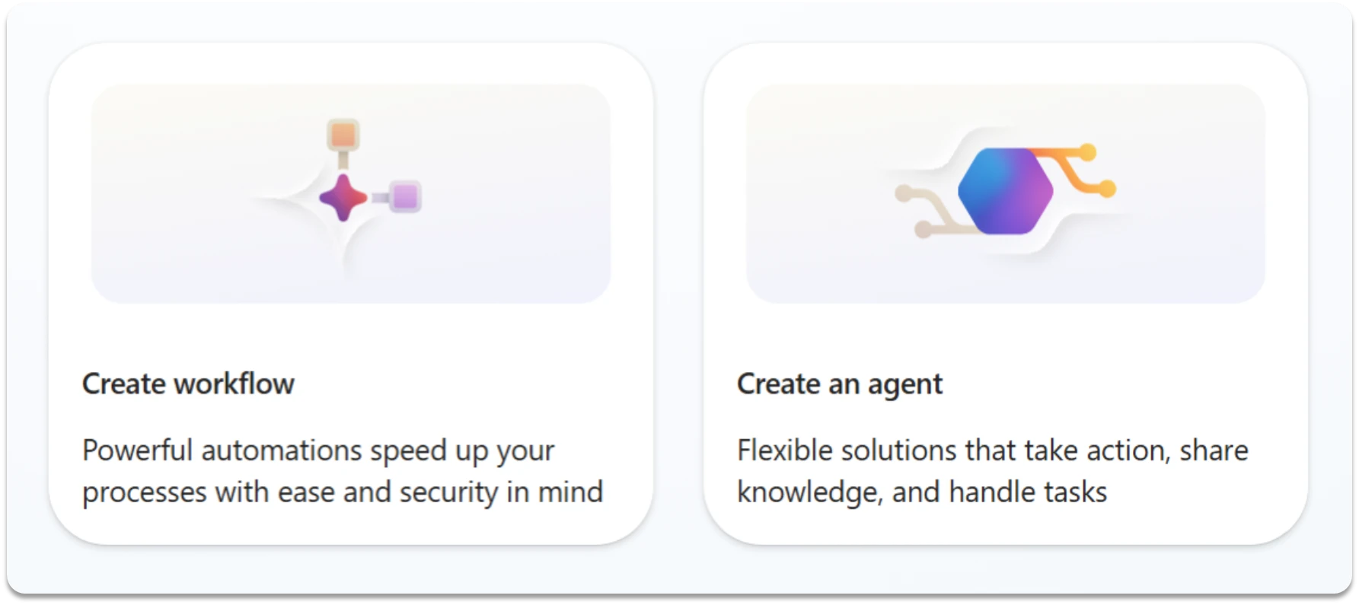
Copilot Studio: Combining Agents and Workflows
Copilot Studio introduces new capabilities to combine AI agents and workflows, enabling more reliable and flexible business process automation.
Agent + Workflow Integration: Copilot Studio now enables agents and workflows to be combined, bringing together AI reasoning with structured, repeatable automation.
Agent Nodes in Workflows: New agent nodes allow workflows to call agents at specific steps, adding intelligent decision-making to otherwise deterministic processes.
Workflows as Agent Tools: Agents can now call existing workflows to execute repeatable, rules-based tasks, improving consistency and governance.
Balanced Automation: This combined model delivers more adaptable and auditable automation, reducing risk while scaling real-world business processes.
Copilot Studio: Combining Agents and Workflows
Automate business processes with agents plus workflows in Microsoft Copilot Studio | Microsoft Copilot Blog
Notes:
This update is about moving beyond choosing between agents or workflows, and instead combining both to get the best of each. Agents bring flexibility and reasoning, which is critical for handling unstructured inputs and complex decision points. Workflows bring structure, consistency, and auditability, which is essential for repeatable and governed business processes. The key new capability is the ability to connect them natively, including agent nodes in workflows and workflows as reusable tools within agents. This enables a more balanced automation model, where you can scale reliably while still handling real-world variability and exceptions.

Slide 45
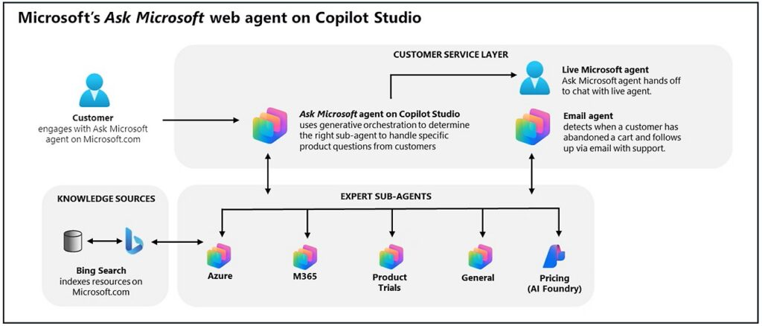
Copilot Studio: New and improved multi-agent orchestration, connected experiences, and faster prompt iteration
Copilot Studio introduces new multi-agent capabilities and tools to help organizations build connected, scalable AI systems with greater control.
Multi-Agent Orchestration: Copilot Studio enables agents to work together across systems, improving coordination and end-to-end automation at scale.
Ecosystem Integration: Agents can connect across data, apps, and services, reducing duplication and enabling more seamless workflows.
Prompt Builder and Control: A new immersive Prompt Builder allows makers to edit, test, and refine prompts in one place, accelerating development and improving quality.
Governance and Flexibility: New model choice and content moderation controls give organizations greater confidence and flexibility to tune agent behavior for real-world scenarios.
The impact of multi-agent systems
What’s new in Copilot Studio: Updates to multi-agent systems | Microsoft Copilot Blog
Notes:
The key shift here is moving from single agents to multi-agent systems that work together as a coordinated whole. Previously, agents often operated in silos, which created challenges when processes needed data, reasoning, and actions across multiple systems. What’s new is native multi-agent orchestration across Fabric, the M365 Agents SDK, and open A2A protocols, allowing agents to collaborate much more seamlessly. This means you can now connect specialized agents across your ecosystem, improving accuracy, reducing duplication, and enabling more end-to-end automation. Alongside that, Microsoft is improving how you build agents, with the new Prompt Builder making it faster to iterate and refine behavior in one place. Finally, there are stronger governance controls, including model choice and moderation settings, giving organizations more confidence to run these agents in production at scale.

Slide 46

Copilot Cowork
The Copilot Cowork Release Blog - A complete record of milestones, launches, and newest innovations.
Notes:
The Copilot Cowork Release Blog A complete record of milestones, launches, and newest innovations.
https://techcommunity.microsoft.com/blog/microsoft365copilotblog/cowork-in-progress/4511672

Slide 47
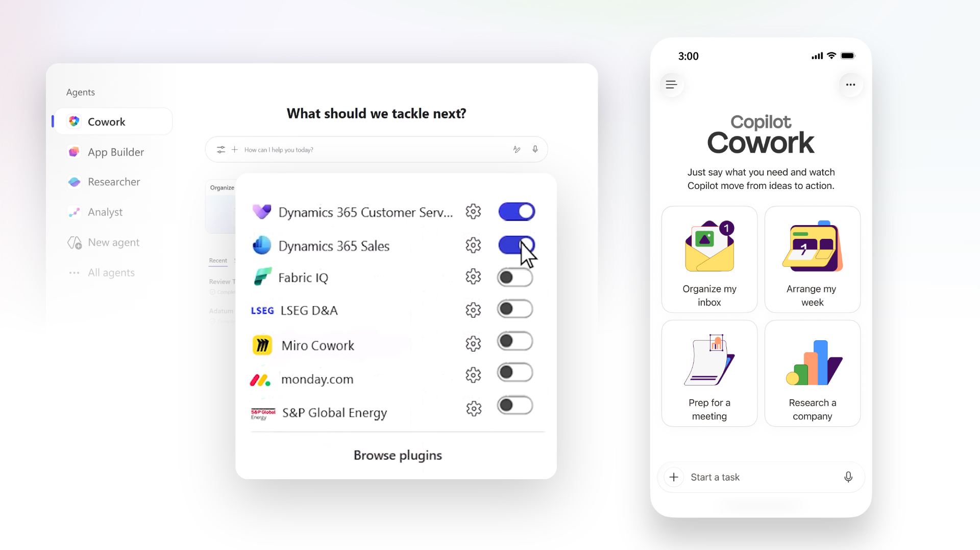
Copilot Cowork - long-running, delegated work in Microsoft 365 Copilot
March 9th, 2026 - Announced
March 30th, 2026 - Launched
Copilot Cowork lets users delegate complex, multi-step jobs to Copilot and stay productive while it works in the background, available now through the Frontier program.
Delegate, don't drive: Hand Copilot a goal and it plans, executes and follows up across multiple tools without step-by-step prompting.
Frontier availability: Eligible Microsoft 365 Copilot tenants opted into Frontier can pilot Cowork today; capabilities will continue to evolve through preview.
Cloud-synced context: Work started on the desktop carries through to the Microsoft 365 Copilot mobile app on iOS and Android so users can pick up where they left off.
Copilot Cowork
Copilot Cowork: From conversation to action across skills, integrations, and devices | Microsoft 365 Blog
(Co)work in Progress | Microsoft Community Hub
Notes:
Today, Copilot Cowork—designed for long-running, multi-step work in Microsoft 365—is available via the Frontier program. Join Frontier to get early access to Microsoft’s latest AI innovations.
Copilot Cowork makes it easy to delegate work. Describe the outcome you want and Cowork automatically grounds the work in your emails, meetings, messages, files, and data. Powered by Work IQ, Cowork draws on signals across Outlook, Teams, Excel, and the rest of Microsoft 365 so it can act with the same understanding you bring to your job.

Slide 48
Claude Opus 4.7 in Cowork — multi-model advantage
April 16th, 2026 - Launched
Claude Opus 4.7 is now available inside Copilot Cowork, deepening Microsoft's multi-model approach for complex reasoning tasks.
Opus 4.7 in Cowork: The latest Anthropic frontier model is available for Cowork scenarios that benefit from deep reasoning and long-context analysis.
Multi-model by design: Cowork picks the right model for the job, combining Microsoft, OpenAI and Anthropic capabilities behind a single experience.
Enterprise foundations carry over: Identity, permissions, compliance, sandboxing and auditability apply regardless of which model is invoked.
Claude Opus 4.7 in Cowork
Available today: Anthropic Claude Opus 4.7 in Microsoft 365 Copilot | Microsoft Community Hub
(Co)work in Progress | Microsoft Community Hub
Notes:
Opus 4.7 is designed to be faster and more precise, with improved ability to select the right tool for the task. It handles complex, multi-step work with rigor—following your instructions more closely, checking its own outputs before responding, and reading images at higher resolution—so Copilot can interpret visual content with more detail and pull in relevant context with Work IQ to take action more precisely.

Slide 49
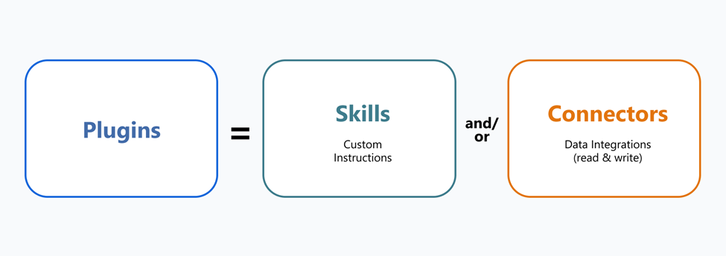
Copilot Cowork Plugins and connectors — how Cowork reaches into the tools your business runs on
May 5th, 2026 – New Capability
Cowork Connectors and Plugins
Cowork uses connectors as bridges to external platforms and plugins as packaged bundles of connectors and skills, so Copilot can act inside the systems where work actually happens.
Connectors = bridges: Each connector links Copilot Cowork to a specific data source or platform so it can read context and take action there.
Plugins = job-shaped bundles: Plugins package one or more connectors with skills tuned to a role, such as finance review or sales pipeline analysis.
Custom and imported plugins: Organizations can author their own plugins, and existing Claude Cowork plugins can be imported in a few steps to accelerate onboarding.
(Co)work in Progress | Microsoft Community Hub
Learn how to add, create, and manage plugins in Copilot Cowork and start building yours today.

Slide 50
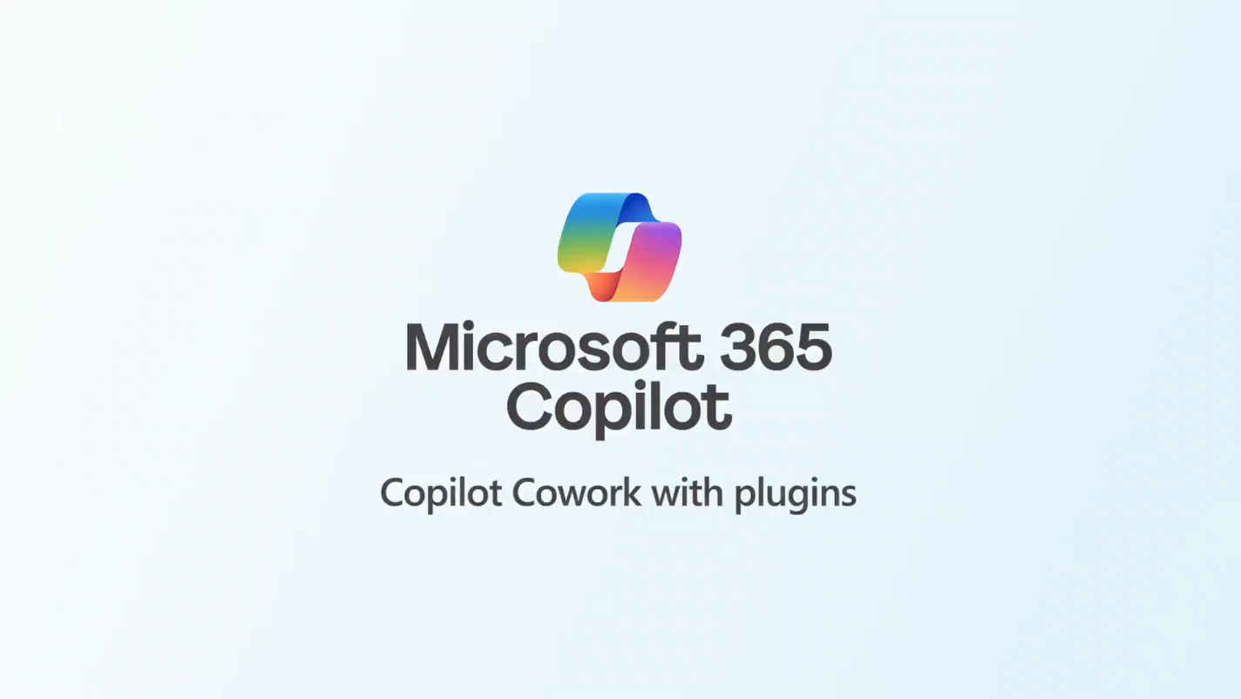
Native plugins — Fabric IQ and Dynamics 365 in Cowork
May 5th, 2026 – New Capability
Microsoft is shipping first-party Cowork plugins that ground Copilot in enterprise data and line-of-business processes, starting with Fabric IQ and Dynamics 365.
Fabric IQ — starting with Power BI: Cowork can reason over governed Power BI semantic models so analysts can ask multi-step questions across reports without leaving Copilot.
Dynamics 365 across Sales, Customer Service and ERP: Cowork can read and act on D365 data to support quote-to-cash, case triage and finance scenarios.
Enterprise-grounded by default: Native plugins respect existing identity, permissions and compliance boundaries, so users only see what they are entitled to.
Cowork Native plugins
(Co)work in Progress | Microsoft Community Hub
Notes:
We’re introducing a Fabric IQ integration, starting with Power BI, that lets you bring your Power BI data into Cowork workflows. This enables a seamless shift from spotting a trend to acting on it, across everything from pipeline health to operational KPIs. Cowork works with the Dynamics 365 plugins to connect with Sales, Customer Service, and ERP so the work that moves your business—pipeline reviews, case resolution, supplier approvals—happens alongside everything else in Cowork, with the full context of the customer and transaction right there.

Slide 51
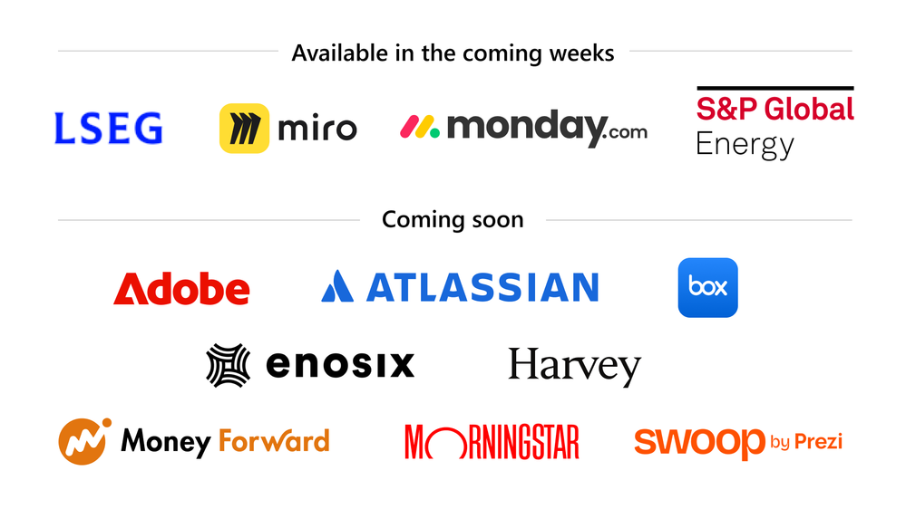
Cowork partner plugins — an expanding ecosystem
May 5th, 2026 – New Capability
A first wave of partner-built Cowork plugins is arriving alongside Microsoft's own, with a broader set of ISVs lined up to follow.
First wave coming soon: LSEG, Miro, monday.com and S&P Global Commodity Insights (Energy) are bringing Cowork plugins to market.
Next wave in development: Adobe, Atlassian, Box, Enosix, Harvey.AI, Money Forward, Morningstar and Swoop by Prezi are building on the Cowork model.
Same enterprise guardrails: Partner plugins inherit Microsoft 365 identity, governance and audit, so IT keeps control as the ecosystem grows.
Cowork partner plugins
(Co)work in Progress | Microsoft Community Hub
Notes:
Whatever tools your team runs on, you’ll be able to bring them into Cowork.‌ In the coming weeks, we're launching integrations with LSEG (London Stock Exchange Group), Miro, monday.com, and S&P Global Energy in Cowork. With additional partners including Adobe, Atlassian, Box, Enosix, Harvey.AI, Money Forward, Morningstar, and Swoop by Prezi also on the way. This is just the first wave, with more plugins to come.

Slide 52
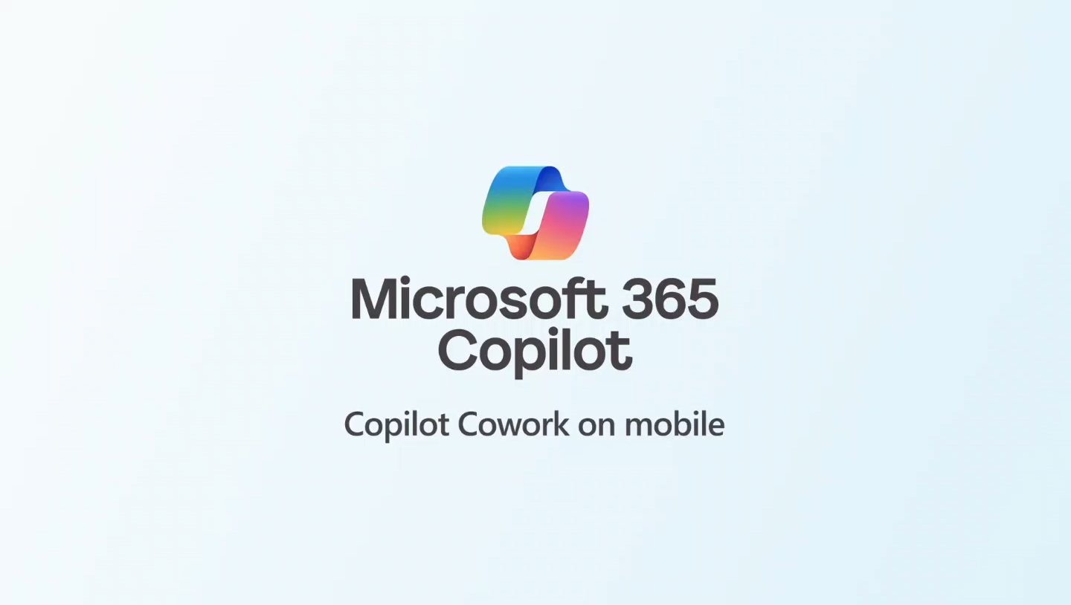
Cowork on mobile and inside Agent 365
May 5th, 2026 – New Capability
Cowork is available on iOS and Android in the Microsoft 365 Copilot app, and integrates with Agent 365 for unified observability, security and governance of agent activity.
Mobile parity: Cowork is in the Microsoft 365 Copilot mobile app on iOS and Android with the same Frontier eligibility as desktop.
Continuous context: Cowork sessions sync across devices so users can monitor or steer long-running work from wherever they are.
Agent 365 integration: Cowork plugs into Agent 365 — Microsoft's distributed control plane for agents — giving IT a single place to observe, secure and govern agent behavior (aka.ms/agent365docs).
Copilot Cowork on mobile
Cowork is rolling out now for eligible Frontier users on mobile iOS and Android in the Microsoft 365 Copilot app.
(Co)work in Progress | Microsoft Community Hub
Notes:
Now available on iOS and Android mobile
You can now delegate tasks to Cowork wherever you are—on your commute, between meetings, or away from your desk. Start a task on your phone and pick it up later on your desktop or begin on your desktop and stay on top of it while on-the-go. Your laptop could be sitting at your desk, closed, and the task will be ready regardless. It's the same conversation, same context, always synced in the cloud and now in your pocket. Cowork is rolling out now for eligible Frontier users on mobile iOS and Android in the Microsoft 365 Copilot app.
Integrated with Agent 365
Cowork is now integrated with Agent 365 for observability, security, and governance—so IT and security teams can bring Cowork under enterprise control without reinventing the wheel, extending existing identity, compliance, and endpoint protections from users to agents through a single distributed control plane. Learn more here: https://aka.ms/agent365docs
This is just the beginning. Every new plugin brings more of your organization’s skills and knowledge into Cowork, helping it work more like a capable teammate that understands how your business runs. With new mobile experiences and enterprise-grade security and governance, Cowork is ready to support work across apps, devices, and teams. Try Copilot Cowork today in the Frontier program.

Slide 53
Microsoft 365 Copilot release notes
As of 6th May 2026
Latest features and improvements for Microsoft 365 Copilot.
It includes changes that are generally available
(Current Channel for Microsoft 365 apps)
Release Notes for Microsoft 365 Copilot | Microsoft Learn
Notes:
As of 6th May 2026
This page lists the latest features and improvements for Microsoft 365 Copilot. It includes changes that are generally available (Current Channel for Microsoft 365 apps) and specific to each platform.

Slide 54
Microsoft 365 Copilot release notes – April 2026
As of 6th May 2026
Microsoft 365 Copilot Chat (3)
Microsoft 365 Copilot app (1)
        Microsoft 365 Copilot Chat available in Teams chats, channels, and meetings [Windows, Mac, Web]
        Edit scheduled prompts for Copilot [Windows, Mac, Web]
        Rich Bing web answer cards in Copilot Chat [Windows, Web]
Employee Self-Service agent: New rich landing page
Microsoft Viva (1)
Copilot adoption report updated with streamlined UX and power user insights [Web]
OneDrive (1)
Share OneDrive files with a Copilot-generated summary in Windows [Windows]
Copilot extensibility (4)
Code interpreter now works on files found via Chat search
Smarter answers with embedded image understanding [Windows]
Fewer confirmation prompts for Copilot actions [Web]
Share agents to Teams [Web]
Microsoft 365 Copilot admin center (1)
Copilot setting for video generation
Latest features and improvements for Microsoft 365 Copilot generally available on Current Channel for Microsoft 365 apps. 11 updates released between 7 April 2026 and 21 April 2026.
Learn more | Release Notes for Microsoft 365 Copilot
Notes:
Latest features and improvements for Microsoft 365 Copilot generally available on Current Channel for Microsoft 365 apps. 11 updates released between 7 April 2026 and 21 April 2026.
This page lists the latest features and improvements for Microsoft 365 Copilot. It includes changes that are generally available (Current Channel for Microsoft 365 apps) and specific to each platform.
As of 6th May 2026
Learn more - Release Notes for Microsoft 365 Copilot | Microsoft Learn
https://learn.microsoft.com/en-us/copilot/microsoft-365/release-notes?tabs=all

Slide 55
Microsoft 365 Copilot Public Roadmap
Changes this month
As of 6th May 2026
Microsoft 365 Roadmap - See What's Coming | Microsoft 365
Notes:
As of 6th May 2026

Slide 56

Microsoft 365 Copilot Public Roadmap
As of 6th May 2026
Launched and Rolling Out “Changed within last month”
Launched (28) 🚀
  Rolling Out (9)
Access Copilot Chat in your Microsoft 365 apps
Microsoft Copilot (Microsoft 365): Open Word, Excel, and PowerPoint Files in Copilot Chat
Microsoft Viva: Copilot Analytics - Copilot configuration insights in the Copilot Dashboard Readiness page
Edit with the model of your choice in PowerPoint
Copilot can edit your document in PowerPoint
Enable watermarks for AI-generated content for M365 Copilot
[Copilot Extensibility] IT Admins will be able to enable Anthropic models by specific users and groups in the tenant
Copilot chats conversations
Video recap in Copilot Chat
Copilot Chat in Outlook expands to reason over inbox, calendar, and enterprise data
Copilot Chat in Word, Excel, PowerPoint, and OneNote for GCC-M
Say "Hey Copilot" to activate voice conversations with the Microsoft 365 Copilot app on Windows
Infinite Scroll Chat History
Unified Plus menu (+)
Reference an attached PowerPoint deck’s style when creating a new presentation with Agent Mode in PowerPoint
Create executive summary slides with Agent Mode in PowerPoint
Create presentations with Work IQ using Agent Mode in Copilot in PowerPoint
Create presentations with Work IQ using Agent Mode in PowerPoint
Create presentations with Work IQ using Agent Mode in PowerPoint
Microsoft Viva: Copilot Dashboard - Broader access to M365 Copilot Chat insights
Microsoft Viva: Copilot Analytics: Copilot adoption PBI version update including Power user insights.
Researcher Agent for GCC
Upload Local Files now Support .eml and .msg file types
Updated Copilot Notebooks UX
Generative-AI skills for Create in Microsoft 365 Copilot app for Government Clouds
Rich Bing web answer cards on M365 Copilot
Intelligent meeting recap can summarize content shared on screen
Share agents to Teams
Branded footer in the Microsoft 365 Copilot app
Consecutive interpretation in Interpreter
Outlook: Triage your inbox on-the-go with Copilot voice for Outlook mobile
Copilot uses enterprise assets hosted on Adobe Experience Manager when creating presentations
Researcher Output Formats
Microsoft Purview: Data Loss Prevention to prevent Microsoft 365 Copilot processing content with sensitivity labels supports all storage locations
Real-time voice interactions in a podcast in Word
Video recap in Teams
Spoken language detection is now automatic
Notes:
As of 6th May 2026

Slide 57
Microsoft 365 Copilot Public Roadmap
As of 6th May 2026
New items added “New within the last month”
New items – In development (27)
Copilot in Forms - US Government clouds
Work IQ APIs – Unified REST Endpoint for Agents and Workflows
Work IQ APIs – Remote MCP Server Support
Work IQ APIs - Endpoints: Declarative Agent Access
Simplified design for the Microsoft 365 Copilot app
SharePoint: Authoritative Sites
Generate documents using forms in SharePoint with Power Automate
Teams Meetings in Copilot Notebooks
Microsoft Edge: Unifying Copilot Chat policy controls
Additional meeting results in Copilot responses
AI-powered notes for in-person meetings with Facilitator in Teams Rooms on Android
Copilot improved long files navigation using document structure, enabling more accurate answers and clearer citations.
Proactive push notifications for the Microsoft 365 Copilot mobile app
Microsoft Viva: Copilot Analytics - Power user insights in Copilot dashboard
Create a presentation with Copilot in PowerPoint directly from the PowerPoint Home
Microsoft Viva: Copilot Analytics - Export metrics from Agent Dashboard
Create a presentation with Copilot in PowerPoint directly from the PowerPoint Web App
Now smarter with visuals: Copilot Chat leverages embedded images for richer, more accurate answers.
AI-powered notes for in-person meetings with Facilitator in Teams Rooms on Windows
Microsoft Edge: Shadow AI
Copilot Chat can now better match search results from Scanned PDFs and from text inside images embedded in Word, Excel, and PowerPoint
PowerPoint: Create and Edit images with the model of your choice
Find meetings based on topics and keywords
SharePoint: Create charts on pages with AI
AI-generated meeting archive for knowledge retention
Microsoft Viva: New Overview experience and agent categories in Agent Dashboard
Microsoft Viva: Unlocking Deeper Copilot Insights with Enhanced Power BI Filtering
Notes:
As of 6th May 2026

Slide 58
Microsoft 365 Copilot Public Roadmap
As of 6th May 2026
In development “Changed within last month”
In development (57)
Critique in Researcher
Researcher Council
Microsoft Viva: New Overview experience and agent categories in Agent Dashboard
Microsoft Viva: Unlocking Deeper Copilot Insights with Enhanced Power BI Filtering
Sharing recap access
Microsoft Viva: Copilot Analytics - Export metrics in the Copilot Dashboard at Day Level
Facilitator detects and answers questions
Microsoft Viva: Insights - New Copilot Metrics Available
Outlook: Triage your inbox on-the-go with Copilot voice for Outlook mobile
Discover graph connector prompts in the Prompt Gallery when using Copilot Chat
Create Excel spreadsheets from Copilot Notebooks
[Copilot Search] [Copilot Search] Copilot Chat available when using Copilot Search
Consecutive interpretation in Interpreter
Researcher Output Formats
Engage private content in M365 Copilot
Copilot uses enterprise assets hosted on Adobe Experience Manager when creating presentations
Outlook: Copilot provides coaching feedback in chat as you draft, edit and format emails
Web Link as a Reference in Copilot Notebooks
Enhanced Copilot chat summary
PowerPoint: Create and Edit images with the model of your choice
Microsoft Viva: Copilot Analytics: "All"- licensed user page Copilot dashboard
Intelligent meeting recap available without saving transcript
[Copilot Extensibility] IT Admins will be able to enable Anthropic models by specific users and groups in the tenant
Microsoft Viva: Copilot Analytics - Copilot configuration insights in the Copilot Dashboard Readiness page
Microsoft Purview: Data Loss Prevention to prevent Microsoft 365 Copilot processing content with sensitivity labels supports all storage locations
Copilot Chat in Outlook expands to reason over inbox, calendar, and enterprise data
Express voice enrollment in Microsoft Teams
SharePoint: Chat one-on-one with SharePoint agents in Teams
Federated Copilot Connectors
Export Copilot metrics in the Copilot Dashboard
Domain exclusion for web grounding
List email attachments in M365 Copilot
Updated chat-first design in the Microsoft 365 Copilot mobile app
OneNote: Multimodal capture in Copilot Notebooks (iPhone)
Mind Maps in Copilot Notebooks
Microsoft 365 admin center: Usage reports – Microsoft 365 Copilot Connectors
Create interactive visuals in Copilot Pages
Microsoft 365 admin center: Agents usage report
Frontier and Microsoft agent user request approval flow in Microsoft 365 admin center
Microsoft 365 Admin Center: Usage reports - Message consumption for Pay-as-you-go experiences in Copilot Chat.
Create PowerPoint presentations from Copilot Notebooks
Create Word documents from Copilot Notebooks
Infinite Scroll Chat History
Enhanced M365 Copilot Memory - Copilot is now personalized with work data
Delete meeting generated content in recap
Intelligent Summaries in Copilot Dashboard
Business Justification for Copilot License Requests
Microsoft Edge: Adding contextual nudges to the Microsoft 365 Copilot Chat icon
Real-time voice interactions in a podcast in Word
Microsoft 365 Admin Center: M365 Copilot - Billing and usage - Usage insights
Deep citations in Copilot
Agent Mode in Excel for GCC
Copilot Prompt Gallery - Company-wide prompt publishing
Chose Anthropic models when editing with Copilot in Word
Edit with the model of your choice in PowerPoint
Microsoft Edge: Ground Microsoft 365 Copilot Chat in Edge for Business in your open OneDrive and SharePoint documents
Outlook: Draft, edit and format emails conversationally with Copilot in Outlook
Notes:
As of 6th May 2026

Slide 59
Thank you 👏
Got feedback ?
https://aka.ms/WhatsNewCopilot/Feedback
Notes:
Thank you.

Slide 60

Feedback Form

Slide 61
Resources
Microsoft 365 Copilot Blog | Microsoft Community Hub
Extend AI voice support with real‑time voice agents in Copilot Studio | Microsoft Copilot Blog
Release Notes for Microsoft 365 Copilot | Microsoft Learn
What's new in Copilot Studio - Microsoft Copilot Studio | Microsoft Learn
Microsoft 365 E7 and Agent 365 are now generally available | Microsoft Community Hub
Microsoft Agent 365, now generally available, expands capabilities and integrations | Microsoft Security Blog
Available today: Anthropic Claude Opus 4.7 in Microsoft 365 Copilot | Microsoft Community Hub
(Co)work in Progress | Microsoft Community Hub
Word: Legal Agent in Frontier | Microsoft Community Hub
Copilot in OneNote now understands more of your notes | Microsoft Community Hub
Available today: GPT-5.5 Thinking and ChatGPT Images 2.0 in Microsoft 365 Copilot | Microsoft Community Hub
Available today: Anthropic Claude Opus 4.7 in Microsoft 365 Copilot | Microsoft Community Hub
Copilot's agentic capabilities in Word, Excel, and PowerPoint are generally available | Microsoft 365 Blog
Copilot in Outlook: New agentic experiences for email and calendar | Microsoft Community Hub

Slide 62
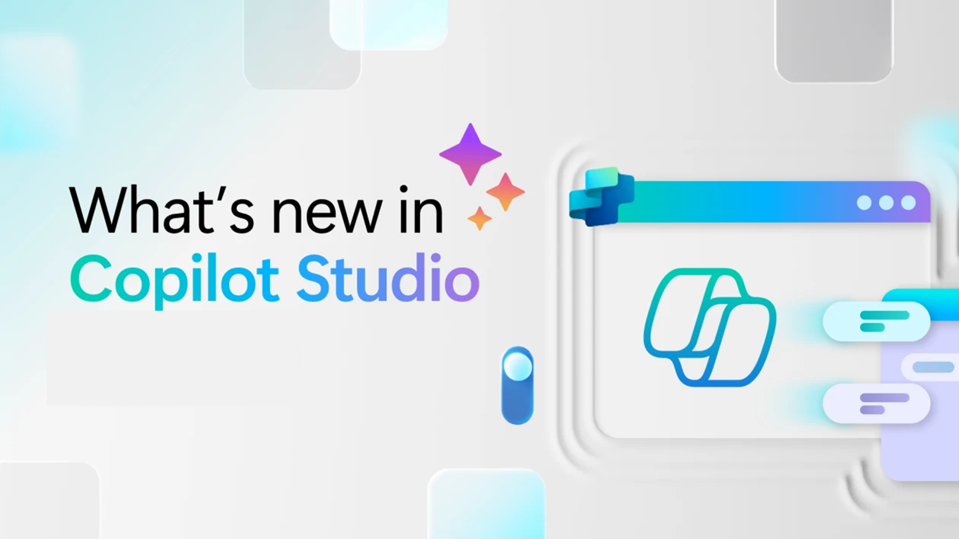
Whats new in Copilot Studio

Slide 63
What's new in Copilot Studio
The following table displays the month of release for each new feature.
Month of release | What’s new
March 2026 | (Preview) Use Work IQ tools to connect Microsoft 365 Copilot and your agents to the Work IQ service. By using this connection, you can access real-time work insights and context from Microsoft 365 files, emails, meetings, chats, and more. View and filter detailed lists of user questions and reactions from your agent's conversations. Use this data to identify gaps, create evaluation test sets, and export data for further analysis. For users with Bot transcript viewer privileges, downloaded session transcripts from Copilot Studio now include session-level customer satisfaction (CSAT) values. For users with Bot transcript viewer privileges, after you filter your list of questions or reactions, you can download the filtered questions or reactions to a .csv file. Use the Prompt assistant in Prompt builder to draft prompts faster with GPT model–powered suggestions. This feature reduces the time needed to craft effective prompts. Add Bing Custom Search as a knowledge source to ground your agent's responses in a curated, scoped web index by using a Custom Configuration ID. Configure post-call action topics for voice-enabled agents to trigger backend actions automatically after a call ends, based on how the conversation concluded. Configure reprompt messages in Question nodes with randomization support to improve conversation recovery for retry prompts, entity recognition failures, and voice scenarios. Apply accessibility best practices for Adaptive Cards to support screen readers, keyboard navigation, and Teams-specific scenarios. These practices help you build more inclusive agent experiences. Agent evaluations are now generally available (GA). You can validate agent performance using customizable test sets to help identify strengths and areas for improvement across diverse scenarios. Create multi‑turn conversation tests in Copilot Studio to evaluate how agents perform across realistic dialog flows instead of single‑turn interactions. ChatGPT‑5 is now generally available globally (excluding GCC environments) for use in production agents. Claude Sonnet 4.5, Claude Sonnet 4.6, and Claude Opus are now generally available globally (excluding GCC environments). Use these models to optimize reasoning depth, quality, latency, and cost for your agents. Availability of some models might require data processing and storage outside of your organization's geographical boundaries. Learn more in Choose an external model as the primary AI model. Use an agent node to call a Copilot Studio agent from an agent flow.
What's new in Copilot Studio - Microsoft Copilot Studio | Microsoft Learn | Copilot Studio Archive | Microsoft Copilot Blog
Notes:
As of 8th April 2026
What's new in Copilot Studio - Microsoft Copilot Studio | Microsoft Learn
https://learn.microsoft.com/en-us/microsoft-copilot-studio/whats-new
Copilot Studio Archive | Microsoft Copilot Blog
https://www.microsoft.com/en-us/microsoft-copilot/blog/copilot-studio/
What’s new in Copilot Studio: May 2025 | Microsoft Copilot Blog

Slide 64

What's new in Frontier
Get hands-on with breakthrough preview features, share your insights with product teams, and help shape the future of AI.
With Frontier, you’re not just adopting new technology, you’re co-creating what comes next.
Frontier program – Microsoft Adoption

Slide 65
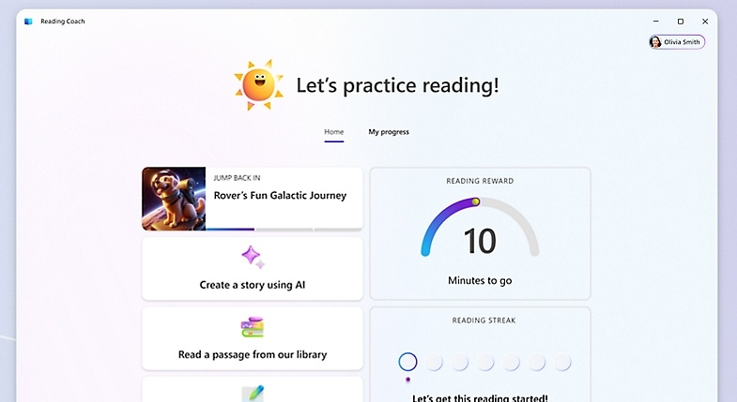
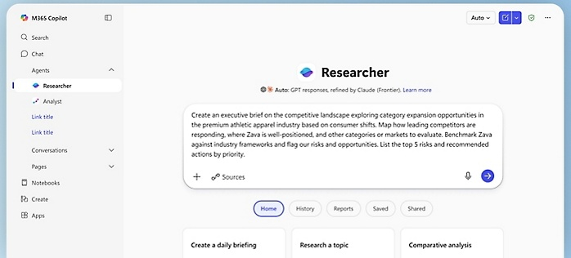
What's new in Frontier
Try out the latest agents and features in Microsoft 365 Copilot and see how they can transform your day-to-day.​
Plugins and Mobile come to Copilot Cowork
New agentic email and calendar experiences with Copilot in Outlook
Focus on the Teams Phone calls that matter most with Copilot call delegation
Learn about the new capabilities of Copilot in Word
Go from to dos to done with Copilot Cowork
Learn about the improved Researcher, powered by multi-model intelligence
Frontier Getting started guide

Slide 66
Microsoft 365 Copilot
January 2026
As of 2nd Jan 2026
Copilot Control System
User capabilities
        Expanded availability of Copilot Chat Insights in Copilot Dashboard
        Drive secure adoption of Copilot with Microsoft Purview
        New overview and readiness report in Microsoft 365 admin center
        Accelerating Microsoft 365 Copilot Adoption with Automated Readiness Assessment
        General availability of Microsoft 365 Copilot Business
        GPT-5.2 in Microsoft 365 Copilot
        Voice chats reference memory in Microsoft 365 Copilot app
        Copilot in Outlook mobile now offers an interactive voice experience
        Implicit grounding on emails and text in Copilot Chat in Outlook
        Common email triage actions using natural language
        Set up automatic replies using natural language
        Locally stored modern workbooks for Copilot in Excel
        View-only mode for Copilot in PowerPoint and enterprise assets for Copilot in PowerPoint
        Enterprise assets for Copilot in PowerPoint
        more control when creating presentations with Copilot in PowerPoint.
        General availability of source specific filters in Copilot Search
Agents
        Agent mode in Word, Excel, and PowerPoint
        Word, Excel, and PowerPoint Agents from Copilot Chat
        Ground Agents on a Copilot Notebook
Notes:
As of 2nd February 2026

Slide 67
Microsoft 365 Copilot
February 2026
As of 3rd March 2026
IT admin capabilities
User capabilities
        Power user report and intelligent summaries for Copilot Dashboard
        Business justification when requesting a Microsoft 365 Copilot license
        A new Copilot readiness page in the Microsoft 365 admin center
        Admins can now enable AI-powered skill updates for user profiles
        Risk-based inventory of AI agents for Microsoft Defender
        GPT-5.3 Instant in Microsoft 365 Copilot
        Text selection for Copilot Chat
        Expanded grounding for Copilot Chat – SharePoint Lists or sites and Outlook
        Project Manager Agent
        Copilot Chat integrated with Copilot Search
        Copilot mobile widgets and actions buttons
        Brand kits within Copilot Create
        Copilot Search – Email attachment search
        Agents in communities
        Updated recaps and customizable templates for Copilot in Teams
        Meeting scheduling and preparation for Copilot in Outlook
        Copilot meeting time analytics
        Edits documents by default with Copilot in Word
        Copilot is now agentic in PowerPoint on the Web
        Agents in OneDrive
        Agent recommendations
        Expansion of People Skills
Copilot Extensibility
        Expanded grounding, access, and coordination for agents
        35 new Copilot connectors
        Introducing Copilot Connector Checker
        Federated Copilot connectors are now available in Public Preview
        Connector Usage report
Notes:
As of 2nd February 2026

Slide 68
Microsoft 365 Copilot
March 2026
As of 8th April 2026
IT admin capabilities
User capabilities
        Safeguard web searches and prompts with Microsoft Purview Data Loss Prevention
        Manage authoritative sources, high-usage users, and domain exclusion in Microsoft 365 admin center
        Tracking satisfaction, intent, and usage with Copilot Dashboard
        Secure and Govern Microsoft 365 Copilot – a Foundational Deployment Guide updated
        Video recap of meetings in Copilot Chat
        Researcher in Microsoft 365 Copilot introduces new output formats
        Copilot Notebooks features a new, revamped user experience
        Audio recap in more languages for Copilot in Teams
        Knowledge Agent rebranded as AI in SharePoint
        AI in SharePoint new capabilities
        Work IQ automatically brings in the most relevant context in Excel
        Copilot can now make multi-step edits to modern Excel workbooks stored locally
        Citations display for Copilot in Word
        Standardize format with Copilot in PowerPoint
Copilot agents and extensibility
        Copilot Tuning templates in Agent Builder
        Microsoft 365 Copilot Declarative Agents Are Getting Smarter with GPT‑5.2
        Researcher in Microsoft 365 Copilot introduces new multi‑model intelligence capabilities with critique and council.
Notes:
As of 8th April 2026

