Slide 1


What’s new in
Microsoft 365 Copilot
As of 8th April 2026
March 2026
Presenter name
Title
Notes:
As of 8th April 2026
Thank you.
Got Feedback ? – https://aka.ms/WhatsNewCopilot/Feedback
Resources - check appendix slides ☺

Slide 2
What's new in Microsoft 365 Copilot
Updates listed in this document are selected based on relevance to Microsoft 365 Copilot.
Release dates and timings are subject to change.
For a complete list of Copilot for Microsoft 365 roadmap items refer to
Microsoft 365 Roadmap | Microsoft 365
Got feedback ?
https://aka.ms/WhatsNewCopilot/Feedback
Notes:
Feedback – https://aka.ms/WhatsNewCopilot/Feedback
Please note that the dates mentioned in this presentation are tentative and subject to change.

Slide 3

What’s new in Microsoft 365 Copilot
March 2026
As of 8th April 2026
IT admin capabilities
User capabilities
        Safeguard web searches and prompts with Microsoft Purview Data Loss Prevention
        Manage authoritative sources, high-usage users, and domain exclusion in Microsoft 365 admin center
        Tracking satisfaction, intent, and usage with Copilot Dashboard
        Secure and Govern Microsoft 365 Copilot – a Foundational Deployment Guide updated
        Video recap of meetings in Copilot Chat
        Researcher in Microsoft 365 Copilot introduces new output formats
        Copilot Notebooks features a new, revamped user experience
        Audio recap in more languages for Copilot in Teams
        Knowledge Agent rebranded as AI in SharePoint
        AI in SharePoint new capabilities
        Work IQ automatically brings in the most relevant context in Excel
        Copilot can now make multi-step edits to modern Excel workbooks stored locally
        Citations display for Copilot in Word
        Standardize format with Copilot in PowerPoint
Copilot agents and extensibility
        Copilot Tuning templates in Agent Builder
        Microsoft 365 Copilot Declarative Agents Are Getting Smarter with GPT‑5.2
        Researcher in Microsoft 365 Copilot introduces new multi‑model intelligence capabilities with critique and council.
Notes:
As of 8th April 2026

Slide 4

User capabilities

Slide 5
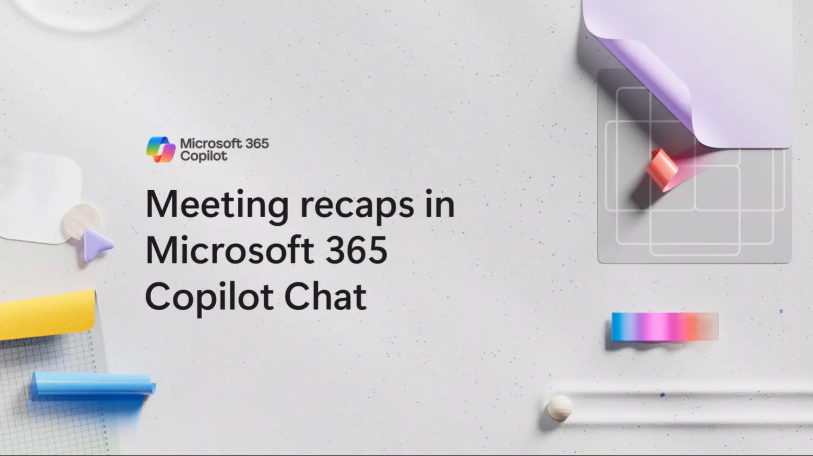
Video recap of meetings in Microsoft 365 Copilot Chat
Microsoft 365 Copilot Chat now enhances meeting summaries with a video recap that pairs written insights with narrated highlight clips to help users quickly catch up on what matters most.
Video Highlights: Video recap generates a narrated highlight reel that combines key takeaways with short, relevant meeting clips to bring important moments to life.
Faster Catch‑Up: Users can understand the discussion quickly without watching a full recording by viewing curated segments alongside the written summary.
Availability: Video recap is available in Copilot Chat and the Microsoft Clipchamp web player for recorded meetings that are at least 10 minutes long.
Video recap of meetings in M365 Copilot Chat
Video recap will launch initially in English only.
This feature is rolling out in March.
Notes:
This update introduces video recap as a new way to consume meeting summaries in Copilot Chat.Instead of relying only on a written summary, Copilot now pairs that recap with an auto‑generated, narrated highlight reel. This means users can both read the key takeaways and see the most important moments from the meeting.The value here is speed and relevance. Rather than scrubbing through a full recording, users get short, curated clips that surface the decisions, insights, and key discussion points that matter most.Video recap works for meetings that are at least 10 minutes long and have recording enabled, and it’s available directly in Copilot Chat as well as the Microsoft Clipchamp web player.At launch, the experience is English‑only, with rollout beginning in March.

Slide 6
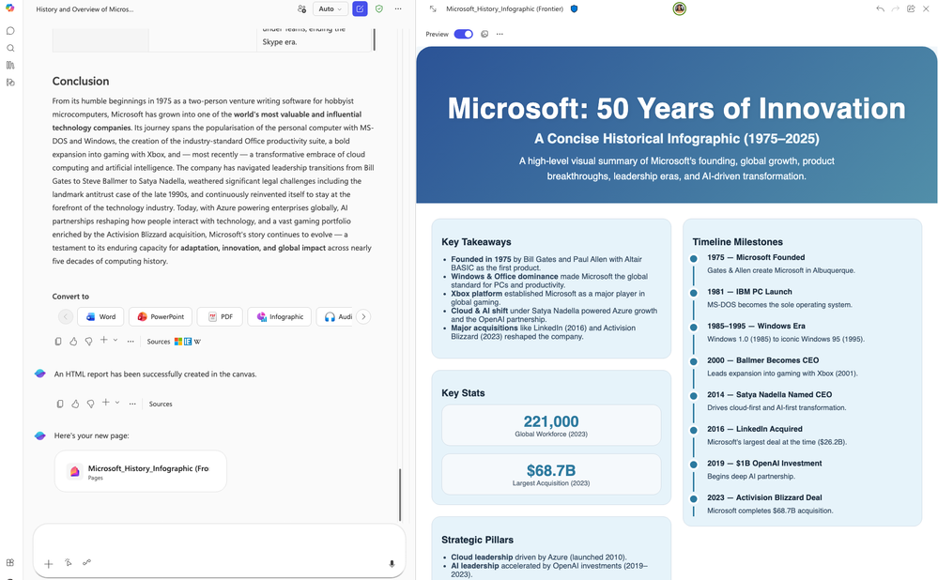
Researcher in Microsoft 365 Copilot introduces new output formats
Researcher in Microsoft 365 Copilot now makes it easy to repurpose research insights into multiple polished formats with a single click.
Flexible Outputs: Users can convert Researcher reports into PowerPoint, PDF, infographic, or audio overview formats to match different communication needs.
Audience‑Ready Content: The same set of insights can be adapted for executives, teams, or broader audiences without rewriting or reformatting.
One‑Click Conversion: New output formats eliminate duplicate work by transforming reports instantly into the desired format.
Researcher: New output formats
This feature rolled out in March.
Roadmap ID
546246
Notes:
This update enhances Researcher in Microsoft 365 Copilot by making it much easier to reuse and repurpose research insights.
Once a report is generated, users can instantly convert it into multiple output formats, such as a PowerPoint deck, a PDF document, an infographic, or even a short audio overview.
The key benefit here is efficiency. Instead of reworking the same content for different audiences, users can adapt their insights with a single click while keeping the core analysis consistent.
This makes Researcher especially valuable for scenarios where the same research needs to be shared with executives, project teams, or external stakeholders in different formats.
These new output options rolled out in March as part of the Researcher experience in Microsoft 365 Copilot.

Slide 7
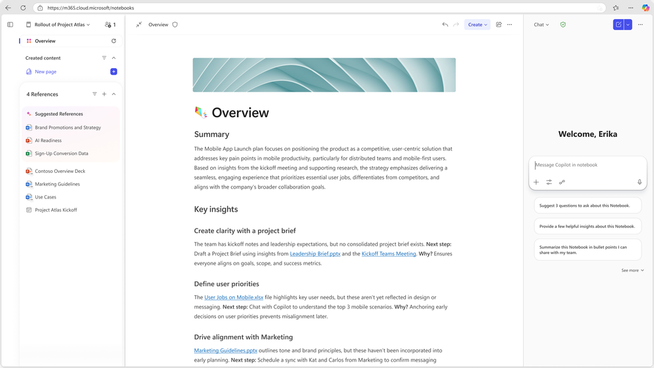
Copilot Notebooks features a new, revamped user experience
Copilot Notebooks now delivers a refreshed, more intuitive experience that brings context, content, and conversations together in one unified workspace.
Unified Side‑by‑Side View: References, Copilot Pages content, and Copilot chats are now displayed together.
Richer Context: Enhanced reference sets and a new Overview page help users quickly understand and organize their work.
Faster Creation: Improvements to Copilot accelerate artifact creation directly within Notebooks.
Improved Collaboration: Sharing notebooks with teammates is simpler, supporting smoother collaboration and reuse.
Learn more
Copilot Notebooks
This feature rolled out in February.
Roadmap ID
516042
Notes:
This update focuses on improving how users work within Copilot Notebooks by delivering a more intuitive and connected experience.
The refreshed interface brings references, Copilot Pages content, and Copilot chats into a single, side‑by‑side view, so users can move between context, content, and conversation without losing focus.
Copilot Notebooks also introduces richer reference sets and a new Overview page, helping users quickly understand what’s included in a notebook and how everything fits together.
In addition, Copilot now supports faster artifact creation directly within Notebooks, reducing the friction between exploration and output.
Finally, sharing notebooks with teammates is simpler, making it easier to collaborate, reuse work, and keep everyone aligned.
These improvements rolled out in February.

Slide 8
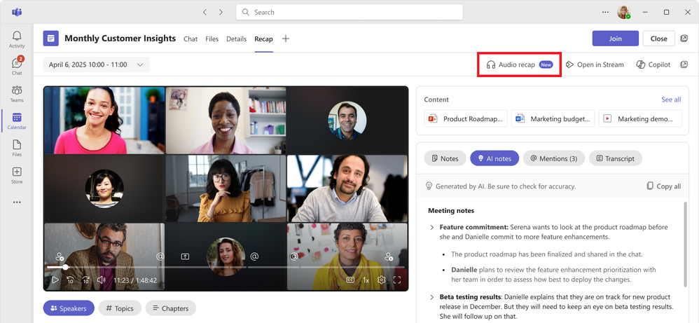
Audio recap is now available in seven additional languages
Audio recap now supports additional languages, making it easier for global teams to catch up on meetings in the way that works best for them.
Expanded Language Support: Audio recap is now available in seven new languages, including Chinese, French, German, Italian, Japanese, Portuguese, and Spanish, in addition to English.
Availability: This language expansion for audio recap rolled out in March.
Audio recap in more languages for Copilot in Teams
This feature rolled out in March.
Roadmap ID
554926
Notes:
This update extends Audio recap to better support global teams by expanding its language coverage.
In addition to English, users can now generate and listen to AI‑powered audio summaries in seven more languages, including Chinese, French, German, Italian, Japanese, Portuguese, and Spanish.
The goal here is flexibility. Some users prefer listening over reading, especially when commuting or multitasking, and audio recap makes it easier to consume meeting content in those moments.
Audio recap focuses on the outcomes that matter most, surfacing key discussion points, decisions, and action items from one or multiple meetings in a concise, narrated format.
This language expansion rolled out in March and helps ensure Copilot meeting experiences feel accessible and inclusive for distributed, multilingual teams.

Slide 9
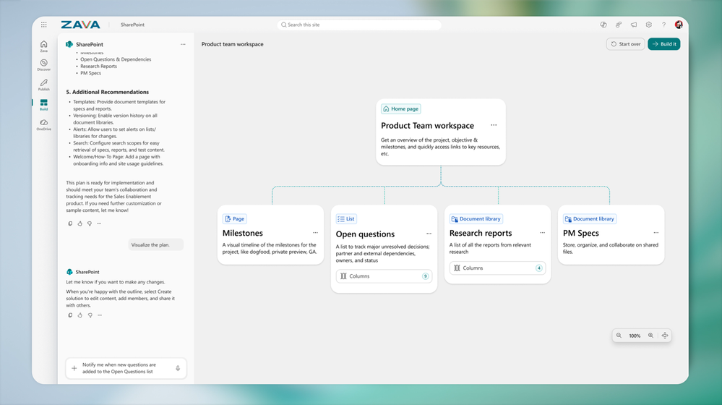
Knowledge Agent rebranded as AI in SharePoint
AI in SharePoint brings agentic building and content intelligence directly into SharePoint, enabling anyone to create and structure content using natural language.
Rebranded Experience: Previously known as Knowledge Agent, AI in SharePoint introduces expanded capabilities under a refreshed name and experience.
Natural Language Building: Users can plan and build SharePoint sites, pages, libraries, and lists simply by describing what they want in plain language.
Lower Barrier to Entry: This approach removes the need for technical expertise, making SharePoint creation more accessible to a broader range of users.
AI in SharePoint
AI in SharePoint rolled out to Public Preview in March
Rolling out worldwide in May.
Notes:
This update represents the evolution of what was previously called Knowledge Agent, now refreshed and rebranded as AI in SharePoint with expanded capabilities.AI in SharePoint brings agentic building and content intelligence directly into the SharePoint experience, allowing teams to describe what they want to create using natural language.Instead of needing deep SharePoint or technical expertise, users can simply explain their intent, such as building a site, page, library, or list, and Copilot helps plan and structure it for them.This significantly lowers the barrier to entry for SharePoint creation, enabling more people across the organization to contribute without relying on specialists.AI in SharePoint entered public preview in March and begins rolling out worldwide in May.

Slide 10
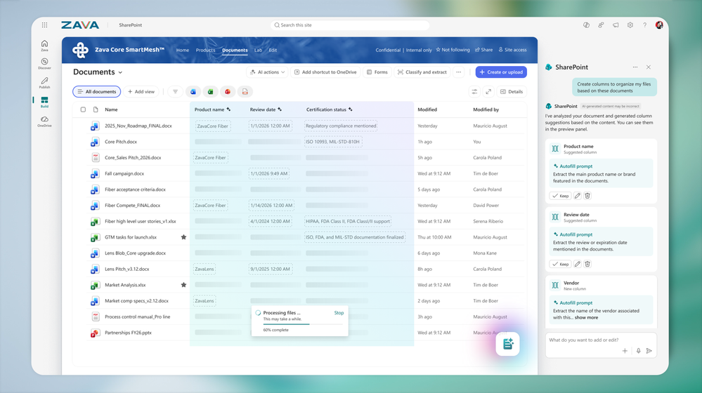
AI in SharePoint new capabilities
AI in SharePoint enhances content intelligence by automatically structuring and adapting information to support high‑quality Copilot and agent experiences across Microsoft 365.
Automatic Metadata Application: AI in SharePoint extracts and applies metadata automatically, reducing manual effort and improving content organization.
Adaptive Libraries: Document libraries evolve as content changes, helping maintain structure and relevance over time.
Copilot‑Ready Information: Structured content supports more accurate and effective Copilot and agent experiences across Microsoft 365.
AI in SharePoint new capabilities
These features rolled out to Public Preview in March and are rolling out worldwide in May.
Notes:
Beyond planning and building experiences, AI in SharePoint also strengthens how content is structured and maintained over time.The platform now automatically extracts and applies metadata, reducing manual tagging and helping ensure information is consistently organized.As content evolves, libraries adapt dynamically, maintaining relevance and structure without requiring users to manage these changes themselves.This structured approach is critical for Copilot and agent experiences across Microsoft 365, because well‑organized information leads to more accurate answers and better AI outputs.These preview capabilities are powered by Anthropic’s Claude model and entered public preview in March, with worldwide rollout beginning in May.

Slide 11
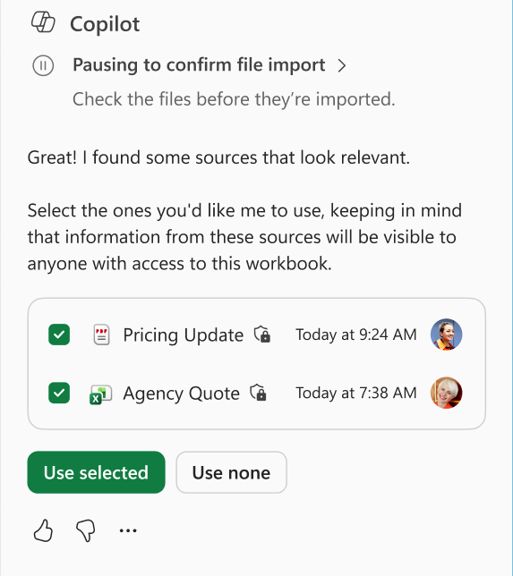
Work IQ automatically brings in the most relevant context in Excel
Work IQ now enhances Copilot in Excel by automatically supplying relevant context so Copilot can make more accurate and intelligent edits.
Automatic Context Gathering: Work IQ pulls in relevant information from emails, meetings, chats, and files without requiring users to manually reference them.
Smarter Copilot Edits: With richer context, Copilot can perform more accurate, multi‑step edits directly within Excel.
Context‑Aware Intelligence: Edits better reflect the latest information about users, their work, and their relationships.
Work IQ
This feature rolled out in March.
Notes:
This update improves how Copilot works inside Excel by automatically grounding it in the most relevant work context.
When users edit with Copilot, Work IQ brings in context from emails, meetings, chats, and files without the user needing to manually reference any of it.
With that richer context, Copilot can perform more accurate and more complex, multi‑step edits that better reflect what’s actually happening across a user’s work.
This means Excel outputs are more aligned to current priorities, relationships, and decisions, rather than isolated spreadsheet data.
The result is faster, more intelligent edits with less prompting, and this capability rolled out in March.

Slide 12
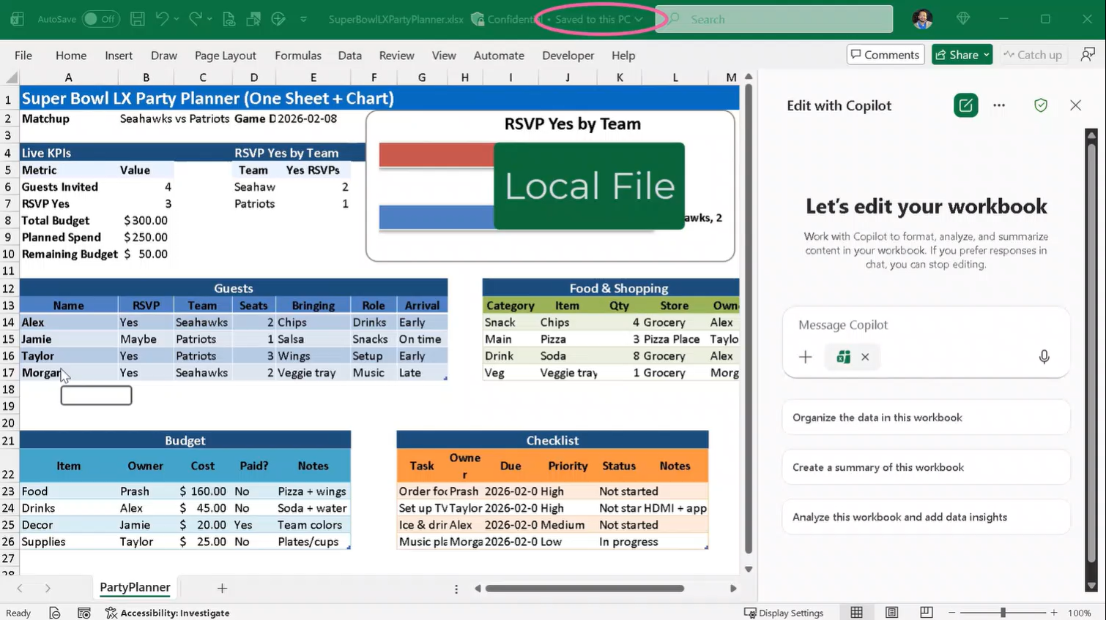
Copilot can now make multi-step edits to modern Excel workbooks stored locally
Copilot in Excel now supports multi‑step edits on locally stored workbooks, giving users more flexibility over where they work with AI.
Local File Support: Copilot can edit modern Excel workbooks stored locally on Windows and Mac devices.
Multi‑Step Intelligence: Users can apply complex, multi‑step Copilot edits without moving files to the cloud.
Greater Flexibility: This removes the requirement for cloud storage, letting users work with Copilot wherever their files reside.
Copilot in Excel multi‑step edits on locally stored workbooks
This feature rolled out in March.
Notes:
This update expands where Copilot can be used in Excel by supporting modern workbooks that are stored locally on a user’s device.
Copilot can now perform multi‑step edits on Excel files saved locally on both Windows and Mac, removing the previous dependency on cloud‑stored files.
This gives users more flexibility to work the way they want, especially in scenarios where files can’t or shouldn’t be moved to the cloud.
Importantly, users still get the same intelligent, multi‑step Copilot experience, whether the workbook lives locally or online.
This capability rolled out in March and helps make Copilot in Excel more inclusive of real‑world working patterns.

Slide 13
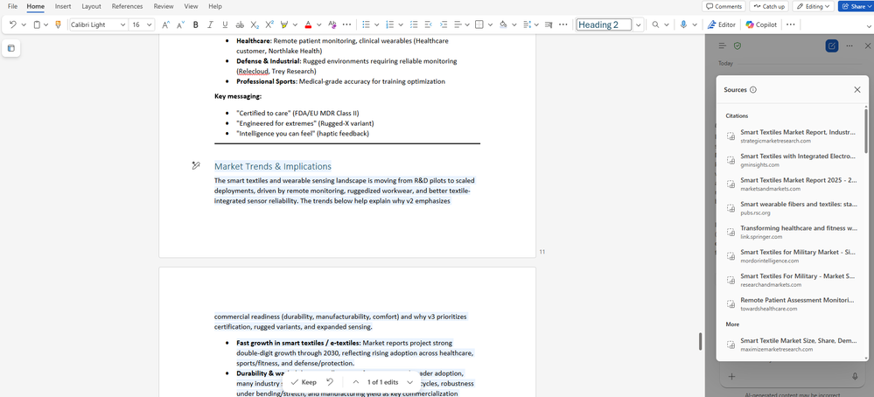
Citations display for Copilot in Word
Copilot in Word now automatically adds citations to generated content, improving transparency, trust, and confidence in document accuracy.
Automatic Citations: Copilot displays citations whenever content is generated using web sources or Work IQ data.
Improved Transparency: Users can easily see where information comes from, making it simpler to verify and validate content.
Reliable Referencing: Built‑in citations help ensure accurate and consistent referencing across all Copilot‑assisted edits.
Citations display for Copilot in Word
This feature rolled out in March.
Notes:
This update improves trust and transparency when using Copilot to edit documents in Word.
When Copilot generates or edits content using information from web sources or Work IQ context, citations are now automatically displayed inline.
This makes it easy for users to see where information comes from, helping them quickly validate sources and verify accuracy as they work.
It also ensures more reliable referencing across Copilot‑assisted edits, which is especially important for formal documents, reviews, and collaborative writing.
Overall, this change increases confidence in Copilot‑generated content while reducing the effort needed to track and confirm sources.
This capability rolled out in March.

Slide 14
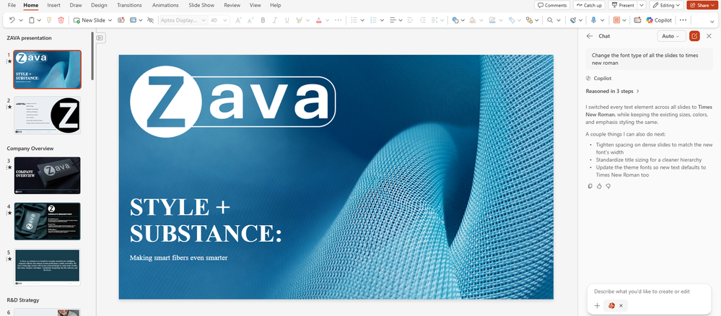
Standardize format with Copilot in PowerPoint
Copilot in PowerPoint can now automatically standardize slide formatting, helping users achieve a consistent, professional design with minimal effort.
One-Click formatting: Using Edit with Copilot, users can update fonts, font sizes, and bullet styles across all slides at once.
Consistent Design: Automatic standardization ensures a polished, cohesive look throughout the entire presentation.
Reduced Manual Effort: Eliminates time‑consuming, slide‑by‑slide formatting so users can focus on content and messaging.
Edit with Copilot
This feature rolled out on Web in March, and is rolling out on Windows and Mac soon.
Notes:
This feature is all about removing friction from slide clean‑up.
With Edit with Copilot, users can standardize the entire presentation in one action instead of manually fixing fonts and bullets slide by slide.
Copilot automatically updates fonts, font sizes, and bullet styles across the deck, which is especially useful when combining content from multiple sources or reusing older slides.
The real value here is consistency. By enforcing a unified design, the presentation looks more polished and professional without extra effort from the author.
Because formatting is handled for you, users can spend more time refining their message and storytelling rather than worrying about layout details.
The capability is already available in PowerPoint on the web and is rolling out soon to Windows and Mac, making it consistent across the major PowerPoint platforms.

Slide 15
Copilot agents and extensibility

Slide 16
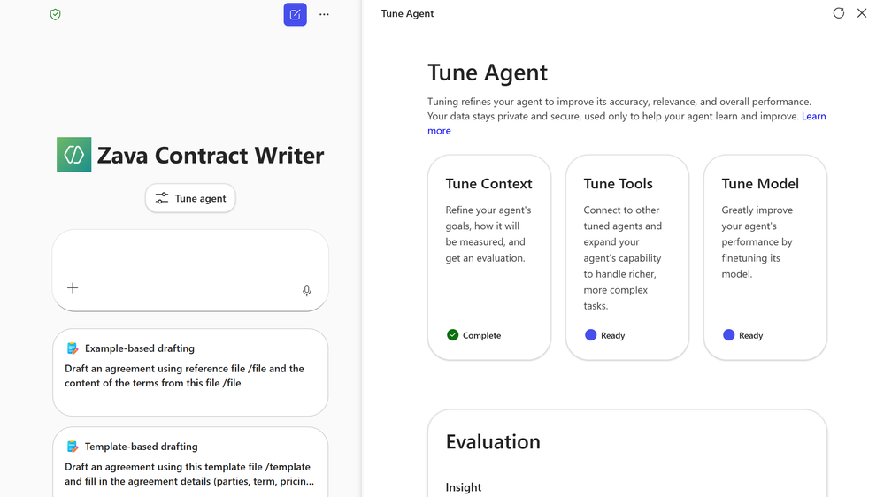
Copilot Tuning templates in Agent Builder
Copilot Tuning introduces new Agent Builder templates that enable teams to create customized agents aligned to organizational writing styles, guidelines, and business processes.
Agent Templates: New templates support tasks such as drafting complex documents, validating content, and editing for specific writing styles.
Organizational Customization: Agents can be tuned using proprietary data, processes, and standards.
Model and Tool Control: Users can customize agent context, tools, and underlying models.
Copilot Tuning introduces new templates in Agent Builder
This feature will be available to enterprises with at least 5,000 Microsoft 365 Copilot licenses, will roll out to Frontier in April, and will roll out worldwide in June.
Roadmap ID
552589
Notes:
This update introduces Copilot Tuning capabilities within Agent Builder, providing new templates designed for complex document‑focused tasks such as drafting content, validating documents against organizational guidelines, and editing to match a defined writing style.
With Copilot Tuning enabled, organizations can further customize these template‑based agents by incorporating proprietary data, internal processes, and company standards. This includes tuning the agent’s context, tools, and even the underlying language models to better reflect how work gets done across the business.
This enables teams to create more tailored and consistent AI‑driven outputs that align with organizational requirements, writing styles, and governance policies.
This capability will be available to enterprises with at least 5,000 Microsoft 365 Copilot licenses, rolling out to Frontier customers in April and worldwide in June.

Slide 17
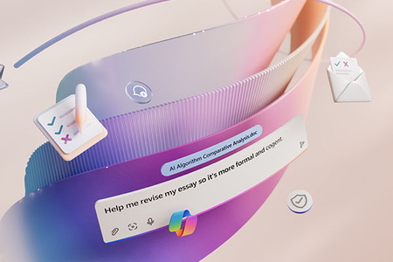
Microsoft 365 Copilot Declarative Agents Are Getting Smarter with GPT‑5.2
Microsoft 365 Copilot Declarative Agents are being upgraded to GPT‑5.2 to improve reasoning, planning, and response quality across complex agent scenarios.
Enhanced Reasoning: Improves agent performance on multi‑step tasks that require planning, iteration, and decision‑making.
Tool Orchestration: Provides more reliable coordination between agents, enterprise data sources, and APIs.
Document Analysis: Enhances comprehension and synthesis of longer or more complex documents.
Learn more
Microsoft 365 Copilot Declarative Agents
Rolling out globally with completion expected by the end of March 2026.
Notes:
This update introduces an upgrade to GPT‑5.2 for Microsoft 365 Copilot Declarative Agents, designed to improve how agents reason, plan, and generate structured outputs across more complex scenarios.
With this model update, agents are better equipped to handle multi‑step tasks that require planning or iteration, as well as more reliably interact with enterprise data sources, APIs, and tools.
Customers may notice improvements in document analysis, structured summaries, and formatted outputs, helping make agent‑generated responses easier to consume and act on.
The update is rolling out gradually to all tenants worldwide, with rollout expected to be completed by the end of March 2026.
How will this update roll out?
The GPT‑5.2 update is rolling out gradually. Not all users within a tenant will receive the update at the same time. This phased approach helps ensure a smooth transition and allows us to monitor quality closely as the update expands.
What should admins and agent builders do?
No configuration changes are required to receive this update. However, we recommend a few simple steps to ensure a smooth experience:
For admins
Inform agent builders that a model update is rolling out so they can plan light validation.
For agent builders
Validate your most important scenarios
Run a quick check on your top workflows (for example, your top 5–10 prompts or use cases).
Confirm expectations are still met
Pay attention to accuracy, tone, reasoning, and formatting.
Adjust agent instructions if needed
Small prompt or instruction refinements can help agents take full advantage of GPT‑5.2’s capabilities.

Slide 18
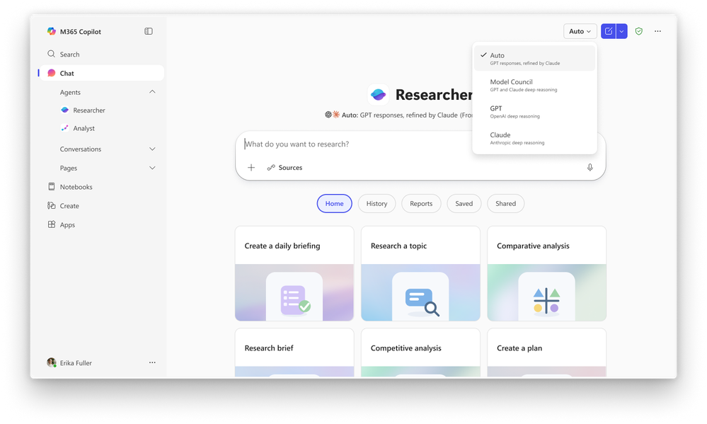
Researcher in Microsoft 365 Copilot introduces new multi‑model intelligence capabilities
Researcher in Microsoft 365 Copilot introduces new multi‑model intelligence capabilities (Critique and Council) to improve the accuracy, depth, and reliability of complex research tasks.
Critique Capability: Uses multiple models to separate content generation from evaluation to improve research quality.
Council Capability: Enables side‑by‑side comparison of outputs from different models within the Researcher experience.
Improved Accuracy: Enhances factual grounding, analytical depth, and presentation of research outputs.
Learn more
Researcher introduces new multi-model capabilities
Critique and Council are currently available through the Frontier program.
Introducing multi-model intelligence in Researcher | Microsoft Community Hub
Notes:
These updates introduce new multi‑model intelligence capabilities that are intended to improve the accuracy, completeness, and reliability of research‑based outputs. Rather than relying on a single model to perform planning, synthesis, and reporting, Researcher can now leverage multiple models working together to enhance analytical depth and validate results.
This represents a shift toward more structured and evidence‑grounded AI‑assisted research, especially in scenarios that require higher levels of confidence, reasoning, or source validation.
We’ll walk through two of these new capabilities next — Critique and Council — and how they enhance the overall quality and trustworthiness of research outputs generated by Copilot.

Slide 19
Critique in Researcher
Critique in Researcher uses a multi‑model architecture that separates content generation from evaluation to improve the quality of complex research outputs.
Dual‑Model Approach: One model generates the research output while a second model independently reviews and refines it.
Improved Accuracy: Strengthens factual grounding by challenging weak claims and enforcing reliable citations.
Analytical Depth: Identifies missing perspectives and improves completeness of research responses.
Structured Output: Enhances organization, clarity, and presentation of final reports.
Critique in Researcher
Critique and Council are currently available through the Frontier program.
Introducing multi-model intelligence in Researcher | Microsoft Community Hub
Roadmap ID 558538
Notes:
Critique introduces a multi‑model approach within the Researcher experience that separates content generation from evaluation to improve the quality of complex research outputs.
In this model, one AI generates the initial research content, while a second AI independently reviews the output. The reviewer model evaluates accuracy, checks the strength of claims, validates citations, and identifies gaps or missing perspectives.
This separation creates an internal quality‑control loop that helps reduce hallucinations, strengthen factual grounding, and improve the overall structure and clarity of research results.
By emphasizing evaluation as much as generation, Critique delivers more reliable, well‑reasoned research outputs, especially for high‑stakes or complex analysis scenarios.

Slide 20
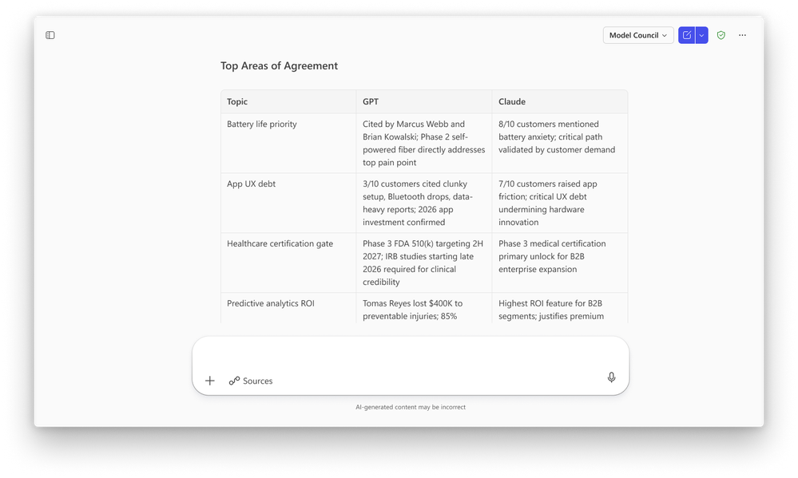
Council in Researcher
Council in Researcher enables side‑by‑side comparison of outputs from multiple AI models to improve confidence in research outcomes.
Parallel Reports: Multiple models generate independent research reports simultaneously.
Agreement Analysis: Highlights where model outputs align or meaningfully differ.
Unique Insights: Surfaces distinct perspectives or findings from each model.
Evidence‑Based Summary: A judge model distills key findings into a validated final output.
Council in Researcher
Critique and Council are currently available through the Frontier program.
Introducing multi-model intelligence in Researcher | Microsoft Community Hub
Roadmap ID
553213
Notes:
Council introduces an alternative multi‑model approach within the Researcher experience that enables parallel analysis across multiple AI models.
Instead of generating and reviewing a single research output, Council prompts multiple models to independently produce complete reports on the same topic at the same time.
These reports are then evaluated by a separate judge model, which highlights areas of agreement, identifies meaningful differences in interpretation or emphasis, and surfaces unique insights contributed by each model.
This allows users to compare perspectives across models and gain greater confidence in the final output by understanding where conclusions align or diverge across different analytical approaches.
Council is particularly valuable for complex or ambiguous research scenarios where multiple viewpoints can strengthen decision‑making or analysis outcomes.

Slide 21
IT admin capabilities

Slide 22
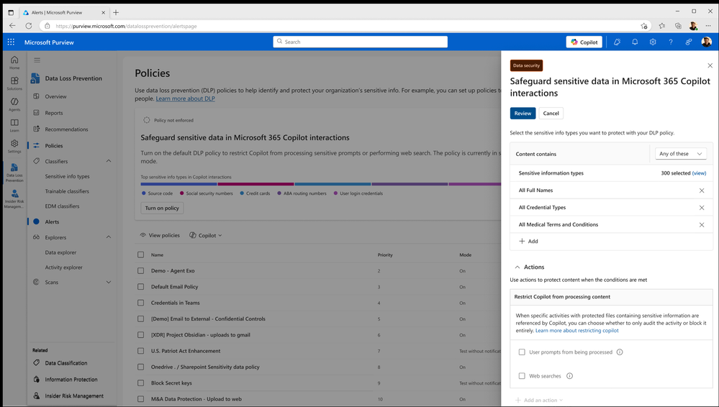
Safeguard web searches with Microsoft Purview Data Loss Prevention
Microsoft Purview Data Loss Prevention (DLP) for Copilot and Copilot Chat now helps prevent sensitive organizational data from being used in web search prompts.
Prompt Protection: DLP can block sensitive data from being included in Copilot web search prompts.
Real-Time Enforcement: Policies are applied instantly to reduce the risk of data leakage or oversharing.
Internal Grounding: Copilot can still generate responses using approved Microsoft 365 internal data sources.
Microsoft Purview Data Loss Prevention
This feature rolled out to Public Preview in March and is rolling out worldwide in June.
Roadmap ID
548671
Notes:
This update expands Microsoft Purview Data Loss Prevention to Copilot and Copilot Chat to cover web search scenarios. It helps prevent users from including sensitive organizational data in prompts that could expose information outside the tenant boundary.
If a prompt contains sensitive data, DLP policies can block its use in web-grounded responses in real time. Copilot can still generate grounded responses using approved internal Microsoft 365 data sources such as SharePoint or OneDrive.
This feature entered Public Preview in March and is scheduled for worldwide rollout in June.

Slide 23
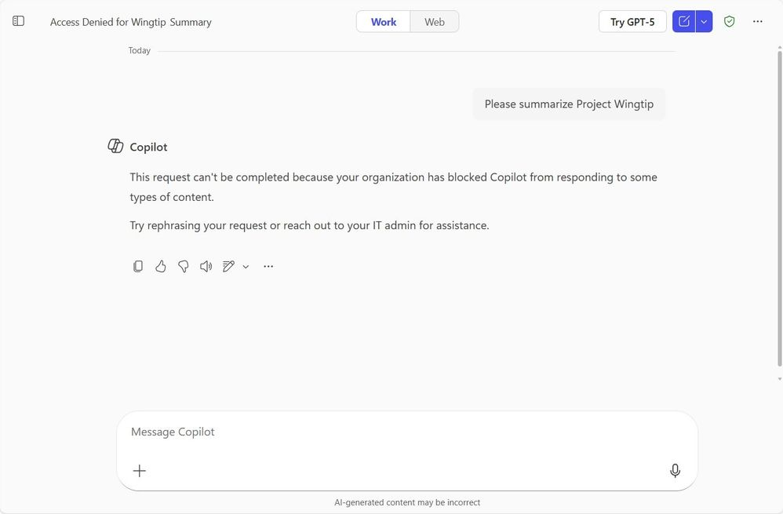
Microsoft Purview DLP is further expanding to safeguard prompts
Microsoft Purview Data Loss Prevention (DLP) is expanding to safeguard Copilot prompts to help prevent sensitive organizational information from being used in AI interactions.
Prompt Detection: Admins can define policies to detect sensitive data such as financial information, national IDs, and bank account numbers in Copilot prompts.
Response Restriction: Copilot can be restricted from responding to prompts that contain sensitive or regulated information.
Access Control: Policies can block Copilot from connecting to internal data sources or performing web searches when sensitive data is detected.
Safeguard prompts
This feature is rolling out in March.
Roadmap ID
515945
Notes:
This update expands Microsoft Purview Data Loss Prevention capabilities to safeguard Copilot prompts before any action is taken. It helps prevent sensitive organizational information from being used in prompts that could lead to oversharing through AI-assisted responses.
Admins can define policies to detect sensitive data such as financial information, national identification numbers, bank details, or custom sensitive information types directly within Copilot prompts. When this data is detected, Copilot can be restricted from responding, accessing internal data sources, or performing web searches.
This gives organizations greater control over how AI interacts with sensitive data and ensures compliant use of Copilot across both internal and external information scenarios.
This feature is scheduled to begin rolling out in March.

Slide 24
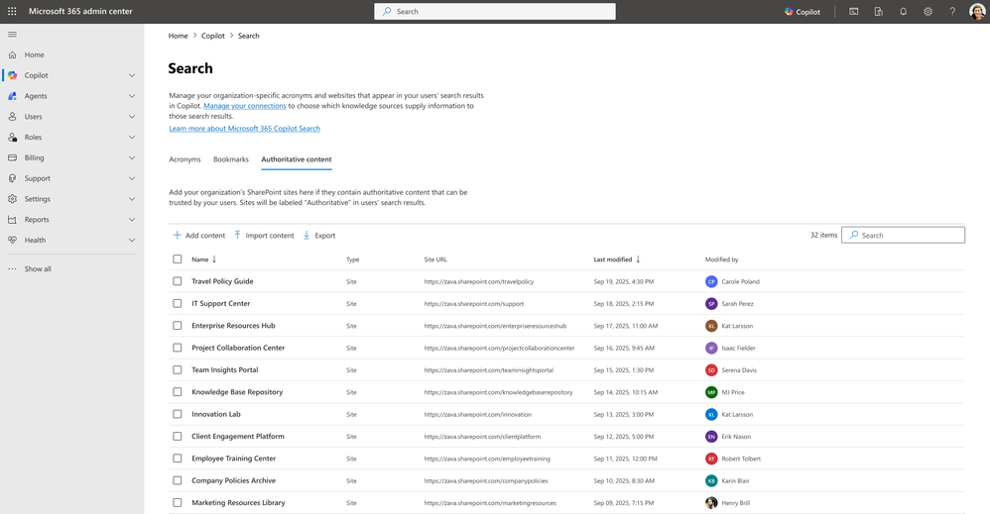
Admins can now manage authoritative sources within the Copilot Search
Admins can now manage authoritative sources within the Copilot Search experience in the Microsoft 365 admin center to improve the relevance of organizational content in search results.
Authoritative Sources: Admins can designate specific SharePoint Online sites as trusted content sources.
Improved Relevance: Copilot prioritizes content from these sites to enhance search result accuracy.
Content Ranking: Designated sites are ranked higher within Copilot search experiences.
Manage authoritative sources within the Copilot Search
This feature is rolling out in April.
Roadmap ID
503553
Notes:
This update introduces the ability for admins to manage authoritative sources within the Copilot Search experience directly from the Microsoft 365 admin center. It allows organizations to designate specific SharePoint Online sites as trusted or authoritative content sources.
By identifying these sites, Copilot can prioritize content from them in search results, helping improve both the relevance and ranking of organizational information surfaced to users. This ensures that Copilot is more likely to highlight validated or business-critical content when responding to search queries.
This capability gives IT greater control over the quality and trustworthiness of content used by Copilot across Microsoft 365 experiences.
This feature is scheduled to begin rolling out in April.

Slide 25
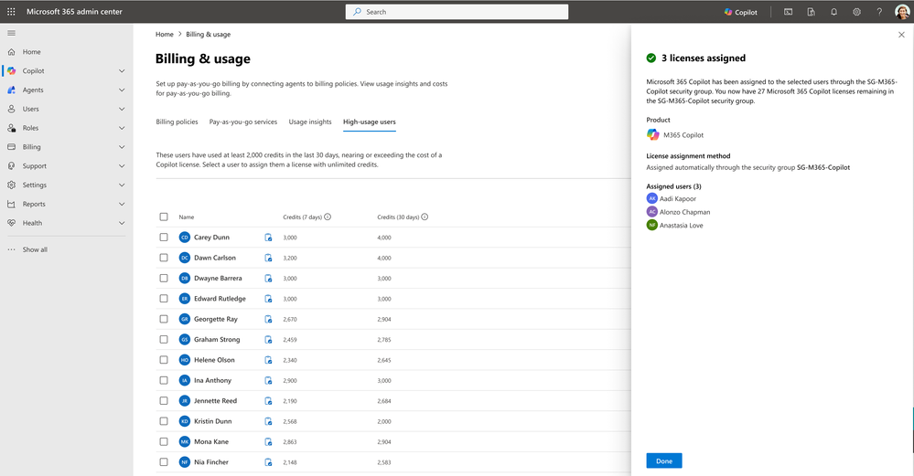
Quickly identify individuals driving high consumption across Copilot usage‑based services
High‑usage users is a new category that helps IT and finance teams identify individuals driving higher consumption across Copilot pay‑as‑you‑go services.
Usage Visibility: Admins can identify users generating high levels of Copilot usage‑based consumption.
Cost Insights: Provides early visibility into potential cost drivers across pay‑as‑you‑go services.
License Optimization: Enables faster investigation and more informed licensing and allocation decisions.
High‑usage users is a new category
This feature rolled out in March.
Roadmap ID
557176
Notes:
This update introduces a new High‑Usage Users category for Copilot pay‑as‑you‑go services, giving IT and finance teams greater visibility into usage‑based consumption across the organization.
By surfacing individuals driving higher levels of Copilot usage in one place, admins can quickly identify potential cost drivers and investigate unexpected consumption trends earlier.
This enables more informed decisions around license allocation and optimization, helping organizations better manage spend while ensuring Copilot usage continues to align with business value.
This feature rolled out in March.

Slide 26
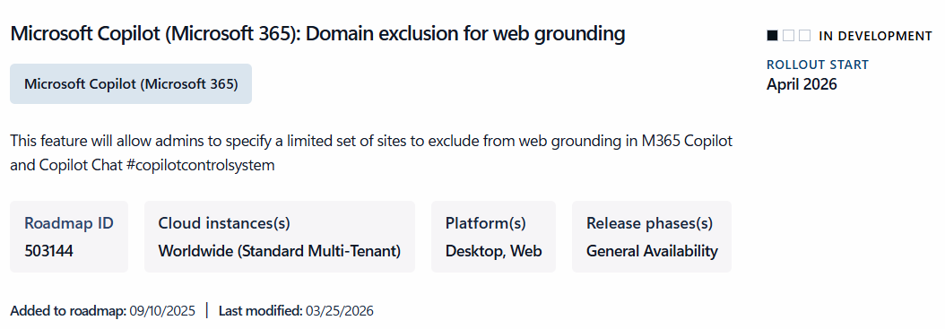
Domain exclusion for web grounding
Domain exclusion for web grounding gives admins greater control over which external websites Copilot can reference when generating responses.
External Source Control: Admins can exclude specific web domains from Copilot web grounding.
Governance Support: Helps prevent Copilot from referencing unapproved or non‑compliant external sources.
Compliance Alignment: Supports organizational content governance and regulatory requirements.
Admin Management: Provides IT with more control over how external web data is used in Copilot responses.
Domain exclusion for web grounding
This feature is rolling out in April.
Roadmap ID
503144
Notes:
Domain exclusion for web grounding lets admins specify a limited set of sites to exclude from web grounding in Microsoft 365 Copilot and Copilot Chat, giving IT teams control over which external web sources Copilot can reference when generating responses, supporting compliance and content governance requirements.

Slide 27
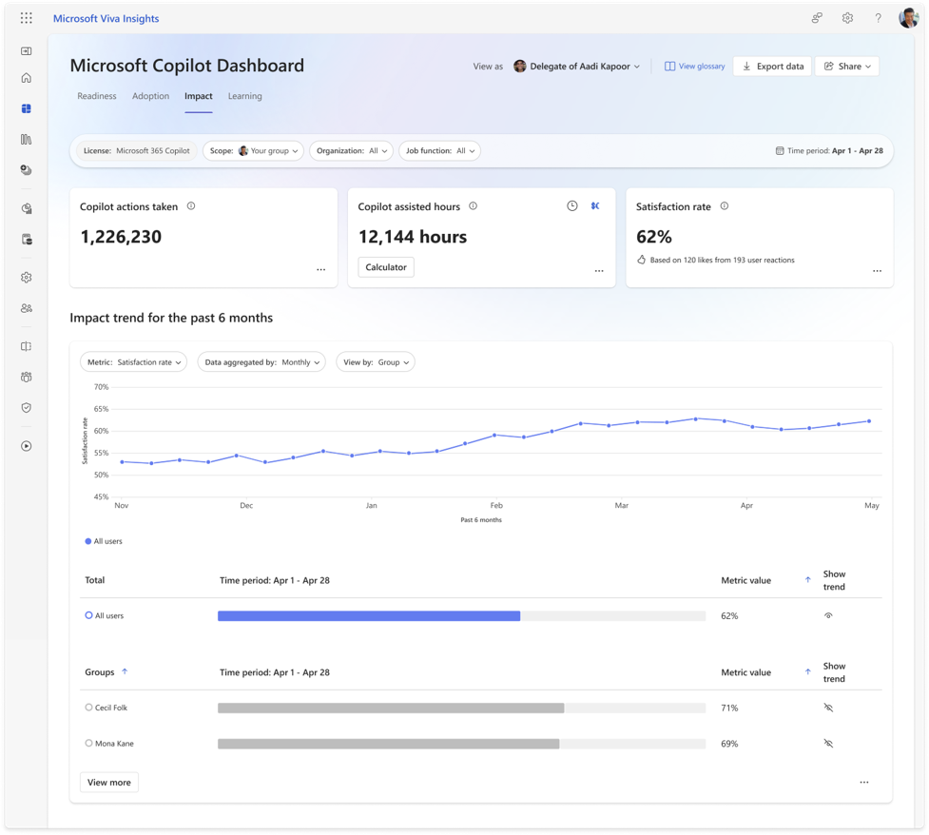
Track user satisfaction of Microsoft 365 Copilot at scale.
Analysts can now track user satisfaction with Microsoft 365 Copilot at scale through insights available in the Copilot Dashboard.
Satisfaction Insights: Analysts can measure how users perceive Copilot’s value based on response feedback.
Feedback Breakdown: Thumbs up and thumbs down ratings can be analyzed across Copilot interactions.
Trend Analysis: User satisfaction trends can be tracked over time and by group.
This feature rolled out in March.
Track user satisfaction of Microsoft 365 Copilot
Roadmap ID
496655
Notes:
Analysts can now track user satisfaction of Microsoft 365 Copilot at scale. In the Copilot Dashboard, analysts can understand how users perceive Copilot value by analyzing the breakdown of thumbs up and thumbs down for Copilot responses, as well as see trends over time and breakdowns by group. This feature rolled out in March.

Slide 28
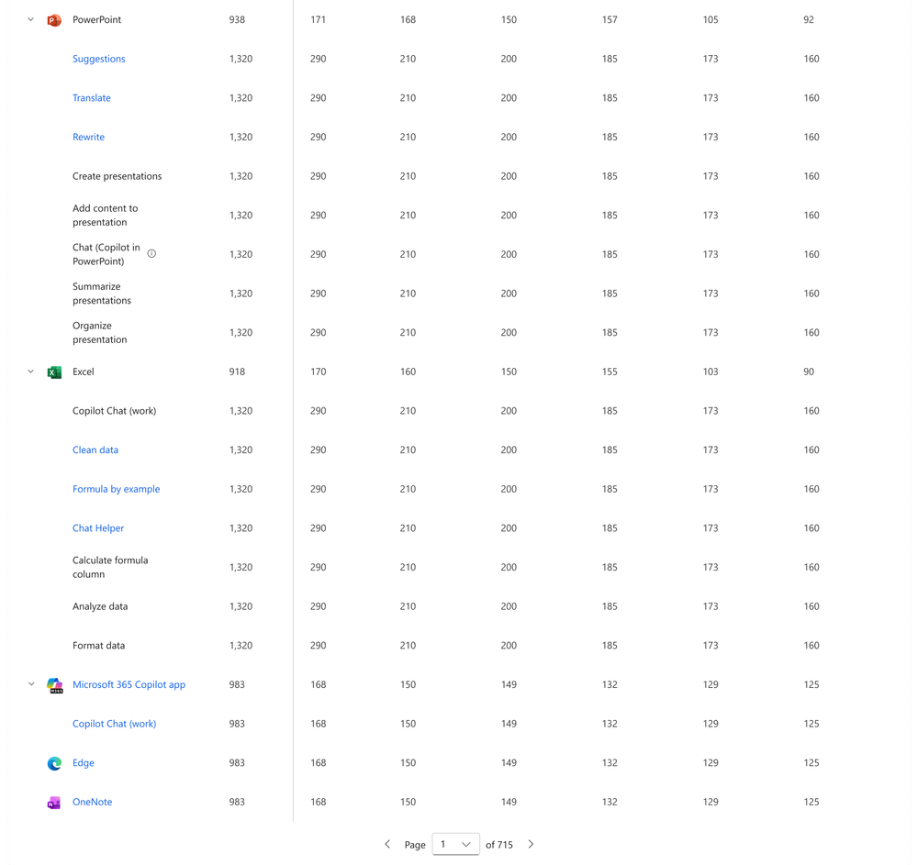
New metrics to better understand common user intents and usage patterns for Copilot
Common user intents and usage patterns for Copilot
Admins can now use new Copilot metrics to better understand user intent and usage patterns across Microsoft 365 apps.
Intent Insights: Admins can track common Copilot usage scenarios across Microsoft 365 apps.
Cross-App Tracking: Copilot tasks can be monitored in the Copilot app, Edge, and OneNote.
App-Level Scenarios: Enables analysis of key scenarios in Outlook, Word, Excel, and PowerPoint, such as suggested reply, translate, coach, and clean data.
This feature is rolling out in April.
Roadmap ID
557981
Notes:
Microsoft Defender AI Security Posture Management now provides SOC teams with a risk-based inventory of AI agents across Microsoft Foundry and Copilot Studio. Analysts can view an agent’s overall security posture, easily implement security recommendations, and identify vulnerabilities such as misconfigurations and excessive permissions. Agent activity is captured for investigation with hunting available through Defender's unified experience. This gives a security team the visibility needed to manage AI agents with the same rigor as human identities. This feature rolled out to Public Preview in November and rolled out worldwide in February.

Slide 29
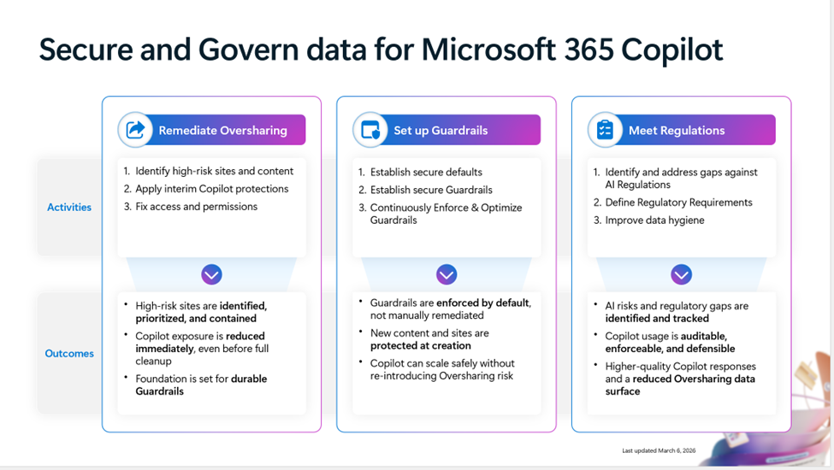
Secure and Govern Microsoft 365 Copilot – a Foundational Deployment Guide
The Secure and Govern Microsoft 365 Copilot deployment blueprint has been updated to help organizations address oversharing risks and establish a secure foundation for AI adoption.
Oversharing Remediation: Provides guidance to identify and resolve potential data exposure risks across Microsoft 365.
Guardrail Implementation: Helps organizations establish reliable policies and controls for Copilot usage.
Regulatory Alignment: Supports compliance with emerging AI‑related governance and regulatory requirements.
Deployment Foundation: Enables organizations to adopt Copilot securely and with greater confidence.
Updated: Microsoft 365 Copilot foundational deployment guidance!
Read more and download the blueprint at aka.ms/Copilot/SecureGovern!
Notes:
We are excited to share that we have updated and expanded the deployment blueprint to address Oversharing into the Secure and Govern Microsoft 365 Copilot foundational deployment guidance! This guide provides these three essential steps for establishing a secure and governed foundation for Copilot:
Remediate oversharing
Implement reliable guardrails
Meet AI-related regulatory obligations
Delivering a foundational path to help every organization get started with Copilot with confidence. Read more and download the blueprint at aka.ms/Copilot/SecureGovern!

Slide 30
Microsoft 365 Copilot release notes
As of 8th April 2026
Latest features and improvements for Microsoft 365 Copilot.
It includes changes that are generally available
(Current Channel for Microsoft 365 apps)
Release Notes for Microsoft 365 Copilot | Microsoft Learn
Notes:
As of 8th April 2026
This page lists the latest features and improvements for Microsoft 365 Copilot. It includes changes that are generally available (Current Channel for Microsoft 365 apps) and specific to each platform.

Slide 31
Microsoft 365 Copilot release notes – March 2026
As of 8th April 2026
Microsoft 365 Copilot Chat (8)
Microsoft 365 Copilot app (1)
        Expanded AI skill inferencing for E3 and E5 users [Windows, Web]
        Chat History filtering experience refresh
        Explainable AI with deep and inline citations for connectors
        Summarize and explain PDFs with Copilot in Microsoft Edge [Web]
        Ask Copilot directly from the Microsoft Edge address bar [Web]
        Scope Copilot Chat prompts to Teams channels with Context IQ [Web]
        Summarize and Explain actions in PDF reader [Web]
        Delegate calendar search in Microsoft 365 Copilot [Android, Windows, iOS, Mac, Web]
Scatter image effect [Android, Windows, iOS, Mac, Web]
Microsoft Excel (1)
Edit with Copilot in Excel to enhance your productivity (formerly Agent Mode) [Windows, Web, Mac]
Microsoft PowerPoint (1)
Edit images in PowerPoint with Designer Editor [Windows, Web, Mac]
Copilot extensibility (13)
Connect Copilot with Shortcut to manage agile development workflows
Connect Copilot to Amazon S3 document repositories [Web]
Query Coda docs and wikis with Copilot connectors [Web]
Query Bitbucket pull requests with Copilot connectors [Web]
Copilot Chat recommends installed agents [Windows, Web]
Connect Copilot with Zendesk Help Center to retrieve support articles [Web]
Query GitLab merge requests and content with Copilot connectors [Web]
Track GitLab issues in Copilot with a connector [Web]
Bring Asana tasks into Copilot with a connector [Web]
Connect Copilot with Egnyte for secure file collaboration [Web]
Search Aha! features and ideas in Copilot with a connector [Web]
Connect Copilot to Smartsheet for project and task management [Web]
Faster connector authentication setup for Gong, GitHub, and Monday [Web]
Learn more | Release Notes for Microsoft 365 Copilot
24 Updates released between March 10, 2026, and March 24, 2026.
Notes:
Updates released March 10, 2026, and March 24, 2026
This page lists the latest features and improvements for Microsoft 365 Copilot. It includes changes that are generally available (Current Channel for Microsoft 365 apps) and specific to each platform.
As of 8th April 2026
Learn more - Release Notes for Microsoft 365 Copilot | Microsoft Learn
https://learn.microsoft.com/en-us/copilot/microsoft-365/release-notes?tabs=all

Slide 32
Microsoft 365 Copilot Public Roadmap
Changes this month
As of 8th April 2026
Microsoft 365 Roadmap - See What's Coming | Microsoft 365
Notes:
As of 3rd March 2026

Slide 33
Microsoft 365 Copilot Public Roadmap
As of 8th April 2026
Launched and Rolling Out “Changed within last month”
Launched (36) 🚀
  Rolling Out (14)
Copilot can edit your document in PowerPoint
Now smarter with visuals: Declarative Agents leverage embedded images for richer, more accurate answers
Files found via Chat search can be now analyzed by code interpreter
Microsoft 365 app: Overview Page in Copilot Notebooks
Admins can create and deploy custom Model Context Protocol (MCP) connectors across Microsoft 365.
Voice chat in Microsoft 365 Copilot
Project Manager Agent in M365 Copilot
Access audio overviews from the top of your Word document
Microsoft Viva: Satisfaction Rate Metric for Microsoft 365 Copilot in Copilot Dashboard
Microsoft Edge: v.144 - Contextual nudges on address bar offering help summarizing webpages.
Quickly edit an image in PowerPoint
Microsoft 365 admin center: Copilot settings – Optimize view
Customers can connect M365 Copilot with Egnyte to collaborate on secure file storage with Copilot Connector
Copilot Chat for Teams Chats, Channels, Calling and Meetings
Image Upload in Copilot Chat for Government Cloud
Scatter image effect in Microsoft 365 Copilot
Use Copilot to get a detailed and contextual explanation
SharePoint list agent
Copilot Chat Tools Control
[Copilot Extensibility] [Search UX] Custom filter support for data sources on Copilot Search
Query Coda Docs and Wikis with Copilot Connectors
Connect Microsoft 365 Copilot to Guru for Internal Knowledge and Insights
No-Code Publishing for Azure AI Foundry Agents to Microsoft 365 Copilot Agent Store
Customers can connect M365 Copilot with Monday.com to track work and team progress with Copilot Connector
Customers can connect M365 Copilot with Asana to manage projects and tasks with Copilot Connector
[Copilot Extensibility] Customers can connect M365 Copilot with GitLab Issues (Cloud and Server) to track engineering tasks and bugs with Copilot Connector
[Copilot Extensibility] Customers can connect M365 Copilot with Amazon S3 to access structured document repositories with Copilot Connector
[Copilot Extensibility] Customers can connect M365 Copilot with Zendesk Help Center to retrieve support articles and FAQs with Copilot Connector
Microsoft 365 admin center: Agent metadata in inventory export
Microsoft Viva: Copilot Analytics - Copilot Studio agent report in Insights enhanced with autonomous agents.
Easier access to Researcher in Microsoft Word
Copilot extensibility – Embedded Knowledge capability support for declarative agents.
Calendar search for email delegates
Image effects in Microsoft 365 Copilot
Edit Scheduled prompts
OneDrive: OneDrive files as knowledge sources for agents
Video recap in Teams
Spoken language detection is now automatic
Planner: Planner Agent in group-based basic plans
Microsoft SharePoint: New web part for FAQs
Microsoft Purview: Data Loss Prevention for Microsoft 365 Copilot to safeguard prompts
Employee Self-Service Agent in M365 Copilot
Researcher Agent for GCC
Microsoft Viva: Copilot Analytics: Copilot adoption PBI version update including Power user insights.
Say "Hey Copilot" to activate voice conversations with the Microsoft 365 Copilot app on Windows
Microsoft Viva: Copilot Dashboard - Broader access to M365 Copilot Chat insights
Simplifying Content in the Input Box
Excel Agent
PowerPoint Agent
Knowledge Agent
Notes:
As of 3rd March 2026

Slide 34
Microsoft 365 Copilot Public Roadmap
As of 8th April 2026
New items added “New within the last month”
New items – In development (22)
  New Items - Rolling Out (2)
Microsoft Viva: New Overview experience and agent categories in Agent Dashboard
Microsoft Viva: Unlocking Deeper Copilot Insights with Enhanced Power BI Filtering
Sharing recap access
Facilitator detects and answers questions
Create Excel spreadsheets from Copilot Notebooks
Outlook: Copilot provides coaching feedback in chat as you draft, edit and format emails
Critique in Researcher
Researcher Council
PowerPoint: Create and Edit images with the model of your choice
Microsoft Viva: Copilot Analytics: "All"- licensed user page Copilot dashboard
Intelligent meeting recap available without saving transcript
Federated Copilot Connectors
Updated chat-first design in the Microsoft 365 Copilot mobile app
OneNote: Multimodal capture in Copilot Notebooks (iPhone)
Mind Maps in Copilot Notebooks
Create interactive visuals in Copilot Pages
Create PowerPoint presentations from Copilot Notebooks
Create Word documents from Copilot Notebooks
Intelligent Summaries in Copilot Dashboard
Chose Anthropic models when editing with Copilot in Word
Edit with the model of your choice in PowerPoint
Outlook: Draft, edit and format emails conversationally with Copilot in Outlook
Spoken language detection is now automatic
Video recap in Teams
Notes:
As of 3rd March 2026

Slide 35
Microsoft 365 Copilot Public Roadmap
As of 8th April 2026
In development “Changed within last month”
In development (57)
Critique in Researcher
Researcher Council
Microsoft Viva: New Overview experience and agent categories in Agent Dashboard
Microsoft Viva: Unlocking Deeper Copilot Insights with Enhanced Power BI Filtering
Sharing recap access
Microsoft Viva: Copilot Analytics - Export metrics in the Copilot Dashboard at Day Level
Facilitator detects and answers questions
Microsoft Viva: Insights - New Copilot Metrics Available
Outlook: Triage your inbox on-the-go with Copilot voice for Outlook mobile
Discover graph connector prompts in the Prompt Gallery when using Copilot Chat
Create Excel spreadsheets from Copilot Notebooks
[Copilot Search] [Copilot Search] Copilot Chat available when using Copilot Search
Consecutive interpretation in Interpreter
Researcher Output Formats
Engage private content in M365 Copilot
Copilot uses enterprise assets hosted on Adobe Experience Manager when creating presentations
Outlook: Copilot provides coaching feedback in chat as you draft, edit and format emails
Web Link as a Reference in Copilot Notebooks
Enhanced Copilot chat summary
PowerPoint: Create and Edit images with the model of your choice
Microsoft Viva: Copilot Analytics: "All"- licensed user page Copilot dashboard
Intelligent meeting recap available without saving transcript
[Copilot Extensibility] IT Admins will be able to enable Anthropic models by specific users and groups in the tenant
Microsoft Viva: Copilot Analytics - Copilot configuration insights in the Copilot Dashboard Readiness page
Microsoft Purview: Data Loss Prevention to prevent Microsoft 365 Copilot processing content with sensitivity labels supports all storage locations
Copilot Chat in Outlook expands to reason over inbox, calendar, and enterprise data
Express voice enrollment in Microsoft Teams
SharePoint: Chat one-on-one with SharePoint agents in Teams
Federated Copilot Connectors
Export Copilot metrics in the Copilot Dashboard
Domain exclusion for web grounding
List email attachments in M365 Copilot
Updated chat-first design in the Microsoft 365 Copilot mobile app
OneNote: Multimodal capture in Copilot Notebooks (iPhone)
Mind Maps in Copilot Notebooks
Microsoft 365 admin center: Usage reports – Microsoft 365 Copilot Connectors
Create interactive visuals in Copilot Pages
Microsoft 365 admin center: Agents usage report
Frontier and Microsoft agent user request approval flow in Microsoft 365 admin center
Microsoft 365 Admin Center: Usage reports - Message consumption for Pay-as-you-go experiences in Copilot Chat.
Create PowerPoint presentations from Copilot Notebooks
Create Word documents from Copilot Notebooks
Infinite Scroll Chat History
Enhanced M365 Copilot Memory - Copilot is now personalized with work data
Delete meeting generated content in recap
Intelligent Summaries in Copilot Dashboard
Business Justification for Copilot License Requests
Microsoft Edge: Adding contextual nudges to the Microsoft 365 Copilot Chat icon
Real-time voice interactions in a podcast in Word
Microsoft 365 Admin Center: M365 Copilot - Billing and usage - Usage insights
Deep citations in Copilot
Agent Mode in Excel for GCC
Copilot Prompt Gallery - Company-wide prompt publishing
Chose Anthropic models when editing with Copilot in Word
Edit with the model of your choice in PowerPoint
Microsoft Edge: Ground Microsoft 365 Copilot Chat in Edge for Business in your open OneDrive and SharePoint documents
Outlook: Draft, edit and format emails conversationally with Copilot in Outlook
Notes:
As of 3rd March 2026

Slide 36
Thank you 👏
Got feedback ?
https://aka.ms/WhatsNewCopilot/Feedback
Notes:
Thank you.

Slide 37

Feedback Form

Slide 38
Resources
Microsoft 365 Copilot Blog | Microsoft Community Hub
What’s New in Microsoft 365 Copilot | March 2026 | Microsoft Community Hub
Introducing multi-model intelligence in Researcher | Microsoft Community Hub
Announcing the Microsoft Copilot Connector v2 for Veeva Vault | Microsoft Community Hub
Latest enhancements for Copilot security, management, and analytics | Microsoft Community Hub
Copilot Notebooks: Enhancements to support creation, collaboration and learning | Microsoft Community Hub
Meet the updated Copilot Notebooks experience: Your home for understanding work, projects, and more | Microsoft Community Hub
Act Now: Lock in Current Pricing on Microsoft 365 Copilot Business Bundles | Microsoft Community Hub
In Case You Missed It: Frontier Transformation and Wave 3 of Microsoft 365 Copilot Announcements | Microsoft Community Hub
Microsoft 365 Copilot Declarative Agents Are Getting Smarter with GPT‑5.2 | Microsoft Community Hub
What's new in Copilot Studio - Microsoft Copilot Studio | Microsoft Learn

Slide 39
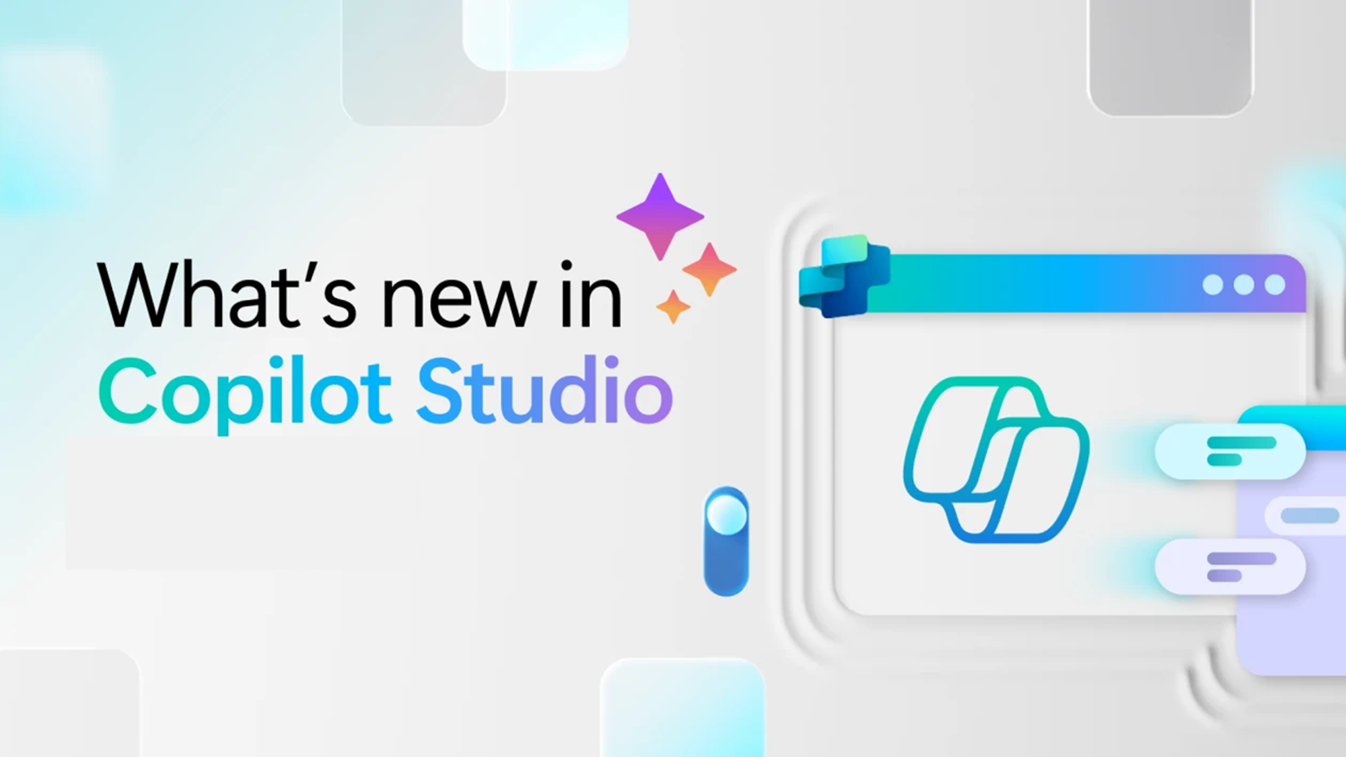
Whats new in Copilot Studio

Slide 40
What's new in Copilot Studio
The following table displays the month of release for each new feature.
Month of release | What’s new
March 2026 | (Preview) Use Work IQ tools to connect Microsoft 365 Copilot and your agents to the Work IQ service. By using this connection, you can access real-time work insights and context from Microsoft 365 files, emails, meetings, chats, and more. View and filter detailed lists of user questions and reactions from your agent's conversations. Use this data to identify gaps, create evaluation test sets, and export data for further analysis. For users with Bot transcript viewer privileges, downloaded session transcripts from Copilot Studio now include session-level customer satisfaction (CSAT) values. For users with Bot transcript viewer privileges, after you filter your list of questions or reactions, you can download the filtered questions or reactions to a .csv file. Use the Prompt assistant in Prompt builder to draft prompts faster with GPT model–powered suggestions. This feature reduces the time needed to craft effective prompts. Add Bing Custom Search as a knowledge source to ground your agent's responses in a curated, scoped web index by using a Custom Configuration ID. Configure post-call action topics for voice-enabled agents to trigger backend actions automatically after a call ends, based on how the conversation concluded. Configure reprompt messages in Question nodes with randomization support to improve conversation recovery for retry prompts, entity recognition failures, and voice scenarios. Apply accessibility best practices for Adaptive Cards to support screen readers, keyboard navigation, and Teams-specific scenarios. These practices help you build more inclusive agent experiences. Agent evaluations are now generally available (GA). You can validate agent performance using customizable test sets to help identify strengths and areas for improvement across diverse scenarios. Create multi‑turn conversation tests in Copilot Studio to evaluate how agents perform across realistic dialog flows instead of single‑turn interactions. ChatGPT‑5 is now generally available globally (excluding GCC environments) for use in production agents. Claude Sonnet 4.5, Claude Sonnet 4.6, and Claude Opus are now generally available globally (excluding GCC environments). Use these models to optimize reasoning depth, quality, latency, and cost for your agents. Availability of some models might require data processing and storage outside of your organization's geographical boundaries. Learn more in Choose an external model as the primary AI model. Use an agent node to call a Copilot Studio agent from an agent flow.
What's new in Copilot Studio - Microsoft Copilot Studio | Microsoft Learn | Copilot Studio Archive | Microsoft Copilot Blog
Notes:
As of 8th April 2026
What's new in Copilot Studio - Microsoft Copilot Studio | Microsoft Learn
https://learn.microsoft.com/en-us/microsoft-copilot-studio/whats-new
Copilot Studio Archive | Microsoft Copilot Blog
https://www.microsoft.com/en-us/microsoft-copilot/blog/copilot-studio/
What’s new in Copilot Studio: May 2025 | Microsoft Copilot Blog

Slide 41

What's new in Frontier
Get hands-on with breakthrough preview features, share your insights with product teams, and help shape the future of AI.
With Frontier, you’re not just adopting new technology, you’re co-creating what comes next.
Frontier program – Microsoft Adoption

Slide 42
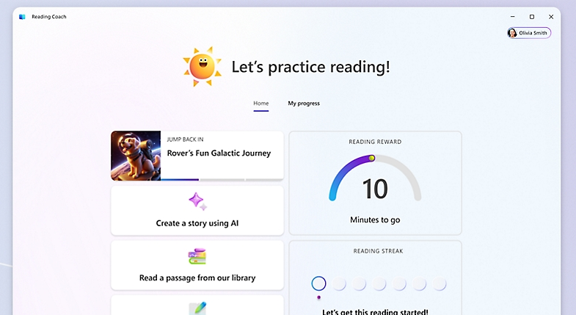
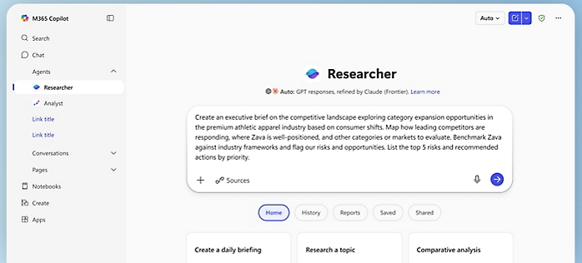
What's new in Frontier
Try out the latest agents and features in Microsoft 365 Copilot and see how they can transform your day-to-day.​
Copilot Cowork introduces a new way to get work done in Microsoft 365 Copilot
[Multi-model + Critique] New and improved Researcher powered with multi-model intelligence
Agents that help drive AI workforce transformation
Frontier Getting started guide

Slide 43
Microsoft 365 Copilot
January 2026
As of 2nd Jan 2026
Copilot Control System
User capabilities
        Expanded availability of Copilot Chat Insights in Copilot Dashboard
        Drive secure adoption of Copilot with Microsoft Purview
        New overview and readiness report in Microsoft 365 admin center
        Accelerating Microsoft 365 Copilot Adoption with Automated Readiness Assessment
        General availability of Microsoft 365 Copilot Business
        GPT-5.2 in Microsoft 365 Copilot
        Voice chats reference memory in Microsoft 365 Copilot app
        Copilot in Outlook mobile now offers an interactive voice experience
        Implicit grounding on emails and text in Copilot Chat in Outlook
        Common email triage actions using natural language
        Set up automatic replies using natural language
        Locally stored modern workbooks for Copilot in Excel
        View-only mode for Copilot in PowerPoint and enterprise assets for Copilot in PowerPoint
        Enterprise assets for Copilot in PowerPoint
        more control when creating presentations with Copilot in PowerPoint.
        General availability of source specific filters in Copilot Search
Agents
        Agent mode in Word, Excel, and PowerPoint
        Word, Excel, and PowerPoint Agents from Copilot Chat
        Ground Agents on a Copilot Notebook
Notes:
As of 2nd February 2026

Slide 44
Microsoft 365 Copilot
February 2026
As of 3rd March 2026
IT admin capabilities
User capabilities
        Power user report and intelligent summaries for Copilot Dashboard
        Business justification when requesting a Microsoft 365 Copilot license
        A new Copilot readiness page in the Microsoft 365 admin center
        Admins can now enable AI-powered skill updates for user profiles
        Risk-based inventory of AI agents for Microsoft Defender
        GPT-5.3 Instant in Microsoft 365 Copilot
        Text selection for Copilot Chat
        Expanded grounding for Copilot Chat – SharePoint Lists or sites and Outlook
        Project Manager Agent
        Copilot Chat integrated with Copilot Search
        Copilot mobile widgets and actions buttons
        Brand kits within Copilot Create
        Copilot Search – Email attachment search
        Agents in communities
        Updated recaps and customizable templates for Copilot in Teams
        Meeting scheduling and preparation for Copilot in Outlook
        Copilot meeting time analytics
        Edits documents by default with Copilot in Word
        Copilot is now agentic in PowerPoint on the Web
        Agents in OneDrive
        Agent recommendations
        Expansion of People Skills
Copilot Extensibility
        Expanded grounding, access, and coordination for agents
        35 new Copilot connectors
        Introducing Copilot Connector Checker
        Federated Copilot connectors are now available in Public Preview
        Connector Usage report
Notes:
As of 2nd February 2026

