Slide 1


What’s new in Microsoft Copilot
As of 8th Sept 2026
August 2026
Presenter name
Title
Notes:
As of 8th September 2026

Slide 2

What's new in Microsoft Copilot updates
Updates listed in this document are selected based on relevance to Microsoft Copilot.
Release dates and timings are subject to change.
For a complete list of Microsoft Copilot roadmap items refer to
Microsoft 365 Roadmap | Microsoft 365
Got feedback ?
https://aka.ms/WhatsNewCopilot/Feedback

Slide 3


What’s new in Microsoft Copilot
August 2026
As of 8th Sept 2026
IT admin capabilities
User capabilities
        Admin can export row-level Copilot and Agent 365 usage data
        The Consumption Dashboard now tracks Github Copilot AI Credits
        OpenAI GPT-6 Astra in Microsoft Copilot
        Anthropic Claude Fable 5.1 in Microsoft Copilot
        More control for effort level and cost in Cowork
        Text selections, session sharing, and more for Copilot Chat
        New ways to work in Copilot Notebooks
        Change languages for meeting recaps with Copilot in Teams
        Hyperlinks, image understanding, and highlights for Copilot in Word
        Chat history and change history skill for Copilot in Excel
        Personal skills in Copilot in SharePoint
        Agents, email drafting, and management enhancements for Copilot in Outlook
        Improved file capabilities with Copilot in OneDrive
        Status reports and task enhancements for Copilot in Planner
        New Connectors and Plugins
Agents
        Custom engine agents are available directly in Outlook
        Planner Agent turns plan data into stakeholder-ready status report
        Copilot creates and queries Planner tasks
Notes:
As of 8th September 2026

Slide 4

User capabilities

Slide 5
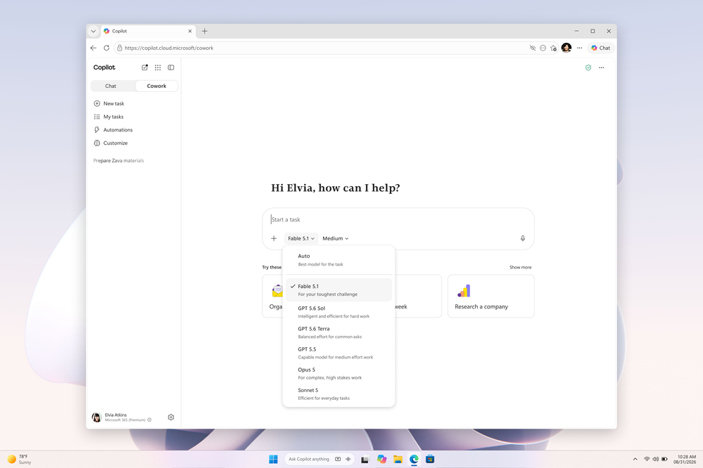
Claude Fable 5.1 is available in Copilot Cowork and Copilot Studio
Claude Fable 5.1 joins the frontier models in Copilot, giving customers more choice as they delegate more complex tasks to AI.
Built For Long-running Work — Fable 5.1 is designed for long-running work, financial analysis, and front-end visual coding.
Tighter Plans, Shorter Summaries — The model produces tighter plans up front and more concise summaries at the end.
Grounded By Work IQ — Work IQ grounds Fable 5.1 in files, meetings, chats, and business data within existing permissions, so responses are more relevant and traceable back to the user's own work.
Rollout And Admin Control — Rolling out today to eligible users in Copilot Cowork and Copilot Studio; availability varies by region and organization, and admins configure access in the Microsoft 365 admin center.
Learn more
Claude Fable 5.1
Available today: Anthropic Claude Fable 5.1 in Microsoft Copilot | Microsoft Community Hub
Notes:
Claude Fable 5.1 is now joining the frontier models available in Copilot Cowork and Copilot Studio, giving customers more choice as they delegate more complex tasks to AI.
Fable 5.1 is designed for long-running work, financial analysis, and front-end visual coding, with tighter plans up front and more concise summaries at the end.
As more work is delegated to AI, the quality of the result depends on both the model and the context — Work IQ grounds Fable 5.1 in your files, meetings, chats, and business data within your existing permissions, so it reasons over your work instead of the prompt alone, with sources you can trace back.
It is rolling out today to eligible users in Copilot Cowork and Copilot Studio; availability may vary by region and organization, and admins can manage access through the Microsoft 365 admin center.
Source: Available today: Anthropic Claude Fable 5.1 in Microsoft Copilot — https://techcommunity.microsoft.com/blog/microsoft365copilotblog/available-today-anthropic-claude-fable-5-1-in-microsoft-copilot/4551974

Slide 6
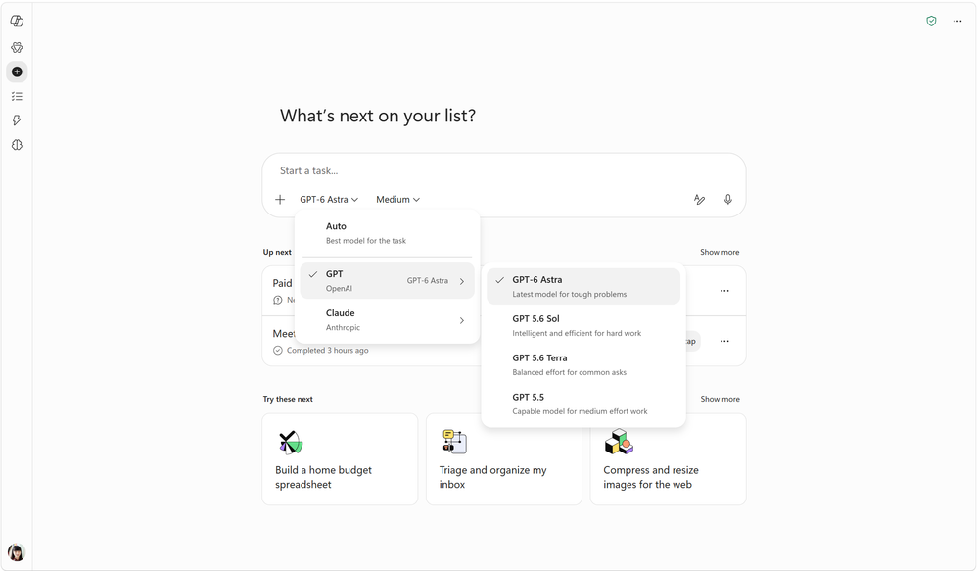
OpenAI GPT-6 Astra is available in Copilot Cowork and Copilot Studio
GPT-6 Astra joins the frontier models in Copilot, expanding the range of work customers can hand off to AI.
Delegate Larger Tasks — Instead of breaking work into smaller pieces and guiding it step by step, users can delegate larger tasks.
Time Spent On Decisions — Users focus their time on reviewing results, making decisions, and moving work forward.
Grounded By Work IQ — Work IQ grounds GPT-6 Astra in files, meetings, chats, and business data within existing permissions, producing more relevant and accurate responses.
Rollout And Admin Control — Rolling out today to users in Copilot Cowork and Copilot Studio; availability varies by region and organization, and admins configure access in the Microsoft 365 admin center.
Learn more
OpenAI GPT-6 Astra
Available today: OpenAI GPT-6 Astra in Microsoft Copilot | Microsoft Community Hub
Notes:
GPT-6 Astra joins the frontier models available in Copilot Cowork and Copilot Studio, giving customers more choice for complex work they want to delegate to AI.
Astra expands the range of work that can be handed off to Copilot: instead of breaking work into smaller pieces and guiding it step by step, users can delegate larger tasks and focus their time on reviewing results, making decisions, and moving work forward.
As more work is delegated, the quality of the outcome depends on both the model and the context it can reason over, and Work IQ grounds GPT-6 Astra in your files, meetings, chats, and business data within existing permissions.
It is rolling out today to users in Copilot Cowork and Copilot Studio; availability may vary by region and organization, and admins can manage access and configure availability through the Microsoft 365 admin center.
Source: Available today: OpenAI GPT-6 Astra in Microsoft Copilot — https://techcommunity.microsoft.com/blog/microsoft365copilotblog/available-today-openai-gpt-6-astra-in-microsoft-copilot/4552808

Slide 7
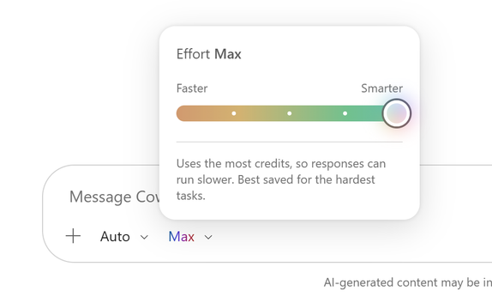
More control for effort level and cost in Cowork
MC1461699
Users can tune how much effort Cowork puts into a task so they can balance depth of analysis against speed and credit usage.
Five Effort Levels — Light handles simpler tasks, Medium is the default for everyday work, and High, Extra High, and Max allow deeper analysis and more complex reasoning.
Predictable Trade-offs — Higher effort levels produce more thorough responses but may take longer and use limits faster.
In-flow Controls — Model and effort controls now appear together directly in the compose box.
August Rollout — This feature rolled out in August.
Users can now choose an effort level
What’s New in Microsoft Copilot | August 2026 | Microsoft Community Hub
Notes:
Users can now choose an effort level to control how Cowork balances quality, speed, and credit usage.
Medium is the default for everyday work, while Light is designed for simpler tasks. High, Extra High, and Max give Cowork more room for deeper analysis, complex reasoning, and more thorough responses, but may take longer and use limits faster. Model and effort controls now appear directly in the compose box together.
This feature rolled out in August.
Source: What's New in Microsoft Copilot | August 2026 — https://techcommunity.microsoft.com/blog/microsoft365copilotblog/what%E2%80%99s-new-in-microsoft-copilot--august-2026/4551960

Slide 8
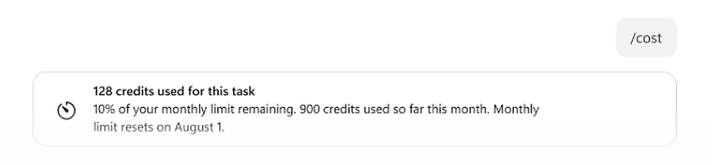
The /cost skill shows how much of the monthly credit limit is left
Cowork users get clearer visibility into credit consumption so they can plan work against their monthly limit.
Session Estimates — The /cost skill estimates the credits used for the current task session.
Monthly Limit View — It now shows the percentage of the monthly credit limit remaining and credits used month to date.
Reset Visibility — Users can also see when the monthly limit resets.
August Rollout — This feature rolled out in August.
Learn more
The /cost skill
What’s New in Microsoft Copilot | August 2026 | Microsoft Community Hub
Notes:
The /cost skill now provides more visibility into Cowork credit usage.
In addition to estimating the credits used for the current task session, it shows the percentage of the monthly credit limit remaining, credits used month to date, and when the monthly limit resets.
This feature rolled out in August.
Source: What's New in Microsoft Copilot | August 2026 — https://techcommunity.microsoft.com/blog/microsoft365copilotblog/what%E2%80%99s-new-in-microsoft-copilot--august-2026/4551960

Slide 9
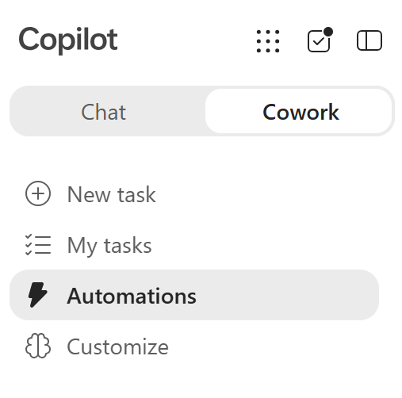
Automations in Cowork
Cowork brings scheduled and event-triggered tasks together in one place so users can manage everything they have automated.
Renamed Section — The Scheduled tab in Cowork is now called Automations.
All Automated Tasks — Users view and manage both scheduled and event-triggered tasks from a single section.
August Rollout — This feature rolled out in August.
Automations in Cowork
What’s New in Microsoft Copilot | August 2026 | Microsoft Community Hub
Notes:
The Scheduled tab in Cowork has been renamed to Automations. The updated section gives users one place to view and manage all of their automated tasks, including both scheduled and event-triggered tasks. This is a small change with a practical benefit: users no longer have to think about how an automation was started to find it again.
This feature rolled out in August.
Source: What's New in Microsoft Copilot | August 2026 — https://techcommunity.microsoft.com/blog/microsoft365copilotblog/what%E2%80%99s-new-in-microsoft-copilot--august-2026/4551960

Slide 10
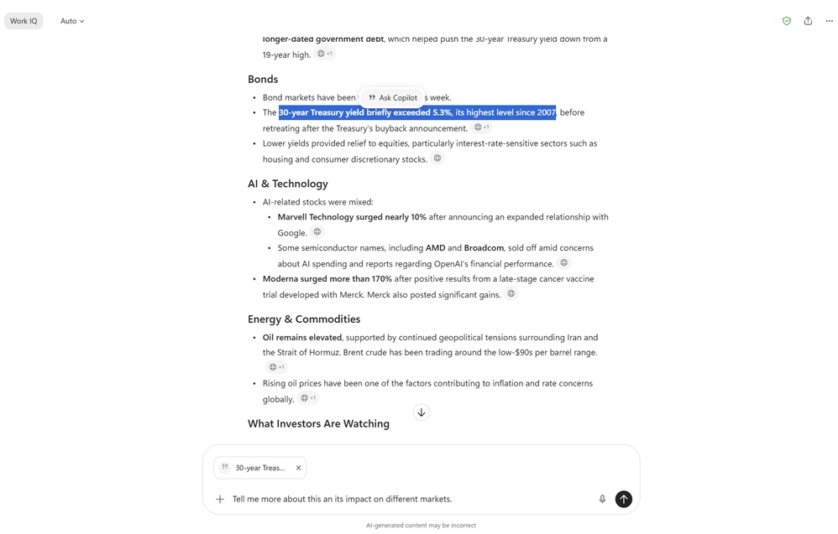
Text selections in Copilot Chat
ID 522616
Copilot now works on just the text a user selects in a Chat response, making follow-up requests more focused.
Granular Selection — Users can select a sentence, paragraph, or table in a Chat response and ask Copilot to work only on that content.
Preview Before Sending — The selected text is previewed in the prompt before the user sends it.
Focused Follow-ups — This enables more focused explanations, summaries, translations, and next steps.
August Rollout — This feature rolled out in August.
Text selections in Copilot Chat
What’s New in Microsoft Copilot | August 2026 | Microsoft Community Hub
Notes:
Now in Copilot, users can select a sentence, paragraph, or table in a Chat response and ask Copilot to work only on that content. The selected text is previewed in the prompt before sending, enabling more focused explanations, summaries, translations, and next steps.
This feature rolled out in August.
Source: What's New in Microsoft Copilot | August 2026 — https://techcommunity.microsoft.com/blog/microsoft365copilotblog/what%E2%80%99s-new-in-microsoft-copilot--august-2026/4551960

Slide 11
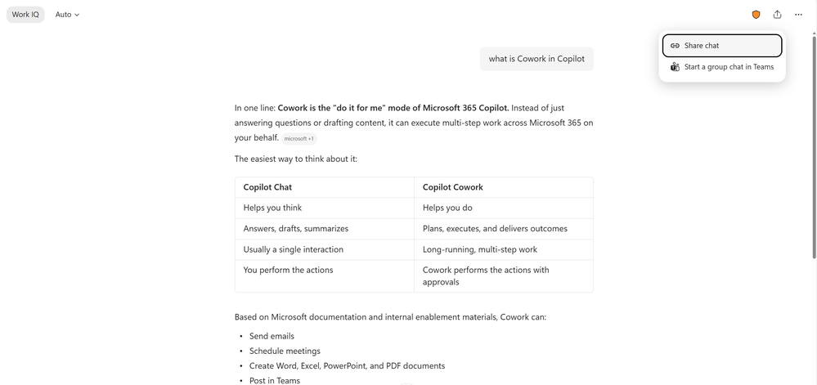
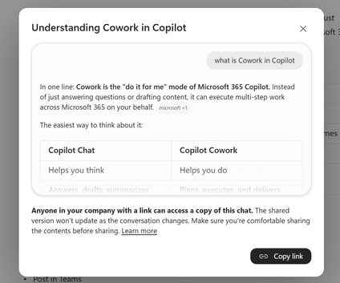
Chat sessions and individual responses can be shared by link
ID 562353
Copilot users can pass their work to colleagues through a simple link while staying within organizational controls.
Two Sharing Options — Users can share a full chat session with 'Share chat' or a single response with 'Share response’.
Continue The Conversation — Recipients get a read-only view and can continue the chat as if it were their own.
Governed Reuse — Work is easy to reuse and collaborate on within organizational controls.
August Rollout — This feature rolled out in August.
Chat sessions and individual responses can be shared by link
What’s New in Microsoft Copilot | August 2026 | Microsoft Community Hub
Notes:
Copilot users can now share either a full chat session or an individual response through a simple link. Recipients get a read-only view and can continue the chat like it was their own, so they can easily reuse work and collaborate within organizational controls. Users share a full session by selecting 'Share chat' from the Share menu at the top right of the chat, or an individual response by selecting 'Share response' from the More options menu at the end of a response. This feature rolled out in August. Source: What's New in Microsoft Copilot | August 2026 — https://techcommunity.microsoft.com/blog/microsoft365copilotblog/what%E2%80%99s-new-in-microsoft-copilot--august-2026/4551960

Slide 12
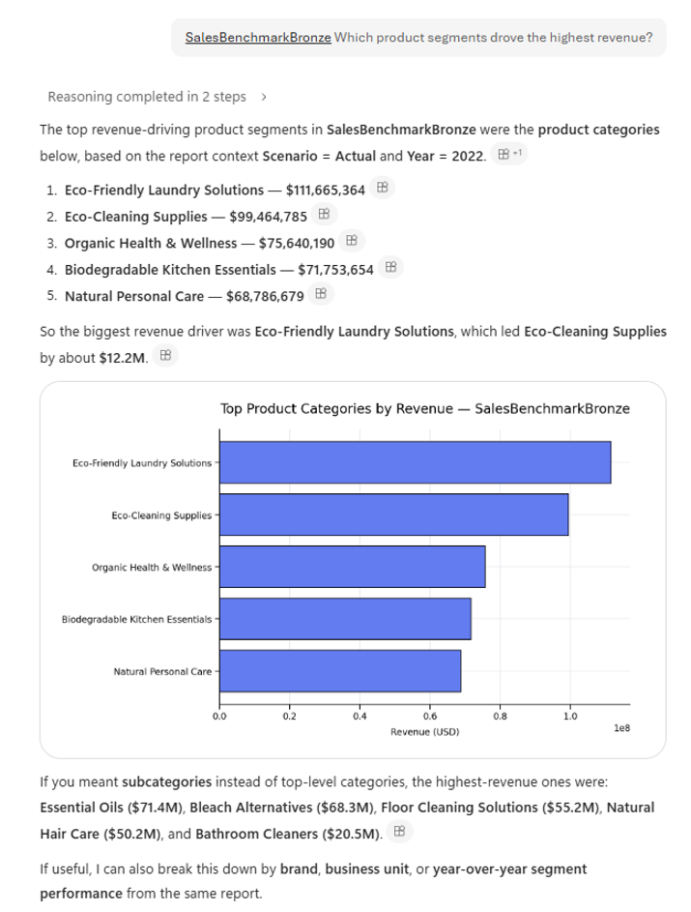
Copilot answers questions from Power BI reports and semantic models
ID 567891
Copilot brings governed business intelligence data into everyday chat so users can get grounded answers without opening a report.
Enterprise Data Reasoning — Copilot can reason over data from Power BI reports and semantic models in both Chat and Cowork.
Natural-language Questions — Users ask questions in plain language rather than building a query.
Grounded Answers — Responses are accurate and grounded in data the user already has access to.
Worldwide Availability — Rolled out to Public Preview in June and worldwide in August.
Power BI reports and semantic models
What’s New in Microsoft Copilot | August 2026 | Microsoft Community Hub
Notes:
Copilot can now reason over enterprise data from Power BI reports and semantic models in both Chat and Cowork. Users can ask natural-language questions and receive accurate, grounded answers directly from data they have access to.
This feature rolled out to Public Preview in June and rolled out worldwide in August.
Source: What's New in Microsoft Copilot | August 2026 — https://techcommunity.microsoft.com/blog/microsoft365copilotblog/what%E2%80%99s-new-in-microsoft-copilot--august-2026/4551960
Message Center ID - MC1323266

Slide 13
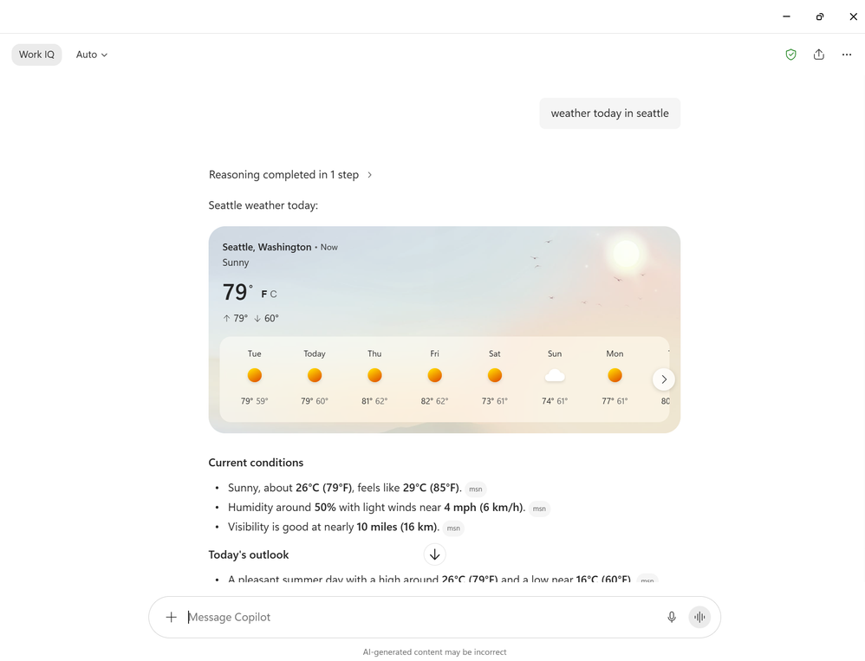
New model-driven answer cards
ID 567008
Copilot Chat now returns model-driven cards that display everyday information visually rather than as plain text.
Rich Content Types — Cards dynamically display weather, sports, finance, images, video, places, and news.
Prompt-driven Display — Cards surface based on the user's prompt across supported Copilot experiences.
Broad Account Support — Available to Entra and Microsoft account users.
August Rollout — This feature rolled out in August.
New model-driven answer cards
What’s New in Microsoft Copilot | August 2026 | Microsoft Community Hub
Notes:
New model-driven answer cards dynamically display content in Chat like weather, sports, finance, images, video, places, and news. The cards surface rich answers for Entra and Microsoft account users based on the user prompt across supported experiences in Copilot.
This feature rolled out in August.
Source: What's New in Microsoft Copilot | August 2026 — https://techcommunity.microsoft.com/blog/microsoft365copilotblog/what%E2%80%99s-new-in-microsoft-copilot--august-2026/4551960

Slide 14
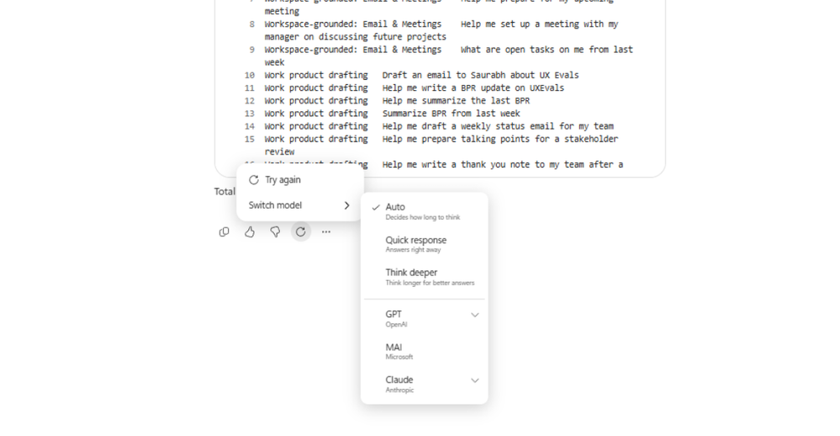
Users can retry a prompt with the same or a different model
Copilot Chat lets users regenerate an answer in place, so refining output no longer means starting a new conversation.
Try Again — Users can generate a new response to their latest prompt with the same model.
Model Switching — They can also select a new model and have Copilot run the same prompt.
Refine Without Restarting — Users explore different answers and improve output quality inside the same conversation.
August Rollout — This feature rolled out in August.
Users can retry a prompt
What’s New in Microsoft Copilot | August 2026 | Microsoft Community Hub
Notes:
Users can now generate a new response to their latest prompt in Chat without having to start over. They can select 'Try again' to generate a new response with the same model, or they can select a new model and have Copilot run the same prompt. This lets users explore different answers and refine output quality without restarting their conversations.
This feature rolled out in August.
Source: What's New in Microsoft Copilot | August 2026 — https://techcommunity.microsoft.com/blog/microsoft365copilotblog/what%E2%80%99s-new-in-microsoft-copilot--august-2026/4551960

Slide 15
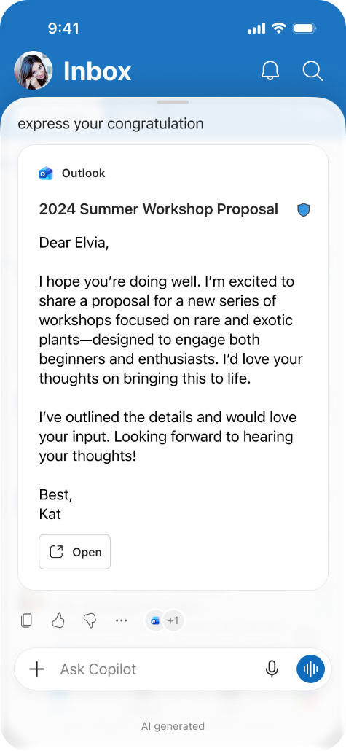
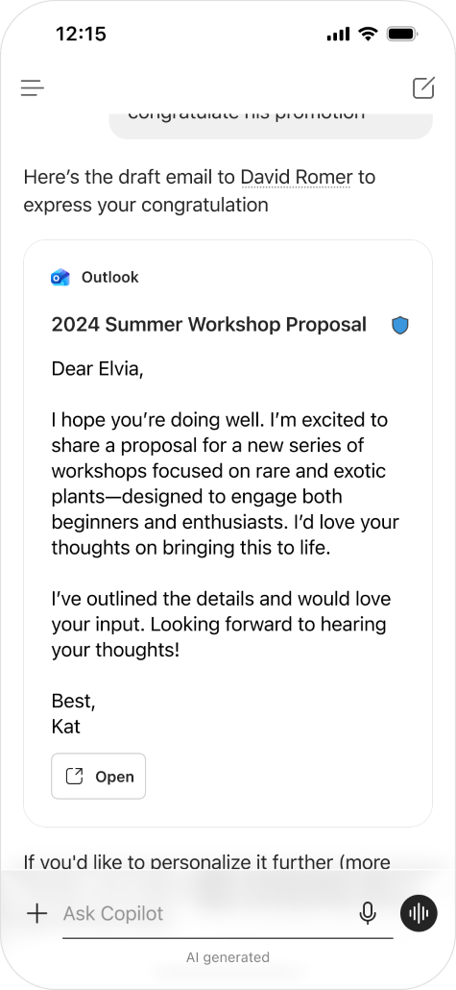
Mobile users turn an idea into an Outlook draft inside Copilot Chat
MC1462472
Copilot turns a described message into a ready-to-send email without the user leaving their flow of work on mobile.
Describe The Message — Users simply describe the email they need in Copilot Chat.
Embedded Outlook Draft — Copilot creates an embedded Outlook draft directly in the chat.
Finish In Outlook — Users open the draft in Outlook mobile to edit and send.
August Rollout — This feature rolled out in August.
Idea into an Outlook draft
What’s New in Microsoft Copilot | August 2026 | Microsoft Community Hub
Notes:
Mobile users can now turn an idea into a ready-to-send email. They simply describe the message they need, and Copilot creates an embedded Outlook draft directly in Copilot Chat. Users can then open the draft directly in Outlook mobile to edit and send. This seamless experience helps users move from idea to action without leaving their flow of work.
This feature rolled out in August.
Source: What's New in Microsoft Copilot | August 2026 — https://techcommunity.microsoft.com/blog/microsoft365copilotblog/what%E2%80%99s-new-in-microsoft-copilot--august-2026/4551960

Slide 16
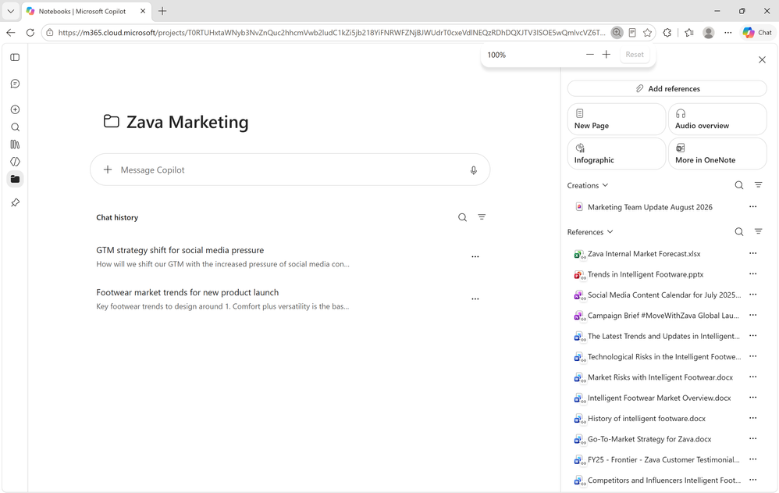
Copilot Notebooks now spans the Copilot app and OneNote
ID 562662
Notebooks gives users a lightweight experience for quick work and a full workspace for deeper project work, without losing context between them.
Lightweight Experience — In the Copilot app, users chat with Copilot, explore references, and create artifacts.
Workspace Experience — In OneNote, users get deeper project work, expanded artifact creation, and team collaboration.
Continuous Context — Notebooks stay in sync across both, and 'Open in OneNote' moves users straight across.
August Rollout — This feature rolled out in August.
Copilot Notebooks now spans the Copilot app and OneNote
What’s New in Microsoft Copilot | August 2026 | Microsoft Community Hub
Notes:
Copilot Notebooks now gives users two connected ways to work: a lightweight experience in the Copilot app, and a workspace experience in OneNote.
In the Copilot app, users can quickly chat with Copilot, explore references, and create artifacts. In OneNote, users get a workspace experience for deeper project work, expanded artifact creation, and team collaboration. Because notebooks stay in sync across the Copilot app and OneNote, users can move between the two without losing context, going directly from the Copilot app to OneNote by selecting "Open in OneNote."
This feature rolled out in August.
Source: What's New in Microsoft Copilot | August 2026 — https://techcommunity.microsoft.com/blog/microsoft365copilotblog/what%E2%80%99s-new-in-microsoft-copilot--august-2026/4551960

Slide 17
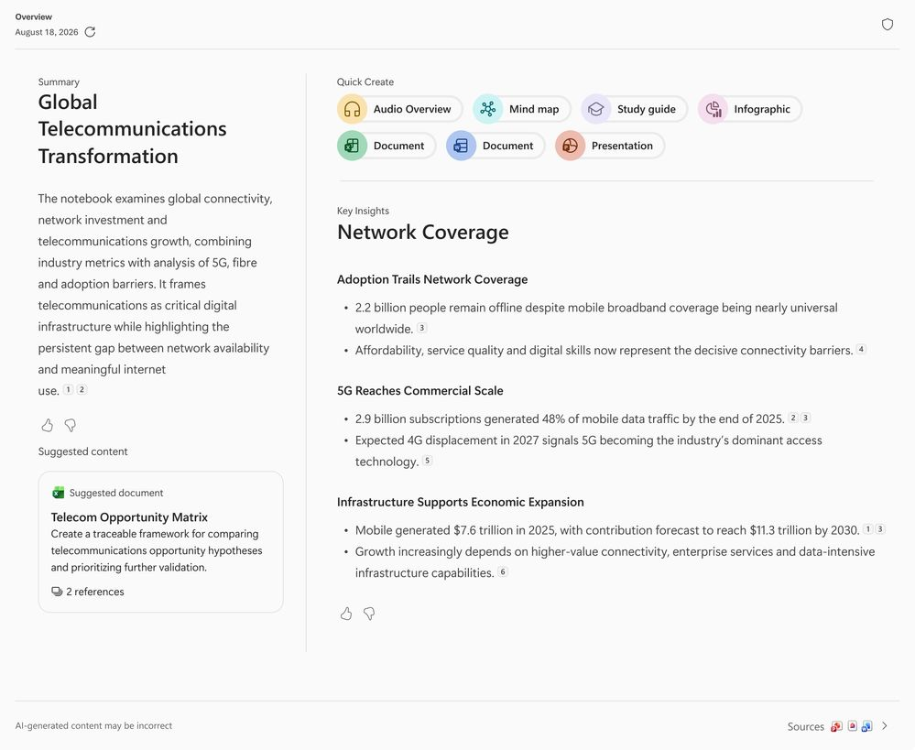
Copilot Notebooks recommends the artifacts to create next
Notebooks proactively suggests the documents worth generating so users can move from notes to deliverables in one step.
Proactive Suggestions — Recommendations are based on WorkIQ and the content of the user's notebook.
One-select Generation — Selecting a suggestion prompts Copilot to generate a Word, Excel, or PowerPoint artifact.
Project-aware Output — Generated artifacts reflect the notebook content and the user's current project.
August Rollout — This feature rolled out in August.
Proactive Suggestions
What’s New in Microsoft Copilot | August 2026 | Microsoft Community Hub
Notes:
Copilot Notebooks proactively lets users easily generate relevant documents by recommending artifacts based on WorkIQ and their notebook content. Selecting a suggestion prompts Copilot to generate a more specific Word, Excel, or PowerPoint artifact based on the user's notebook content and current project.
This feature rolled out in August.
Source: What's New in Microsoft Copilot | August 2026 — https://techcommunity.microsoft.com/blog/microsoft365copilotblog/what%E2%80%99s-new-in-microsoft-copilot--august-2026/4551960

Slide 18
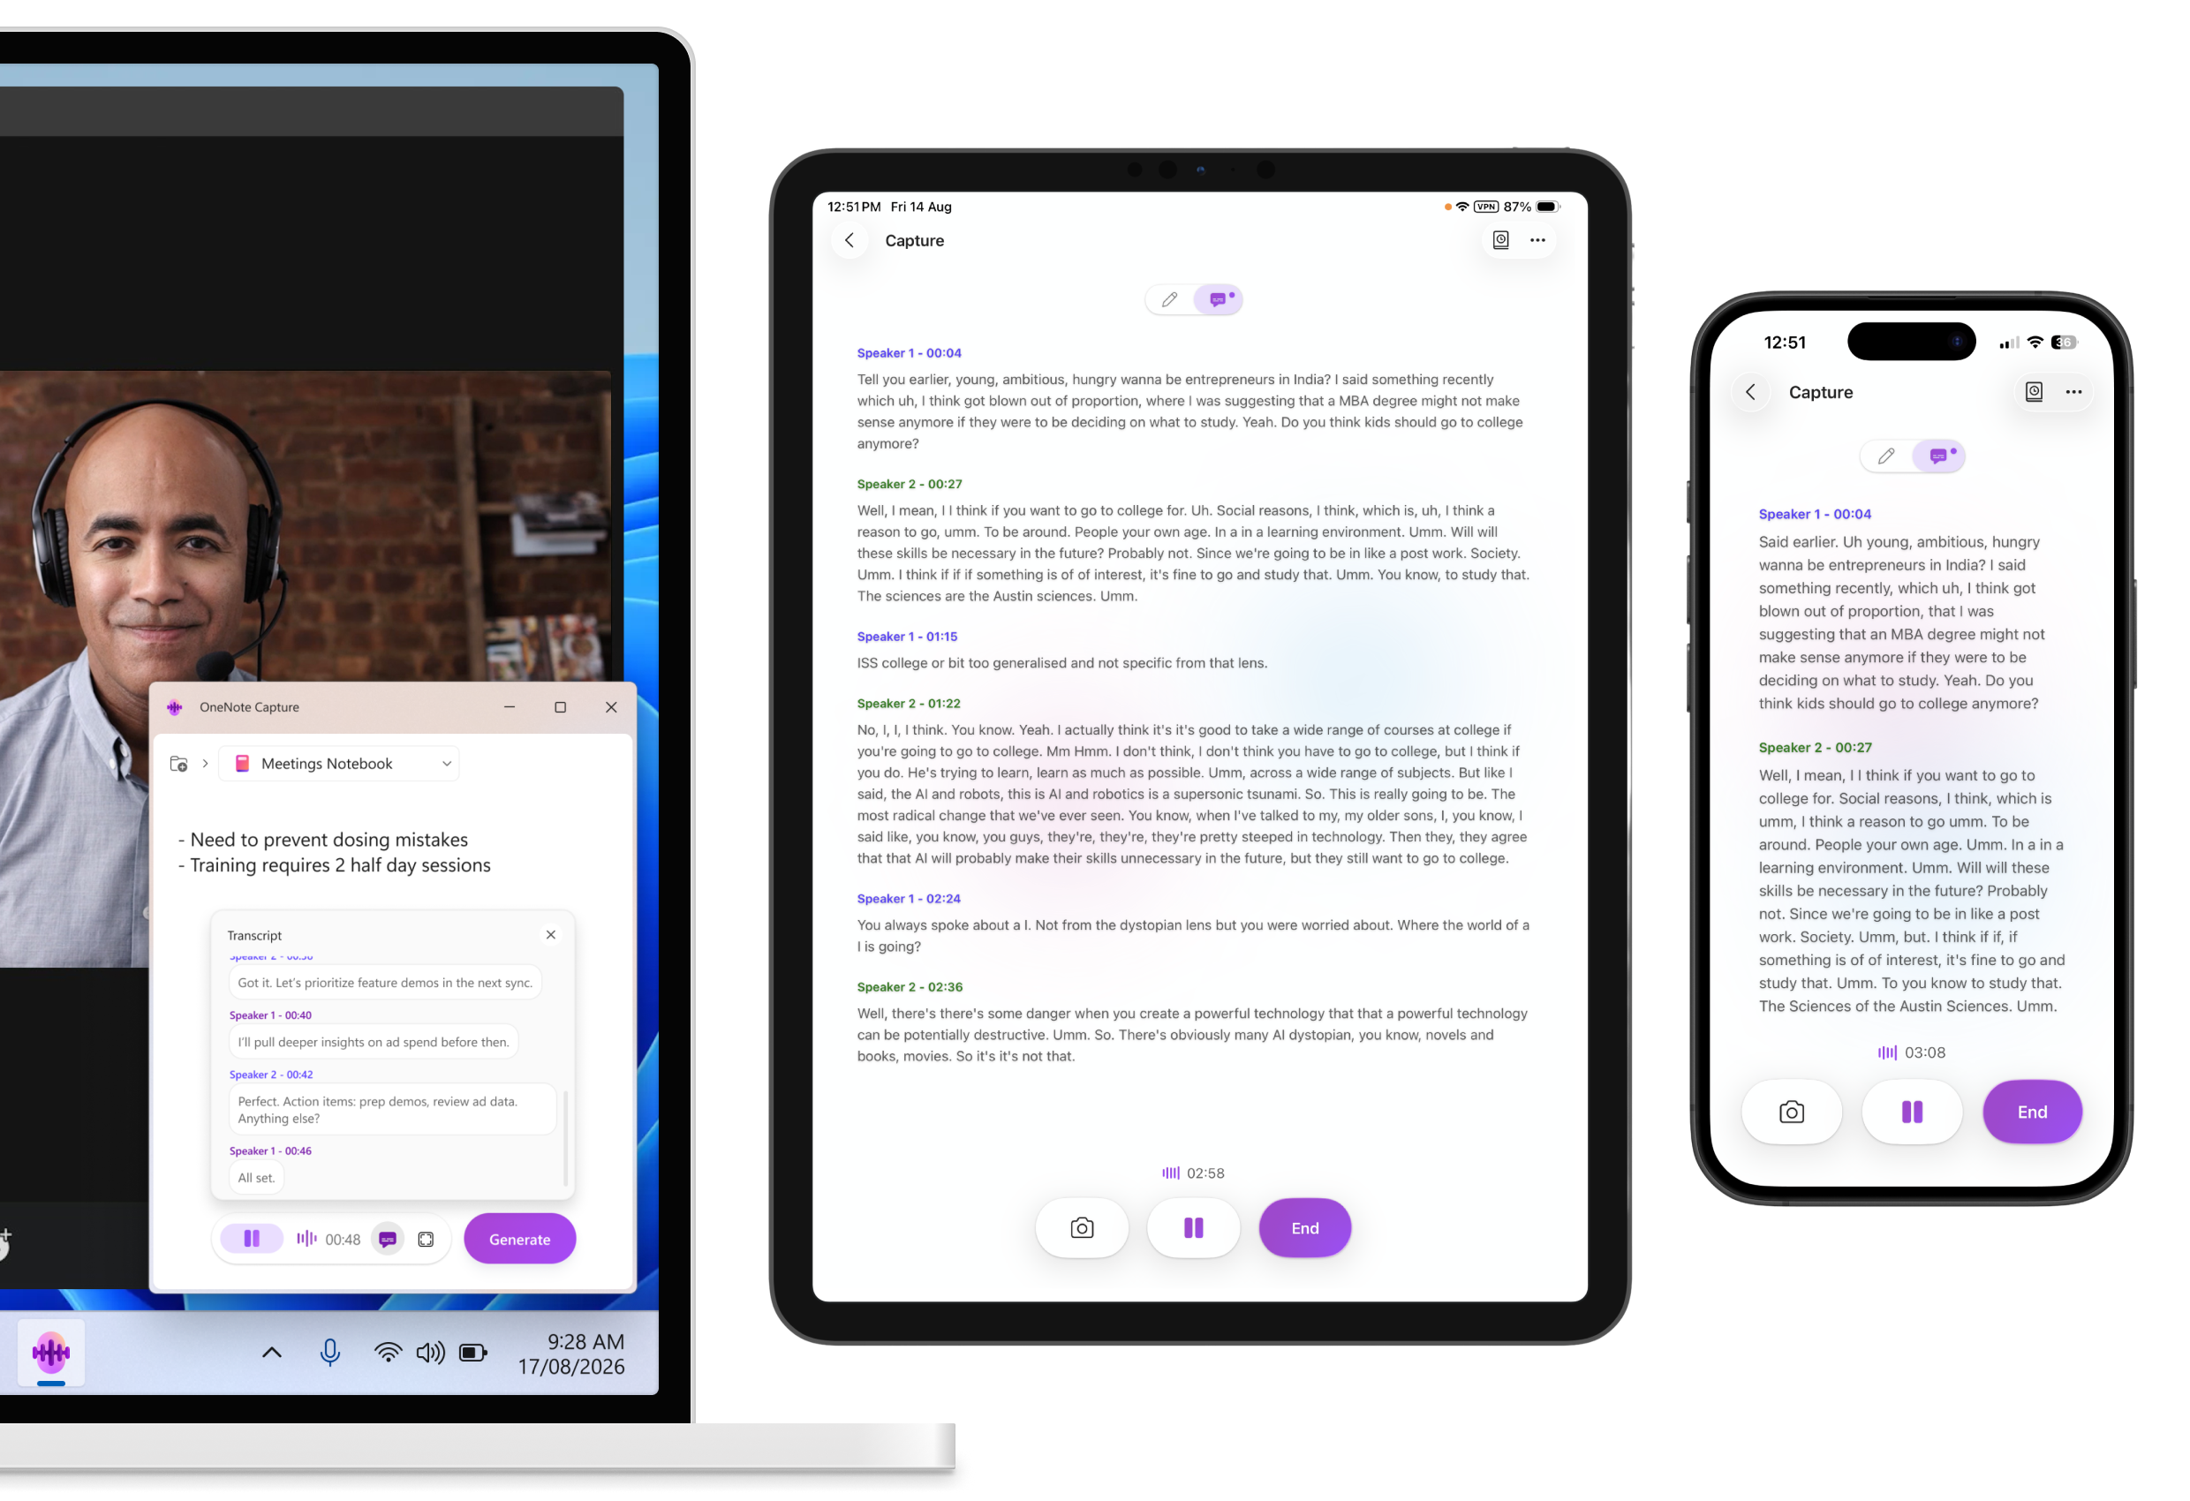
Multimodal capture brings audio, images, and notes into Copilot Notebooks
ID 567895
Multimodal capture into Copilot Notebooks
Users can capture real work moments on their phone and have Copilot turn them into structured notes.
Work Moments Captured — Conversations, meetings, and brainstorms can be brought into Copilot Notebooks.
One Capture Experience — Users capture audio, images, and notes together in a single flow.
Structured Notes — Copilot automatically generates structured notes for the user's Copilot Notebooks.
September Rollout — Multimodal capture on Android rolls out in September, and is also available in the OneNote app on iOS and iPad.
What’s New in Microsoft Copilot | August 2026 | Microsoft Community Hub

Slide 19
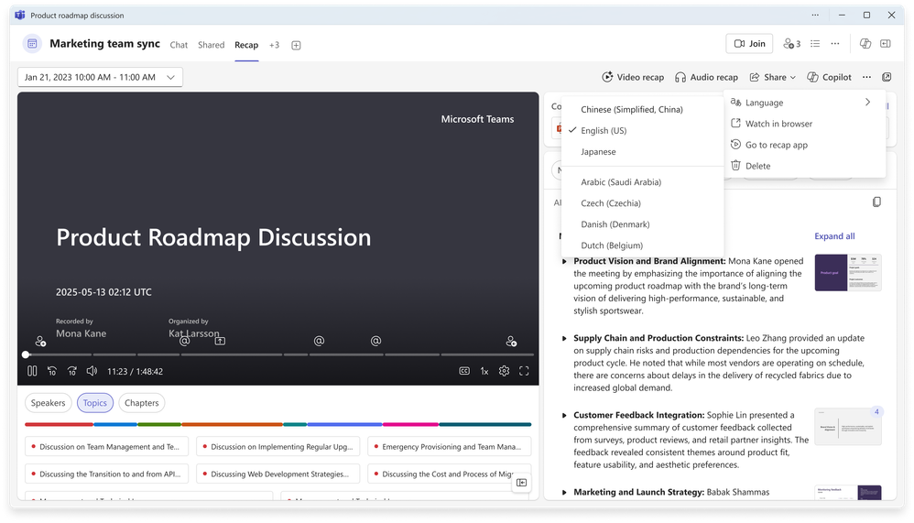
Users can change the language of a Teams meeting recap
ID 567458
Copilot in Teams makes multilingual recaps more flexible by translating a recap after it has already been generated.
Post-generation Translation — Users can change the language of a meeting recap after it has been generated.
One-select Control — A translation button sits directly on the recap.
Multilingual Teams — Recaps can be read in the language each participant needs.
August Rollout — This feature rolled out in August.
Change the language of a Teams meeting recap
What’s New in Microsoft Copilot | August 2026 | Microsoft Community Hub
Notes:
Users can now change the language of a meeting recap after it has been generated. A translation button makes multilingual recaps more flexible when users need the recap in a different language.
This feature rolled out in August.
Source: What's New in Microsoft Copilot | August 2026 — https://techcommunity.microsoft.com/blog/microsoft365copilotblog/what%E2%80%99s-new-in-microsoft-copilot--august-2026/4551960

Slide 20
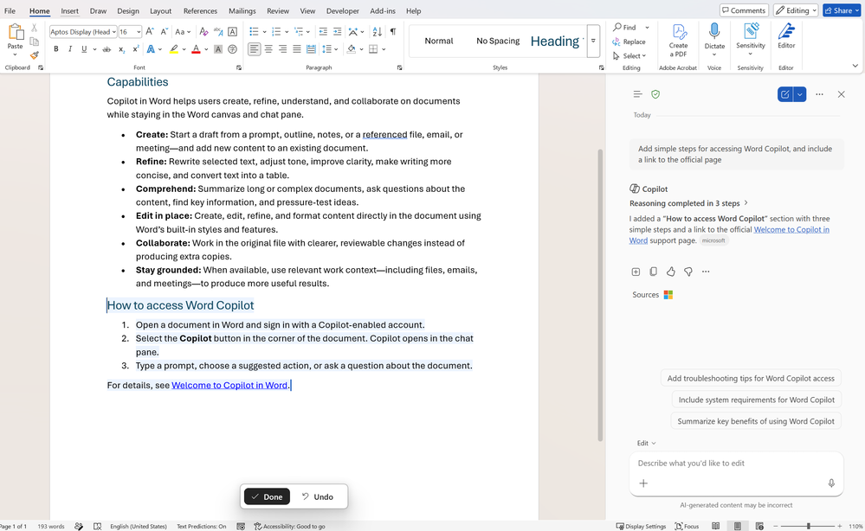
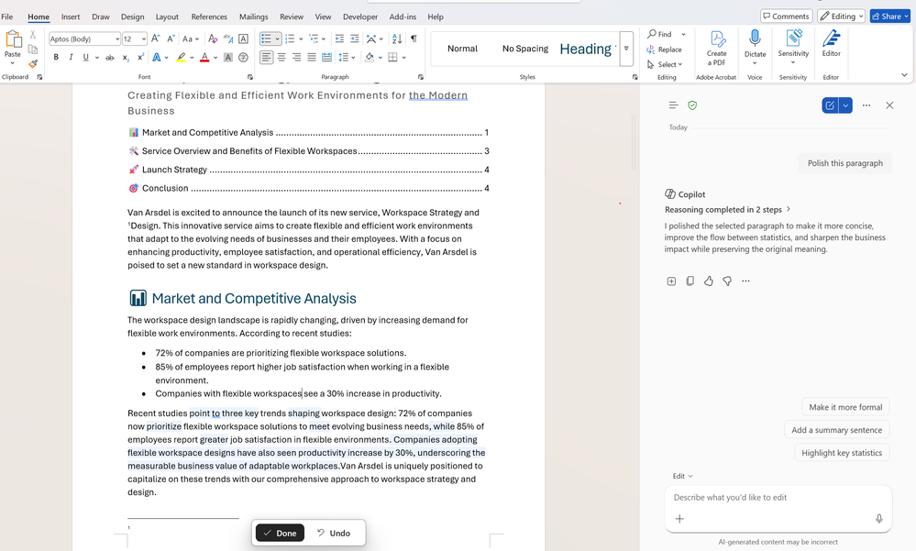
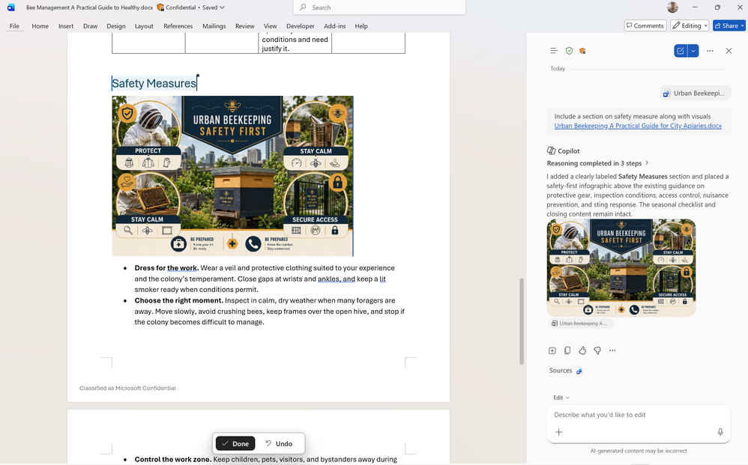
Hyperlinks, image understanding, and edit highlights for Copilot in Word
Copilot in Word helps users create more complete, polished documents and makes its own edits easier to review.
Automatic Hyperlinks — Users can ask Copilot to add hyperlinks, and it inserts and formats linked text directly in the document.
Image Understanding — Copilot understands images in reference documents and uses relevant text and visuals from those files in the content it creates.
Word-level Highlights — When Copilot rewrites or refines text it highlights the exact words it edited rather than marking whole paragraphs.
August Rollout — These capabilities rolled out in August.
Hyperlinks, image understanding, and edit highlights
What’s New in Microsoft Copilot | August 2026 | Microsoft Community Hub
Notes:
Click animations
Creating polished documents is now easier with Copilot. Users can simply ask Copilot to add hyperlinks, and it can insert and format linked text directly in their document, helping them create professional, connected content without manual editing.
Copilot can also understand images in a user's reference documents and incorporate them into the content it creates, so it can use relevant text and visuals from referenced files.
When Copilot rewrites or refines text, it now highlights the exact words it edited rather than marking an entire paragraph, making it easier to review, understand, and accept changes with confidence.
These capabilities rolled out in August.
Source: What's New in Microsoft Copilot | August 2026 — https://techcommunity.microsoft.com/blog/microsoft365copilotblog/what%E2%80%99s-new-in-microsoft-copilot--august-2026/4551960

Slide 21
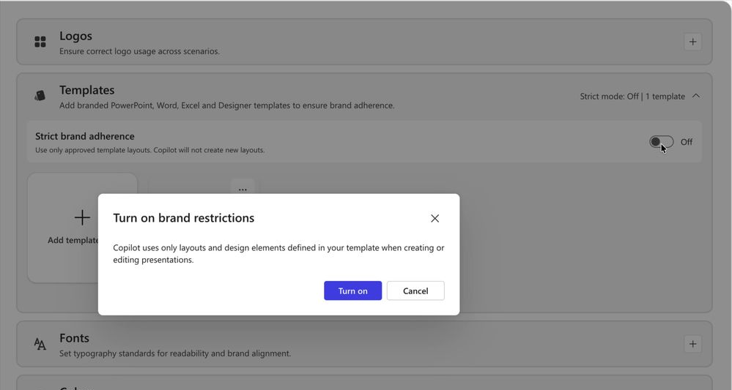
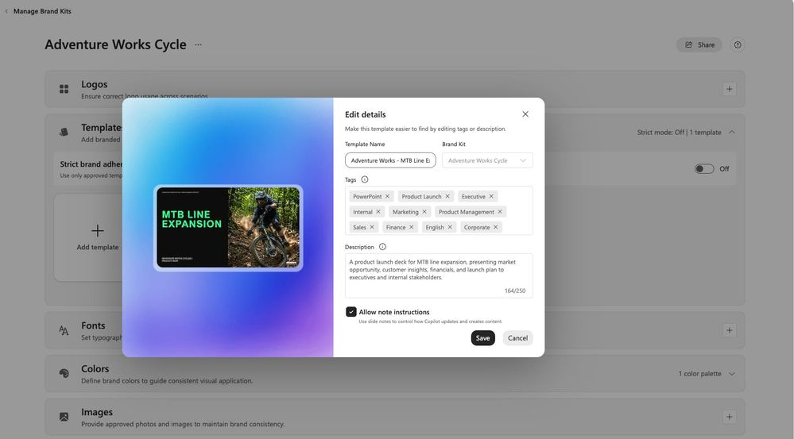
Brand curation for Copilot in PowerPoint
Organizations can hold Copilot to their approved template and give it standing instructions, so generated decks stay on brand.
Strict Brand Adherence — Copilot is restricted to approved template and slide master layouts, and will not add or remove placeholders or invent new layouts.
Note Steering — Plain-language instructions written in a slide's notes give slide-by-slide governance that Copilot reads each time it builds from the template.
Custom Skills — Users can upload, create, edit, and delete their own skills, turning repeated instructions into reusable guidance.
August Rollout — These capabilities rolled out in August.
Brand curation for Copilot in PowerPoint
What’s New in Microsoft Copilot | August 2026 | Microsoft Community Hub
Notes:
Strict brand adherence restricts Copilot to your approved template and slide master layouts; when it is on, Copilot will not add or remove placeholders or invent new layouts. Use it when brand consistency matters more than creative flexibility, for official, customer-facing, or regulated presentations.
Note steering lets you guide Copilot with plain-language instructions written in a slide's notes for slide-by-slide governance, and Copilot reads those notes each time it creates a presentation from your template so you do not have to repeat preferences in every prompt.
Users can also upload, create, edit and delete their own custom skills, turning repeated instructions into reusable guidance Copilot applies in the flow of presentation work.
These capabilities rolled out in August.
Source: What's New in Microsoft Copilot | August 2026 — https://techcommunity.microsoft.com/blog/microsoft365copilotblog/what%E2%80%99s-new-in-microsoft-copilot--august-2026/4551960

Slide 22
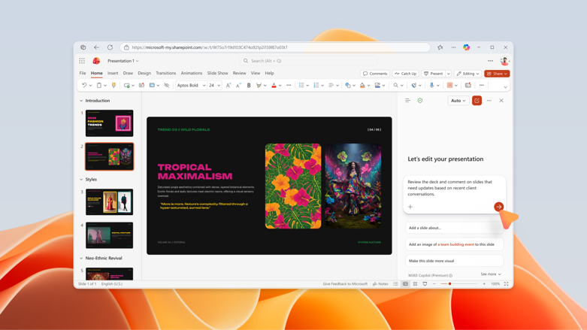
Collaboration, translation, and SmartArt for Copilot in PowerPoint
Copilot in PowerPoint helps teams move from feedback to action and takes on the manual work of translating and building diagrams.
Comments And Follow-ups — Users can ask Copilot to pull stakeholders into a comment thread and automatically assign tasks, keeping reviews organized.
Faster Translation — Translation has moved from the ribbon into Copilot and can dynamically resize text boxes depending on the text.
SmartArt Editing — Copilot can edit diagrams and shapes on the canvas while staying on brand, instead of manual adding and aligning.
Rollout Timing — Comments and translation rolled out in August; SmartArt editing is in Frontier in August.
Comments And Follow-ups
What’s New in Microsoft Copilot | August 2026 | Microsoft Community Hub
Notes:
Users can now assign tasks and notify relevant stakeholders in comments using Copilot in PowerPoint, asking Copilot to pull in stakeholders and automatically assign follow-ups directly in the comment thread. This helps teams move from feedback to action faster, keeps presentation reviews organized, and reduces the manual effort needed to track next steps.
Translation capabilities have moved from the ribbon to Copilot in PowerPoint and are now faster, with the ability to dynamically resize text boxes depending on the text. Copilot can also edit smart art while staying on brand, so users edit diagrams and shapes on the canvas instead of manually adding and aligning them.
Comments and translation rolled out in August; SmartArt editing is in Frontier in August.
Source: What's New in Microsoft Copilot | August 2026 — https://techcommunity.microsoft.com/blog/microsoft365copilotblog/what%E2%80%99s-new-in-microsoft-copilot--august-2026/4551960

Slide 23
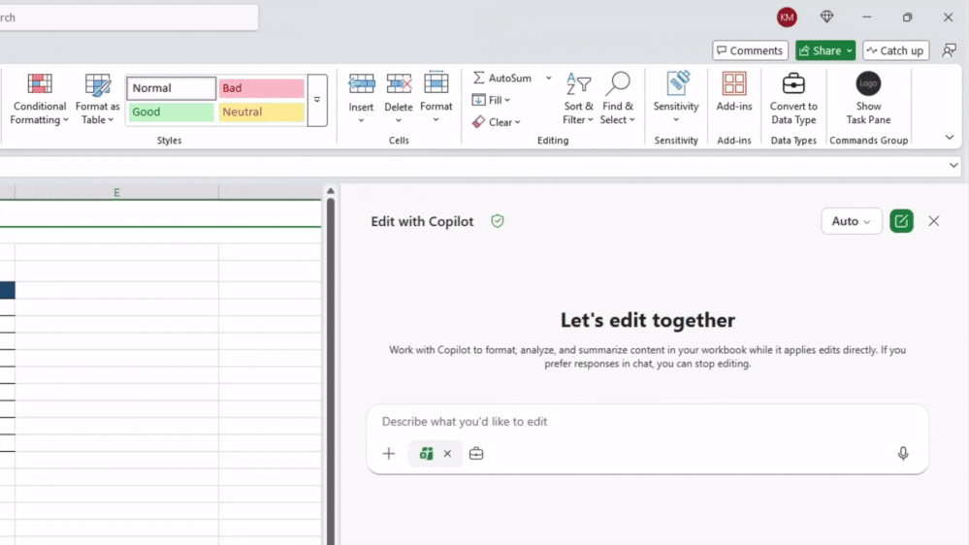
Chat history and change history skill for Copilot in Excel
Copilot in Excel helps users understand how a workbook has changed and pick up their previous analysis where they left off.
Change History Skill — Copilot summarizes recent changes, identifies who made edits, and explains how both people and AI modified the workbook.
Safe Recovery — It can help undo specific edits or restore formulas by returning the workbook to a previous working state.
Chat History — Past conversations are preserved and listed by recency in the Copilot pane, so users can reopen and continue earlier sessions.
August Rollout — These capabilities rolled out in August.
Chat history and change history skill
What’s New in Microsoft Copilot | August 2026 | Microsoft Community Hub
Notes:
The change history skill helps users understand how a workbook has evolved over time. Copilot can summarize recent changes, identify who made edits, and explain how both people and AI have modified the workbook. It can also help undo specific edits or restore formulas by returning the workbook to a previous working state. Chat history helps users pick up where they left off by preserving past conversations and sessions, accessed from the menu icon in the upper left of the Copilot in Excel pane, with conversations listed by recency. These capabilities rolled out in August. Source: What's New in Microsoft Copilot | August 2026 — https://techcommunity.microsoft.com/blog/microsoft365copilotblog/what%E2%80%99s-new-in-microsoft-copilot--august-2026/4551960

Slide 24
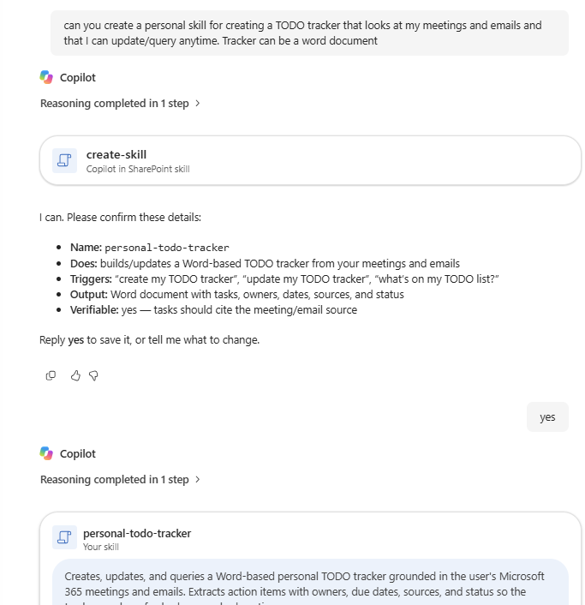
Personal skills in Copilot in SharePoint
ID 567668
Users can build their own skills once and apply them wherever they work with content in SharePoint and OneDrive.
User-owned Skills — Users create personal skills in Copilot in SharePoint.
Portable Across Sites — Skills can be used across SharePoint sites and OneDrive rather than recreated for every site.
Saved In OneDrive — Each skill is saved as a markdown file in the user's OneDrive.
Rollout Timing — Rolled out to Public Preview in August and rolls out worldwide in December.
Personal skills in Copilot in SharePoint
What’s New in Microsoft Copilot | August 2026 | Microsoft Community Hub
Notes:
Users can create personal skills in Copilot in SharePoint and use them across SharePoint sites and OneDrive. Each user-owned skill is saved as a markdown file in OneDrive, so users do not need to recreate skills for every site.
This feature rolled out to Public Preview in August and rolls out worldwide in December.
Source: What's New in Microsoft Copilot | August 2026 — https://techcommunity.microsoft.com/blog/microsoft365copilotblog/what%E2%80%99s-new-in-microsoft-copilot--august-2026/4551960

Slide 25
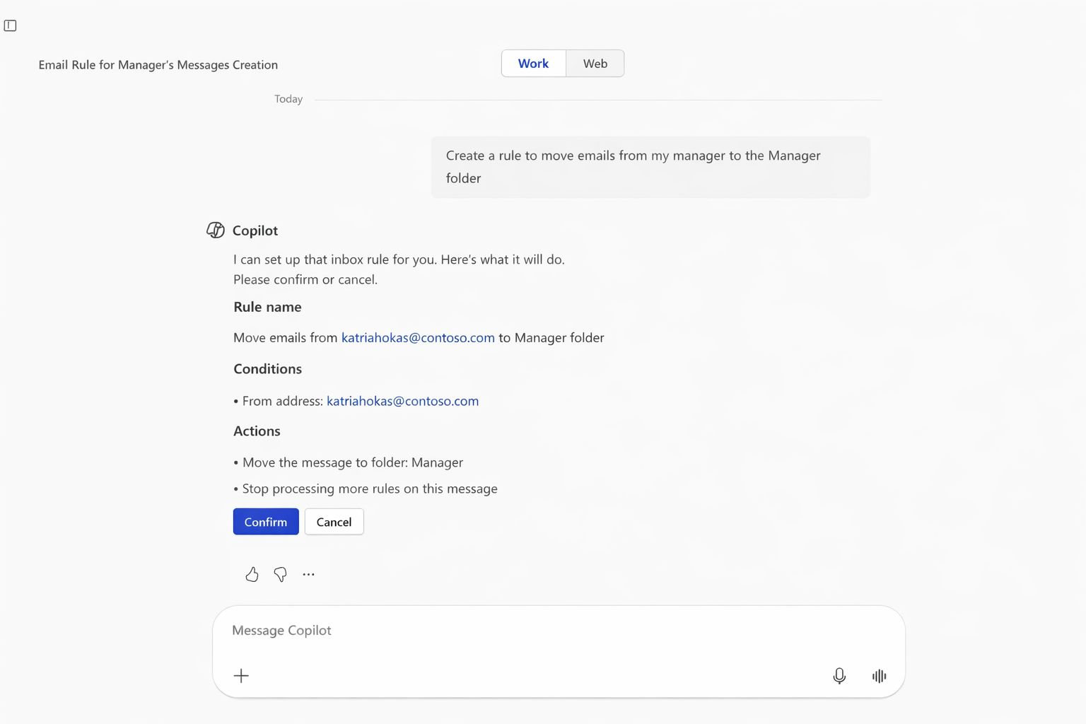
Natural-language email and calendar management in Copilot in Outlook
Copilot in Outlook takes on more mailbox and calendar housekeeping directly from chat, so users stay in flow.
Inbox Organization — Users can ask Copilot to organize messages, apply categories, create folders, and manage inbox rules.
Calendar Actions — Copilot can take action on meetings and events from the same chat experience.
Fewer Context Switches — Bringing more Outlook actions into chat helps users get work done more efficiently.
August Rollout — This feature rolled out in August.
Natural-language email and calendar management
What’s New in Microsoft Copilot | August 2026 | Microsoft Community Hub
Notes:
Copilot in Outlook can help users manage more email and calendar tasks using natural language. Users can ask Copilot to organize messages, apply categories, create folders, manage inbox rules, and take action on meetings and events, all from chat. By bringing more Outlook actions directly into the chat experience, Copilot helps them stay in flow and get work done more efficiently.
This feature rolled out in August.
Source: What's New in Microsoft Copilot | August 2026 — https://techcommunity.microsoft.com/blog/microsoft365copilotblog/what%E2%80%99s-new-in-microsoft-copilot--august-2026/4551960

Slide 26
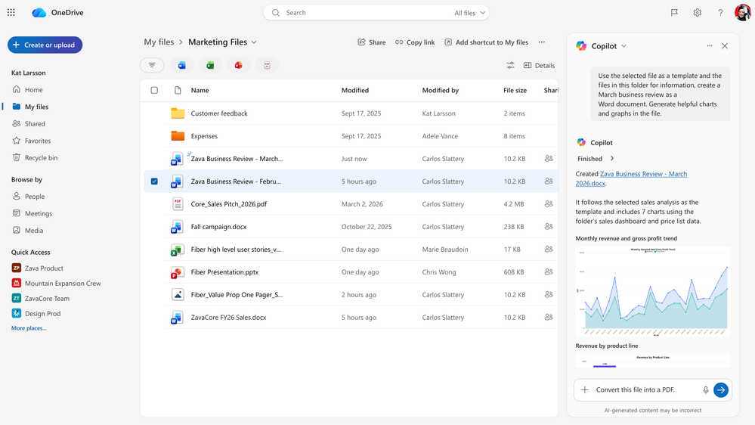
Improved file capabilities with Copilot in OneDrive
ID 569215
Copilot in OneDrive takes users from files to finished work without leaving chat.
Find And Analyze — Copilot helps users find the right content and analyze files and data.
Polished Outputs — Users can create summaries, dashboards, and presentations from their files.
Share From OneDrive — Results can be saved or shared straight from OneDrive to collaborate.
Rollout Timing — Rolled out to Public Preview in August and rolls out worldwide in December.
Improved file capabilities
What’s New in Microsoft Copilot | August 2026 | Microsoft Community Hub
Notes:
With improved Copilot file capabilities in OneDrive, users can go from files to finished work directly from chat. Copilot helps users find the right content, analyze files and data, create polished outputs like summaries, dashboards, and presentations, and collaborate by saving or sharing the results from OneDrive.
This feature rolled out to Public Preview in August and rolls out worldwide in December.
Source: What's New in Microsoft Copilot | August 2026 — https://techcommunity.microsoft.com/blog/microsoft365copilotblog/what%E2%80%99s-new-in-microsoft-copilot--august-2026/4551960

Slide 27
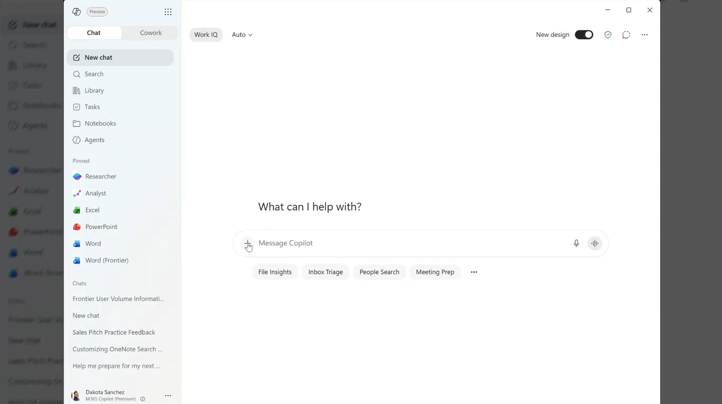
New connectors and plugins
Microsoft continues to grow the Copilot ecosystem so organizations can ground Copilot in the business data they already rely on.
Industry Coverage — New connectors and plugins span financial services, legal, professional and business services, energy and resources, healthcare and life sciences, and software and technology.
Named Additions — These include Mercury, Xero, iManage Work, Boardwise, Harvey, Descrybe Legal Engine, Relativity, Everlaw, Statista, Crossbeam, ZoomInfo, IDC, S&P Global Energy, Scite, Consensus, Adobe Journey Optimizer, GoDaddy, and Asana.
Richer Context — Connecting Copilot to business data and domain-specific knowledge unlocks deeper insights and more relevant experiences across everyday workflows.
New connectors and plugins
What’s New in Microsoft Copilot | August 2026
Notes:
Microsoft continues to grow the Microsoft Copilot ecosystem with new connectors and plugins spanning multiple industries. By connecting Copilot to valuable business data and domain-specific knowledge, organizations can unlock richer context, deeper insights, and more relevant experiences across everyday workflows. New additions cover financial services (Mercury, Xero), legal services (iManage Work, Boardwise, Harvey, Descrybe Legal Engine, Relativity, Everlaw), professional and business services (Statista, Crossbeam, ZoomInfo, IDC), energy and resources (S&P Global Energy), healthcare and life sciences (Scite, Consensus), and software and technology (Adobe Journey Optimizer, GoDaddy, Asana).
Source: What's New in Microsoft Copilot | August 2026 — https://techcommunity.microsoft.com/blog/microsoft365copilotblog/what%E2%80%99s-new-in-microsoft-copilot--august-2026/4551960

Slide 28

Agents

Slide 29

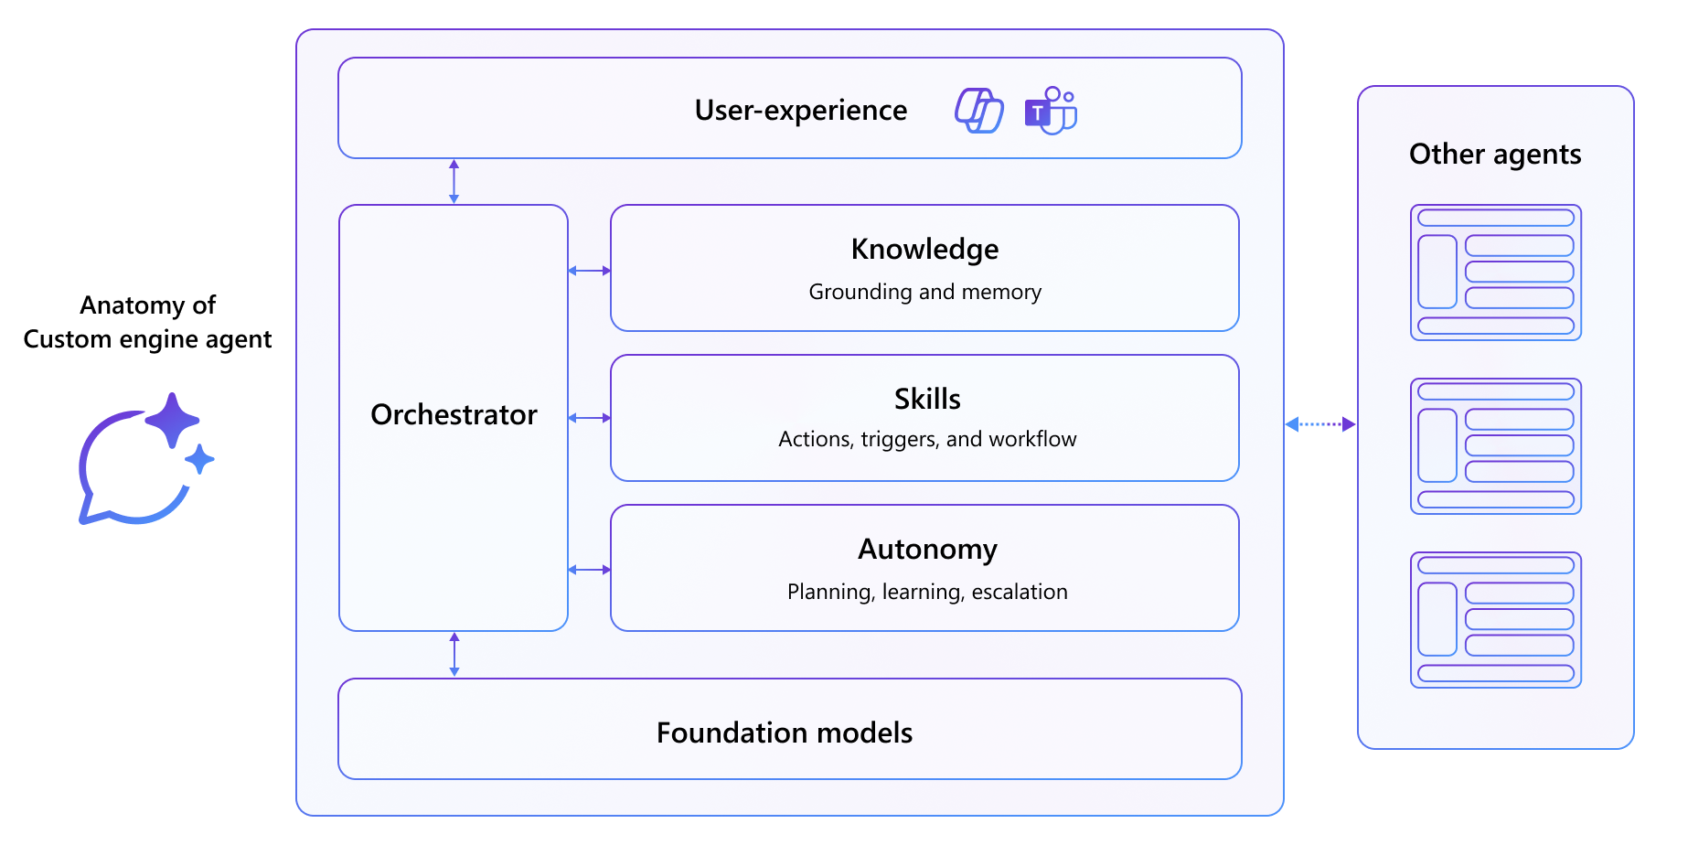

Custom engine agents are available directly in Outlook
Agent capabilities now sit inside the app where users already manage their work.
Agents In Outlook — Custom engine agents are available directly in Outlook.
Work Where Users Are — Users access these agents where they manage their email and calendar.
Capabilities In Context — Agent capabilities become available within the Outlook experience.
August Rollout — This feature rolled out in August.
Custom engine agents are available directly in Outlook
What’s New in Microsoft Copilot | August 2026
Notes:
Custom engine agents are now available directly in Outlook. Users can access these agents where they manage their work, making their capabilities available within the Outlook experience.
This feature rolled out in August.
Source: What's New in Microsoft Copilot | August 2026 — https://techcommunity.microsoft.com/blog/microsoft365copilotblog/what%E2%80%99s-new-in-microsoft-copilot--august-2026/4551960

Slide 30
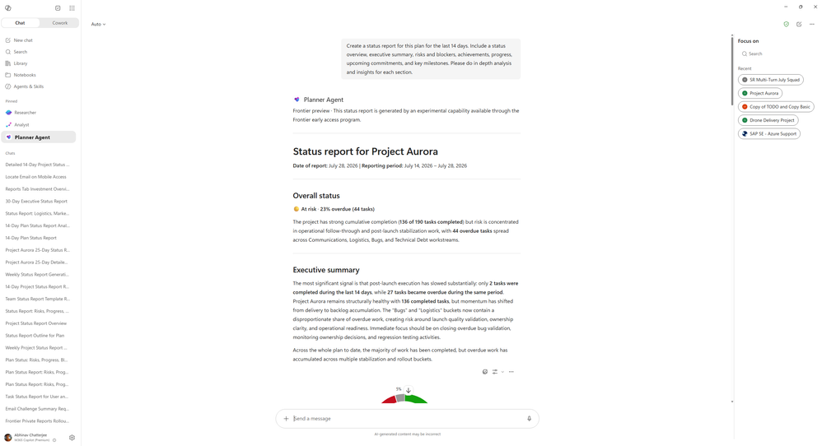
Planner Agent turns plan data into a stakeholder-ready status report
ID 567866
Planner Agent converts live plan data into a polished update, removing the manual work of writing status reports.
Complete Status Picture — Reports cover progress, risks, overall status, and next steps.
Audience Control — Users can specify the audience, tone, length, and sections.
Ready For Stakeholders — The result is a polished update that can go straight to stakeholders.
Frontier Rollout — This feature rolled out to Frontier in August.
Planner Agent
What’s New in Microsoft Copilot | August 2026
Notes:
Planner Agent can help turn plan data into a polished status report covering progress, risks, overall status, and next steps. Users can specify the audience, tone, length, and sections to quickly produce a stakeholder-ready update.
This feature rolled out to Frontier in August.
Source: What's New in Microsoft Copilot | August 2026 — https://techcommunity.microsoft.com/blog/microsoft365copilotblog/what%E2%80%99s-new-in-microsoft-copilot--august-2026/4551960

Slide 31
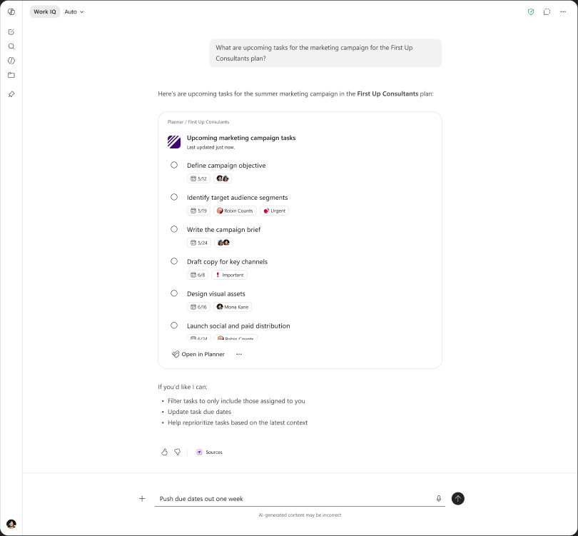
Copilot creates and queries Planner tasks
ID 516577
Task work moves more seamlessly between Copilot and Planner.
Task Creation — Copilot will support creating Planner tasks.
Task Queries — Copilot can query Planner task information.
Connected Task Work — Users manage task work across Copilot and Planner more seamlessly.
September Rollout — This feature rolls out in September.
Copilot creates and queries Planner tasks
What’s New in Microsoft Copilot | August 2026
Notes:
Copilot will now support creating Planner tasks and querying Planner task information. This lets users manage task work across Copilot and Planner more seamlessly.
This feature rolls out in September.
Source: What's New in Microsoft Copilot | August 2026 — https://techcommunity.microsoft.com/blog/microsoft365copilotblog/what%E2%80%99s-new-in-microsoft-copilot--august-2026/4551960

Slide 32

IT admin capabilities

Slide 33
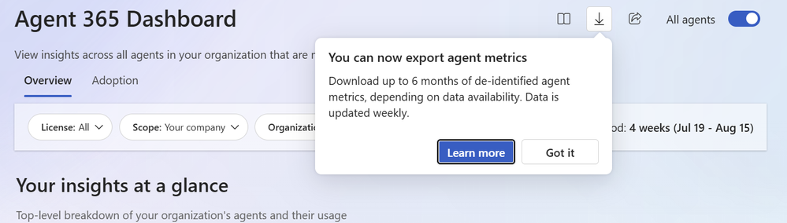
Admins can export row-level Copilot and Agent 365 usage data
MC1411435
New data export capabilities let admins build their own reports on Copilot and agent usage while protecting individual privacy.
Custom Reporting — Admins can create custom reports using data exported from the Copilot and Agent 365 Dashboards.
Row-level Metrics — The dashboards support exporting de-identified, row-level metrics and attributes.
Privacy Preserved — Admins get deeper insight into organizational usage and user-level interactions with personal identifiers removed.
September Rollout — These features roll out in September.
Export row-level Copilot and Agent 365 usage data
What’s New in Microsoft Copilot | August 2026
Notes:
Admins can create custom reports with new data export capabilities from the Copilot and Agent 365 Dashboards. These dashboards now support exporting de-identified, row-level metrics and attributes. Admins can get deeper insights into organizational Copilot and agent usage and user-level interactions while removing personal identifiers.
These features roll out in September.
Source: What's New in Microsoft Copilot | August 2026 — https://techcommunity.microsoft.com/blog/microsoft365copilotblog/what%E2%80%99s-new-in-microsoft-copilot--august-2026/4551960

Slide 34
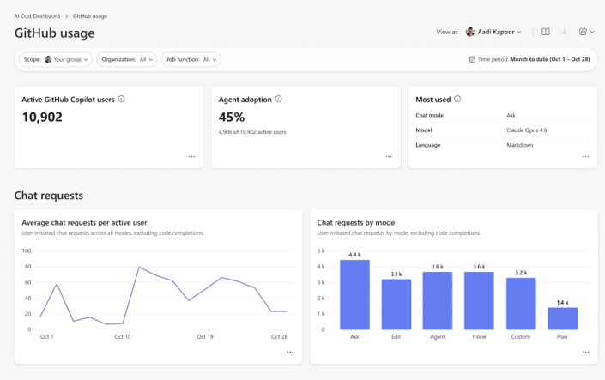
The Consumption Dashboard now tracks GitHub Copilot AI Credits
Organizations can see how developers consume GitHub Copilot and manage that investment against budget.
Credit Usage Visibility — The Consumption Dashboard in Insights supports GitHub Copilot AI Credit usage.
Adoption Management — Admins can analyze how developers use GitHub Copilot to manage adoption and credits.
Budget Decisions — Managers, Insights analysts, and Global admins can compare spending with budgets and make data-driven investment decisions.
July Rollout — This feature rolled out in July.
Consumption Dashboard
What’s New in Microsoft Copilot | August 2026
Notes:
The Consumption Dashboard in Insights now supports GitHub Copilot AI Credit usage. Admins can analyze how developers use GitHub Copilot to manage adoption and credits. Managers, Insights analysts, and Global admins can compare spending with budgets and make data-driven decisions about GitHub Copilot investment.
This feature rolled out in July.
Source: What's New in Microsoft Copilot | August 2026 — https://techcommunity.microsoft.com/blog/microsoft365copilotblog/what%E2%80%99s-new-in-microsoft-copilot--august-2026/4551960

Slide 35
Microsoft Copilot
Public Roadmap
Changes this month
As of 8th Sept 2026
Microsoft 365 Roadmap - See What's Coming | Microsoft 365
Notes:
As of 8th September 2026

Slide 36
Microsoft Copilot Public Roadmap
As of 8th Sept 2026
Launched and Rolling Out “Changed within last month”
Launched (17) 🚀
  Rolling Out (9)
Create Videos in the Clipchamp Start Page
Federated Copilot Connectors
Meeting Prepare from Up Next
Employee Self-Service Agent in M365 Copilot
Now smarter with visuals: Copilot Chat leverages embedded images for richer, more accurate answers.
Newly created Declarative Agents now understand referenced scanned PDFs
People Skills- removal and deletion admin control
Microsoft 365 admin center – New Microsoft 365 Copilot usage report for GCC High & DoD
Work IQ APIs – Unified REST Endpoint for Agents and Workflows
Reference an email with Work IQ when using Edit with Copilot in PowerPoint to create a presentation
Work IQ APIs - Endpoints: Declarative Agent Access
Attach and reference an image when creating a presentation with Copilot in PowerPoint using Agent Mode.
Updated UI for Copilot Chat entry point in Word, Excel and PowerPoint apps
Teams Meetings in Copilot Notebooks
Microsoft 365 admin center: Agents usage report
Outlook Emails in Copilot Notebooks
Vision in Microsoft 365 Copilot can analyze content shared on desktop screen and through mobile camera
Intelligent call recaps in Queues app
Use Copilot Chat after a call in Queues app
Power BI integration in M365 Copilot
Capture voice notes in the Microsoft 365 Copilot mobile app
Updates to Memory and Personalization in Microsoft 365 Copilot
Domain exclusion for web grounding
Intelligent Summaries in Copilot Dashboard
Support for MCP Agents with Interactive UI Widgets in Government Clouds
Multilingual recap available with translation button
Notes:
As of 8th September 2026

Slide 37
Microsoft Copilot Public Roadmap
As of 8th Sept 2026
New items added “New within the last month”
New items – In development (12)
Power BI reports as references in Copilot Notebooks
Microsoft Copilot (Microsoft 365) Writing Blocks in M365 Copilot
Self-serve sync connectors
Code Blocks in M365 Copilot
Microsoft Copilot (Microsoft M365): Delegated prompt publishing for organization prompts
Federated Copilot Connectors in Microsoft 365 Copilot
OneDrive: Improved capabilities for files with Copilot in OneDrive Web
Add Agents and Skills from the Plus menu
JPG and PNG references in Copilot Notebooks
CSV and TSV references in Copilot Notebooks
SharePoint: HTML pages
Review PDFs using the Copilot context menu on OneDrive iOS
Notes:
As of 8th September 2026

Slide 38
Microsoft Copilot Public Roadmap
As of 8th Sept 2026
In development “Changed within last month”
In development (32)
Microsoft Viva: Copilot Analytics - Agent Dashboard.
Copilot Chat for chats, channels, calls, and meetings in GCC, GCC High, and DoD
Copilot Chat can now better match search results from Scanned PDFs
Structured Document Generation with Forms
OneNote: Summary and Q&A in OneNote Mobile with Copilot (Iphone)
OneNote: Summary and Q&A in OneNote Mobile with Copilot (Android)
Outlook: New Copilot entry point in Classic Outlook
Planner: Planner Agent chat in Basic Plans
OneNote: Multimodal capture in Copilot Notebooks (Windows)
Generate documents using forms in SharePoint with Power Automate
AI-generated meeting archive for knowledge retention
AI-powered notes for in-person meetings with Facilitator in Teams Rooms on Android
AI-powered notes for in-person meetings with Facilitator in Teams Rooms on Windows
Facilitator detects and answers questions
Power BI reports as references in Copilot Notebooks
Reference files saved in SharePoint libraries and OneDrive folders when creating a presentation with Agent Mode in PowerPoint
Microsoft Copilot (Microsoft 365) Writing Blocks in M365 Copilot
Self-serve sync connectors
Code Blocks in M365 Copilot
Planner: Save AI-generated filters in Planner Agent chat
Microsoft Copilot (Microsoft M365): Delegated prompt publishing for organization prompts
Federated Copilot Connectors in Microsoft 365 Copilot
Microsoft Edge: Upgraded Copilot new tab page
Enhanced Copilot chat summary
Microsoft Purview compliance portal: Data Lifecycle Management - Retention based on Last Accessed for files in OneDrive and SharePoint
OneDrive: Improved capabilities for files with Copilot in OneDrive Web
Add Agents and Skills from the Plus menu
JPG and PNG references in Copilot Notebooks
CSV and TSV references in Copilot Notebooks
SharePoint: HTML pages
Get actionable suggestions from Copilot in your Copilot Page
Review PDFs using the Copilot context menu on OneDrive iOS
Notes:
As of 8th September 2026

Slide 39
Microsoft Copilot release notes
As of 8th Sept 2026
Latest features and improvements for Microsoft 365 Copilot.
It includes changes that are generally available
(Current Channel for Microsoft 365 apps)
Release Notes for Microsoft 365 Copilot | Microsoft Learn
Notes:
As of 8th September 2026

Slide 40
Microsoft Copilot release notes – August 2026
As of 8th Sept 2026
August 25, 2026 · 19 updates
Microsoft 365 Copilot app (3)
Microsoft 365 Copilot Chat (1)
Page steering and auto-triggering of pages on mobile [Android, iOS
Simplified design for the Microsoft 365 Copilot app [Windows, Mac, Web]
Generate and edit images in Copilot Cowork [Android, Windows, iOS, Mac, Web]
Select models when using Researcher in Copilot Chat [Windows, Web]
OneNote (1)
Teams Meetings in Copilot Notebooks [Android, Windows, iOS, Web]
Microsoft 365 Copilot extensibility (1)
Work IQ APIs – Unified REST Endpoint for Agents and Workflows [Developer, Web]
PowerPoint (2)
Excel (1)
Reference an email when using Copilot in PowerPoint to create a presentation [Windows]
Explain slide selection during PowerPoint Live with Microsoft 365 Copilot [Windows]
Use Python when Editing with Copilot in Excel [Windows, Mac, Web]
Outlook (1)
Scheduling with Copilot chat in classic Outlook for Windows [Windows]
Word (2)
Use voice for Q&A during Read Aloud in Word [Windows]
Enable Sonnet 5 in models menu [Web]
Microsoft 365 admin center (1)
Organizational Messages now supports Hybrid-joined Devices [Web]
Learn more | Release Notes for Microsoft Copilot
Latest features and improvements for Microsoft Copilot generally available on Current Channel for Microsoft 365 apps. 19 updates.

Slide 41
Microsoft Copilot release notes – August 2026
As of 8th Sept 2026
August 11, 2026 · 11 updates
Microsoft 365 Copilot Extensibility (2)
Microsoft 365 Copilot (1)
Parallel content and identity crawl improves content freshness [Web]
ServiceNow connectors support role-based permissions [Web]
Planner Agent in group-based basic plans [Windows, Mac, Web]
PowerPoint (4)
Microsoft 365 SharePoint (1)
Copilot uses enterprise assets hosted on Adobe Experience Manager when creating presentations [Web]
Create a presentation with Copilot in PowerPoint directly from the PowerPoint Web App [Web]
Reference web sources when creating a presentation with Copilot in PowerPoint [Web, Windows, Mac]
Copilot uses enterprise assets hosted on Adobe Experience Manager when creating presentations [Windows]
SharePoint: Authoritative Sites [Windows, Web]
Outlook (2)
Copilot provides coaching feedback in chat as you draft, edit, and format emails [Android, Windows, iOS, Mac, Web]
Prepare for meetings with Copilot in classic Outlook for Windows [Windows]
Viva Insights (1)
Microsoft 365 SharePoint (1)
Consumption Dashboard tracks Copilot credit usage [Web]
SharePoint: Authoritative Sites [Windows, Web]
Learn more | Release Notes for Microsoft Copilot
Latest features and improvements for Microsoft Copilot generally available on Current Channel for Microsoft 365 apps. 11 updates.

Slide 42
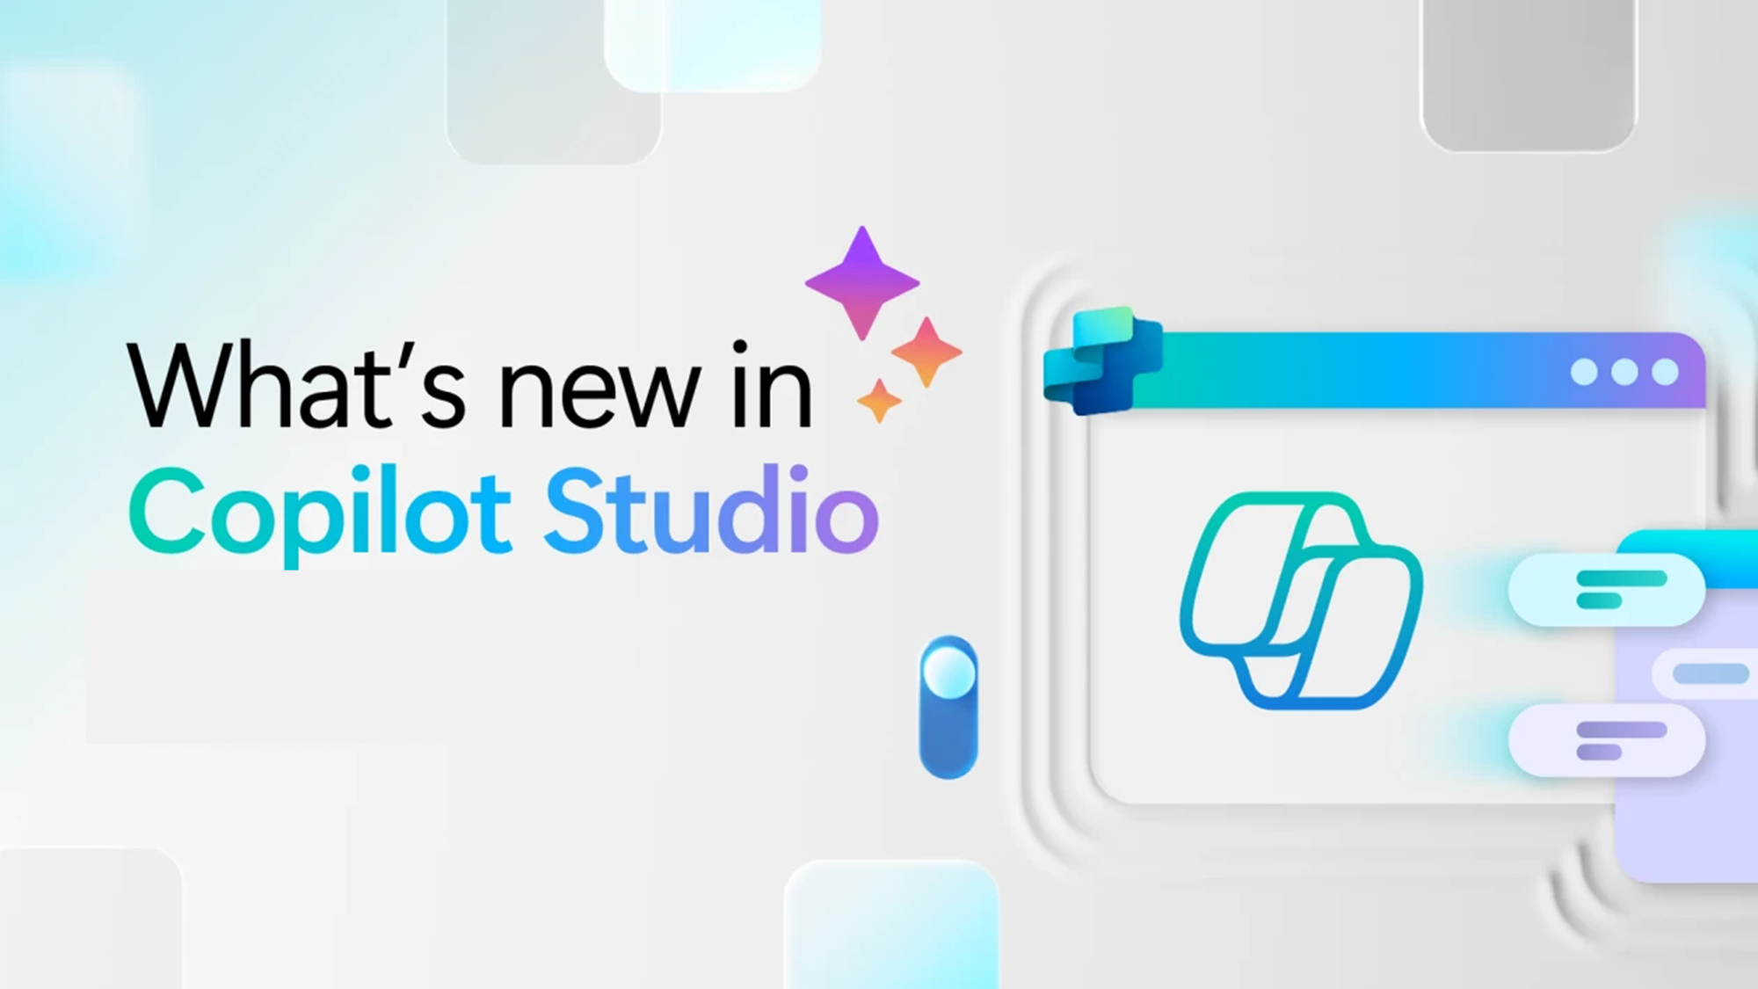
Whats new in Copilot Studio
Notes:
Section transition — Copilot Studio.
Use this slide to pivot from end-user features to the maker/IT story. Copilot Studio is where teams build, orchestrate, and manage custom agents. The next slide lists what shipped, by month of release.

Slide 43

What's new in Copilot Studio
The following table displays the month of release for each new feature.
Month of release | What’s new
July 2026 | Starting in July 2026, Copilot Studio automatically creates a Microsoft Entra Agent ID for every new agent, and you can no longer opt out at the environment level. (Preview) Add a workflow or MCP server as a tool for agents powered by the GitHub Copilot harness to extend your agent with multistep automated processes or external services. (Preview) Submit your MCP server for Microsoft certification to give customers and administrators confidence that it meets Microsoft's expectations for reliability, security, compliance, and responsible operation. Deploy the same real-time agent across voice and digital messaging channels (digital messaging in preview) for consistent, natural, context-aware conversations. Use the GPT-5-Chat (Preview) model for greater voice customization and deployment flexibility, and monitor real-time agents with Application Insights. (Preview) Export environment-level agent telemetry to Azure Application Insights through the Power Platform admin center. (Preview) Let users attach files to a conversation and view files your agent creates during a conversation, for agents powered by the GitHub Copilot harness.
What's new in Copilot Studio - Microsoft Copilot Studio | Microsoft Learn | Copilot Studio Archive | Microsoft Copilot Blog
Notes:
What’s new in Copilot Studio — release table.

Slide 44

What's new in Frontier
Get hands-on with breakthrough preview features, share your insights with product teams, and help shape the future of AI.
With Frontier, you’re not just adopting new technology, you’re co-creating what comes next.
Frontier program – Microsoft Adoption
Notes:
Frontier — what it is.
Frame Frontier as Microsoft’s early-access program: “you’re not just adopting new technology, you’re co-creating what comes next.” Customers in Frontier get the newest agents and features first and help shape them through feedback. Mention it ties into Microsoft Adoption resources.

Slide 45
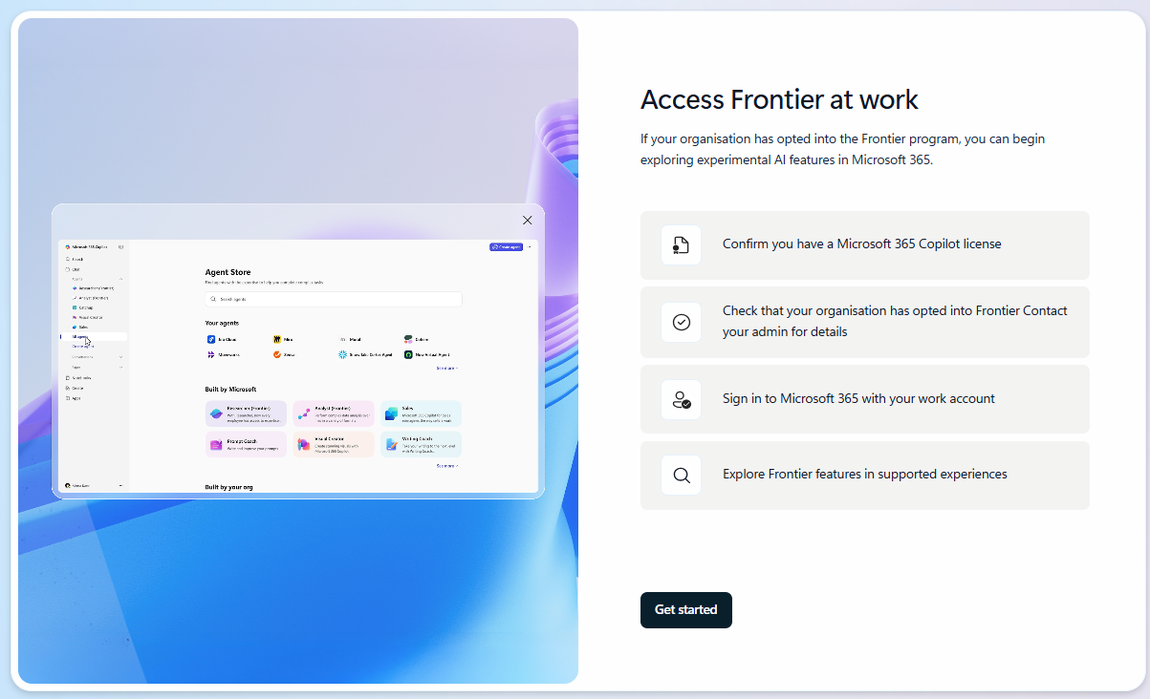
What's new in Frontier
Try out the latest agents and features in Microsoft Copilot and see how they can transform your day-to-day.​
Communicate project progress more easily with Status Reports in Planner Agent
Frontier Getting started guide
Notes:
Frontier — try it out.
Encourage the audience to get hands-on. Point them to the Frontier getting-started guide and the newest items, including:
• Agents to drive AI workforce transformation
• Microsoft Agent 365 — the control plane for AI agents
• Build and create with Copilot Pages
• Sales Development Agent (and how it connects with Dynamics 365)
• Project Opal
• Windows 365 AI-enabled Cloud PCs
Close by inviting them to try these in their own day-to-day and share feedback.

Slide 46
Thank you 👏
Got feedback ?
https://aka.ms/WhatsNewCopilot/Feedback

Slide 47

Feedback Form

Slide 48
Resources
Microsoft 365 Copilot Blog | Microsoft Community Hub
What’s New in Microsoft Copilot | August 2026 | Microsoft Community Hub
Release Notes for Microsoft 365 Copilot | Microsoft Learn
Microsoft 365 Roadmap | Microsoft 365
What's new in Copilot Studio - Microsoft Copilot Studio | Microsoft Learn
Copilot Studio | Microsoft Copilot Blog
Available today: Anthropic Claude Fable 5.1 in Microsoft Copilot | Microsoft Community Hub
Available today: OpenAI GPT-6 Astra in Microsoft Copilot | Microsoft Community Hub

Slide 49

Microsoft 365 Copilot
June 2026
As of 6th July 2026
Copilot Control System
User capabilities
        Organization Prompts in M365 Admin Center
        Cost Management Dashboard
        Team-Level Cost Reporting in Insights
        Agent Metrics for Custom Reporting
        Organizational Messages on Hybrid-Joined Devices
        Admin Control for Vision
        Purview DLP — Restrict External Emails
        Purview Controls for Copilot Cowork
        Copilot Cowork
          General Availability
          Model Choice
          Expanded Plugins
          Custom Skills
          Visual Creation
          Edge and Mobile
        Claude Sonnet 5 in M365 Copilot
        Power BI Reasoning in Copilot
        Dataverse Data in Copilot
        Deep Citations
        Regenerate in Copilot Chat
        Vision in M365 Copilot
        Suggested Edits for Copilot Pages
        Copilot Notebooks - References and Access
        Copilot in Outlook - Settings and Draft Refinement
        Model Choice in Copilot in Word
        Copilot Catchup in Word
        Agentic Editing in Copilot in Word
        Copilot in Word on iOS and Chat Continuity
        Brand Kit Picker in Copilot in PowerPoint
        Skills in Copilot in PowerPoint
        SharePoint and OneDrive References in Copilot in PowerPoint
        Skills in Copilot in Excel
        Personalization in Copilot in Excel
        Workbook Rules in Copilot in Excel
Agents
        Researcher Model and Mode Choice
        Planner Agent in Microsoft 365 Copilot
        Sales Agent — General Availability
        Learning Agent — General Availability

Slide 50
Microsoft 365 Copilot
July 2026
As of 5th August 2026
IT admin capabilities
User capabilities
        Domain exclusion for web grounding
        Purview DLP — restrict external emails
        Agent 365 Dashboard in Insights
        Copilot Connectors usage report
        Copilot Chat usage report (GCC, GCC High, DoD)
        Cost Management updates
        Agent Access Insights Heatmap
        GPT-5.6 in M365 Copilot
        Claude Sonnet 5 in M365 Copilot
        Claude Opus 5 in M365 Copilot
        Copilot Search Enhancements
        Push Notifications in Copilot App
        Claude Fable 5 in Cowork
        Edge Browser Automation in Cowork
        Event-Triggered Tasks in Cowork
        Skills and Plugins in Cowork
        References in Copilot Notebooks
        Review and drafting Workflows in Word
        Brand Kit & Theme Skills in Excel
        Power BI Context & AutoSave in Excel
        Branded Assets in PowerPoint
        Custom Skills in PowerPoint
        Comments and Tasks in PowerPoint
        Mobile Capabilities in PowerPoint
        Reference & Restyle in PowerPoint
        Meeting Recaps App in Teams
        Audio Summary for SharePoint News
        Docs from SharePoint Forms
        More Copilot Connectors
        Copilot Connectors for DoD Clouds
Agents
        Add Word, Excel and PowerPoint agents in Copilot Chat
        Sales Agent - General Availability

