Slide 1

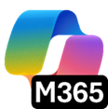
What’s new in
Microsoft 365 Copilot
As of 5th August 2026
July 2026
Notes:
As of 5th August 2026

Slide 2
What's new in Microsoft 365 Copilot
Updates listed in this document are selected based on relevance to Microsoft 365 Copilot.
Release dates and timings are subject to change.
For a complete list of Copilot for Microsoft 365 roadmap items refer to
Microsoft 365 Roadmap | Microsoft 365
Got feedback ?
https://aka.ms/WhatsNewCopilot/Feedback

Slide 3

What’s new in Microsoft 365 Copilot
July 2026
As of 5th August 2026
IT admin capabilities
User capabilities
        Domain exclusion for web grounding
        Purview DLP — restrict external emails
        Agent 365 Dashboard in Insights
        Copilot Connectors usage report
        Copilot Chat usage report (GCC, GCC High, DoD)
        Cost Management updates
        Agent Access Insights Heatmap
        GPT-5.6 in M365 Copilot
        Claude Sonnet 5 in M365 Copilot
        Claude Opus 5 in M365 Copilot
        Copilot Search Enhancements
        Push Notifications in Copilot App
        Claude Fable 5 in Cowork
        Edge Browser Automation in Cowork
        Event-Triggered Tasks in Cowork
        Skills and Plugins in Cowork
        References in Copilot Notebooks
        Review and drafting Workflows in Word
        Brand Kit & Theme Skills in Excel
        Power BI Context & AutoSave in Excel
        Branded Assets in PowerPoint
        Custom Skills in PowerPoint
        Comments and Tasks in PowerPoint
        Mobile Capabilities in PowerPoint
        Reference & Restyle in PowerPoint
        Meeting Recaps App in Teams
        Audio Summary for SharePoint News
        Docs from SharePoint Forms
        More Copilot Connectors
        Copilot Connectors for DoD Clouds
Agents
        Add Word, Excel and PowerPoint agents in Copilot Chat
        Sales Agent - General Availability

Slide 4

IT admin capabilities

Slide 5
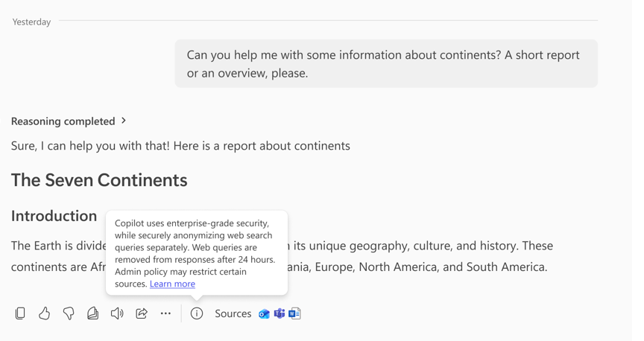
Domain exclusion gives admins more control over web grounding
MC1411435
Admins can exclude specified domains from Copilot web grounding for more governed web-grounded answers.
Exclude Up To 1,000 Domains: Define domains that are not used in Copilot responses relying on web grounding.
Targeted Control: Sits between broad web grounding and turning web search off entirely, across Copilot and Copilot Chat.
Admin-Configured: Not enabled by default; configured via a PowerShell script by a Search or Global Administrator.
July Rollout
Rolled out in July.
Domain exclusion for web grounding
What's New in Microsoft 365 Copilot | July 2026
More control over web grounding with Domain Exclusion for Microsoft 365 Copilot
Notes:
Domain exclusion for web grounding
Admins can exclude specified domains from Copilot web grounding for more governed web-grounded answers.
• Exclude Up To 1,000 Domains — Define domains that are not used in Copilot responses relying on web grounding.
• Targeted Control — Sits between broad web grounding and turning web search off entirely, across Copilot and Copilot Chat.
• Admin-Configured — Not enabled by default; configured via a PowerShell script by a Search or Global Administrator.
July Rollout — Rolled out in July.
Source: More control over web grounding with Domain Exclusion for Microsoft 365 Copilot — https://techcommunity.microsoft.com/blog/microsoft365copilotblog/more-control-over-web-grounding-with-domain-exclusion-for-microsoft-365-copilot/4540151

Slide 6
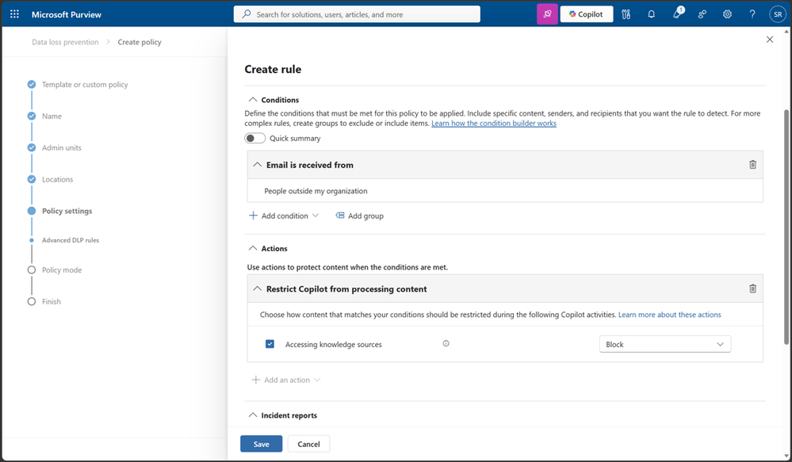
Purview DLP can restrict external emails from Copilot responses
Microsoft Purview DLP can prevent external emails from being referenced in Copilot responses.
Exclude External Senders: Admins can stop messages from external senders being summarized, referenced, or used as grounding data.
Purview DLP Extension: Extends Microsoft Purview DLP for Microsoft 365 Copilot and Copilot Chat.
Greater Control: Gives organizations greater control over how email data is used in Copilot responses.
June Preview
Rolled out to Public Preview in June.
Purview DLP for external emails
What's New in Microsoft 365 Copilot | July 2026
Notes:
Purview DLP for external emails
Microsoft Purview DLP can prevent external emails from being referenced in Copilot responses.
• Exclude External Senders — Admins can stop messages from external senders being summarized, referenced, or used as grounding data.
• Purview DLP Extension — Extends Microsoft Purview DLP for Microsoft 365 Copilot and Copilot Chat.
• Greater Control — Gives organizations greater control over how email data is used in Copilot responses.
June Preview — Rolled out to Public Preview in June.
Source: What's New in Microsoft 365 Copilot | July 2026 — https://techcommunity.microsoft.com/blog/microsoft365copilotblog/what%E2%80%99s-new-in-microsoft-365-copilot--july-2026/4538332

Slide 7
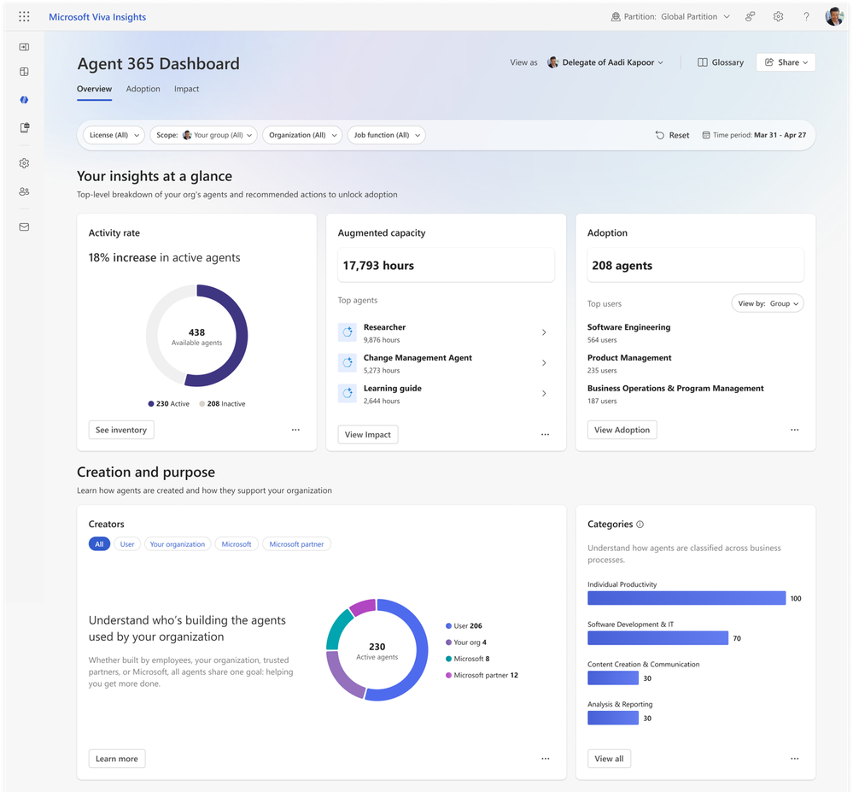
The Agent 365 Dashboard tracks agent usage and adoption
The Agent 365 Dashboard helps leaders track agent usage and adoption across their teams.
Unified Agent Data: Unifies data from Agent 365 across sources and agent types.
Adoption And Trends: View adoption by group, track retention, identify top agents, and compare usage trends.
Org-Wide Reporting: Analysts can filter org-wide; historical reporting for Copilot Studio agents is available via a toggle.
July Rollout
Rolled out in July.
Agent 365 Dashboard in Insights
What's New in Microsoft 365 Copilot | July 2026
Notes:
Agent 365 Dashboard in Insights
The Agent 365 Dashboard helps leaders track agent usage and adoption across their teams.
• Unified Agent Data — Unifies data from Agent 365 across sources and agent types.
• Adoption And Trends — View adoption by group, track retention, identify top agents, and compare usage trends.
• Org-Wide Reporting — Analysts can filter org-wide; historical reporting for Copilot Studio agents is available via a toggle.
July Rollout — Rolled out in July.
Source: What's New in Microsoft 365 Copilot | July 2026 — https://techcommunity.microsoft.com/blog/microsoft365copilotblog/what%E2%80%99s-new-in-microsoft-365-copilot--july-2026/4538332

Slide 8
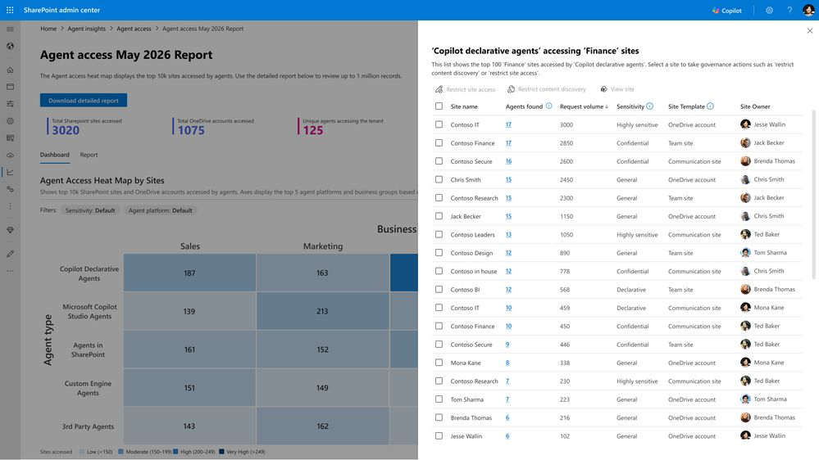
The Agent Access Insights heatmap reveals agent activity for admins
A new Agent Access Insights heatmap shows agent activity across SharePoint and OneDrive sites.
Visual Heatmap: Visualizes agent activity across SharePoint and OneDrive sites.
Detect Patterns: Helps admins quickly spot patterns, hotspots, and unusual access behavior.
Targeted Adoption: Gives IT teams a clearer path to support rollout and adoption.
July Rollout
Rolled out in July.
Agent Access Insights heatmap
What's New in Microsoft 365 Copilot | July 2026
Notes:
Agent Access Insights heatmap
A new Agent Access Insights heatmap shows agent activity across SharePoint and OneDrive sites.
• Visual Heatmap — Visualizes agent activity across SharePoint and OneDrive sites.
• Detect Patterns — Helps admins quickly spot patterns, hotspots, and unusual access behavior.
• Targeted Adoption — Gives IT teams a clearer path to support rollout and adoption.
July Rollout — Rolled out in July.
Source: What's New in Microsoft 365 Copilot | July 2026 — https://techcommunity.microsoft.com/blog/microsoft365copilotblog/what%E2%80%99s-new-in-microsoft-365-copilot--july-2026/4538332

Slide 9
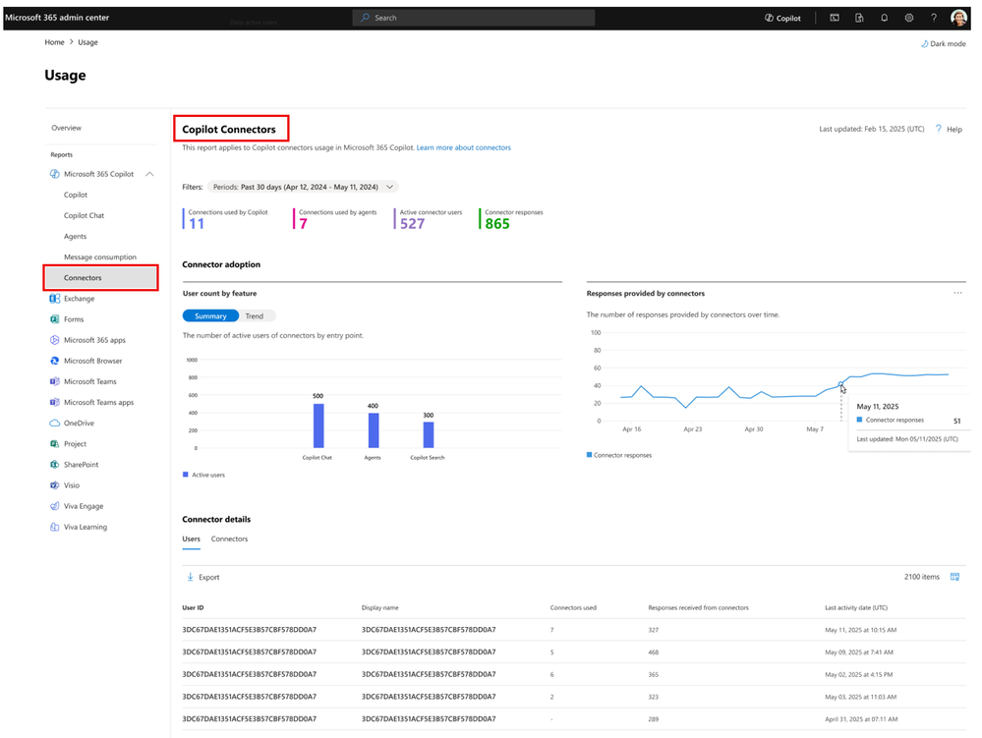
Copilot Connectors usage report shows connected-knowledge impact
A new Copilot Connectors usage report shows how connected knowledge is used across Copilot.
Grounding Insights: Shows how often Copilot Chat, Copilot Search, and agents ground responses in connector content.
Adoption View: Reveals connector adoption, engagement, usage patterns, and connector-level impact.
Optimize Deployment: Helps admins evaluate which sources drive value and refine connector strategy.
June Preview
Available in Public Preview in the Microsoft 365 admin center; rolled out in June.
Copilot Connectors usage report
What's New in Microsoft 365 Copilot | July 2026
Notes:
Copilot Connectors usage report
A new Copilot Connectors usage report shows how connected knowledge is used across Copilot.
• Grounding Insights — Shows how often Copilot Chat, Copilot Search, and agents ground responses in connector content.
• Adoption View — Reveals connector adoption, engagement, usage patterns, and connector-level impact.
• Optimize Deployment — Helps admins evaluate which sources drive value and refine connector strategy.
June Preview — Available in Public Preview in the Microsoft 365 admin center; rolled out in June.
Source: What's New in Microsoft 365 Copilot | July 2026 — https://techcommunity.microsoft.com/blog/microsoft365copilotblog/what%E2%80%99s-new-in-microsoft-365-copilot--july-2026/4538332

Slide 10
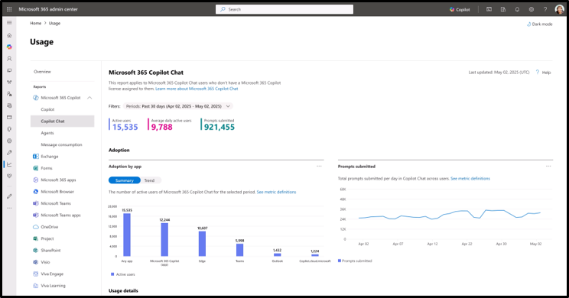
Copilot Chat usage reports arrive for GCC, GCC High, and DoD
Government cloud customers can now track Copilot Chat adoption in the Microsoft 365 admin center.
Org And User Views: View organization-level trends and user-level details to inform licensing decisions.
Detailed Metrics: Includes total active users, usage per Microsoft 365 app, and anonymized user-level activity.
Drive Adoption: Helps government customers understand and drive Copilot Chat adoption.
July Rollout
Rolled out in July for GCC, GCC High, and DoD.
Copilot Chat usage report for gov clouds
What's New in Microsoft 365 Copilot | July 2026
Notes:
Copilot Chat usage report for gov clouds
Government cloud customers can now track Copilot Chat adoption in the Microsoft 365 admin center.
• Org And User Views — View organization-level trends and user-level details to inform licensing decisions.
• Detailed Metrics — Includes total active users, usage per Microsoft 365 app, and anonymized user-level activity.
• Drive Adoption — Helps government customers understand and drive Copilot Chat adoption.
July Rollout — Rolled out in July for GCC, GCC High, and DoD.
Source: What's New in Microsoft 365 Copilot | July 2026 — https://techcommunity.microsoft.com/blog/microsoft365copilotblog/what%E2%80%99s-new-in-microsoft-365-copilot--july-2026/4538332

Slide 11
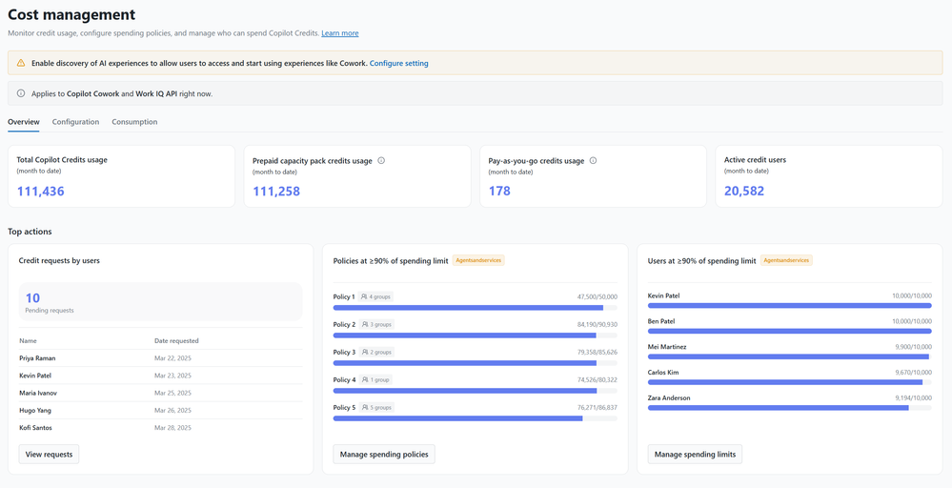
Cost Management updates sharpen usage-based billing controls
Cost Management updates improve spending controls for usage-based billing services.
Reliable Alerts: Improved spending alerts help admins act when consumption approaches policy thresholds.
Clearer Enforcement: Better policy enforcement, overage handling, and visibility into Copilot Credits.
Confident Cost Control: More confidence managing AI consumption across services such as Cowork and Work IQ APIs.
Action Needed
Admins should recreate alerts on existing spending policies where notifications are required.
Cost Management updates in admin center
What's New in Microsoft 365 Copilot | July 2026
Notes:
Cost Management updates in admin center
Cost Management updates improve spending controls for usage-based billing services.
• Reliable Alerts — Improved spending alerts help admins act when consumption approaches policy thresholds.
• Clearer Enforcement — Better policy enforcement, overage handling, and visibility into Copilot Credits.
• Confident Cost Control — More confidence managing AI consumption across services such as Cowork and Work IQ APIs.
Action Needed — Admins should recreate alerts on existing spending policies where notifications are required.
Source: What's New in Microsoft 365 Copilot | July 2026 — https://techcommunity.microsoft.com/blog/microsoft365copilotblog/what%E2%80%99s-new-in-microsoft-365-copilot--july-2026/4538332

Slide 12

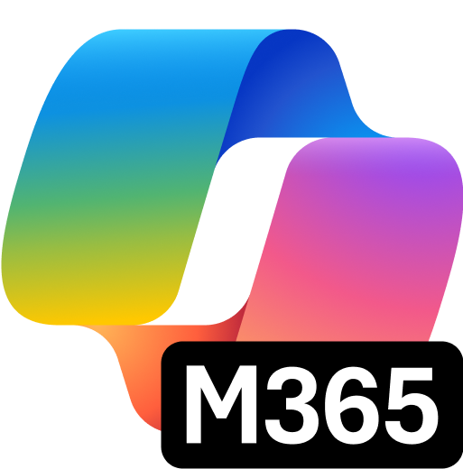
User capabilities

Slide 13
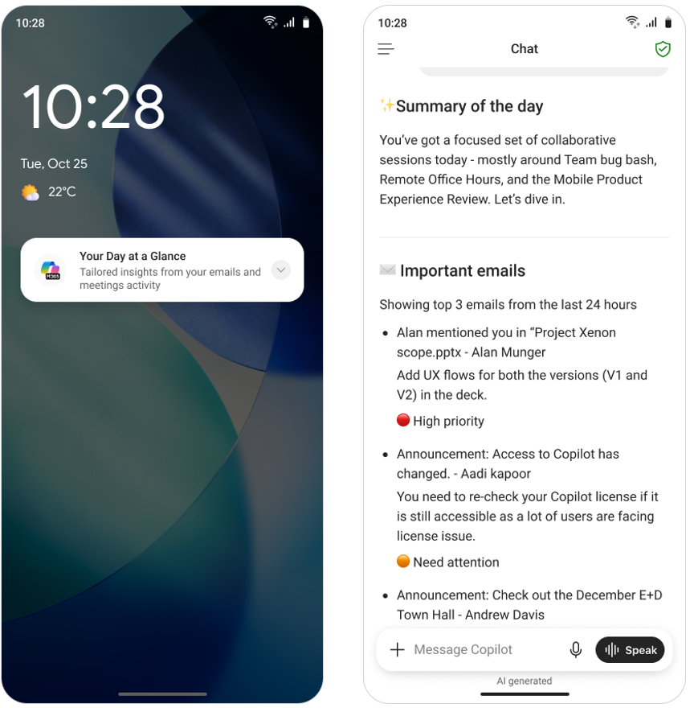
Push notifications help users catch up in the Copilot app
ID 560339
The Microsoft 365 Copilot mobile app now sends push notifications so users can catch up on work items quickly.
Timely Prompts: Users receive prompts such as Your Day at a Glance and Items waiting for you on iOS and Android.
Answer On Open: Opening a notification launches the app with the prompt's response already on screen.
Less App-Hopping: Reduces the need to manually check across Outlook, Teams, and other Microsoft 365 experiences.
July Rollout
Available for users with Microsoft 365 Copilot licenses; rolled out in July.
Push notifications in the Copilot app
What's New in Microsoft 365 Copilot | July 2026
Notes:
Push notifications in the Copilot app
The Microsoft 365 Copilot mobile app now sends push notifications so users can catch up on work items quickly.
• Timely Prompts — Users receive prompts such as Your Day at a Glance and Items waiting for you on iOS and Android.
• Answer On Open — Opening a notification launches the app with the prompt's response already on screen.
• Less App-Hopping — Reduces the need to manually check across Outlook, Teams, and other Microsoft 365 experiences.
July Rollout — Available for users with Microsoft 365 Copilot licenses; rolled out in July.
Source: What's New in Microsoft 365 Copilot | July 2026 — https://techcommunity.microsoft.com/blog/microsoft365copilotblog/what%E2%80%99s-new-in-microsoft-365-copilot--july-2026/4538332

Slide 14

Claude Fable 5 comes to Cowork for long-running work
Anthropic's Claude Fable 5 is available in Copilot Cowork for longer, more complex, long-running work.
Sustained Reasoning: Built for ambitious, long-running projects with deeper context handling.
Plan, Execute, Check: Plans, executes, and checks work across multi-stage tasks with less step-by-step supervision.
More Model Choice: Gives Cowork users another option for agentic work that needs persistence and depth.
July Rollout
Off by default; rolled out in July.
Claude Fable 5 in Copilot Cowork
What's New in Microsoft 365 Copilot | July 2026
Notes:
Claude Fable 5 in Copilot Cowork
Anthropic's Claude Fable 5 is available in Copilot Cowork for longer, more complex, long-running work.
• Sustained Reasoning — Built for ambitious, long-running projects with deeper context handling.
• Plan, Execute, Check — Plans, executes, and checks work across multi-stage tasks with less step-by-step supervision.
• More Model Choice — Gives Cowork users another option for agentic work that needs persistence and depth.
July Rollout — Off by default; rolled out in July.
Source: What's New in Microsoft 365 Copilot | July 2026 — https://techcommunity.microsoft.com/blog/microsoft365copilotblog/what%E2%80%99s-new-in-microsoft-365-copilot--july-2026/4538332

Slide 15
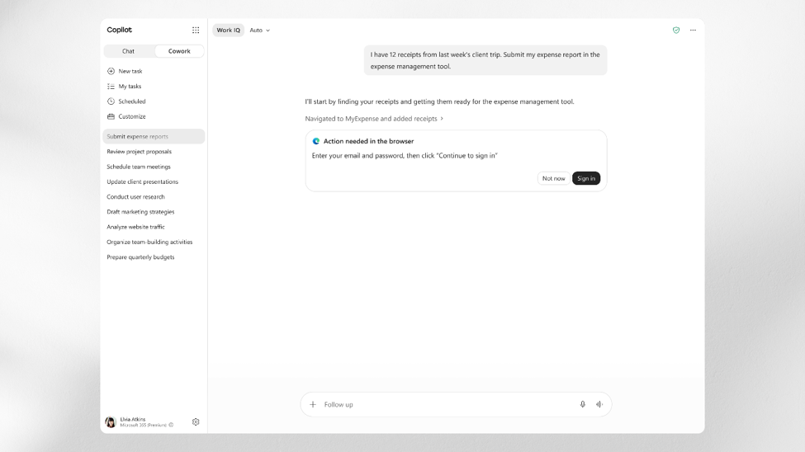
Cowork automates web work in Microsoft Edge
Copilot Cowork can now act across web-based systems in Microsoft Edge on the user's behalf.
Works In Edge: Signed-in users let Cowork work across SaaS tools, internal portals, and other websites.
Acts For You: Cowork performs actions across sites so users switch tabs less.
Less Manual Work: Users spend less time moving between web systems to get work done.
July Rollout
Rolled out in July.
Local browser automation with Edge
What's New in Microsoft 365 Copilot | July 2026
Notes:
Local browser automation with Edge
Copilot Cowork can now act across web-based systems in Microsoft Edge on the user's behalf.
• Works In Edge — Signed-in users let Cowork work across SaaS tools, internal portals, and other websites.
• Acts For You — Cowork performs actions across sites so users switch tabs less.
• Less Manual Work — Users spend less time moving between web systems to get work done.
July Rollout — Rolled out in July.
Source: What's New in Microsoft 365 Copilot | July 2026 — https://techcommunity.microsoft.com/blog/microsoft365copilotblog/what%E2%80%99s-new-in-microsoft-365-copilot--july-2026/4538332

Slide 16
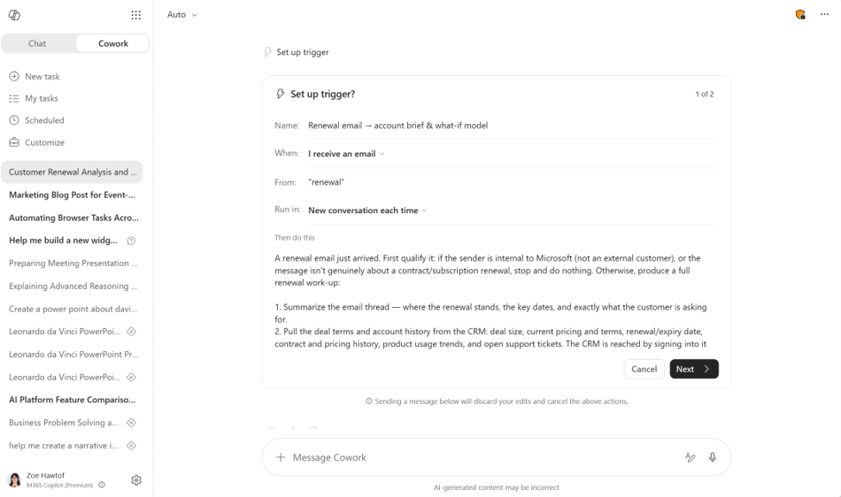
Event-triggered tasks let Cowork watch for the moments that matter
Cowork can watch e-mail and Teams for the moments that matter and have a response ready before users ask.
Plain-Language Triggers: Create event-driven tasks triggered by a sender, an @mention, a keyword or topic, or an event name.
Across Work Surfaces: Triggers execute across Teams chats, channels, Outlook email, and meetings.
No More Refreshing: Cowork catches the moment it lands, so users stop constantly checking their inbox.
July Rollout (Frontier)
Rolled out in July to the Frontier program.
Event-triggered tasks in Cowork
What's New in Microsoft 365 Copilot | July 2026
Notes:
Event-triggered tasks in Cowork
Cowork can watch mail and Teams for the moments that matter and have a response ready before users ask.
• Plain-Language Triggers — Create event-driven tasks triggered by a sender, an @mention, a keyword or topic, or an event name.
• Across Work Surfaces — Triggers execute across Teams chats, channels, Outlook email, and meetings.
• No More Refreshing — Cowork catches the moment it lands, so users stop constantly checking their inbox.
July Rollout (Frontier) — Rolled out in July to the Frontier program.
Source: What's New in Microsoft 365 Copilot | July 2026 — https://techcommunity.microsoft.com/blog/microsoft365copilotblog/what%E2%80%99s-new-in-microsoft-365-copilot--july-2026/4538332

Slide 17
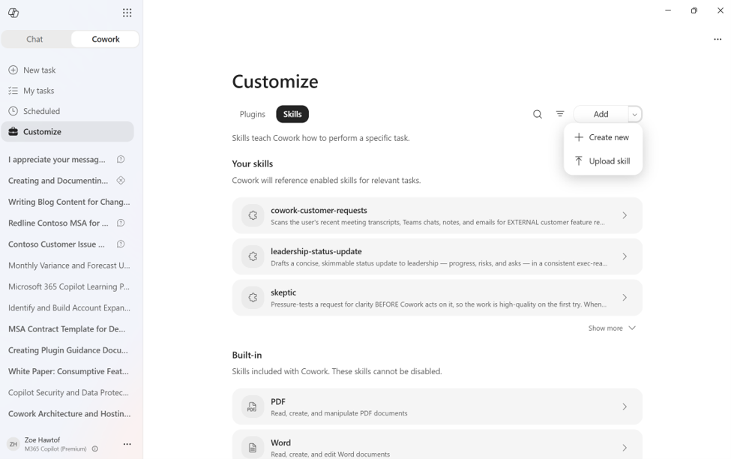
Custom skills and plugins tailor Cowork and share across the org
Users can tailor Cowork with custom skills and plugins from the Customize tab and share them across the org.
Guided Skill Creation: Add a skill through a Create new flow or drag and drop an .md, .zip, or .skill file to upload.
Plugin Packaging: Claude or Open-Plugin zips are auto-converted into publishable packages with bundled skills and MCP connectors.
Owner-Controlled Sharing: Share any skill or plugin with specific people while remaining the owner, so every edit flows out automatically.
July Rollout
Rolled out in July.
Skills and plugins in Cowork
What's New in Microsoft 365 Copilot | July 2026
Notes:
Skills and plugins in Cowork
Users can tailor Cowork with custom skills and plugins from the Customize tab and share them across the org.
• Guided Skill Creation — Add a skill through a Create new flow or drag and drop an .md, .zip, or .skill file to upload.
• Plugin Packaging — Claude or Open-Plugin zips are auto-converted into publishable packages with bundled skills and MCP connectors.
• Owner-Controlled Sharing — Share any skill or plugin with specific people while remaining the owner, so every edit flows out automatically.
July Rollout — Rolled out in July.
Source: What's New in Microsoft 365 Copilot | July 2026 — https://techcommunity.microsoft.com/blog/microsoft365copilotblog/what%E2%80%99s-new-in-microsoft-365-copilot--july-2026/4538332

Slide 18
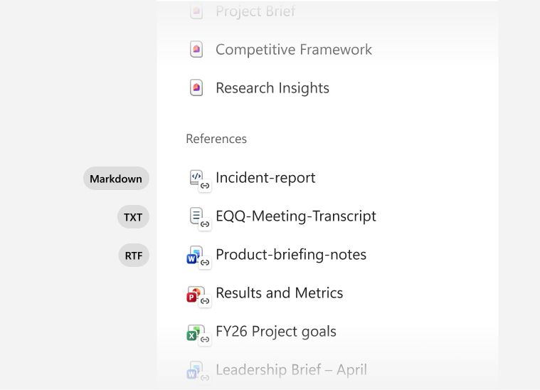
Copilot Notebooks accept Markdown, TXT, and RTF references
MC1420894
Copilot Notebooks now accept Markdown, TXT, and RTF files as references to reason over more project context.
New File Types: Add .md, .txt, and .rtf files such as software documentation, video transcripts, and rich-text notes.
Project Context: Reason over additional project context directly inside the notebook.
Turn Inputs Into Artifacts: Use Copilot to turn added references into helpful project artifacts.
Rollout Timing
TXT and RTF support rolled out in July; Markdown support rolls out in August.
Reference support for Copilot Notebooks
What's New in Microsoft 365 Copilot | July 2026
Notes:
Reference support for Copilot Notebooks
Copilot Notebooks now accept Markdown, TXT, and RTF files as references to reason over more project context.
• New File Types — Add .md, .txt, and .rtf files such as software documentation, video transcripts, and rich-text notes.
• Project Context — Reason over additional project context directly inside the notebook.
• Turn Inputs Into Artifacts — Use Copilot to turn added references into helpful project artifacts.
Rollout Timing — TXT and RTF support rolled out in July; Markdown support rolls out in August.
Source: What's New in Microsoft 365 Copilot | July 2026 — https://techcommunity.microsoft.com/blog/microsoft365copilotblog/what%E2%80%99s-new-in-microsoft-365-copilot--july-2026/4538332

Slide 19
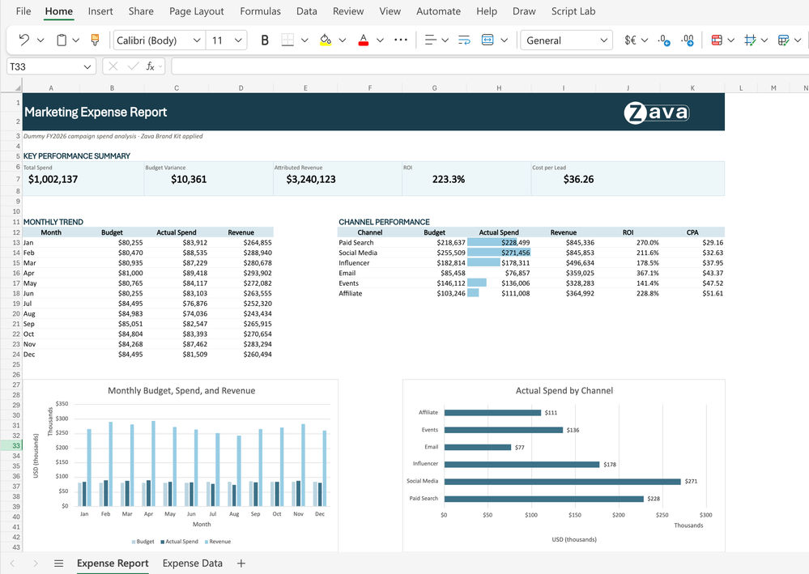
The Brand kit skill formats Excel workbooks on-brand
Copilot in Excel can format workbooks with an organization's Brand Kit for on-brand, presentation-ready reports.
Approved Brand Elements: Applies approved colors, fonts, and logo from the Microsoft 365 brand center to tables and charts.
On-Brand Reports: Ask Copilot to brand a sheet for a polished report that follows company guidelines.
No Manual Formatting: Reports follow branding without manual styling.
July Rollout
Rolled out in July.
Brand kit skill for Copilot in Excel
What's New in Microsoft 365 Copilot | July 2026
Notes:
Brand kit skill for Copilot in Excel
Copilot in Excel can format workbooks with an organization's Brand Kit for on-brand, presentation-ready reports.
• Approved Brand Elements — Applies approved colors, fonts, and logo from the Microsoft 365 brand center to tables and charts.
• On-Brand Reports — Ask Copilot to brand a sheet for a polished report that follows company guidelines.
• No Manual Formatting — Reports follow branding without manual styling.
July Rollout — Rolled out in July.
Source: What's New in Microsoft 365 Copilot | July 2026 — https://techcommunity.microsoft.com/blog/microsoft365copilotblog/what%E2%80%99s-new-in-microsoft-365-copilot--july-2026/4538332

Slide 20
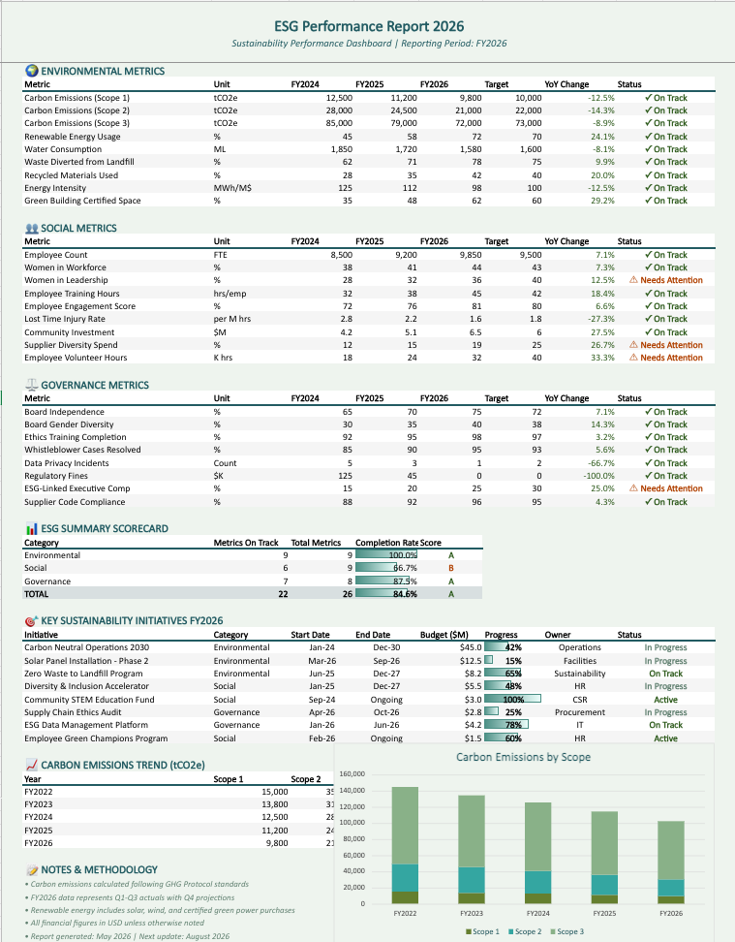
The theme design skill makes Excel insights stand out
Copilot in Excel can apply a coordinated design theme so key insights stand out.
Harmonized Design: Choose a harmonized color palette, style charts, and structure the layout.
Clear Visual Hierarchy: The theme-design skill turns raw data into a clean, readable report.
Less Manual Design: Copilot delivers formatting so users skip the manual design work.
August Rollout
Rolls out in August.
Theme design skill for Copilot in Excel
What's New in Microsoft 365 Copilot | July 2026
Notes:
Theme design skill for Copilot in Excel
Copilot in Excel can apply a coordinated design theme so key insights stand out.
• Harmonized Design — Choose a harmonized color palette, style charts, and structure the layout.
• Clear Visual Hierarchy — The theme-design skill turns raw data into a clean, readable report.
• Less Manual Design — Copilot delivers formatting so users skip the manual design work.
August Rollout — Rolls out in August.
Source: What's New in Microsoft 365 Copilot | July 2026 — https://techcommunity.microsoft.com/blog/microsoft365copilotblog/what%E2%80%99s-new-in-microsoft-365-copilot--july-2026/4538332

Slide 21
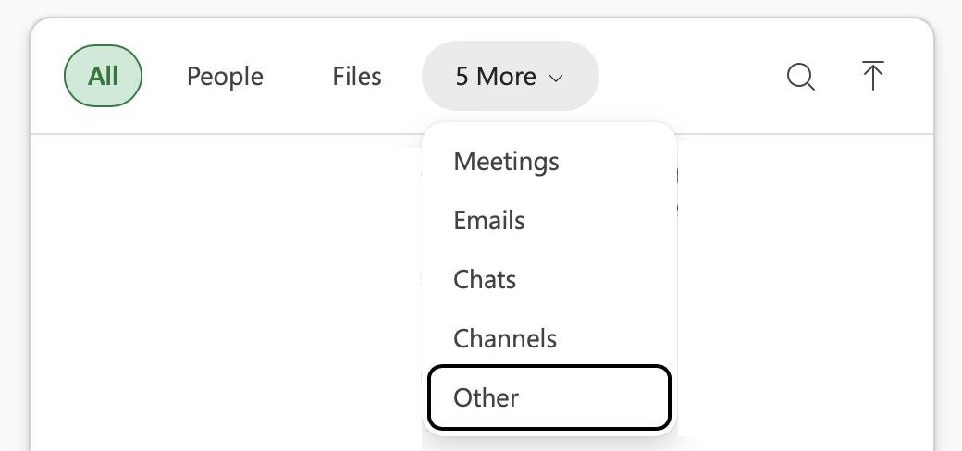
Copilot in Excel grounds analysis in governed Power BI data
ID 567891
Copilot in Excel can ground analysis in governed Power BI data directly in the Excel grid.
Trusted Business Metrics: Attach a Power BI report from the work content selector to bring governed data into Excel.
Analyze In Place: Ask Copilot to analyze performance, identify trends, and build summaries or supporting calculations.
Security Respected: Works with report data while respecting existing row-level security, with no exporting or reconciling.
August Rollout
Rolls out in August.
Learn more
Power BI context for Copilot in Excel
What's New in Microsoft 365 Copilot | July 2026
Notes:
Power BI context for Copilot in Excel
Copilot in Excel can ground analysis in governed Power BI data directly in the Excel grid.
• Trusted Business Metrics — Attach a Power BI report from the work content selector to bring governed data into Excel.
• Analyze In Place — Ask Copilot to analyze performance, identify trends, and build summaries or supporting calculations.
• Security Respected — Works with report data while respecting existing row-level security, with no exporting or reconciling.
August Rollout — Rolls out in August.
Source: What's New in Microsoft 365 Copilot | July 2026 — https://techcommunity.microsoft.com/blog/microsoft365copilotblog/what%E2%80%99s-new-in-microsoft-365-copilot--july-2026/4538332

Slide 22

Branded assets bring company brand kits into Copilot in PowerPoint
MC1405505
Users can apply their company's branded assets from the Microsoft 365 Brand kit in Copilot in PowerPoint.
Brand Kit Assets: Use logos, icons, themes, and fonts from the Microsoft 365 Brand kit.
Managed By Brand Owners: Brand managers securely update and roll out the preferred brand kit for consistent design.
On-Brand Presentations: Apply company templates, brand colors, images, and icons within PowerPoint.
July Rollout
Rolled out in July.
Branded assets for Copilot in PowerPoint
What's New in Microsoft 365 Copilot | July 2026
Notes:
Branded assets for Copilot in PowerPoint
Users can apply their company's branded assets from the Microsoft 365 Brand kit in Copilot in PowerPoint.
• Brand Kit Assets — Use logos, icons, themes, and fonts from the Microsoft 365 Brand kit.
• Managed By Brand Owners — Brand managers securely update and roll out the preferred brand kit for consistent design.
• On-Brand Presentations — Apply company templates, brand colors, images, and icons within PowerPoint.
July Rollout — Rolled out in July.
Source: What's New in Microsoft 365 Copilot | July 2026 — https://techcommunity.microsoft.com/blog/microsoft365copilotblog/what%E2%80%99s-new-in-microsoft-365-copilot--july-2026/4538332

Slide 23
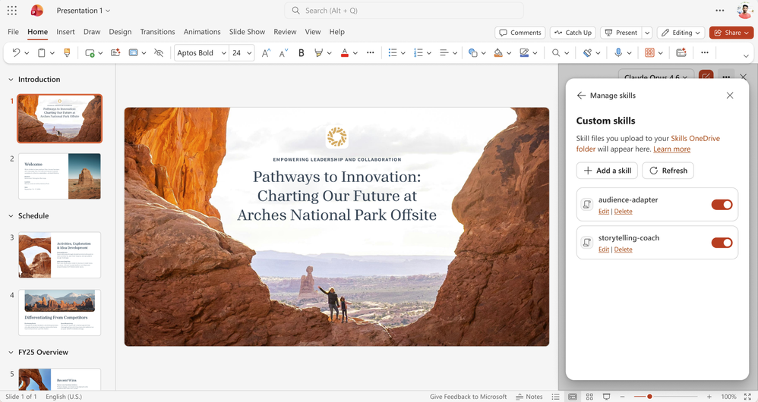
Custom user skills come to Copilot in PowerPoint
Users can create, upload, and update their own custom skills for Copilot in PowerPoint.
Reusable Guidance: Skills turn repeated instructions into reusable guidance Copilot applies in the flow of work.
Stored In OneDrive: Create, upload, and update custom skills in OneDrive.
In-Flow Application: Copilot applies your skills in the flow of presentation work.
August Rollout
Rolls out in August.
Learn more
Custom user skills in PowerPoint
What's New in Microsoft 365 Copilot | July 2026
Notes:
Custom user skills in PowerPoint
Users can create, upload, and update their own custom skills for Copilot in PowerPoint.
• Reusable Guidance — Skills turn repeated instructions into reusable guidance Copilot applies in the flow of work.
• Stored In OneDrive — Create, upload, and update custom skills in OneDrive.
• In-Flow Application — Copilot applies your skills in the flow of presentation work.
August Rollout — Rolls out in August.
Source: What's New in Microsoft 365 Copilot | July 2026 — https://techcommunity.microsoft.com/blog/microsoft365copilotblog/what%E2%80%99s-new-in-microsoft-365-copilot--july-2026/4538332

Slide 24
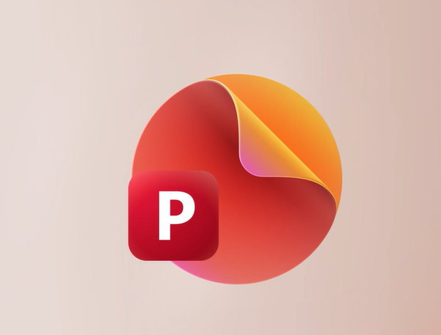
Assign tasks and notify stakeholders from PowerPoint comments
Copilot in PowerPoint will let users assign tasks and notify stakeholders from within comments.
Feedback To Follow-Ups: Ask Copilot to turn feedback into assigned follow-ups.
Bring In The Right People: Notify relevant stakeholders directly from the comment thread.
Track Next Steps: Helps teams move from feedback to action and keeps reviews organized.
August Rollout
Rolls out in August.
Assign tasks in PowerPoint comments
What's New in Microsoft 365 Copilot | July 2026
Notes:
Assign tasks in PowerPoint comments
Copilot in PowerPoint will let users assign tasks and notify stakeholders from within comments.
• Feedback To Follow-Ups — Ask Copilot to turn feedback into assigned follow-ups.
• Bring In The Right People — Notify relevant stakeholders directly from the comment thread.
• Track Next Steps — Helps teams move from feedback to action and keeps reviews organized.
August Rollout — Rolls out in August.
Source: What's New in Microsoft 365 Copilot | July 2026 — https://techcommunity.microsoft.com/blog/microsoft365copilotblog/what%E2%80%99s-new-in-microsoft-365-copilot--july-2026/4538332

Slide 25
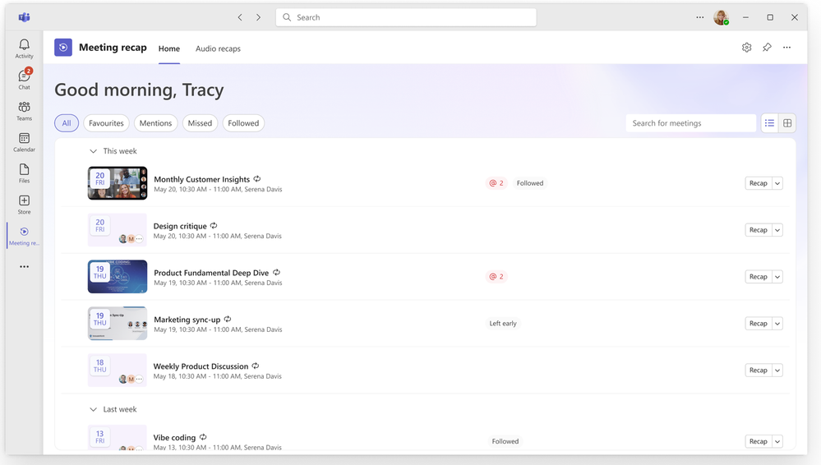
The Meeting recaps app brings Teams recaps into one place
MC1404322
A new Meeting recaps app brings AI-generated recaps together in one pinnable Teams app.
One Place To Catch Up: Pin the app in the Teams sidebar to find recaps easily.
Filter And Revisit: Apply quick filters and browse recaps from the past 30 days.
Audio Recaps: Generate an audio recap to catch up on highlights on the go.
July Rollout
Rolled out in July.
Meeting recaps app for Copilot in Teams
What's New in Microsoft 365 Copilot | July 2026
Notes:
Meeting recaps app for Copilot in Teams
A new Meeting recaps app brings AI-generated recaps together in one pinnable Teams app.
• One Place To Catch Up — Pin the app in the Teams sidebar to find recaps easily.
• Filter And Revisit — Apply quick filters and browse recaps from the past 30 days.
• Audio Recaps — Generate an audio recap to catch up on highlights on the go.
July Rollout — Rolled out in July.
Source: What's New in Microsoft 365 Copilot | July 2026 — https://techcommunity.microsoft.com/blog/microsoft365copilotblog/what%E2%80%99s-new-in-microsoft-365-copilot--july-2026/4538332

Slide 26
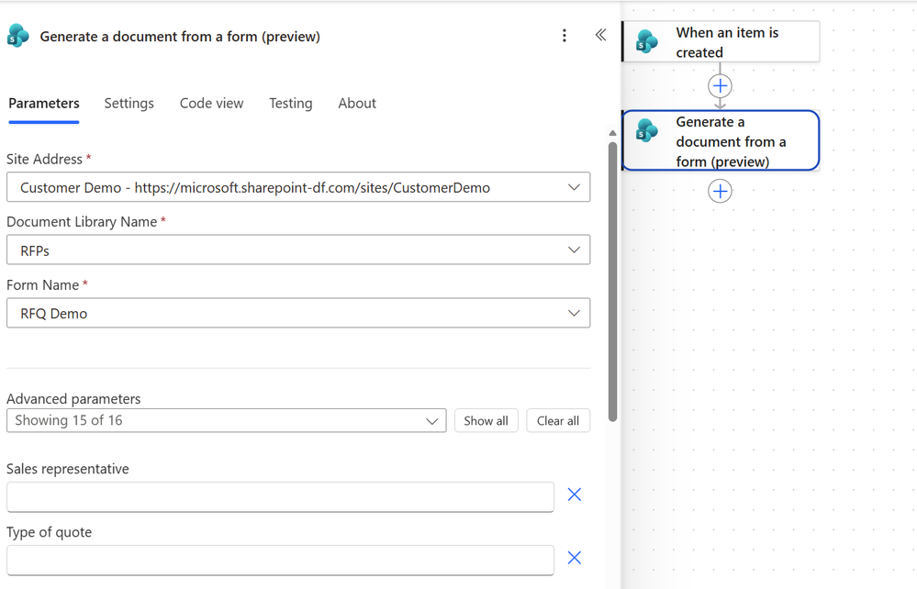
Generate documents from SharePoint forms with Power Automate
A new Power Automate action generates documents from DocGen forms in SharePoint.
Automated Generation: A new Power Automate action automates document generation in SharePoint.
DocGen Forms: Generate documents from a template using document generation (DocGen) forms.
Map Data To Fields: Generate document from form (Preview) maps data inputs to predefined template fields.
June Rollout
Rolled out in June.
Document generation from SharePoint forms
What's New in Microsoft 365 Copilot | July 2026
Notes:
Document generation from SharePoint forms
A new Power Automate action generates documents from DocGen forms in SharePoint.
• Automated Generation — A new Power Automate action automates document generation in SharePoint.
• DocGen Forms — Generate documents from a template using document generation (DocGen) forms.
• Map Data To Fields — Generate document from form (Preview) maps data inputs to predefined template fields.
June Rollout — Rolled out in June.
Source: What's New in Microsoft 365 Copilot | July 2026 — https://techcommunity.microsoft.com/blog/microsoft365copilotblog/what%E2%80%99s-new-in-microsoft-365-copilot--july-2026/4538332

Slide 27
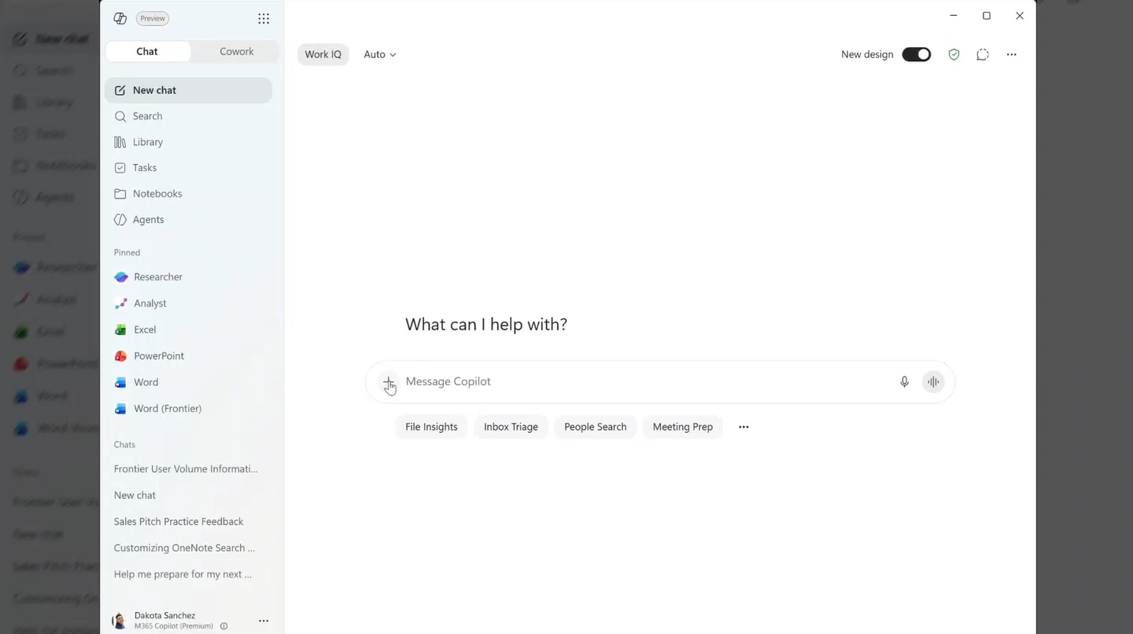
More Copilot connectors bring industry knowledge into the flow of work
New industry-specific Copilot connectors bring specialized enterprise data into the flow of work.
Industry Coverage: New connectors span financial services, professional services, industrial, software, healthcare, retail, and cross-industry sources.
Discover And Scope: Discover and connect sources from the Add and manage sources menu and scope prompts to a specific connector.
Governed Access: Honors existing security, compliance, and permissions; now generally available for admins to manage.
July Rollout
Rolled out in July.
More Copilot connectors
What's New in Microsoft 365 Copilot | July 2026
Notes:
More Copilot connectors
New industry-specific Copilot connectors bring specialized enterprise data into the flow of work.
• Industry Coverage — New connectors span financial services, professional services, industrial, software, healthcare, retail, and cross-industry sources.
• Discover And Scope — Discover and connect sources from the Add and manage sources menu and scope prompts to a specific connector.
• Governed Access — Honors existing security, compliance, and permissions; now generally available for admins to manage.
July Rollout — Rolled out in July.
Source: What's New in Microsoft 365 Copilot | July 2026 — https://techcommunity.microsoft.com/blog/microsoft365copilotblog/what%E2%80%99s-new-in-microsoft-365-copilot--july-2026/4538332

Slide 28
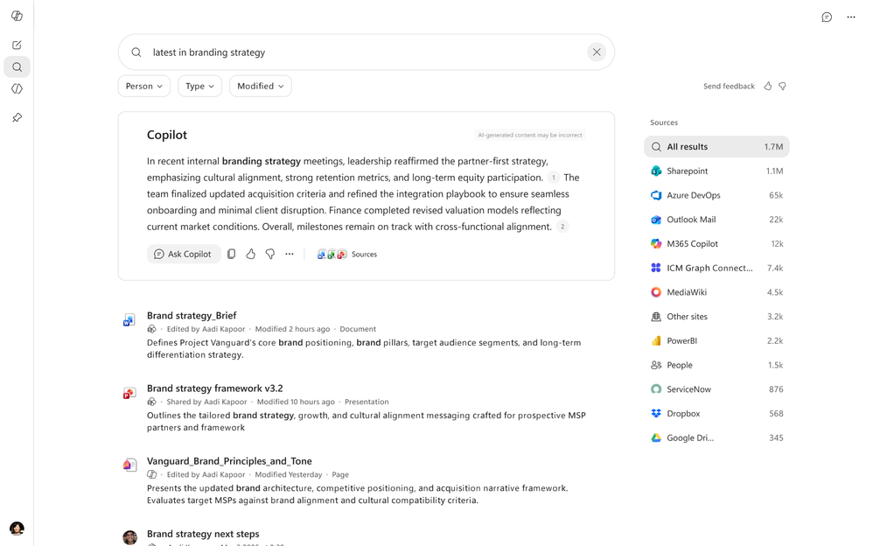
Copilot Search answers get more concise and connect to Chat
ID 562354
Copilot answers in the Copilot Search module are now more concise and connect users into Copilot Chat.
More Concise Answers: Copilot answers now provide shorter, more targeted responses.
Continue In Chat: Answers highlight more prominently that users can continue the conversation in Copilot Chat on the sidebar.
Smoother Adoption: Less manual effort for users and a clearer path for IT teams to support rollout.
July Rollout
Rolled out in July.
Copilot Search answer enhancements
What's New in Microsoft 365 Copilot | July 2026
Notes:
Copilot Search answer enhancements
Copilot answers in the Copilot Search module are now more concise and connect users into Copilot Chat.
• More Concise Answers — Copilot answers now provide shorter, more targeted responses.
• Continue In Chat — Answers highlight more prominently that users can continue the conversation in Copilot Chat on the sidebar.
• Smoother Adoption — Less manual effort for users and a clearer path for IT teams to support rollout.
July Rollout — Rolled out in July.
Source: What's New in Microsoft 365 Copilot | July 2026 — https://techcommunity.microsoft.com/blog/microsoft365copilotblog/what%E2%80%99s-new-in-microsoft-365-copilot--july-2026/4538332

Slide 29

Agents

Slide 30
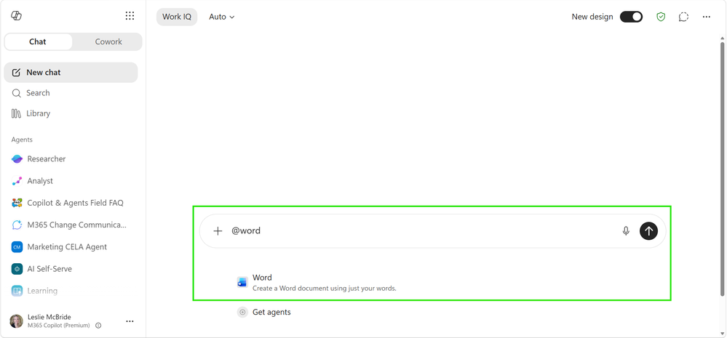
Add Word, Excel, and PowerPoint agents in Copilot Chat
ID 548641
Users can add the Word, Excel, and PowerPoint agents directly into Copilot Chat to create files without leaving the app.
In-Chat Mention: Open Copilot and @mention the Word, Excel, or PowerPoint agent to add it to the chat.
Create In Place: Build documents, spreadsheets, and presentations without leaving the Copilot app.
Fewer App Switches: Keep the whole creation flow inside a single Copilot conversation.
July Rollout
Rolled out in July.
Adding agents in Copilot Chat
What's New in Microsoft 365 Copilot | July 2026
Notes:
Adding agents in Copilot Chat
Users can add the Word, Excel, and PowerPoint agents directly into Copilot Chat to create files without leaving the app.
• In-Chat Mention — Open Copilot and @mention the Word, Excel, or PowerPoint agent to add it to the chat.
• Create In Place — Build documents, spreadsheets, and presentations without leaving the Copilot app.
• Fewer App Switches — Keep the whole creation flow inside a single Copilot conversation.
July Rollout — Rolled out in July.
Source: What's New in Microsoft 365 Copilot | July 2026 — https://techcommunity.microsoft.com/blog/microsoft365copilotblog/what%E2%80%99s-new-in-microsoft-365-copilot--july-2026/4538332

Slide 31
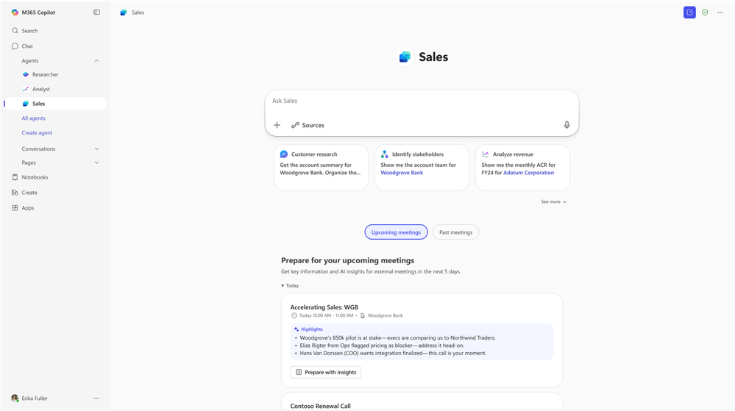
Sales Agent — General Availability
Sales Agent is generally available in Microsoft 365 Copilot, bringing customer and deal intelligence into the flow of work.
Conversational CRM: Sellers use natural language to search, summarize, and act on sales data across connected CRM and past customer conversations.
Grounded in Context: Combines CRM records such as opportunities and contacts with Microsoft 365 data such as emails, meetings, and calendars.
Works Where Sellers Work: Same capabilities and shared context across Outlook, Teams, and Dynamics 365, respecting each user's CRM access level.
Now Generally Available
GA following public preview; admins control which environments, users, and applications have access.
Learn more
Sales Agent — General Availability
What's New in Microsoft 365 Copilot | June 2026
Notes:
Sales Agent — General Availability
Sales Agent is generally available in Microsoft 365 Copilot, bringing customer and deal intelligence into the flow of work.
• Conversational CRM — Sellers use natural language to search, summarize, and act on sales data across connected CRM and past customer conversations.
• Grounded in Context — Combines CRM records such as opportunities and contacts with Microsoft 365 data such as emails, meetings, and calendars.
• Works Where Sellers Work — Same capabilities and shared context across Outlook, Teams, and Dynamics 365, respecting each user's CRM access level.
Now Generally Available — GA following public preview; admins control which environments, users, and applications have access.
Source: Sales Agent — General Availability — https://techcommunity.microsoft.com/blog/microsoft365copilotblog/sales-agent-is-now-generally-available-bringing-customer-and-deal-intelligence-i/4532629

Slide 32
Microsoft 365 Copilot Public Roadmap
Changes this month
As of 5th August 2026
Microsoft 365 Roadmap - See What's Coming | Microsoft 365
Notes:
As of 6th July 2026

Slide 33

Microsoft 365 Copilot Public Roadmap
As of 5th August 2026
Launched and Rolling Out “Changed within last month”
Launched (20) 🚀
  Rolling Out (9)
Microsoft Viva: New Overview experience in Agent Dashboard
Referenced sources are cited in drafted content
Microsoft 365: New profile cards for buildings, rooms and desks
Microsoft Viva: Insights for GitHub Copilot spend and usage
Admins can now edit user mappings and query filters for ServiceNow Connector
[Copilot Search] [Copilot Search] Copilot Chat available when using Copilot Search
Seamless Search and Chat Integration
Declarative agents with Actions available in GCC High and DoD
Domain exclusion for web grounding
Microsoft Purview: Data Loss Prevention to prevent Microsoft 365 Copilot processing content with sensitivity labels supports all storage locations
SharePoint list support in Agent Builder
Find meetings based on topics and keywords
Microsoft Viva: Copilot Analytics - Insights in Cowork and WorkIQ spend and usage
Copilot connectors are available for U.S. Department of Defense environment
Surveys Agent and Copilot Chat in Microsoft Forms
Admins can manage access more precisely with support for nested permissions in Jira, Confluence, and ServiceNow
Engage private content in M365 Copilot
Frontier and Microsoft agent user request approval flow in Microsoft 365 admin center
Agent Mode in Word for Enhanced document editing
Copilot Prompt Gallery - Company-wide prompt publishing
Ability for IT admins to customize the user notification messages for recording and transcription in calls
Notes:
As of 6th July 2026

Slide 34
Microsoft 365 Copilot Public Roadmap
As of 5th August 2026
New items added “New within the last month”
New items – In development (21)
Planner: AI-generated Status Reports in Planner Agent
New Rich Answer Cards
Workforce Insights Agent
Outlook: New Copilot entry point in Classic Outlook
OneNote: Multimodal capture in Copilot Notebooks (Android)
Power BI integration in M365 Copilot
Use Agent 365 agents within Microsoft 365 Copilot Chat and Declarative Agents
Session and Response Sharing in M365 Copilot
Planner: Planner Agent chat in Basic Plans
Multilingual recap available with translation button
Microsoft Copilot Studio: Enable express mode for flows invoked by an agent or app
Microsoft 365 app: New Copilot Notebooks design in the Microsoft 365 Copilot App (Android)
Link meetings to CRM records automatically with AI
Enrich Sales agent meeting prep with more data sources
Add custom insights to record summaries in Sales agent
Engage customers across multiple channels (web, voice, SMS & email)
Engage prospects faster with Sales Agent-enriched leads
Planner: Capabilities in Microsoft Cowork
Microsoft Copilot Studio: Use SharePoint lists as a knowledge source
Microsoft 365 admin center - Usage reports - Copilot Chat for GCC, GCC High and DoD
Microsoft 365 admin center – New Microsoft 365 Copilot usage report for GCC High & DoD
Notes:
As of 6th July 2026

Slide 35
Microsoft 365 Copilot release notes
As of 5th August 2026
Latest features and improvements for Microsoft 365 Copilot.
It includes changes that are generally available
(Current Channel for Microsoft 365 apps)
Release Notes for Microsoft 365 Copilot | Microsoft Learn

Slide 36
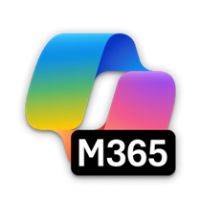
Microsoft 365 Copilot release notes – July 2026
As of 5th August 2026
July 01, 2026 · 27 updates
Microsoft 365 Copilot app (11)
Microsoft 365 Copilot Chat (3)
Enable watermarks for AI-generated content for Microsoft 365 Copilot [Android, Windows, iOS, Mac, Web]
View long running agent tasks in Windows taskbar [Windows]
Scheduled prompts for Agents [Windows, Mac, Web]
Create PowerPoint presentations from Copilot Notebooks [Windows, Web]
Mind maps in Copilot Notebooks [Windows, Web]
Generated files inherit sensitivity labels [Android, Windows, iOS, Mac, Web]
Copilot Search Matches on People's Department [Web]
Quickly launch the Microsoft 365 Copilot app on your iOS device [iOS]
Create Word documents from Copilot Notebooks [Windows, Web]
Create Excel spreadsheets from Copilot Notebooks [Windows, Web]
Customize employee self-service agent landing page [Web]
MAI‑Image‑2‑Efficient is now available in Copilot in PowerPoint [Windows, Mac, Web]
Apply brand kit and style to visual creations in Copilot chat [Windows, Mac, Web]
Open Word, Excel, and PowerPoint, and PDF files in Copilot Chat [Windows, Mac, Web]
OneNote (3)
OneNote: Copilot Notebooks available in OneNote on Web [Web]
Multimodal capture in Copilot Notebooks (iPhone) [iOS]
Copilot Notebook in OneNote for iPhone and iPad [iOS]
PowerPoint (3)
Microsoft 365 Copilot extensibility (1)
Create presentations with Work IQ using Agent Mode in Copilot in PowerPoint [Windows]
Reference a Teams meeting or chat when creating a presentation with Agent Mode in PowerPoint [Windows, Web, Mac]
Reuse content and style from existing PowerPoint presentations with Copilot in PowerPoint [Windows, Web, Mac]
Edit capability for selecting permission reading option for existing ServiceNow Knowledge & Catalog Connections [Web]
Microsoft 365 Copilot Studio (1)
Share agents to Teams [Web]
Microsoft 365 SharePoint (1)
Metadata understanding support for queries scoped to SharePoint document libraries or folders [Web]
Outlook (1)
Copilot Chat in Outlook expands to reason over inbox, calendar, and enterprise data [Android, Windows, iOS, Mac, Web]
Viva Glint (1)
AI-generated survey insights with Copilot Highlights [Web]
Viva Insights (1)
Word (1)
Copilot Analytics: "All"- licensed user page Copilot dashboard [Web]
Real-time voice interactions with Audio Overview [Web]
Learn more | Release Notes for Microsoft 365 Copilot
Latest features and improvements for Microsoft 365 Copilot generally available on Current Channel for Microsoft 365 apps. 27 updates.

Slide 37
Microsoft 365 Copilot release notes – July 2026
As of 5th August 2026
July 15, 2026 · 7 updates
Microsoft 365 Copilot Extensibility (3)
Microsoft 365 Copilot (2)
Access agents with Model Context Protocol in Office apps [Web]
Admins can manage access more precisely with support for nested permissions in Confluence and ServiceNow [Web]
Manage Federated Copilot Connectors in Microsoft 365 admin center connectors tab [Web]
Copilot Prompt Gallery - Company-wide prompt publishing [Windows, Web]
Microsoft Edge: v.149 - Modern, unified, and updated Look and Feel [Web]
Microsoft 365 admin center (1)
Microsoft 365 Copilot App (1)
Submit agent to Agent Store from Agent Builder [Windows, Web]
Create brand kits from your brand guidelines [Web]
July 29, 2026 · 10 updates
Microsoft 365 Copilot Chat (3)
Microsoft 365 Copilot extensibility (3)
Lists in Context IQ [Web]
List email attachments in Microsoft 365 Copilot [Android, Windows, iOS, Mac, Web]
Take Screenshot in Copilot [Windows]
Admins can now edit user mappings and query filters for ServiceNow Connector [Web]
SharePoint list support in Agent Builder [Windows, Web]
Enable adaptive card refresh in custom engine agents [Web]
Microsoft 365 SharePoint (2)
Microsoft 365 Copilot (1)
Plan and build solutions on SharePoint with Copilot in SharePoint [Web]
Floating Copilot icon in File Previewer for OneDrive [Web]
Surface rich images inline within responses [Windows, Web]
OneNote (1)
Redesign Overview experience in Copilot notebooks in OneNote [Windows, Mac, Web]
Learn more | Release Notes for Microsoft 365 Copilot
Latest features and improvements for Microsoft 365 Copilot generally available on Current Channel for Microsoft 365 apps. 17 updates.

Slide 38
Thank you 👏
Got feedback ?
https://aka.ms/WhatsNewCopilot/Feedback

