Slide 1


What’s new in Microsoft Copilot
As of 7th Oct 2026
September 2026
Presenter name
Title
Notes:
As of 7th October 2026

Slide 2

What's new in Microsoft Copilot updates
Updates listed in this document are selected based on relevance to Microsoft Copilot.
Release dates and timings are subject to change.
For a complete list of Microsoft Copilot roadmap items refer to
Microsoft 365 Roadmap | Microsoft 365
Got feedback?
https://aka.ms/WhatsNewCopilot/Feedback

Slide 3


What’s new in Microsoft Copilot
September 2026
As of 7th Oct 2026
The new Copilot: Home, Code and Autopilot
User capabilities
        Home brings Chat and Cowork together
        Code: build apps, dashboards, and automations
        Autopilot, a persistent and proactive agent
        Office in Copilot: Word, Excel, and PowerPoint
        Today in Home: what needs attention
        @Copilot in Teams with shared team context
        AI spend: licensing, billing, and FinOps
        OpenAI GPT-6 Astra, GPT-6.1 Sol and Claude Opus 5.5, Sonnet 5.5 in Microsoft Copilot
        Grok models in Word, Excel, and PowerPoint
        Work IQ grounding in Dynamics 365 and Power Platform
        New design, Edge new tab page, and Android for Copilot
        Connectors, plugins, and the new plugin registry
        Record in the Microsoft Copilot mobile app
        Citations and image modifications for Copilot in Word
        Brand Kit, Skills, and more for Copilot in PowerPoint
        Copilot in SharePoint and OneDrive general availability
        Credit usage and balances in Copilot
        Teams Phone Agent
IT admin capabilities
        Evolution of the Copilot pricing model
        Cost management in Agent 365
        Model access controls and Cowork consumption insights
        Copilot Managed Runtime and the Apps experience
        Authoritative sources for Copilot Search
        Targeted surveys in the Copilot Dashboard
Notes:
As of 7th October 2026

Slide 4
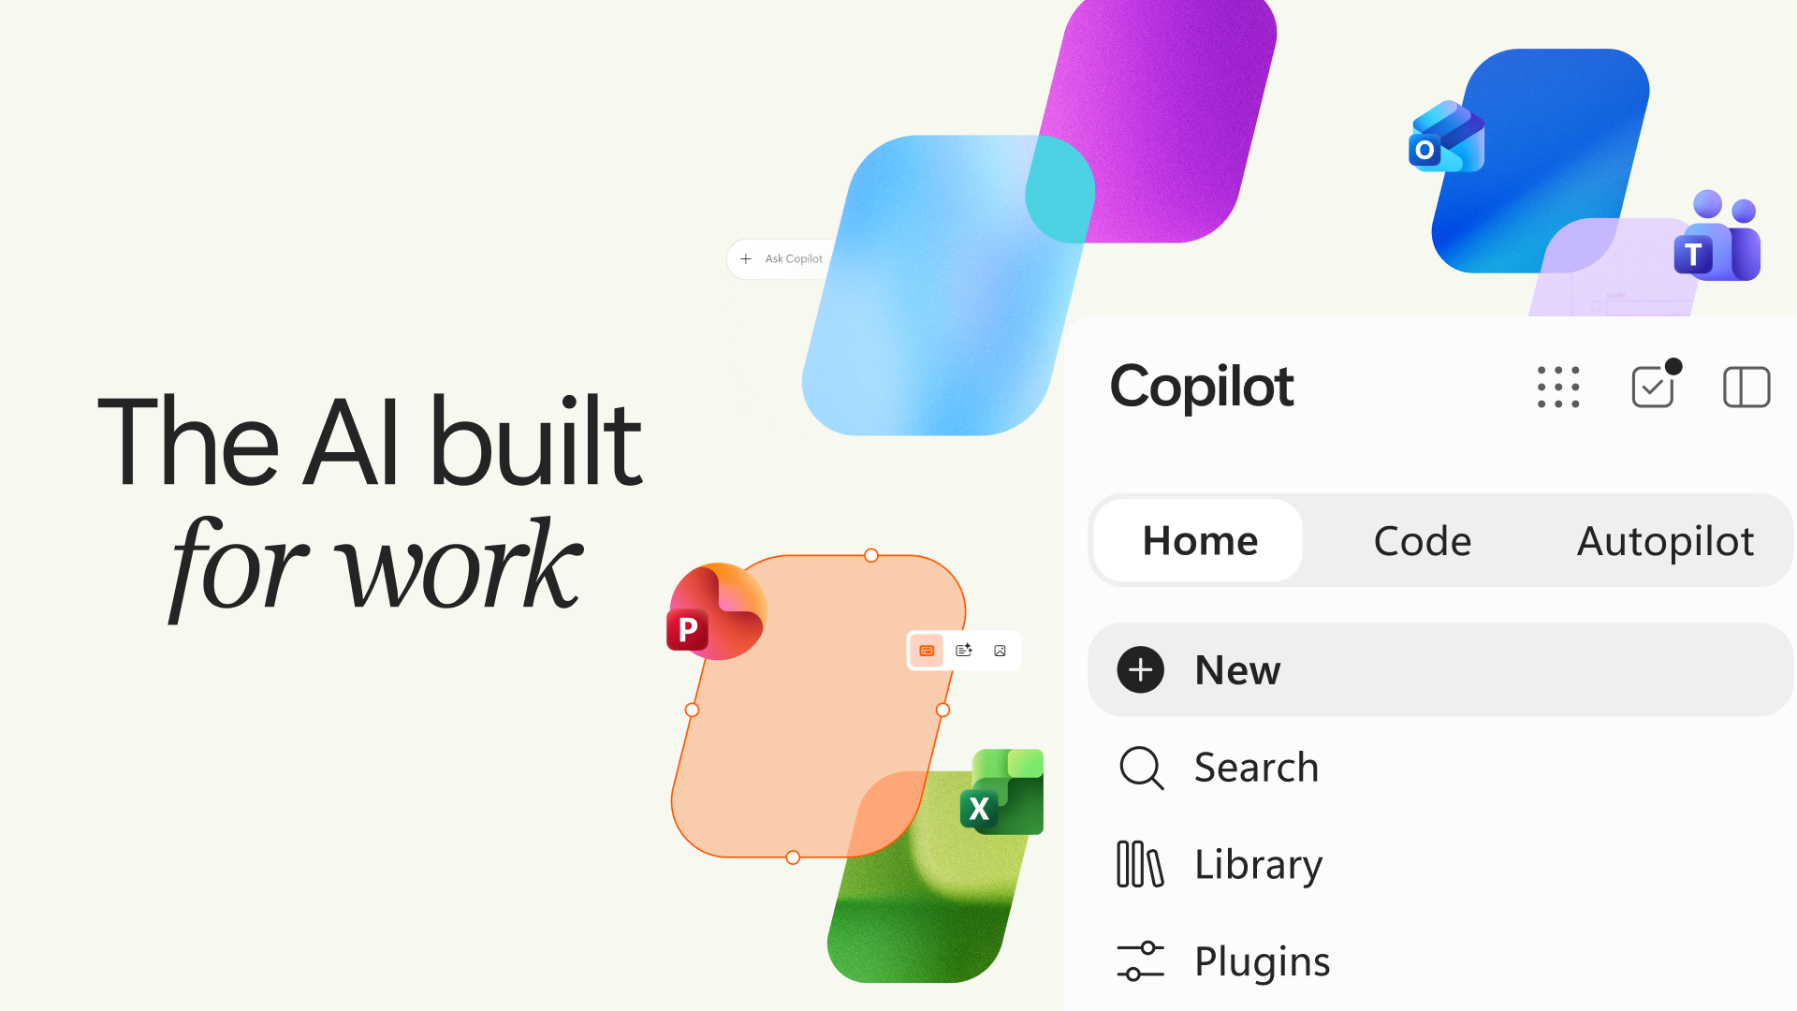

The new Copilot: Home, Code and Autopilot

Slide 5
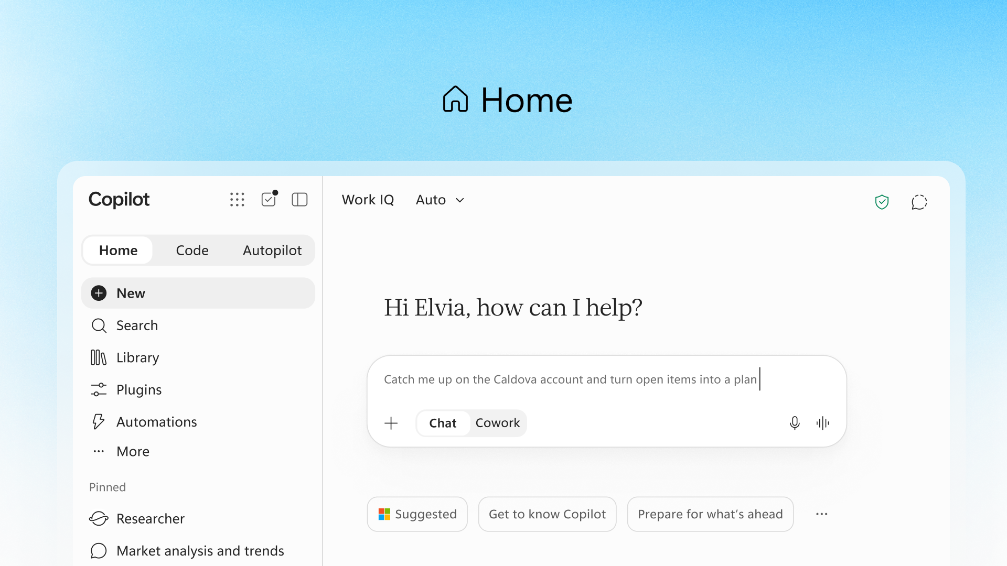
Introducing the new Copilot with Home, Code and Autopilot
MC1479277
Home is the new starting point in Copilot, where users get their bearings and move between quick answers and delegated work.
One Starting Point — Review recent activity, get suggestions, and pick up work where you left off.
Chat and Cowork — Chat handles quick questions and drafts; Cowork runs delegated tasks end-to-end to a completed result.
Automatic Routing — Coming soon, Copilot routes work to Chat, Cowork, or Code without users choosing a mode.
Frontier Rollout — Starts rolling out in the Frontier program in the coming weeks.
Home in Copilot
Introducing the new Copilot with Home, Code and Autopilot
Notes:
Home is the new starting point in Copilot, where Chat and Cowork come together in one place. Users can review recent activity, get suggestions on what Copilot can help with, and pick up work right where they left off. Chat is instant and conversational, while Cowork runs a delegated task end-to-end and returns a completed result such as an RFP response or customer briefing; coming soon, Copilot will route work to Chat, Cowork, or Code automatically.
Home starts rolling out in the Frontier program in the coming weeks.
Source: Introducing the new Copilot with Home, Code and Autopilot — https://blogs.microsoft.com/blog/2026/09/25/introducing-the-new-copilot-with-home-code-and-autopilot/
MC1479277

Slide 6
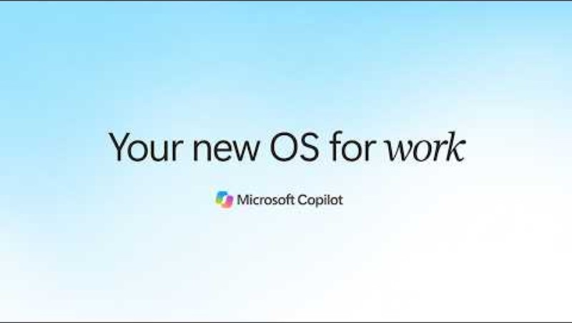
The new Copilot: where AI-powered work comes together

Slide 7
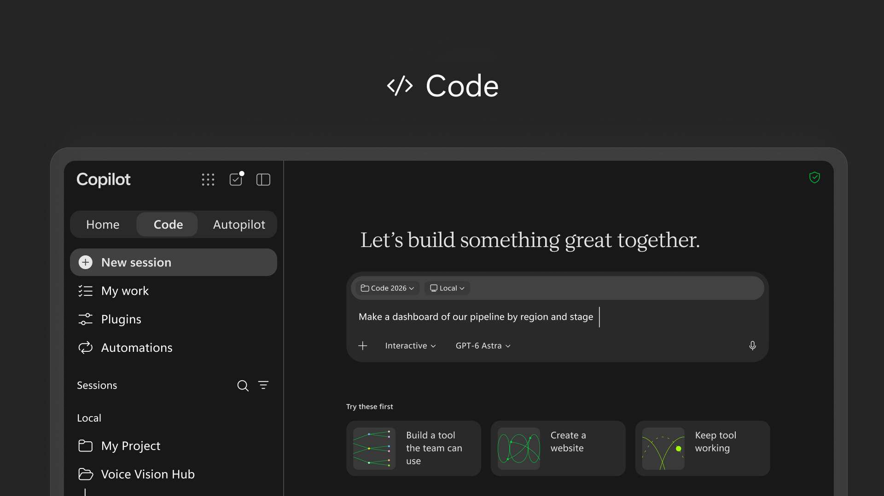
Code lets anyone build apps, dashboards, and automations in Copilot
Copilot Code lets anyone describe a solution in natural language and have Copilot build and run it safely.
Build From Description — Describe an app, tracker, dashboard, automation, or workflow and Copilot builds it.
Safe by Design — Built on the same technology as GitHub Copilot, Code runs in a sandbox and can be hosted in your tenant.
Grounded and Connected — Microsoft IQ grounds what you create in your work context, and plugins sync automatically.
Frontier Rollout — Rolling out to Frontier at the end of September, with broad availability in the coming weeks.
Code in Copilot
Introducing the new Copilot with Home, Code and Autopilot
Notes:
Code moves solution-building beyond developers: users describe an app, tracker, dashboard, automation, or workflow in natural language, and Copilot chooses an approach and builds it, from desktop widgets and interactive dashboards to cloud-hosted internal apps shared with the team. Code is powered by the same underlying technology as GitHub Copilot, runs in a sandboxed environment, and can be hosted securely within the tenant. With Microsoft IQ, what users create is grounded in their work context and plugins sync automatically.
Code rolls out to Frontier at the end of the month with broad availability in the coming weeks, and will be in preview for Microsoft 365 Premium and Pro subscribers later this year.
Source: Introducing the new Copilot with Home, Code and Autopilot — https://blogs.microsoft.com/blog/2026/09/25/introducing-the-new-copilot-with-home-code-and-autopilot/
MC1479277

Slide 8
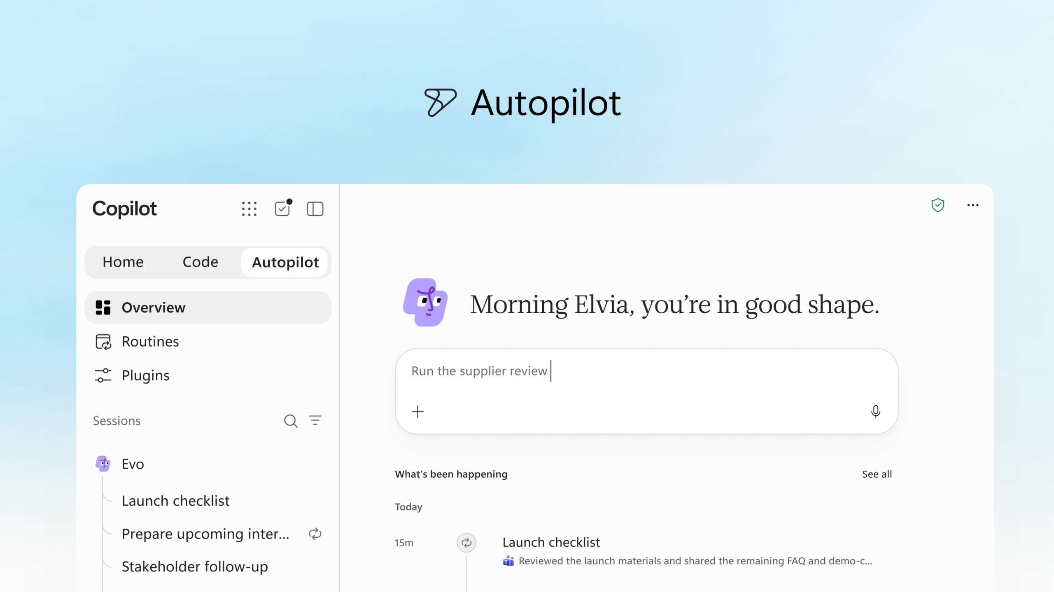
Autopilot is a persistent, proactive agent that works for you
Autopilot, previously called Scout, is a cloud-hosted digital teammate that keeps working toward a goal without waiting for a prompt.
Goal-Driven Teammate — Give it a name, role, and goal; it follows up on threads, runs recurring work, and resumes projects.
In Your Apps — @mention it in Teams, Outlook, chats, channels, and documents like a colleague.
Governed by Design — Lives in your tenant with its own identity and memory, plus permissions, audit, and governance.
Private Preview — Expanding to private preview at the end of September.
Autopilot
Introducing the new Copilot with Home, Code and Autopilot
Notes:
Autopilot, previously called Scout, is a persistent, proactive, and personal agent: give it a name, a role, and a goal, and it watches channels, follows up on threads, runs recurring work, and picks projects back up days later without waiting for a prompt. For example, it can set up and manage a supplier review process, from building the schedule and workback plan to handling prep, meetings, and follow-ups. It is cloud-hosted and lives in the tenant with its own identity, memory, computer, and workspace, built on Microsoft IQ, and shows up in Teams, Outlook, chats, channels, and documents with permissions, audit, and governance behind it.
Autopilot is expanding to private preview at the end of the month. Source:
Introducing the new Copilot with Home, Code and Autopilot — https://blogs.microsoft.com/blog/2026/09/25/introducing-the-new-copilot-with-home-code-and-autopilot/

Slide 9
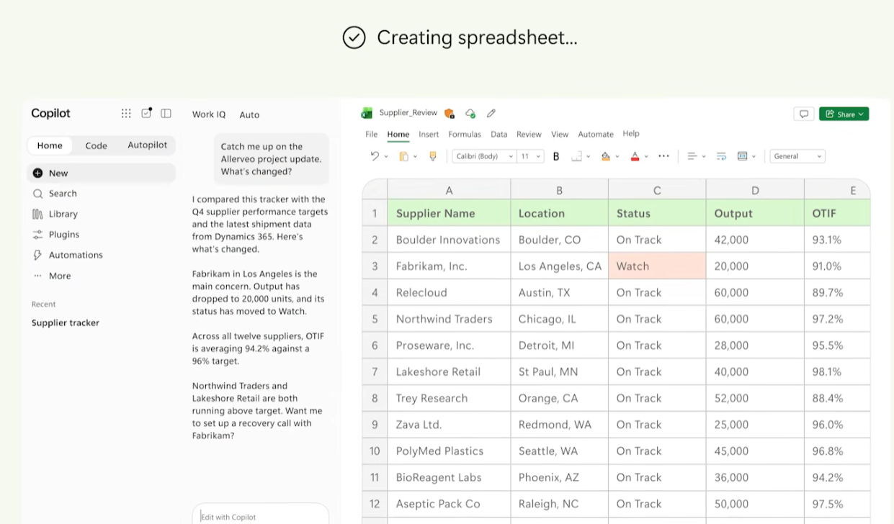
Office in Copilot brings Word, Excel, and PowerPoint into Copilot
Office in Copilot creates and updates real, editable documents, workbooks, and presentations directly from the Copilot experience.
Real Office Files — Ask Copilot from Home to draft, model, or build, and get a live, editable file for the whole team.
Side-by-Side Refinement — Refine the file next to the conversation, or @mention a teammate and see their edits as they happen.
Stays in Sync — Changes stay in sync between Copilot and the Office apps, with no broken formatting or stray versions.
Office in Copilot
Introducing the new Copilot with Home, Code and Autopilot
Notes:
With Office in Copilot, the full power of Word, Excel, and PowerPoint is built into the Copilot experience. From Home, users can ask Copilot to draft a launch brief, model a budget, build a deck, or pick up a file their team is already working on, and Copilot creates or updates a real, editable file that is live for the whole team. Users refine it side by side with the conversation, or @mention a teammate whose edits show up as they make them, and everything stays in sync with the Office apps.
The new Copilot is rolling out through the Frontier program.
Source: Introducing the new Copilot with Home, Code and Autopilot — https://blogs.microsoft.com/blog/2026/09/25/introducing-the-new-copilot-with-home-code-and-autopilot/

Slide 10
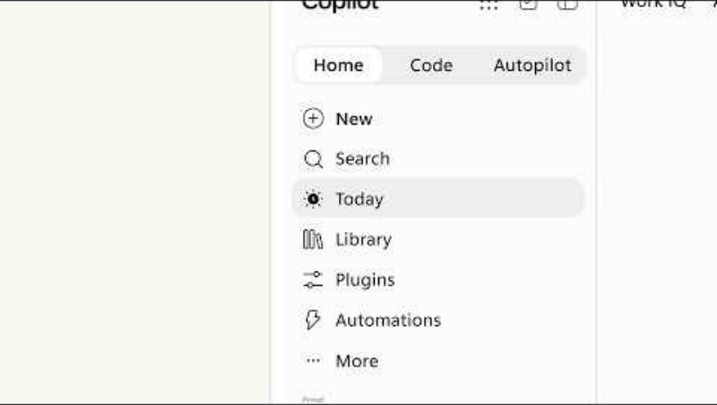
Today in Home shows what needs attention and prepares the work
Today is an upcoming, personalized command center in Home that surfaces what needs attention and gets the work started.
Personal Command Center — Brings mail, calendar, Teams threads, meetings, and tasks into one view.
Clear Priorities — Shows what you missed, what needs attention now, and what can wait.
Prepared Work — Drafts, proposed schedule changes, and follow-ups are ready to review and send.
October Private Preview — Enters private preview in Copilot in October, with Outlook and Teams to follow.
Today in Home
Introducing the new Copilot with Home, Code and Autopilot
Notes:
Coming soon in Home, Today is a proactive, personalized command center across mail, calendar, Teams threads, meetings, and tasks. It shows what users missed, what needs attention now, and what can wait. Today does not just surface the work: the draft is written and ready to edit, the schedule change is proposed, and the forgotten follow-up is waiting to be sent, with context to catch up quickly.
Today enters private preview in October in Copilot and will also come to Outlook and Teams; this was presented as a sneak peek.
Source: Introducing the new Copilot with Home, Code and Autopilot — https://blogs.microsoft.com/blog/2026/09/25/introducing-the-new-copilot-with-home-code-and-autopilot/

Slide 11
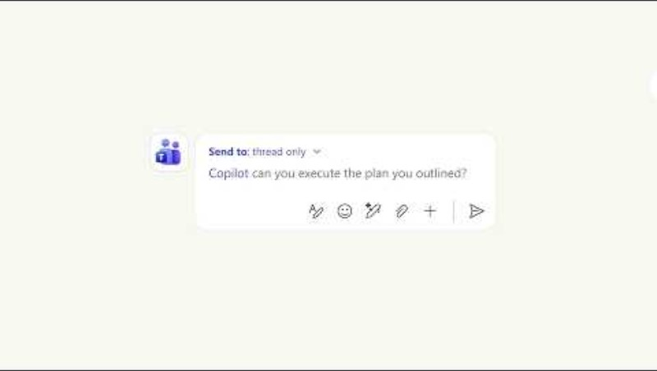
@Copilot in Teams works with the shared context of the team
When users invoke @Copilot in Teams, the whole team gets the shared context and permissions of the channel, group chat, or meeting.
Shared Team Context — Copilot pulls background from across conversations, so no one has to dig or re-explain.
Cross-Functional Reviews — Copilot can prepare a review with dependencies, owners, open questions, and decisions.
Aligned Teams — Everyone sees how their work connects and what still needs resolving.
Private Preview — Expected in private preview in Teams by the end of September.
@Copilot in Teams
Introducing the new Copilot with Home, Code and Autopilot
Notes:
When users invoke @Copilot in Teams, the entire team gets the shared context and permissions of the channel, group chat, or meeting. Ask why a product decision was made and Copilot pulls the background from across conversations. When that decision affects other functions, Copilot can offer to prepare a cross-functional review with dependencies, owners, open questions, and decisions so the team stays aligned.
The @Copilot capability will be in private preview in Teams by the end of the month.
Source: Introducing the new Copilot with Home, Code and Autopilot — https://blogs.microsoft.com/blog/2026/09/25/introducing-the-new-copilot-with-home-code-and-autopilot/

Slide 12

AI spend you can see and control
Copilot pairs a fixed-cost license for everyday AI with usage-based billing for agentic work, plus new FinOps for AI capabilities to manage spend.
Per-User License — Everyday AI at a fixed cost, with Auto routing each request to the model best suited for the job.
Usage-Based Billing — Cowork, Code, Autopilot, and frontier models run on usage-based billing, so you choose models and match cost to value.
FinOps for AI — New capabilities across Agent 365, Insights, and Microsoft Copilot help organizations manage spend and value.
Rollout Timing — Introduced September 25; Copilot Studio agents join Agent 365 cost management, planned for October.
Learn more
AI spend and FinOps for AI
Introducing the new Copilot with Home, Code and Autopilot
Notes:
For everyday AI such as quick answers, first drafts, summaries, and analysis, the user subscription license (USL) gives the best possible quality at a fixed cost: Copilot in Chat and across Word, Excel, PowerPoint, Outlook, and Teams, model selection, and new capabilities and models, with Auto weighing accuracy, speed, and cost on each request to route to the best-suited model.
Agentic work requires a different type of spend, so usage-based billing (UBB) gives full control to choose models and match cost to value; Cowork, Code, Autopilot, new long-running agentic capabilities, and frontier models like Astra and Fable all run on UBB. FinOps for AI is a shared discipline for managing AI spend and optimizing it for business value, and Microsoft is introducing new capabilities across Agent 365, Insights, and Microsoft Copilot to support it.
Cost management in Agent 365 expands beyond Cowork and Work IQ APIs to Code and Copilot Managed Runtime (Copilot Studio agents planned for October); admins can manage spending policies with API access, route end-user credit requests into approval workflows, and set which model families groups can use; business leaders and admins can understand which Cowork tasks generate the strongest outcomes; and end users can view credit usage, remaining balances, and usage history in Copilot.
Source: Introducing the new Copilot with Home, Code and Autopilot — https://blogs.microsoft.com/blog/2026/09/25/introducing-the-new-copilot-with-home-code-and-autopilot/
Detail slides: pricing model, Agent 365 cost management, model access and consumption insights (IT admin), and end-user credit visibility (User capabilities).

Slide 13
User capabilities

Slide 14
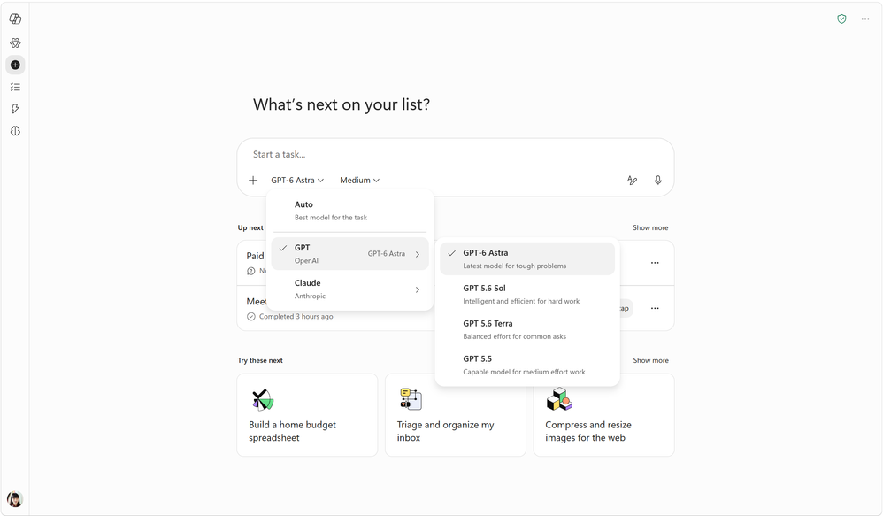
More model choice in Microsoft Copilot
See detail slides
Six new models from OpenAI, Anthropic, and SpaceXAI give users more model choice in Copilot.
Office Apps and Chat — Claude Opus 5.5 and GPT-6 Sol roll out across Word, Excel, PowerPoint, and Chat; GPT-6.1 Sol and Sonnet 5.5 follow in phases.
Cowork and Copilot Studio — GPT-6 Astra joins Opus 5.5, GPT-6 Sol, GPT-6.1 Sol, and Sonnet 5.5 in Copilot Cowork and Copilot Studio.
Grok for Frontier — Grok models from SpaceXAI reach Word, Excel, and PowerPoint through Frontier, behind an admin setting.
September Rollout — Began rolling out September 4–30; availability may vary by license, access, and region.
New models in Microsoft Copilot
More Models, One Copilot
Notes:
OpenAI GPT-6 Astra began rolling out on September 4 in Copilot Cowork and Copilot Studio, where frontier models like Astra run on usage-based billing with Copilot Credits.
Grok models from SpaceXAI are rolling out in Word, Excel, and PowerPoint through the Frontier program, behind a dedicated admin setting that is disabled by default, and are not available in the EU, EFTA, and UK during the preview.
Anthropic Claude Opus 5.5 and OpenAI GPT-6 Sol began rolling out on September 22 across Word, Excel, PowerPoint, Chat, Cowork, and Copilot Studio; availability may vary by license, access, and region.
OpenAI GPT-6.1 Sol and Anthropic Claude Sonnet 5.5 began rolling out on September 30 with usage-based billing in Copilot Cowork and Copilot Studio, and roll out in phases across Word, Excel, PowerPoint, and Chat under the user subscription license, with limits.
Sources: Available today: OpenAI GPT-6 Astra in Microsoft Copilot — https://techcommunity.microsoft.com/blog/microsoft-copilot-blog/available-today-openai-gpt-6-astra-in-microsoft-copilot/4552808;
Expanding model choice in Copilot with Grok — https://techcommunity.microsoft.com/blog/microsoft-copilot-blog/expanding-model-choice-in-copilot-with-grok/4555749;
More Models, One Copilot — https://techcommunity.microsoft.com/blog/microsoft-copilot-blog/more-models-one-copilot/4559035;
Available today: OpenAI's GPT-6.1 Sol and Claude Sonnet 5.5 in Microsoft Copilot — https://techcommunity.microsoft.com/blog/microsoft-copilot-blog/available-today-openais-gpt-6-1-sol-and-claude-sonnet-5-5-in-microsoft-copilot/4560801

Slide 15
OpenAI GPT-6 Astra is available in Copilot Cowork and Copilot Studio
OpenAI's GPT-6 Astra is rolling out in Copilot Cowork and Copilot Studio, adding another frontier model for advanced, delegated work.
Frontier Model Choice — GPT-6 Astra joins the models available in Copilot Cowork and Copilot Studio.
Advanced AI Billing — Frontier models like Astra run on usage-based billing (UBB) with Copilot Credits.
September Rollout — Began rolling out on September 4 in Copilot Cowork and Copilot Studio.
OpenAI GPT-6 Astra
Available today: OpenAI GPT-6 Astra in Microsoft Copilot
Notes:
OpenAI's GPT-6 Astra is rolling out in Copilot Cowork and Copilot Studio, announced on September 4. Frontier models like Astra and Fable run on usage-based billing with Copilot Credits, alongside Cowork, Code and Autopilot.
Source: Available today: OpenAI GPT-6 Astra in Microsoft Copilot — https://techcommunity.microsoft.com/blog/microsoft-copilot-blog/available-today-openai-gpt-6-astra-in-microsoft-copilot/4552808

Slide 16
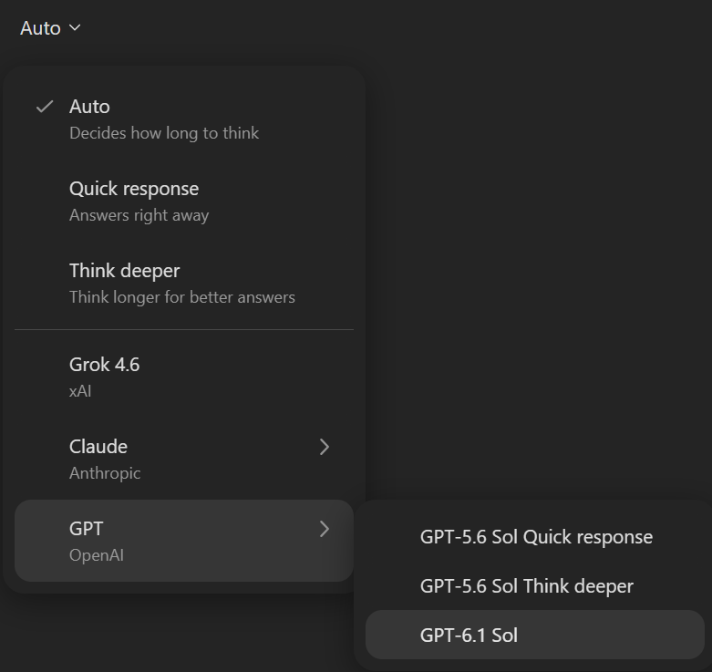
GPT-6.1 Sol is available in Microsoft Copilot
MC1483844
OpenAI's GPT-6.1 Sol gives users another model option for how they delegate work to Copilot.
Cowork and Studio — Available with usage-based billing in Copilot Cowork and Copilot Studio.
Everyday Apps — Rolling out in phases across Word, Excel, PowerPoint, and Chat as part of the user subscription license, with limits.
Clear Usage Limits — Users are warned near a limit and can switch to Auto or select another model.
September Rollout — Began rolling out on September 30; the Office apps and Chat follow in the coming week.
OpenAI GPT-6.1 Sol
Available today: OpenAI's GPT-6.1 Sol and Claude Sonnet 5.5 in Microsoft Copilot
Notes:
GPT-6.1 Sol continues the expansion of model choice in Copilot, following Claude Opus 5.5 and GPT-6 Sol earlier in the month. It begins rolling out with usage-based billing in Copilot Cowork and Copilot Studio, and in phases across Word, Excel, PowerPoint, and Chat in the coming week as part of the user subscription license. Limits apply but are designed so the vast majority of users do not reach them; users are warned as they approach a limit and can switch to Auto or select another model. Work IQ grounds the model in the organization's files, meetings, chats, and business data.
Source: Available today: OpenAI's GPT-6.1 Sol and Claude Sonnet 5.5 in Microsoft Copilot — https://techcommunity.microsoft.com/blog/microsoft-copilot-blog/available-today-openais-gpt-6-1-sol-and-claude-sonnet-5-5-in-microsoft-copilot/4560801
MC ID: 1483844

Slide 17
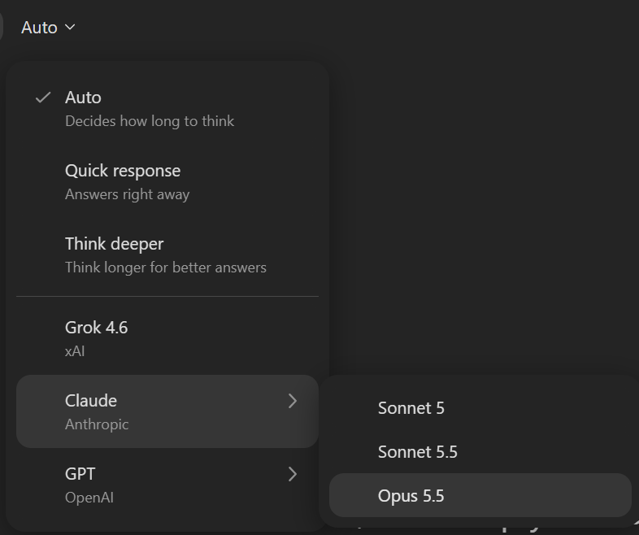
Claude Opus 5.5 is available in Microsoft Copilot
MC1483844
Anthropic's Claude Opus 5.5 joins model choice in Microsoft Copilot, so users can pick the model that best fits the work.
Broad Availability — Rolling out across Word, Excel, PowerPoint, Chat, Cowork, and Copilot Studio.
Task-Fit Choice — Users can choose among multiple frontier models, since no single model is ideal for every task.
Work IQ Grounding — Responses draw on the organization's files, meetings, chats, and business data.
September Rollout — Began rolling out on September 22; availability may vary by license, access, and region.
Claude Opus 5.5
More Models, One Copilot
Notes:
Anthropic's Claude Opus 5.5 is rolling out to Microsoft Copilot across Word, Excel, PowerPoint, Chat, Cowork, and Copilot Studio. Microsoft is expanding model choice so customers can benefit from the strengths of different models in a familiar, enterprise-ready experience, because no single model is ideal for every task. Through Work IQ, Copilot grounds responses in the organization's files, meetings, chats, and business data. Rollout began on September 22, and availability may vary by license, access, and region.
Source: More Models, One Copilot — https://techcommunity.microsoft.com/blog/microsoft-copilot-blog/more-models-one-copilot/4559035
MC ID: 1483844

Slide 18
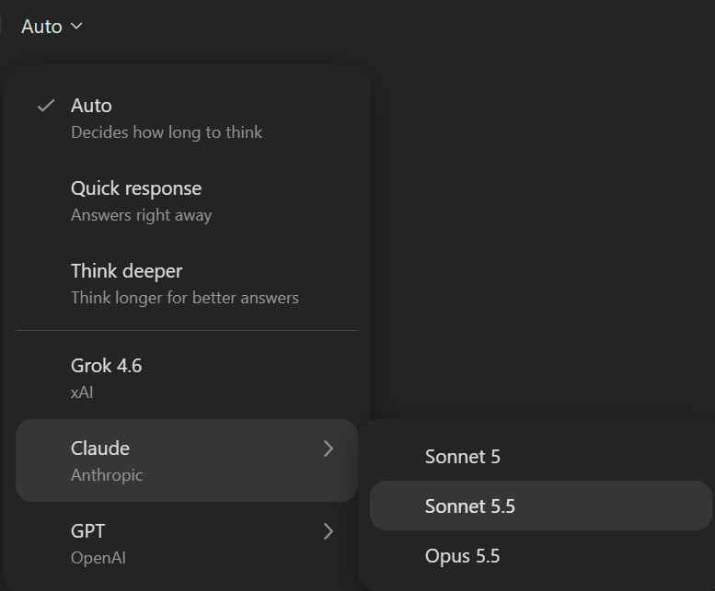
Claude Sonnet 5.5 is available in Microsoft Copilot
MC1483844
Anthropic's Claude Sonnet 5.5 adds more model choice in Copilot for both delegated and everyday work.
Cowork and Studio — Available with usage-based billing in Copilot Cowork and Copilot Studio.
Everyday Apps — Rolling out in phases across Word, Excel, PowerPoint, and Chat under the user subscription license, with limits.
Flexible Switching — Near a limit, users can switch to Auto or choose another model to keep working.
September Rollout — Began rolling out on September 30; the Office apps and Chat follow in the coming week.
Claude Sonnet 5.5
Available today: OpenAI's GPT-6.1 Sol and Claude Sonnet 5.5 in Microsoft Copilot
Notes:
Claude Sonnet 5.5 arrives in Microsoft Copilot together with GPT-6.1 Sol, giving users more options for how they delegate work. It begins rolling out with usage-based billing in Copilot Cowork and Copilot Studio, and will roll out in phases across Word, Excel, PowerPoint, and Chat in the coming week as part of the user subscription license. Limits apply, users are warned as they approach them, and they can switch to Auto or select another model. Availability and usage may vary by license, access, and region.
Source: Available today: OpenAI's GPT-6.1 Sol and Claude Sonnet 5.5 in Microsoft Copilot — https://techcommunity.microsoft.com/blog/microsoft-copilot-blog/available-today-openais-gpt-6-1-sol-and-claude-sonnet-5-5-in-microsoft-copilot/4560801
MC ID: MC1483844

Slide 19
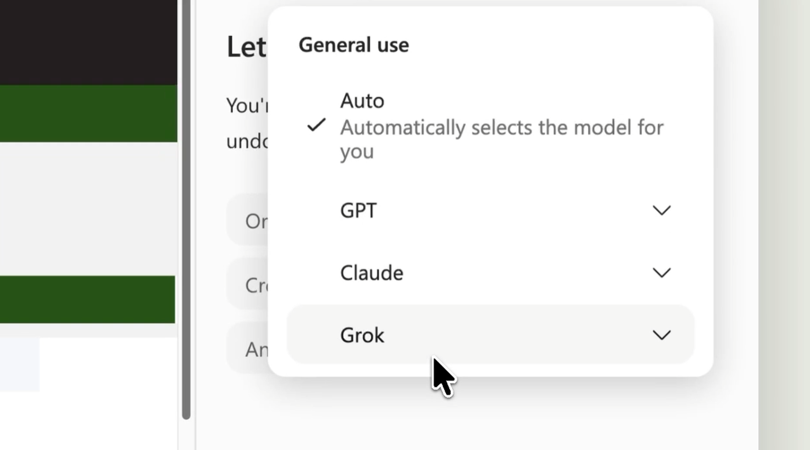
Expanding model choice in Copilot with Grok
Copilot expands model choice with Grok models from SpaceXAI in Word, Excel, and PowerPoint, with access controlled by admins.
Expanded Model Choice — Grok models from SpaceXAI join Copilot in Word, Excel, and PowerPoint.
Admin Opt-In — A dedicated admin setting, disabled by default, must be enabled before users can access SpaceXAI models.
Data Transparency — SpaceXAI is added to Microsoft's Online Services Subprocessor List, so admins keep visibility of data processing.
Frontier Preview — Rolling out through the Frontier program; not available in the EU, EFTA, and UK during the preview.
Grok models in Word, Excel, and PowerPoint
Expanding model choice in Copilot with Grok
Notes:
Microsoft is expanding model choice in Copilot with Grok models from SpaceXAI, and SpaceXAI has been added to the Online Services Subprocessor List. Access is managed through a dedicated administrative setting that is disabled by default, so organizations enable it first and admins keep transparency and control over the data processed. Grok is rolling out through the Microsoft Frontier program in Word, Excel, and PowerPoint as a focused release to gather feedback, and is not available to Frontier customers in the EU, EFTA, and the UK during the preview. Microsoft will evaluate feedback, usage, and product fit before broadening availability.
Source: Expanding model choice in Copilot with Grok — https://techcommunity.microsoft.com/blog/microsoft-copilot-blog/expanding-model-choice-in-copilot-with-grok/4555749

Slide 20
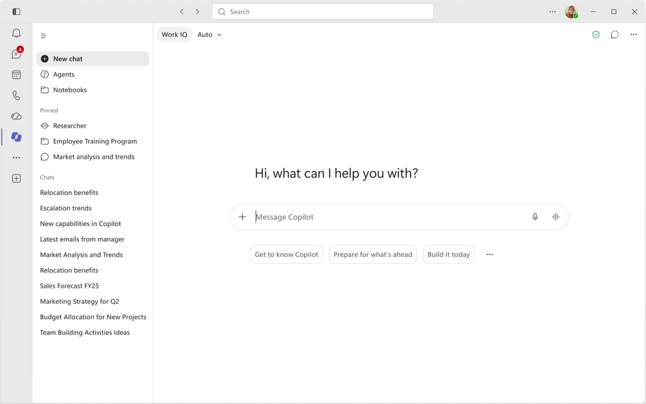
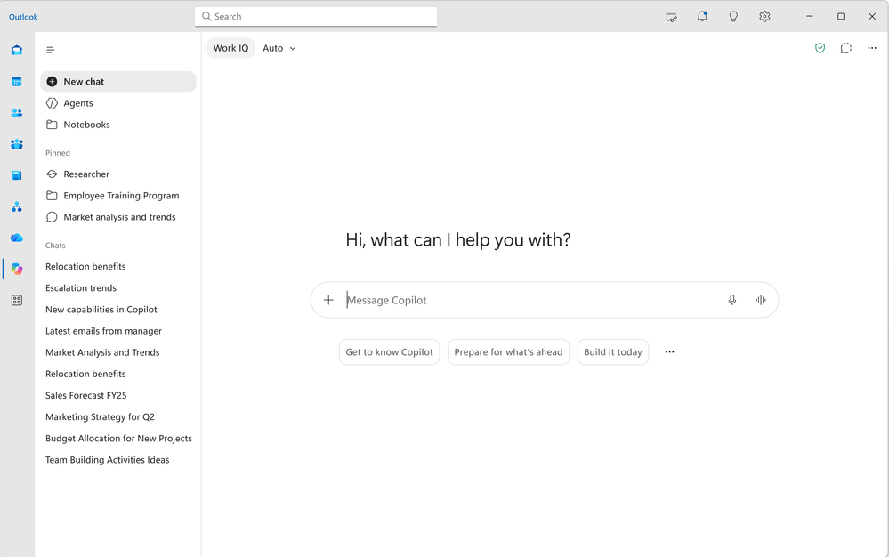
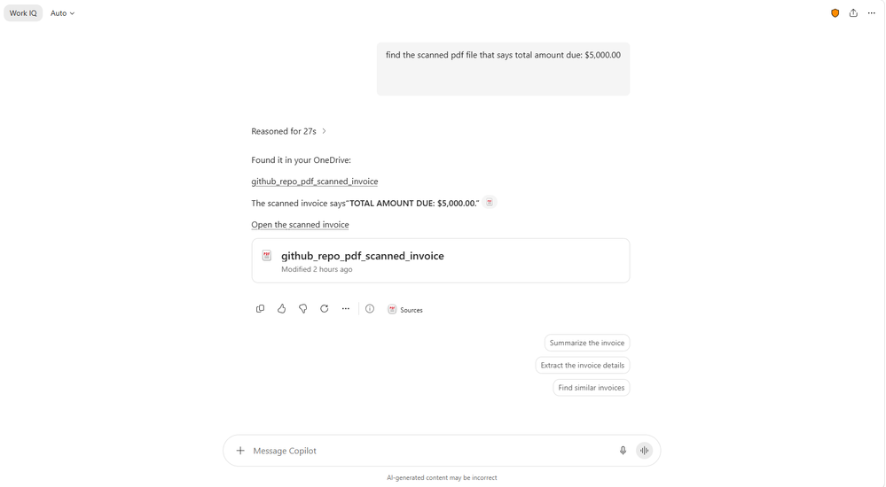
New design, inline agents and skills, and PDF search for Copilot Chat
Copilot Chat gets a refreshed design and faster ways to bring in agents, skills, and file content.
Refreshed Design — Copilot in Teams and Outlook aligns with the Copilot app, simplifying navigation in full screen and the side pane.
Inline Agents, Skills — Type '/' for agents or '@' for skills to compose prompts in one continuous flow.
Scanned PDF Search — Copilot Chat better matches search results from scanned PDFs, so information surfaces faster.
September Rollout — All three rolled out in September.
Refreshed Copilot Chat
What's New in Microsoft Copilot | September 2026
Notes:
Copilot experiences in Teams and Outlook get a refreshed look aligned with the broader Copilot app, simplifying navigation, streamlining chat, and adding new ways to organize work, in both the full-screen experience and the side pane. Users can also bring agents and skills directly into prompts by typing '/' for agents or '@' for skills, so they can compose prompts in one continuous flow. Copilot Chat now better matches search results from scanned PDFs, reducing time spent searching manually through documents. All three rolled out in September.
Source: What's New in Microsoft Copilot | September 2026 — https://techcommunity.microsoft.com/blog/microsoft-copilot-blog/what%E2%80%99s-new-in-microsoft-copilot--september-2026/4559107
MC ID (scanned PDF search): 559613

Slide 21
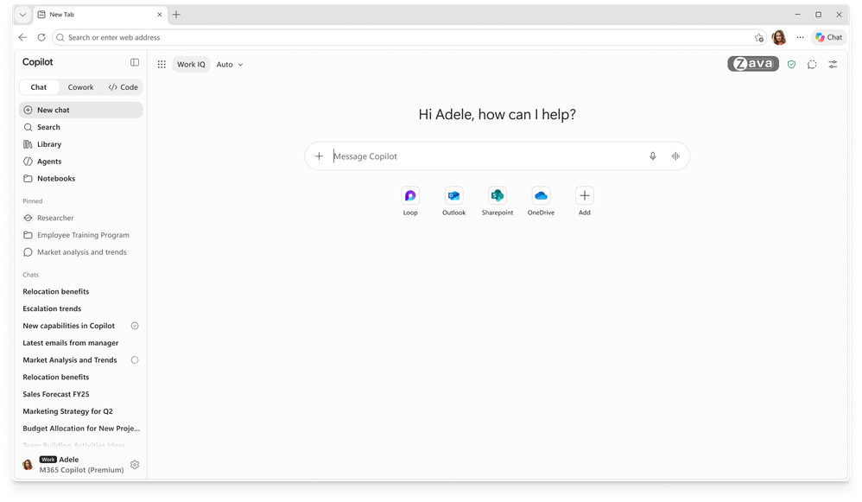
The Copilot new tab page in Edge brings search, chat, and web together
The upgraded Copilot new tab page in Edge combines search, chat, and web exploration in a single search box.
Single Search Box — Search, chat, and web exploration start from one place.
Suggested Next Steps — Copilot-suggested actions and curated work content sit alongside the search box.
Faster Task Switching — Users move to the next task without hunting for the right entry point.
October Rollout — Rolls out in October.
Copilot new tab page in Edge
What's New in Microsoft Copilot | September 2026
ID 566703 | MC1440972
Notes:
The upgraded Copilot new tab page in Edge brings search, chat, and web exploration together in a single search box. Copilot-suggested actions and curated work content sit alongside it. This helps users move to the next task without hunting for the right entry point. The feature rolls out in October. Source: What's New in Microsoft Copilot | September 2026 — https://techcommunity.microsoft.com/blog/microsoft-copilot-blog/what%E2%80%99s-new-in-microsoft-copilot--september-2026/4559107
Link title: What's New in Microsoft Copilot | September 2026
Link URL: https://techcommunity.microsoft.com/blog/microsoft-copilot-blog/what%E2%80%99s-new-in-microsoft-copilot--september-2026/4559107
Roadmap ID: 566703
MC ID: MC1440972

Slide 22
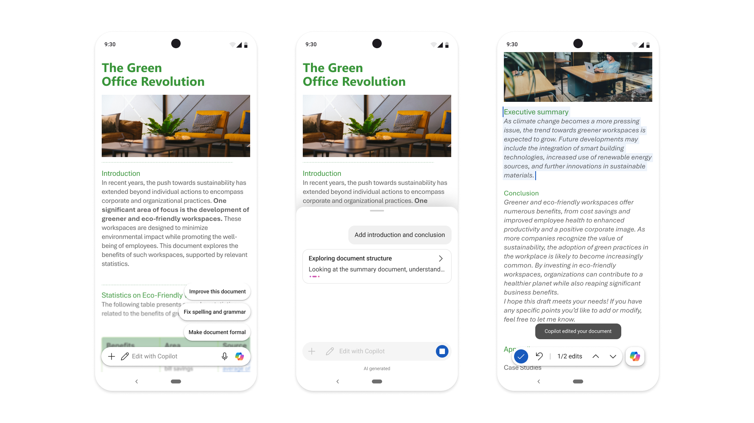
Copilot-powered editing in Word, PowerPoint, and Excel is available on Android
ID 518290
Copilot-powered editing in Word, PowerPoint, and Excel comes to Android, so users can make changes with Copilot on the go.
Mobile Editing — Users make changes with Copilot in Word, PowerPoint, and Excel on Android devices.
Productive Anywhere — A more seamless editing experience makes it easier to stay productive away from the desk.
September Rollout (Android) — Rolled out on Android in September, following iOS earlier this year.
Copilot on Android
What's New in Microsoft Copilot | September 2026
Notes:
Copilot in Word, PowerPoint, and Excel on Android brings Copilot-powered editing to mobile devices. Users can make changes with Copilot wherever they are working. This creates a more seamless editing experience and makes it easier to stay productive on the go.
The feature rolled out on iOS earlier this year and on Android in September.
Source: What's New in Microsoft Copilot | September 2026 — https://techcommunity.microsoft.com/blog/microsoft-copilot-blog/what%E2%80%99s-new-in-microsoft-copilot--september-2026/4559107
Roadmap ID 518290

Slide 23
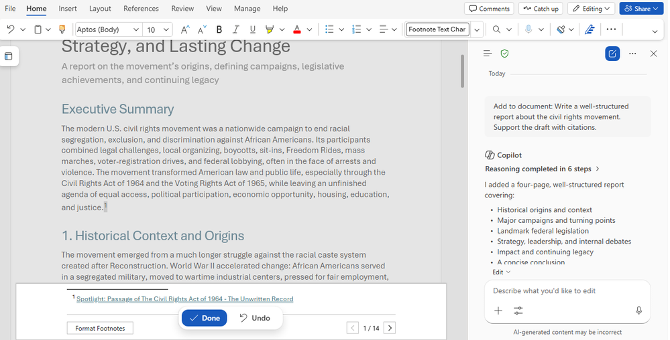
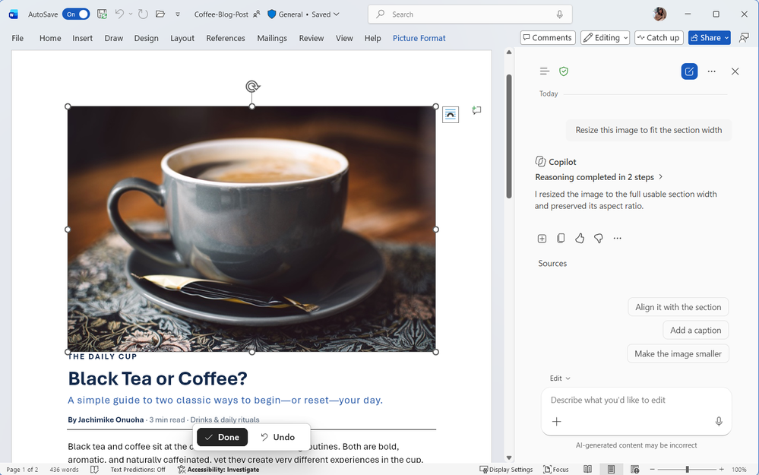
Citations and image modifications for Copilot in Word
Copilot in Word shows where its answers come from and helps users lay out images and shapes with less effort.
Response Citations — Users see citations to relevant web and work content in Copilot's responses, for more transparency.
Images and Shapes — Copilot helps arrange and modify images and shapes for polished, well-organized layouts.
September Rollout — Both rolled out in September.
Copilot in Word
What's New in Microsoft Copilot | September 2026
Notes:
Citations in Copilot responses in Word let users see the sources behind Copilot's answers, with citations to relevant web and work content directly in the response, so they understand where the information comes from. Users can also arrange and modify images and shapes directly within Word documents, and Copilot makes it easier to create layouts where visual elements look polished and well organized. This helps users create professional-looking documents with less manual effort. Both features rolled out in September.
Source: What's New in Microsoft Copilot | September 2026 — https://techcommunity.microsoft.com/blog/microsoft-copilot-blog/what%E2%80%99s-new-in-microsoft-copilot--september-2026/4559107

Slide 24
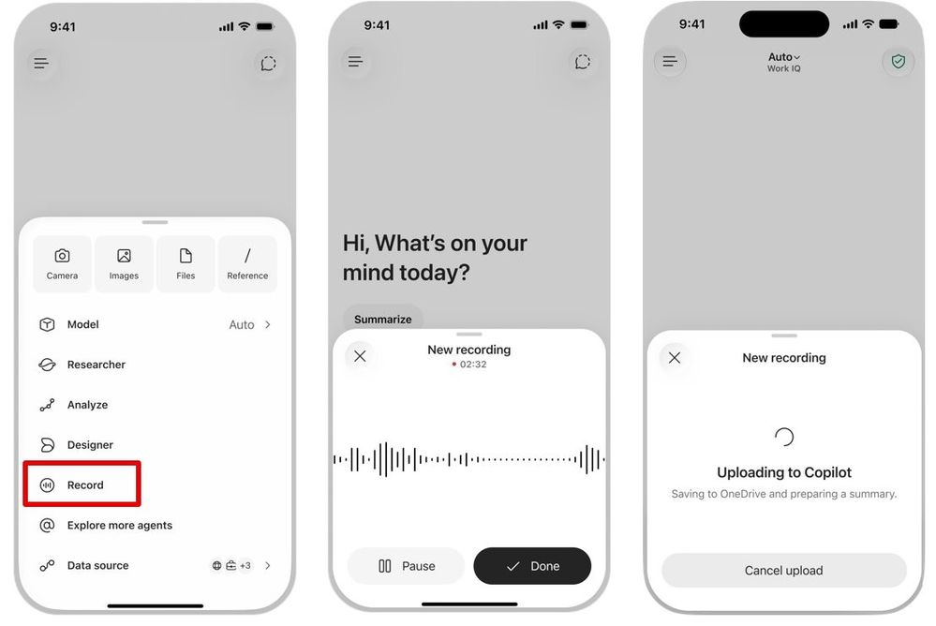
Record in the Copilot mobile app turns conversations into content
ID 498640
Record in the Microsoft Copilot mobile app captures in-person conversations and voice notes and turns them into content users can act on.
Mobile Capture — Record hallway conversations, customer visits, and ideas from the mobile app.
Transcript and Summary — Copilot Chat provides an AI-generated transcript and summary of the recording.
Follow-Up Actions — Ask follow-up questions, extract action items, or keep working with the content in Copilot.
September Rollout — Rolled out in September.
Record in the Copilot mobile app
What's New in Microsoft Copilot | September 2026
Notes:
With Record in the Microsoft Copilot mobile app, users can capture in-person conversations and voice notes on the go. Record brings real-world audio into Copilot and provides an AI-generated transcript and summary in Copilot Chat, preserving conversations that might otherwise get lost. Users can then ask follow-up questions, extract action items, or continue working with the content directly in Copilot.
The feature rolled out in September.
Source: What's New in Microsoft Copilot | September 2026 — https://techcommunity.microsoft.com/blog/microsoft-copilot-blog/what%E2%80%99s-new-in-microsoft-copilot--september-2026/4559107
Roadmap ID: 498640
MC ID: MC1437679

Slide 25
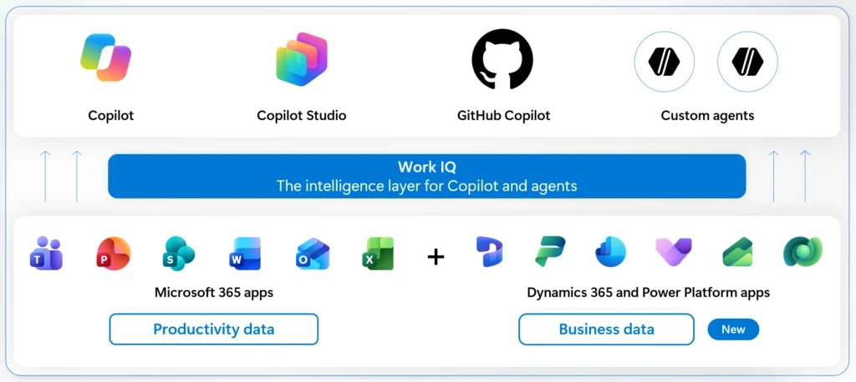
Work IQ grounds Copilot in Dynamics 365 and Power Platform data
Copilot can now reason across business data from Dynamics 365 and Power Platform, so users ask about the business instead of navigating apps.
Ask the Business — Ask in Copilot Home which renewals need attention and get one answer across systems of record.
Shared Business Understanding — Semantic models use views, forms, relationships, and a glossary for more accurate, consistent answers.
Linked Sources — Responses bring data together and link back to the underlying records.
Public Preview — Available in preview from September 30, with rollout continuing through October.
Work IQ business data grounding
Work IQ: Business and workplace intelligence in the flow of work
Notes:
Work IQ now grounds Microsoft Copilot and agents in core business data from Dynamics 365 and Power Platform, with business applications remaining the systems of record. A sales lead can start in Copilot Home and ask which renewals need attention; Copilot connects the opportunity across Dynamics 365 Sales, Customer Service, and custom apps, plus emails and Teams meetings, and links to the underlying sources. Semantic models combine a focused data scope, semantic indexing, and business logic from views, forms, relationships, and a glossary for faster, more accurate, and consistent answers. It is available in preview starting September 30, with rollout continuing through October; Finance and Operations apps roll out in late October. Also covered in Introducing the new Copilot with Home, Code and Autopilot.
Source: Work IQ: Business and workplace intelligence in the flow of work — https://www.microsoft.com/en-us/dynamics-365/blog/it-professional/2026/09/25/work-iq-business-and-workplace-intelligence-in-the-flow-of-work/

Slide 26
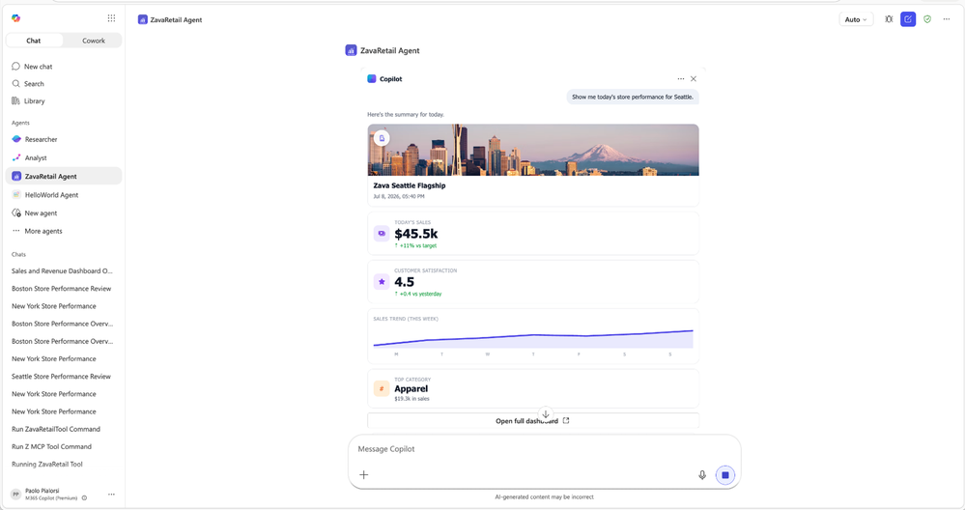
SharePoint Framework apps and SharePoint tools in Work IQ for Copilot
SharePoint content and apps become more actionable inside Copilot, with interactive UI and new tools in Work IQ.
Interactive SPFx UI — Apps built with SharePoint Framework can show interactive UI in Copilot chat, so users act without leaving the conversation.
SharePoint Work IQ Tools — SharePoint content and action tools let Copilot use SharePoint content intelligence and act on content.
Frontier Rollout — Both are rolling out to Frontier in September.
SharePoint in Work IQ
What's New in Microsoft Copilot | September 2026
Notes:
Apps built with SharePoint Framework can now include interactive UI directly in Copilot chat as UX components, so users can view information, interact with controls, and take action without leaving the conversation. SharePoint content and action tools are also coming to Work IQ, enabling Copilot to use SharePoint content intelligence and take action on that content.
Both features are rolling out to Frontier in September.
Source: What's New in Microsoft Copilot | September 2026 — https://techcommunity.microsoft.com/blog/microsoft-copilot-blog/what%E2%80%99s-new-in-microsoft-copilot--september-2026/4559107

Slide 27
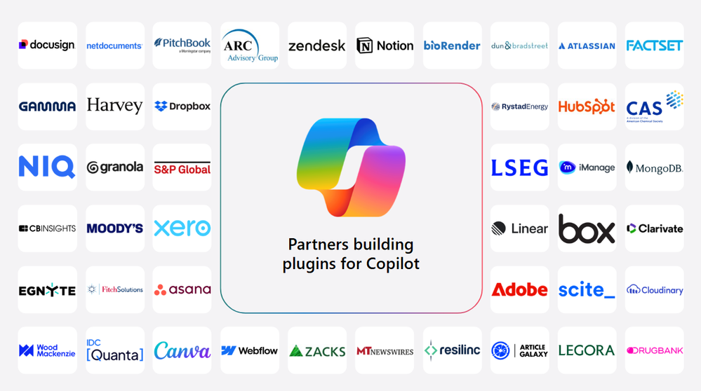
New connectors and plugins
New connectors, plugins, and agents bring business data and industry knowledge into everyday Copilot workflows.
Industry Connectors — New options across manufacturing, financial services, healthcare and life sciences, energy, HR, software, and retail.
100+ Plugins — More than 100 plugins are available, covering finance, sales, project management, creative work, and more.
Familiar Business Tools — Plugins connect Copilot to services such as HubSpot, Asana, Canva, Notion, and MongoDB.
September Rollout — Available now; some connectors are still rolling out.
New connectors and plugins
What's New in Microsoft Copilot | September 2026
Notes:
New connectors, plugins, and agents help users get more value from Copilot by bringing business data and industry knowledge into everyday workflows. This month's additions include Autodesk for manufacturing; Morningstar Credit Analytics, S&P Global Kensho, and D&B for financial services; PubMed, DrugBank, and BioRender for healthcare and life sciences; Rystad Energy; TechWolf for HR; Webflow; and NielsenIQ for retail. The plugin registry post adds that more than 100 plugins are already available, connecting Copilot to services such as HubSpot, Linear, Atlassian, Asana, Webflow, Canva, Notion, MongoDB, IDC, NielsenIQ, and CAS. Some connectors are still in the process of rolling out. Also covered in Introducing the plugin registry - one place to discover and govern plugins for Microsoft Copilot.
Source: What's New in Microsoft Copilot | September 2026 — https://techcommunity.microsoft.com/blog/microsoft-copilot-blog/what%E2%80%99s-new-in-microsoft-copilot--september-2026/4559107

Slide 28
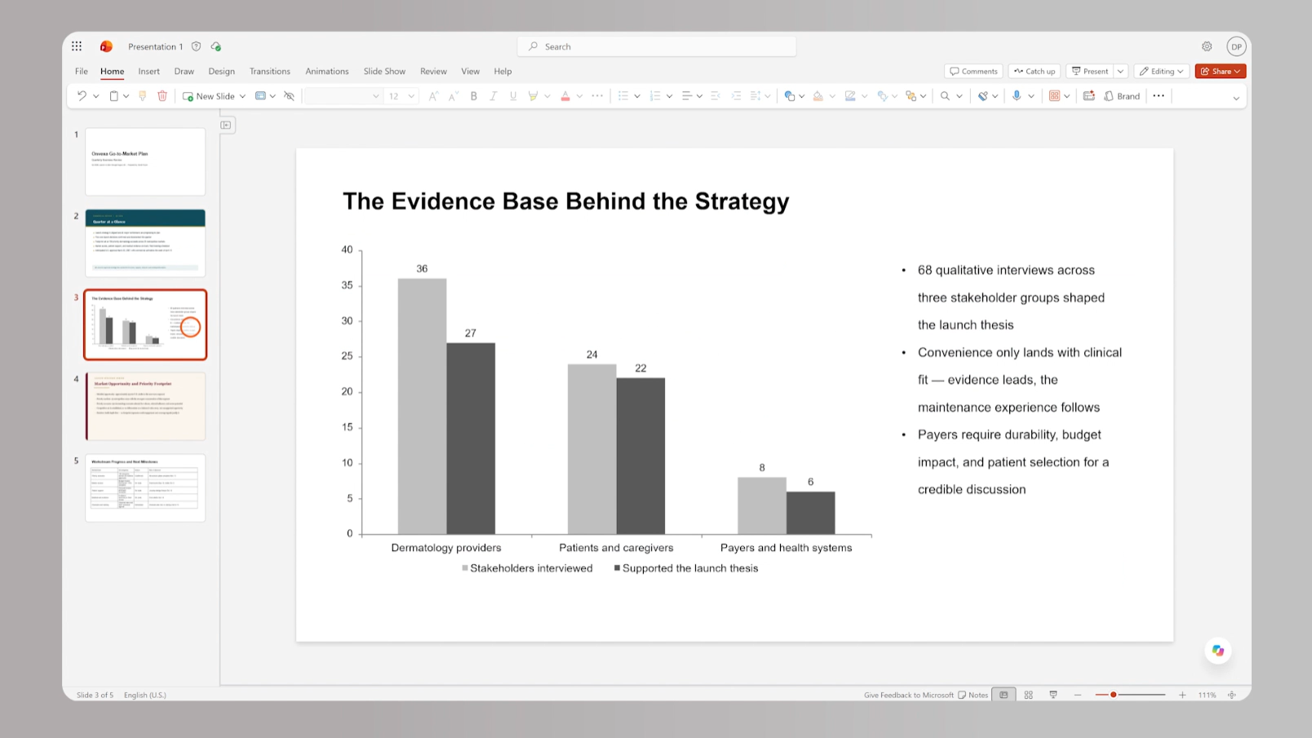
Brand Kit, brand adherence, and brand skills for Copilot in PowerPoint
Brand Kit helps Copilot in PowerPoint start every presentation with the organization's look and ways of working.
Brand Kit — Copilot uses approved templates, imagery, icons, and fonts from the start, not as a cleanup pass.
Stricter Brand Adherence — A stricter mode follows approved layouts, and brand managers can add slide-by-slide direction.
Brand Kit Skills — Brand managers can include reusable Skills alongside visual guidance (rolls out in October).
Rollout Timing — Brand Kit is generally available with a Microsoft 365 Copilot license; Skills in Brand Kit arrive in October.
Learn more
Brand Kit in PowerPoint
Brand Kit and Skills in Copilot in PowerPoint
Notes:
Brand Kit brings the organization's templates, imagery, icons, fonts, and other assets into PowerPoint creation; users choose an approved Brand Kit and Copilot draws on its templates and assets as it builds or updates slides. For regulated presentations, a stricter brand adherence mode makes Copilot follow approved layouts instead of suggesting creative ones, and brand managers can add slide-by-slide direction that lives inside the Brand Kit. Per the September monthly post, brand managers can also include Skills that capture repeated team processes alongside guidance on how presentations should look; this rolls out in October.
Brand Kit in PowerPoint is generally available with a Microsoft 365 Copilot license.
Source: Brand Kit and Skills in Copilot in PowerPoint — https://techcommunity.microsoft.com/blog/microsoft-copilot-blog/brand-kit-and-skills-in-copilot-in-powerpoint/4554932
Roadmap ID (Skills in Brand Kit): 569018

Slide 29
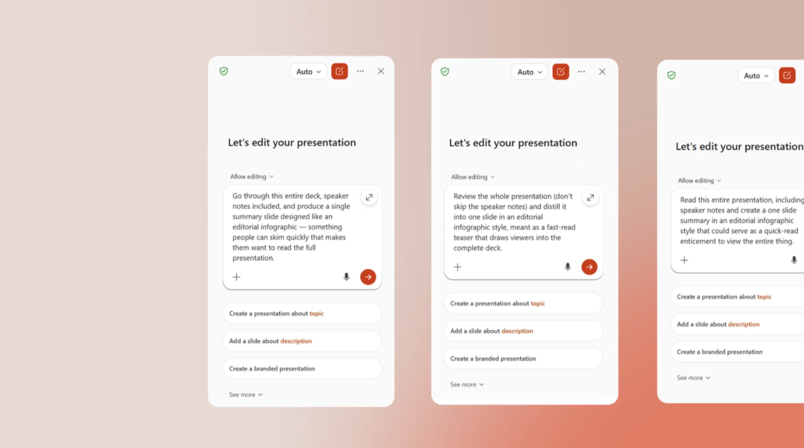
Prebuilt, custom, and organization Skills for Copilot in PowerPoint
Skills package multi-step presentation workflows into reusable capabilities, so users get consistent results without rebuilding prompts.
Custom Skills — Users call on a Skill to guide Copilot through each step instead of prompting step by step.
Prebuilt Skills — Ready-made Skills such as Explain this presentation and Sharpen slide titles refine decks quickly.
Organization Skills — Admins publish approved Skills to users, groups, or the whole organization.
September Rollout — All three rolled out in September.
Skills in PowerPoint
What's New in Microsoft Copilot | September 2026
Notes:
Skills in Copilot for PowerPoint package multi-step workflows into reusable capabilities, so users call on a Skill instead of rebuilding the process prompt by prompt, producing more cohesive presentations. Prebuilt Skills cover common tasks: Explain this presentation assesses narrative, audience fit, and flow, and Sharpen slide titles rewrites titles to summarize each slide; the Brand Kit post also lists Prepare for Questions, Review Presentation, and Visualize Slide. Administrators can publish approved Skills to specific users, groups, or the entire organization, so workflows are available without each person creating or uploading them. These rolled out in September.
Source: What's New in Microsoft Copilot | September 2026 — https://techcommunity.microsoft.com/blog/microsoft-copilot-blog/what%E2%80%99s-new-in-microsoft-copilot--september-2026/4559107

Slide 30
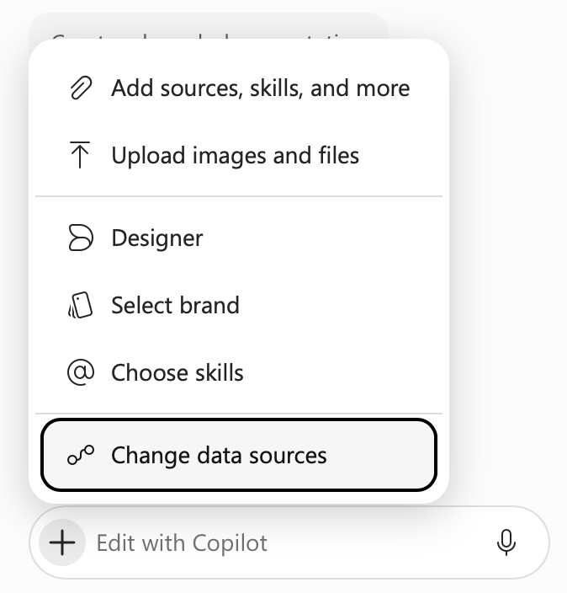
Connectors and long-running tasks for Copilot in PowerPoint
Copilot in PowerPoint brings in information from connected sources and keeps working on long tasks while users move on.
Connectors in PowerPoint — Users bring information from the apps and sources they already use into their slides (rolled out in September).
Long-Running Tasks — Copilot keeps working after users leave PowerPoint, switch devices, or go offline, and notifies them when done (rolls out in October).
Rollout Timing — Connectors rolled out in September; long-running tasks roll out in October.
Connectors and long-running tasks
What's New in Microsoft Copilot | September 2026
Notes:
Connectors in Copilot for PowerPoint let users bring information from the apps and sources they already work with into their presentations, so decks are grounded in the information they use across their work. Copilot in PowerPoint can also continue working on long-running tasks after users leave PowerPoint, switch devices, go offline, or end their workday. Notifications let users know when Copilot has finished or needs attention, giving more flexibility across desktop, web, and mobile.
Connectors rolled out in September and long-running tasks roll out in October.
Source: What's New in Microsoft Copilot | September 2026 — https://techcommunity.microsoft.com/blog/microsoft-copilot-blog/what%E2%80%99s-new-in-microsoft-copilot--september-2026/4559107

Slide 31
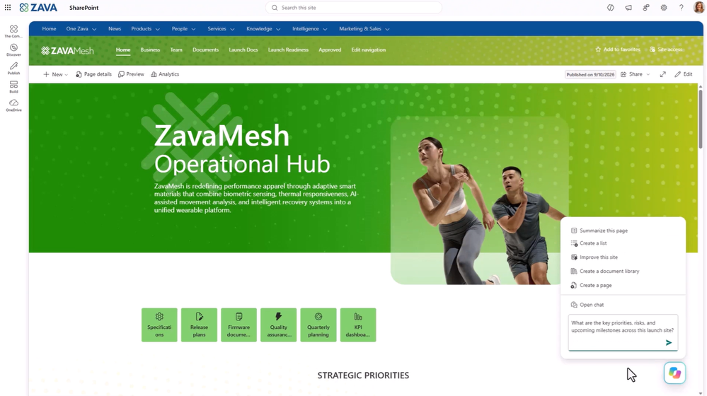
Copilot in SharePoint GA and Copilot Search as the default search
ID 501451
Copilot in SharePoint helps teams create, organize, and understand content, and Copilot Search becomes the default search in SharePoint and OneDrive.
Copilot in SharePoint — Create and organize content, ask grounded questions, generate images, run site analytics, and autofill metadata.
Copilot Search Default — Natural-language questions return grounded answers from content users are authorized to access.
Rollout Timing — Copilot in SharePoint rolled out in September; Copilot Search as default is rolling out to Frontier in September.
Copilot in SharePoint
What's New in Microsoft Copilot | September 2026
Notes:
Copilot in SharePoint is generally available and helps teams create and organize content, ask questions grounded in SharePoint, enrich libraries with AI-generated metadata, and build reusable skills for repeatable business processes. Advanced capabilities in sites and libraries include image generation and editing, AI-generated site analytics reports, and near real-time metadata autofill. Copilot Search is also becoming the default search experience across SharePoint and OneDrive, combining natural language understanding, semantic retrieval, and AI-generated answers grounded in content users are authorized to access.
Copilot in SharePoint rolled out in September; Copilot Search as default is rolling out to Frontier in September.
Source: What's New in Microsoft Copilot | September 2026 — https://techcommunity.microsoft.com/blog/microsoft-copilot-blog/what%E2%80%99s-new-in-microsoft-copilot--september-2026/4559107
MC1311968

Slide 32
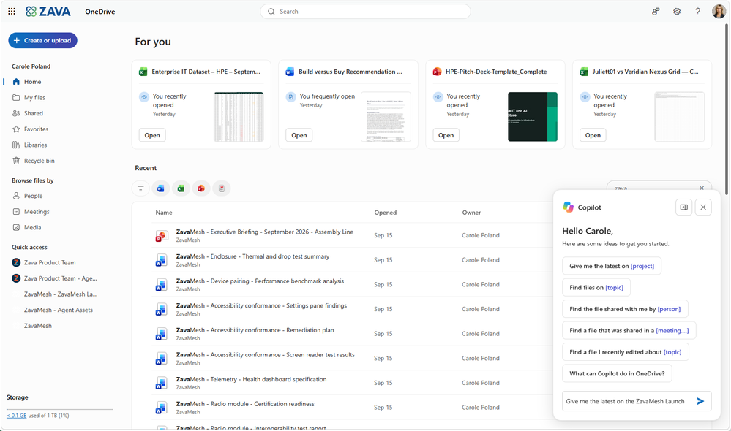
Copilot in OneDrive is generally available on a new foundation
Copilot in OneDrive has been rebuilt on the same foundation as Copilot in SharePoint for a consistent experience wherever files live.
Consistent Experience — Shared foundation with Copilot in SharePoint for creating content and organizing information.
Work With Files — Users work with files the same way wherever their content lives.
Aligned Licensing — Copilot in OneDrive follows the same licensing approach as Copilot in SharePoint.
September Rollout — Updated capabilities rolled out in September.
Copilot in OneDrive
What's New in Microsoft Copilot | September 2026
Notes:
Copilot in OneDrive has been rebuilt on the same foundation as Copilot in SharePoint. This creates a more consistent experience for creating content, organizing information, and working with files wherever content lives. Copilot in OneDrive follows the same licensing approach as Copilot in SharePoint.
The updated capabilities rolled out in September.
Source: What's New in Microsoft Copilot | September 2026 — https://techcommunity.microsoft.com/blog/microsoft-copilot-blog/what%E2%80%99s-new-in-microsoft-copilot--september-2026/4559107

Slide 33
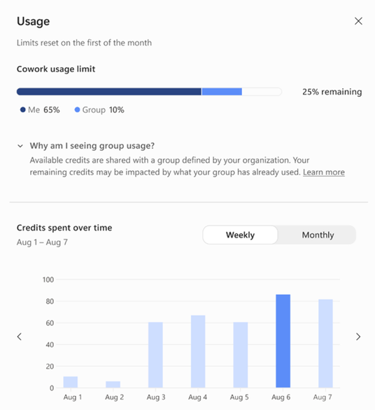
Users can view their credit usage and balances in Copilot
End users can see their own credit usage, remaining balance, and usage history directly in Microsoft Copilot.
Spend Visibility — Credit usage, remaining credits, and usage history are shown in Microsoft Copilot.
Self-Managed Usage — Users manage their own AI usage within organizational guardrails.
Rollout Timing — Announced on September 25 as part of new FinOps for AI capabilities.
Credit usage and balances
New FinOps for AI capabilities: Control spend, measure value, and optimize for impact
Notes:
As part of the new FinOps for AI capabilities, end users can view credit usage, remaining balances, and usage history directly in Microsoft Copilot. This helps them manage their own AI usage within organizational guardrails. It complements the admin cost-management controls covered in the IT admin section.
Source: New FinOps for AI capabilities: Control spend, measure value, and optimize for impact — https://techcommunity.microsoft.com/blog/ai-finops-blog/new-finops-for-ai-capabilities-control-spend-measure-value-and-optimize-for-impa/4559660

Slide 34

Agents

Slide 35
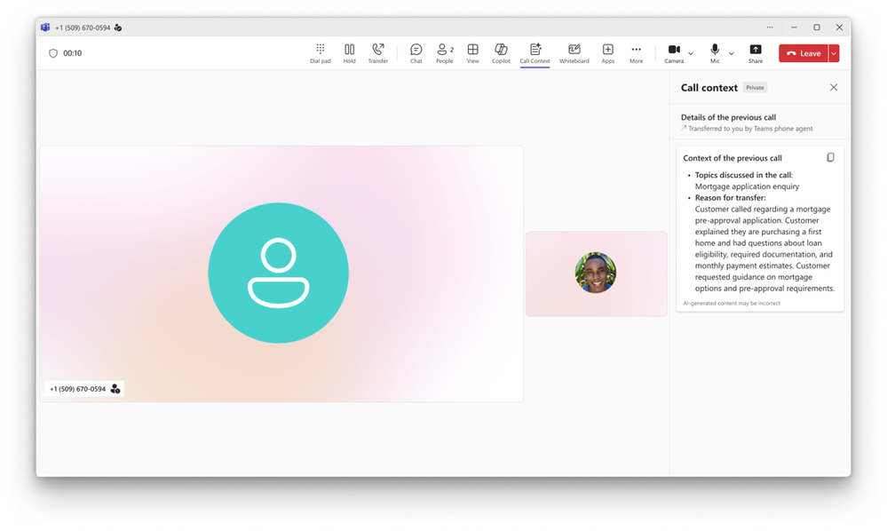
Teams Phone Agent answers and routes customer calls
Copilot helps customers get answers and the right support faster with Teams Phone Agent, an AI-powered calling receptionist.
Handles Repetitive Calls — Answers common questions and books or reschedules appointments, in over 60 languages.
Smart Call Routing — Routes callers to the right department or person with an AI-generated summary of the conversation.
Focus for Employees — Staff in bank branches or IT help desks focus on calls that need a human touch.
September Rollout — Rolled out in September.
Teams Phone Agent
What's New in Microsoft Copilot | September 2026
Notes:
Teams Phone Agent is an AI-powered calling receptionist for customer-facing organizations and departments using Teams Phone, such as bank branches or IT help desks. With support for over 60 languages, it picks up incoming calls to answer common questions or book and reschedule appointments, so employees can focus on conversations that need a human touch. It can also route callers to the right department or employee with an AI-generated summary, so customers do not navigate phone menus or repeat themselves.
The feature rolled out in September.
Source: What's New in Microsoft Copilot | September 2026 — https://techcommunity.microsoft.com/blog/microsoft-copilot-blog/what%E2%80%99s-new-in-microsoft-copilot--september-2026/4559107

Slide 36
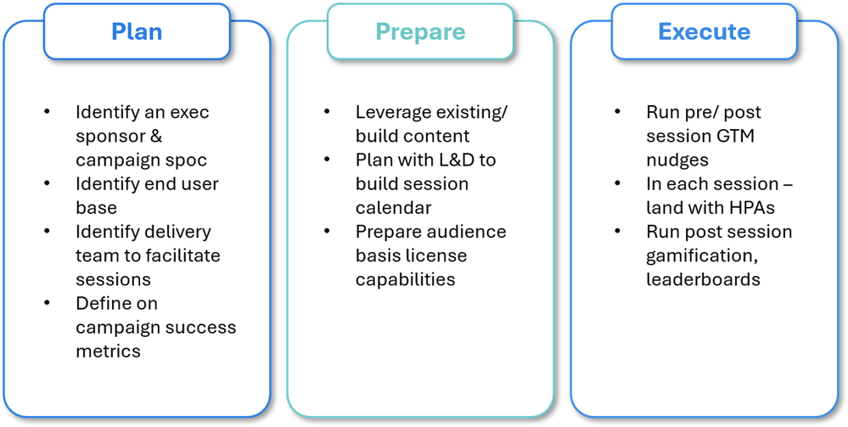
Change management best practices drive Agent Builder adoption
Microsoft shares a practical plan, prepare, and execute approach to scale agent creation and usage with Agent Builder.
Three-Phase Model — Plan with sponsorship and metrics, prepare by clearing access issues, and execute with hands-on co-build sessions.
Makers and Users — Track the Users by creator type metric in the Agents Usage Report in the Microsoft 365 admin center.
Proven at Scale — At HCLTech, active agent users rose from 3,056 to 13,727 during a structured campaign.
Change Management Operating Model
Change Management Best Practices to Drive Value with Agent Builder
Notes:
This is guidance, not a new feature: agent adoption is framed as a change management challenge rather than a technical one, and Agent Builder in Microsoft 365 Copilot lets anyone create an agent with natural language, manual configuration, or templates such as Plan my Day. The suggested operating model has three phases: plan (executive sponsorship, audience segmentation, success metrics such as Users by creator type in the Agents Usage Report), prepare (license and access checks, real-work use cases), and execute (teach by building, with champions and follow-up). HCLTech invited more than 80,000 employees between mid-May and the end of June 2026 and saw active agent users rise from 3,056 to 13,727, a 349% increase. Key takeaways include measuring both makers and users, using champion-led co-build sessions, and securing leadership sponsorship.
Source: Change Management Best Practices to Drive Value with Agent Builder — https://techcommunity.microsoft.com/blog/microsoft-copilot-blog/change-management-best-practices-to-drive-value-with-agent-builder/4559753

Slide 37

IT admin capabilities

Slide 38
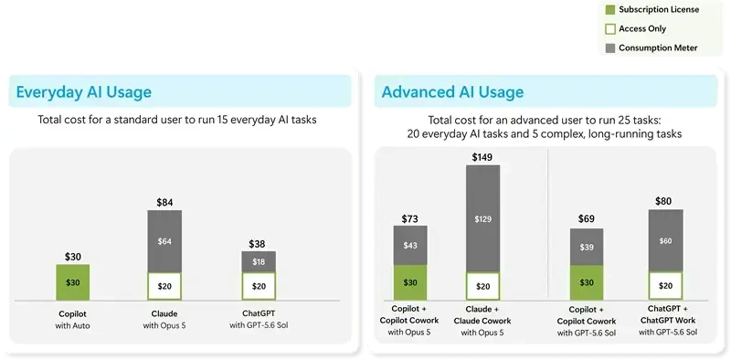
Copilot pricing combines per-user licensing with usage-based billing
Copilot pricing evolves to pair a fixed per-user license for everyday AI with usage-based billing for advanced, agentic work.
Everyday AI — The user subscription license covers Chat, the Office apps, Auto, and model selection, with fair-use limits.
Advanced AI — Cowork, Code, Autopilot, and frontier models like Fable and Astra run on Copilot Credits.
Admin in Control — Usage-based services stay off until an admin creates a spending policy; nothing is billed before then.
Copilot pricing model
Evolution of the Copilot pricing model
Notes:
Copilot pricing is evolving to combine predictable per-user pricing with usage-based pricing. Everyday AI is covered by the Copilot user subscription license, priced per user per month with no change to existing value; Auto routes each request to the best-suited model, model selection is included, and usage limits are set so the vast majority never reach them, with a warning and a choice to switch to Auto or move to credits. Advanced AI, such as Cowork, Code, Autopilot, new advanced SharePoint experiences, and frontier models like Fable and Astra, runs on usage-based billing with Copilot Credits, which builds on the user subscription license.
For enterprise customers, usage-based services stay off until an admin creates a spending policy in the Microsoft 365 admin center.
Also covered in Introducing the new Copilot with Home, Code and Autopilot. Source: Evolution of the Copilot pricing model — https://techcommunity.microsoft.com/blog/microsoft-copilot-blog/evolution-of-the-copilot-pricing-model/4559416

Slide 39
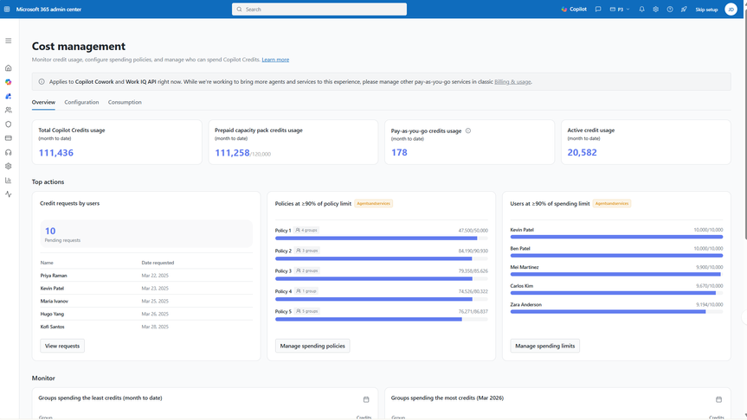
Agent 365 cost management expands to Code and Managed Runtime
Cost management in Agent 365 covers more AI workloads and gives admins programmatic and workflow-based control of spend.
More Workloads — Now covers Code and Copilot Managed Runtime alongside Cowork and Work IQ APIs; Copilot Studio agents follow in October.
Policies via API — Manage spending policies at scale with Microsoft Graph API in your own BI and FinOps tools.
Credit Request Workflows — Route end-user credit requests into existing approval and automation workflows.
Rollout Timing — Rolling out now; Copilot Studio agent support begins in October.
Cost management in Agent 365
New FinOps for AI capabilities: Control spend, measure value, and optimize for impact
Notes:
Expanding beyond Cowork and Work IQ APIs, cost management in Agent 365 now supports Code and Copilot Managed Runtime, and beginning in October will support agents built with Copilot Studio, with more AI workloads to follow. Admins can manage spending policies at scale with Microsoft Graph API in their own business intelligence and FinOps tools. Admins can also route credit requests from end users into existing approval and automation workflows. This builds on the existing foundation of off-by-default usage-based services, tenant, group, and user-level spending controls, departmental billing, and detailed usage reporting.
Also covered in Evolution of the Copilot pricing model and Introducing the new Copilot with Home, Code and Autopilot.
Source: New FinOps for AI capabilities: Control spend, measure value, and optimize for impact — https://techcommunity.microsoft.com/blog/ai-finops-blog/new-finops-for-ai-capabilities-control-spend-measure-value-and-optimize-for-impa/4559660

Slide 40
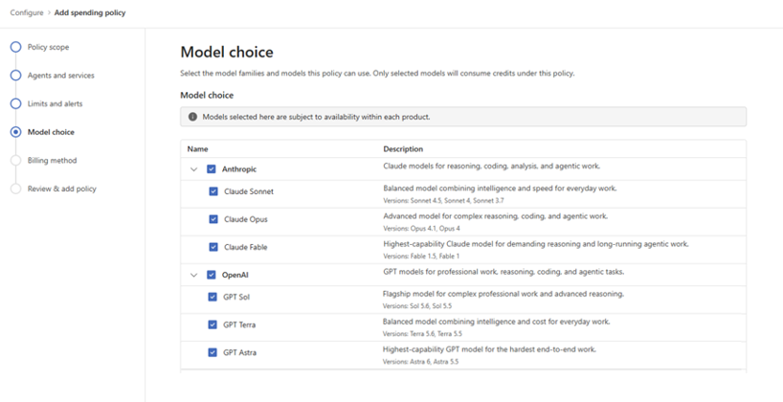
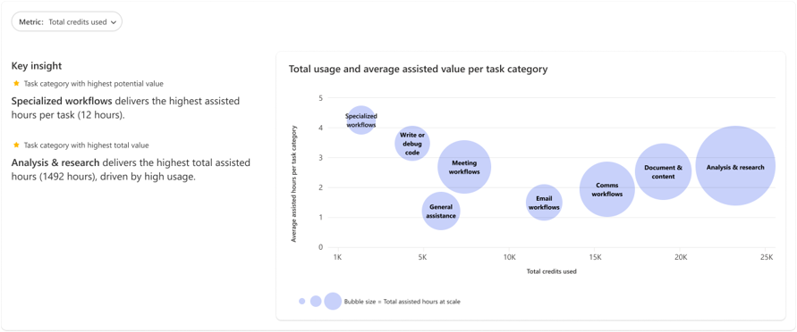
Admins control model access and see Cowork consumption insights
Admins can match model families to user groups and see which Cowork scenarios drive credit consumption and value.
Group Model Access — Set which model families different groups can use; these settings also shape what Auto selects from.
Cowork Consumption Insights — See which scenarios drive credit use and what they produced, to sustain, expand, or optimize.
Rollout Timing — Model access controls are rolling out in Cowork, with plans to expand to more workloads.
Model access and Cowork insights
New FinOps for AI capabilities: Control spend, measure value, and optimize for impact
Notes:
Admins can tailor model family access for different groups of users, matching the right models to the right users or scenarios, and those settings also shape which models Auto can select from. This is rolling out in Cowork, with plans to expand to additional workloads. Consumption insights for Cowork show which scenarios are driving credit consumption and what they produced, so business leaders and admins can decide where to sustain, expand, or optimize usage.
Source: New FinOps for AI capabilities: Control spend, measure value, and optimize for impact — https://techcommunity.microsoft.com/blog/ai-finops-blog/new-finops-for-ai-capabilities-control-spend-measure-value-and-optimize-for-impa/4559660

Slide 41

Copilot Managed Runtime hosts Copilot-built apps in your tenant
Copilot Managed Runtime runs code created with Copilot inside the Microsoft 365 tenant boundary, governed by IT.
Managed Hosting — Microsoft-operated hosting with Entra identity, governed data access, and lifecycle management.
Any Build Tool — Powers apps from Copilot Cowork, Copilot Code, and Copilot Studio, plus SDK-compatible third-party tools.
SDK and CLI — Developers scaffold, preview, deploy, and version apps with Git-backed code and typed connector services.
Public Preview — The host and SDK are in public preview now.
Copilot Managed Runtime
Build where you want, run with confidence: Now Microsoft hosts and manages the code created by Copilot
Notes:
Microsoft Copilot Managed Runtime is an enterprise-grade platform in public preview to run code within the Microsoft 365 tenant boundary, governed by IT, with the sharing, live data connections, and easy access users expect. It already powers apps built in Copilot Cowork, Copilot Code, and Copilot Studio, bringing together Microsoft-operated cloud hosting, Entra identity, organizational policies for connectors and data, Git-based version control, and lifecycle management. The Copilot Managed Runtime SDK and CLI let Microsoft and third-party tools, such as Lovable, scaffold, preview, deploy, and version apps against the host. The host and SDK are in public preview. Also covered in Introducing the new Copilot with Home, Code and Autopilot. Source: Build where you want, run with confidence: Now Microsoft hosts and manages the code created by Copilot — https://www.microsoft.com/en-us/copilot/blog/copilot-studio/build-where-you-want-run-with-confidence-now-microsoft-hosts-and-manages-the-code-created-by-copilot/

Slide 42
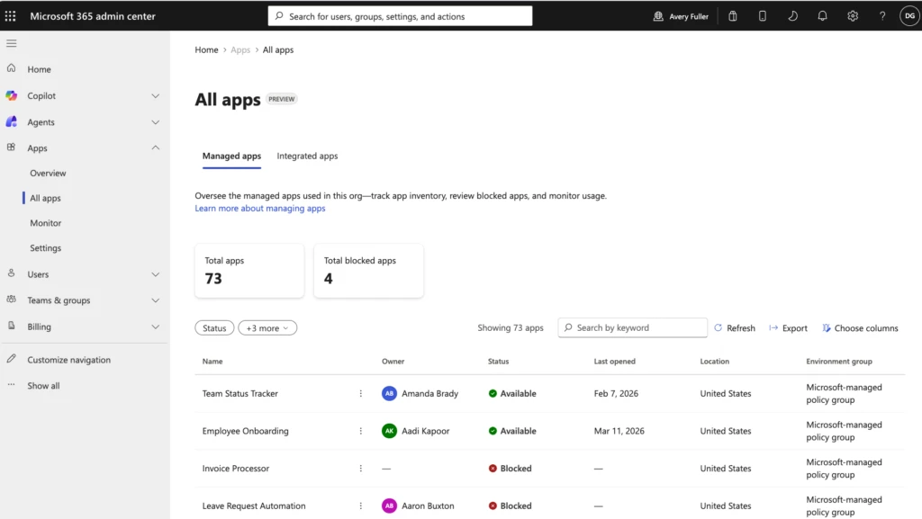
Admins govern Copilot-built apps in the new Apps experience
Apps hosted with Copilot Managed Runtime appear in a central inventory in the Microsoft 365 admin center, wherever they were built.
Central App Inventory — Review access, usage, health, and policy for apps in one place.
One Governance Model — The same controls apply to apps from Cowork, Code, Copilot Studio, or third-party tools.
App Controls — Admins enable or disable apps and review default policies.
Public Preview — Available with the Copilot Managed Runtime public preview.
Apps experience in admin center
Build where you want, run with confidence: Now Microsoft hosts and manages the code created by Copilot
Notes:
Apps hosted with Copilot Managed Runtime appear in the new Apps experience in the Microsoft 365 admin center, giving administrators a central inventory and a consistent place to review access, usage, health, and policy. The same model applies regardless of where the app was built, so IT does not need a separate governance playbook for every creation tool. Administrators can enable and disable apps and review the default policies in the Apps experience. It is part of the Copilot Managed Runtime public preview. Source: Build where you want, run with confidence:
Now Microsoft hosts and manages the code created by Copilot — https://www.microsoft.com/en-us/copilot/blog/copilot-studio/build-where-you-want-run-with-confidence-now-microsoft-hosts-and-manages-the-code-created-by-copilot/

Slide 43
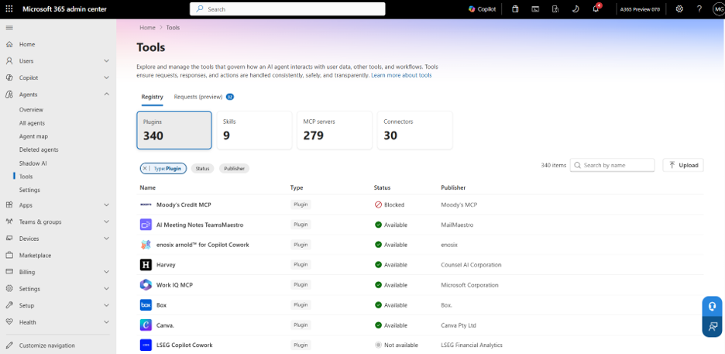
Users discover approved plugins through the new plugin registry
The Microsoft plugin registry brings Microsoft, partner, and custom plugins together, so users find approved skills, connectors, and agents in one place.
Unified Catalog — One catalog of Microsoft, partner, and custom plugins across the Copilot app and Microsoft 365 apps.
New Plugins Page — A consistent Plugins page replaces the Agents page, keeping agents alongside skills and connectors.
Fewer Setup Steps — Users find enabled plugins as they move between Home, Code, Autopilot, and supported apps.
September Rollout — Rolling out now, with general availability across surfaces in the coming weeks.
Control plugin access from one place
Introducing the plugin registry - one place to discover and govern plugins for Microsoft Copilot
Notes:
The Microsoft plugin registry is a unified catalog of Microsoft, partner, and custom-built plugins that work across the Copilot app and Microsoft 365 apps, where plugins bring skills, connectors, and agents to Copilot. Users discover enabled plugins through a consistent Plugins page in Home (Chat and Cowork), Code, Autopilot, and supported Microsoft 365 apps; it replaces and expands the existing Agents page, so agents remain available alongside skills and connectors. This reduces repeated discovery and setup as users move across apps.
The registry is rolling out now, with general availability across surfaces in the coming weeks; admin controls are covered in the IT admin section.
Also covered in What's New in Microsoft Copilot | September 2026 and Introducing the new Copilot with Home, Code and Autopilot.
Source: Introducing the plugin registry - one place to discover and govern plugins for Microsoft Copilot — https://techcommunity.microsoft.com/blog/microsoft-copilot-blog/introducing-the-plugin-registry---one-place-to-discover-and-govern-plugins-for-m/4559682

Slide 44
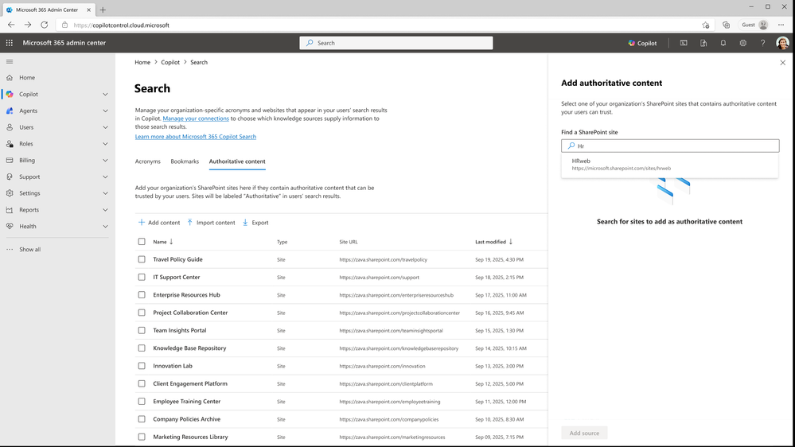
Admins manage authoritative sources for Copilot Search
Admins can designate verified SharePoint sites as authoritative sources to improve the relevance and trustworthiness of Copilot results.
100 Authoritative Sites — Designate up to 100 SharePoint sites as authoritative, official content.
More Trusted Results — Improves the relevance and trustworthiness of Copilot Search and Chat results.
Central Management — View, add, remove, and bulk import or export sources in the Microsoft 365 admin center.
September Rollout — Rolled out in September.
Authoritative sources
What's New in Microsoft Copilot | September 2026
Notes:
Admins can now manage authoritative sources for Copilot Search in the Microsoft 365 admin center. They can designate up to 100 SharePoint sites as authoritative, signaling that the sites contain verified, official content and helping improve the relevance and trustworthiness of Copilot Search and Chat results. From this centralized governance layer, admins can view, add, remove, and bulk import or export authoritative sources.
The feature rolled out in September.
Source: What's New in Microsoft Copilot | September 2026 — https://techcommunity.microsoft.com/blog/microsoft-copilot-blog/what%E2%80%99s-new-in-microsoft-copilot--september-2026/4559107

Slide 45
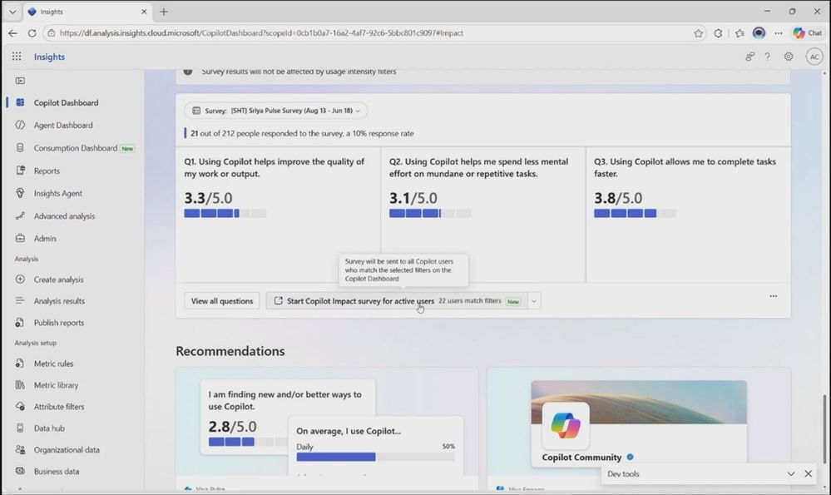
Leaders run targeted surveys in the Copilot Dashboard
Leaders can launch targeted Pulse surveys using dynamic lists to understand Copilot adoption and impact.
Dynamic Survey Lists — Audiences are built from Copilot adoption data and filtered with existing criteria, with no manual lists.
Sentiment Plus Adoption — Combine employee sentiment with adoption insights to find ways to improve impact.
Privacy Preserved — Reporting is aggregated at population level rather than showing individual users.
September Rollout — Rolled out in September.
Targeted surveys in the Copilot Dashboard
What's New in Microsoft Copilot | September 2026
Notes:
Leaders can now launch targeted Pulse surveys in the Copilot Dashboard using dynamic survey lists to understand Copilot adoption and impact. Survey audiences are created dynamically from Copilot adoption data and can be filtered using existing criteria, so there is no need to build and maintain lists manually. Bringing employee sentiment together with adoption insights helps organizations understand how users experience AI and identify ways to improve adoption and impact, while privacy is maintained through aggregated, population-level reporting.
The feature rolled out in September.
Source: What's New in Microsoft Copilot | September 2026 — https://techcommunity.microsoft.com/blog/microsoft-copilot-blog/what%E2%80%99s-new-in-microsoft-copilot--september-2026/4559107

Slide 46
Microsoft Copilot
Public Roadmap
Changes this month
As of 8th Oct 2026
Microsoft 365 Roadmap - See What's Coming | Microsoft 365
Notes:
As of 8th October 2026

Slide 47
Microsoft Copilot Public Roadmap
As of 8th Oct 2026
Launched and Rolling Out “Changed within last month”
Launched (26) 🚀
  Rolling Out (9)
[Copilot Extensibility] Improved discovery of Copilot connector sources in Microsoft 365 Copilot (optionally add chat) with Content Source filter(s)
Overview of recent comments and changes in Word
Dataverse data connected to Microsoft 365 Copilot
Branded footer in the Microsoft 365 Copilot app
Use Copilot Chat after a call in Queues app
Microsoft 365 admin center - Usage reports - Copilot Chat for GCC, GCC High and DoD
Excel Agent
Live subtitles on voice chat in Copilot when using the quick composer
OneNote: Multimodal capture in Copilot Notebooks (Android)
Reference files saved in SharePoint libraries and OneDrive folders when creating a presentation with Agent Mode in PowerPoint
Attach and reference an image when creating a presentation with Copilot in PowerPoint using Agent Mode.
Work IQ APIs: Pay‑As‑You‑Go usage
Microsoft Viva: Fresh Copilot Metrics in Custom Person Queries & Reports- Viva Advanced Analysis
SharePoint: Create charts on pages with AI
[Copilot Extensibility] Users in DoD will be able to use custom engine agents
Microsoft Viva: Copilot Analytics - Power user insights in Copilot dashboard
Microsoft 365 app: Add references to your Copilot Notebooks from the Quick Access section in Search on the M365 Copilot app
Metadata understanding support for queries scoped to SharePoint document libraries or folders
Microsoft Viva: Copilot Analytics: Copilot usage snapshot PBI at day level with fresh data
Express voice enrollment in Microsoft Teams
Semantic Goodbye word for voice in Microsoft 365 Copilot
[Copilot Extensibility]​​[Search UX] Rich entity representation for connectors in Search results
[Copilot Extensibility] Users in GCC-M will able to use custom engine agents
Insights: Copilot Analytics - Cowork adoption and impact
AI Generated video drafts include text animations and new layout options
Microsoft Clipchamp: Upgraded music selection for Copilot AI Videos
Structured Document Generation with Forms
Copilot Chat can now better match search results from Scanned PDFs
Planner capabilities in Copilot chat (M365 Copilot)
Ask Copilot about highlighted response content
Session and Response Sharing in M365 Copilot
OneNote: Suggested Artifact Creation in Copilot Notebooks
New Rich Answer Cards
Planner: Planner Agent chat in Basic Plans
Enhanced personalization with memory in Copilot
Notes:
As of 8th October 2026

Slide 48
Microsoft Copilot Public Roadmap
As of 8th Oct 2026
New items added “New within the last month”
New items – In development (16)
Chat: Access to UBB models via the model selector
Use Dataverse Business Skills in Sales Agent
Microsoft Edge: Commercial Journeys - AI-powered task completion for Microsoft 365 Copilot users
Intelligent call delegation
Work IQ: ExpandedContextIQ
Work IQ: Custom agents + 3P calls
Word: Legal plugins in Copilot
OneDrive: Prompt gallery for Copilot
Microsoft Clipchamp: Copilot video creation updates
PowerPoint: Skills in Brand Kit
Federated Copilot Connectors will support write, update and delete actions
Local inferencing
Copilot Cowork for Government Clouds
Word: Copilot edit mode is available to users in Office 365 GCC
Microsoft Copilot (Microsoft M365): Copilot Chat can now better match search results from text that appears inside images embedded in Word and PowerPoint files
Meeting Shared Files
Notes:
As of 8th October 2026

Slide 49
Microsoft Copilot Public Roadmap
As of 8th Oct 2026
In development “Changed within last month”
In development (44)
Workforce Insights Agent
Microsoft Edge: Adding contextual nudges to the Microsoft 365 Copilot Chat icon
Planner: AI-generated Status Reports in Planner Agent
Intelligent call delegation
[Copilot Extensibility] Users in GCC-H will be able to use custom engine agents
Microsoft Viva: Copilot Analytics - Agent Dashboard.
Chat: Access to UBB models via the model selector
Use Dataverse Business Skills in Sales Agent
Microsoft Edge: Commercial Journeys - AI-powered task completion for Microsoft 365 Copilot users
Deep citations in Copilot
OneNote: Summary and Q&A in OneNote Mobile with Copilot (Iphone)
OneNote: Summary and Q&A in OneNote Mobile with Copilot (Android)
Work IQ: ExpandedContextIQ
Work IQ: Custom agents + 3P calls
Microsoft Copilot (Microsoft M365): Delegated prompt publishing for organization prompts
Microsoft Viva: Copilot Analytics - Export metrics from Agent Dashboard
Word: Legal plugins in Copilot
OneDrive: Prompt gallery for Copilot
Microsoft Clipchamp: Copilot video creation updates
Microsoft Copilot (Microsoft M365): Copilot Chat can now better match search results from text that appears inside images embedded in Word and PowerPoint files
Outlook: New Copilot entry point in Classic Outlook
Copilot Chat in Outlook expands to reason over inbox, calendar, and enterprise data
Copilot in SharePoint
Microsoft Edge: Ground Microsoft 365 Copilot Chat in Edge for Business in your open OneDrive and SharePoint documents
OneNote: Multimodal capture in Copilot Notebooks (Windows)
AI-powered notes for in-person meetings with Facilitator in Teams Rooms on Android
PowerPoint: Skills in Brand Kit
Local inferencing
Federated Copilot Connectors will support write, update and delete actions
AI-generated meeting archive for knowledge retention
Copilot Cowork for Government Clouds
Edit your document with Copilot in PowerPoint in Government Clouds
Copilot in PowerPoint for Government clouds
Realtime voice interactions in Word and PowerPoint
Meeting Shared Files
Microsoft Edge: Ask Copilot about an image
Export Copilot metrics in the Copilot Dashboard
Power BI reports as references in Copilot Notebooks
Microsoft Edge: Upgraded Copilot new tab page
Planner: Capabilities in Microsoft Cowork
Word: Copilot edit mode is available to users in Office 365 GCC
Edit with Copilot in Excel (Web, Win32, Mac) - GCC
Microsoft Purview compliance portal: Data Lifecycle Management - Retention based on Last Accessed for files in OneDrive and SharePoint
Microsoft Viva: Copilot Analytics - Export metrics in the Copilot Dashboard at Day Level
Notes:
As of 8th October 2026

Slide 50
Microsoft Copilot release notes
As of 7th Oct 2026
Latest features and improvements for Microsoft Copilot.
It includes changes that are generally available
(Current Channel for Microsoft 365 apps)
Release Notes for Microsoft 365 Copilot | Microsoft Learn
Notes:
As of 7th October 2026

Slide 51
Microsoft Copilot release notes – October 2026
As of 7th Oct 2026
October 6, 2026 · 7 updates
Microsoft 365 Copilot (2)
PowerPoint (2)
Seamless Search and Chat Integration [Windows, Web]
Regenerate response for alternative answers [Web]
Create custom skills in Copilot in PowerPoint [Windows]
Reference files saved in SharePoint libraries and OneDrive folders when creating a presentation with Copilot in PowerPoint [Mac]
Microsoft 365 Copilot extensibility (1)
Viva Insights (1)
Edit query string and user identity mapping rules for Copilot connectors [Windows, Web]
Copilot Analytics - Cowork adoption and impact [Web]
Microsoft 365 SharePoint (1)
Admin Center - detailed report on Everyone except external user permissions [Web]
Learn more | Release Notes for Microsoft Copilot
Latest features and improvements for Microsoft Copilot generally available on Current Channel for Microsoft 365 apps. 7 updates.
Notes:
Release notes summary, October 6, 2026 batch: 7 updates across 5 product groups, released between September 22, 2026, and October 06, 2026. Source: Release Notes for Microsoft 365 Copilot — https://learn.microsoft.com/en-us/copilot/microsoft-365/release-notes#october-6-2026. Preview of next month: this batch will also appear in the October 2026 deck.

Slide 52
Microsoft Copilot release notes – September 2026
As of 7th Oct 2026
September 23, 2026 · 26 updates (1 of 2)
Excel (2)
Microsoft 365 Copilot app (6)
Navigate to your workbook changes directly from the Copilot chat pane response [Windows, Web, Mac]
See Copilot usage in show changes pane [Windows, Mac, Web]
Add references to your Copilot Notebooks from the Quick Access section in Search on the Microsoft Copilot app [Web]
CarPlay support for the Microsoft Copilot app [iOS]
Configure organizational policy link for blocked Microsoft 365 Copilot app [Windows, Mac, Web]
Delegate complex work with Copilot Cowork [Android, Windows, iOS, Mac, Web]
Vision in Microsoft 365 Copilot can analyze content shared on desktop screen and through mobile camera [Android, Windows, iOS, Web]
New Copilot Notebooks design in the Microsoft 365 Copilot App [Web]
Microsoft 365 admin center (1)
New dedicated License Requests page in Microsoft 365 Admin Center [Web]
Microsoft 365 Copilot (9)
See email attachments as pills in Copilot search results [Windows, Web]
"Sort by" filter for Outlook Mail in Copilot search [Windows, Web]
New profile cards for buildings, rooms and desks [Windows]
Find meetings based on topics and keywords [Android, Windows, iOS, Mac]
Unlocking Deeper Copilot Insights with Enhanced Power BI Filtering [Web]
Planner Agent chat [Windows, Web]
Additional Outlook triage actions in Copilot [Android, Windows, iOS, Mac, Web]
People Skills - removal and deletion admin control [Web]
GitHub Copilot AI cost dashboard in Insights [Web]
Learn more | Release Notes for Microsoft Copilot
Latest features and improvements for Microsoft Copilot generally available on Current Channel for Microsoft 365 apps. 26 updates.
Notes:
Release notes summary, September 23, 2026 batch (1 of 2): 26 updates across 10 product groups, released between August 26, 2026, and September 22, 2026.
Source: Release Notes for Microsoft 365 Copilot — https://learn.microsoft.com/en-us/copilot/microsoft-365/release-notes#september-23-2026

Slide 53
Microsoft Copilot release notes – September 2026
As of 7th Oct 2026
September 23, 2026 · 26 updates (2 of 2)
Microsoft 365 Copilot Chat (1)
PowerPoint (1)
Copilot chat pane available in Microsoft Forms [Web]
Create user-defined custom skills in Copilot in PowerPoint [Web]
Microsoft 365 Copilot extensibility (2)
Viva Glint (1)
Federated Copilot Connectors [Web]
Pre-setup guides, editability, actionable errors & alerting support available for Connector admins [Web]
Copilot Enhanced Topic Assignment [Web]
Viva Insights (2)
Outlook (1)
Copilot Analytics - Power user insights in Copilot dashboard [Web]
Copilot usage snapshot PBI at day level with fresh data [Web]
Integrated extensibility experience capability for declarative agents for Microsoft 365 Copilot available in Copilot Chat in classic Outlook for Windows [Windows]
Learn more | Release Notes for Microsoft Copilot
Latest features and improvements for Microsoft Copilot generally available on Current Channel for Microsoft 365 apps. 26 updates.
Notes:
Release notes summary, September 23, 2026 batch (2 of 2): 26 updates across 10 product groups, released between August 26, 2026, and September 22, 2026.
Source: Release Notes for Microsoft 365 Copilot — https://learn.microsoft.com/en-us/copilot/microsoft-365/release-notes#september-23-2026

Slide 54
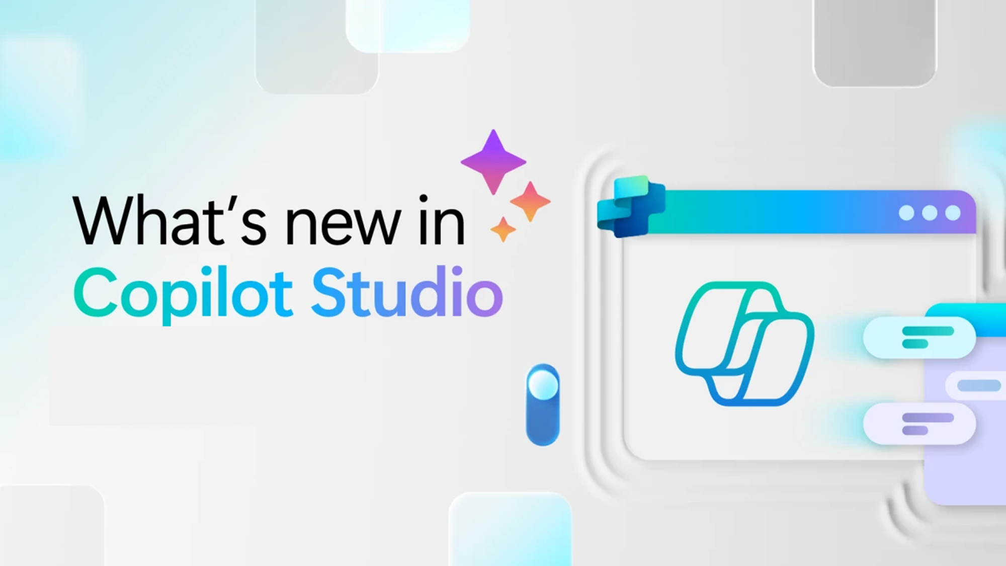
Whats new in Copilot Studio
Notes:
Section transition — Copilot Studio.
Use this slide to pivot from end-user features to the maker/IT story. Copilot Studio is where teams build, orchestrate, and manage custom agents. The next slide lists what shipped, by month of release.

Slide 55

What's new in Copilot Studio
The following table displays the month of release for each new feature.
Month of release | What’s new
September 2026 | Add an extract node to a workflow to pull named values and tables out of documents, such as invoices, contracts, and financial statements, so later steps can use the extracted data. (Preview) Add a Copilot node to a workflow to run Copilot Chat or a Cowork task, grounded in the connected user's mail, files, calendar, and chats, and to call agents like Researcher and Analyst or your own Agent Builder agents. Choose a model for your agent powered by the GitHub Copilot harness from a simple dropdown menu, and try out experimental models early to evaluate them before they're production-ready. Configure a content safety test method to evaluate your agent's responses for potentially harmful content, such as hateful, sexual, violent, or self-harm content, with configurable severity thresholds. (General availability) Attach files to a conversation so your agent can read, summarize, or otherwise reason over them, now expanded to support Excel, PowerPoint, and Word files. Add Dataverse tables as a knowledge source to ground your agent in your organization's Dataverse data, including (preview) unstructured reasoning over Multiline Text and File columns so your agent can find answers in notes, descriptions, and attached documents, not just structured fields.
What's new in Copilot Studio - Microsoft Copilot Studio | Microsoft Learn | Copilot Studio Archive | Microsoft Copilot Blog
Notes:
What’s new in Copilot Studio — release table.

Slide 56

What's new in Frontier
Get hands-on with breakthrough preview features, share your insights with product teams, and help shape the future of AI.
With Frontier, you’re not just adopting new technology, you’re co-creating what comes next.
Frontier program – Microsoft Adoption
Notes:
Frontier — what it is.
Frame Frontier as Microsoft’s early-access program: “you’re not just adopting new technology, you’re co-creating what comes next.” Customers in Frontier get the newest agents and features first and help shape them through feedback. Mention it ties into Microsoft Adoption resources.

Slide 57
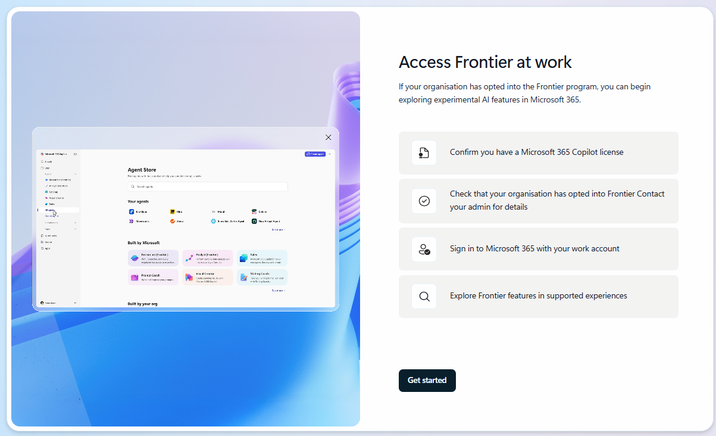
What's new in Frontier
Try out the latest agents and features in Microsoft Copilot and see how they can transform your day-to-day.​
Do more with new capabilities in Copilot Chat
App Building in Cowork
New agentic capabilities coming to Copilot Notebooks
Frontier Program Features | Microsoft Frontier
Frontier Getting started guide
Notes:
Frontier — try it out.
Encourage the audience to get hands-on. Point them to the Frontier getting-started guide and the newest items.
Close by inviting them to try these in their own day-to-day and share feedback.

Slide 58
Thank you 👏
Got feedback ?
https://aka.ms/WhatsNewCopilot/Feedback

Slide 59

Feedback Form

Slide 60
Resources
What's New in Microsoft Copilot | September 2026
Introducing the new Copilot with Home, Code and Autopilot
Available today: OpenAI's GPT-6.1 Sol and Claude Sonnet 5.5 in Microsoft Copilot
Introducing the plugin registry - one place to discover and govern plugins for Microsoft Copilot
Change Management Best Practices to Drive Value with Agent Builder
Evolution of the Copilot pricing model
More Models, One Copilot
Brand Kit and Skills in Copilot in PowerPoint
Expanding model choice in Copilot with Grok
Available today: OpenAI GPT-6 Astra in Microsoft Copilot
Build where you want, run with confidence: Now Microsoft hosts and manages the code created by Copilot
Work IQ: Business and workplace intelligence in the flow of work
New FinOps for AI capabilities: Control spend, measure value, and optimize for impact
Microsoft 365 Copilot Blog | Microsoft Community Hub
Release Notes for Microsoft 365 Copilot | Microsoft Learn
Microsoft 365 Roadmap | Microsoft 365
What's new in Copilot Studio - Microsoft Copilot Studio | Microsoft Learn
Copilot Studio | Microsoft Copilot Blog

Slide 61

Microsoft 365 Copilot
June 2026
As of 6th July 2026
Copilot Control System
User capabilities
        Organization Prompts in M365 Admin Center
        Cost Management Dashboard
        Team-Level Cost Reporting in Insights
        Agent Metrics for Custom Reporting
        Organizational Messages on Hybrid-Joined Devices
        Admin Control for Vision
        Purview DLP — Restrict External Emails
        Purview Controls for Copilot Cowork
        Copilot Cowork
          General Availability
          Model Choice
          Expanded Plugins
          Custom Skills
          Visual Creation
          Edge and Mobile
        Claude Sonnet 5 in M365 Copilot
        Power BI Reasoning in Copilot
        Dataverse Data in Copilot
        Deep Citations
        Regenerate in Copilot Chat
        Vision in M365 Copilot
        Suggested Edits for Copilot Pages
        Copilot Notebooks - References and Access
        Copilot in Outlook - Settings and Draft Refinement
        Model Choice in Copilot in Word
        Copilot Catchup in Word
        Agentic Editing in Copilot in Word
        Copilot in Word on iOS and Chat Continuity
        Brand Kit Picker in Copilot in PowerPoint
        Skills in Copilot in PowerPoint
        SharePoint and OneDrive References in Copilot in PowerPoint
        Skills in Copilot in Excel
        Personalization in Copilot in Excel
        Workbook Rules in Copilot in Excel
Agents
        Researcher Model and Mode Choice
        Planner Agent in Microsoft 365 Copilot
        Sales Agent — General Availability
        Learning Agent — General Availability

Slide 62
Microsoft 365 Copilot
July 2026
As of 5th August 2026
IT admin capabilities
User capabilities
        Domain exclusion for web grounding
        Purview DLP — restrict external emails
        Agent 365 Dashboard in Insights
        Copilot Connectors usage report
        Copilot Chat usage report (GCC, GCC High, DoD)
        Cost Management updates
        Agent Access Insights Heatmap
        GPT-5.6 in M365 Copilot
        Claude Sonnet 5 in M365 Copilot
        Claude Opus 5 in M365 Copilot
        Copilot Search Enhancements
        Push Notifications in Copilot App
        Claude Fable 5 in Cowork
        Edge Browser Automation in Cowork
        Event-Triggered Tasks in Cowork
        Skills and Plugins in Cowork
        References in Copilot Notebooks
        Review and drafting Workflows in Word
        Brand Kit & Theme Skills in Excel
        Power BI Context & AutoSave in Excel
        Branded Assets in PowerPoint
        Custom Skills in PowerPoint
        Comments and Tasks in PowerPoint
        Mobile Capabilities in PowerPoint
        Reference & Restyle in PowerPoint
        Meeting Recaps App in Teams
        Audio Summary for SharePoint News
        Docs from SharePoint Forms
        More Copilot Connectors
        Copilot Connectors for DoD Clouds
Agents
        Add Word, Excel and PowerPoint agents in Copilot Chat
        Sales Agent - General Availability

Slide 63
Microsoft Copilot
August 2026
As of 8th Sept 2026
IT admin capabilities
User capabilities
        Admin can export row-level Copilot and Agent 365 usage data
        The Consumption Dashboard now tracks Github Copilot AI Credits
        OpenAI GPT-6 Astra in Microsoft Copilot
        Anthropic Claude Fable 5.1 in Microsoft Copilot
        More control for effort level and cost in Cowork
        Text selections, session sharing, and more for Copilot Chat
        New ways to work in Copilot Notebooks
        Change languages for meeting recaps with Copilot in Teams
        Hyperlinks, image understanding, and highlights for Copilot in Word
        Chat history and change history skill for Copilot in Excel
        Personal skills in Copilot in SharePoint
        Agents, email drafting, and management enhancements for Copilot in Outlook
        Improved file capabilities with Copilot in OneDrive
        Status reports and task enhancements for Copilot in Planner
        New Connectors and Plugins
Agents
        Custom engine agents are available directly in Outlook
        Planner Agent turns plan data into stakeholder-ready status report
        Copilot creates and queries Planner tasks
Notes:
As of 8th September 2026

