Slide 1


What’s new in
Microsoft 365 Copilot
As of 6th July 2026
June 2026
Presenter name
Title

Slide 2
What's new in Microsoft 365 Copilot
Updates listed in this document are selected based on relevance to Microsoft 365 Copilot.
Release dates and timings are subject to change.
For a complete list of Copilot for Microsoft 365 roadmap items refer to
Microsoft 365 Roadmap | Microsoft 365
Got feedback ?
https://aka.ms/WhatsNewCopilot/Feedback

Slide 3

What’s new in Microsoft 365 Copilot
June 2026
As of 6th July 2026
Copilot Control System
User capabilities
        Organization Prompts in M365 Admin Center
        Cost Management Dashboard
        Team-Level Cost Reporting in Insights
        Agent Metrics for Custom Reporting
        Organizational Messages on Hybrid-Joined Devices
        Admin Control for Vision
        Purview DLP — Restrict External Emails
        Purview Controls for Copilot Cowork
        Copilot Cowork
          General Availability
          Model Choice
          Expanded Plugins
          Custom Skills
          Visual Creation
          Edge and Mobile
        Claude Sonnet 5 in M365 Copilot
        Power BI Reasoning in Copilot
        Dataverse Data in Copilot
        Deep Citations
        Regenerate in Copilot Chat
        Vision in M365 Copilot
        Suggested Edits for Copilot Pages
        Copilot Notebooks - References and Access
        Copilot in Outlook - Settings and Draft Refinement
        Model Choice in Copilot in Word
        Copilot Catchup in Word
        Agentic Editing in Copilot in Word
        Copilot in Word on iOS and Chat Continuity
        Brand Kit Picker in Copilot in PowerPoint
        Skills in Copilot in PowerPoint
        SharePoint and OneDrive References in Copilot in PowerPoint
        Skills in Copilot in Excel
        Personalization in Copilot in Excel
        Workbook Rules in Copilot in Excel
Agents
        Researcher Model and Mode Choice
        Planner Agent in Microsoft 365 Copilot
        Sales Agent — General Availability
        Learning Agent — General Availability

Slide 4

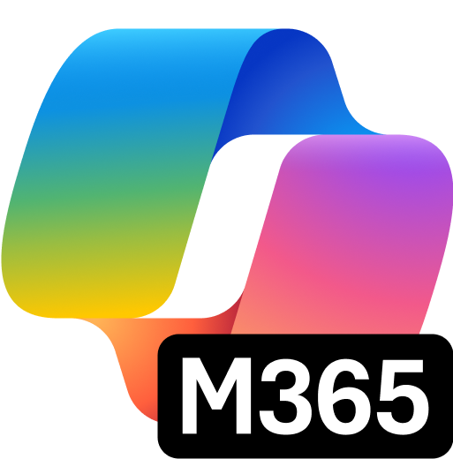
User capabilities

Slide 5
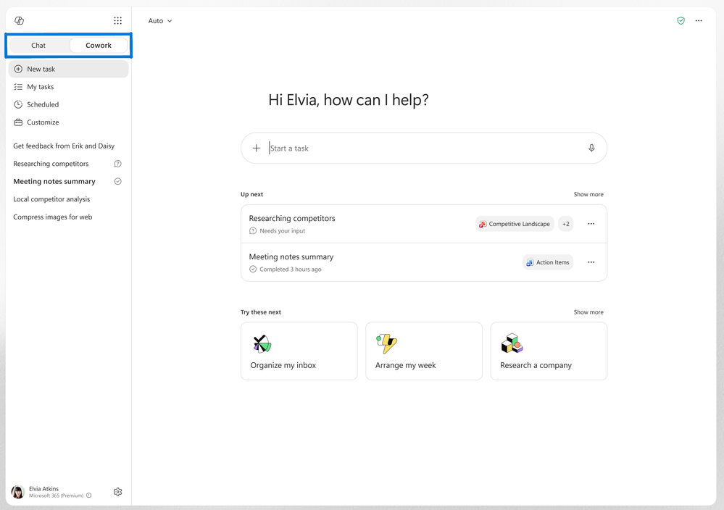
Copilot Cowork — now generally available worldwide
MC1393471
Copilot Cowork, an agentic system that plans, executes, and delivers completed work, is now generally available worldwide.
Completed Deliverables: Users define the task and Cowork executes it end to end, returning finished work rather than a draft or recommendation.
Grounded in Context: Powered by Work IQ, Cowork grounds every task in the systems the business already runs on, so output reflects real context.
Chat and Cowork Toggle: The Microsoft 365 Copilot app adds a toggle to switch between Chat for answers and Cowork for action.
June Rollout
Generally available worldwide; enabled via usage-based billing, with the toggle rolling out in June.
Copilot Cowork — General Availability
What's New in Microsoft 365 Copilot | June 2026
Notes:
Copilot Cowork — General Availability
Copilot Cowork, an agentic system that plans, executes, and delivers completed work, is now generally available worldwide.
• Completed Deliverables — Users define the task and Cowork executes it end to end, returning finished work rather than a draft or recommendation.
• Grounded in Context — Powered by Work IQ, Cowork grounds every task in the systems the business already runs on, so output reflects real context.
• Chat and Cowork Toggle — The Microsoft 365 Copilot app adds a toggle to switch between Chat for answers and Cowork for action.
June Rollout — Generally available worldwide; enabled via usage-based billing, with the toggle rolling out in June.
Source: Copilot Cowork — General Availability — https://techcommunity.microsoft.com/blog/microsoft365copilotblog/what%E2%80%99s-new-in-microsoft-365-copilot--june-2026/4529572

Slide 6
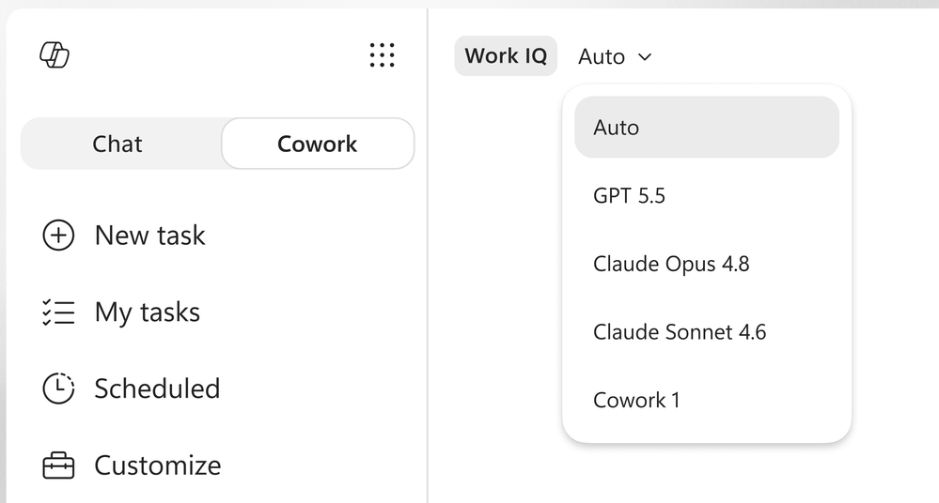
Model Choice in Copilot Cowork
Cowork can now choose the model that best fits each task, so users get tailored support without selecting a model manually.
Task-Matched Models: Cowork can use OpenAI GPT 5.5 Thinking, or choose the right model for the job automatically.
Model Specialization: Anthropic models handle visual work like PowerPoint and graphics, while GPT 5.5 supports deeper research with citations.
No Manual Switching: Users get more suitable support across different types of work without picking a model themselves.
June Rollout (Frontier)
Rolled out in June to the Frontier program.
Model Choice in Copilot Cowork
What's New in Microsoft 365 Copilot | June 2026
Notes:
Model Choice in Copilot Cowork
Cowork can now choose the model that best fits each task, so users get tailored support without selecting a model manually.
• Task-Matched Models — Cowork can use OpenAI GPT 5.5 Thinking, or choose the right model for the job automatically.
• Model Specialization — Anthropic models handle visual work like PowerPoint and graphics, while GPT 5.5 supports deeper research with citations.
• No Manual Switching — Users get more suitable support across different types of work without picking a model themselves.
June Rollout (Frontier) — Rolled out in June to the Frontier program.
Source: Model Choice in Copilot Cowork — https://techcommunity.microsoft.com/blog/microsoft365copilotblog/what%E2%80%99s-new-in-microsoft-365-copilot--june-2026/4529572

Slide 7
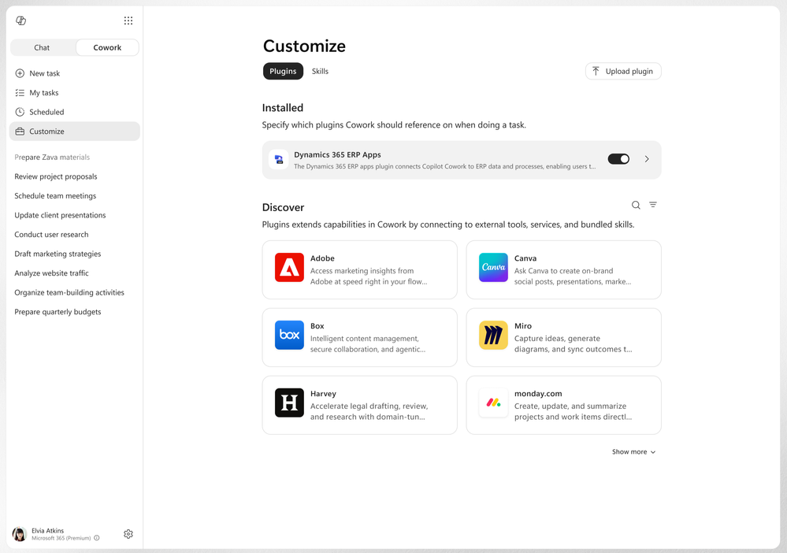
Expanded Plugins in Copilot Cowork
Cowork supports more plugins, giving users access to additional business systems directly in the flow of work.
New Plugin Store Options: Adds Enosix, Harvey, LSEG, Miro, monday.com, Moodys, Morningstar, S&P Global Energy, and TeamsMaestro, with Databricks via sideloading.
Microsoft Ecosystem: Microsoft Fabric and the full Dynamics 365 portfolio, including Sales, Customer Service, and ERP apps, are supported.
In-Flow Access: Users reach these systems inside Cowork without leaving their work.
June Rollout
Plugins rolled out in June.
Expanded Plugins in Copilot Cowork
What's New in Microsoft 365 Copilot | June 2026
Notes:
Expanded Plugins in Copilot Cowork
Cowork supports more plugins, giving users access to additional business systems directly in the flow of work.
• New Plugin Store Options — Adds Enosix, Harvey, LSEG, Miro, monday.com, Moodys, Morningstar, S&P Global Energy, and TeamsMaestro, with Databricks via sideloading.
• Microsoft Ecosystem — Microsoft Fabric and the full Dynamics 365 portfolio, including Sales, Customer Service, and ERP apps, are supported.
• In-Flow Access — Users reach these systems inside Cowork without leaving their work.
June Rollout — Plugins rolled out in June.
Source: Expanded Plugins in Copilot Cowork — https://techcommunity.microsoft.com/blog/microsoft365copilotblog/what%E2%80%99s-new-in-microsoft-365-copilot--june-2026/4529572

Slide 8
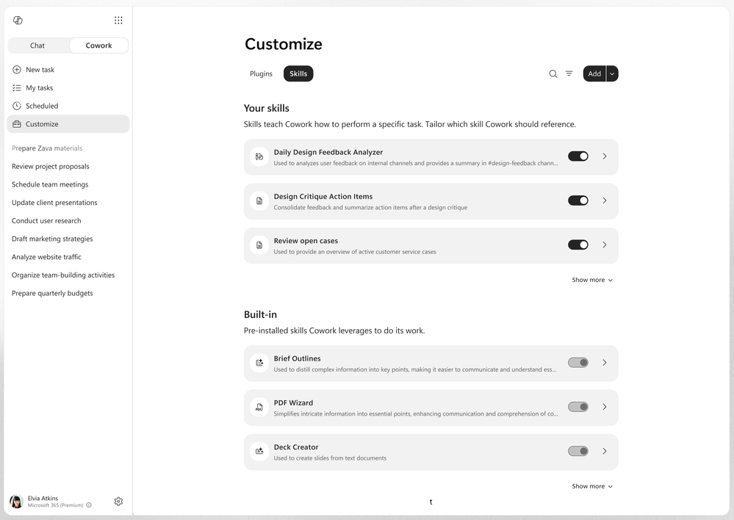
Custom Skills in Copilot Cowork
Users can create, edit, and manage custom skills in Cowork through the Customize tab to personalize what Cowork can do.
Personalized Instructions: Skills are custom instructions that make Cowork work the way each user does.
Build and Refine: Users can more easily build and refine skills over time as their needs evolve.
Combine Workflows: Personal workflows can be combined with partner-provided or org-wide skills deployed through plugins.
June Rollout
Rolled out in June.
Custom Skills in Copilot Cowork
What's New in Microsoft 365 Copilot | June 2026
Notes:
Custom Skills in Copilot Cowork
Users can create, edit, and manage custom skills in Cowork through the Customize tab to personalize what Cowork can do.
• Personalized Instructions — Skills are custom instructions that make Cowork work the way each user does.
• Build and Refine — Users can more easily build and refine skills over time as their needs evolve.
• Combine Workflows — Personal workflows can be combined with partner-provided or org-wide skills deployed through plugins.
June Rollout — Rolled out in June.
Source: Custom Skills in Copilot Cowork — https://techcommunity.microsoft.com/blog/microsoft365copilotblog/what%E2%80%99s-new-in-microsoft-365-copilot--june-2026/4529572

Slide 9
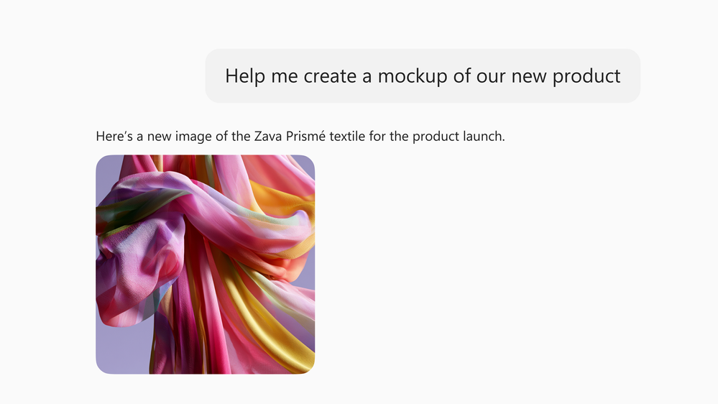
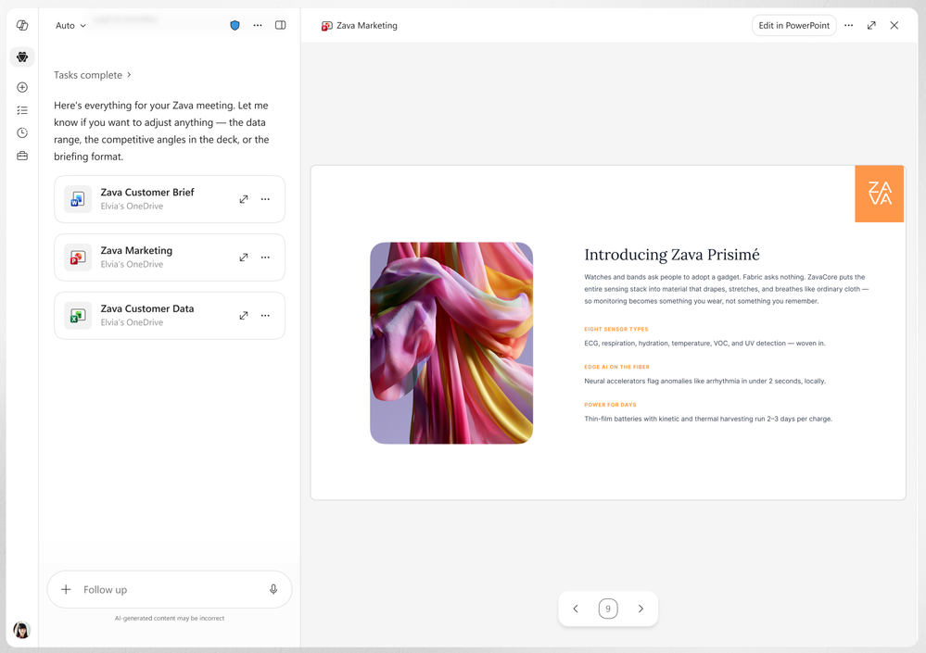
Visual Creation in Copilot Cowork
Cowork can now create and edit visuals directly in the flow of work, without switching tools.
In-Flow Imagery: Powered by OpenAI's ChatGPT Images 2.0, Cowork creates and edits deck graphics, document illustrations, and email imagery.
Branded Templates: Cowork can use branded PowerPoint templates from an organization's asset library, starting decks with approved colors, fonts, logos, and layouts.
Less Cleanup: Starting on-brand reduces manual formatting and brand cleanup after a presentation is generated.
June Rollout
Rolled out in June.
Visual Creation in Copilot Cowork
What's New in Microsoft 365 Copilot | June 2026
Notes:
Visual Creation in Copilot Cowork
Cowork can now create and edit visuals directly in the flow of work, without switching tools.
• In-Flow Imagery — Powered by OpenAI's ChatGPT Images 2.0, Cowork creates and edits deck graphics, document illustrations, and email imagery.
• Branded Templates — Cowork can use branded PowerPoint templates from an organization's asset library, starting decks with approved colors, fonts, logos, and layouts.
• Less Cleanup — Starting on-brand reduces manual formatting and brand cleanup after a presentation is generated.
June Rollout — Rolled out in June.
Source: Visual Creation in Copilot Cowork — https://techcommunity.microsoft.com/blog/microsoft365copilotblog/what%E2%80%99s-new-in-microsoft-365-copilot--june-2026/4529572

Slide 10
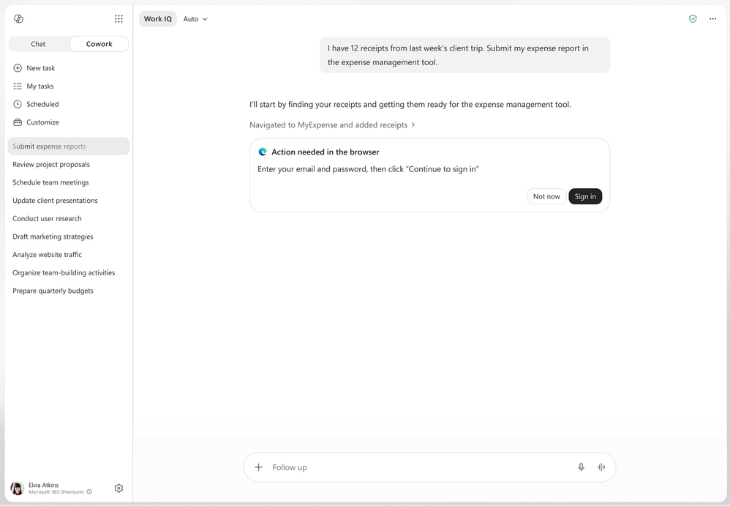
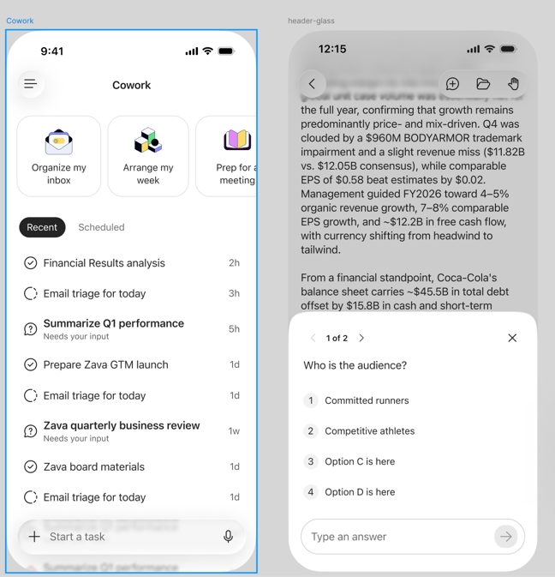
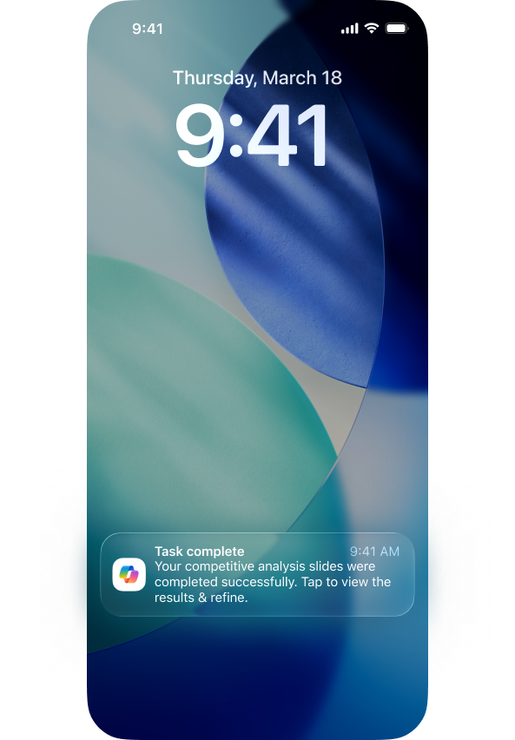
Copilot Cowork on Edge and Mobile
Cowork extends to the Edge browser and mobile devices, keeping work moving wherever users are.
Edge Browser: Cowork can use the Edge browser to work across an organization's business systems, websites, and intranet sites.
Mobile Continuity: Available on iOS and Android, so users can start on one device and continue on another with context and conversation intact.
Push Notifications: Cowork sends notifications for long-running tasks, including approvals, input requests, and completions.
June Rollout
Mobile and notifications rolled out in June; Edge browser work rolled out in June to Frontier.
Copilot Cowork on Edge and Mobile
What's New in Microsoft 365 Copilot | June 2026
Notes:
Copilot Cowork on Edge and Mobile
Cowork extends to the Edge browser and mobile devices, keeping work moving wherever users are.
• Edge Browser Work — Cowork can use the Edge browser to work across an organization's business systems, websites, and intranet sites.
• Mobile Continuity — Available on iOS and Android, so users can start on one device and continue on another with context and conversation intact.
• Push Notifications — Cowork sends notifications for long-running tasks, including approvals, input requests, and completions.
June Rollout — Mobile and notifications rolled out in June; Edge browser work rolled out in June to Frontier.
Source: Copilot Cowork on Edge and Mobile — https://techcommunity.microsoft.com/blog/microsoft365copilotblog/what%E2%80%99s-new-in-microsoft-365-copilot--june-2026/4529572

Slide 11

Claude Sonnet 5 in Microsoft 365 Copilot
Anthropic's Claude Sonnet 5, a frontier model built for agentic, multi-step work, is now available in Microsoft 365 Copilot.
Agentic Multi-Step Work: Built for planning across steps, reasoning through context, and turning information into polished business artifacts.
Where It Runs: Rolling out in Copilot Cowork and Copilot in PowerPoint for documents, spreadsheets, and presentation tasks.
Admin-Managed Access: Admins can manage access based on organization policy and readiness; availability may vary by region and tenant.
Available Now
Announced July 2, 2026; rolling out now.
Learn more
Claude Sonnet 5 in Microsoft 365 Copilot
What's New in Microsoft 365 Copilot | June 2026
Notes:
Claude Sonnet 5 in Microsoft 365 Copilot
Anthropic's Claude Sonnet 5, a frontier model built for agentic, multi-step work, is now available in Microsoft 365 Copilot.
• Agentic Multi-Step Work — Built for planning across steps, reasoning through context, and turning information into polished business artifacts.
• Where It Runs — Rolling out in Copilot Cowork and Copilot in PowerPoint for documents, spreadsheets, and presentation tasks.
• Admin-Managed Access — Admins can manage access based on organization policy and readiness; availability may vary by region and tenant.
Available Now — Announced July 2, 2026; rolling out now.
Source: Claude Sonnet 5 in Microsoft 365 Copilot — https://techcommunity.microsoft.com/blog/microsoft365copilotblog/available-today-anthropic%E2%80%99s-claude-sonnet-5-in-microsoft-365-copilot/4532188

Slide 12
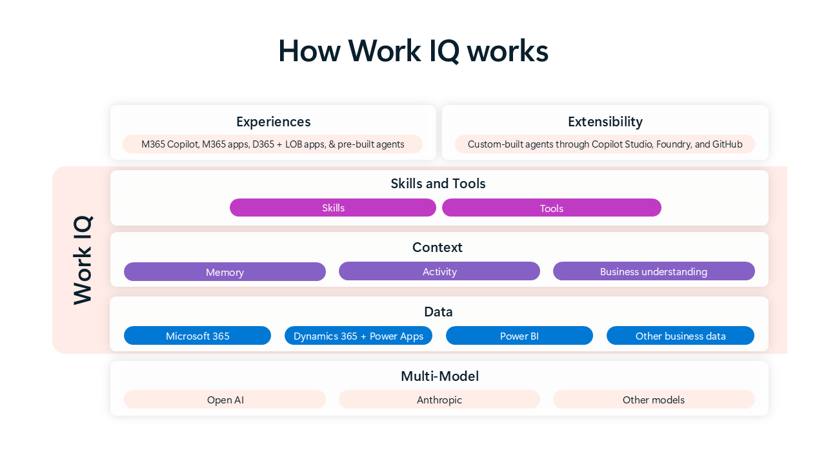
Power BI Reasoning in Copilot
With Work IQ, Copilot can reason over Power BI enterprise data and return grounded answers from reports and semantic models.
Natural-Language Queries: Users ask questions in plain language and get accurate answers without building queries themselves.
Governed BI Data: Answers come directly from Power BI reports and semantic models, bringing governed BI into the Copilot experience.
Trustworthy Insights: Users get faster, more trustworthy insights grounded in enterprise data.
June Rollout (Frontier)
Rolled out to the Frontier program in June.
Power BI Reasoning in Copilot
What's New in Microsoft 365 Copilot | June 2026
Notes:
Power BI Reasoning in Copilot
With Work IQ, Copilot can reason over Power BI enterprise data and return grounded answers from reports and semantic models.
• Natural-Language Queries — Users ask questions in plain language and get accurate answers without building queries themselves.
• Governed BI Data — Answers come directly from Power BI reports and semantic models, bringing governed BI into the Copilot experience.
• Trustworthy Insights — Users get faster, more trustworthy insights grounded in enterprise data.
June Rollout (Frontier) — Rolled out to the Frontier program in June.
Source: Power BI Reasoning in Copilot — https://techcommunity.microsoft.com/blog/microsoft365copilotblog/what%E2%80%99s-new-in-microsoft-365-copilot--june-2026/4529572

Slide 13
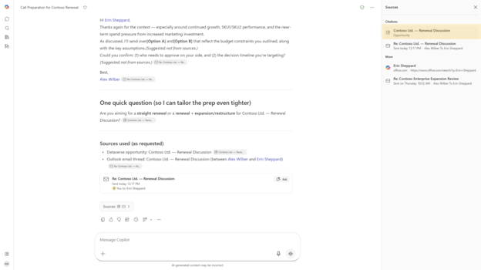
Dataverse Data in Copilot
Work IQ enables Copilot to search and query Dataverse business data, bringing line-of-business records into the flow of work.
Structured Business Records: Copilot reaches the structured line-of-business data organizations keep in Dataverse.
Ask in Natural Language: Users ask about their Dataverse data in plain language and get grounded answers without leaving Copilot.
Across Chat Experiences: Records surface across Copilot Chat experiences in the flow of work.
Rollout Timing
Public preview in June, with general availability in September.
Dataverse Data in Copilot
What's New in Microsoft 365 Copilot | June 2026
Notes:
Dataverse Data in Copilot
Work IQ enables Copilot to search and query Dataverse business data, bringing line-of-business records into the flow of work.
• Structured Business Records — Copilot reaches the structured line-of-business data organizations keep in Dataverse.
• Ask in Natural Language — Users ask about their Dataverse data in plain language and get grounded answers without leaving Copilot.
• Across Chat Experiences — Records surface across Copilot Chat experiences in the flow of work.
Rollout Timing — Public preview in June, with general availability in September.
Source: Dataverse Data in Copilot — https://techcommunity.microsoft.com/blog/microsoft365copilotblog/what%E2%80%99s-new-in-microsoft-365-copilot--june-2026/4529572

Slide 14
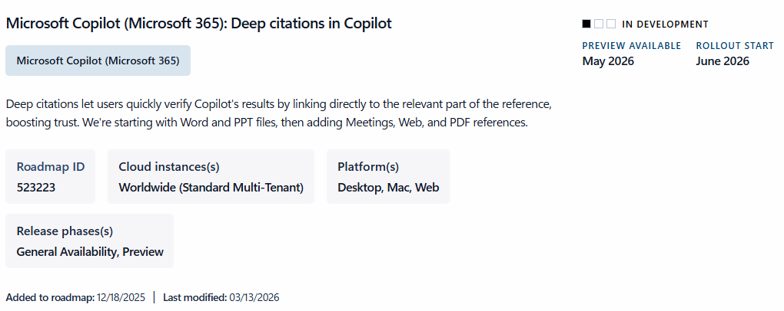
Deep Citations
Roadmap 523225
Deep citations let users verify Copilot's results by linking to the specific part of a referenced file rather than the whole file.
Pinpoint References: Citations link directly to the relevant section of a source, not just the file.
Builds Trust: Tracing an answer back to its source builds confidence in Copilot's output.
Expanding Coverage: Supports Word and PowerPoint files now, with Meetings, Web, and PDF references coming soon.
June Rollout
Rolled out in June.
Deep Citations
What's New in Microsoft 365 Copilot | June 2026
Notes:
Deep Citations
Deep citations let users verify Copilot's results by linking to the specific part of a referenced file rather than the whole file.
• Pinpoint References — Citations link directly to the relevant section of a source, not just the file.
• Builds Trust — Tracing an answer back to its source builds confidence in Copilot's output.
• Expanding Coverage — Supports Word and PowerPoint files now, with Meetings, Web, and PDF references coming soon.
June Rollout — Rolled out in June.
Source: Deep Citations — https://techcommunity.microsoft.com/blog/microsoft365copilotblog/what%E2%80%99s-new-in-microsoft-365-copilot--june-2026/4529572

Slide 15
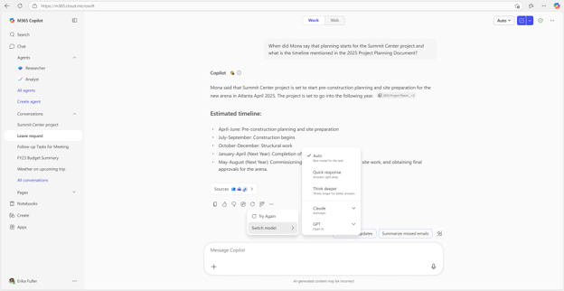
Regenerate in Copilot Chat
The new Regenerate action lets users quickly get an alternative response to their latest prompt directly in Copilot Chat.
Simple Options: Try Again or Switch Model to produce a new response without re-prompting.
Refine In Place: Users explore different answers and refine output without starting over.
Better Fit: Helps improve quality and find the response that fits the need.
June Rollout
Rolled out in June.
Regenerate in Copilot Chat
What's New in Microsoft 365 Copilot | June 2026
Notes:
Regenerate in Copilot Chat
The new Regenerate action lets users quickly get an alternative response to their latest prompt directly in Copilot Chat.
• Simple Options — Try Again or Switch Model to produce a new response without re-prompting.
• Refine In Place — Users explore different answers and refine output without starting over.
• Better Fit — Helps improve quality and find the response that fits the need.
June Rollout — Rolled out in June.
Source: Regenerate in Copilot Chat — https://techcommunity.microsoft.com/blog/microsoft365copilotblog/what%E2%80%99s-new-in-microsoft-365-copilot--june-2026/4529572

Slide 16
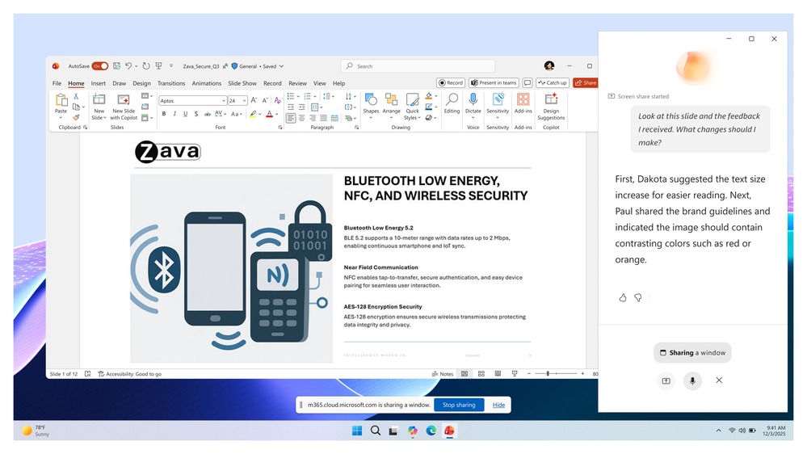
Vision in Microsoft 365 Copilot
MC1325421
Roadmap 561037
Vision helps users get answers faster when work depends on what they see on screen or through their phone camera.
Show, Don't Describe: Users can show a dashboard, document, image, error message, or real-world object instead of describing it.
Voice Conversation: Users ask questions in a voice conversation as Copilot uses the visual context.
Guided Next Steps: Copilot explains what is in front of the user, surfaces insights, and guides next steps using work and web context.
July Rollout
Rolling out in July.
Vision in Microsoft 365 Copilot
What's New in Microsoft 365 Copilot | June 2026
Notes:
Vision in Microsoft 365 Copilot
Vision helps users get answers faster when work depends on what they see on screen or through their phone camera.
• Show, Don't Describe — Users can show a dashboard, document, image, error message, or real-world object instead of describing it.
• Voice Conversation — Users ask questions in a voice conversation as Copilot uses the visual context.
• Guided Next Steps — Copilot explains what is in front of the user, surfaces insights, and guides next steps using work and web context.
July Rollout — Rolling out in July.
Source: Vision in Microsoft 365 Copilot — https://techcommunity.microsoft.com/blog/microsoft365copilotblog/what%E2%80%99s-new-in-microsoft-365-copilot--june-2026/4529572

Slide 17
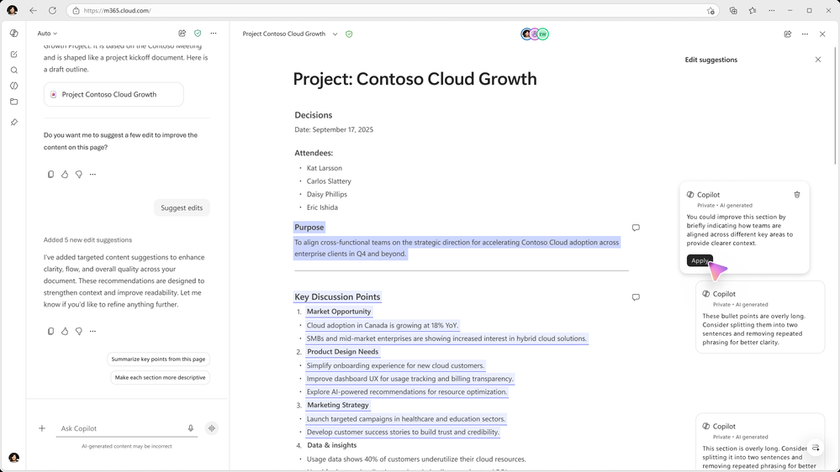
Suggested Edits for Copilot Pages
MC1330886
Roadmap 562351
Users can get actionable, in-line feedback on a Copilot Page to polish their work without switching tools.
In Shortcuts Menu: Select Suggested edits in the Copilot Shortcuts menu to request feedback.
In-Line Suggestions: Copilot analyzes page content and offers feedback and suggestions in-line to improve clarity and quality.
Apply Directly: Users can apply the suggestions directly to the page and keep momentum.
June Rollout
Rolled out in June.
Suggested Edits for Copilot Pages
What's New in Microsoft 365 Copilot | June 2026
Notes:
Suggested Edits for Copilot Pages
Users can get actionable, in-line feedback on a Copilot Page to polish their work without switching tools.
• In Shortcuts Menu — Select Suggested edits in the Copilot Shortcuts menu to request feedback.
• In-Line Suggestions — Copilot analyzes page content and offers feedback and suggestions in-line to improve clarity and quality.
• Apply Directly — Users can apply the suggestions directly to the page and keep momentum.
June Rollout — Rolled out in June.
Source: Suggested Edits for Copilot Pages — https://techcommunity.microsoft.com/blog/microsoft365copilotblog/what%E2%80%99s-new-in-microsoft-365-copilot--june-2026/4529572

Slide 18
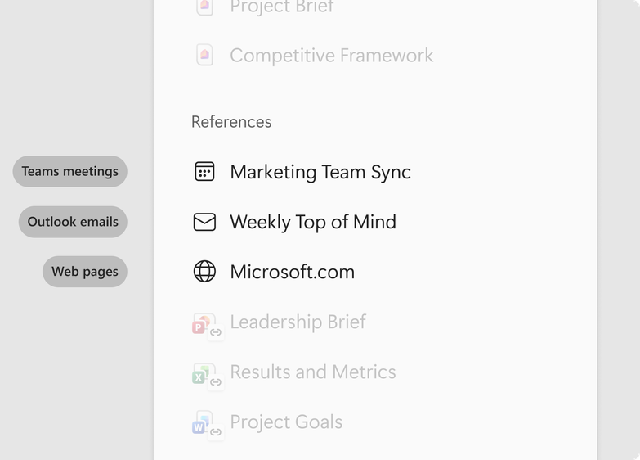
Copilot Notebooks — References and Copilot Chat users
Copilot Notebooks adds Outlook email references and opens up to Copilot Chat users for a shared project workspace.
Emails as References: Users can add Outlook emails as references to ground Copilot in the conversations, decisions, and context that drive their work.
Available to Chat Users: Previously limited to licensed users, Notebooks now rolls out to Copilot Chat users.
Learning Tools: Teams gather project context and turn reference sources into mind maps and study guides.
Rollout Timing
Access for Chat users rolled out in June; email references rolling out in July.
Copilot Notebooks — References and Access
What's New in Microsoft 365 Copilot | June 2026
Notes:
Copilot Notebooks — References and Access
Copilot Notebooks adds Outlook email references and opens up to Copilot Chat users for a shared project workspace.
• Emails as References — Users can add Outlook emails as references to ground Copilot in the conversations, decisions, and context that drive their work.
• Available to Chat Users — Previously limited to licensed users, Notebooks now rolls out to Copilot Chat users.
• Learning Tools — Teams gather project context and turn reference sources into mind maps and study guides.
Rollout Timing — Access for Chat users rolled out in June; email references rolling out in July.
Source: Copilot Notebooks — References and Access — https://techcommunity.microsoft.com/blog/microsoft365copilotblog/what%E2%80%99s-new-in-microsoft-365-copilot--june-2026/4529572
MC1392569
Roadmap ID 564910

Slide 19

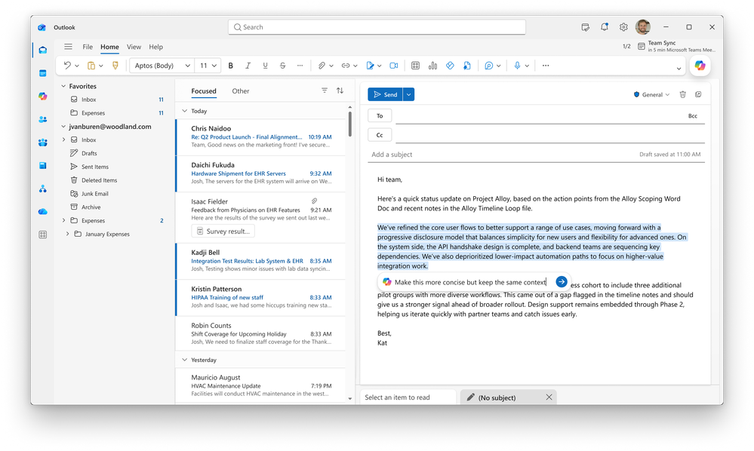

Copilot in Outlook — Settings and Draft Refinement
Copilot in Outlook adds direct settings access and in-canvas draft refinement for faster, targeted edits.
Settings Access: Classic Outlook for Windows provides direct access to Copilot settings without leaving Outlook.
In-Canvas Refinement: Users select a section of a draft and ask Copilot to adjust its length, tone, or structure.
Targeted Edits: Changes apply to the selected section without rewriting the whole message.
Rollout Timing
Draft refinement rolled out in June on the web; settings access rolling out in July.
Copilot in Outlook — Settings and Draft Refinement
What's New in Microsoft 365 Copilot | June 2026
Notes:
Copilot in Outlook — Settings and Draft Refinement
Copilot in Outlook adds direct settings access and in-canvas draft refinement for faster, targeted edits.
• Settings Access — Classic Outlook for Windows provides direct access to Copilot settings without leaving Outlook.
• In-Canvas Refinement — Users select a section of a draft and ask Copilot to adjust its length, tone, or structure.
• Targeted Edits — Changes apply to the selected section without rewriting the whole message.
Rollout Timing — Draft refinement rolled out in June on the web; settings access rolling out in July.
Source: Copilot in Outlook — Settings and Draft Refinement — https://techcommunity.microsoft.com/blog/microsoft365copilotblog/what%E2%80%99s-new-in-microsoft-365-copilot--june-2026/4529572

Slide 20

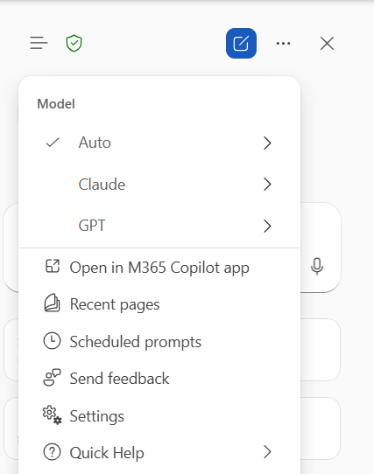
Model Choice in Copilot in Word
MC1296489
Roadmap 558440
Model choice comes to Copilot in Word, letting users pick Anthropic models when editing documents.
Anthropic Option: Users can choose Anthropic models for editing tasks in Word.
Flexible Editing: Better suited for rewriting, summarizing, restructuring, and refining content.
More Control: Users get a better chance at the right tone, structure, and detail without rewriting prompts repeatedly.
June Rollout
Rolled out in June.
Model Choice in Copilot in Word
What's New in Microsoft 365 Copilot | June 2026
Notes:
Model Choice in Copilot in Word
Model choice comes to Copilot in Word, letting users pick Anthropic models when editing documents.
• Anthropic Option — Users can choose Anthropic models for editing tasks in Word.
• Flexible Editing — Better suited for rewriting, summarizing, restructuring, and refining content.
• More Control — Users get a better chance at the right tone, structure, and detail without rewriting prompts repeatedly.
June Rollout — Rolled out in June.
Source: Model Choice in Copilot in Word — https://techcommunity.microsoft.com/blog/microsoft365copilotblog/what%E2%80%99s-new-in-microsoft-365-copilot--june-2026/4529572

Slide 21
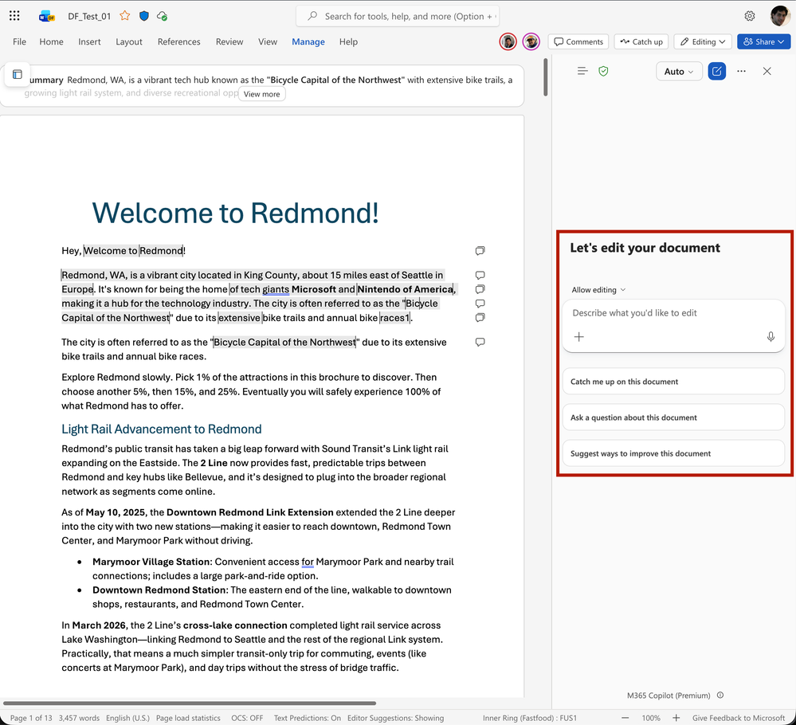
Copilot Catchup in Word
Copilot Catchup surfaces a quick recap of what has changed in a document since a user last opened it.
Content Card Recap: A content card shows what changed up front instead of requiring a full reread.
Back Up to Speed: Users quickly catch up on shared and evolving files.
Keeps Momentum: A fast way to re-engage with documents that change often.
June Rollout
Rolled out in June.
Copilot Catchup in Word
What's New in Microsoft 365 Copilot | June 2026
Notes:
Copilot Catchup in Word
Copilot Catchup surfaces a quick recap of what has changed in a document since a user last opened it.
• Content Card Recap — A content card shows what changed up front instead of requiring a full reread.
• Back Up to Speed — Users quickly catch up on shared and evolving files.
• Keeps Momentum — A fast way to re-engage with documents that change often.
June Rollout — Rolled out in June.
Source: Copilot Catchup in Word — https://techcommunity.microsoft.com/blog/microsoft365copilotblog/what%E2%80%99s-new-in-microsoft-365-copilot--june-2026/4529572

Slide 22
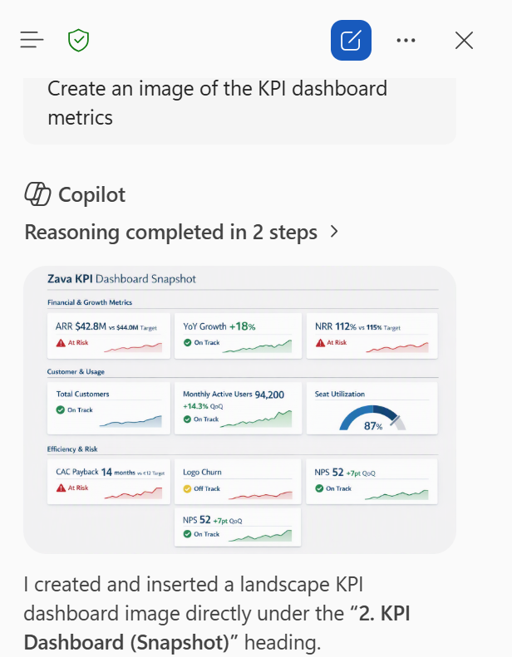
Create and insert an image using Copilot in Word
Copilot in Word can generate images inline and apply changes based on document comments as part of the agentic editing flow.
Inline Image Creation: Users create and insert an image with Copilot, placed inline as part of agentic editing.
Comment-Driven Edits: Copilot reasons over comments and applies the suggested changes to the document.
Faster Revisions: Rather than working through feedback manually, users have Copilot implement it, speeding the revision cycle.
June Rollout
Rolled out in June.
Agentic Editing in Copilot in Word
What's New in Microsoft 365 Copilot | June 2026
Notes:
Agentic Editing in Copilot in Word
Copilot in Word can generate images inline and apply changes based on document comments as part of the agentic editing flow.
• Inline Image Creation — Users create and insert an image with Copilot, placed inline as part of agentic editing.
• Comment-Driven Edits — Copilot reasons over comments and applies the suggested changes to the document.
• Faster Revisions — Rather than working through feedback manually, users have Copilot implement it, speeding the revision cycle.
June Rollout — Rolled out in June.
Source: Agentic Editing in Copilot in Word — https://techcommunity.microsoft.com/blog/microsoft365copilotblog/what%E2%80%99s-new-in-microsoft-365-copilot--june-2026/4529572

Slide 23
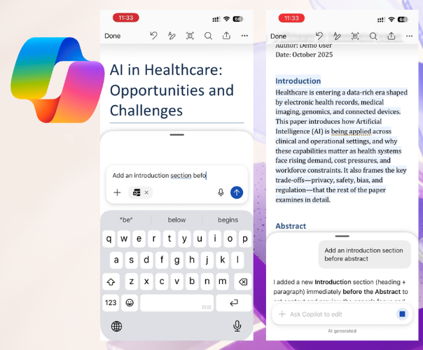
Copilot in Word on iOS and Chat Continuity
Copilot in Word brings agentic capabilities to iOS and preserves Copilot Chat conversation history across apps.
Agentic on iOS: Users edit and add content from iPhone or iPad, making quick updates, drafting, and refining on the go.
Advanced Actions: Image insertion and tracked changes remain available in the full Word experience.
Preserved History: Word keeps Copilot Chat conversation history from chat to the apps, so multi-step work stays continuous.
June Rollout
Rolled out in June.
Learn more
Copilot in Word on iOS and Chat Continuity
What's New in Microsoft 365 Copilot | June 2026
Notes:
Copilot in Word on iOS and Chat Continuity
Copilot in Word brings agentic capabilities to iOS and preserves Copilot Chat conversation history across apps.
• Agentic on iOS — Users edit and add content from iPhone or iPad, making quick updates, drafting, and refining on the go.
• Advanced Actions — Image insertion and tracked changes remain available in the full Word experience.
• Preserved History — Word keeps Copilot Chat conversation history from chat to the apps, so multi-step work stays continuous.
June Rollout — Rolled out in June.
Source: Copilot in Word on iOS and Chat Continuity — https://techcommunity.microsoft.com/blog/microsoft365copilotblog/what%E2%80%99s-new-in-microsoft-365-copilot--june-2026/4529572

Slide 24
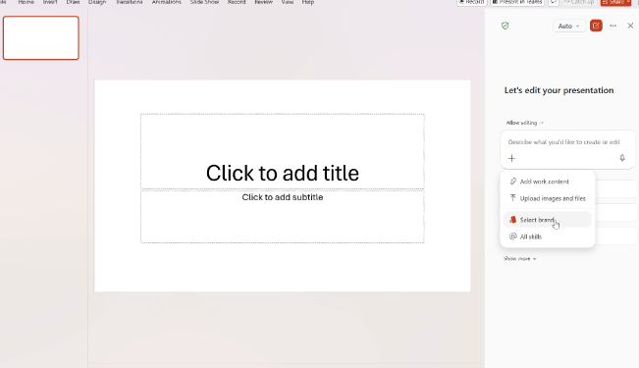
Brand Kit Picker in Copilot in PowerPoint
Brand Kit Picker lets users build Copilot presentations that follow their organization's approved brand templates.
Admin-Approved Kits: Users select an admin-approved brand kit so decks start with the right colors, fonts, and visual style.
On-Brand from the Start: Presentations follow approved templates as Copilot builds them.
Less Manual Cleanup: Reduces the need for manual formatting or brand cleanup after generation.
June Rollout
Rolled out in June.
Brand Kit Picker in Copilot in PowerPoint
What's New in Microsoft 365 Copilot | June 2026
Notes:
Brand Kit Picker in Copilot in PowerPoint
Brand Kit Picker lets users build Copilot presentations that follow their organization's approved brand templates.
• Admin-Approved Kits — Users select an admin-approved brand kit so decks start with the right colors, fonts, and visual style.
• On-Brand from the Start — Presentations follow approved templates as Copilot builds them.
• Less Manual Cleanup — Reduces the need for manual formatting or brand cleanup after generation.
June Rollout — Rolled out in June.
Source: Brand Kit Picker in Copilot in PowerPoint — https://techcommunity.microsoft.com/blog/microsoft365copilotblog/what%E2%80%99s-new-in-microsoft-365-copilot--june-2026/4529572

Slide 25
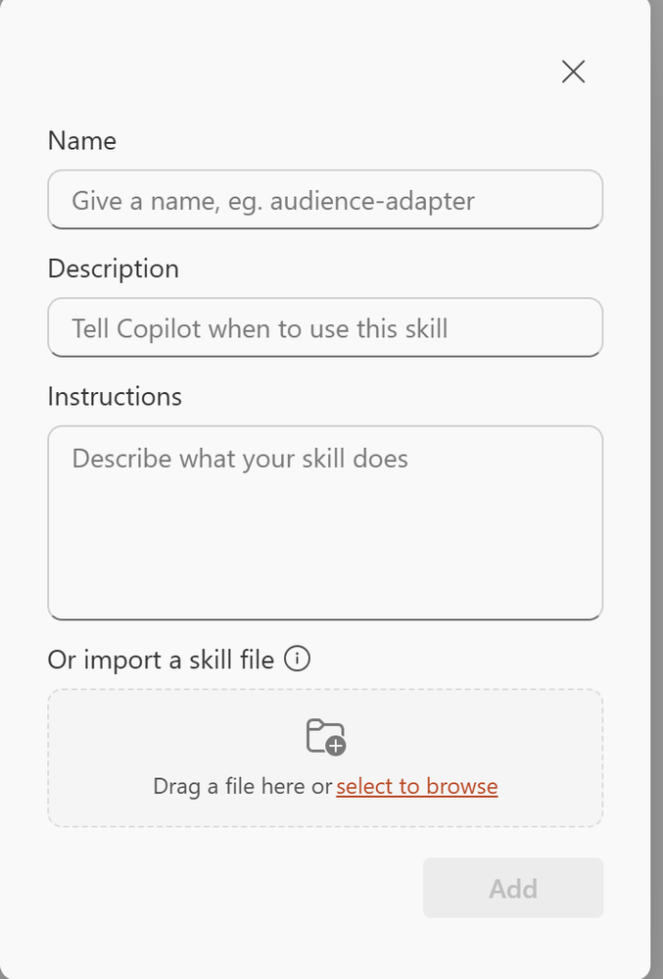
Skills in Copilot in PowerPoint
Users can create and reuse Copilot skills for repeatable PowerPoint presentation tasks.
Reusable Skills: Save common instructions as skills to reuse across presentation work.
Standardized Builds: Standardize how decks are built, refined, and formatted without recreating prompts.
Consistency: Repeatable tasks stay consistent each time.
June Rollout (Web)
Rolled out in June on the web.
Skills in Copilot in PowerPoint
What's New in Microsoft 365 Copilot | June 2026
Notes:
Skills in Copilot in PowerPoint
Users can create and reuse Copilot skills for repeatable PowerPoint presentation tasks.
• Reusable Skills — Save common instructions as skills to reuse across presentation work.
• Standardized Builds — Standardize how decks are built, refined, and formatted without recreating prompts.
• Consistency — Repeatable tasks stay consistent each time.
June Rollout (Web) — Rolled out in June on the web.
Source: Skills in Copilot in PowerPoint — https://techcommunity.microsoft.com/blog/microsoft365copilotblog/what%E2%80%99s-new-in-microsoft-365-copilot--june-2026/4529572

Slide 26
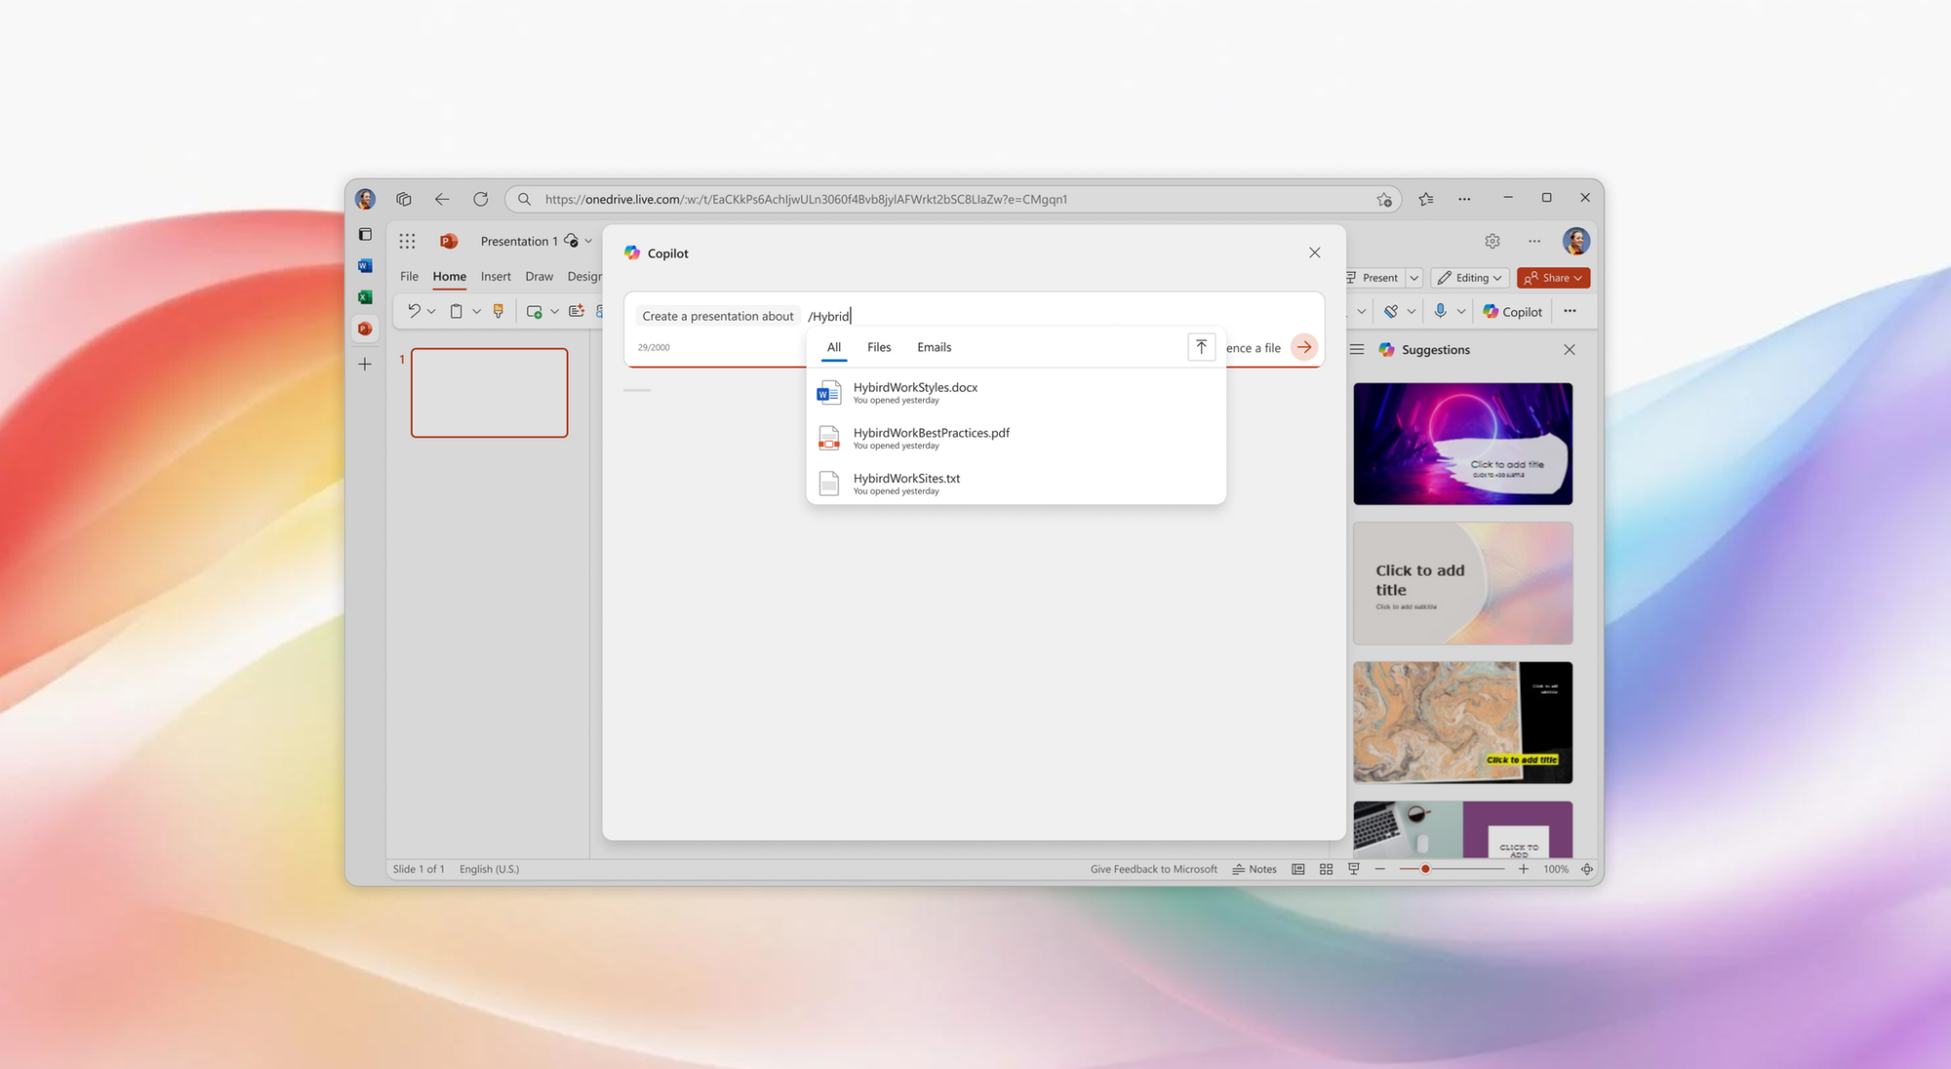
SharePoint and OneDrive References in Copilot in PowerPoint
Copilot in PowerPoint can reference SharePoint libraries and OneDrive folders to ground new decks in existing content.
Source Grounding: Copilot draws on SharePoint libraries and OneDrive folders when creating a presentation.
Reflects Real Material: Decks reflect specific organizational content instead of general information.
Relevant Decks: Users build presentations grounded in the material that matters.
June Rollout
Rolled out in June.
SharePoint and OneDrive References in Copilot in PowerPoint
What's New in Microsoft 365 Copilot | June 2026
Notes:
SharePoint and OneDrive References in Copilot in PowerPoint
Copilot in PowerPoint can reference SharePoint libraries and OneDrive folders to ground new decks in existing content.
• Source Grounding — Copilot draws on SharePoint libraries and OneDrive folders when creating a presentation.
• Reflects Real Material — Decks reflect specific organizational content instead of general information.
• Relevant Decks — Users build presentations grounded in the material that matters.
June Rollout — Rolled out in June.
Source: SharePoint and OneDrive References in Copilot in PowerPoint — https://techcommunity.microsoft.com/blog/microsoft365copilotblog/what%E2%80%99s-new-in-microsoft-365-copilot--june-2026/4529572

Slide 27
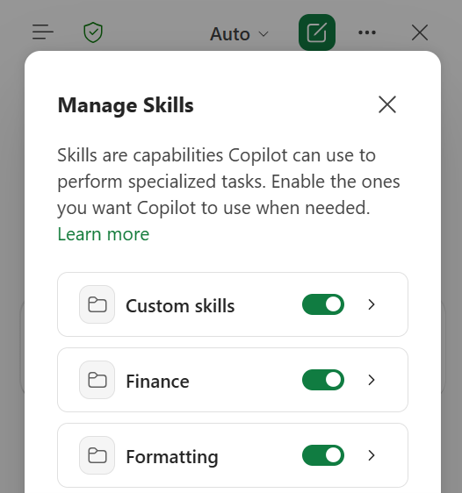
Skills in Copilot in Excel
Skills in Copilot in Excel package repeatable workflows as reusable instructions.
Repeatable Workflows: Teams create custom skills for common analysis, modeling, or reporting tasks.
Invoke on Demand: Users call skills while working in Excel.
Standardized Work: Standardize complex work without rewriting the same prompts each time.
June Rollout
Rolled out in June.
Skills in Copilot in Excel
What's New in Microsoft 365 Copilot | June 2026
Notes:
Skills in Copilot in Excel
Skills in Copilot in Excel package repeatable workflows as reusable instructions.
• Repeatable Workflows — Teams create custom skills for common analysis, modeling, or reporting tasks.
• Invoke on Demand — Users call skills while working in Excel.
• Standardized Work — Standardize complex work without rewriting the same prompts each time.
June Rollout — Rolled out in June.
Source: Skills in Copilot in Excel — https://techcommunity.microsoft.com/blog/microsoft365copilotblog/what%E2%80%99s-new-in-microsoft-365-copilot--june-2026/4529572

Slide 28
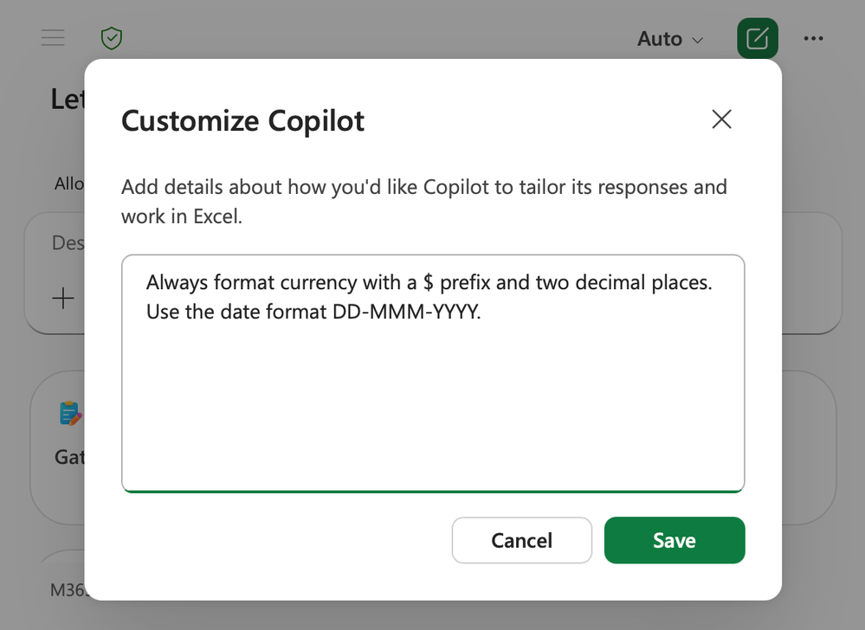
Personalization in Copilot in Excel
Personalization lets users set standing preferences once and have Copilot apply them consistently across workbooks.
Standing Preferences: Define guidance for formatting, naming conventions, formulas, PivotTables, and report styles.
Applied Consistently: Copilot's edits reflect how users prefer to work without repeating instructions in every prompt.
Less Rework: More consistent outputs, less rework, and more control over edits.
June Rollout
Rolled out in June.
Personalization in Copilot in Excel
What's New in Microsoft 365 Copilot | June 2026
Notes:
Personalization in Copilot in Excel
Personalization lets users set standing preferences once and have Copilot apply them consistently across workbooks.
• Standing Preferences — Define guidance for formatting, naming conventions, formulas, PivotTables, and report styles.
• Applied Consistently — Copilot's edits reflect how users prefer to work without repeating instructions in every prompt.
• Less Rework — More consistent outputs, less rework, and more control over edits.
June Rollout — Rolled out in June.
Source: Personalization in Copilot in Excel — https://techcommunity.microsoft.com/blog/microsoft365copilotblog/what%E2%80%99s-new-in-microsoft-365-copilot--june-2026/4529572

Slide 29
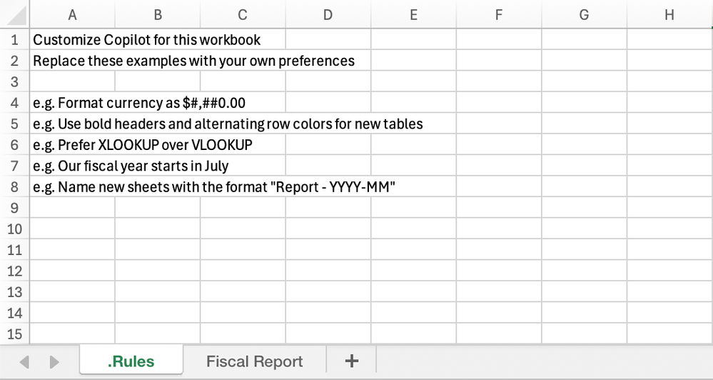
Workbook Rules in Copilot in Excel
Workbook rules sheets let teams define standards that stay with a specific workbook.
Standards That Travel
A .Rules sheet captures structure, formatting, naming, formula conventions, and examples.
Shared Guidance
Everyone using Copilot to edit the file follows the same workbook-specific guidance.
Reference Examples
Rules can reference examples, formulas, ranges, and other sheets to standardize templates and workflows.
June Rollout
Rolled out in June.
Workbook Rules in Copilot in Excel
What's New in Microsoft 365 Copilot | June 2026
Notes:
Workbook Rules in Copilot in Excel
Workbook rules sheets let teams define standards that stay with a specific workbook.
• Standards That Travel — A .Rules sheet captures structure, formatting, naming, formula conventions, and examples.
• Shared Guidance — Everyone using Copilot to edit the file follows the same workbook-specific guidance.
• Reference Examples — Rules can reference examples, formulas, ranges, and other sheets to standardize templates and workflows.
June Rollout — Rolled out in June.
Source: Workbook Rules in Copilot in Excel — https://techcommunity.microsoft.com/blog/microsoft365copilotblog/what%E2%80%99s-new-in-microsoft-365-copilot--june-2026/4529572

Slide 30

Agents

Slide 31
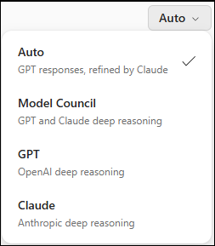
Researcher Model and Mode Choice
When the Researcher agent is added to a Copilot chat, users can choose from supported Researcher models and modes in the conversation.
In-Conversation Choice: Pick from supported Researcher models and modes directly in the chat.
Control Depth: Users set the depth and approach for each research task.
Match Model to Job: Teams get flexibility to match the model to the task at hand.
June Rollout
Rolled out in June.
Learn more
Researcher Model and Mode Choice
What's New in Microsoft 365 Copilot | June 2026
Notes:
Researcher Model and Mode Choice
When the Researcher agent is added to a Copilot chat, users can choose from supported Researcher models and modes in the conversation.
• In-Conversation Choice — Pick from supported Researcher models and modes directly in the chat.
• Control Depth — Users set the depth and approach for each research task.
• Match Model to Job — Teams get flexibility to match the model to the task at hand.
June Rollout — Rolled out in June.
Source: Researcher Model and Mode Choice — https://techcommunity.microsoft.com/blog/microsoft365copilotblog/what%E2%80%99s-new-in-microsoft-365-copilot--june-2026/4529572

Slide 32
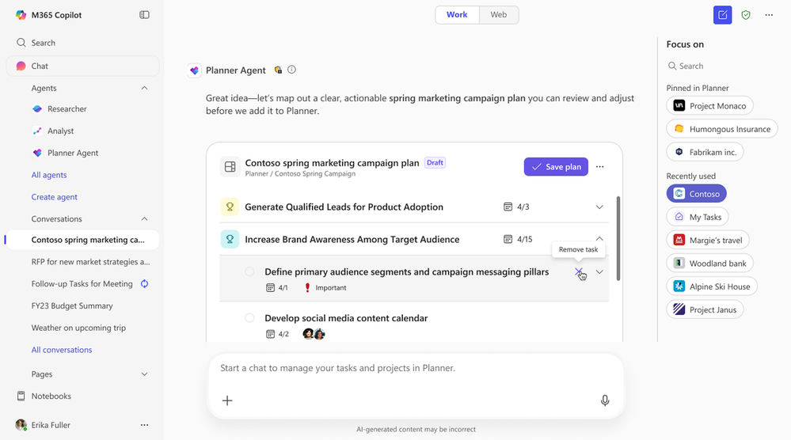
Planner Agent in Microsoft 365 Copilot
The Planner Agent helps users plan, organize, and manage work more efficiently inside Microsoft 365 Copilot.
Interactive Task Cards
Delivers task cards and actionable insights so users prioritize across Planner plans.
Natural-Language Tasks
Users create and update tasks with plain-language prompts.
Structured Plans
Ask the agent to build structured plans with goals and buckets.
June Rollout
Rolled out in June.
Planner Agent in Microsoft 365 Copilot
What's New in Microsoft 365 Copilot | June 2026
Notes:
Planner Agent in Microsoft 365 Copilot
The Planner Agent helps users plan, organize, and manage work more efficiently inside Microsoft 365 Copilot.
• Interactive Task Cards — Delivers task cards and actionable insights so users prioritize across Planner plans.
• Natural-Language Tasks — Users create and update tasks with plain-language prompts.
• Structured Plans — Ask the agent to build structured plans with goals and buckets.
June Rollout — Rolled out in June.
Source: Planner Agent in Microsoft 365 Copilot — https://techcommunity.microsoft.com/blog/microsoft365copilotblog/what%E2%80%99s-new-in-microsoft-365-copilot--june-2026/4529572

Slide 33
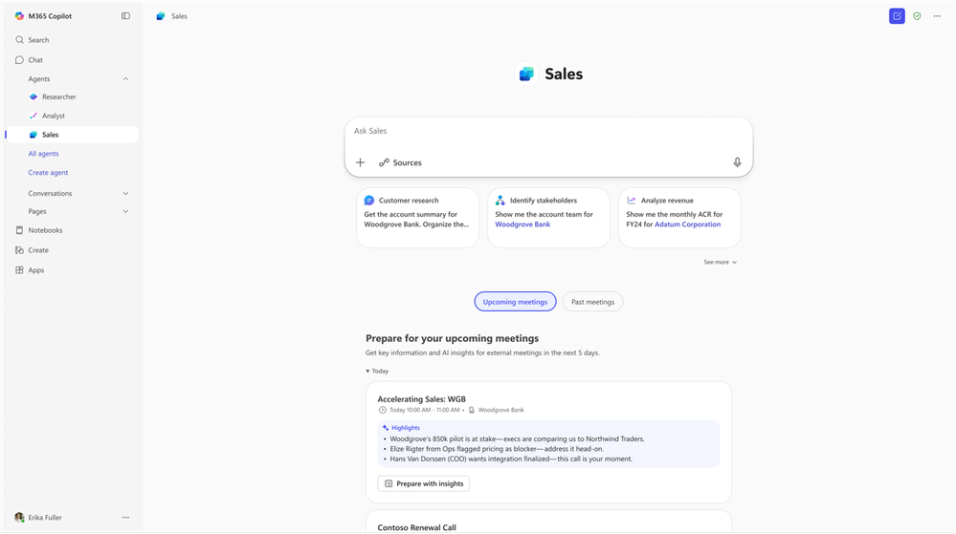
Sales Agent — General Availability
Sales Agent is generally available in Microsoft 365 Copilot, bringing customer and deal intelligence into the flow of work.
Conversational CRM: Sellers use natural language to search, summarize, and act on sales data across connected CRM and past customer conversations.
Grounded in Context: Combines CRM records such as opportunities and contacts with Microsoft 365 data such as emails, meetings, and calendars.
Works Where Sellers Work: Same capabilities and shared context across Outlook, Teams, and Dynamics 365, respecting each user's CRM access level.
Now Generally Available
GA following public preview; admins control which environments, users, and applications have access.
Learn more
Sales Agent — General Availability
What's New in Microsoft 365 Copilot | June 2026
Notes:
Sales Agent — General Availability
Sales Agent is generally available in Microsoft 365 Copilot, bringing customer and deal intelligence into the flow of work.
• Conversational CRM — Sellers use natural language to search, summarize, and act on sales data across connected CRM and past customer conversations.
• Grounded in Context — Combines CRM records such as opportunities and contacts with Microsoft 365 data such as emails, meetings, and calendars.
• Works Where Sellers Work — Same capabilities and shared context across Outlook, Teams, and Dynamics 365, respecting each user's CRM access level.
Now Generally Available — GA following public preview; admins control which environments, users, and applications have access.
Source: Sales Agent — General Availability — https://techcommunity.microsoft.com/blog/microsoft365copilotblog/sales-agent-is-now-generally-available-bringing-customer-and-deal-intelligence-i/4532629

Slide 34
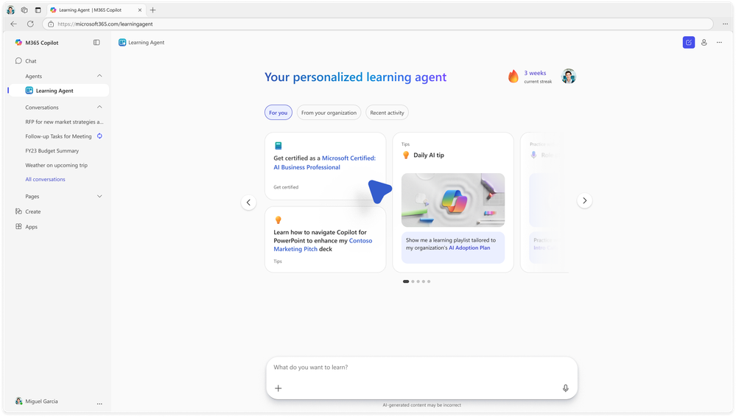
Learning Agent — General Availability
Learning Agent delivers personalized, in-the-flow learning to help employees build Copilot and AI skills faster.
Tailored Learning: Powered by Work IQ and AI Skills Navigator (preview), content adapts to each role and daily work.
Learn By Doing: Provides tips, skill assessments, customized plans, certifications, and roleplay practice in the flow of work.
Continuous Growth: Helps people keep improving over time directly within their workflow.
Rollout
Rolling out in June.
Learning Agent
Learning Agent now generally available — personalized AI upskilling for every employee | Microsoft Community Hub
Notes:
Learning Agent
Learning Agent delivers personalized, in-the-flow learning to help employees build Copilot and AI skills faster.
• Tailored Learning — Powered by Work IQ and AI Skills Navigator (preview), content adapts to each role and daily work.
• Learn By Doing — Provides tips, skill assessments, customized plans, certifications, and roleplay practice in the flow of work.
• Continuous Growth — Helps people keep improving over time directly within their workflow.
Rollout — Rolling out in June.
Source: What's New in Microsoft 365 Copilot | May 2026 — https://techcommunity.microsoft.com/blog/microsoft365copilotblog/what%E2%80%99s-new-in-microsoft-365-copilot--may-2026/4522010

Slide 35

Copilot Control System

Slide 36

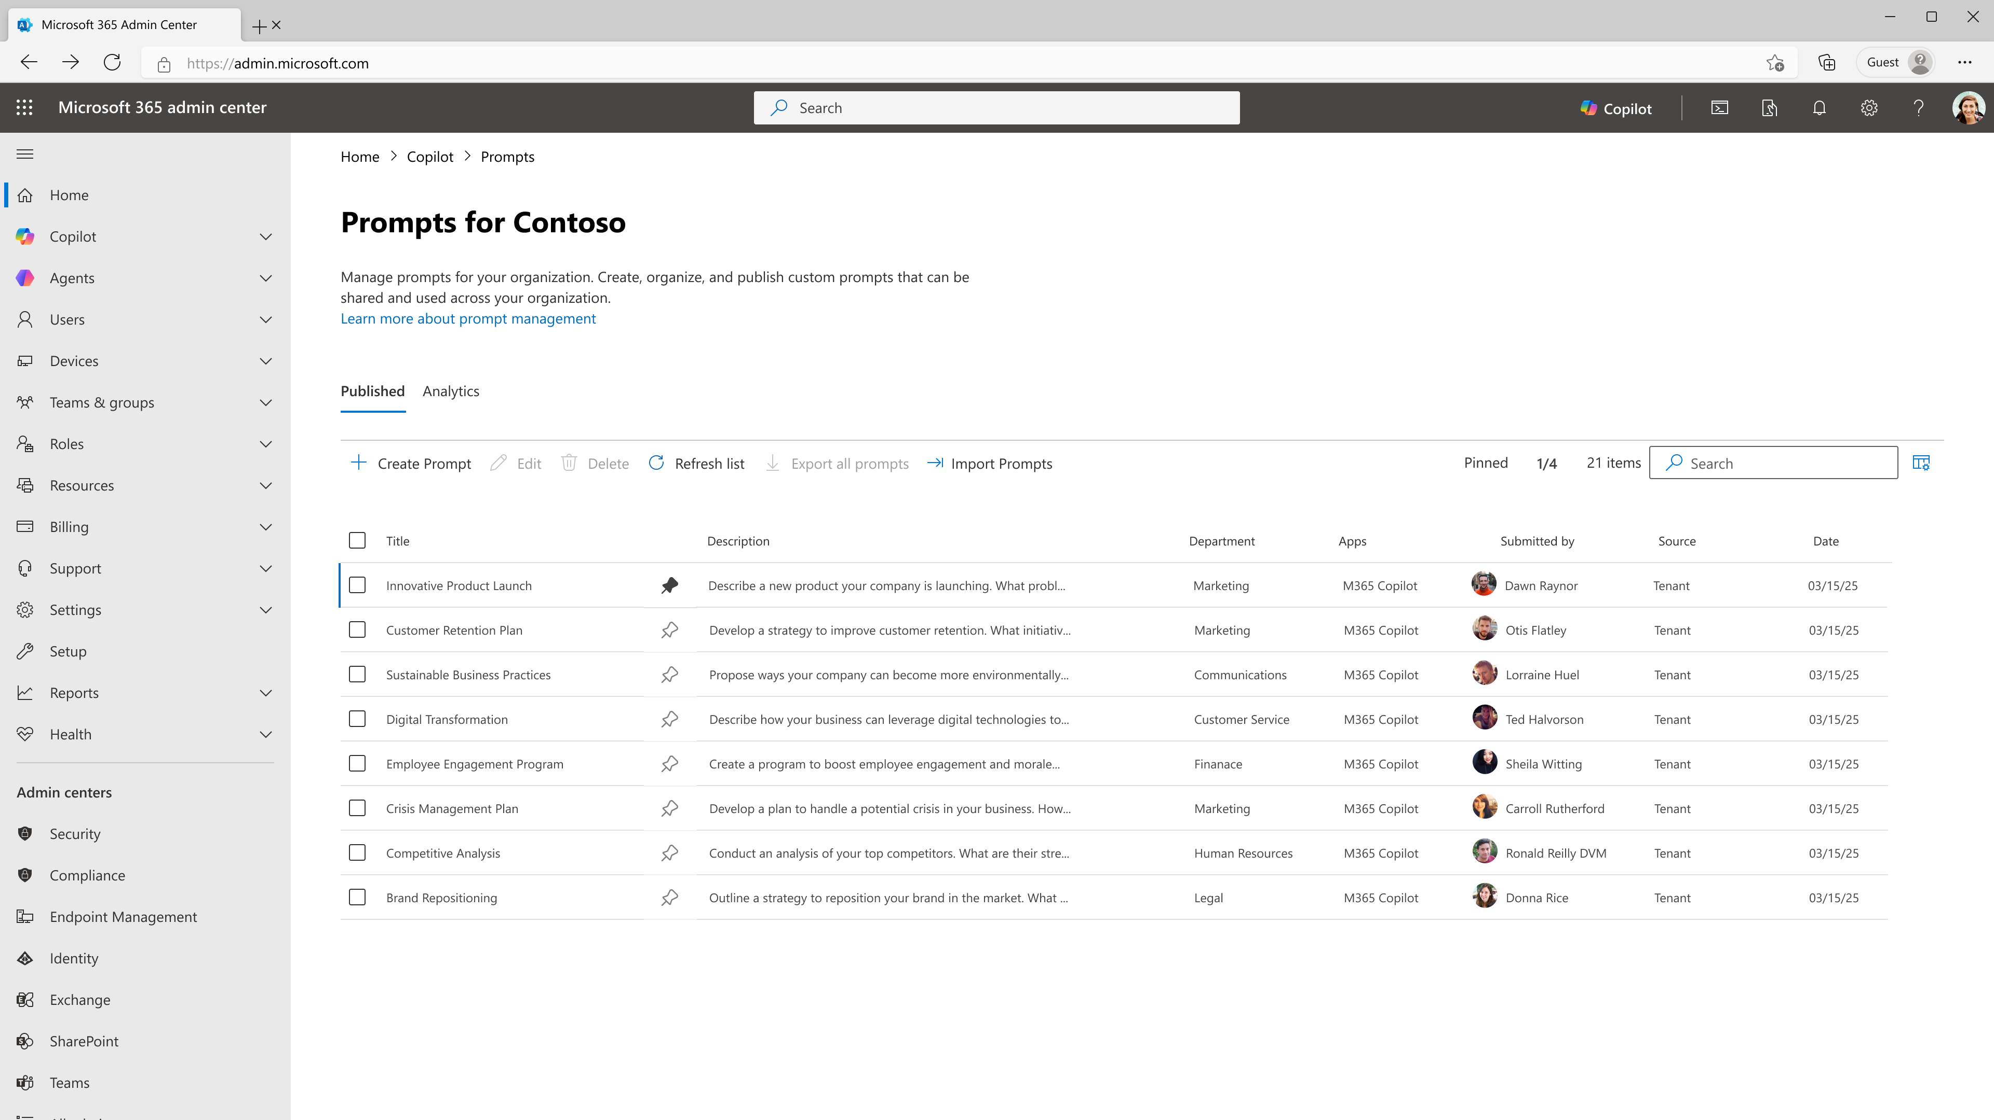
Organization Prompts in Microsoft 365 Admin Center
Admins can create and publish organization prompts to guide users toward effective Copilot use for common workflows.
Admin-Published Prompts: Create and publish organization prompts in the Microsoft 365 Admin Center.
Surfaced to Users: Users find them in Copilot Chat prompt suggestions and the Prompt Gallery.
Builds Good Habits: Helps users form effective prompting habits and explore tailored use cases.
June Rollout
Rolled out in June.
Organization Prompts in Microsoft 365 Admin Center
What's New in Microsoft 365 Copilot | June 2026
Notes:
Organization Prompts in Microsoft 365 Admin Center
Admins can create and publish organization prompts to guide users toward effective Copilot use for common workflows.
• Admin-Published Prompts — Create and publish organization prompts in the Microsoft 365 Admin Center.
• Surfaced to Users — Users find them in Copilot Chat prompt suggestions and the Prompt Gallery.
• Builds Good Habits — Helps users form effective prompting habits and explore tailored use cases.
June Rollout — Rolled out in June.
Source: Organization Prompts in Microsoft 365 Admin Center — https://techcommunity.microsoft.com/blog/microsoft365copilotblog/what%E2%80%99s-new-in-microsoft-365-copilot--june-2026/4529572

Slide 37
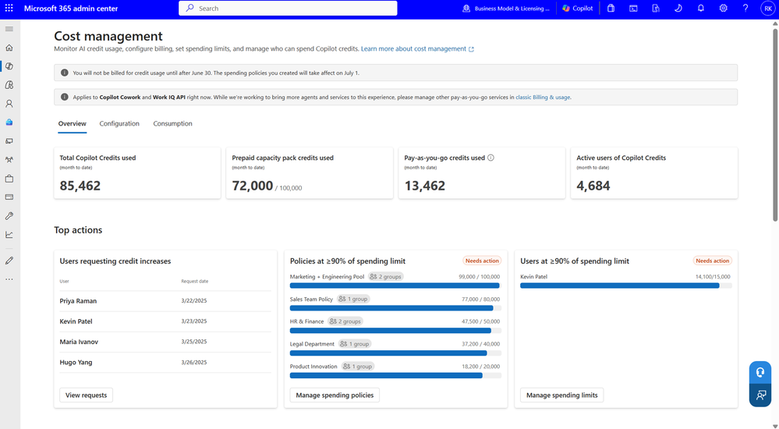
Cost Management Dashboard
The Cost Management Dashboard provides a centralized way to activate, manage, and optimize spending on usage-based AI experiences, including Copilot Cowork.
Allocate and Limit: Allocate Copilot Credits and create spending policies and limits by group.
Billing Models: Choose between prepaid credits and pay-as-you-go billing.
Monitor and Cap: Reporting, budgets, alerts, and hard caps help control costs and manage spend.
June Rollout
Rolled out in June.
Cost Management Dashboard
What's New in Microsoft 365 Copilot | June 2026
Notes:
Cost Management Dashboard
The Cost Management Dashboard provides a centralized way to activate, manage, and optimize spending on usage-based AI experiences, including Copilot Cowork.
• Allocate and Limit — Allocate Copilot Credits and create spending policies and limits by group.
• Billing Models — Choose between prepaid credits and pay-as-you-go billing.
• Monitor and Cap — Reporting, budgets, alerts, and hard caps help control costs and manage spend.
June Rollout — Rolled out in June.
Source: Cost Management Dashboard — https://techcommunity.microsoft.com/blog/microsoft365copilotblog/what%E2%80%99s-new-in-microsoft-365-copilot--june-2026/4529572

Slide 38
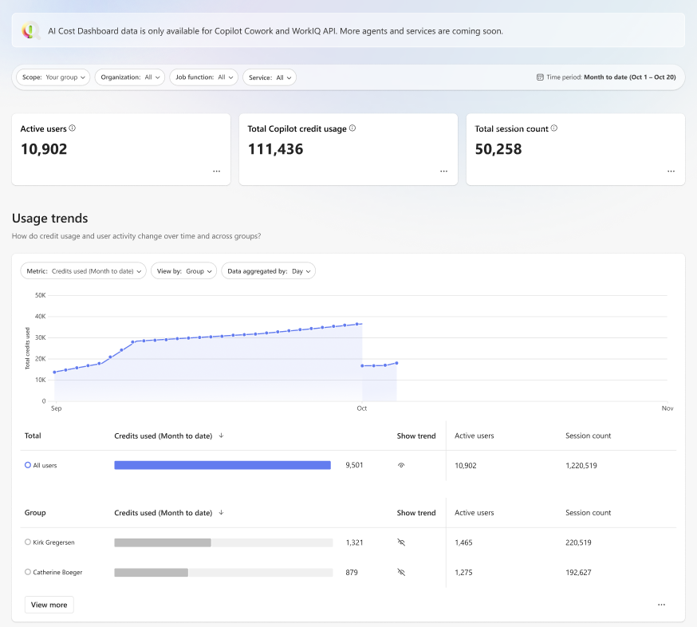
Team-Level Cost Reporting in Insights
Additional cost reporting gives team leaders a view into their team's use of Copilot Credits through a dashboard in Insights.
Group and Team View: Cost reporting at the group or team level surfaces in an Insights dashboard.
Enabled by Default: Available to managers with at least five direct reports, plus Insights Analysts and Global Administrators.
Manage AI Spend: Helps leaders quickly understand and manage AI spend.
July Rollout
Rolls out in July.
Team-Level Cost Reporting in Insights
What's New in Microsoft 365 Copilot | June 2026
Notes:
Team-Level Cost Reporting in Insights
Additional cost reporting gives team leaders a view into their team's use of Copilot Credits through a dashboard in Insights.
• Group and Team View — Cost reporting at the group or team level surfaces in an Insights dashboard.
• Enabled by Default — Available to managers with at least five direct reports, plus Insights Analysts and Global Administrators.
• Manage AI Spend — Helps leaders quickly understand and manage AI spend.
July Rollout — Rolls out in July.
Source: Team-Level Cost Reporting in Insights — https://techcommunity.microsoft.com/blog/microsoft365copilotblog/what%E2%80%99s-new-in-microsoft-365-copilot--june-2026/4529572

Slide 39
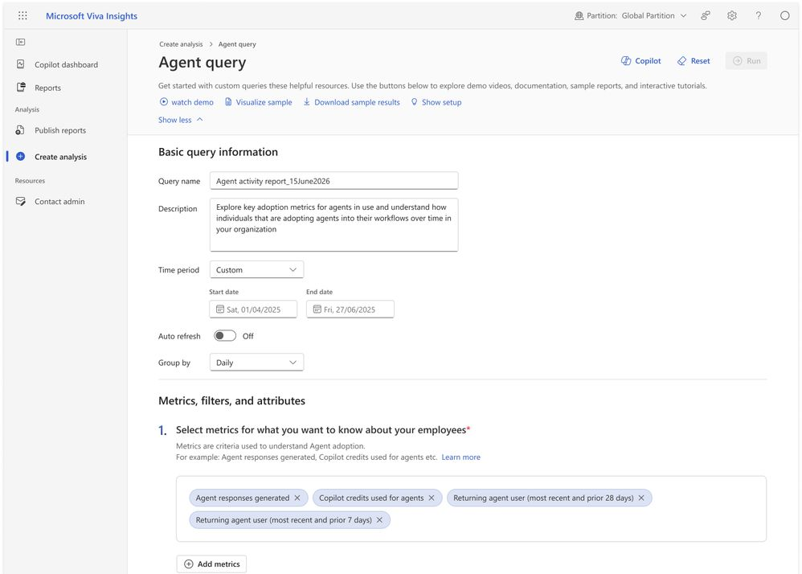
Agent Metrics for Custom Reporting
Agent metrics in Insights let analysts explore and combine granular agent usage data with organizational context.
Granular Usage Data: Explore agent usage combined with organizational context.
Custom Reports: Identify adoption trends and build custom reports without relying on predefined dashboards.
Data-Driven Decisions: Supports data-driven decisions on agent adoption.
Rollout Timing
Public preview in July, generally available in September.
Agent Metrics for Custom Reporting
What's New in Microsoft 365 Copilot | June 2026
Notes:
Agent Metrics for Custom Reporting
Agent metrics in Insights let analysts explore and combine granular agent usage data with organizational context.
• Granular Usage Data — Explore agent usage combined with organizational context.
• Custom Reports — Identify adoption trends and build custom reports without relying on predefined dashboards.
• Data-Driven Decisions — Supports data-driven decisions on agent adoption.
Rollout Timing — Public preview in July, generally available in September.
Source: Agent Metrics for Custom Reporting — https://techcommunity.microsoft.com/blog/microsoft365copilotblog/what%E2%80%99s-new-in-microsoft-365-copilot--june-2026/4529572

Slide 40
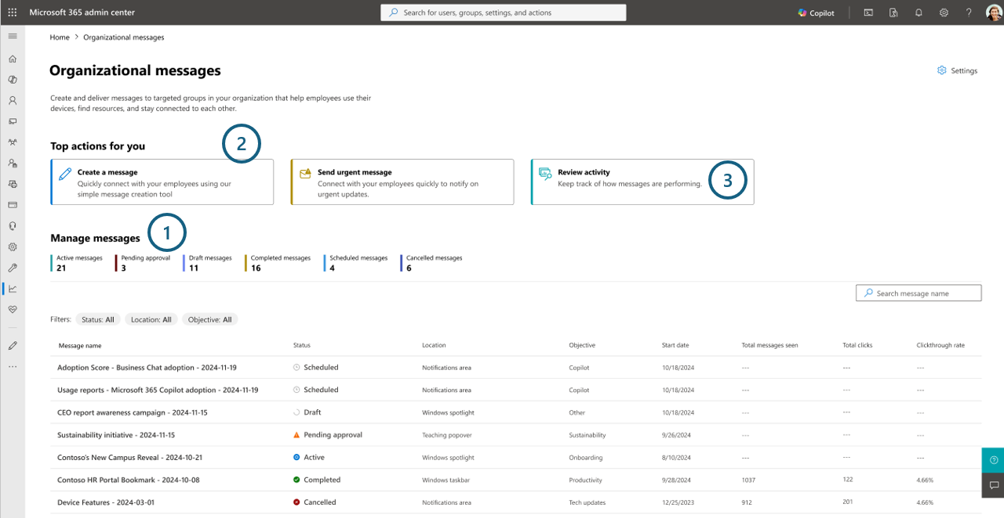
Organizational Messages on Hybrid-Joined Devices
Organizational Messages now support hybrid-joined devices, extending targeted in-product communications to more managed endpoints.
Hybrid Identity Reach: Deliver messages to users on devices joined to both on-premises Active Directory and Microsoft Entra ID.
Closes Coverage Gap: Expands message reach across enterprise environments where hybrid identity is common.
Drives Adoption: Helps drive awareness, onboarding, and adoption of Copilot, agents, and other Microsoft 365 experiences.
June Rollout
Rolled out in June.
Organizational Messages on Hybrid-Joined Devices
What's New in Microsoft 365 Copilot | June 2026
Notes:
Organizational Messages on Hybrid-Joined Devices
Organizational Messages now support hybrid-joined devices, extending targeted in-product communications to more managed endpoints.
• Hybrid Identity Reach — Deliver messages to users on devices joined to both on-premises Active Directory and Microsoft Entra ID.
• Closes Coverage Gap — Expands message reach across enterprise environments where hybrid identity is common.
• Drives Adoption — Helps drive awareness, onboarding, and adoption of Copilot, agents, and other Microsoft 365 experiences.
June Rollout — Rolled out in June.
Source: Organizational Messages on Hybrid-Joined Devices — https://techcommunity.microsoft.com/blog/microsoft365copilotblog/what%E2%80%99s-new-in-microsoft-365-copilot--june-2026/4529572

Slide 41
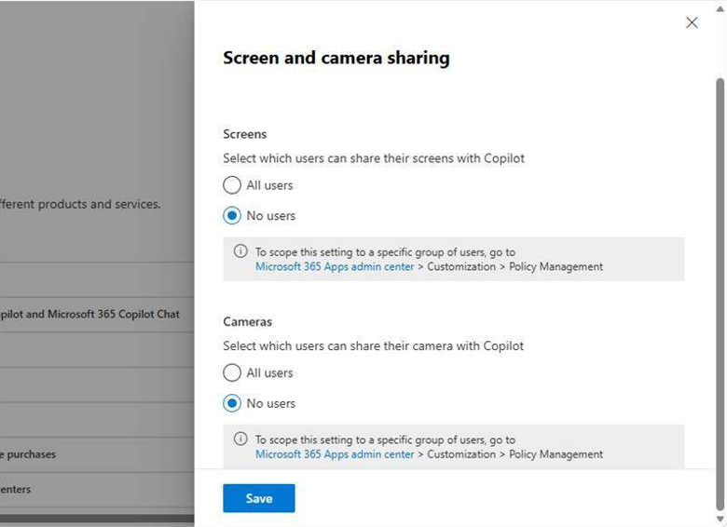
Admin Control for Vision
Admins get a control for vision in Microsoft 365, governing when and where vision can be used.
Governs Visual Input: Controls the feature that uses a stream of images from screen or camera sharing as model input.
When and Where: Organizations decide when and where vision can be used.
Org-Level Oversight: Gives IT oversight of the vision experience.
June Rollout
Rolled out in June.
Admin Control for Vision
What's New in Microsoft 365 Copilot | June 2026
Notes:
Admin Control for Vision
Admins get a control for vision in Microsoft 365, governing when and where vision can be used.
• Governs Visual Input — Controls the feature that uses a stream of images from screen or camera sharing as model input.
• When and Where — Organizations decide when and where vision can be used.
• Org-Level Oversight — Gives IT oversight of the vision experience.
June Rollout — Rolled out in June.
Source: Admin Control for Vision — https://techcommunity.microsoft.com/blog/microsoft365copilotblog/what%E2%80%99s-new-in-microsoft-365-copilot--june-2026/4529572

Slide 42
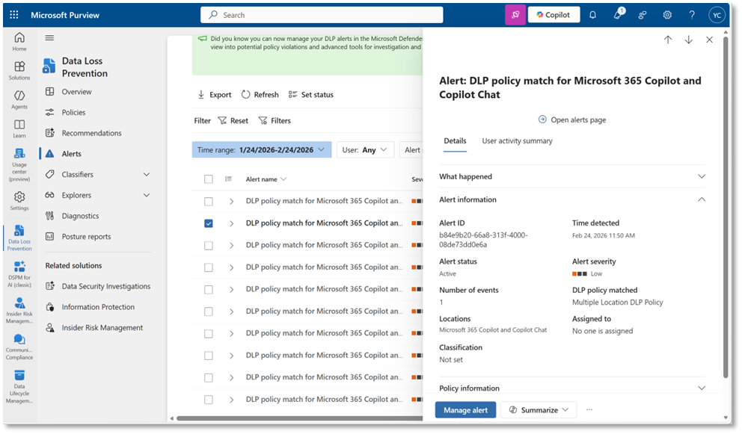
Purview DLP — Restrict External Emails
Microsoft Purview Data Loss Prevention can restrict external emails from being referenced in Microsoft 365 Copilot and Copilot Chat.
Exclude External Senders: Stop messages from external senders being summarized, referenced, or used as grounding data.
Reduces Risk: Limits external, third-party, or unvetted information appearing in AI-generated responses.
Scope: Applies to Microsoft 365 Copilot and agents built in Copilot Studio published to Copilot, using only Microsoft 365 data.
Rollout Timing
Public preview in June, generally available in July.
Purview DLP — Restrict External Emails
What's New in Microsoft 365 Copilot | June 2026
Notes:
Purview DLP — Restrict External Emails
Microsoft Purview Data Loss Prevention can restrict external emails from being referenced in Microsoft 365 Copilot and Copilot Chat.
• Exclude External Senders — Stop messages from external senders being summarized, referenced, or used as grounding data.
• Reduces Risk — Limits external, third-party, or unvetted information appearing in AI-generated responses.
• Scope — Applies to Microsoft 365 Copilot and agents built in Copilot Studio published to Copilot, using only Microsoft 365 data.
Rollout Timing — Public preview in June, generally available in July.
Source: Purview DLP — Restrict External Emails — https://techcommunity.microsoft.com/blog/microsoft365copilotblog/what%E2%80%99s-new-in-microsoft-365-copilot--june-2026/4529572

Slide 43
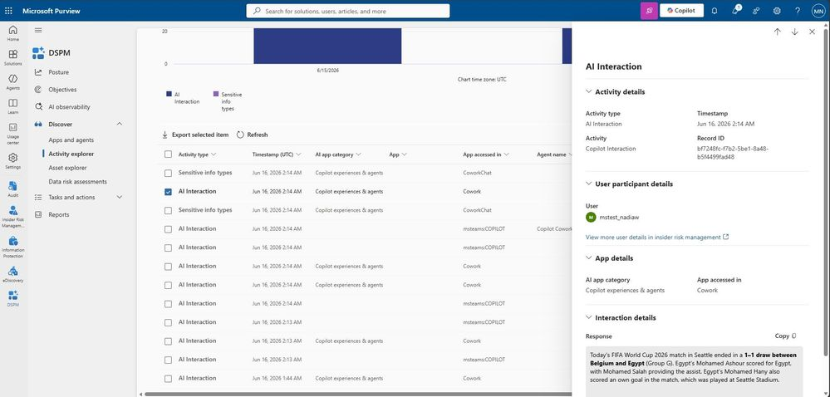
Purview Controls for Copilot Cowork
Microsoft Purview controls extend to Cowork, letting organizations govern it with the same tools used for Microsoft 365 Copilot.
Familiar Controls: Manage security and compliance for Cowork with the same tools as Copilot.
Data Security: Supports sensitivity label inheritance and display, audit logging, and DSPM interaction content in Activity Explorer.
Risk and Compliance: Covers Insider Risk Management, eDiscovery, Data Lifecycle Management, and Communication Compliance of Cowork interactions.
June Rollout
Rolled out in June.
Purview Controls for Copilot Cowork
What's New in Microsoft 365 Copilot | June 2026
Notes:
Purview Controls for Copilot Cowork
Microsoft Purview controls extend to Cowork, letting organizations govern it with the same tools used for Microsoft 365 Copilot.
• Familiar Controls — Manage security and compliance for Cowork with the same tools as Copilot.
• Data Security — Supports sensitivity label inheritance and display, audit logging, and DSPM interaction content in Activity Explorer.
• Risk and Compliance — Covers Insider Risk Management, eDiscovery, Data Lifecycle Management, and Communication Compliance of Cowork interactions.
June Rollout — Rolled out in June.
Source: Purview Controls for Copilot Cowork — https://techcommunity.microsoft.com/blog/microsoft365copilotblog/what%E2%80%99s-new-in-microsoft-365-copilot--june-2026/4529572

Slide 44
Microsoft 365 Copilot Public Roadmap
Changes this month
As of 6th July 2026
Microsoft 365 Roadmap - See What's Coming | Microsoft 365
Notes:
As of 6th July 2026

Slide 45

Microsoft 365 Copilot Public Roadmap
As of 6th July 2026
Launched and Rolling Out “Changed within last month”
Launched (27) 🚀
  Rolling Out (9)
Pre-setup guides, editability, actionable errors & alerting support available for Connector admins
Web Link as a Reference in Copilot Notebooks
Work IQ APIs – Remote MCP Server Support
Planner: Planner Agent chat
Planner Agent in Microsoft 365 Copilot
Unlocking Deeper Copilot Insights with Enhanced Power BI Filtering
Create Word documents from Copilot Notebooks
Explain slide selection during PowerPoint Live
Create Excel spreadsheets from Copilot Notebooks
Microsoft Viva: Insights - New Copilot Metrics Available
Copilot provides coaching feedback in chat as you draft, edit and format emails
Create PowerPoint presentations from Copilot Notebooks
PowerPoint Agent
Ground Microsoft 365 Copilot Chat in Edge for Business in your open YouTube videos
Microsoft Edge: Microsoft 365 Copilot Chat access to page content will soon extend to work across multiple open tabs
Microsoft Viva: Copilot Analytics: "All"- licensed user page Copilot dashboard
Mind Maps in Copilot Notebooks
Quickly launch the Microsoft 365 Copilot app on your iOS device
Microsoft Copilot (Microsoft 365): Open Word, Excel, and PowerPoint Files in Copilot Chat
Learning Agent in Microsoft 365 Copilot
Copilot Chat-centered experience for creating new documents in the Microsoft 365 Copilot app on iPhone and iPad
Initiate Copilot Chat by sharing files to the Microsoft 365 Copilot app on iPhone and iPad
Preview and chat with Microsoft Word, Excel, and PowerPoint files in the M365 Copilot app on iPhone
Unifying Copilot Chat policy controls
Copy Tables in Microsoft 365 Copilot Chat
Researcher Output Formats
Copilot uses enterprise assets hosted on Adobe Experience Manager when creating presentations
Branded footer in the Microsoft 365 Copilot app
Attach and reference an image when creating a presentation with Copilot in PowerPoint using Agent Mode.
Simplified design for the Microsoft 365 Copilot app
Vision in Microsoft 365 Copilot can analyze content shared on desktop screen and through mobile camera
Microsoft Viva: New Overview experience in Agent Dashboard
Now smarter with visuals: Copilot Chat leverages embedded images for richer, more accurate answers.
Express voice enrollment in Microsoft Teams
Business Justification for Copilot License Requests
Seamless Search and Chat Integration
Notes:
As of 6th July 2026

Slide 46
Microsoft 365 Copilot Public Roadmap
As of 6th July 2026
New items added “New within the last month”
New items – In development (15)
Microsoft Copilot Studio: Block the use of maker-provided credentials for authentication
Microsoft Copilot Studio: Invoke agents as workflow steps with the agent node
Microsoft Copilot Studio: Enforce safe sharing by detecting credential oversharing
Complex web search with Copilot in Excel
Microsoft Edge: Ask Copilot about an image
Insights: Copilot Analytics - Cowork adoption and impact
OneNote: Suggested Artifact Creation in Copilot Notebooks
Planner: Save AI-generated filters in Planner Agent chat
Edit your document with Copilot in PowerPoint in Government Clouds
Microsoft Edge: Upgraded Copilot new tab page
Microsoft Viva: Insights for GitHub Copilot spend and usage
Updated Copilot Answers
Microsoft Viva: Copilot Analytics - Insights in Cowork and WorkIQ spend and usage
OneNote: Multimodal capture in Copilot Notebooks (Windows)
People Skills- removal and deletion admin control
Notes:
As of 6th July 2026

Slide 47
Microsoft 365 Copilot Public Roadmap
As of 6th July 2026
In development “Changed within last month”
In development (34)
Microsoft Copilot Studio: Block the use of maker-provided credentials for authentication
Get actionable suggestions from Copilot in your Copilot Page
[Copilot Extensibility] [Search UX] Enable customization of icon & name for data sources in Search (& chat)
Microsoft Copilot Studio: Invoke agents as workflow steps with the agent node
Microsoft Copilot Studio: Enforce safe sharing by detecting credential oversharing
Complex web search with Copilot in Excel
Microsoft Edge: Ask Copilot about an image
AI-powered notes for in-person meetings with Facilitator in Teams Rooms on Android
AI-powered notes for in-person meetings with Facilitator in Teams Rooms on Windows
Improved content freshness using Copilot connectors with webhooks-led notifications
Insights: Copilot Analytics - Cowork adoption and impact
OneNote: Suggested Artifact Creation in Copilot Notebooks
Planner: Save AI-generated filters in Planner Agent chat
Copilot Chat can now better match search results from Scanned PDFs and from text inside images embedded in Word, Excel, and PowerPoint
Facilitator detects and answers questions
Copilot Prompt Gallery - Company-wide prompt publishing
OneNote: Summary and Q&A in OneNote Mobile with Copilot (Iphone)
Edit your document with Copilot in PowerPoint in Government Clouds
OneNote: Multimodal capture in Copilot Notebooks (Windows)
Microsoft Edge: Upgraded Copilot new tab page
Copilot in PowerPoint for Government clouds
Copilot improved long files navigation using document structure, enabling more accurate answers and clearer citations.
Microsoft 365 admin center: Usage reports – Microsoft 365 Copilot Connectors
OneNote: Summary and Q&A in OneNote Mobile with Copilot (Android)
Microsoft Viva: Insights for GitHub Copilot spend and usage
Updated Copilot Answers
Microsoft Viva: Fresh Copilot Metrics in Custom Person Queries & Reports- Viva Advanced Analysis
Enhanced M365 Copilot Memory - Copilot is now personalized with work data
Microsoft Viva: Copilot Analytics - Insights in Cowork and WorkIQ spend and usage
People Skills- removal and deletion admin control
AI-generated meeting archive for knowledge retention
Work IQ APIs: Pay‑As‑You‑Go usage
Intelligent meeting recap available without saving transcript
Microsoft Purview compliance portal: Data Lifecycle Management - Retention based on Last Accessed for files in OneDrive and SharePoint
Notes:
As of 6th July 2026

Slide 48
Microsoft 365 Copilot release notes
As of 6th Jul 2026
Latest features and improvements for Microsoft 365 Copilot.
It includes changes that are generally available
(Current Channel for Microsoft 365 apps)
Release Notes for Microsoft 365 Copilot | Microsoft Learn

Slide 49
Microsoft 365 Copilot release notes – June 2026
As of 7th July 2026
Microsoft 365 Copilot Chat (3)
Word (1)
Anthropic's Claude now available in Microsoft 365 Copilot [Android, Windows, iOS, Mac, Web]
Infinite scroll chat history [Web]
Modern, unified, and updated look and feel in Microsoft Edge [Web]
Copilot can edit your document by default in Word [Web]
Microsoft 365 Copilot Studio (2)
Add expected response for agent evaluation test cases [Web]
Grader Framework for Agent Evaluation [Web]
Copilot extensibility (3)
Connect 15Five data to surface team priorities and recognition [Web]
Federated Copilot Connectors are now generally available [Web]
Automate agent lifecycle management with policy-based rules [Windows, Web]
Microsoft 365 Copilot app (1)
Use Microsoft 365 Copilot in model‑driven apps (Work IQ) [Web]
PowerPoint (4)
Black Forest Lab's FLUX.2 Flex model is available in PowerPoint for Microsoft 365 Copilot [Web]
Use Copilot to get a detailed and contextual explanation for shapes and images (Win32) [Windows, Web, Mac]
Edit with Copilot for PowerPoint uses enterprise assets hosted on multiple SharePoint OALs [Windows, Web, Mac]
MAI‑Image‑2‑Efficient is now available in Copilot in PowerPoint [Windows, Mac, Web]
Microsoft 365 admin center (2)
Organizational Messages Usage‑based targeting is now generally available in the Microsoft 365 admin center! [Web]
Organizational Messages now supports Email messages [Web]
Latest features and improvements for Microsoft 365 Copilot generally available on Current Channel for Microsoft 365 apps. 9 updates released between 5 May 2026 and 19 May 2026.
Learn more | Release Notes for Microsoft 365 Copilot

Slide 50
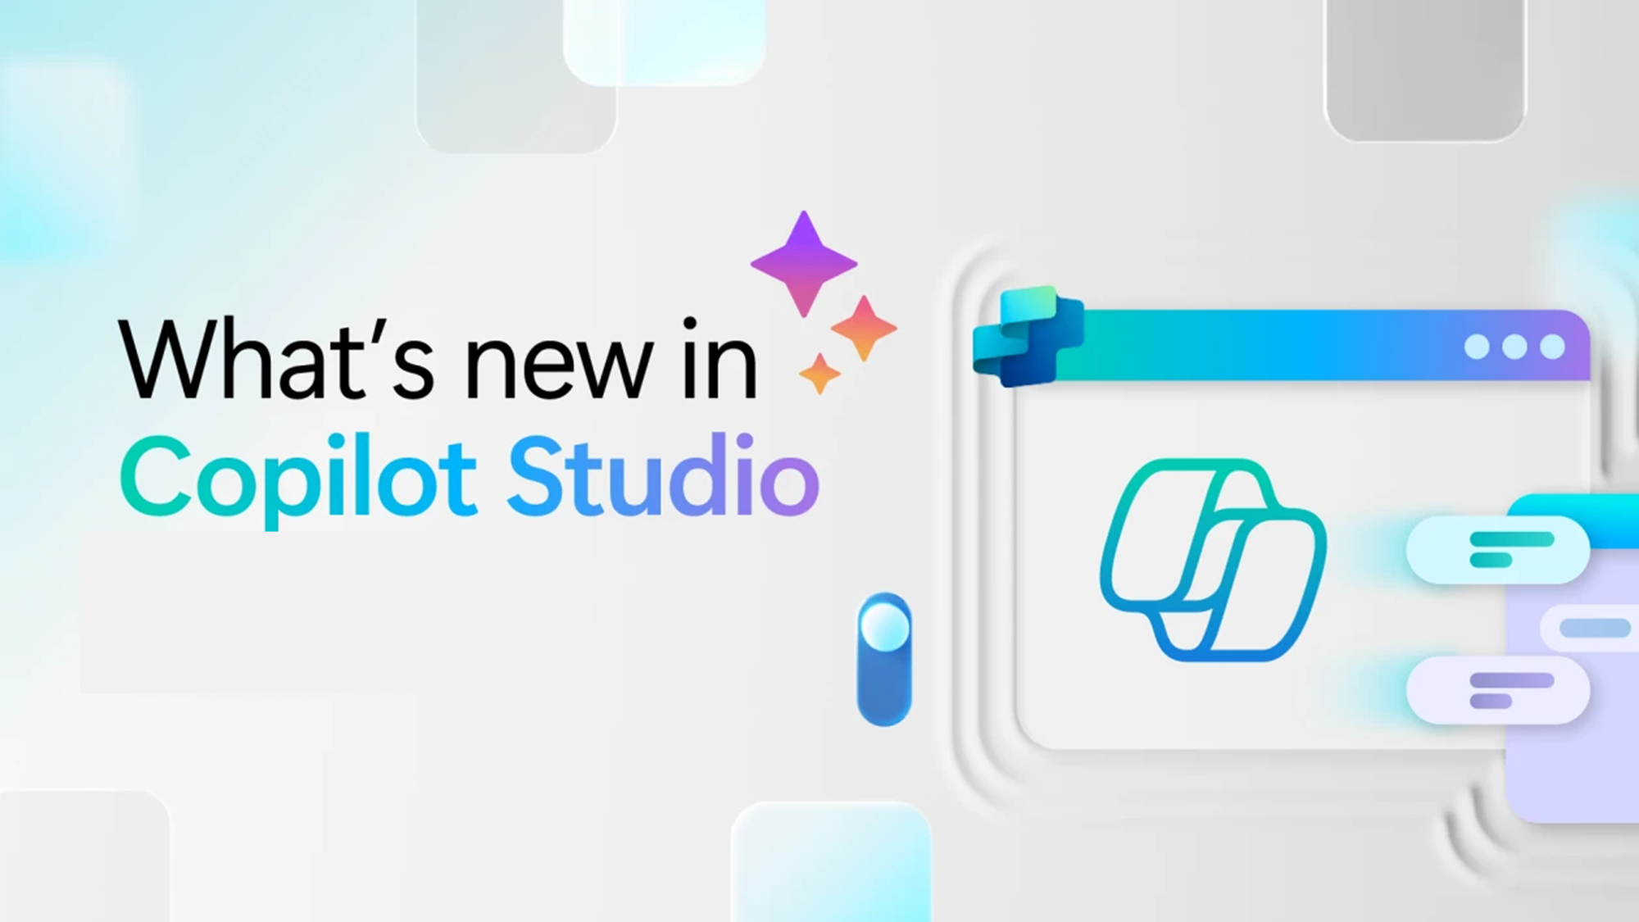
Whats new in Copilot Studio
Notes:
Section transition — Copilot Studio.
Use this slide to pivot from end-user features to the maker/IT story. Copilot Studio is where teams build, orchestrate, and manage custom agents. The next slide lists what shipped, by month of release.

Slide 51

What's new in Copilot Studio
The following table displays the month of release for each new feature.
Month of release | What’s new
June 2026 | (Production-ready preview) Use the new agent experience in Copilot Studio to build agents. The new experience uses an enhanced orchestration runtime for improved response quality and reasoning, available alongside the classic experience. Use Microsoft IQ in the new agent experience to connect your agent to organizational data, giving it access to emails, calendar events, files, Teams messages, and people information. Build and reuse skills in the new agent experience to extend your agent's capabilities with modular, self-contained sets of instructions. Create a skill once, add it to multiple agents, and export it as a Markdown file or package to share with others. Turn on memory in the new agent experience to give your agent persistent context across interactions. It captures user preferences and patterns, stores them per user, and applies them to deliver more relevant and personalized responses over time.
What's new in Copilot Studio - Microsoft Copilot Studio | Microsoft Learn | Copilot Studio Archive | Microsoft Copilot Blog
Notes:
What’s new in Copilot Studio — release table.

Slide 52

What's new in Frontier
Get hands-on with breakthrough preview features, share your insights with product teams, and help shape the future of AI.
With Frontier, you’re not just adopting new technology, you’re co-creating what comes next.
Frontier program – Microsoft Adoption
Notes:
Frontier — what it is.
Frame Frontier as Microsoft’s early-access program: “you’re not just adopting new technology, you’re co-creating what comes next.” Customers in Frontier get the newest agents and features first and help shape them through feedback. Mention it ties into Microsoft Adoption resources.

Slide 53
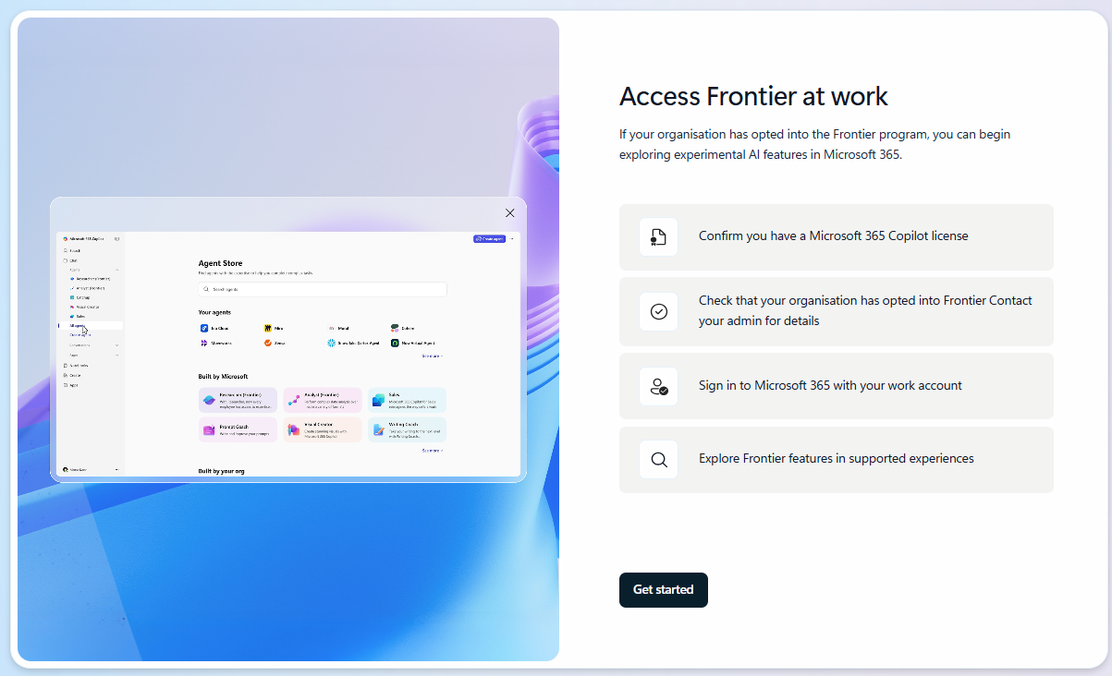
What's new in Frontier
Try out the latest agents and features in Microsoft 365 Copilot and see how they can transform your day-to-day.​
Critique and Council: Researcher powered with multi-model intelligence
Agents that help drive AI workforce transformation
Plugins and Mobile Come to Copilot Cowork
Frontier Getting started guide
Notes:
Frontier — try it out.
Encourage the audience to get hands-on. Point them to the Frontier getting-started guide and the newest items, including:
• Agents to drive AI workforce transformation
• Microsoft Agent 365 — the control plane for AI agents
• Build and create with Copilot Pages
• Sales Development Agent (and how it connects with Dynamics 365)
• Project Opal
• Windows 365 AI-enabled Cloud PCs
Close by inviting them to try these in their own day-to-day and share feedback.

Slide 54
Thank you 👏
Got feedback ?
https://aka.ms/WhatsNewCopilot/Feedback

Slide 55

Feedback Form

Slide 56
Resources
Microsoft 365 Copilot Blog | Microsoft Community Hub
What’s New in Microsoft 365 Copilot | June 2026 | Microsoft Community Hub
Release Notes for Microsoft 365 Copilot | Microsoft Learn
Microsoft 365 Roadmap | Microsoft 365
What's new in Copilot Studio - Microsoft Copilot Studio | Microsoft Learn
Copilot Studio | Microsoft Copilot Blog
Microsoft 365 Copilot News and Insights | Microsoft 365 Blog
Available today: Anthropic’s Claude Sonnet 5 in Microsoft 365 Copilot | Microsoft Community Hub
Sales Agent is now generally available: Bringing customer and deal intelligence into the flow of work | Microsoft Community Hub
The workflow is the product: Copilot Cowork plugins change what AI can do for businesses | Microsoft Community Hub

Slide 57
Microsoft 365 Copilot
May 2026
As of 3rd Jun 2026
Copilot Control System
User capabilities
        Expanded ISO certifications across the Copilot portfolio
        The new Copilot Adoption Hub
        Federated Copilot connectors
        Enabling watermarks for sensitive material
        Claude Opus 4.8 in Microsoft 365 Copilot
        Refreshed Microsoft 365 Copilot app design
        Copilot Notebooks enhancements
        Copilot in Apple CarPlay
        GPT-5.5 Instant for Copilot Chat and Studio
        Expanded Copilot Prompt Gallery
        Account selector and voice for Copilot in Outlook
        Call delegation with Copilot in Teams
        Recap deletion in Teams
        Video recap with Copilot in Teams
        Document activity summaries in Word
        Personalization with Copilot memory in Word
        Writing suggestions from the Word Agent
        Slide explanations and built-in skills in PowerPoint
        Custom skills for Copilot in SharePoint
Agents & Microsoft Build 2026
        Learning Agent
        Work IQ
        Microsoft Scout
        Microsoft IQ
        MAI-Image-2.5
        Agent 365
        Web IQ
        MAI-Code-1
        MAI-Voice-2 & Transcribe 1.5
        Autopilot agents
        Publish agents to Teams/M365
        Windows 365 for Agents

