Slide 1


What’s new in
Microsoft 365 Copilot
As of 3rd Jun 2026
May 2026
Presenter name
Title

Slide 2
What's new in Microsoft 365 Copilot
Updates listed in this document are selected based on relevance to Microsoft 365 Copilot.
Release dates and timings are subject to change.
For a complete list of Copilot for Microsoft 365 roadmap items refer to
Microsoft 365 Roadmap | Microsoft 365
Got feedback ?
https://aka.ms/WhatsNewCopilot/Feedback

Slide 3

What’s new in Microsoft 365 Copilot
May 2026
As of 3rd Jun 2026
Copilot Control System
User capabilities
        Expanded ISO certifications across the Copilot portfolio
        The new Copilot Adoption Hub
        Federated Copilot connectors
        Enabling watermarks for sensitive material
        Claude Opus 4.8 in Microsoft 365 Copilot
        Refreshed Microsoft 365 Copilot app design
        Copilot Notebooks enhancements
        Copilot in Apple CarPlay
        GPT-5.5 Instant for Copilot Chat and Studio
        Expanded Copilot Prompt Gallery
        Account selector and voice for Copilot in Outlook
        Call delegation with Copilot in Teams
        Recap deletion in Teams
        Video recap with Copilot in Teams
        Document activity summaries in Word
        Personalization with Copilot memory in Word
        Writing suggestions from the Word Agent
        Slide explanations and built-in skills in PowerPoint
        Custom skills for Copilot in SharePoint
Agents & Microsoft Build 2026
        Learning Agent
        Work IQ
        Microsoft Scout
        Microsoft IQ
        MAI-Image-2.5
        Agent 365
        Web IQ
        MAI-Code-1
        MAI-Voice-2 & Transcribe 1.5
        Autopilot agents
        Publish agents to Teams/M365
        Windows 365 for Agents

Slide 4

User capabilities

Slide 5
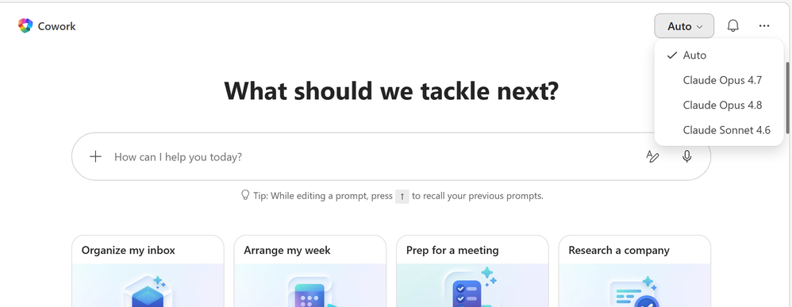
Claude Opus 4.8 in Microsoft 365 Copilot
Anthropic's Claude Opus 4.8 is now available in Microsoft 365 Copilot, expanding model choice for advanced, multi-step work.
Advanced Reasoning
Handles complex, multi-step tasks and long-running workflows with better tool selection and instruction following.
Stronger Outputs
Improves results for drafting documents, analyzing
data, and building presentations.
Grounded Results
With Work IQ, outputs are grounded in your organization's data for more relevant, accurate answers.
Rollout
Available in Copilot Cowork (Frontier); Rolling out to Copilot Studio early release, Copilot Chat, Excel, and PowerPoint.
Claude Opus 4.8 in Microsoft 365 Copilot
Available today: Anthropic Claude Opus 4.8 in Microsoft 365 Copilot | Microsoft Community Hub
Notes:
Claude Opus 4.8 in Microsoft 365 Copilot
Anthropic's Claude Opus 4.8 is now available in Microsoft 365 Copilot, expanding model choice for advanced, multi-step work.
• Advanced Reasoning — Handles complex, multi-step tasks and long-running workflows with better tool selection and instruction following.
• Stronger Outputs — Improves results for drafting documents, analyzing data, and building presentations.
• Grounded Results — With Work IQ, outputs are grounded in your organization's data for more relevant, accurate answers.
Rollout — Available in Copilot Cowork (Frontier); rolling out to Copilot Studio early release, Copilot Chat, Excel, and PowerPoint.
Source: What's New in Microsoft 365 Copilot | May 2026 — https://techcommunity.microsoft.com/blog/microsoft365copilotblog/what%E2%80%99s-new-in-microsoft-365-copilot--may-2026/4522010

Slide 6
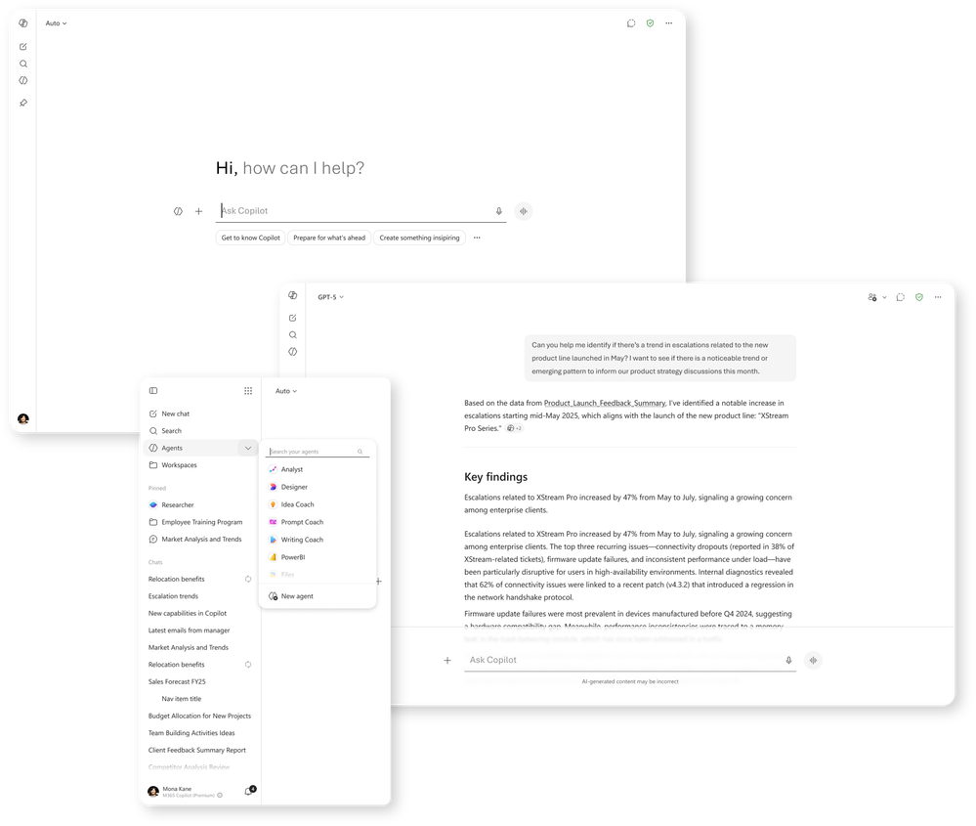
Refreshed Microsoft 365 Copilot app design
The Microsoft 365 Copilot app gains a refreshed, chat-centered design that helps users stay focused and organized.
Chat-Centered Layout
A streamlined design puts chat and responses front and center for a cleaner experience.
Simpler Navigation
Easier navigation helps users move through the app and keep context across tasks.
Organized Work
New ways to organize work make it easier to pick up where you left off.
Rollout
Rolling out in June.
Learn more
Refreshed Microsoft 365 Copilot app design
What's New in Microsoft 365 Copilot | May 2026
Notes:
Refreshed Microsoft 365 Copilot app design
The Microsoft 365 Copilot app gains a refreshed, chat-centered design that helps users stay focused and organized.
• Chat-Centered Layout — A streamlined design puts chat and responses front and center for a cleaner experience.
• Simpler Navigation — Easier navigation helps users move through the app and keep context across tasks.
• Organized Work — New ways to organize work make it easier to pick up where you left off.
Rollout — Rolling out in June.
Source: What's New in Microsoft 365 Copilot | May 2026 — https://techcommunity.microsoft.com/blog/microsoft365copilotblog/what%E2%80%99s-new-in-microsoft-365-copilot--may-2026/4522010

Slide 7
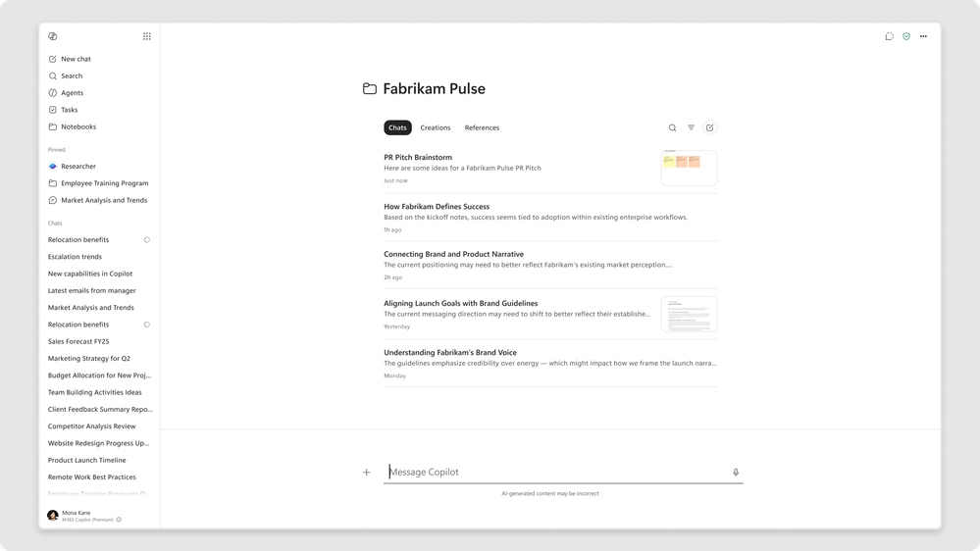
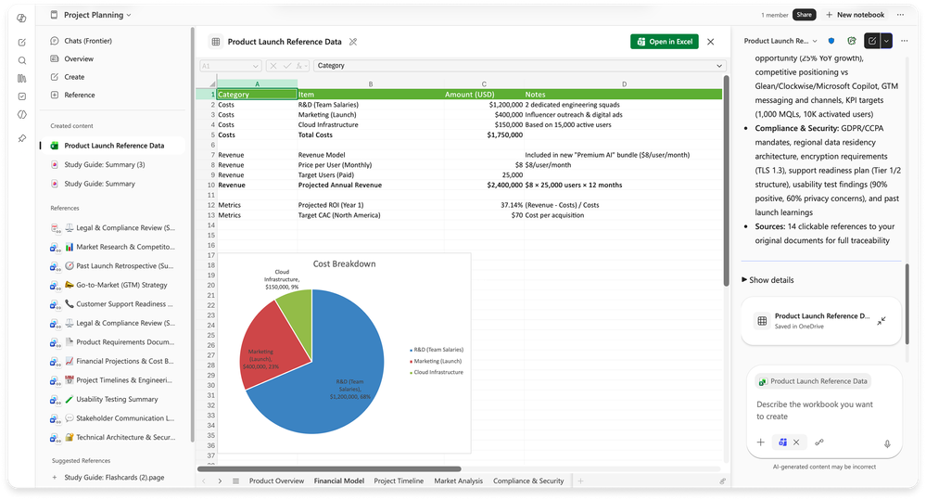
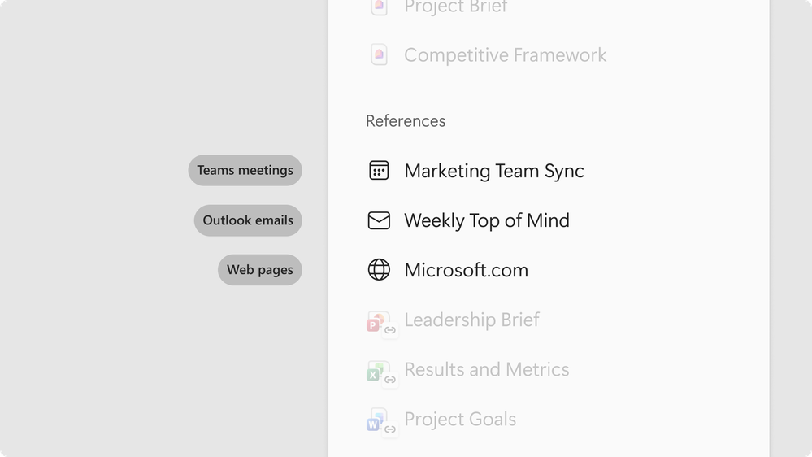
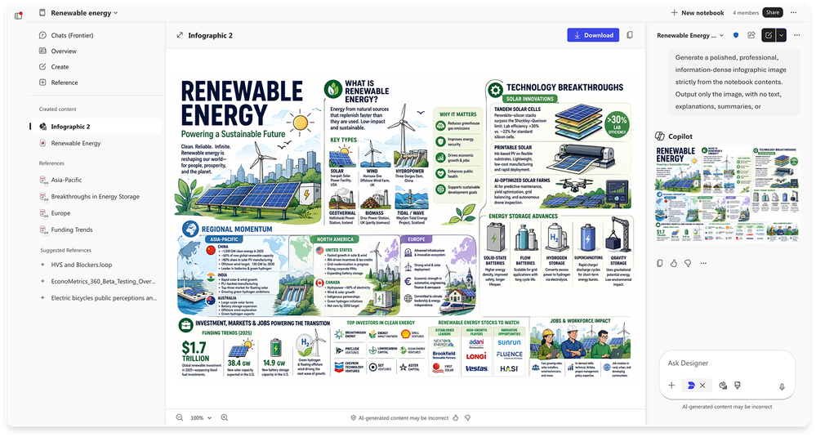
Copilot Notebooks enhancements in the Microsoft 365 Copilot app
Copilot Notebooks gain a unified interface, Teams meetings as knowledge, and new ways to turn notes into spreadsheets and infographics.
Unified Notebook View
An updated interface brings chats, created outputs, and references together, with OneNote sync.
Meetings As Knowledge
Reference individual Teams meetings — transcripts, notes, chats, and shared content — as notebook knowledge.
Spreadsheets And Infographics
Generate Excel spreadsheets via the Excel agent and auto-convert notebook content into visual infographics.
Rollout
Updated UI and OneNote sync in June; meetings, spreadsheets, and infographics to Frontier in May, worldwide in June.
Copilot Notebooks enhancements
What’s New in Notebooks | May 2026 | Microsoft Community Hub
Notes:
Copilot Notebooks enhancements
Copilot Notebooks gain a unified interface, Teams meetings as knowledge, and new ways to turn notes into spreadsheets and infographics.
• Unified Notebook View — An updated interface brings chats, created outputs, and references together, with OneNote sync.
• Meetings As Knowledge — Reference individual Teams meetings — transcripts, notes, chats, and shared content — as notebook knowledge.
• Spreadsheets And Infographics — Generate Excel spreadsheets via the Excel agent and auto-convert notebook content into visual infographics.
Rollout — Updated UI and OneNote sync in June; meetings, spreadsheets, and infographics to Frontier in May, worldwide in June.
Source: What's New in Microsoft 365 Copilot | May 2026 — https://techcommunity.microsoft.com/blog/microsoft365copilotblog/what%E2%80%99s-new-in-microsoft-365-copilot--may-2026/4522010

Slide 8

Copilot in Apple CarPlay
Microsoft 365 Copilot comes to Apple CarPlay so users can catch up on work hands-free while driving.
Hands-Free Access
Start or continue a Copilot chat by voice through the car's display.
Stay Safe
Catch up on work without taking your hands off the wheel or eyes off the road.
On The Go
Pick up conversations and get quick answers while commuting.
Rollout
This feature rolled out in May.
Copilot in Apple CarPlay
What's New in Microsoft 365 Copilot | May 2026
Notes:
Copilot in Apple CarPlay
Microsoft 365 Copilot comes to Apple CarPlay so users can catch up on work hands-free while driving.
• Hands-Free Access — Start or continue a Copilot chat by voice through the car's display.
• Stay Safe — Catch up on work without taking your hands off the wheel or eyes off the road.
• On The Go — Pick up conversations and get quick answers while commuting.
Rollout — Live in May.
Source: What's New in Microsoft 365 Copilot | May 2026 — https://techcommunity.microsoft.com/blog/microsoft365copilotblog/what%E2%80%99s-new-in-microsoft-365-copilot--may-2026/4522010

Slide 9
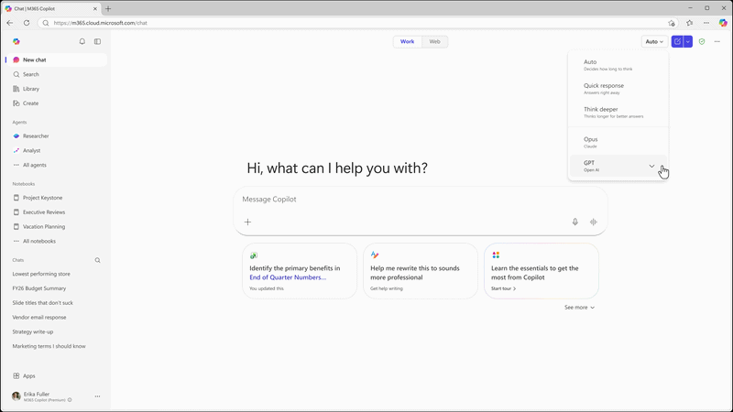
GPT-5.5 Instant for Copilot Chat and Studio
OpenAI's GPT-5.5 Instant brings higher-quality, more concise responses for everyday work across Copilot Chat and Copilot Studio.
Faster Answers
Clearer, less verbose responses with fewer unnecessary follow-up questions.
Broader Strengths
Improved image analysis and STEM-related responses, building on GPT-5.3 Instant.
Where To Find It
Appears as "GPT-5.5 Quick response" in Copilot Chat and "GPT-5.5 Chat" in Copilot Studio early release environments.
Rollout
Rolled out in May.
GPT-5.5 Instant for Copilot Chat and Studio
Available today: GPT-5.5 Instant in Microsoft 365 Copilot | Microsoft Community Hub
Notes:
GPT-5.5 Instant for Copilot Chat and Studio
OpenAI's GPT-5.5 Instant brings higher-quality, more concise responses for everyday work across Copilot Chat and Copilot Studio.
• Faster Answers — Clearer, less verbose responses with fewer unnecessary follow-up questions.
• Broader Strengths — Improved image analysis and STEM-related responses, building on GPT-5.3 Instant.
• Where To Find It — Appears as "GPT-5.5 Quick response" in Copilot Chat and "GPT-5.5 Chat" in Copilot Studio early release environments.
Rollout — Rolled out in May.
Source: What's New in Microsoft 365 Copilot | May 2026 — https://techcommunity.microsoft.com/blog/microsoft365copilotblog/what%E2%80%99s-new-in-microsoft-365-copilot--may-2026/4522010

Slide 10
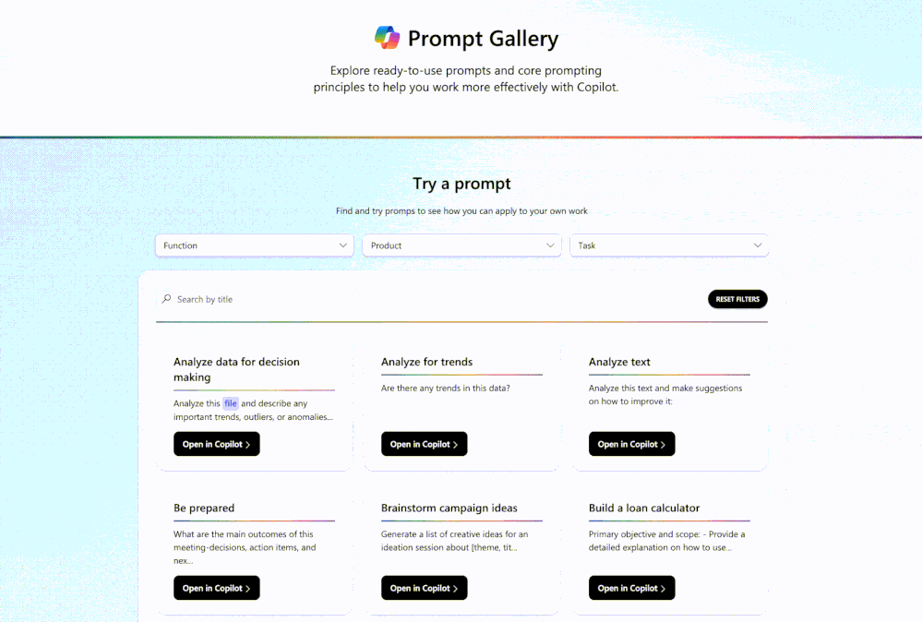
Expanded Copilot Prompt Gallery
The new Prompt Gallery brings ready-to-use prompts and task-based ideas together so users can act on Copilot right away.
Ready-To-Use Prompts
Curated prompts for drafting, meeting prep, analysis, and catching up on work.
Guided Discovery
Simple guidance helps users find a starting point and try a prompt in Copilot.
Shared Workflows
Teams can share useful prompt workflows across the organization.
Learn more
Expanded Copilot Prompt Gallery
What's New in Microsoft 365 Copilot | May 2026
Notes:
Expanded Copilot Prompt Gallery
The new Prompt Gallery brings ready-to-use prompts and task-based ideas together so users can act on Copilot right away.
• Ready-To-Use Prompts — Curated prompts for drafting, meeting prep, analysis, and catching up on work.
• Guided Discovery — Simple guidance helps users find a starting point and try a prompt in Copilot.
• Shared Workflows — Teams can share useful prompt workflows across the organization.
Source: What's New in Microsoft 365 Copilot | May 2026 — https://techcommunity.microsoft.com/blog/microsoft365copilotblog/what%E2%80%99s-new-in-microsoft-365-copilot--may-2026/4522010

Slide 11
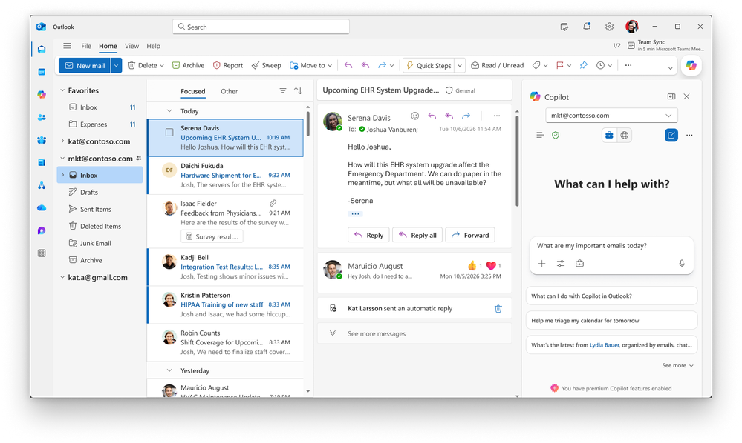
Account selector and voice for Copilot in Outlook
Outlook for Windows adds an account selector and voice to make multi-account Copilot use clearer and safer.
Account Clarity
A dropdown in the calendar Copilot side pane shows which account Copilot is acting on.
Easy Switching
Users can switch between Copilot-enabled accounts without confusion.
Fewer Errors
Reduces accidental cross-account actions for multi-tenant users.
Rollout
Rolled out in May.
Account selector and voice for Copilot in Outlook
What's New in Microsoft 365 Copilot | May 2026
Notes:
Account selector and voice for Copilot in Outlook
Outlook for Windows adds an account selector and voice to make multi-account Copilot use clearer and safer.
• Account Clarity — A dropdown in the calendar Copilot side pane shows which account Copilot is acting on.
• Easy Switching — Users can switch between Copilot-enabled accounts without confusion.
• Fewer Errors — Reduces accidental cross-account actions for multi-tenant users.
Rollout — Rolled out in May.
Source: What's New in Microsoft 365 Copilot | May 2026 — https://techcommunity.microsoft.com/blog/microsoft365copilotblog/what%E2%80%99s-new-in-microsoft-365-copilot--may-2026/4522010

Slide 12
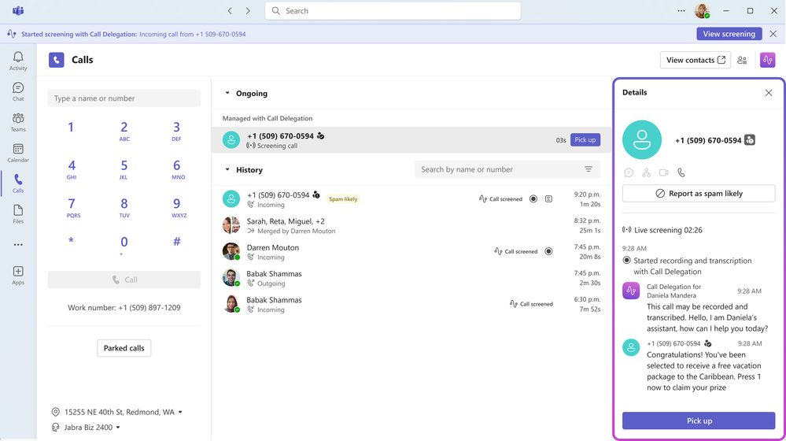
Call delegation with Copilot in Teams
Copilot can answer missed Teams Phone calls, capture what the caller needed, and set up follow-ups so users stay responsive.
Answer Missed Calls
Copilot answers missed Teams Phone calls on your behalf and captures the caller's intent.
Summarized For You
Get a clear summary of what the caller needed so nothing slips through.
Auto Follow-Ups
Copilot can book follow-up time through Bookings based on the call.
Rollout
Rolling out to Frontier in June.
Call delegation with Copilot in Teams
What's New in Microsoft 365 Copilot | May 2026
Notes:
Call delegation with Copilot in Teams
Copilot can answer missed Teams Phone calls, capture what the caller needed, and set up follow-ups so users stay responsive.
• Answer Missed Calls — Copilot answers missed Teams Phone calls on your behalf and captures the caller's intent.
• Summarized For You — Get a clear summary of what the caller needed so nothing slips through.
• Auto Follow-Ups — Copilot can book follow-up time through Bookings based on the call.
Rollout — Rolling out to Frontier in June.
Source: What's New in Microsoft 365 Copilot | May 2026 — https://techcommunity.microsoft.com/blog/microsoft365copilotblog/what%E2%80%99s-new-in-microsoft-365-copilot--may-2026/4522010

Slide 13
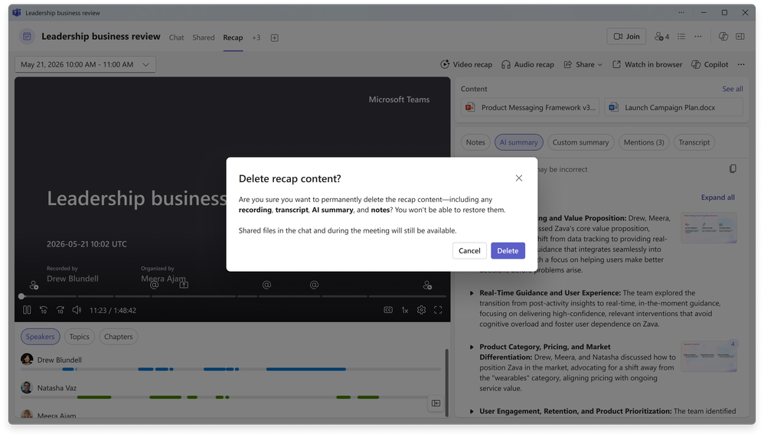
Recap deletion in Teams
Meeting organizers can permanently delete meeting recaps to keep sensitive content under control.
Permanent Deletion
Organizers can permanently delete recordings, transcripts, summaries, and notes from the recap page.
Simple Control
Available from the More (…) menu with no admin setup required.
Files Preserved
Shared files remain intact so collaboration isn't lost.
Rollout
Rolled out in May.
Recap deletion in Teams
What's New in Microsoft 365 Copilot | May 2026
Notes:
Recap deletion in Teams
Meeting organizers can permanently delete meeting recaps to keep sensitive content under control.
• Permanent Deletion — Organizers can permanently delete recordings, transcripts, summaries, and notes from the recap page.
• Simple Control — Available from the More (…) menu with no admin setup required.
• Files Preserved — Shared files remain intact so collaboration isn't lost.
Rollout — Rolled out in May.
Source: What's New in Microsoft 365 Copilot | May 2026 — https://techcommunity.microsoft.com/blog/microsoft365copilotblog/what%E2%80%99s-new-in-microsoft-365-copilot--may-2026/4522010

Slide 14
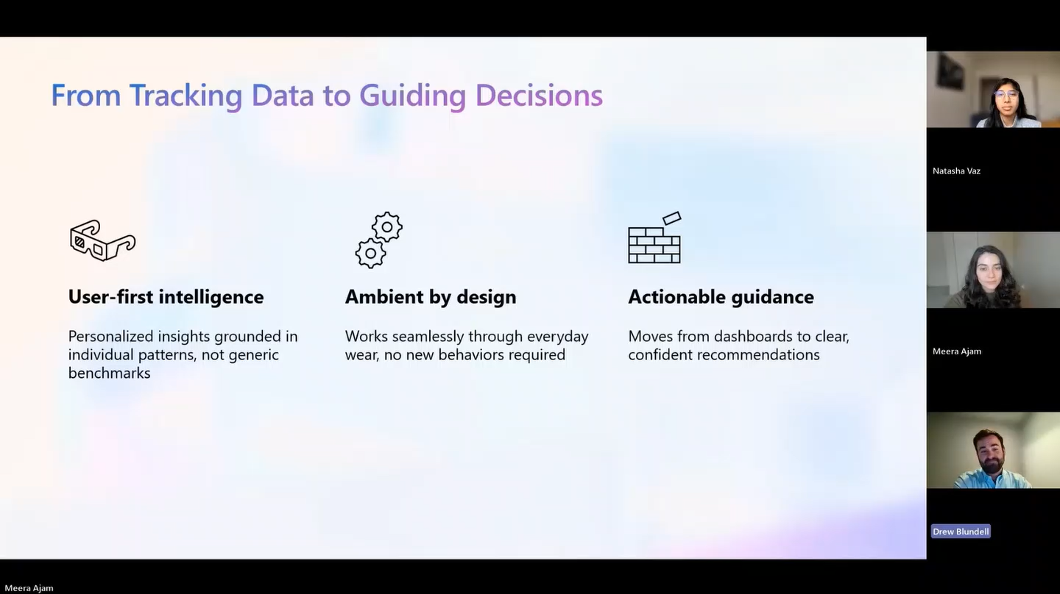
Video recap with Copilot in Teams
Copilot turns recorded Teams meetings into short, narrated highlight reels so people can catch up quickly.
Narrated Highlights
Turns recorded meetings into short highlight reels of key moments and decisions.
AI Voiceover
Combines an AI-generated voiceover with real clips from the meeting.
Faster Catch-Up
Helps people who missed a meeting get the essentials quickly.
Rollout
Rolled out in April.
Video recap with Copilot in Teams
What's New in Microsoft 365 Copilot | May 2026
Notes:
Video recap with Copilot in Teams
Copilot turns recorded Teams meetings into short, narrated highlight reels so people can catch up quickly.
• Narrated Highlights — Turns recorded meetings into short highlight reels of key moments and decisions.
• AI Voiceover — Combines an AI-generated voiceover with real clips from the meeting.
• Faster Catch-Up — Helps people who missed a meeting get the essentials quickly.
Rollout — Rolled out in April.
Source: What's New in Microsoft 365 Copilot | May 2026 — https://techcommunity.microsoft.com/blog/microsoft365copilotblog/what%E2%80%99s-new-in-microsoft-365-copilot--may-2026/4522010

Slide 15
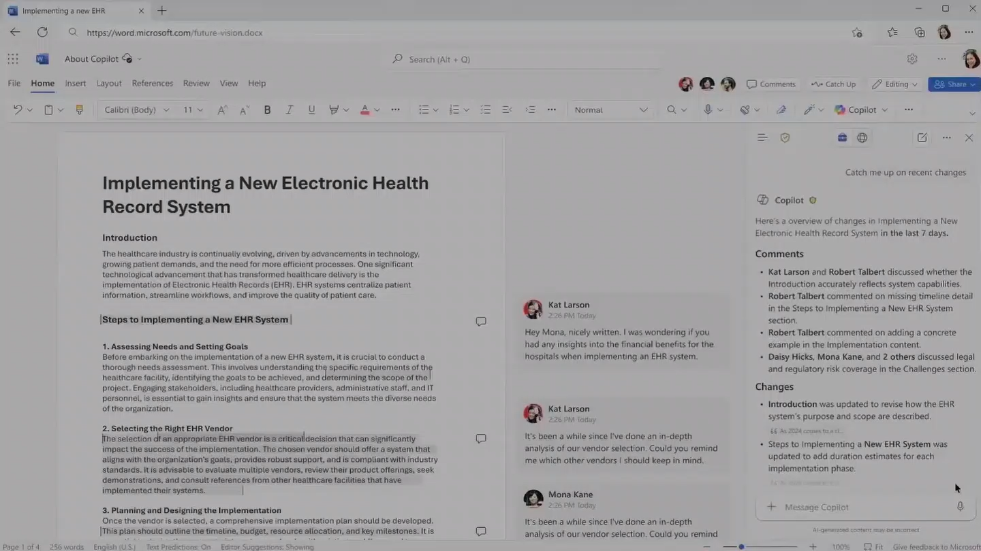
Document activity summaries in Word
Copilot in Word surfaces a consolidated view of recent document activity so users can catch up without rereading.
Recent Activity
A consolidated view of recent edits and comments appears in the Copilot chat pane.
Catch Up Fast
See what changed in a document without scrolling through it.
Stay In Context
Review activity directly alongside your work in Word.
Rollout
Rolled out in May.
Document activity summaries in Word
What's New in Microsoft 365 Copilot | May 2026
Notes:
Document activity summaries in Word
Copilot in Word surfaces a consolidated view of recent document activity so users can catch up without rereading.
• Recent Activity — A consolidated view of recent edits and comments appears in the Copilot chat pane.
• Catch Up Fast — See what changed in a document without scrolling through it.
• Stay In Context — Review activity directly alongside your work in Word.
Rollout — Rolled out in May.
Source: What's New in Microsoft 365 Copilot | May 2026 — https://techcommunity.microsoft.com/blog/microsoft365copilotblog/what%E2%80%99s-new-in-microsoft-365-copilot--may-2026/4522010

Slide 16
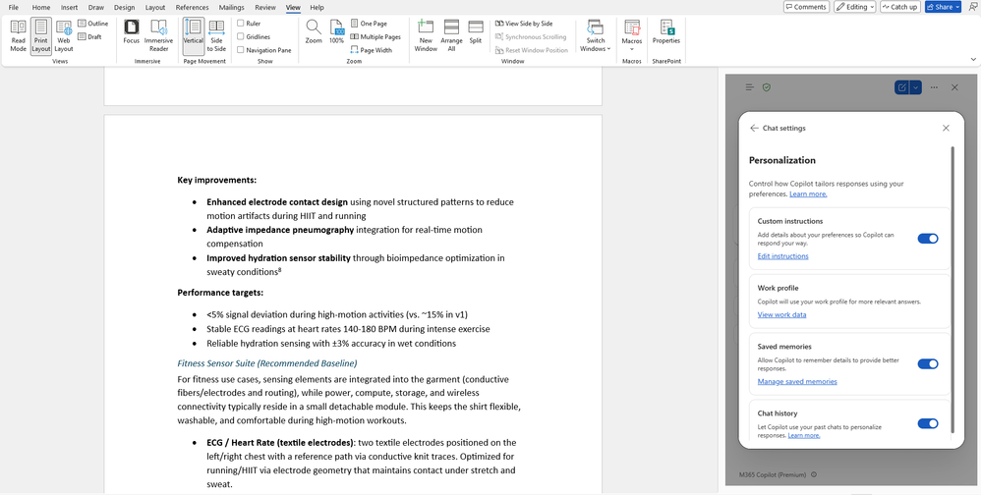
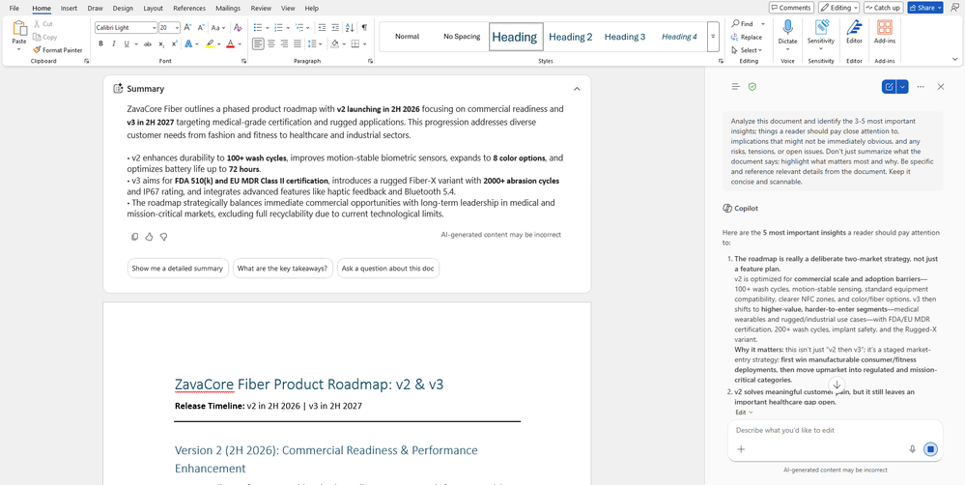
Personalization with Copilot memory and personalized Insights in Word
Copilot in Word tailors responses and insights to each user's context for more relevant help.
Copilot Memory
Responses are tailored using your context and prior interactions.
Personalized Insights
Relevant insights surface at the top of the document.
More Relevant Help
Suggestions fit your work and writing more closely.
Rollout
Rolled out in May.
Personalization with Copilot memory in Word
What's New in Microsoft 365 Copilot | May 2026
Notes:
Personalization with Copilot memory in Word
Copilot in Word tailors responses and insights to each user's context for more relevant help.
• Copilot Memory — Responses are tailored using your context and prior interactions.
• Personalized Insights — Relevant insights surface at the top of the document.
• More Relevant Help — Suggestions fit your work and writing more closely.
Rollout — Rolled out in May.
Source: What's New in Microsoft 365 Copilot | May 2026 — https://techcommunity.microsoft.com/blog/microsoft365copilotblog/what%E2%80%99s-new-in-microsoft-365-copilot--may-2026/4522010

Slide 17
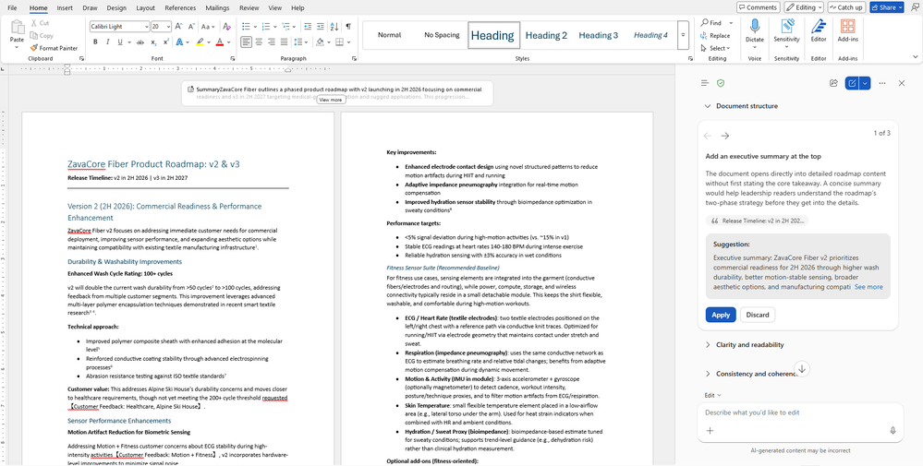
Writing suggestions from the Word Agent
The Word Agent offers real-time writing recommendations to help users produce clearer, stronger drafts.
Real-Time Suggestions
Word Agent offers clarity, tone, and structure recommendations as you write.
In The Flow
Recommendations appear in the writing flow without breaking concentration.
Stronger Drafts
Improves readability and structure with less manual editing.
Rollout
Available on the web in May.
Writing suggestions from the Word Agent
What's New in Microsoft 365 Copilot | May 2026
Notes:
Writing suggestions from the Word Agent
The Word Agent offers real-time writing recommendations to help users produce clearer, stronger drafts.
• Real-Time Suggestions — Word Agent offers clarity, tone, and structure recommendations as you write.
• In The Flow — Recommendations appear in the writing flow without breaking concentration.
• Stronger Drafts — Improves readability and structure with less manual editing.
Rollout — Available on the web in May.
Source: What's New in Microsoft 365 Copilot | May 2026 — https://techcommunity.microsoft.com/blog/microsoft365copilotblog/what%E2%80%99s-new-in-microsoft-365-copilot--may-2026/4522010

Slide 18
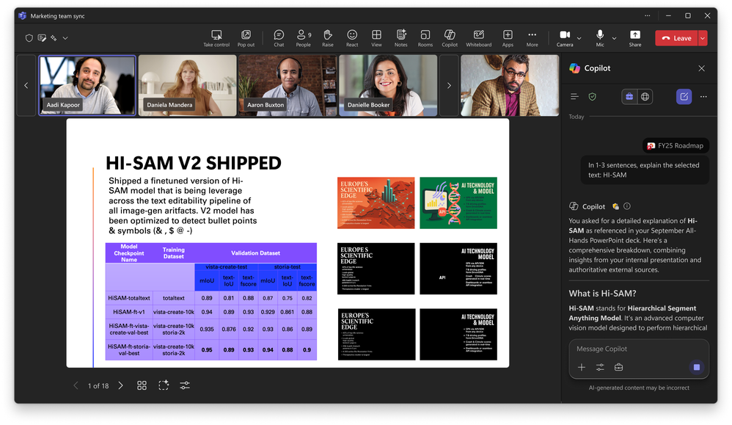
Slide explanations and built-in skills in PowerPoint
Copilot in PowerPoint lets meeting attendees explain slides live and adds one-click built-in skills that act on a deck.
Explain In PowerPoint Live
Attendees select slide text and ask Copilot to explain it without interrupting the presenter.
One-Click Skills
Review this presentation, Visualize this slide, and Prepare for Questions act on a deck instantly.
Better Decks
Improves structure, visuals, and readiness with less prompting.
Rollout
Slide explanations in June; built-in skills in May.
Slide explanations and built-in skills in PowerPoint
What's New in Microsoft 365 Copilot | May 2026
Notes:
Slide explanations and built-in skills in PowerPoint
Copilot in PowerPoint lets meeting attendees explain slides live and adds one-click built-in skills that act on a deck.
• Explain In PowerPoint Live — Attendees select slide text and ask Copilot to explain it without interrupting the presenter.
• One-Click Skills — Review this presentation, Visualize this slide, and Prepare for Questions act on a deck instantly.
• Better Decks — Improves structure, visuals, and readiness with less prompting.
Rollout — Slide explanations in June; built-in skills in May.
Source: What's New in Microsoft 365 Copilot | May 2026 — https://techcommunity.microsoft.com/blog/microsoft365copilotblog/what%E2%80%99s-new-in-microsoft-365-copilot--may-2026/4522010

Slide 19
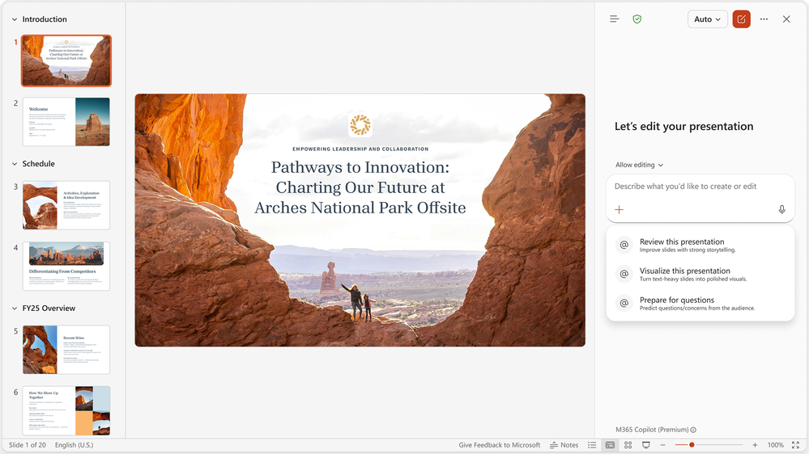
Copilot in PowerPoint now includes built-in skills
Copilot in PowerPoint now includes built-in skills that act on a user’s deck in a single click. Instead of crafting a long prompt, users pick a skill and let Copilot do the work. Three new skills are now available:
Review this presentation provides slide-by-slide suggestions to improve structure, clarity, and storytelling, with recommendations users can review and apply.
Visualize this slide transforms text-heavy slides into engaging visuals to enhance the overall look and impact of presentations.
Prepare for Questions helps understand the presentations weak points and anticipate questions.
Rollout
These features rolled out in May.
Copilot in PowerPoint now includes built-in skills
What's New in Microsoft 365 Copilot | May 2026
Notes:
Slide explanations and built-in skills in PowerPoint
Copilot in PowerPoint lets meeting attendees explain slides live and adds one-click built-in skills that act on a deck.
• Explain In PowerPoint Live — Attendees select slide text and ask Copilot to explain it without interrupting the presenter.
• One-Click Skills — Review this presentation, Visualize this slide, and Prepare for Questions act on a deck instantly.
• Better Decks — Improves structure, visuals, and readiness with less prompting.
Rollout — Slide explanations in June; built-in skills in May.
Source: What's New in Microsoft 365 Copilot | May 2026 — https://techcommunity.microsoft.com/blog/microsoft365copilotblog/what%E2%80%99s-new-in-microsoft-365-copilot--may-2026/4522010

Slide 20
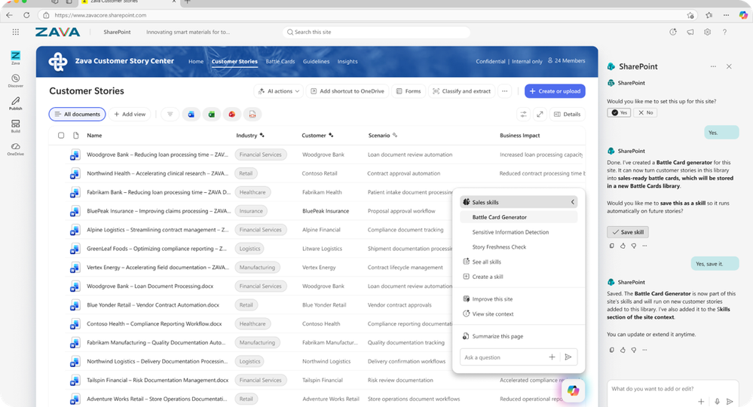
Custom skills for Copilot in SharePoint
Copilot in SharePoint turns repeatable, multi-step workflows into reusable, site-specific skills teams can run consistently.
Reusable Skills
Create and save skills in natural language that teams run the same way every time.
Captured Standards
Encode document guidelines, lists, and review processes for context-aware results.
Consistent Output
Summarize content and apply organizational standards reliably.
Rollout
Rolled out in May.
Custom skills for Copilot in SharePoint
What's New in Microsoft 365 Copilot | May 2026
Notes:
Custom skills for Copilot in SharePoint
Copilot in SharePoint turns repeatable, multi-step workflows into reusable, site-specific skills teams can run consistently.
• Reusable Skills — Create and save skills in natural language that teams run the same way every time.
• Captured Standards — Encode document guidelines, lists, and review processes for context-aware results.
• Consistent Output — Summarize content and apply organizational standards reliably.
Rollout — Rolled out in May.
Source: What's New in Microsoft 365 Copilot | May 2026 — https://techcommunity.microsoft.com/blog/microsoft365copilotblog/what%E2%80%99s-new-in-microsoft-365-copilot--may-2026/4522010

Slide 21
Agents

Slide 22
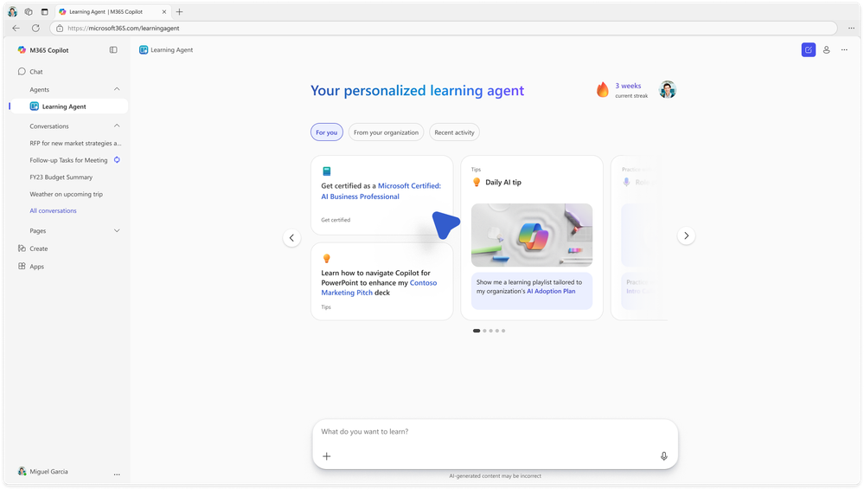
Learning Agent
Learning Agent delivers personalized, in-the-flow learning to help employees build Copilot and AI skills faster.
Tailored Learning
Powered by Work IQ and AI Skills Navigator (preview), content adapts to each role and daily work.
Learn By Doing
Provides tips, skill assessments, customized plans, certifications, and roleplay practice in the flow of work.
Continuous Growth
Helps people keep improving over time directly within their workflow.
Rollout
Rolling out in June.
Learning Agent
Learning Agent now generally available — personalized AI upskilling for every employee | Microsoft Community Hub
Notes:
Learning Agent
Learning Agent delivers personalized, in-the-flow learning to help employees build Copilot and AI skills faster.
• Tailored Learning — Powered by Work IQ and AI Skills Navigator (preview), content adapts to each role and daily work.
• Learn By Doing — Provides tips, skill assessments, customized plans, certifications, and roleplay practice in the flow of work.
• Continuous Growth — Helps people keep improving over time directly within their workflow.
Rollout — Rolling out in June.
Source: What's New in Microsoft 365 Copilot | May 2026 — https://techcommunity.microsoft.com/blog/microsoft365copilotblog/what%E2%80%99s-new-in-microsoft-365-copilot--may-2026/4522010

Slide 23
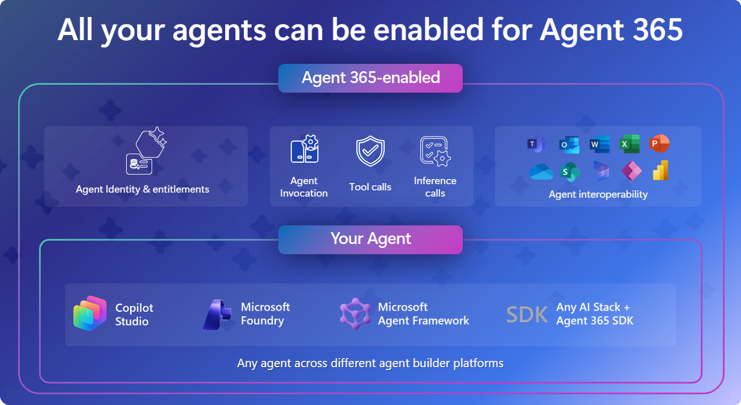
Agent 365 SDK — make any agent enterprise‑ready
The Agent 365 SDK brings agents built on any platform or open-source framework into the Agent 365 control plane to observe, govern and secure them at enterprise scale.
Observe
Registered agents appear in a unified Agent 365 registry and their activity surfaces in Microsoft Defender for SOC threat hunting.
Govern & Secure
Lifecycle policies, reusable Entra/Purview/Defender templates and tool controls, plus a per-agent Entra identity with Conditional Access and runtime protection.
Any Platform
Foundry, OpenAI Agents SDK and open-source agents share one identity, observability and policy engine; onboard in three steps.
Agent 365 SDK
Make any agent enterprise-ready with the Agent 365 SDK | Microsoft Community Hub
Rollout
Generally available now (Python, TypeScript, .NET); builds on Agent 365, GA since 1 May 2026.
Notes:
This is the developer on‑ramp to Agent 365, which reached GA on 1 May 2026. Agents built on Microsoft's own platforms (Agent Builder, Copilot Studio, Foundry) get these controls automatically; the SDK is for everything else — external platforms and open‑source frameworks. Partners including Kore.ai, Zensai, Genspark, Egnyte, Zendesk, Kasisto, and n8n have already integrated. The customer pitch: integrate once, and every enterprise that deploys your agent can switch on enterprise‑grade governance — with Microsoft Purview APIs available for deeper data security and compliance (DLP, DSPM, eDiscovery, audit).
Source: techcommunity.microsoft.com/blog/agent-365-blog/make-any-agent-enterprise-ready-with-the-agent-365-sdk/4524575

Slide 24
Copilot Control System

Slide 25
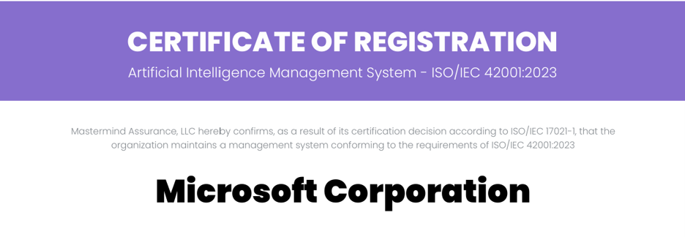
Expanded ISO certifications across the Copilot portfolio
Microsoft is extending ISO/IEC 42001:2023 certification across its Copilot portfolio — the broadest coverage of any AI company to date.
Maintained Coverage
Existing certification continues for Microsoft 365 Copilot and Copilot Chat, Security Copilot, and Microsoft Foundry.
New Experiences
Adds Copilot Studio, GitHub Copilot, Dragon Copilot, and Copilot Health.
Responsible AI
Reflects continued investment in responsible AI; details on the Service Trust Portal.
Expanded ISO certifications across the Copilot portfolio
Recertified: How Microsoft 365 Copilot continues to earn trust and What Changed in a Year | Microsoft Community Hub
Notes:
Expanded ISO certifications across the Copilot portfolio
Microsoft is extending ISO/IEC 42001:2023 certification across its Copilot portfolio — the broadest coverage of any AI company to date.
• Maintained Coverage — Existing certification continues for Microsoft 365 Copilot and Copilot Chat, Security Copilot, and Microsoft Foundry.
• New Experiences — Adds Copilot Studio, GitHub Copilot, Dragon Copilot, and Copilot Health.
• Responsible AI — Reflects continued investment in responsible AI; details on the Service Trust Portal.
Source: What's New in Microsoft 365 Copilot | May 2026 — https://techcommunity.microsoft.com/blog/microsoft365copilotblog/what%E2%80%99s-new-in-microsoft-365-copilot--may-2026/4522010

Slide 26
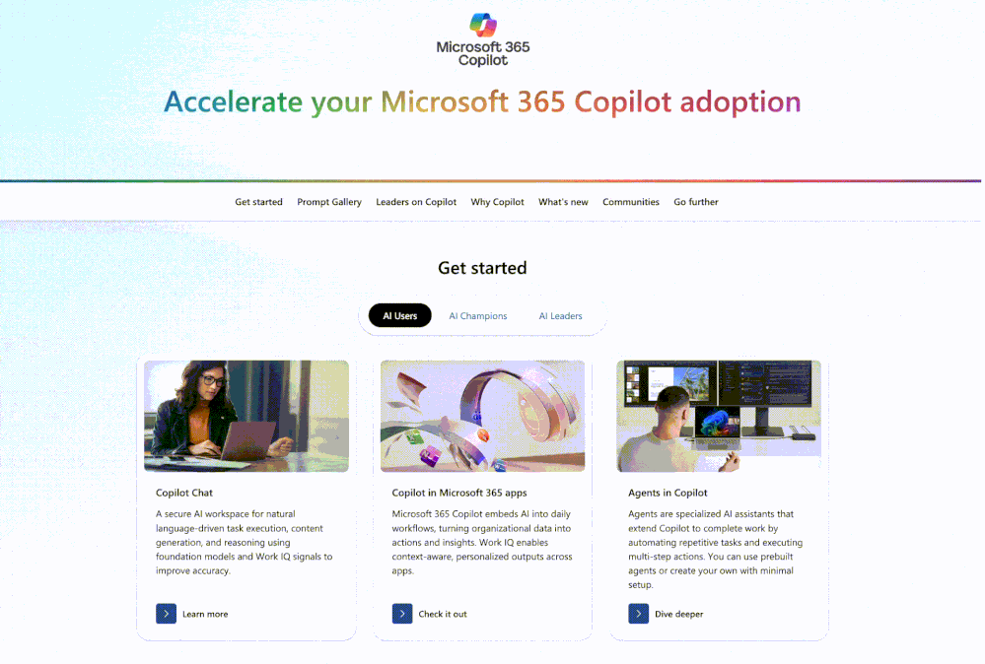
The new Copilot Adoption Hub
The new Copilot Adoption Hub gives deployment leads a single place to find guidance, tools, and next steps to drive Copilot usage.
Guided Paths
Start with the path that fits, from helping a small team to leading org-wide adoption.
Targeted Content
Highlighted resources show what to share with different users based on their needs.
One Starting Point
A single hub for leads to use Copilot themselves or help teams use it effectively.
Learn more at the new Copilot Adoption Hub.
The new Copilot Adoption Hub
Launched: Microsoft 365 Copilot Adoption Hub Redesign
Notes:
The new Copilot Adoption Hub
The new Copilot Adoption Hub gives deployment leads a single place to find guidance, tools, and next steps to drive Copilot usage.
• Guided Paths — Start with the path that fits, from helping a small team to leading org-wide adoption.
• Targeted Content — Highlighted resources show what to share with different users based on their needs.
• One Starting Point — A single hub for leads to use Copilot themselves or help teams use it effectively.
Source: What's New in Microsoft 365 Copilot | May 2026 — https://techcommunity.microsoft.com/blog/microsoft365copilotblog/what%E2%80%99s-new-in-microsoft-365-copilot--may-2026/4522010

Slide 27
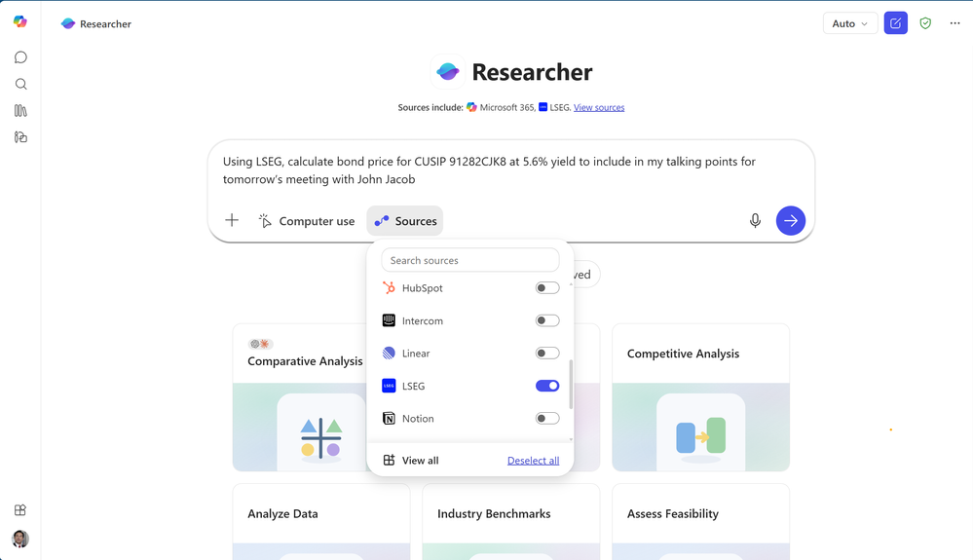
Federated Copilot connectors
Federated Copilot connectors bring real-time enterprise data into Copilot through Model Context Protocol (MCP).
Live Enterprise Data
Connect hundreds of SaaS systems into Work IQ alongside Microsoft 365 content.
Launch Partners
First wave includes LSEG, Moody's, HubSpot, and Notion in Copilot Chat and Researcher; LSEG and Moody's in Excel.
Custom Connectors
Build federated connectors for internal systems while keeping native security controls.
Rollout
Rolled out in May.
Federated Copilot connectors
What's New in Microsoft 365 Copilot | May 2026
Notes:
Federated Copilot connectors
Federated Copilot connectors bring real-time enterprise data into Copilot through Model Context Protocol (MCP).
• Live Enterprise Data — Connect hundreds of SaaS systems into Work IQ alongside Microsoft 365 content.
• Launch Partners — First wave includes LSEG, Moody's, HubSpot, and Notion in Copilot Chat and Researcher; LSEG and Moody's in Excel.
• Custom Connectors — Build federated connectors for internal systems while keeping native security controls.
Rollout — Rolled out in May.
Source: What's New in Microsoft 365 Copilot | May 2026 — https://techcommunity.microsoft.com/blog/microsoft365copilotblog/what%E2%80%99s-new-in-microsoft-365-copilot--may-2026/4522010

Slide 28
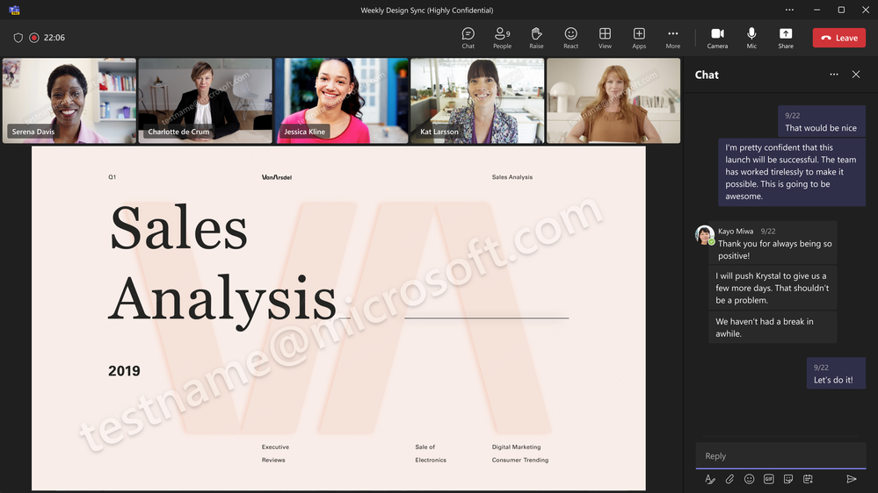
Enabling watermarks for sensitive material in Teams meetings
Teams meeting organizers can overlay each attendee's email address as a watermark across shared content for added accountability.
Deter Capture
Watermarks help discourage screen captures of sensitive material.
Meeting Control
Enabled in Meeting options and enforced for all attendees.
Added Accountability
Lets users share confidential information with more confidence.
Rollout
GA in March, GCC-High in May, DoD in June.
Enabling watermarks for sensitive material
What's New in Microsoft 365 Copilot | May 2026
Notes:
Enabling watermarks for sensitive material
Teams meeting organizers can overlay each attendee's email address as a watermark across shared content for added accountability.
• Deter Capture — Watermarks help discourage screen captures of sensitive material.
• Meeting Control — Enabled in Meeting options and enforced for all attendees.
• Added Accountability — Lets users share confidential information with more confidence.
Rollout — GA in March, GCC-High in May, DoD in June.
Source: What's New in Microsoft 365 Copilot | May 2026 — https://techcommunity.microsoft.com/blog/microsoft365copilotblog/what%E2%80%99s-new-in-microsoft-365-copilot--may-2026/4522010

Slide 29
Microsoft Build 2026

Slide 30
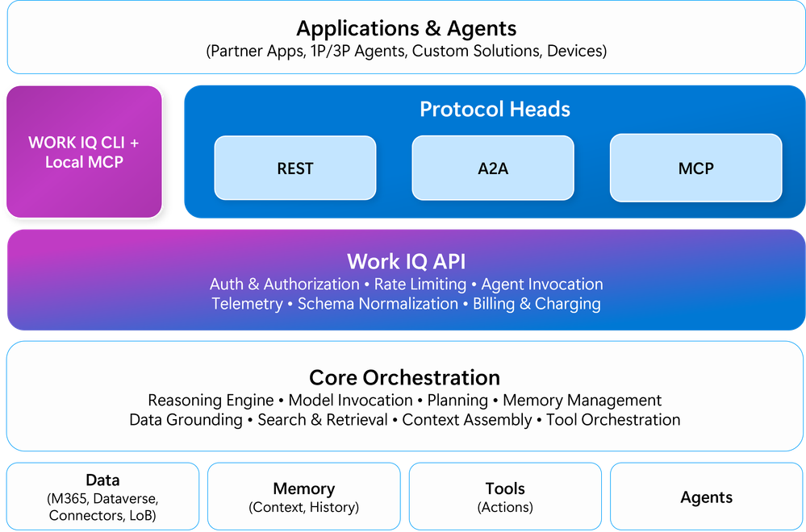
Work IQ APIs
Work IQ is the workplace intelligence layer for agents, capturing how work actually happens across Microsoft 365 and connected systems.
Workplace Context
Captures people, emails, documents and meetings across Microsoft 365, organizational systems and external sources, and how they connect.
Programmatic Access
The Work IQ APIs give agents the context they need to work effectively in your organization.
Grounded Agents
Lets agents reason over real work patterns rather than generic knowledge.
Rollout
Work IQ APIs generally available June 16, 2026.
Learn more
Work IQ API
Work IQ API public preview: Build Copilot powered agents with A2A | Microsoft Community Hub
Notes:
Work IQ
Work IQ is the workplace intelligence layer for agents, capturing how work actually happens across Microsoft 365 and connected systems.
• Workplace Context — Captures people, emails, documents and meetings across Microsoft 365, organizational systems and external sources, and how they connect.
• Programmatic Access — The Work IQ APIs give agents the context they need to work effectively in your organization.
• Grounded Agents — Lets agents reason over real work patterns rather than generic knowledge.
Rollout — Work IQ APIs generally available June 16, 2026.
Source: Microsoft Build 2026: Be yourself at work — https://blogs.microsoft.com/blog/2026/06/02/microsoft-build-2026-be-yourself-at-work/

Slide 31
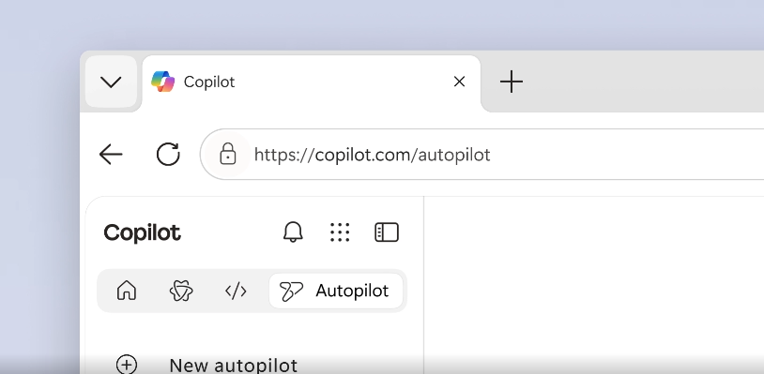
Autopilot agents
Autopilot agents are a new class of always-on agents that work autonomously in the background, acting on your behalf without waiting for a prompt.
Always-On
Stay active in the background, understand how work gets done across your apps and take action without being prompted each time.
Governed Identity
Each agent operates under its own Entra identity, so its work is attributable to a known actor in your directory.
First Of Its Kind
Microsoft Scout is Microsoft's first Autopilot agent.
Rollout
Introduced at Microsoft Build 2026; Microsoft Scout available to Frontier organizations as an early experimental release.
Autopilot agents
Microsoft Build Live
Notes:
Autopilot agents
Autopilot agents are a new class of always-on agents that work autonomously in the background, acting on your behalf without waiting for a prompt.
• Always-On — Stay active in the background and take action without being prompted each time.
• Governed Identity — Each agent operates under its own Entra identity, attributable to a known actor in your directory.
• First Of Its Kind — Microsoft Scout is Microsoft's first Autopilot agent.
Rollout — Introduced at Microsoft Build 2026; Microsoft Scout available to Frontier organizations as an early experimental release.
Source: Microsoft Build Live — https://news.microsoft.com/build-2026-live-blog

Slide 32
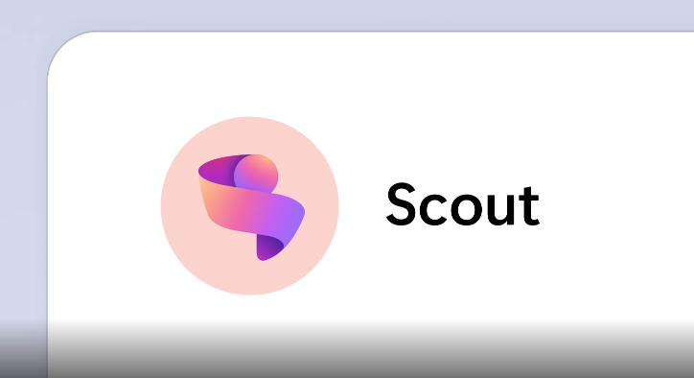
Microsoft Scout
Microsoft Scout is Microsoft's first Autopilot agent — an always-on personal agent for work, built on Work IQ, that proactively handles routine tasks.
Proactive Help
Handles meeting prep, scheduling conflicts and routine tasks without being asked.
Works Where You Do
Lives in Teams and Outlook for conversation, with OneDrive and SharePoint for files.
Governed Identity
Operates under its own Entra identity so its actions are attributable and admin-controlled.
Rollout
Early experimental release to Frontier organizations; requires Frontier enrollment, Intune policy, opt-in attestation and a GitHub Copilot licence.
Microsoft Scout
Microsoft Build 2026: Be yourself at work
Introducing Microsoft Scout: Your always-on personal agent | Microsoft 365 Blog
Notes:
Microsoft Scout
Microsoft Scout is Microsoft's first Autopilot agent — an always-on personal agent for work, built on Work IQ, that proactively handles routine tasks.
• Proactive Help — Handles meeting prep, scheduling conflicts and routine tasks without being asked.
• Works Where You Do — Lives in Teams and Outlook for conversation, with OneDrive and SharePoint for files.
• Governed Identity — Operates under its own Entra identity so its actions are attributable and admin-controlled.
Rollout — Early experimental release to Frontier organizations; requires Frontier enrollment, Intune policy, opt-in attestation and a GitHub Copilot licence.
Source: Microsoft Build 2026: Be yourself at work — https://blogs.microsoft.com/blog/2026/06/02/microsoft-build-2026-be-yourself-at-work/

Slide 33
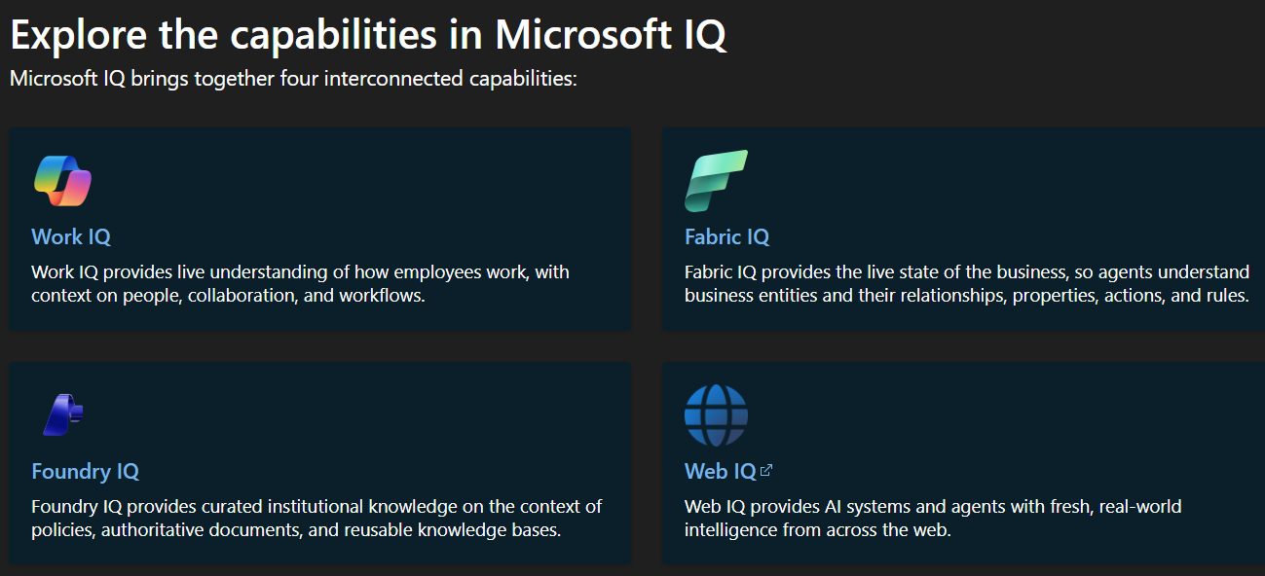
Microsoft IQ
Microsoft IQ is a shared intelligence foundation for the agent era, grounding agents in both world knowledge and your enterprise knowledge.
Dual Grounding
Combines world knowledge with enterprise knowledge for more relevant answers.
Across The Stack
Brings Work IQ, Fabric IQ and Foundry IQ together across GitHub Copilot, Microsoft Foundry and Copilot Studio.
Build Once
Reuse trusted organizational context everywhere your agents run.
Rollout
Microsoft IQ generally available now; Work IQ GA this month, Foundry IQ GA now, Fabric IQ ontology in preview. Learn more
Microsoft IQ
Microsoft Build 2026: Be yourself at work
Notes:
Microsoft IQ
Microsoft IQ is a shared intelligence foundation for the agent era, grounding agents in both world knowledge and your enterprise knowledge.
• Dual Grounding — Combines world knowledge with enterprise knowledge for more relevant answers.
• Across The Stack — Brings Work IQ, Fabric IQ and Foundry IQ together across GitHub Copilot, Microsoft Foundry and Copilot Studio.
• Build Once — Reuse trusted organizational context everywhere your agents run.
Rollout — Microsoft IQ generally available now; Work IQ GA this month, Foundry IQ GA now, Fabric IQ ontology in preview.
Source: Microsoft Build 2026: Be yourself at work — https://blogs.microsoft.com/blog/2026/06/02/microsoft-build-2026-be-yourself-at-work/

Slide 34
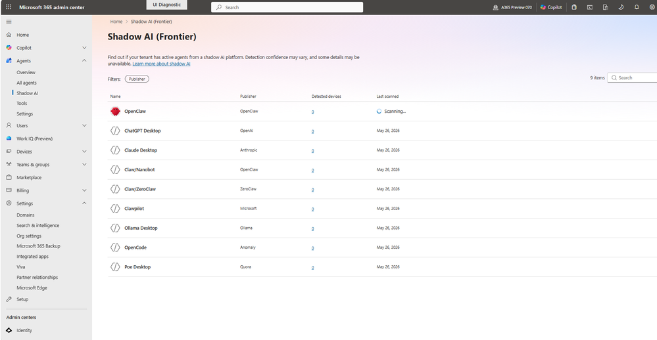
Agent 365 for local agents
Agent 365 for local agents extends Entra, Defender and Purview into a single control plane to observe, govern and secure agents.
Single Control Plane
Observe, govern and secure agents across your estate.
Host-Agnostic
Works regardless of where agents are hosted or what framework they are built on.
Built On Trust
Extends your existing Entra, Defender and Purview controls.
Rollout
Announced at Microsoft Build 2026.
Learn more
Agent 365 for local agents
Microsoft Build 2026: Be yourself at work
Securing Local Agents, Claws, Runtimes | Microsoft Security
Notes:
Agent 365
Agent 365 for local agents extends Entra, Defender and Purview into a single control plane to observe, govern and secure agents.
• Single Control Plane — Observe, govern and secure agents across your estate.
• Host-Agnostic — Works regardless of where agents are hosted or what framework they are built on.
• Built On Trust — Extends your existing Entra, Defender and Purview controls.
Rollout — Announced at Microsoft Build 2026.
Source: Microsoft Build 2026: Be yourself at work — https://blogs.microsoft.com/blog/2026/06/02/microsoft-build-2026-be-yourself-at-work/

Slide 35
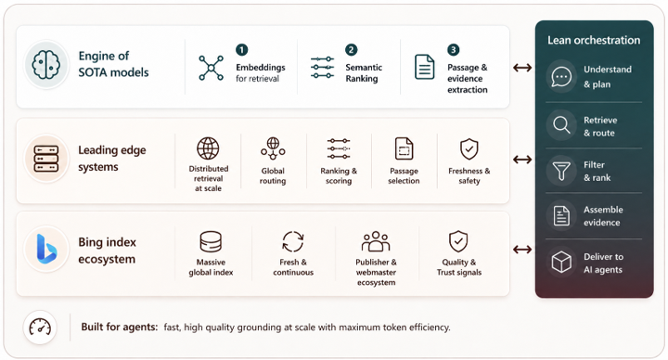
Web IQ
Web IQ is a new member of the IQ family that gives agents the fastest real-world web grounding.
Real-Time Grounding
An AI-first web search stack for grounding agents in live web data.
Open & Model-Agnostic
MCP-native and works with any model.
Fast
Returns relevant passages at nearly 2.5x the speed of the next best alternative.
Rollout
Announced at Microsoft Build 2026.
Learn more
Web IQ
Microsoft Build 2026: Be yourself at work
Notes:
Web IQ
Web IQ is a new member of the IQ family that gives agents the fastest real-world web grounding.
• Real-Time Grounding — An AI-first web search stack for grounding agents in live web data.
• Open & Model-Agnostic — MCP-native and works with any model.
• Fast — Returns relevant passages at nearly 2.5x the speed of the next best alternative.
Rollout — Announced at Microsoft Build 2026.
Source: Microsoft Build 2026: Be yourself at work — https://blogs.microsoft.com/blog/2026/06/02/microsoft-build-2026-be-yourself-at-work/

Slide 36

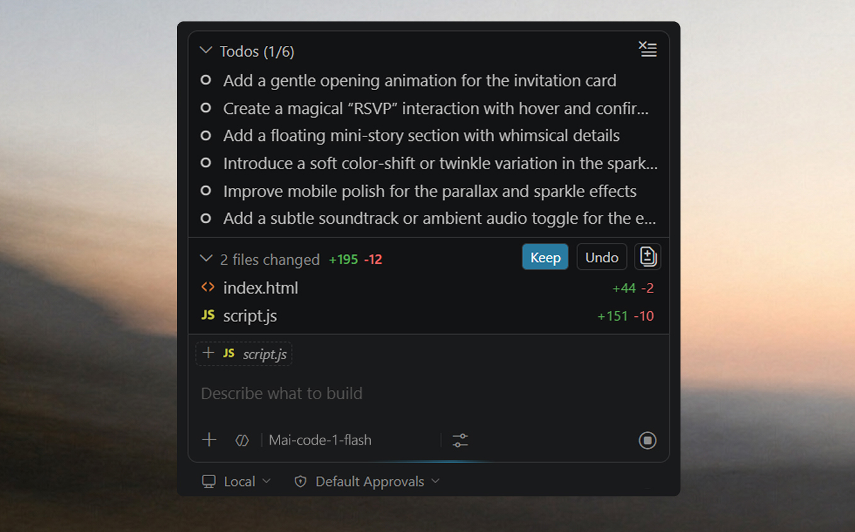
MAI-Code-1
MAI-Code-1 is Microsoft's inference-efficient coding model, tuned for GitHub.
Coding Focus
Tuned for efficient, high-quality code generation.
In Copilot
The MAI-Code-1-Flash variant is purpose-built for GitHub Copilot and VS Code, for higher performance at lower cost.
Model Choice
Part of Microsoft's expanding in-house MAI model family.
Rollout
Available now in Copilot and VS Code.
Learn more
MAI-Code-1
Microsoft Build 2026: Be yourself at work
Notes:
MAI-Code-1
MAI-Code-1 is Microsoft's inference-efficient coding model, tuned for GitHub.
• Coding Focus — Tuned for efficient, high-quality code generation.
• In Copilot — The MAI-Code-1-Flash variant is purpose-built for GitHub Copilot and VS Code, for higher performance at lower cost.
• Model Choice — Part of Microsoft's expanding in-house MAI model family.
Rollout — Available now in Copilot and VS Code.
Source: Microsoft Build 2026: Be yourself at work — https://blogs.microsoft.com/blog/2026/06/02/microsoft-build-2026-be-yourself-at-work/

Slide 37
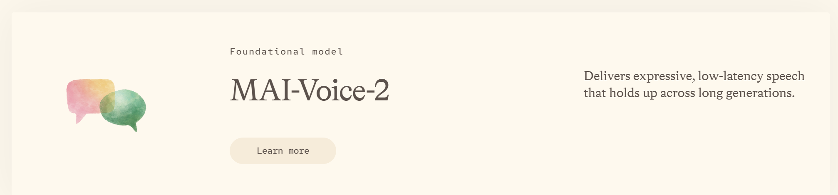
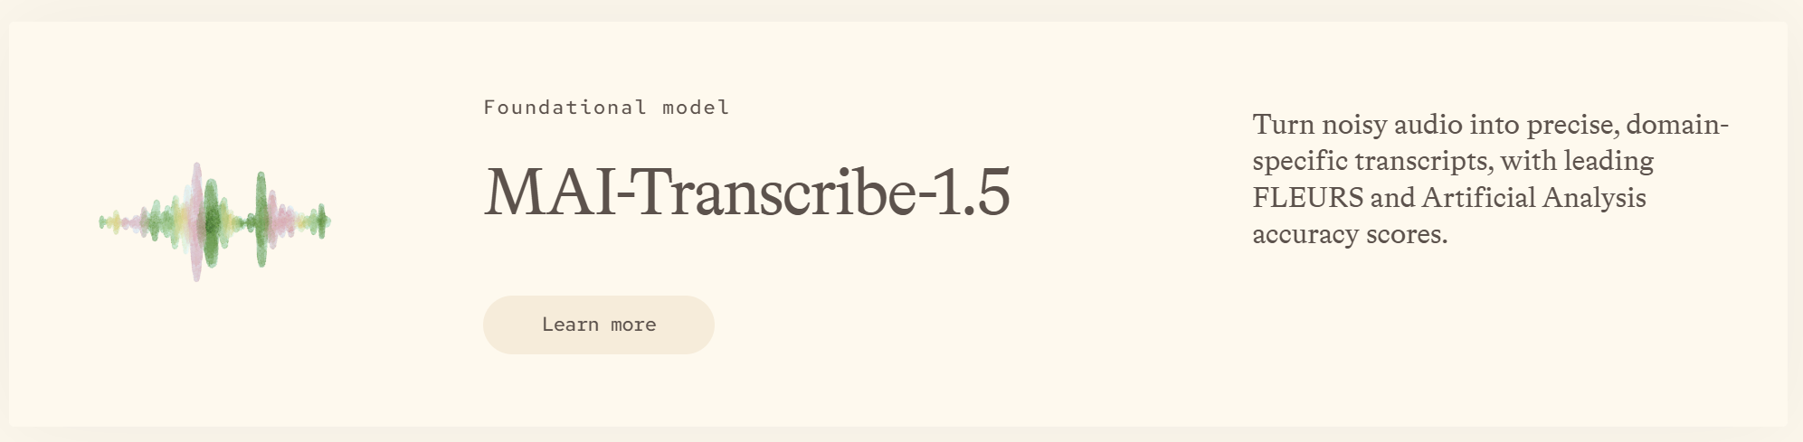
MAI-Voice-2 and MAI Transcribe 1.5
New MAI voice and transcription models expand language coverage for speech experiences.
More Languages
MAI-Voice-2 and its flash variant add 15+ additional languages with new voice options.
Accurate Transcription
MAI Transcribe 1.5 combines state-of-the-art accuracy across 43 languages.
Streaming Soon
Streaming transcription is coming soon.
Rollout
Generally available now on Microsoft Foundry and MAI Playground; streaming transcription coming soon.
MAI-Voice-2 and MAI Transcribe 1.5
Microsoft Build 2026: Be yourself at work
Notes:
MAI-Voice-2 and MAI Transcribe 1.5
New MAI voice and transcription models expand language coverage for speech experiences.
• More Languages — MAI-Voice-2 and its flash variant add 15+ additional languages with new voice options.
• Accurate Transcription — MAI Transcribe 1.5 combines state-of-the-art accuracy across 43 languages.
• Streaming Soon — Streaming transcription is coming soon.
Rollout — Generally available now on Microsoft Foundry and MAI Playground; streaming transcription coming soon.
Source: Microsoft Build 2026: Be yourself at work — https://blogs.microsoft.com/blog/2026/06/02/microsoft-build-2026-be-yourself-at-work/

Slide 38
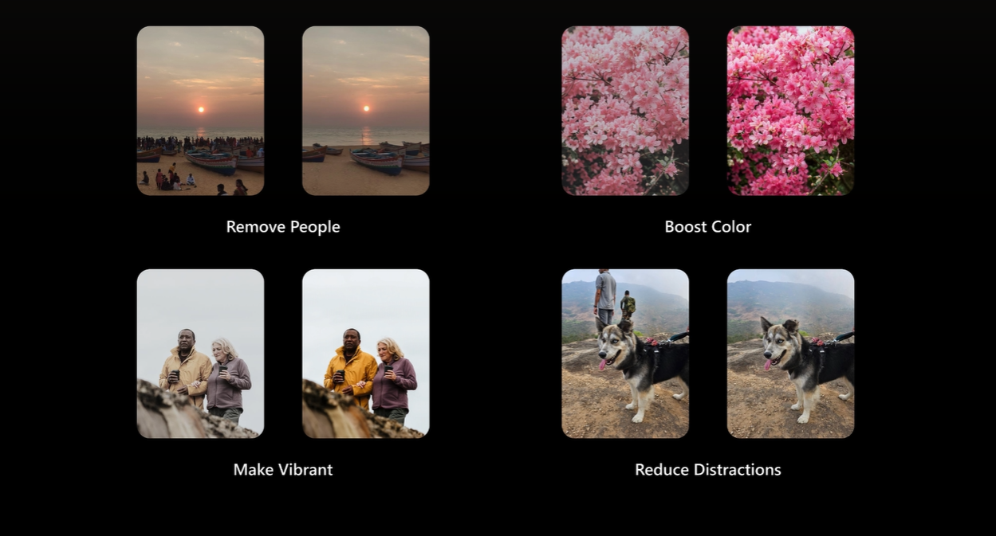
MAI-Image-2.5
MAI-Image-2.5 and its flash variant are Microsoft's first models to serve both text-to-image and image-to-image workloads.
Creative Workflows
Helps take a concept into reality or enhance existing image work.
In Your Apps
Live in PowerPoint and rolling out on OneDrive.
Benchmark Strength
Ranks #3 (text-to-image) and #2 (image-to-image) on the Arena AI leaderboard.
Rollout
Live in PowerPoint; rolling out on OneDrive; generally available now on Microsoft Foundry and MAI Playground.
Learn more
MAI-Image-2.5
Microsoft Build 2026: Be yourself at work
Notes:
MAI-Image-2.5
MAI-Image-2.5 and its flash variant are Microsoft's first models to serve both text-to-image and image-to-image workloads.
• Creative Workflows — Helps take a concept into reality or enhance existing image work.
• In Your Apps — Live in PowerPoint and rolling out on OneDrive.
• Benchmark Strength — Ranks #3 (text-to-image) and #2 (image-to-image) on the Arena AI leaderboard.
Rollout — Live in PowerPoint; rolling out on OneDrive; generally available now on Microsoft Foundry and MAI Playground.
Source: Microsoft Build 2026: Be yourself at work — https://blogs.microsoft.com/blog/2026/06/02/microsoft-build-2026-be-yourself-at-work/

Slide 39
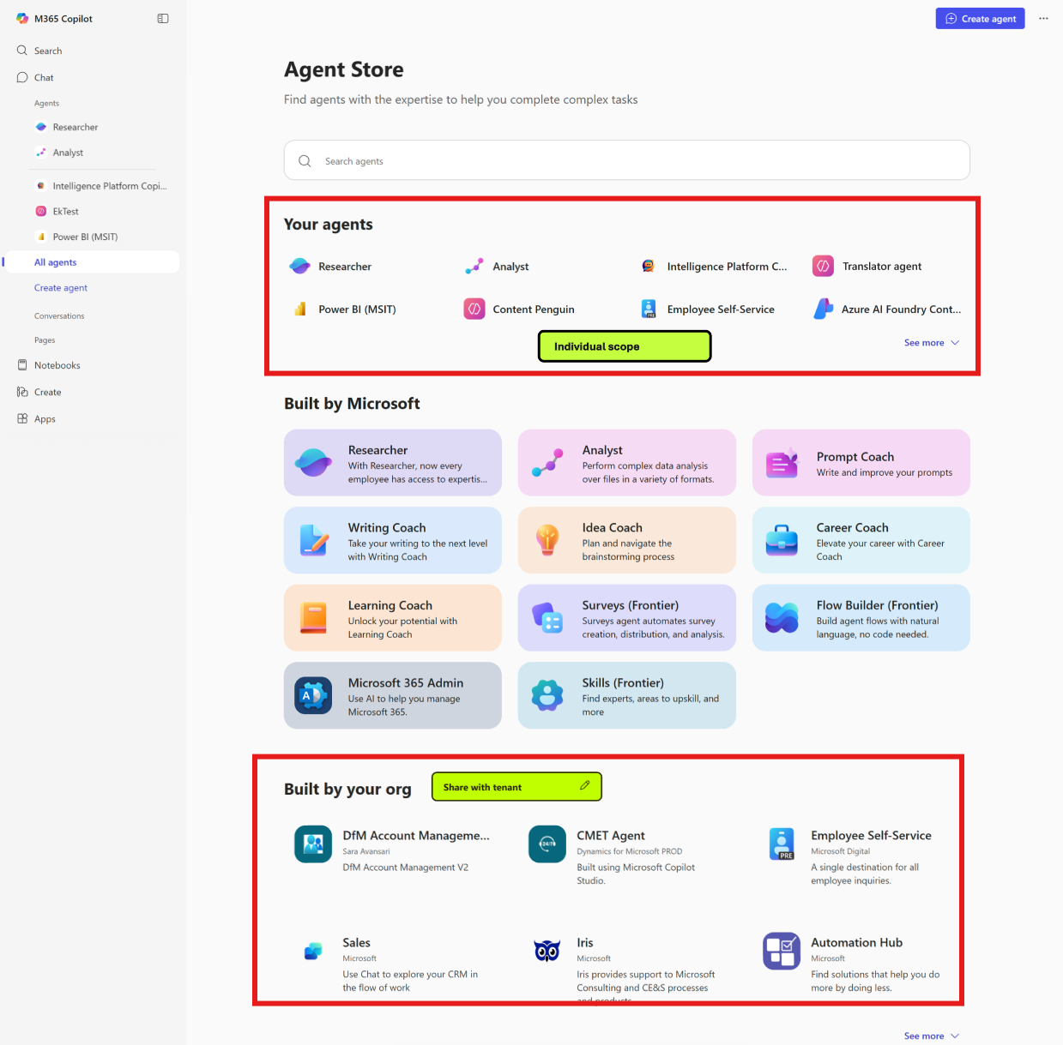
Publish agents to Teams and Microsoft 365 Copilot
Agents built in Microsoft Foundry can be published to Microsoft Teams and Microsoft 365 Copilot in one click, with identity and tenant policy flowing through automatically.
Reach Your Users
Publish agents straight into Teams and Microsoft 365 Copilot where people already work.
Policy Built In
Identity and tenant policy flow through automatically on publish.
From Foundry
Part of the latest Microsoft Foundry Agent Service updates.
Rollout
Generally available next month (from July 2026).
Learn more
Publish agents to Teams and Microsoft 365 Copilot
Microsoft Build Live
Publish agents to Microsoft 365 Copilot and Microsoft Teams - Microsoft Foundry | Microsoft Learn
Notes:
Publish agents to Teams and Microsoft 365 Copilot
Agents built in Microsoft Foundry can be published to Microsoft Teams and Microsoft 365 Copilot in one click, with identity and tenant policy flowing through automatically.
• Reach Your Users — Publish agents straight into Teams and Microsoft 365 Copilot.
• Policy Built In — Identity and tenant policy flow through automatically on publish.
• From Foundry — Part of the latest Microsoft Foundry Agent Service updates.
Rollout — Generally available next month (from July 2026).
Source: Microsoft Build Live — https://news.microsoft.com/build-2026-live-blog

Slide 40
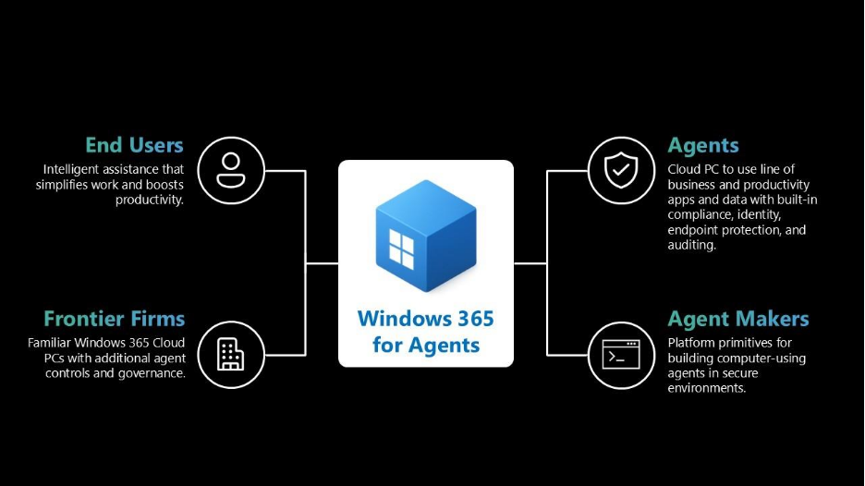
Windows 365 for Agents
Windows 365 for Agents gives AI agents secure, managed Cloud PCs so they can run real, multi-step work inside enterprise environments.
Cloud PCs For Agents
Agents interact directly with applications and browsers and execute multi-step workflows on managed Cloud PCs.
Secure By Default
Every Cloud PC is Entra ID-joined, Intune-managed and policy-enforced for consistent IT control.
How To Get It
Available through Agent 365 tools, with a preview in Microsoft Copilot Studio.
Rollout
Agent 365 tools generally available; Copilot Studio access in preview.
Learn more
Windows 365 for Agents
Microsoft Build Live
Notes:
Windows 365 for Agents
Windows 365 for Agents gives AI agents secure, managed Cloud PCs so they can run real, multi-step work inside enterprise environments.
• Cloud PCs For Agents — Agents run multi-step workflows on managed Cloud PCs, interacting with apps and browsers.
• Secure By Default — Every Cloud PC is Entra ID-joined, Intune-managed and policy-enforced.
• How To Get It — Available through Agent 365 tools, with a preview in Microsoft Copilot Studio.
Rollout — Agent 365 tools generally available; Copilot Studio access in preview.
Source: Microsoft Build Live — https://news.microsoft.com/build-2026-live-blog

Slide 41
Microsoft 365 Copilot Public Roadmap
Changes this month
As of 6th June 2026
Microsoft 365 Roadmap - See What's Coming | Microsoft 365
Notes:
As of 6th June 2026

Slide 42

Microsoft 365 Copilot Public Roadmap
As of 6th June 2026
Launched and Rolling Out “Changed within last month”
Launched (19) 🚀
  Rolling Out (15)
Submit agent to Agent Store from Agent Builder
Real-time voice interactions in a podcast in Word
Customize AI-generated notes in meeting recap
Now smarter with visuals: Declarative Agents leverage embedded images for richer, more accurate answers
[Copilot Extensibility] Customers can connect M365 Copilot with 15Five to surface team priorities and recognition with Copilot Connector
Microsoft Copilot (Microsoft 365): Open Word, Excel, and PowerPoint Files in Copilot Chat
List email attachments in M365 Copilot
Video recap in Teams
App Navigation Pane Update
Copilot Search Matches on People's Department
Microsoft Purview: Data Loss Prevention for Microsoft 365 Copilot to safeguard prompts
Admins will be able to define rules to automate agent lifecycle management.
Microsoft Edge: v.148 - Shadow AI
Microsoft Edge: Microsoft Edge can now send work related browsing history to Copilot for more relevant work results when searching on M365 Copilot search
Copilot voice support in Word & PowerPoint.
Microsoft Graph APIs for App & Agent Inventory and Details.
PowerPoint: Create and Edit images with the model of your choice
Microsoft SharePoint: New web part for FAQs
Access Copilot Chat in your Microsoft 365 apps
OneNote: Summary and Q&A in OneNote Mobile with Copilot (Iphone)
SharePoint: Create charts on pages with AI
Web Link as a Reference in Copilot Notebooks
Sharing recap access
Engage private content in M365 Copilot
Start writing, coding, and creating with Copilot in Pages
Mind Maps in Copilot Notebooks
Surveys Agent and Copilot Chat in Microsoft Forms
Create Excel spreadsheets from Copilot Notebooks
SharePoint: Chat one-on-one with SharePoint agents in Teams
Delete meeting generated content in recap
Outlook: Copilot provides coaching feedback in chat as you draft, edit and format emails
Outlook: Draft, edit and format emails conversationally with Copilot in Outlook
Branded footer in the Microsoft 365 Copilot app
Consecutive interpretation in Interpreter
Notes:
As of 6th June 2026

Slide 43
Microsoft 365 Copilot Public Roadmap
As of 6th June 2026
New items added “New within the last month”
New items – In development (18)
Copilot suggested rename
Support for MCP Agents with Interactive UI Widgets in Government Clouds
MCP-Based Agent Enablement for U.S. Government Clouds
Declarative agents with Actions available in GCC High and DoD
Dataverse data connected to Microsoft 365 Copilot
Chat History Filtering by Copilot Experience
Work IQ APIs: Researcher Agent Access
Get actionable suggestions from Copilot in your Copilot Page
Copilot People Connectors introduces people data ingestions with differentiated access control
Microsoft Copilot Studio: Use MCP-compliant tools in agent workflows
Microsoft Copilot Studio: Supercharge your workflows with computer use
Microsoft Viva: Agent metrics for custom reporting in Insights analyst workbench
Microsoft Copilot Studio: Invoke agents as workflow steps with the agent node
Dynamic Tool Discovery for Declarative Agents and Federated Copilot Connectors
Copilot in PowerPoint for Government clouds
Microsoft Viva: Fresh Copilot Metrics in Custom Person Queries & Reports- Viva Advanced Analysis
SharePoint list support in Agent Builder
Vision in Microsoft 365 Copilot can analyze content shared on desktop screen and through mobile camera
Notes:
As of 6th June 2026

Slide 44
Microsoft 365 Copilot Public Roadmap
As of 6th June 2026
In development “Changed within last month”
In development (43)
Copilot suggested rename
Planner: Planner Agent chat
Support for MCP Agents with Interactive UI Widgets in Government Clouds
MCP-Based Agent Enablement for U.S. Government Clouds
Declarative agents with Actions available in GCC High and DoD
Dataverse data connected to Microsoft 365 Copilot
Copilot Shortcuts for Pages on Mobile
Vision in Microsoft 365 Copilot can analyze content shared on desktop screen and through mobile camera
Intelligent meeting recap available without saving transcript
Enhanced M365 Copilot Memory - Copilot is now personalized with work data
Domain exclusion for web grounding
Chat History Filtering by Copilot Experience
Facilitator detects and answers questions
Project Manager Agent in M365 Copilot
Copy Tables in Microsoft 365 Copilot Chat
Explain slide selection during PowerPoint Live
Microsoft Viva: Copilot Analytics - Export metrics in the Copilot Dashboard at Day Level
Work IQ APIs: Researcher Agent Access
AI-powered notes for in-person meetings with Facilitator in Teams Rooms on Android
Structured Document Generation with Forms
Copilot People Connectors introduces people data ingestions with differentiated access control
Microsoft Viva: Copilot Analytics: Copilot usage snapshot PBI at day level with fresh data
AI-powered notes for in-person meetings with Facilitator in Teams Rooms on Windows
Microsoft Copilot Studio: Use MCP-compliant tools in agent workflows
Microsoft Copilot Studio: Supercharge your workflows with computer use
Microsoft Viva: Agent metrics for custom reporting in Insights analyst workbench
Microsoft Copilot Studio: Invoke agents as workflow steps with the agent node
AI in SharePoint
Dynamic Tool Discovery for Declarative Agents and Federated Copilot Connectors
Copilot in PowerPoint for Government clouds
Microsoft Viva: Fresh Copilot Metrics in Custom Person Queries & Reports- Viva Advanced Analysis
SharePoint list support in Agent Builder
AI-generated meeting archive for knowledge retention
Learning Agent in Microsoft 365 Copilot
Microsoft 365 admin center: Agents usage report
Microsoft Edge: Adding contextual nudges to the Microsoft 365 Copilot Chat icon
Export Copilot metrics in the Copilot Dashboard
Copilot in Forms - US Government clouds
Work IQ APIs – Unified REST Endpoint for Agents and Workflows
Work IQ APIs – Remote MCP Server Support
Work IQ APIs - Endpoints: Declarative Agent Access
Simplified design for the Microsoft 365 Copilot app
Natural language support for Scheduling prompts
Notes:
As of 6th June 2026

Slide 45
Microsoft 365 Copilot release notes
As of 3rd Jun 2026
Latest features and improvements for Microsoft 365 Copilot.
It includes changes that are generally available
(Current Channel for Microsoft 365 apps)
Release Notes for Microsoft 365 Copilot | Microsoft Learn

Slide 46
Microsoft 365 Copilot release notes – May 2026
As of 7th June 2026
Microsoft 365 Copilot Chat (4)
SharePoint (1)
        Implicit grounding in Outlook – add emails and text from threads into your prompt [Windows, Web]
        Open PDFs directly within Copilot Chat [Windows, Mac, Web]
        GPT-5.5 Instant for faster, more accurate everyday responses [Android, Windows, iOS, Mac, Web]
        GPT-5.5 Thinking for deeper reasoning and complex problem solving [Android, Windows, iOS, Mac, Web]
Manage your tenant with the new SharePoint Admin Agent [Web]
Microsoft Viva (1)
Simplified Copilot in Viva Glint enablement using Microsoft 365 access controls [Web]
OneDrive (1)
Discover ready-to-use Copilot actions in OneDrive file preview [Web]
Copilot extensibility (2)
Graph API enhancements for custom connectors – icons, visibility, metadata and semantic labels [Web]
IT admins can enable Anthropic models for specific users and groups [Web]
Copilot admin center (1)
IT admins can enable Anthropic and xAI models for specific users and groups [Web]
Latest features and improvements for Microsoft 365 Copilot generally available on Current Channel for Microsoft 365 apps. 9 updates released between 5 May 2026 and 19 May 2026.
Learn more | Release Notes for Microsoft 365 Copilot

Slide 47
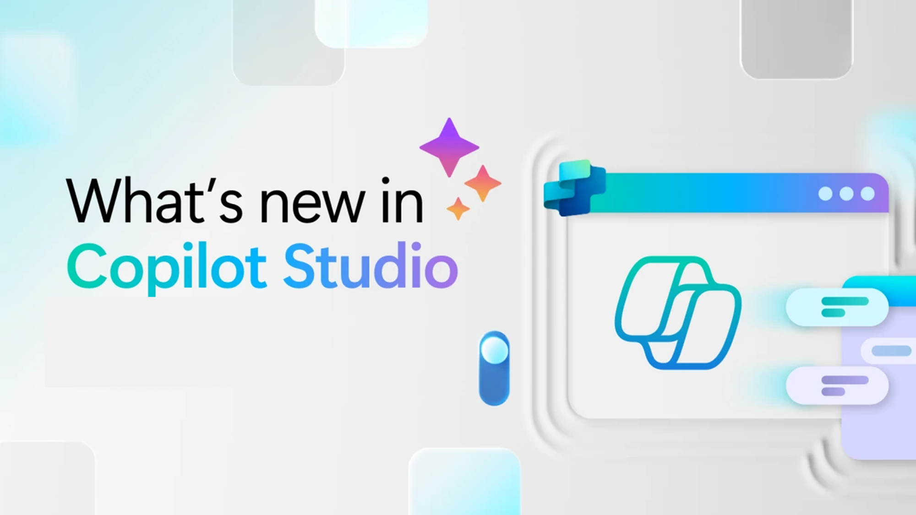
Whats new in Copilot Studio
Notes:
Section transition — Copilot Studio.
Use this slide to pivot from end-user features to the maker/IT story. Copilot Studio is where teams build, orchestrate, and manage custom agents. The next slide lists what shipped, by month of release.

Slide 48
What's new in Copilot Studio
The following table displays the month of release for each new feature.
Month of release | What’s new
May 2026 | (General availability) Computer use is now generally available, letting your agents automate web and desktop apps by controlling browsers and desktop applications on behalf of users. Add a prompt node to an agent flow or workflow to make a single AI call with dynamic content and model selection, useful for scenarios like translation and structured data extraction. Add a Microsoft 365 Copilot node to a workflow to send prompts to Microsoft 365 Copilot or a specific agent, enabling automation scenarios like research and audit drafting. Configure consent-based recording on voice-enabled agents to ask callers for consent before recording, with configurable compliance behavior and retention settings. Use the agent inventory schema to discover and audit all Copilot Studio agents in your organization from the admin center, API, or Azure Resource Graph. (Preview) Review agent readiness and issue status from a consolidated status page that surfaces publishing errors, runtime issues, and configuration blocks with severity levels. Use asynchronous responses for agent flows to let long-running processes exceed the two-minute limit and return results to the agent when they complete. (Preview) Automatically create Microsoft Entra agent identities for each of your agents to scope connector permissions, Conditional Access policies, and DLP governance to individual agents. (Preview) Add computer use standalone tools to agents and agent flows for modular, reusable UI automation with built-in governance, model selection, and observability. (Preview) Choose Mistral Medium 3.5 as the primary AI model for your agent, now available as an experimental option alongside Anthropic, xAI, and other supported providers.
What's new in Copilot Studio - Microsoft Copilot Studio | Microsoft Learn | Copilot Studio Archive | Microsoft Copilot Blog
Notes:
What’s new in Copilot Studio — release table.
Walk the table by month:
• December 2025 — Compare multiple agent versions side by side to validate improvements and quickly spot regressions when evaluating agents with test sets.
• November 2025 — Model updates: GPT-5 Chat reached general availability in Copilot Studio for European and United States regions on 24 November 2025, so GA models can now be used for orchestration in production agents.
Tip: point makers to “Select a primary AI model” guidance when choosing an orchestration model.

Slide 49

What's new in Frontier
Get hands-on with breakthrough preview features, share your insights with product teams, and help shape the future of AI.
With Frontier, you’re not just adopting new technology, you’re co-creating what comes next.
Frontier program – Microsoft Adoption
Notes:
Frontier — what it is.
Frame Frontier as Microsoft’s early-access program: “you’re not just adopting new technology, you’re co-creating what comes next.” Customers in Frontier get the newest agents and features first and help shape them through feedback. Mention it ties into Microsoft Adoption resources.

Slide 50
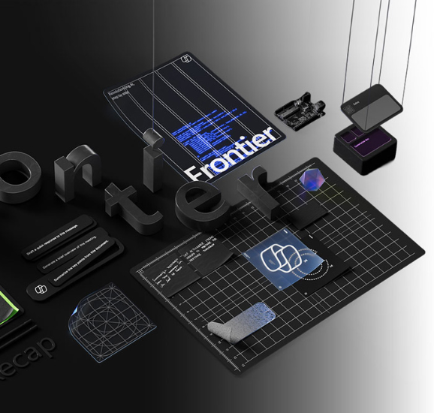
What's new in Frontier
Try out the latest agents and features in Microsoft 365 Copilot and see how they can transform your day-to-day.​
NEW: Agents to drive AI workforce transformation
NEW: Microsoft Agent 365: The control plane for AI Agents
NEW: Build and create with Copilot Pages
NEW: Learn more about the Sales Development Agent
NEW: How Sales Development Agent connects with Dynamics 365
NEW: Learn more about Project Opal
NEW: Experience next-gen productivity with Windows 365 AI-enabled Cloud PCs
Frontier Getting started guide
Notes:
Frontier — try it out.
Encourage the audience to get hands-on. Point them to the Frontier getting-started guide and the newest items, including:
• Agents to drive AI workforce transformation
• Microsoft Agent 365 — the control plane for AI agents
• Build and create with Copilot Pages
• Sales Development Agent (and how it connects with Dynamics 365)
• Project Opal
• Windows 365 AI-enabled Cloud PCs
Close by inviting them to try these in their own day-to-day and share feedback.

Slide 51
Thank you 👏
Got feedback ?
https://aka.ms/WhatsNewCopilot/Feedback

Slide 52

Feedback Form

Slide 53
Resources
Microsoft 365 Copilot Blog | Microsoft Community Hub
What’s New in Microsoft 365 Copilot | May 2026 | Microsoft Community Hub
Release Notes for Microsoft 365 Copilot | Microsoft Learn
Microsoft 365 Roadmap | Microsoft 365
What's new in Copilot Studio - Microsoft Copilot Studio | Microsoft Learn
Copilot Studio | Microsoft Copilot Blog
Microsoft 365 Copilot News and Insights | Microsoft 365 Blog
Launched: Microsoft 365 Copilot Adoption Hub Redesign
Recertified: How Microsoft 365 Copilot continues to earn trust and What Changed in a Year | Microsoft Community Hub
Learning Agent now generally available — personalized AI upskilling for every employee | Microsoft Community Hub
Available today: GPT-5.5 Instant in Microsoft 365 Copilot | Microsoft Community Hub
Available today: Anthropic Claude Opus 4.8 in Microsoft 365 Copilot | Microsoft Community Hub
Microsoft Build 2026: Be yourself at work - The Official Microsoft Blog
Securing Local Agents, Claws, Runtimes | Microsoft Security
Home | Microsoft AI
Microsoft Build Live
Made for developers and agents, Windows 365 at Build 2026
Introducing Microsoft Scout: Your always-on personal agent | Microsoft 365 Blog
What's new in Microsoft Foundry | Build Edition | Microsoft Foundry Blog
Announcing Microsoft Web IQ | Bing Search Blog
Work IQ API public preview: Build Copilot powered agents with A2A | Microsoft Community Hub
Windows 365 for Agents unlocks secured, scalable AI automation - Windows IT Pro Blog

